Slide 1
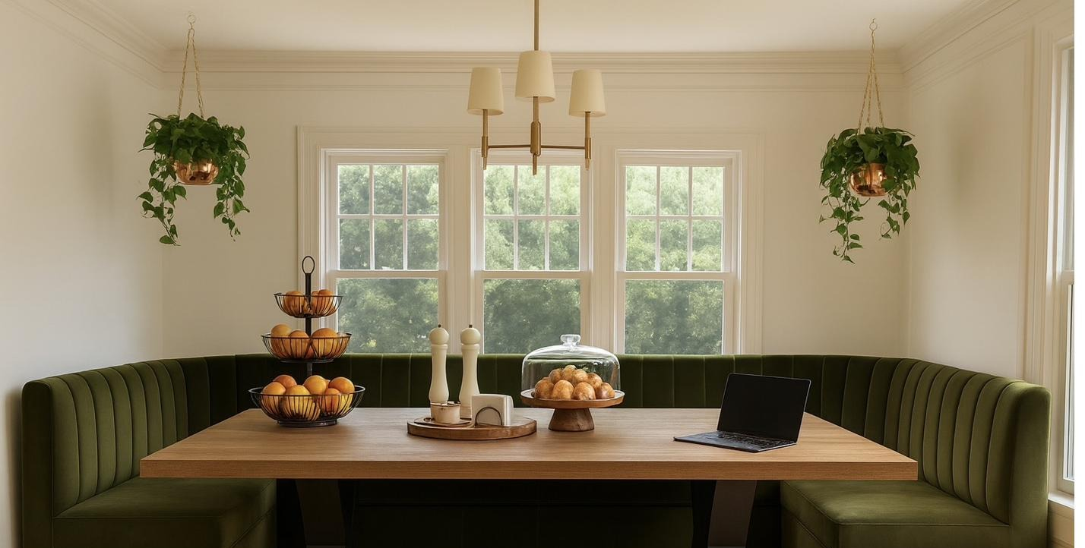
MEDIA KIT · 2026
SEASON ONE
The Sovereign Edit
CREATED BY
E. Boateng
Read Books. Eat Food. Go Places. Grow.
PARIS · LONDON · GHANA · EVANSTON
MUNICH · VIENNA · PRAGUE · BRAZIL

Slide 2
ABOUT THE CHANNEL
A life fully lived.
PROFESSIONAL PEDIGREE
MBA Narrative Architecture & Brand Strategy
ConAgra / Kimberly-Clark Senior brand management
The Sovereign Edit is a lifestyle channel rooted in the belief that the richest life is one built deliberately — through meaningful rituals, nourishing food, purposeful travel, and the ongoing, courageous work of knowing yourself.
Caudalie Insider, Vinothérapie Spa · Plaza Hotel, NYC
Williams College Class of 2003 · Legacy chronicler
Created and hosted by E. Boateng — writer, mother, and strategist — the channel weaves together three interlocking content streams: the Recentering Self series filmed at home, immersive international travel and culinary content, and the slow architecture of a life becoming more fully itself.
Clarisonic / Thinx Beauty and category innovation
Touch Bespoke Founder · Strategic brand consultancy
Season One encompasses seven international destinations and a full arc of at-home socio-emotional episodes.
"The richest table is the one set with intention — for food, for conversation, for what we're becoming."
CREATOR PORTRAIT
— WARM, EDITORIAL —
HOME STUDIO
The Sovereign Edit · Media Kit 2026
01

Slide 3
THE PHILOSOPHY · SOVEREIGNTY
Touch Bespoke
THE PHILOSOPHY
I.
Recentering Self
Sovereignty is
autonomous and inalienable.
FILMED AT HOME
Candid, intimate episodes exploring the interior life — trauma, recovery, identity, motherhood.
Sovereignty is self-sourced. Not conferred by a relationship, an achievement, a salary, or a season. The central thesis of this channel — and of its audience's life — is that identity and worth are autonomous and inalienable.
II.
Travel & Culinary
We speak to highly educated women who have built rich, complex lives and are done organizing themselves around external validation. Women who have arrived — and are learning what to do with the arrival.
INTERNATIONAL · IMMERSIVE
Rich, cinematic content from markets, kitchens, and tables across three continents.
THE INTELLECTUAL THROUGH-LINE
Sovereignty runs across every episode — across relationships, achievement, silence, family wounds, and identity. The work is not self-improvement. It is self-recognition.
III.
Ritual & Beauty
HOME · LIFESTYLE · SUNDAY
Sunday Brunch episodes, skincare arcs, kitchen culture. The slow, repeating rituals that anchor a full life.
The Sovereign Edit · Media Kit 2026
02

Slide 4
THE ENDURANCE AUDIT · OPERATIONAL INTEGRITY
A Quarter-Century of Performance.
These are not aspirational brands. They are 25-year living catalog entries with receipts.
KITCHEN & HOME INFRASTRUCTURE
LIFESTYLE & TRAVEL
Le Creuset
Cast Iron · Anchor
Caudalie
Skincare · Insider
KitchenAid
Stand Mixer · Rosemary Archive
Tumi
Travel Infrastructure
Williams-Sonoma
Ecosystem · 25yr
Pottery Barn
Home · 14yr Wear Test
Cuisinart
Kitchen Foundation
Crate & Barrel
Sculptural Accent
Vitamix
High Performance
NordicTrack
Active Infrastructure
Breville
Espresso · Sunday Ritual
Saatva
Home Foundation
Global Knives
Blade Infrastructure
Benjamin Moore
Color Architecture
The Sovereign Edit · Media Kit 2026
03

Slide 5
THE AUDIENCE · MARKET INTELLIGENCE
She has
arrived.
Highly educated women who have built rich, complex lives and are done organizing themselves around external validation. Forty-something. Accomplished. Ready to grow inward.
01 ·
02 ·
03 ·
The Sovereign Woman
The Deliberate Buyer
The Global Intellectual
She has built something real — a career, a household, an identity — and is actively choosing what stays and what goes. She is not in crisis. She is in curation.
She doesn't buy trend. She buys infrastructure. She owns the Le Creuset, the Tumi, the KitchenAid. Your brand earns her loyalty by deserving it.
She travels with intention. She reads bell hooks and Esther Perel and Philip Roth. She cooks from scratch and understands why the pan matters.
7
20+
3
2
International destinations
Season One
Episodes planned
Season One
Content pillars
Fully developed
Seasons
Mapped
The Sovereign Edit · Media Kit 2026
04

Slide 6
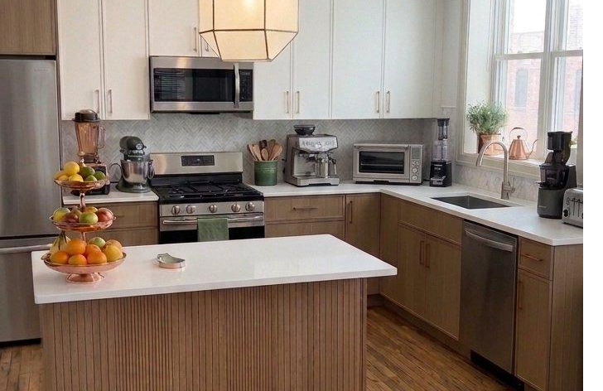
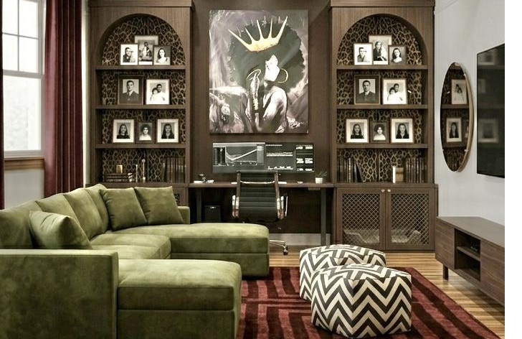
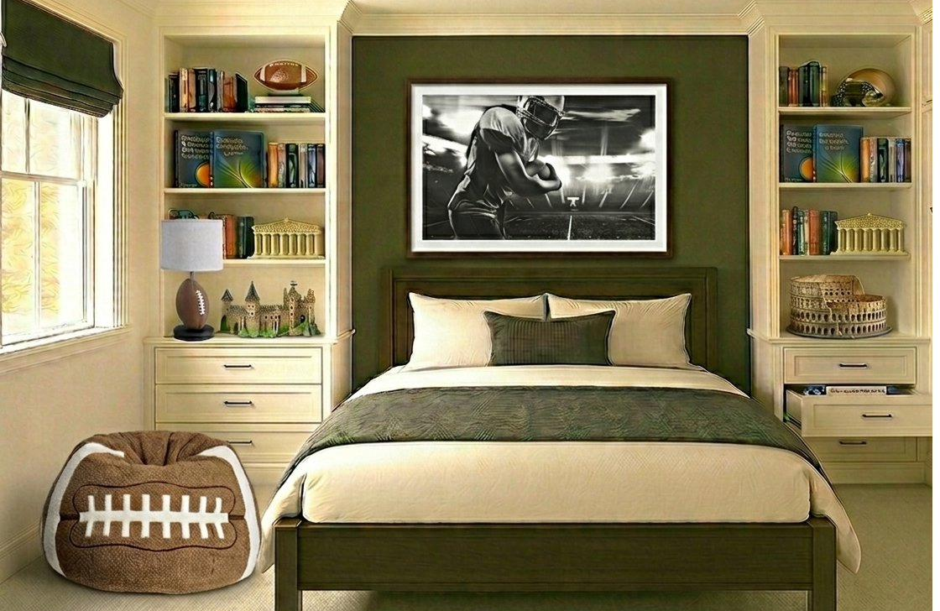
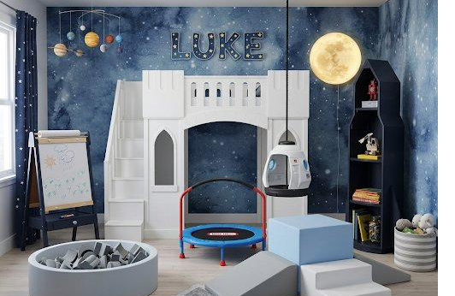
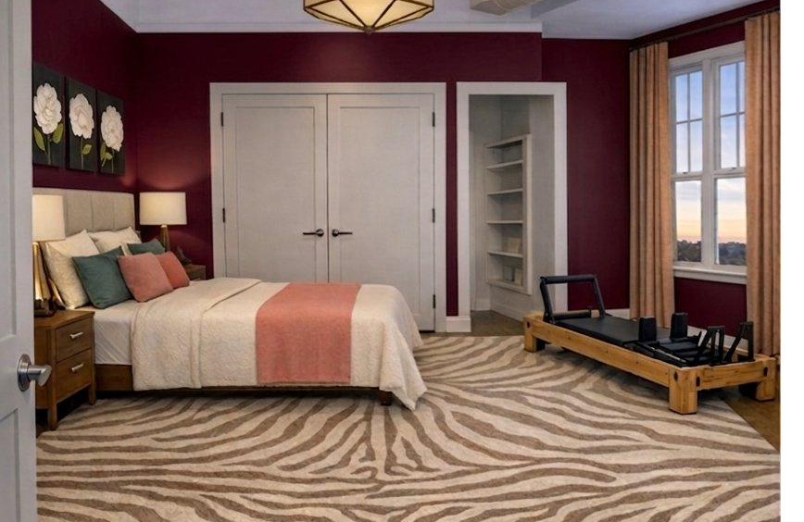
THE SET · DESIGN DIRECTION
The home studio.
A production environment for the long term.
Design direction for the Season One production environment · Renderings
The Dining Room
The Kitchen
The Living Room
Primary evening setting · wine, books, conversation
95% Williams-Sonoma ecosystem · Le Creuset, Breville
Green sectional · walnut ceiling · CB2 Vidro mirror
The Teen Suite
The Children's Room
Primary Suite
Sovereign HQ · olive green · Pottery Barn Teen
Active Haven · space mural · Pottery Barn Kids
Deep burgundy · pilates reformer · slow mornings begin here

Slide 7
SEASON ONE · TRAVEL GROUPINGS
The journey.
GROUP
DESTINATIONS
ARC
CONTENT
Germany
Munich
Invented Tradition
Oktoberfest opening weekend · the two great public parades · Bavarian food culture · engineering and making.
France
Paris
Mastery
Caudalie flagship · patisserie and markets · cooking class · French pharmacy skincare arc · ownership of the past.
Winter Cities
Vienna · Prague · London
Intentional Ritual
Viennese coffeehouses and pastry · Prague Christmas markets · London diaspora and food as cultural memory.
West Africa
Ghana
Inheritance
Family compound · inheritance and land · jollof, fire cooking, market exploration.
South America
Brazil
Restoration
Markets, local cooking, tropical produce · national myth and ancestral arc · sensory and spiritual restoration.
Home Studio
—
Foundation
The Recentering Self series · Sunday Brunch · seasonal cooking · skincare and beauty arcs · the reading list.
The Sovereign Edit · Media Kit 2026
06

Slide 8
PARTNERSHIP OPPORTUNITIES · STRATEGIC RESIDENCY MODEL
Built to integrate.
This channel is not built around products — it is built around a life. Brand integrations feel native because they are: the Le Creuset already lives in the kitchen, the Tumi is already packed for Paris. Partnerships are woven in, not bolted on.
Green Placement
Rosemary Residency
Evergreen Residency
Affiliate + Organic · Priced per discovery
Project / Launch Fee · Priced per activation
Evergreen Retainer · Priced per partnership
— Organic product mentions within daily ritual content
— High-impact, dedicated narrative episode
— Permanent, native seat at the table in daily rituals
— Curated landing pages per category (LTK + Bookshop.org)
— On-location production (Paris flagship, Munich, Brazil)
— Brand lives in the frame because it lives in the life
— Kitchen Essentials / Reading List / New Home Setup
— Co-created content with exclusive category rights
— Raw Apple Log 4K B-roll provided to brand social teams
— Commission-based tracking from day one
— Full social amplification package + first-look access
— Monthly cadence · evergreen placement · no expiration
The Sovereign Edit · Media Kit 2026
07

Slide 9
BRAND ALIGNMENT
The right table.
Every brand on this list already exists in the world of this channel. These are not cold pitches — they are an invitation to show up authentically within content made for their customer.
CORE LEGACY ANCHORS
Le Creuset
Williams-Sonoma
Caudalie
Tumi
Benjamin Moore
KitchenAid
Heritage content in Paris · kitchen anchor brand
25-year ecosystem · kitchen infrastructure · core legacy anchor
Paris flagship spa · insider credential · skincare arc
Travel featured organically · global movement infrastructure
Set design · chromatic architecture
Sunday Brunch series · 15-year Rosemary Archive
KITCHEN & LIFESTYLE
Breville
Cuisinart
Vitamix
Pottery Barn Kids
Pottery Barn Teen
Saatva
Sunday Brunch · espresso & morning ritual
Everyday cooking infrastructure · affiliate launch
High-performance blending · mechanical literacy
Active Haven · sensory design
Sovereign HQ · identity formation
Home setup · sleep as infrastructure
AFFILIATE PLATFORMS · ACTIVE AT LAUNCH
Amazon Influencer
LTK
Bookshop.org
Target Collective
The Sovereign Edit · Media Kit 2026
08

Slide 10
LET'S BUILD SOMETHING WORTH WATCHING
SEASON ONE · TRAVEL GROUPINGS
Pull up a chair.
Munich
Germany
Paris
France
Vienna · Prague · London
Winter cities
FOR BRAND PARTNERSHIPS & SPONSORSHIPS
Ghana · Brazil
Scheduled in discovery
Estelita@touchbespoke.com
ENTITY
Touch Bespoke · est. 2018
CHANNEL & SOCIAL
YouTube
@ASovereignPerspective
Please include your brand name, product category, and proposed campaign window. Discovery calls scheduled within 72 hours.
Instagram
@asovereignperspective
"Read Books. Eat Food. Go Places. Grow."
Touch Bespoke · Season One · 2026

