Slide 1
JOINT KEYNOTE · THERMOKON × SENSISE
Bridging the Gap Between IoT Ideas and Smart Building Reality
The Things Conference · Amsterdam
Marco Dietz
Mario Schröder
Thermokon
Sensise
Notes:
Joint keynote intro – welcome the audience, introduce both speakers.

Slide 2
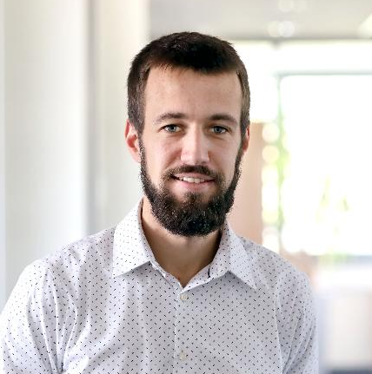

SPEAKER 01 · THERMOKON
Marco Dietz
Twenty years of building field devices for real buildings — thermostats, sensors, gateways that have to survive concrete, dust and years of operation. From that vantage point, one pattern repeats in almost every IoT project.
A great sensor alone never finished a single project.
Notes:
Marco introduces himself and Thermokon's 20-year field-device background.

Slide 3
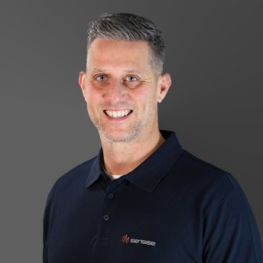

SPEAKER 02 · SENSISE
Mario Schröder
Sensise was founded to solve a problem that Thermokon often faced:
The hardware was excellent, but customers had to combine consulting, networks, installation, visualization and support on their own.
Every project consists out of several pieces.
Someone must put the pieces together and frame it.
Notes:
Good morning, I'm Mario from Sensise.
Sensise was founded to solve a problem that Thermokon run into.
Every project consists of several pieces and someone has to put them together and frame it.
That's exactly what I'll show you today:
how to bring a modernization project from the first idea to the final result.

Slide 4
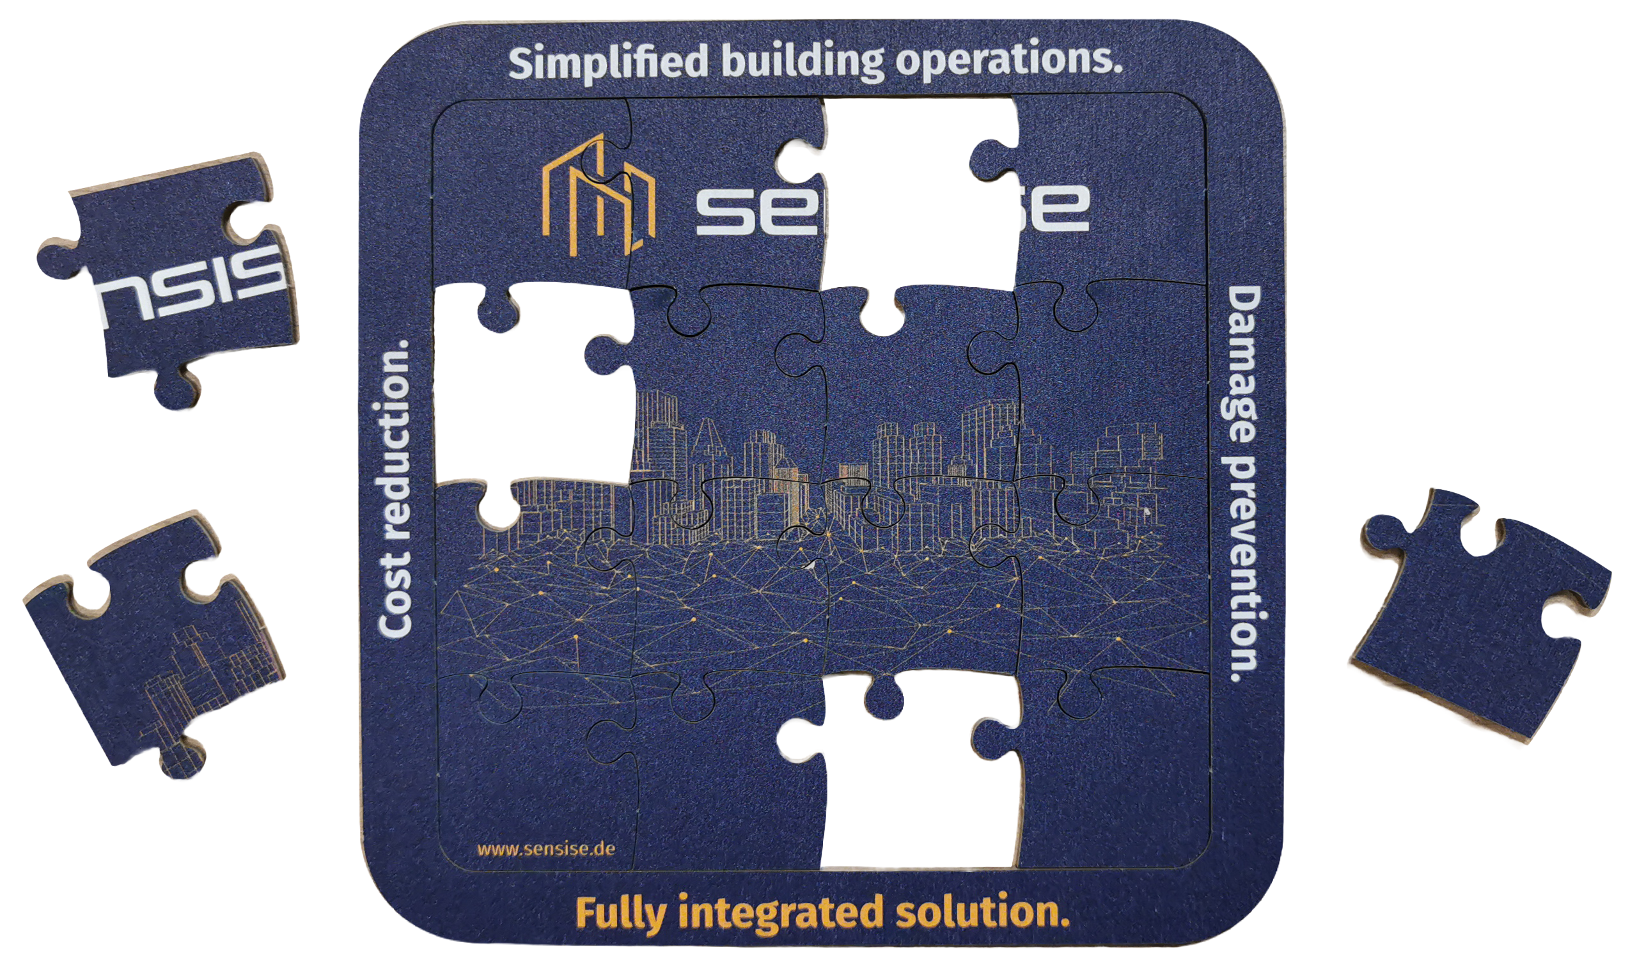
Notes:
„The hardest part of a smart building isn't the technology!
It's everything around it.
When we start, we all picture the finished result, but the real work happens between the plan and that result.
It's like this puzzle:
None of the single pieces is hard on its own.
The hard part is putting them together into one fully integrated solution that
- simplifies building operations,
- reduces cost and
- prevents damage.
Over the next 10 minutes, Marco and I will build that puzzle with you.

Slide 5

THE OBSERVATION
Gap in the
Smart Building Value Chain.
Silos
Ownership
Value uplift
Notes:
State the integrated-solution value proposition plainly.

Slide 6


Three Stages of Building Intelligence
AUTOMATED
SMART
AUTONOMOUS
1
Automated,
rule-based operation.
2
Data-driven decisions.
3
Self-optimizing and goal-setting.
Notes:
Every part you need is already on the shelf. sensors, gateways, integrators, networks, dashboards.
In our experience the gap is almost never the technology. It is what happens between the pieces.
Additional to this puzzle pieces you must involve experts from 2 independent industries → (1) Industry knowledge e.g. Building Automation Management and (2) IT knowledge

Slide 7
Automated vs. Smart Buildings
AXIS OF COMPARISON | AUTOMATED BUILDING | SMART / AUTONOMOUS BUILDING
Intelligence is created | once, during planning | ongoing, during operation
The Sensor is | part of a control loop | data point for multiple applications
Decision is made by | the specialist planner, before acceptance | software and users, daily
Paid from | CAPEX | OPEX – Operational Budget
Success means | acceptance passed | improved KPIs
A change costs | integrator, delay, downtime | a configuration
Lifespan | 15–20 years, frozen | 5–10 years, constantly evolving
Notes:
Every part you need is already on the shelf. sensors, gateways, integrators, networks, dashboards.
In our experience the gap is almost never the technology. It is what happens between the pieces.
Additional to this puzzle pieces you must involve experts from 2 independent industries → (1) Industry knowledge e.g. Building Automation Management and (2) IT knowledge

Slide 8
Eight Trades, Eight Data Islands
Eight Trades Side-by-Side — and None Communicates
 | HVAC | Lighting | Access & Security | Fire Protection | Elevator | Sanitary / Water | IT & Network | FM & Cleaning
Planning | MEP planner | own | MEP planner | MEP planner | Elevator planner | MEP planner | MEP planner | MEP planner
Execution | Plant contractor | Contractor | Contractor | Contractor | Contractor | Plumbing contractor | Contractor | Contractor
Protocol | BACnet, Modbus | DALI | Protocol | Protocol | own | own | IP | Manual
Warranty | own | Warranty | Warranty | Warranty | own | Warranty | Warranty | Warranty
Data ends at | BMS | Lighting Control | Access & Security | Fire Protection | Elevator | Sanitary / Water | IT & Network | FM & Cleaning
Every column ends in its own system — the data stops at the trade boundary.
Notes:
Every part you need is already on the shelf. sensors, gateways, integrators, networks, dashboards.
In our experience the gap is almost never the technology. It is what happens between the pieces.
Additional to this puzzle pieces you must involve experts from 2 independent industries → (1) Industry knowledge e.g. Building Automation Management and (2) IT knowledge

Slide 9
Who Knows Who Is in the Room
The Attendance Paradox
The HVAC knows it — via CO₂ sensors.
Badge control knows it — via the ID card.
The lighting knows it — via the presence detector.
Room booking thinks it knows it — via the calendar.
Cleaning cleans on daily basis
Four systems know the answer. The one that needs it does not.
Notes:
Every part you need is already on the shelf. sensors, gateways, integrators, networks, dashboards.
In our experience the gap is almost never the technology. It is what happens between the pieces.
Additional to this puzzle pieces you must involve experts from 2 independent industries → (1) Industry knowledge e.g. Building Automation Management and (2) IT knowledge

Slide 10
Decision and Value, Years Apart
The timeline doesn't fit.
Value appears in operation — the decision happens years earlier.
DECISION
VALUE
YEARS APART
Design phase
Operation phase
Notes:
Every part you need is already on the shelf. sensors, gateways, integrators, networks, dashboards.
In our experience the gap is almost never the technology. It is what happens between the pieces.
Additional to this puzzle pieces you must involve experts from 2 independent industries → (1) Industry knowledge e.g. Building Automation Management and (2) IT knowledge

Slide 11
Why Customers Reach for IoT
Nobody gets a smart building by default
Holistic smart buildings are possible — but rarely designed that way from day one.
Cleaning rooms nobody entered
ESG report, no meter data
FACILITY MANAGEMENT
SUSTAINABILITY
Comfort complaints, no answer
Legionella flush, no proof
OPERATIONAL MANAGEMENT
OPERATOR RESPONSIBILITY
Various sub-problems with clear ownerships
Notes:
Every part you need is already on the shelf. sensors, gateways, integrators, networks, dashboards.
In our experience the gap is almost never the technology. It is what happens between the pieces.
Additional to this puzzle pieces you must involve experts from 2 independent industries → (1) Industry knowledge e.g. Building Automation Management and (2) IT knowledge

Slide 12
Why IoT Wins
IoT does not win on technology.
It wins because it is the a technology the sub-problme owner can buy himself.
CLASSIC BUILDING AUTOMATION PROJECT
IoT RETROFIT
Design planner · Public tender · Shutdown window · Years of lead time
Own budget · Own decision · Installed in days · No downtime
No cable routes
No tender
No downtime
One budget, one decision
IoT is not the better sensor bus — it is the buyable one.
Notes:
Every part you need is already on the shelf. sensors, gateways, integrators, networks, dashboards.
In our experience the gap is almost never the technology. It is what happens between the pieces.
Additional to this puzzle pieces you must involve experts from 2 independent industries → (1) Industry knowledge e.g. Building Automation Management and (2) IT knowledge

Slide 13
Real sub-problem: Dry-Air Complaints
Customer needs reliable evidence – no devices
He had an operating problem — with a tenant relationship on the line.
MUNICH · 2026 · 4 TENANT UNITS · RETROFIT HUMIDITY METROLOGY
01
02
03
04
SITUATION
PROBLEM
WHY IoT FITS
THE GAP
Building operator, rented units
Landlord–tenant relationship tense
Complaints: air too dry
Rent reductions on the table
No downtime window
Retrofit, no cable routes
No shutdown needed
LoRaWAN as carrier
Thermokon ship the hardware
Radio planning, server, decoder open
Integration, installlation and battery service open
Notes:
Every part you need is already on the shelf. sensors, gateways, integrators, networks, dashboards.
In our experience the gap is almost never the technology. It is what happens between the pieces.
Additional to this puzzle pieces you must involve experts from 2 independent industries → (1) Industry knowledge e.g. Building Automation Management and (2) IT knowledge

Slide 14
Real sub-problem: Unused Church Rooms
The parish needed rooms warm on schedule, not devices.
A listed building with no building management system — and heating costs nobody can allocate.
PARISH · LISTED BUILDING · NO BMS · HEATING COST CONTROL
01
02
03
04
SITUATION
PROBLEM
WHY IoT FITS
THE GAP
Parish wants to use unused parts of the building
Listed building fabric
No building management system
Sub-problem: heating cost control
Owner: the administrative manager
Costs cannot be allocated per room
Retrofit without touching the fabric
Works without a BMS
Installed room by room
Thermokon ships the hardware
Occupancy plans sit in the internal IT system
Control and occupancy logic open
Notes:
Every part you need is already on the shelf. sensors, gateways, integrators, networks, dashboards.
In our experience the gap is almost never the technology. It is what happens between the pieces.
Additional to this puzzle pieces you must involve experts from 2 independent industries → (1) Industry knowledge e.g. Building Automation Management and (2) IT knowledge

Slide 15
Two pattern of gaps
The A hardware manufacturer cannot solve subproblems alone
A
Hardware without a chain
LESSON
The sensor is 10 % of the solution — but 100 % of the expectation.
300 sensors provides byte streams; NS/AS, installation, operation, maintence are not clear
B
Liability without control
LESSON
Visibility creates liability. Not responsibility.
Values go missing in operation. The customer calls hardware manufacturer; the cause sits outside our access
Notes:
Every part you need is already on the shelf. sensors, gateways, integrators, networks, dashboards.
In our experience the gap is almost never the technology. It is what happens between the pieces.
Additional to this puzzle pieces you must involve experts from 2 independent industries → (1) Industry knowledge e.g. Building Automation Management and (2) IT knowledge

Slide 16
THE ANSWER
Fully integrated solution.
Individuale pieces
Build it together
Framing
Notes:
So what's the answer to the questions Marco just raised?
A fully integrated, turn-key solution.
One that that guides you through every step needed to make the idea work!

Slide 17

THE PUZZLE
What a Smart Building project is made of
Network server
Field devices
Consulting
Gateways
Support
Platform
Installation
Application server
Notes:
A project is a puzzle of eight essential pieces.
It starts with Consulting: You need Building Management expertise to design the right solution and pick the right Field devices,
plus a coverage test so every point has a stable signal.
Gateways, the Network server and the Application server carry the data from the field up to
the Platform where both worlds come together into the digital twin of the building.
Installation must be done by people who understand where each device belongs and why.
And finally, Support that can solve both IT and HVAC problems at any time.
It's clearly not just about placing sensors and that's why you need someone to put these pieces together and frame the entire project!

Slide 18
THE FRAME
And who puts it all together
Sensise puts the pieces together and frames the entire project. The customer only sees the final picture.
Field devices
Network server
Consulting
Gateways
Support
Platform
Installation
Application server
Notes:
„And that's exactly what we do as your turn-key solution provider.
We understand every single piece and put them together.
So in the end the customer only sees one thing: the finished picture that works."

Slide 19
Real-life use cases
Notes:
So let's look at some real-life use cases

Slide 20
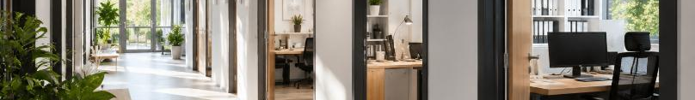




SUCCESS CASE · OFFICE BUILDING
Project duration
Creating transparency in office space
3.5 weeks
PROBLEM
SOLUTION
RESULT
SOLUTION PROVIDER
Complaints about bad indoor air quality
Rent cut every winter season
Building in operation
→ no chance for interruption
Client experienced in HVAC, but no idea how to implement an IoT solution
High-quality LoRaWAN room sensors
Independent LoRaWAN network
Robust, proven network server
Real-time and historical data
Owner proves appropriate indoor air quality with reliable live and historical data
No rent reduction anymore
Scalable → next step: smart thermostats
COMPONENTS
LoRaWAN room sensors,
independent network,
network server
Notes:
An office building.
THE PROBLEM:
The tenant cut the rent by 20% every winter, complaining about poor indoor air quality.
The building wasn't transparent !no data at all! and operations couldn't be interrupted for a wired retrofit.
The owner had no idea how to solve this situation.
THE SOLUTION:
We installed a LoRaWAN (1) IAQ monitoring solution on an (2) independent network,(3) without interrupting operations.
THE SOLUTION:
Now the owner can prove the air quality with live and historical data! No more rent reductions.
And it's scalable: the next step is smart thermostats

Slide 21
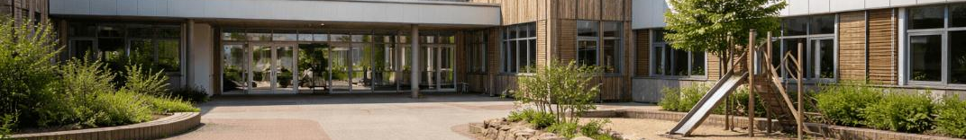
SUCCESS CASE · PRIMARY SCHOOL
Project duration
Room-based heating concept
3 weeks
PROBLEM
SOLUTION
RESULT
SOLUTION PROVIDER
Building in operation — no interruption possible
Old building with poor, inconsistent insulation
Individual heating profiles needed for even temperature across all rooms
Client had no experience with HVAC, installation, integration or IT
High-quality LoRaWAN thermostats
Independent LoRaWAN network
Robust, proven network server
Individual room schedules
Installation ~2.5 hours
Monday–Friday individual heating schedules, no heating on weekends
Comfortably warm in the morning, no overnight heating
Significant cost reduction
COMPONENTS
LoRaWAN thermostats,
independent network,
network server
Notes:
A primary school.
THE PROBLEM:
High operating cost, because rooms were heated overnight just to be warm in the morning.
Old building with poor insulation and no way to interrupt operations.
The facility manager saw no way to improve it without major construction.
THE SOLUTION:
We installed high-quality LoRaWAN thermostats on an independent network, with individual room schedules.
THE RESULT:
(1) comfortable temperatures during lessons, (2) no overnight and no weekend heating, and a (3) cost reduction of around 25%."

Slide 22
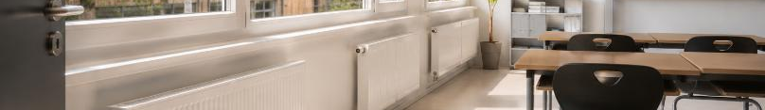

SUCCESS CASE · HIGH SCHOOL
Project duration
Electrical heaters in container classrooms
3 weeks
PROBLEM
SOLUTION
RESULT
SOLUTION PROVIDER
Classrooms housed in containers
heated by electrical heaters
No heating schedule
→ heaters ran overnight
Client had no experience with HVAC, installation, integration or IT
High-quality LoRaWAN switches
Independent LoRaWAN network
Robust, proven network server
On/off time schedule
Installation ~2.5 hours
Heaters powered only during lesson times
room-specific control
No overnight heating
comfortably warm classrooms each morning
Significant cost reduction
COMPONENTS
LoRaWAN switches,
independent network,
network server
Notes:
A high school.
THE PROBLEM:
Same scenario, with one difference:
the classrooms are mobile containers heated by electric heaters.
Again, the facility manager had no idea how to improve it without major work.
THE SOLUTION:
This time we installed smart LoRaWAN switches with an on/off schedule.
The heaters now run only during lesson times, room by room, no overnight heating, warm classrooms every morning,
THE RESULT:
Operating-cost reduction of around 40%.

Slide 23
Summary
Notes:
So!
Let me bring this all together.

Slide 24

Bridging the Gap Between IoT Ideas and
Smart Building Reality
The Idea
The Reality
Notes:
As you've seen, there's a large gap between the initial idea and the final reality.
But that gap can be bridged by working with experts who turn the vision into the expected result.
Every single piece has its value, but on its own it's only a small part of the whole.
Put them together, and the idea becomes a working smart building.
And thats exactly what SENSISE offers.

Slide 25
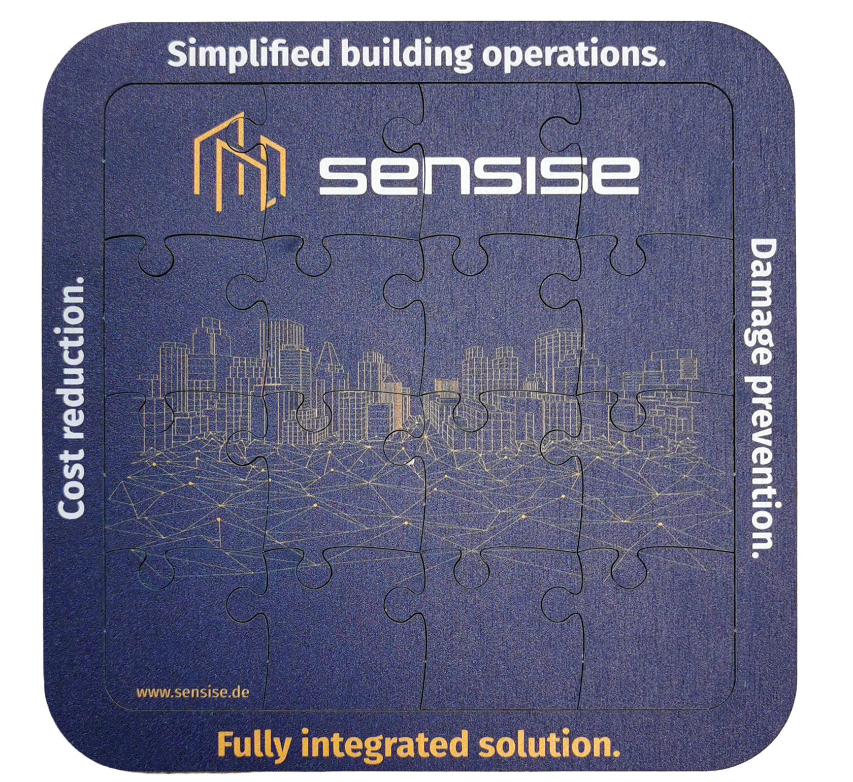
Thermokon × Sensise · Let's put the pieces together.
thermokon.de · sensise.de
Thank you!
Meet us @ booth L12
Notes:
So —
Whatever your idea for a smarter building is:
You don't have to assemble the pieces yourself.
That's what we're here for.
Thank you very much

