Slide 2
Audio for Everyone
Assistive Listening in 2026 and Beyond

Slide 3

Introductions
World Leading Assistive Listening Technology Manufacturers
Built on Seven decadesin AV Business
Two times UK Queen’s Award for Business Winners
¼ of the population will experience hearing loss at some point in their life
Ed Beck
Regional Sales Manager - Europe
Ampetronic / Listen Technologies

Slide 4

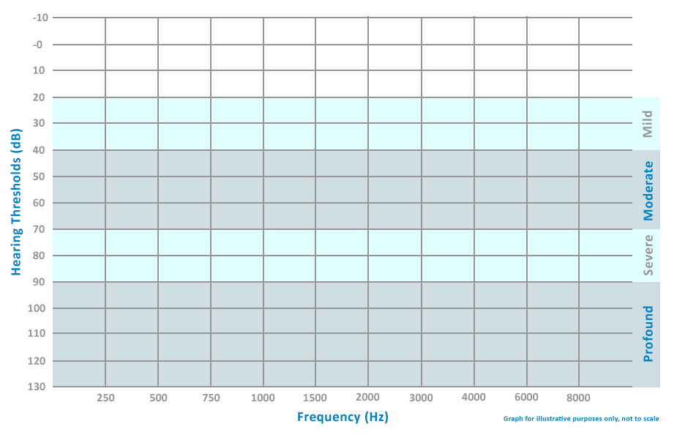
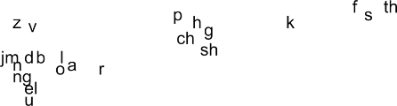

The Purpose of Assistive Listening

Slide 5
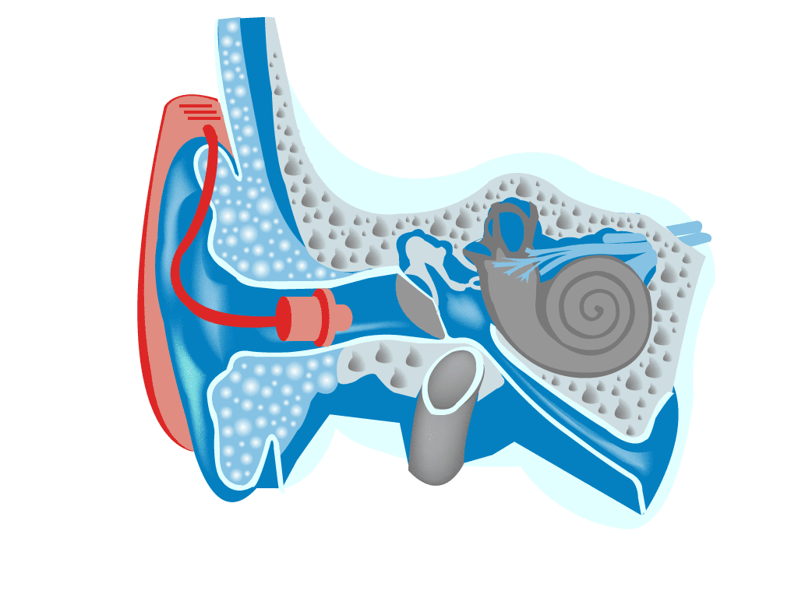
The Hearing Aid
Small microphone behind the ear -> amplified by speaker in ear canal
Optimised for user’s hearing loss
The majority feature a “telecoil” for use with induction-based systems
Not a “complete solution”
Some now feature “Auracast” compatibility

Slide 6
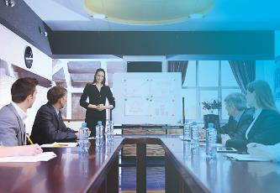
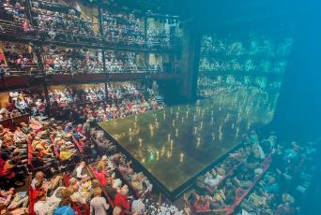
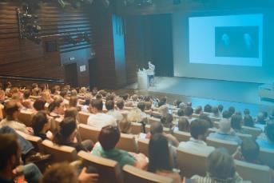


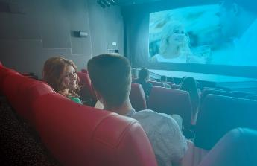
Applications for Assistive Listening

Slide 7






Applications for Assistive Listening cont.

Slide 8

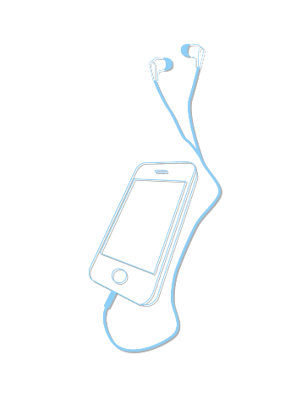
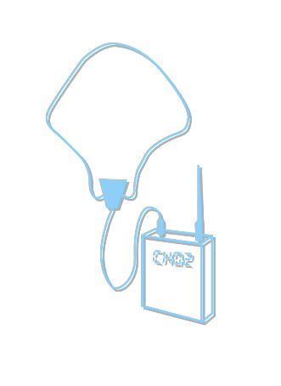
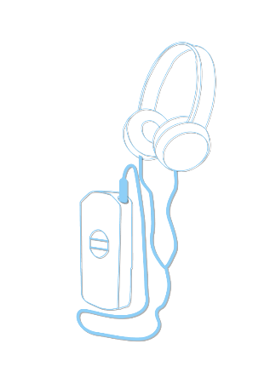


Receiver Types for Assistive Listening

Slide 9
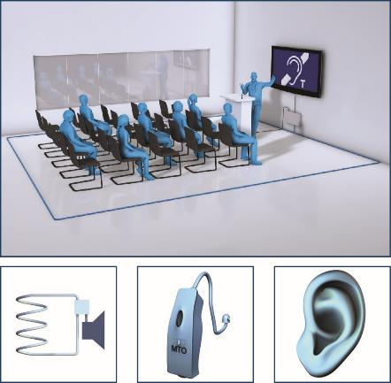

Understanding Hearing (Induction) Loops
  Input ‘source’ audio
  Loop amplifier
  Loop(s) of cables
  Hearing aid telecoil receiver
  Sound direct to the ear

Slide 10
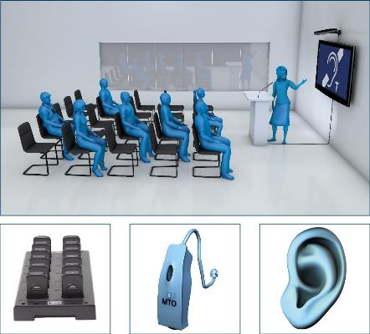
Receiver Based Systems (IR / WIFI / RF)
  Input ‘source’ audio
  Transmitter or access point
  Dedicated receiver with neck loop and charging facility
  Hearing aid telecoil receiver
  Sound direct to the ear

Slide 11
In 2026, ALL Technologies have Pro’s and Con’s
 | Hearing Loop | Infrared | RF | WiFi | Auracast
Direct to hearing aid (no receivers)
No user request/staff management |  |  |  |  | In part
Suitable for transient use |  |  |  |  | WIP
Easy and cheap to install
Privacy / Confidentiality
User is required to bring own device (smart phone)
Low latency Audio (< 10 ms) |  |  |  | 60-120 ms | <40ms

Slide 12


Slide 13
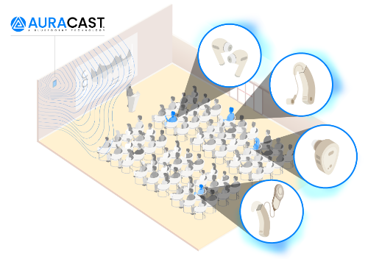
Auracast™ Bluetooth Platform
True broadcast – one to any within range
Optimised for audio – low latency, robust
Simple connection from any compatible device
No bespoke app required
(once Android / iOS adopt it)
Will be direct to hearing aid in time
“Unmute your world”

Slide 14

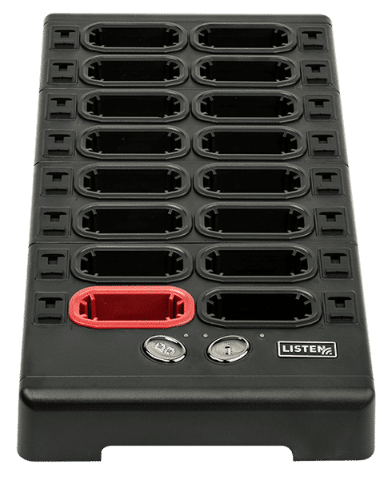
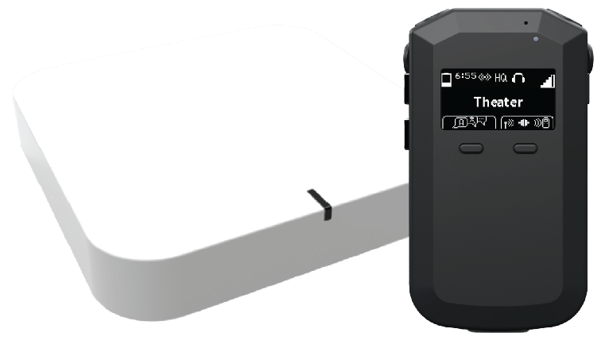

Slide 15
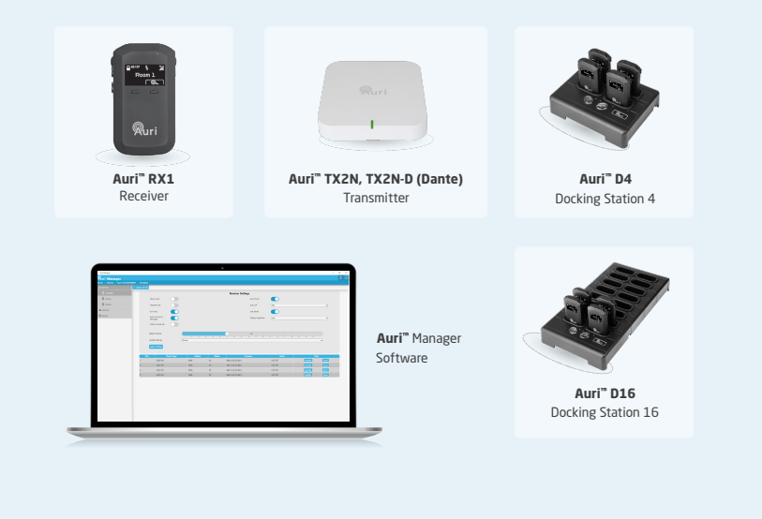

Slide 16
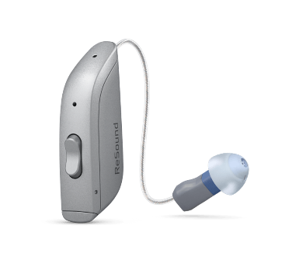
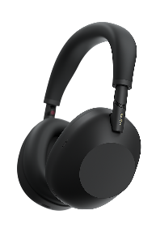
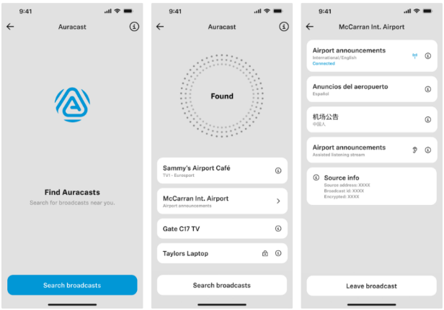
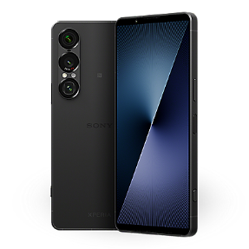
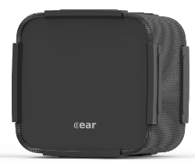
Auracast™ Compatible Devices Available Now

Slide 17

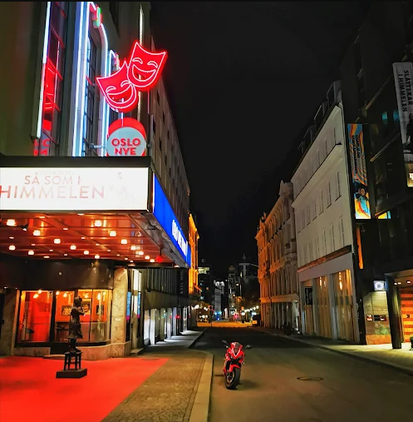
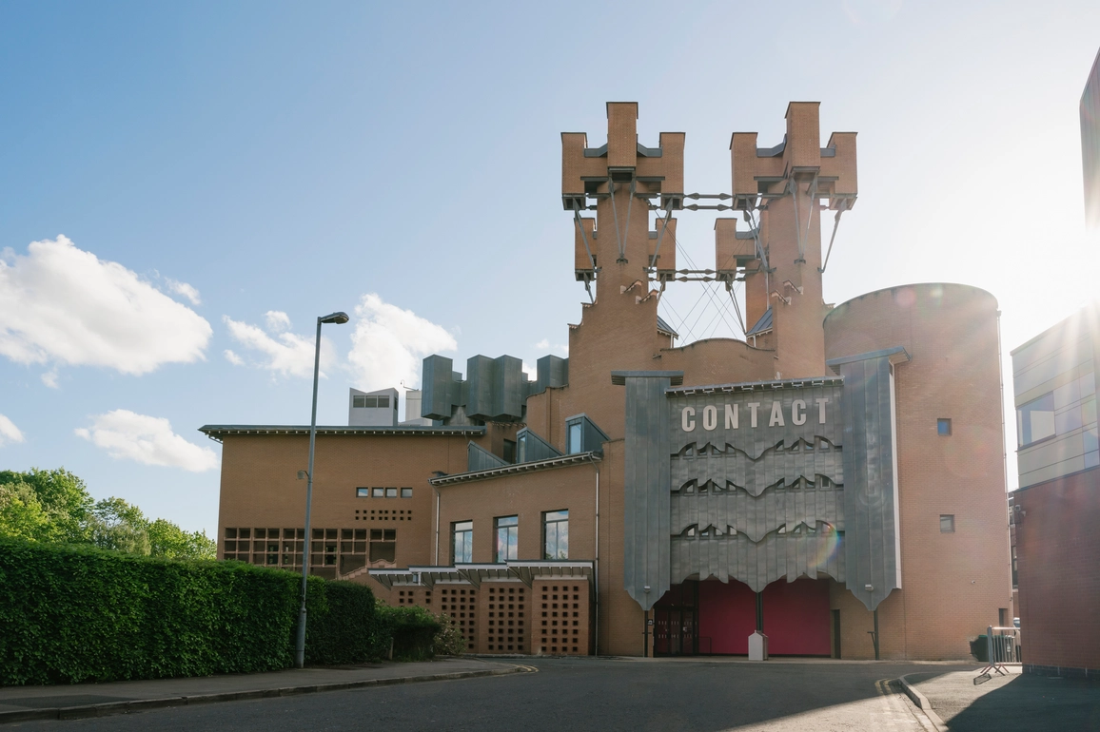

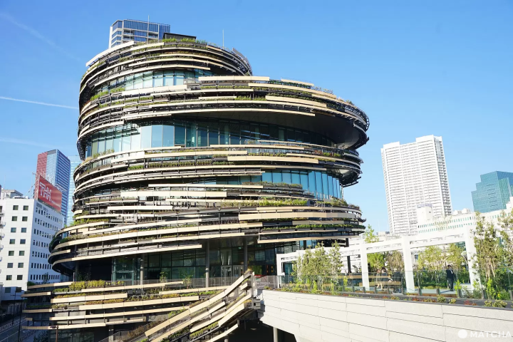

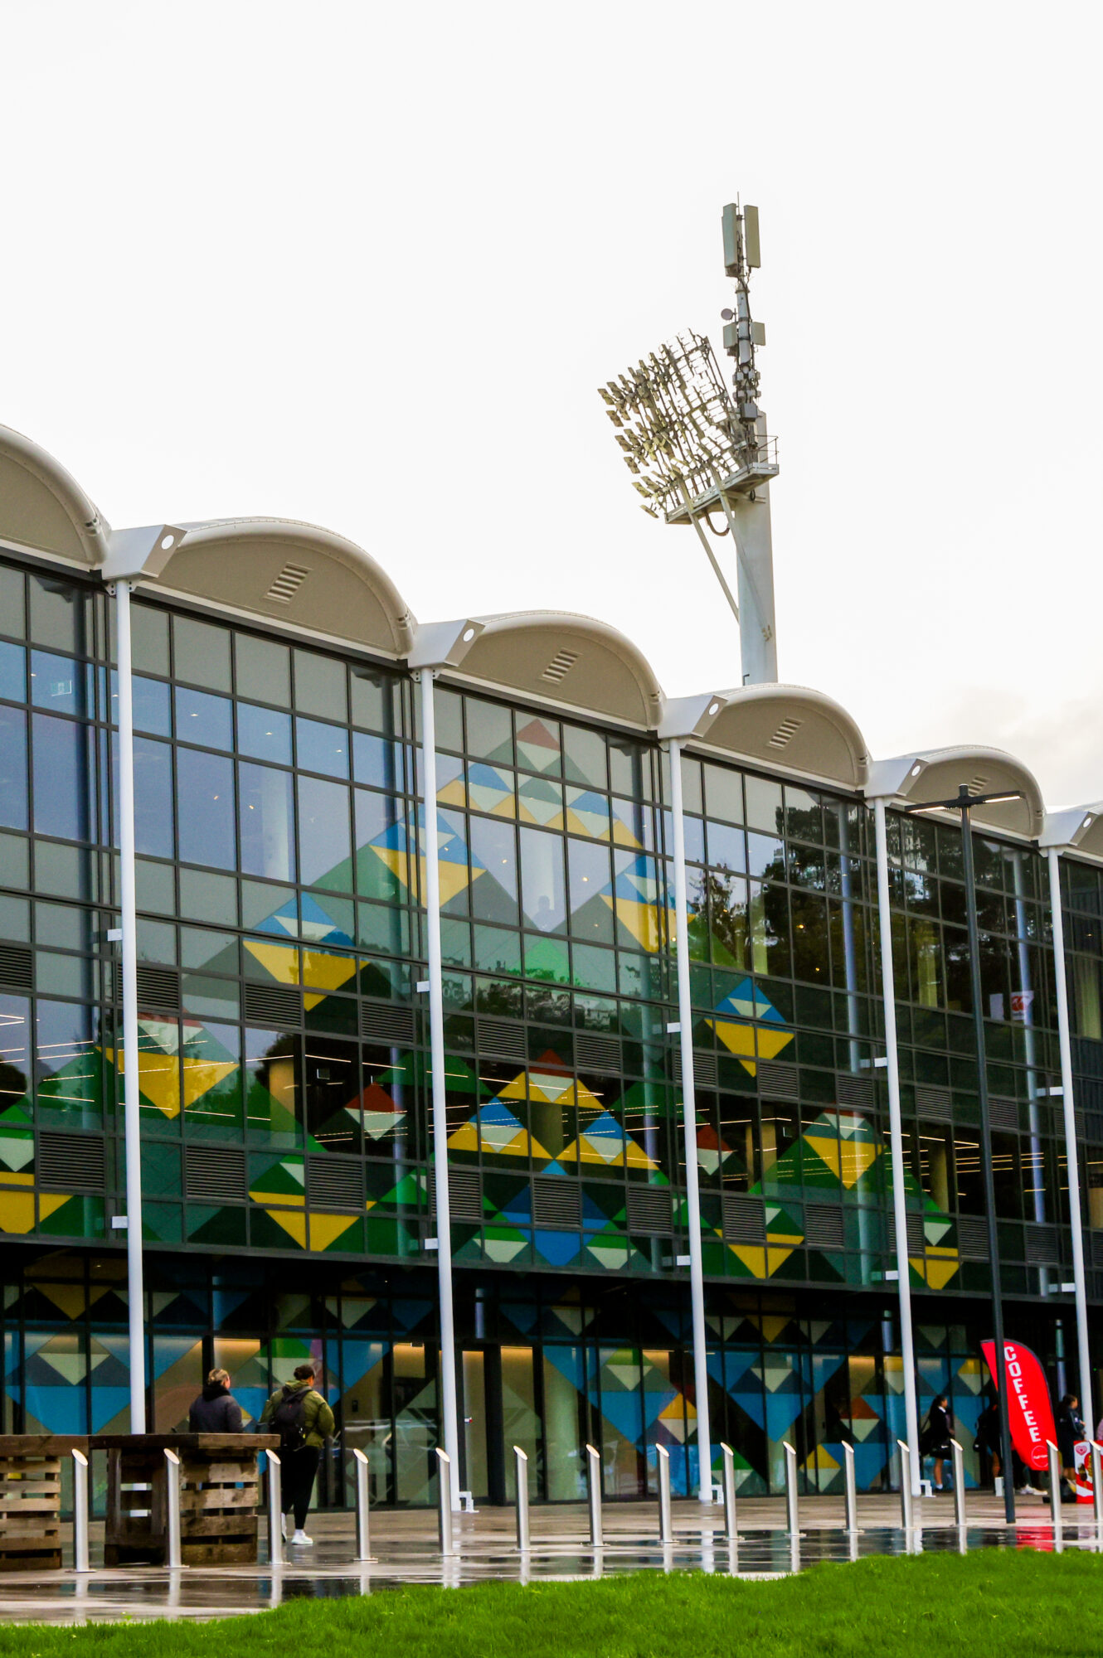

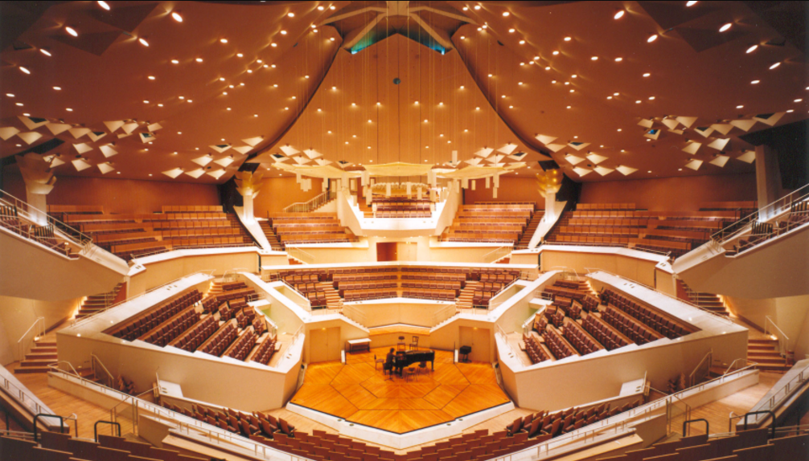

AURI™ Auracast™ Venues around the world

Slide 18
Audio is for Everyone
Hearing loss will impact everyone in this room in some form
The technologies are ready and available now
Auracast™ opens new conversations

Slide 19
Ed Beck
Ampetronic | Listen Technologies
Ed.beck@ampetronic.com
/in/edmatzbeck/
Willem Bakker
Heuff BV
willem@heuff.nl
/in/bakkerwillem/

