Slide 1
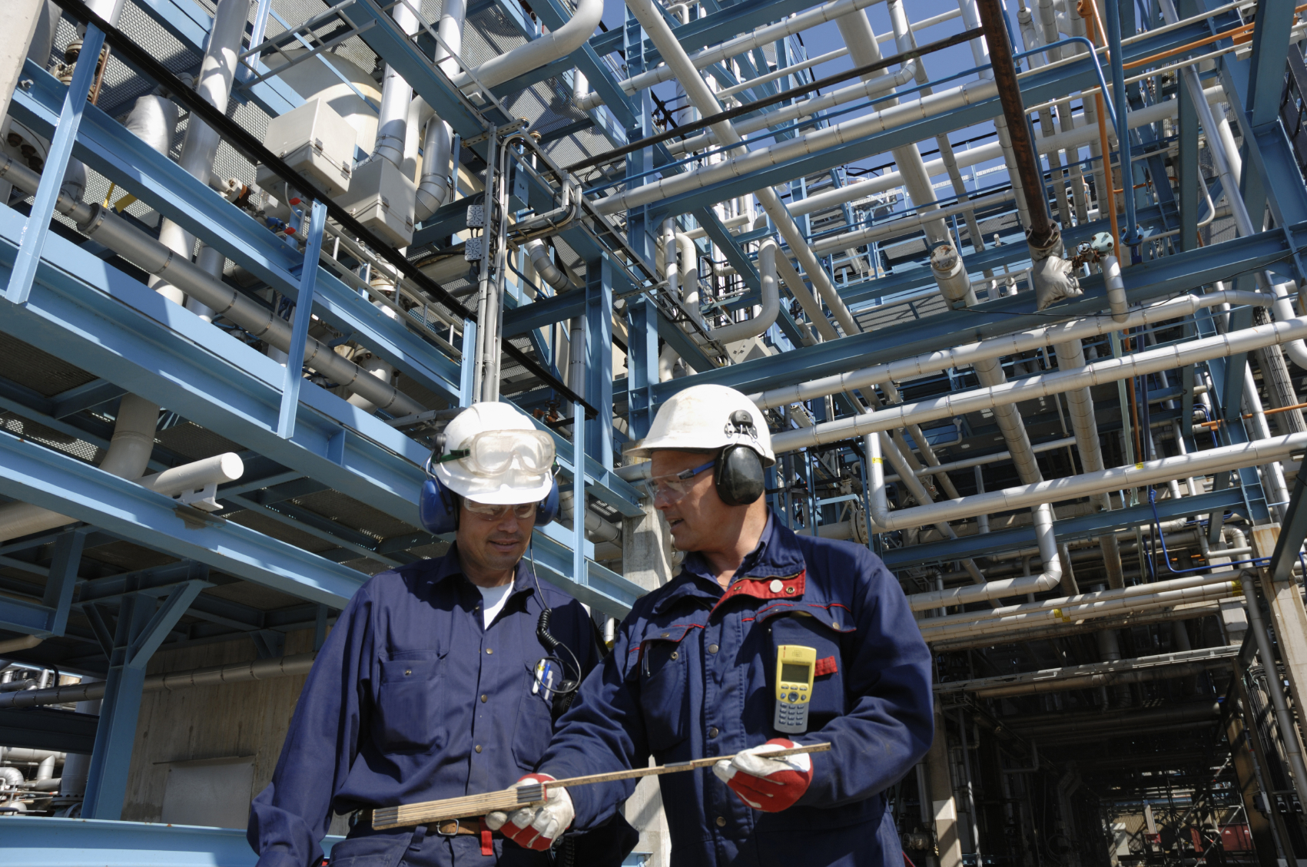
Introduction to Industrial Dust Monitoring
Notes:
The goal of this presentation is to give the listeners a general overview of dust monitoring and Sintrol’s philosophy on how dust monitoring could be a useful tool for monitoring for unexpected events:

Slide 2
Cleaning The Air
“Every year thousands of people die of lung disease or get asthma because of airborne contaminates they have breathed in at work. Many Employers install local exhaust ventilation to protect workers health, but it doesn’t work. This may be because its the wrong type or because its not properly installed, used or maintained. ”
Reference: Health and Safety Executive, UK
Notes:
Dust is one of the single most frustrating issues that industries deal with.
Dust collection systems and dust control is common practice and excellent solutions and procedures are available on the market.
However, monitoring the efficiency of dust control system and monitoring for unexpected events can save a lot of time, money and headaches

Slide 3
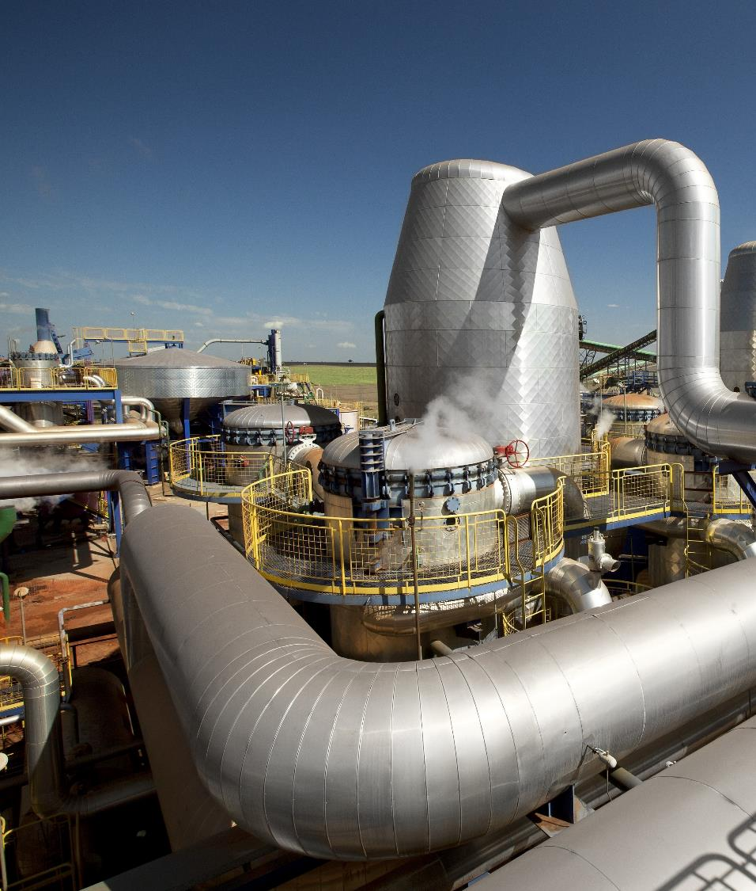
Dust in Industrial Air Quality
Typical challenges
Wide range of sources
Large footprint
Difficult to monitor
Difficult to manage
Continuous changing footprint (temperature, weather, humidity, size...)
Dust control is often a large complex problem
Dust is often a site-specific problem
Notes:
A few words about dust challenges
Dust is very often a unavoidable problem in industries handling bulk and powders

Slide 4

Risks
  Health & Hygiene
  Possible explosions
  Equipment failures
  Neighborhood Nuisance
  Unprofessional working environment
  Product loss
Notes:
Health & Hygiene: Lung disease, Silicosis, Allergies, Bronchitis and many more
Possible explosions: Given the right circumstances, dust will explode
Equipment failure: Dusty environments are very hard on most equipment
Neighborhood nuisance: For sites bordering residential areas, fugitive dust emissions can become a source of tension
Unprofessional working environments: For example it is very unprofessional to have dust accumulations in food industry (bugs, rodents etc…)
Product loss: regardless of your product dust accumulations add up to money surprisingly quickly

Slide 5
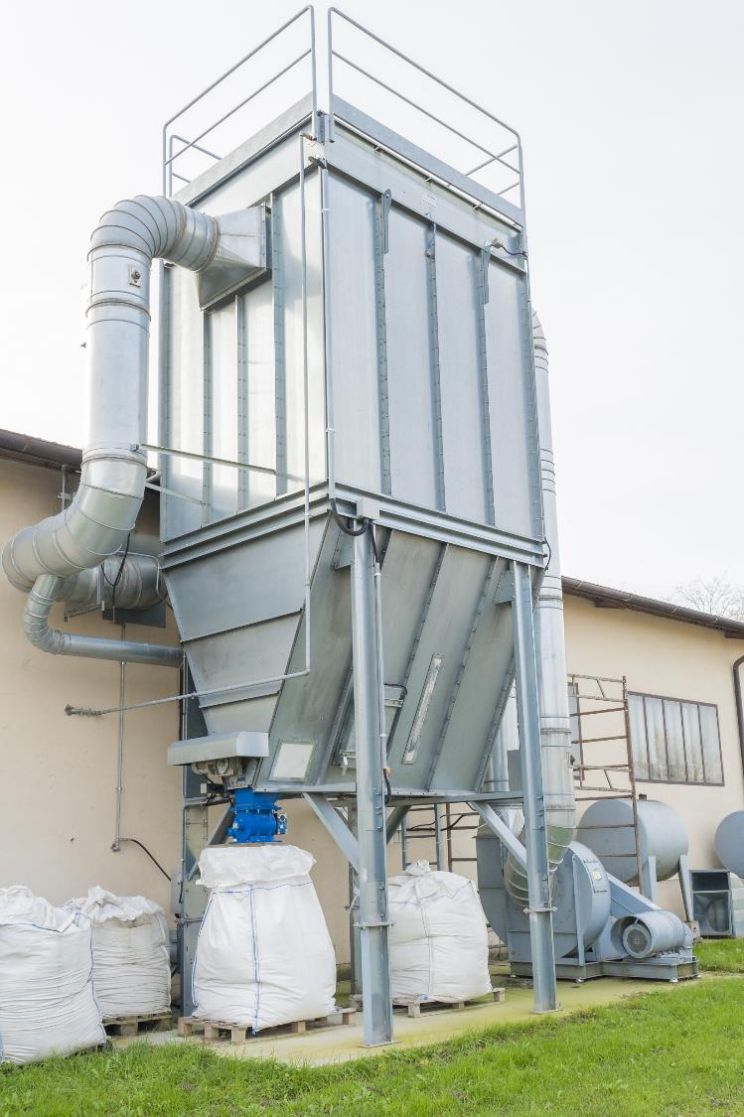
How Dust Control is Handled Today
Dust Control
  Ventilation
  Dust suppression
  Filtration
  Controlling the dust at the source
Drawbacks and Challenges
  High energy impact
  High water consumption
  Continuous maintenance needed
  Changing footprint
Notes:
In theory, if everything works normally, there usually isn’t a problem. But long-term maintenance is needed and easily overlooked

Slide 6

How Dust is Monitored Today Compliance Monitoring
Requirements
  Often industry specific regulation
  Threshold limits adopted by hygienists
  Compliance measurements adopted by local authority
  Precise analysis required
  Reporting done in intervals
  Grab sampling
  PM10, PM2,5, PM1
  Personal dust monitors
Drawbacks
  Slow and involves sampling
  Requires highly accurate and highly priced analyzers
  Not suitable for quick response to dust events
  Grab sample analysis could take days
Notes:
Normal complience monitoring is slow – could be days in some cases

Slide 7

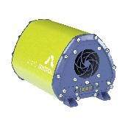
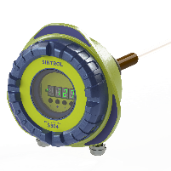
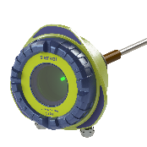
…The Future
Real Time Trend Monitoring
Real time dust monitoring
  Controllers know the dust level in real time
  Allows the possibility to respond to dust events quickly
  Supports the mandatory compliance monitoring to pinpoint source
  Trigger dust control measures quickly and efficiently
  Trigger local sound or siren if dust levels increase above a predetermined level
Drawbacks
  Real time dust monitors not highly accurate
  Calibration

Slide 8

Primary Drivers
Combustible Dust
Nuisance Dust
Health & Hygiene
Filtration Monitoring
Process Improvement
Compliance Monitoring
Notes:
The majority of industrtial dust monitoring needs fall under the five main themes which we will be covering in the next slides:
Main applications ”watch dog” applications monitoring for unexpected events.

Slide 9

Combustible Dust
Given proper conditions done can become a serious risk
Monitoring for dust can help mitigate the risk of:
Employee death or injury
Fires
Destruction of entire facility
Notes:
Given proper conditions done can become a serious risk

Slide 10
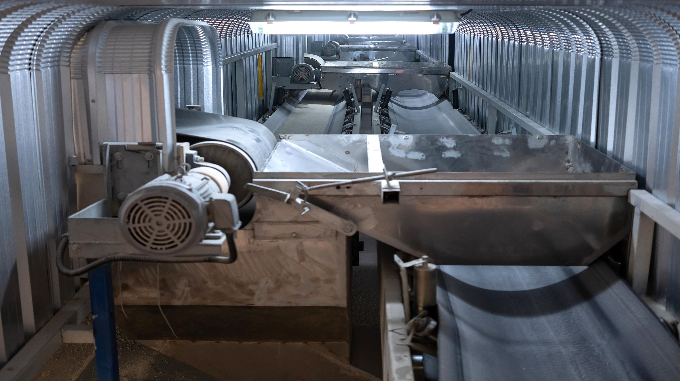
Combustible Dust
Realtime dust monitoring can significantly mitigate the risk of explosions
Dust clouds
Dust accumulation
Notes:
24/7 dust monitoring in high risk areas
Immediately alert operations when abonormal dust levels are detected
Plant cleanliness is necessary to minimize accumulation of combustible dust

Slide 11

Health And Hygiene
“Every year thousands of people die of lung disease or get asthma because of airborne contaminates they have breathed in at work. Many Employers install local exhaust ventilation to protect workers health, but it doesn’t work. This may be because its the wrong type or because its not properly installed, used or maintained. ”
Reference: Health and Safety Executive, UK
Notes:
Respiratory dust is a serious occupational hazard. All particles small enough to stay airbourne may be inhaled through the nose and mouth

Slide 12

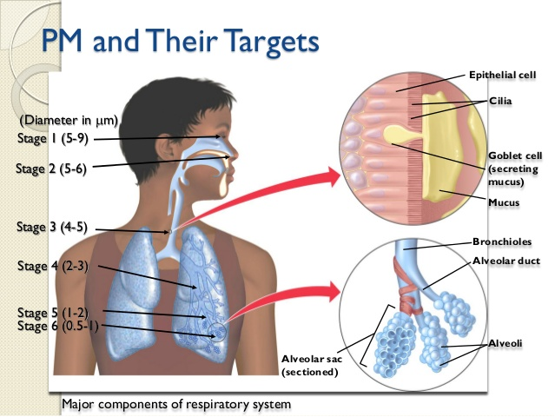
Health and Hygiene
Implementation of dust monitors
Monitoring total suspended dust in chosen areas 24/7
Immediately alert operations when abnormal dust levels are detected
Define the source and areas quickly
Trend and historically record dust levels throughout the plant
Continueous trend monitoring will help verify that the primary dust control is operating properly. If total airborne dust is rising –a problem is likely to exsist
Notes:
Dust control /management is almost always handled via VENTILATION, DUST SUPPRESSION or EXTRACTION/FILTRATION – often undersized or mismanaged, continuous dust monitoring is an extremely useful tool to monitor for unexpected events. Typical installation points would be monitoring ambient air where personnel is present or monitoring around the extraction systems to give assurance that dust control is working properly

Slide 13

Nuisance Dust
Fugitive dust is often considered harmless but frequently is the source to secondary problems.
Notes:
Factories often have many secondary sources of dust that are considered harmless and summed up is a lot of dust and could cause a wide variety of heartache and pain. Examples: For sites bordering residential areas, fugitive dust emissions can become a source of tension – mold, rodents, cockroaches, microbiological growth etc…

Slide 14

Nuisance Dust
Fugitive/Nuisance dust or dust not coming from a combustion source, accounts for about 90% of all emissions. When airborne PM crosses the property lines the facility may be subject to local Nuisance laws
Notes:
TYPICAL SOLUTIONS
Stand-alone ambient dust monitors in unmanned areas to monitor for fugitive dust
Monitoring dust from the numerous outlets of possible secondary dust sources (eg. Filter house)
Fenceline monitoring around facilities
Monitoring ambient dust throughout the facility to pinpoint the source of unwanted dust events

Slide 15
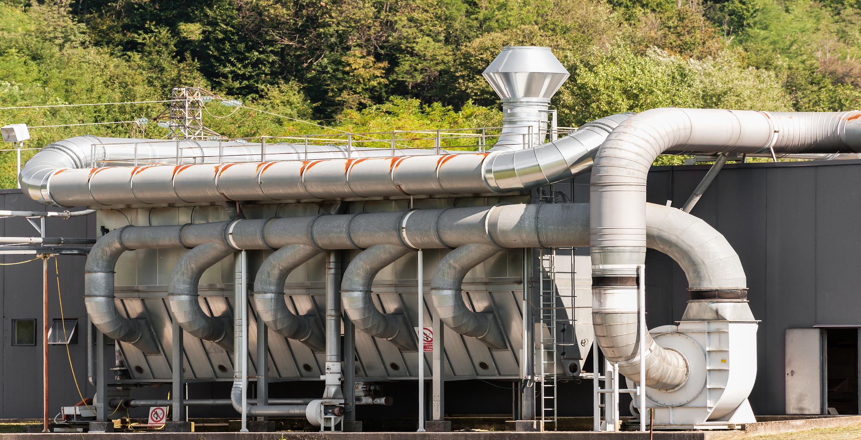
Filtration Monitoring
“Every year thousands of people die of lung disease or get asthma because of airborne contaminates they have breathed in at work. Many Employers install local exhaust ventilation to protect workers health, but it doesn’t work. This may be because its the wrong type or because its not properly installed, used or maintained. ”
Reference: Health and Safety Executive, UK

Slide 16
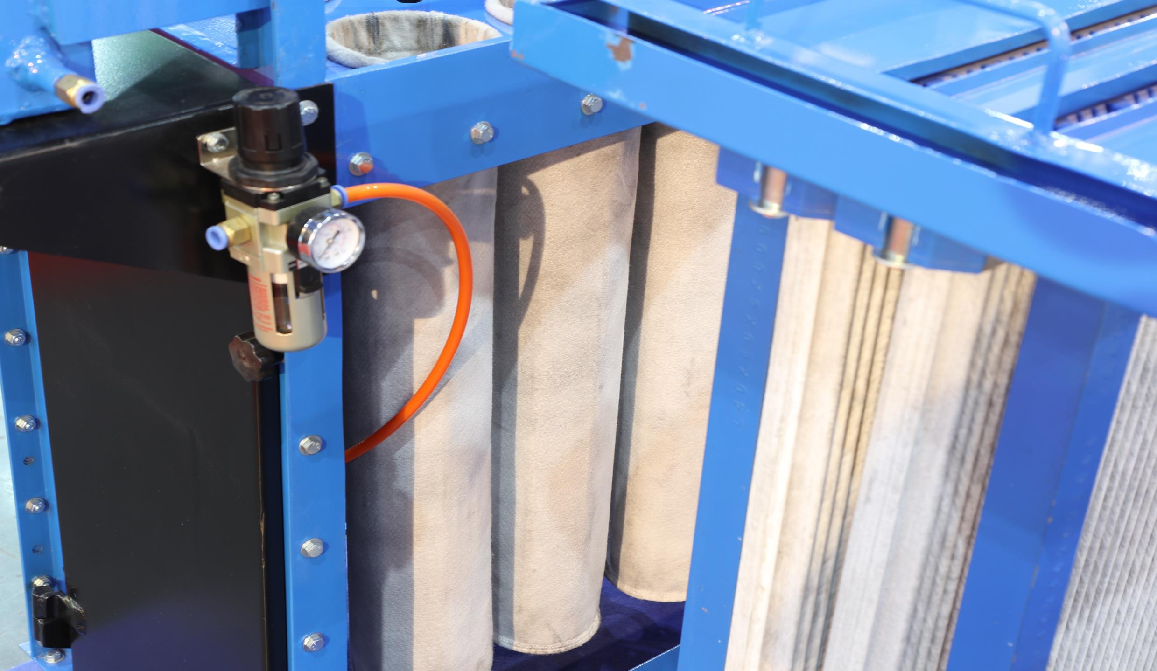
Filtration Monitoring
Dust monitoring to optimize dust collection systems could be the single most significant action companies can make to improve dust control.

Slide 17

Process Improvement
Sintrol has a long history on providing real-time dust monitoring solutions to increase the profitability of our customers.
We provide best practice solutions that give our customers a high ROI

Slide 18

Process Improvement
Examples process improvements
Prevent product loss
HazLoc supervision
Increased filter life
Avoid downtime
Saving Utilities
Improving sustainability

Slide 19
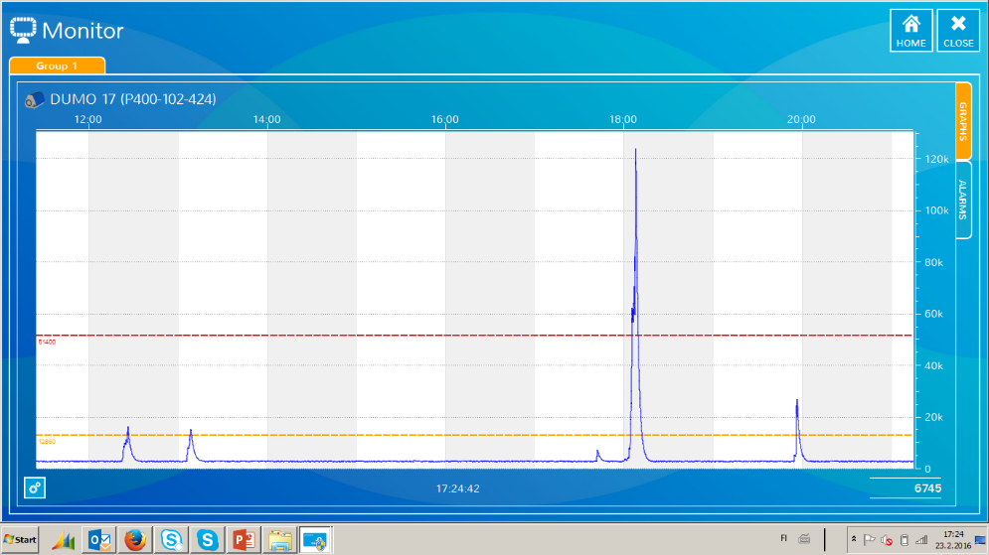
Monitoring for unexpected events
Examples of unwanted events
Change in process conditions
Fresh air intake is contaminated
Dust control not optimized or undersized
Dust collection system failure
Poorly fitted filter or leaking filter
Inadequate water supply
Interruption of clean cycle
Disturbance in ventilation
Leaking filter media
Loss of material
Notes:
Monitoring for unexepected events is a theme of many industries - Since expensive compliance monitors do not provide minute by minute data and or In many cases there is not any regulation forcing the operation to install dust monitoring. The key is that by monitoring dust – the operator will be aware of different ”events” or disturbances in his process
MOST of the above are everyday ”events” that can be seen by monitoring dust –its a question on what the operator will do

Slide 20
