Slide 1

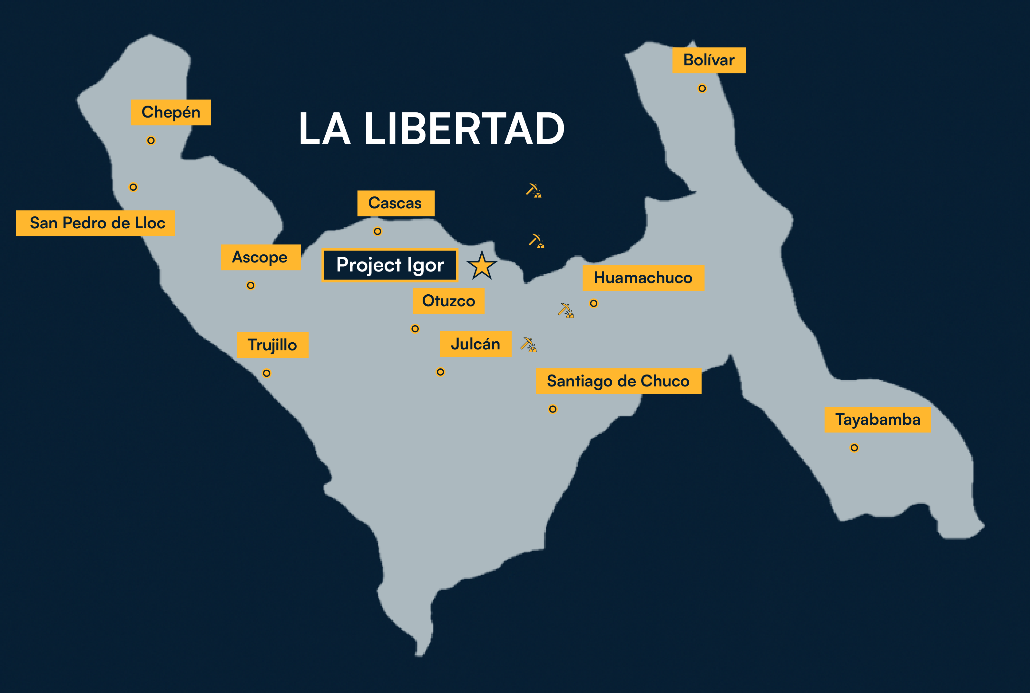






Emerging Gold & Silver Producer in Northern Peru
PPX Mining / Fact Sheet
TSXV: PPX | BVL: PPX
Q1 2026
PPX Mining Corp.
KEY HIGHLIGHTS
Location: Northern Peru, La Libertad Region
Institutional Backing: Glencore acquired 9.9% of PPX for ~C$20M on December 2025 and subscribed an offtake for precious metals concentrates
Callanquitas Operations: Operating asset with ore provisionally processed at a 3rd party facility
    Developing an on-site plant that can process higher volumes and lower grade ore
    Plant is financed and permitted
Callanquitas Exploration: Oct 2025 drill results 1.10m grading 49.52g/t Au, 11,597.1g/t Ag, 11.13% Cu
Portachuelos Exploration: Under explored asset with potential to move PPX from small to medium miner Mar 2, 2018 – 40.2m grading 1.18g/t Au, 115.4g/t Ag, there is: 7.0 m grading 4.9 g/t Au, 396 g/t Ag.
CAJAMARA
Yanacocha
>40 Moz Au
Igor Project
Shahuindo
>1 Moz Au
Lagunas Norte
>10 Moz Au
La Arena
>2 Moz Au
LA LIBERTAD
Directors and Management
Ernest Mast, President & CEO, Director
35+ years experience as a Mining Executive
CEO / MD of multiple mining companies and on multiple boards
John Thomas, COO, Director
44+ years of global mining experience
Worked on base and precious metals in Brazil, Costa Rica, Venezuela, Canada and more
Pompeyo Gallardo, CFO, Corporate Secretary
30+ years corporate finance expert
Senior roles at Scotiabank, CIBC, Chieftain Metals and Redcloud Klondike
Marcial Gutierrez, General Manager
20+ years of experience in large and small cap mining companies
Includes projects like Lagunas Norte and Chucapaca
Karina Rivva, Administrative & PR Manager
30+ years of experience in mining
Worked at SSR Mining and Barrick Gold
Warren Pratt, Technical Advisor
40+ years experience as a geologist
Led the team discovering Callanquitas Au/Ag deposit
Brian Imrie, Executive Chairman
Seasoned mining finance executive
Led global mining M&A at KPMG and previously co-headed M&A at National Bank Financial
John Menzies, Director
18+ years experience managing alternative investment strategies focused on macro and precious metals
Managing Member and Founding Partner of RIVI Capital LLC
Diego Bellido, Director
15+ years of experience in trading
Glencore executive, he is a manager for Glencore Peru SAC and Glencore Lima Trading SAC.
On the Board of Perubar S.A.
Fernando Pickmann, Director
20+ years experience in a corporate and mining law
Advised major Peruvian mining companies, internal legal advisor to the Peruvian Government on the Mining Privatization Committee of Centromin Peru
Bruno Kaiser, Advisor to the Board
30+ years experience in mining finance,
Managing Member and Founding Partner of RIVI Capital LLC
Current CFO of global heath data tech company
Contact: Pompeyo Gallardo, CFO | e:pompeyo.gallardo@ppxmining.com | www.ppxmining.com

Slide 2
Emerging Gold & Silver Producer in Northern Peru
DRILLING HIGHLIGHTS
PPX Mining / Fact Sheet
TSXV: PPX | BVL: PPX
Q1 2026
PPX Mining Corp.
Resource | Class | Tonnes | oz Au | oz Ag | g/t Au Eq. | oz Au Eq.
Oxide | Measured | 22,900 | 3,870 | 35,340 | 5.56 | 4,090
 | Indicated | 640,800 | 77,260 | 2,904,910 | 4.67 | 96,210
 | Measured + Indicated | 663,700 | 81,090 | 2,923,370 | 4.70 | 100,290
Oxide | Inferred | 528,500 | 63,210 | 1,750,140 | 4.40 | 74,760
Sulfide | Inferred | 231,400 | 20,760 | 2,068,230 | 4.63 | 34,450
Total |  | 1,423,600 | 165,060 | 6,741,740 |  | 209,500
(1) Publication of Resources 2024
(2) Excellent metallurgical recovery of oxides and sulfides
Apr 4 2024 – Metallurgical testing in Canada.
Oxides leached for 48hrs, 92.2% Au and 87.5% Ag.
Sulfide flotation for 97% Au and 94.8%.
Concentrate: 22.2 g/t Au, 3,558 g/t, 7.8 % Cu
(3) Confirmation of high-grade gold mineralization and open to the north and at depth
Apr 25 2024 – Drill results in Callanquitas West 18.93 g/t Au over 0.4m.
May 21 2025 –12.98 g/t Au over 0.6m.
May 7 2025 –14.3 g/t Au over 0.65m.
(4) Gold mineralization remains open deep within the East
Aug 20 2025 – Drill results in Callanquitas East 8.30 g/t Au over 0.45m.
Aug 20 2025 – Drill results in Tension vein sulfide 18.91 g/t Au, 217.0 g/t Ag over 0.7m.
(5) Confirmation of the discovery (CA-24-07) of tension vein sulfide, high grades of Au, Ag and Cu, open to the north and south and at depth
Oct 21 2025 – Drill results in Callanquitas East 8.63 g/t Au, 3,756.2 g/t Ag over 0.9m.
Oct 21 2025 – Drill results in Tension vein sulfide 49.52 g/t Au, 11,597.1 g/t Ag, 11.1% Cu over 1.1m. Dispersion 4.71 g/t Au, 921.2 g/t Ag, 0.9% Cu over 14.95m.
SHARE STRUCTURE
SHAREHOLDERS OWNERSHIP
Shares Outstanding | 846M
Options | 48M
Warrants | 149M
Shares Fully Diluted | 1043M
Peruvian Private Investor (Control Person) | 28%
Donald Smith Value Fund LP | 13%
North American Retail Investors | 14%
Other Retail Investors | 30%
Glencore | 10%
Mineral Resources are not Mineral Reserves and have not demonstrated economic viability
The MRE has been categorized in accordance with the CIM Definition Standards (CIM, 2014)
All figures are rounded to reflect the relative accuracy of the estimates. Minor discrepancies may occur due to rounding to appropriate significant figures
The Mineral Resource was estimated by MsMuñoz QP(Geo) of Mining Plus, Independent Qualified Person under NI 43-101
The Mineral Resource is reported inside an underground shell with a cut-off grade of 2.00 g/t gold equivalent, estimated using a gold price of 1,800 US$/oz and silver price of US$ 20 US$/oz
MRE is reported on a 100 percent basis within an underground shell. The gold equivalent is based in the following formula AuEq. = Au + Ag*0.0066
This report is dated the 7 November 2023 and has an effective date of 30 September 2023
The cut-off date for mining depletion is 30 September 2023

