Slide 1

Can AI PREDICT ITSELF ?
THE FUTURE, TOLD BY AI ITSELF
HACKATHON 2025 — JESSICA SANCTIS

Slide 2


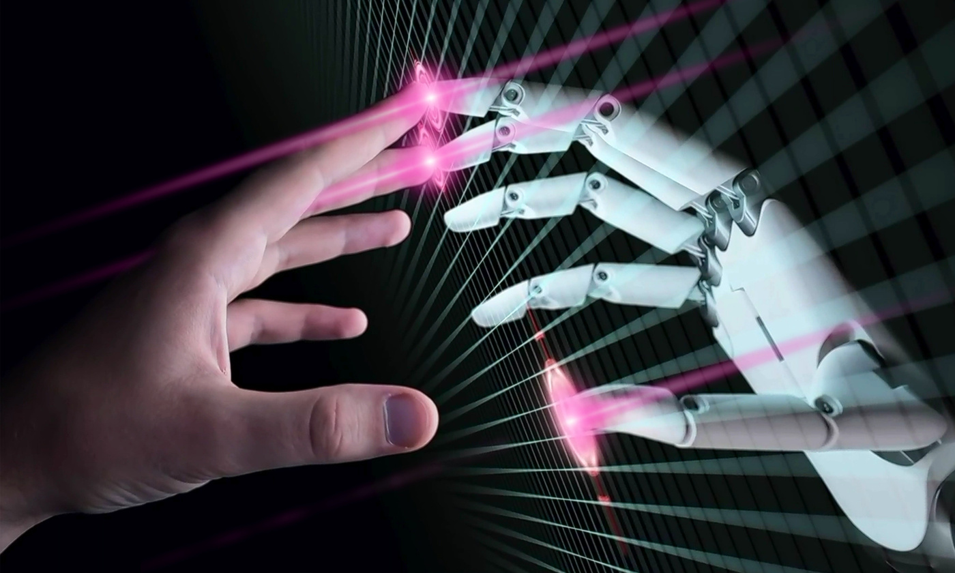
WHY FORECASTING AI MATTERS
  AI progress is accelerating.
  Forecasts guide safety, policy, and research.
  But experts disagree — some say 2027, others say 2050.

Slide 3

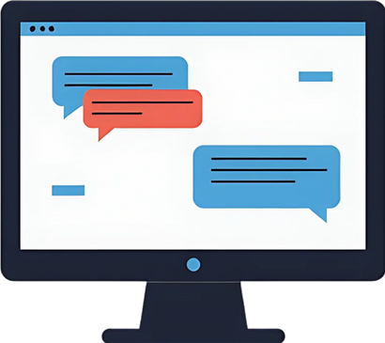



FLOW DIAGRAM
AI MODELS → PROMPTS → JSON FORECASTS → VISUALIZATION → INSIGHTS

Slide 4
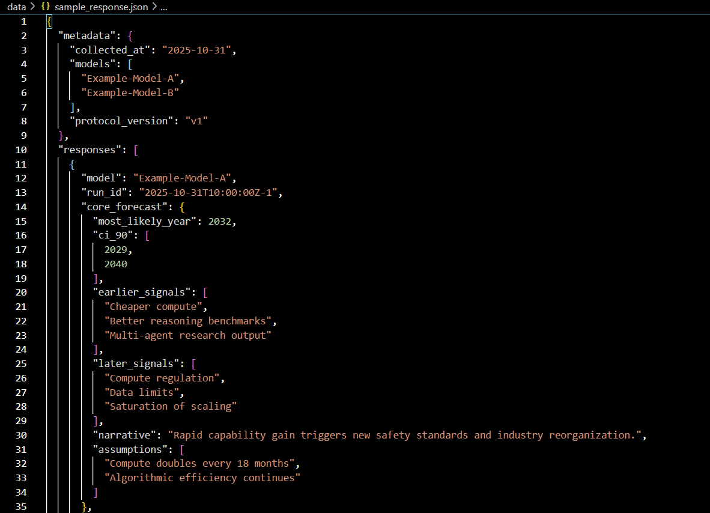
THE METHOD
  1
Same system prompt
  2
JSON format output
  3
Metadata saved

Slide 5
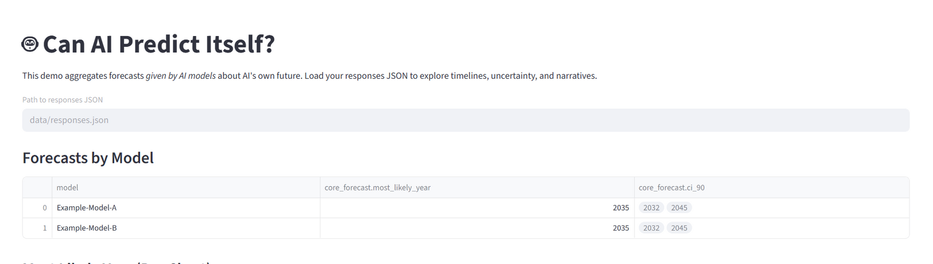
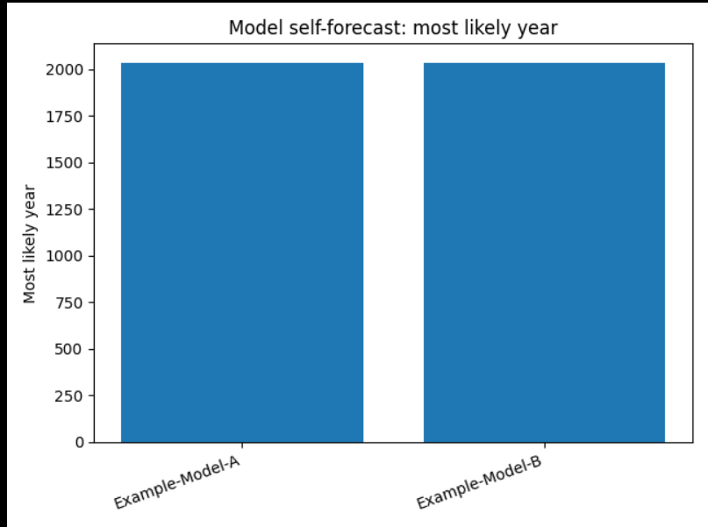
THE FORECASTS: AI’S VIEW OF ITS OWN FUTURE
  Bar chart:
  X-axis: Model names
  Y-axis: “Most likely year for human-level AI”
  Add shaded confidence ranges (CIs).
  Highlight median

Slide 6
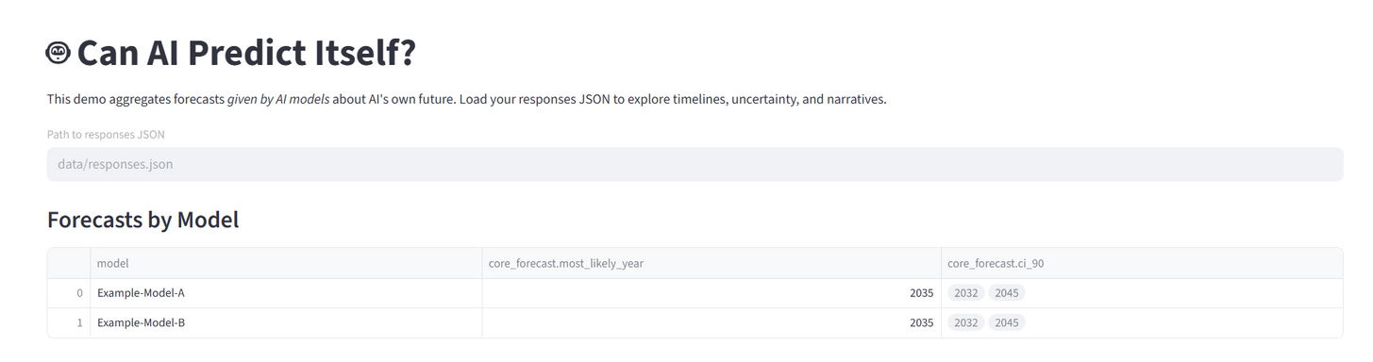
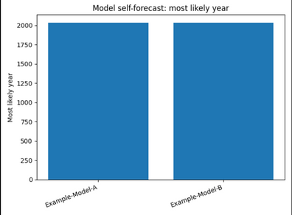
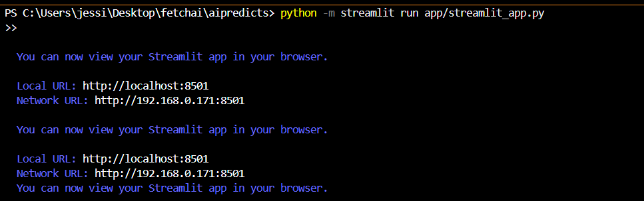
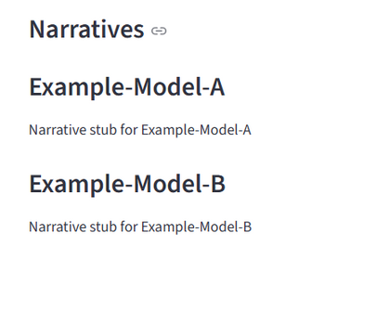
PROJECT SNIPPETS

Slide 7
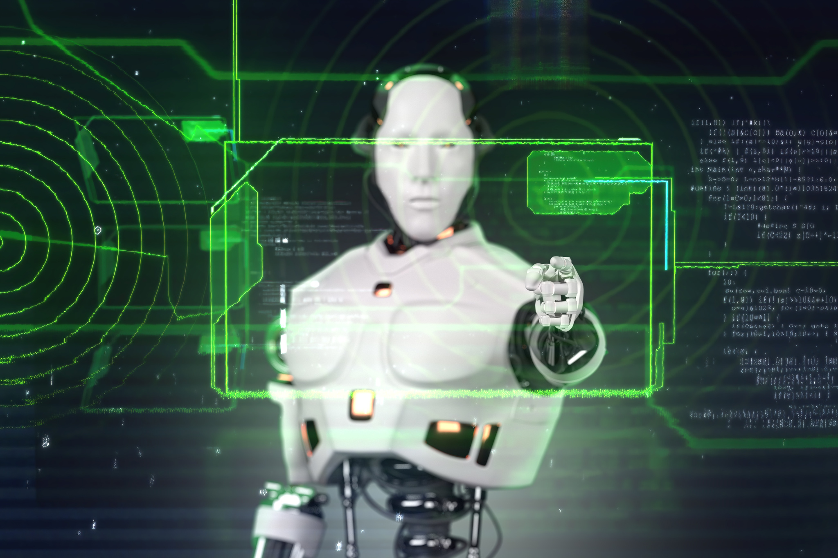
WHAT SIGNALS WOULD SHIFT THEIR FORECASTS?
•EARLIER: CHEAPER COMPUTE, BETTER REASONING, MULTI-AGENT BREAKTHROUGHS
•LATER: REGULATION, DATA LIMITS, SCALING SLOWDOWNS

Slide 8
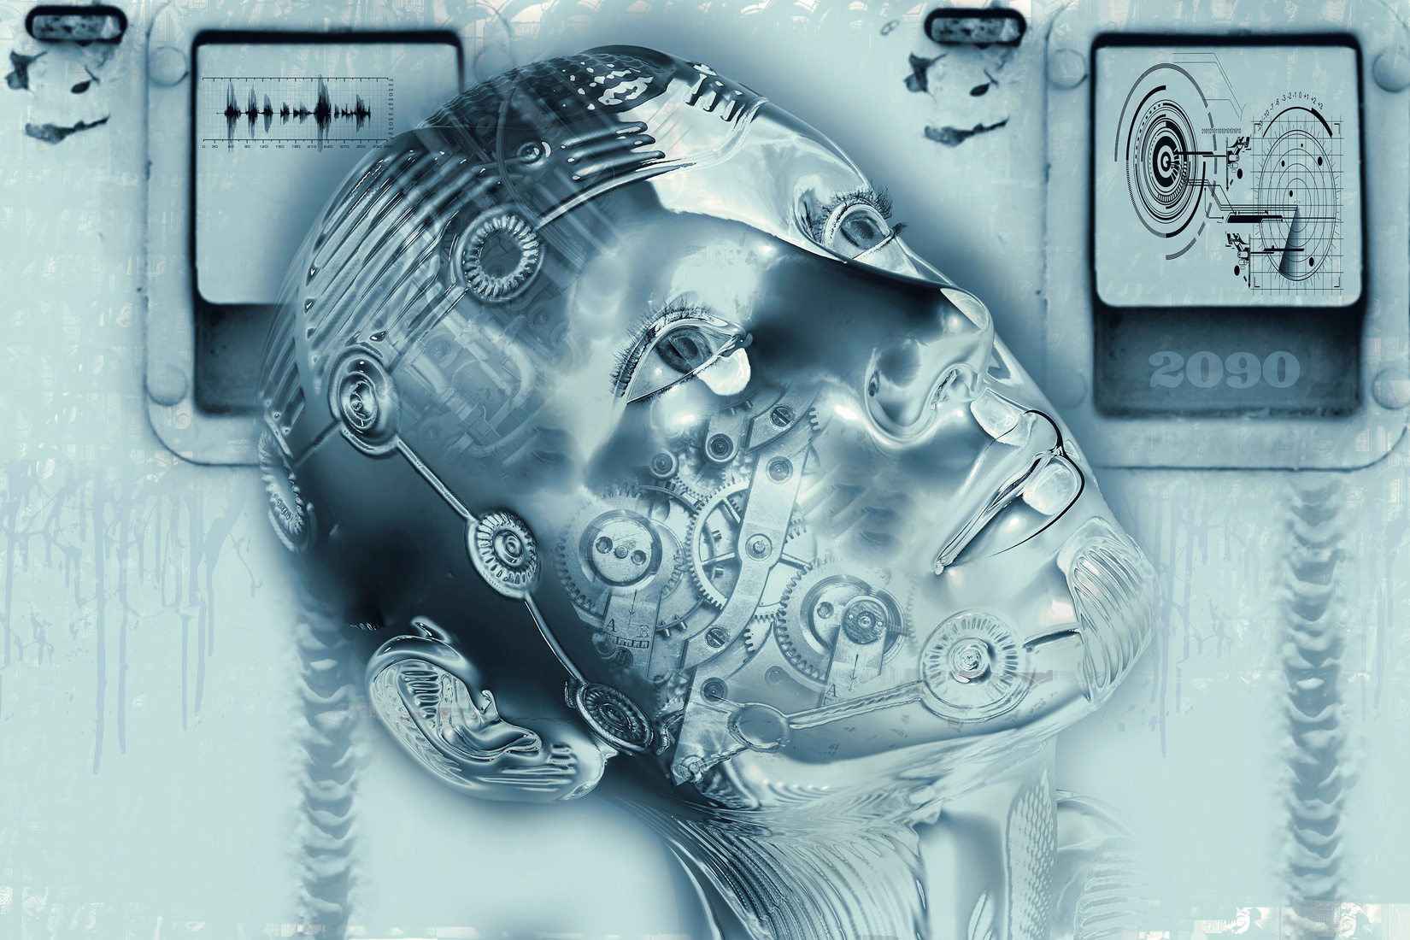
WHY IT MATTERS
FOR RESEARCHERS, POLICYMAKERS, AND SOCIETY:
• OPEN DATASET
• TRANSPARENT PROTOCOL
• EARLY WARNING POTENTIAL
• GOVERNANCE INSIGHTS

Slide 9
CONCLUSION
FORECASTING ISN’T ABOUT PREDICTION — IT’S ABOUT PREPARATION.
“WE LET AI TELL ITS OWN STORY — AND TURNED IT INTO A SIGNAL FOR HUMANITY.”

Slide 10
THANK YOU
NAME: JESSICA SANCTIS
EMAIL: JESSICASANCTIS12@GMAIL.COM
PHONE NO: +9710522980329
GITHUB: HTTPS://GITHUB.COM/JESSICASANCTIS/AI-HACKATHON.GIT

