Slide 1



The Third Wave of LoRaWAN ®:
From Connected Sensors to Operational Edge
Choosing the right gateway architecture when LoRaWAN moves from pilot to operations

Slide 2


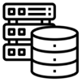






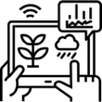
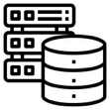

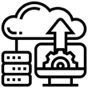
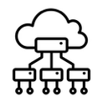



Robustel’s Role Across LoRaWAN® Deployment Models
The Things Conference - The Third Wave of LoRaWAN ®
Meters
Locally Hosted LNS
IoT
Platform
Uplink
(Data)
Leak Detection
LoRaWAN Communication
Built in LNS
TCP/
UDP
Cloud Hosted LNS
MQTT/
HTTPS
Application Server
Temp Sensors
LoRa Basics™
Station Packet Forwarder
Downlink
(OTA Config)
Third-Party Managed LNS
Network Monitoring
Tool
Pulse Counters
LoRaWAN® Enabled
End-Points
Robustel LoRaWAN®
Enabled Gateways
LNS
(LoRa Network Server)
Processing or Monitoring Layer
Deployment models Robustel support
Wireless Backhaul to Existing Network: Add industrial 4G or 5G redundancy to an existing LoRaWAN® network without ’rip and replace’
Industrial Packet Forwarder: Reliable gateway hardware for straightforward LoRaWAN® deployments.
Integrated Gateway + LNS: A simpler all-in-one approach for contained or fast-moving projects.
Open Ecosystem Partner: Fits alongside preferred LNS, sensors, cloud, and application platforms.
Gateway + LNS + Edge Intelligence: Adds local integration, protocol bridging, and edge capability where deeper value is needed.
Notes:
Hello everyone, I’m TY from Robustel. For those who do not know us, Robustel builds industrial IoT gateways and connectivity infrastructure, with a background in cellular, wireless backhaul, remote device management and industrial edge connectivity.
I am not here to give a product presentation, but this slide helps explain our perspective. Robustel usually sits at the gateway and edge infrastructure layer: between LoRaWAN end devices in the field and the systems that need to use the data, such as an LNS, IoT platform, application server, BMS, SCADA system or cloud platform.
The important point is flexibility. We are not trying to force one architecture. Some projects only need reliable LoRa Basics™ Station packet forwarding into an existing cloud or managed LNS. Other projects need local LNS capability, cellular backhaul, protocol bridging, edge processing or site-level visibility. Both models are valid.
Our role is to fit into the customer’s ecosystem, whether that includes LORIOT, The Things Stack, ThingPark, ChirpStack, cloud platforms, BMS platforms or custom applications.
So today I want to explore a practical question: when is packet forwarding enough, and when does a LoRaWAN gateway need to become part of the operational edge?

Slide 3
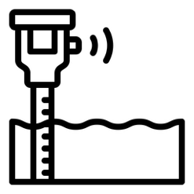



What Do We Mean by the “Third Wave” of LoRaWAN®?
The Things Conference - The Third Wave of LoRaWAN ®
LoRaWAN® has already proven its value for connecting low-power sensors and scaling wide-area IoT networks. The next challenge is operational: making that data usable inside real systems, workflows and decisions.
Wave 1: Connect the Sensor
Prove long-range, low-power field data collection.
Wave 2: Scale the Network
Manage gateways, coverage, onboarding and LNS architecture.
Wave 3: Operationalise the Data
Turn sensor data into usable insight, local action and system integration.
The third wave does not replace packet forwarding or cloud LNS models.
It asks a new question:
“what needs to happen after the packet arrives?”
Notes:
When I use the phrase “third wave,” I do not mean LoRaWAN® is becoming a different technology. I mean the deployment questions are changing.
In the first wave, the question was simple: can we connect low-power sensors over long range and get useful data from the field?
In the second wave, the question became: can we scale this? Can we manage gateways, coverage, onboarding, device fleets and LoRaWAN® Network Server architecture reliably?
Now, in more projects, the question is moving again. Once the packet arrives, what happens next? How is the payload decoded? Where does asset context live? Does the data need to trigger a local alarm? Does it need to reach a dashboard, a BMS, SCADA system, MQTT broker, OPC UA system or cloud platform? What happens when backhaul is unreliable? Who supports the deployment after installation?
That is what I mean by the third wave: moving from connected sensors to operational edge.
This does not make packet forwarding less important. In many LoRaWAN® projects, packet forwarding into a cloud or managed LNS is still the cleanest and best architecture. But for some deployments, especially in industrial, utility and building environments, the gateway starts to become part of the operational system.

Slide 4
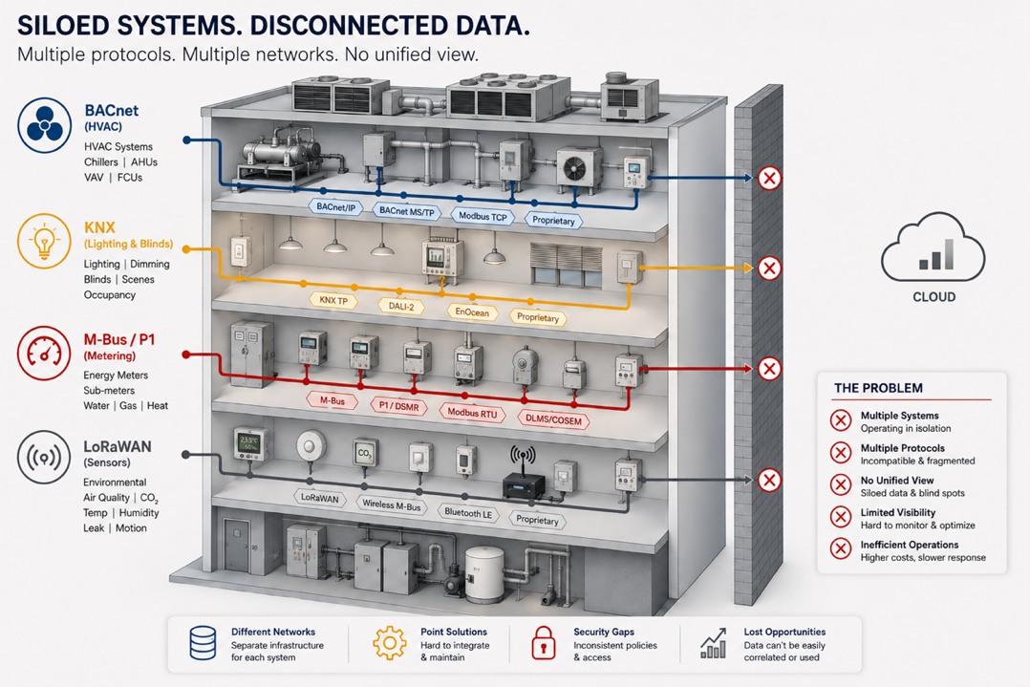
The Industrial Data Problem
What Gets Hard After the Packet Arrives?
The Things Conference - The Third Wave of LoRaWAN ®
A LoRaWAN® pilot proves that data can be collected. An operational deployment needs that data to be decoded, trusted, integrated and maintained across real systems.
1. Data Silos
LoRaWAN® sensors, PLCs, meters, controllers and building systems often sit in separate networks and platforms.
2. Protocol Complexity
LoRaWAN® data often needs to work alongside Modbus, OPC UA, BACnet, KNX, MQTT, SCADA, BMS or cloud systems.
3. Operational Risk
Direct cloud or enterprise integration can create reliability, security and maintenance challenges.
4. Lost Business Value
Raw data has limited value until it is decoded, contextualised, processed and integrated into workflows or decisions.
Connectivity is the start.
Operational value comes from what happens next.
Notes:
After a LoRaWAN® pilot, it is easy to focus on the successful part: sensors are connected, packets are arriving, and the data is visible somewhere. That is important, but it is not the full operational problem.
In real deployments, the customer usually has many existing systems already in place. There may be PLCs, meters, controllers, SCADA systems, BMS platforms, cloud applications and maintenance workflows. LoRaWAN® data has to become useful inside that environment, not create another isolated data island.
The first issue is data silos. Sensor data, equipment data, building data and utility data often live in different systems.
The second issue is protocol complexity. LoRaWAN® data may need to work alongside Modbus, OPC UA, BACnet, KNX, MQTT or other systems the customer already uses.
The third issue is operational risk. If we connect everything directly to cloud or enterprise systems without thinking carefully, we can create reliability, security and maintenance problems.
And the fourth issue is lost value. Raw data is not enough. Before it can support alarms, dashboards, automation or AI, it needs to be decoded, contextualised, processed and integrated.
This is why gateway architecture matters. Not every project needs local edge processing, but every operational project needs a clear answer for what happens after the packet arrives.

Slide 5






Choose the Architecture That Matches the Job
The Things Conference - The Third Wave of LoRaWAN ®
Packet forwarding, cloud LNS and edge integration are all valid LoRaWAN® models.
The right choice depends on what the deployment needs after data is collected.
Sensor(s)
Gateway
Cloud
LNS
Application Server
Sensor(s)
Edge Gateway
Embedded LNS + E2C
Application Server
 | Connectivity-Focused Model | Integrated Edge Model
Architecture | Sensors connect through a gateway into an external or managed LNS and application environment. | Sensors connect into a gateway that can combine LoRaWAN® connectivity, embedded services and local integration.
Best When | The project already has a preferred LNS, cloud platform, dashboard or application layer. | The project needs local visibility, buffering, protocol bridging, alarms or site-level workflows.
Data Handling | Data is mainly transported northbound for processing elsewhere in the stack. | Data can be decoded, filtered, contextualised or acted on closer to the site.
Good Fit For | Simple telemetry, cloud-first deployments, established ecosystem preferences and cost-sensitive rollouts. | Industrial, utility, smart building and remote-site deployments where data must integrate with OT systems.
Start simple.
Add local intelligence only when the deployment problem requires it.
Notes:
There is sometimes a temptation to think about gateway architecture as a maturity ladder, where simple packet forwarding is basic and edge integration is automatically better. I do not think that is the right way to look at it.
In many LoRaWAN® deployments, a connectivity-focused model is the best architecture. The sensors connect through a gateway into an external or managed LoRaWAN® Network Server, and the application layer, dashboards and workflows live elsewhere. If the customer already has a preferred LNS, cloud platform or application environment, this can be simple, scalable and very effective.
In other deployments, especially in industrial, utility, smart building or remote-site environments, the gateway may need to do more. It may need to support local buffering, protocol bridging, alarms, dashboards, payload decoding or integration with systems such as Modbus, OPC UA, BACnet, KNX, MQTT, SCADA or BMS.
The point is not that one model is better than the other. The point is to match the architecture to the real deployment need.
My simple rule is: start with the simplest architecture that solves the problem. Add local intelligence only when the deployment genuinely needs it.

Slide 6
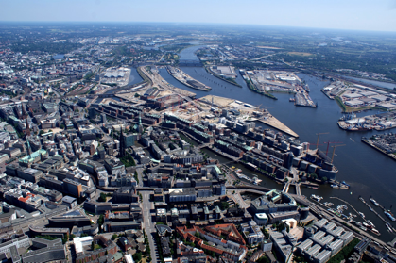
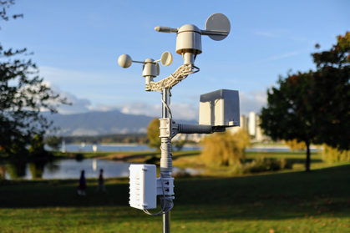
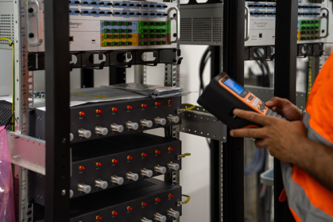


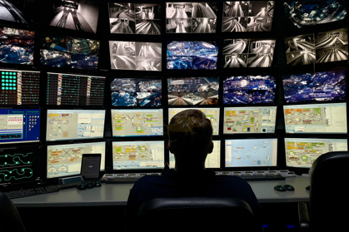
When Does the Edge Start to Matter?
The Things Conference - The Third Wave of LoRaWAN ®
Look beyond “connected sensors” and listen for operational requirements.
Edge capability becomes useful when LoRaWAN® data needs to stay valuable at the site, work with existing systems, or scale across many deployments.
"Our assets are spread across hundreds of locations."
"We're using a mix of wired equipment and wireless sensors."
"We need our field data in the cloud and our existing systems."
Distributed sites need repeatable gateway architecture, remote management and consistent data handling.
Data must be decoded, mapped and integrated into cloud, BMS, SCADA, MQTT or application platforms.
LoRaWAN® data must work alongside Modbus, OPC UA, BACnet, KNX, I/O or serial devices.
"We can't justify sending engineers to every site."
“Backhaul is not always reliable.”
“We need one model we can deploy everywhere.”
Remote diagnostics, configuration, updates and visibility become part of the architecture.
Local buffering, alarms and site-level continuity is needed when cloud connectivity drops.
Reusable edge logic and standardised data handling make
multi-site deployments easier to support.
Edge matters when LoRaWAN® data has to become useful before it leaves the site.
Notes:
After choosing the architecture, the next question is: when does edge capability actually matter?
I do not think edge should be added just because it sounds advanced. It becomes useful when the deployment has operational requirements that cannot be solved by connectivity alone.
These are some of the signals we hear in real projects. The customer may have assets spread across many locations. They may be combining LoRaWAN® sensors with wired industrial equipment, meters, PLCs or building systems. They may need the data inside an existing SCADA, BMS, cloud or application platform.
They may also need to reduce site visits, support many gateways remotely, or keep some local visibility when backhaul is unreliable.
In these situations, the gateway can become more than a radio bridge. It can help decode, buffer, contextualise, integrate and sometimes act on the data locally.
The important point is still the same: not every LoRaWAN® project needs this. But when these operational requirements appear, edge capability can make the deployment easier to support and more valuable over time.

Slide 7

















From LoRaWAN® Packets to Operational Data
The Things Conference - The Third Wave of LoRaWAN ®
When LoRaWAN® data needs to be used locally or integrated with existing systems, the gateway can become a practical edge layer between field devices and operational platforms.
Operational Edge Computing Services
COLLECT
Data Collection
COMPUTE
COMPUTE
CONNECT
Collect operational data from LoRaWAN sensors, PLCs, RTUs and smart meters
Enterprise & Cloud Integration
MQTT • REST • Sparkplug B
AWS • Azure • enterprise apps
Logic Orchestration
Scenario Management
COLLECT
Node-RED workflows, rules and automation
Templates, deployment models and workflows
CONTROL
Sensor Onboarding & Payload Decoding
Operational Data Forwarding
CONTINUITY
COMPUTE
Identify supported LoRaWAN® devices and convert payloads into usable datapoints.
Bridge LoRaWAN and industrial data into existing SCADA, BMS and operational systems.
COLLECT
Data Management
Alarm Management
CANVAS
Local LNS /
Network Services
Local database, buffering and historical storage
Events, notifications and threshold monitoring
Edge SCADA & Dashboards
Support local LoRaWAN® network services where site-level control is needed.
CONTINUITY
Provide local operational visibility, alarms and web dashboards for remote sites.
Reliable Operations & Data Continuity
Store-and-forward keeps operations running during outages and synchronises automatically when connectivity returns.
The ’6C’ Mental Model for Edge Adoption - The goal is not more data. The goal is data operations teams can use.
Collect
Compute
Continuity
Canvas
Connect
Control
Acquire data from LoRaWAN® sensors, meters, PLCs, RTUs, I/O and field equipment.
Decode payloads, normalise values, apply rules, filter noise and prepare data for use.
Buffer data, maintain local visibility and keep operational uptime.
Provide local dashboards, alarms and site-level visibility for operators and teams.
Publish usable data into cloud, MQTT, REST, SCADA, BMS, OPC UA or BACnet/IP.
Trigger local workflows, alerts or automation where site-level action is required.
Notes:
On the previous slide, we looked at when edge capability starts to matter. Now let’s make that more practical: what does the operational edge actually do?
I like to think about it in six simple functions. First, collect. The gateway brings together LoRaWAN® sensors and, in some projects, other field data sources like meters, PLCs, RTUs, Modbus devices, BACnet systems or local I/O.
Second, compute. This does not have to mean heavy AI or complex analytics. Often it means decoding payloads, normalising values, filtering data, applying thresholds or preparing data so other systems can use it.
Third, continuity. If backhaul is unreliable, the site may still need buffering, local alarms or store-and-forward behaviour so data is not lost and operations do not become blind.
Fourth, canvas. People at the site or support centre may need dashboards, alarms or local visibility without waiting for every workflow to be built in the cloud.
Fifth, connect. The data needs to reach the systems the customer already uses: MQTT, REST, SCADA, BMS, OPC UA, BACnet/IP, cloud platforms or application servers.
Finally, control. In some deployments, local alarms, workflows or simple automation need to happen close to the equipment.
The important point is that edge is not about adding complexity for its own sake. The goal is to turn LoRaWAN® packets into operational data that can be trusted, integrated and used.

Slide 8
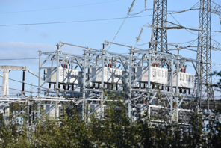
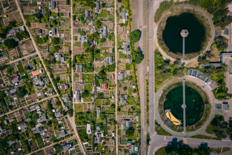
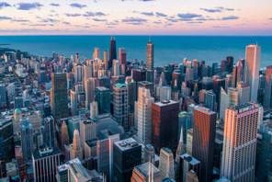
Where Does an Operational Edge Model Help?
Where LoRaWAN® Meets Operational Complexity
The Things Conference - The Third Wave of LoRaWAN ®
Monitor Distributed Infrastructure
Create operational visibility across remote assets without increasing engineering resources.
Edge Capability enables:
Local data collection and buffering
Remote monitoring and diagnostics
Alarm handling
Reduced site visits
Good fit for:
Utilities
Water & wastewater
Renewable energy
Transport infrastructure
Connect Mixed Field Systems
Bring LoRaWAN® sensors, wired equipment and legacy systems into one operational data flow.
Edge Capability enables:
LoRaWAN® and industrial protocol integration
Payload decoding and data mapping
Modbus, OPC UA, BACnet, KNX, MQTT or I/O bridging
Secure OT-to-IT integration
Good fit for:
Smart buildings
Environmental monitoring
Agriculture
Industrial sites
Scale Remote Operations
Use a repeatable architecture that can grow from a few sites to thousands of assets.
Edge Capability enables:
Standardised commissioning
Consistent data handling
Centralised fleet management
Lifecycle support across large deployments
Good fit for:
National utilities
Telecom providers
System integrators
Large infrastructure operators
The value is not the edge gateway itself.
The value is making distributed operations easier to see, support and scale.
Notes:
So where does this operational edge model help? I would group the use cases into three patterns.
The first is distributed infrastructure. This is common in utilities, water, renewable energy and transport. The assets are spread across many locations, and sending engineers to every site is expensive. In this case, edge capability can help with local data collection, buffering, alarms, remote diagnostics and visibility.
The second pattern is mixed field systems. This is where LoRaWAN® sensors are only one part of the environment. The site may also have meters, PLCs, RTUs, Modbus equipment, BACnet controllers, KNX systems, BMS platforms or cloud applications. The value is not just connecting sensors. The value is making LoRaWAN® data work inside the operational systems already used by the customer.
The third pattern is scale. Many IoT projects work at a small number of sites, but become difficult when they need to scale across hundreds or thousands of assets. At that point, repeatable architecture, consistent data handling, remote configuration and lifecycle support become very important.
This is where edge capability can help, but again, only when the operational problem requires it. The goal is not to add another box. The goal is to make distributed operations easier to see, support and scale.

Slide 9
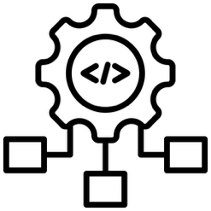

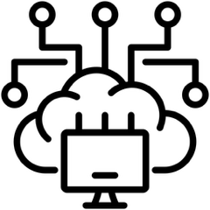
Three Takeaways for the Third Wave of LoRaWAN®
The Things Conference - The Third Wave of LoRaWAN ®
As LoRaWAN® deployments move deeper into operational environments, gateway architecture should be chosen by the problem it needs to solve, not by hype, habit or feature count.
Start with the simplest architecture that works
Packet forwarding, cloud LNS and managed ecosystem models remain valid when the data path is clear.
Plan for what happens after the packet arrives
Payload decoding, data mapping, asset context, alarms, dashboards and integration often determine whether a deployment becomes useful.
Use edge capability when the site needs local usefulness
Edge matters when LoRaWAN® data must be buffered, processed, visualised, integrated or acted on locally before it leaves the site.
The next opportunity for LoRaWAN® is not just connecting more sensors.
It is making field data easier to use in real operations.
Notes:
To finish, I want to leave you with three simple ideas.
First, start with the simplest architecture that works. Packet forwarding, cloud LNS and managed ecosystem models are not outdated. In many projects, they are the cleanest and most scalable answer.
Second, plan early for what happens after the packet arrives. A LoRaWAN® deployment is not successful just because data reaches a server. The data still needs to be decoded, mapped, contextualised and integrated into the systems and workflows people actually use.
Third, use edge capability when the site needs local usefulness. That may mean buffering during backhaul outages, local dashboards, alarms, protocol bridging, integration with SCADA or BMS, or simple site-level automation.
The third wave of LoRaWAN® is not about replacing the architecture that already works. It is about extending LoRaWAN® into real operational environments where data needs to become useful, reliable and supportable.
Thank you.

Slide 10
Thank you for your time
Any Questions?
Continue the conversation with Robustel at the Conference
or at robustel.com

