Slide 1

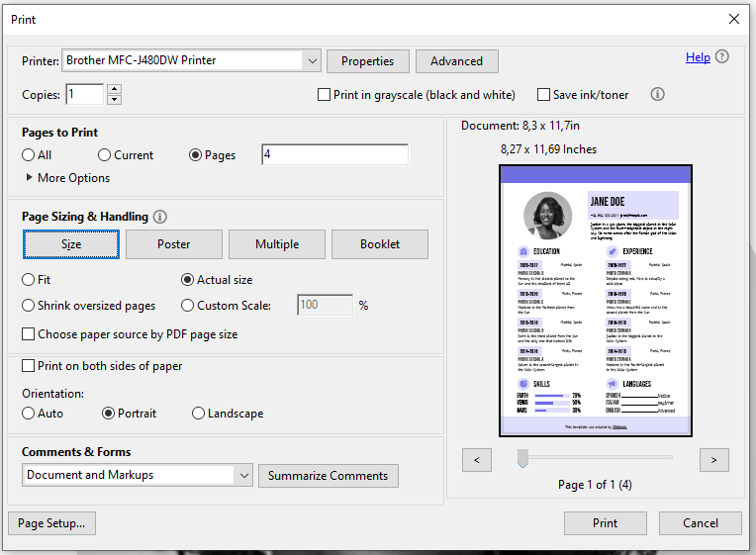
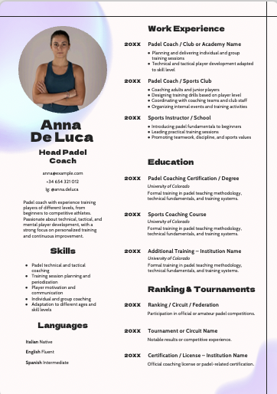
Instructions for printing: A4
Important note: In this template you will find downloadable slides. You can modify them to your liking and then download them as a .pdf file. This way, you’ll have a tailor-made version on your computer
For regular A4 version
Modify or add text and images if needed
Delete all the slides after the “Thanks” slide
Click File > Download > PDF Document
It will be downloaded to your computer
Now let's continue with the print settings!
Print with Adobe Acrobat
Open the downloaded PDF with Adobe Acrobat
Go to File > Print or press CTRL + P (Windows) / CMD + P (MAC)
Select these parameters:
1. Select your printer
2. Check if you want to print it in black and white
3. Select ‘Actual size’
4. Select “Portrait”
This page should be erased

Slide 2
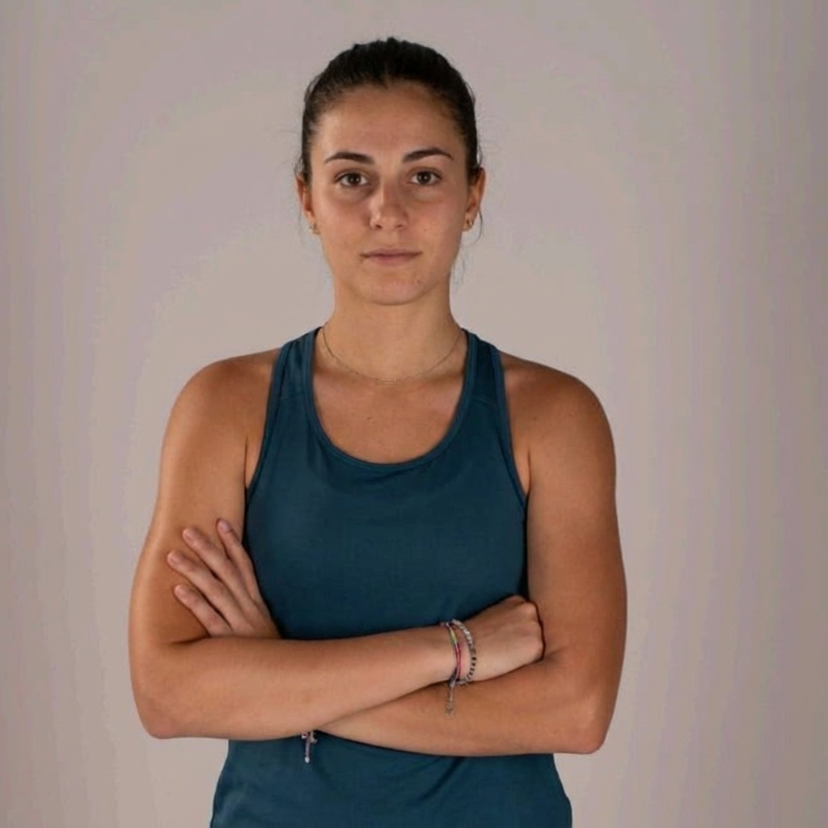
Anna
Head Padel Coach
Work Experience
20XX
Padel Coach / Club or Academy Name
Planning and delivering individual and group training sessions
Technical and tactical player development adapted to skill level
20XX
Padel Coach / Sports Club
Coaching adults and junior players
Designing training drills based on player level
Coordinating with coaching teams and club staff
Organizing internal events and training activities
20XX
Sports Instructor / School
De Luca
Introducing padel fundamentals to beginners
Leading practical training sessions
Promoting teamwork, discipline, and sports values
Education
anna@example.com
20XX
Padel Coaching Certification / Degree
+34 654 321 012
University of Colorado
Ig: @anna.deluca
Formal training in padel teaching methodology, technical fundamentals, and training systems.
Padel coach with experience training players of different levels, from beginners to competitive athletes. Passionate about technical, tactical, and mental player development, with a strong focus on personalized training and continuous improvement.
20XX
Sports Coaching Course
University of Colorado
Formal training in padel teaching methodology, technical fundamentals, and training systems.
Skills
20XX
Additional Training – Institution Name
Padel technical and tactical coaching
Training session planning and periodization
Player motivation and communication
Individual and group coaching
Adaptation to different ages and skill levels
University of Colorado
Formal training in padel teaching methodology, technical fundamentals, and training systems.
Ranking & Tournaments
20XX
Ranking / Circuit / Federation
Participation in official or amateur padel competitions.
Languages
20XX
Tournament or Circuit Name
Italian Native
Notable results or competitive experience.
English Fluent
20XX
Certification / License – Institution Name
Spanish Intermediate
Official coaching license or padel-related certification.

