Slide 1
Your Physical AI Applications
Are Only As Smart
As Your Network
THE THINGS CONFERENCE 2026
Global by Design, Sovereign by Law
Rony Cohen , FLOLIVE® × Mario de Lijster ,Odido

Slide 2
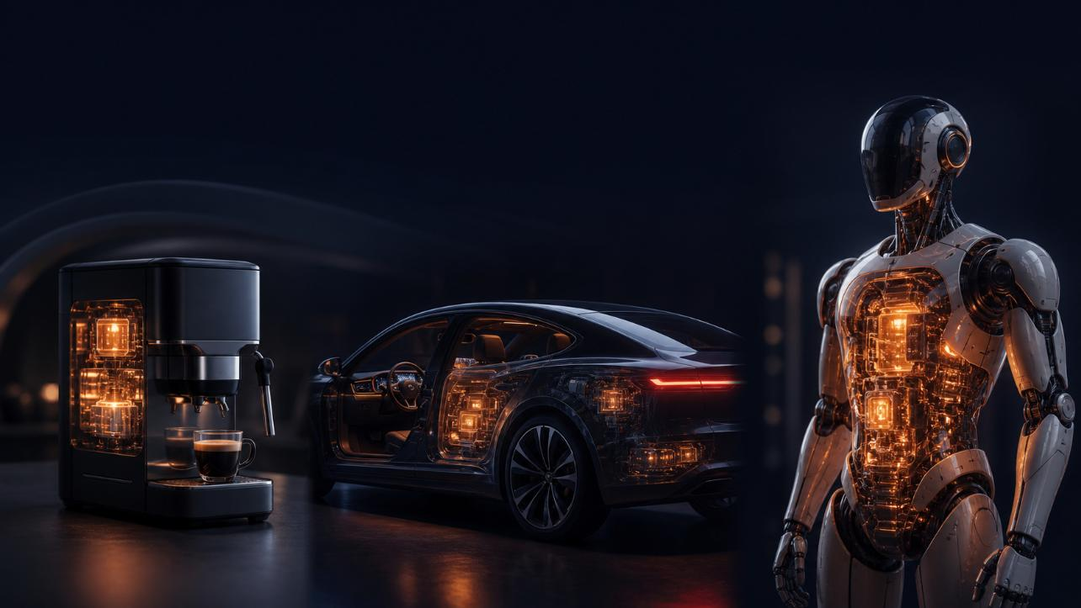

We are entering the era of physical AI
Devices with AI inside them - from the trivial to the powerful.
2

Slide 3
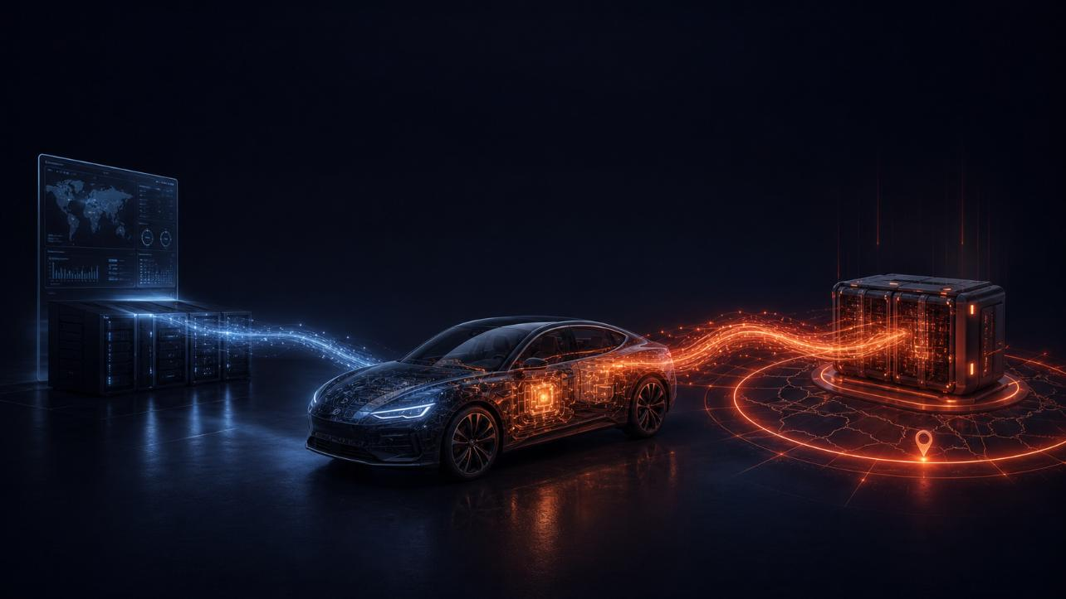
Every physical-AI device now has two conversations
Device-management system
AI model inference point
the conversation we always had
the new one - and it must stay in-jurisdiction
3

Slide 4
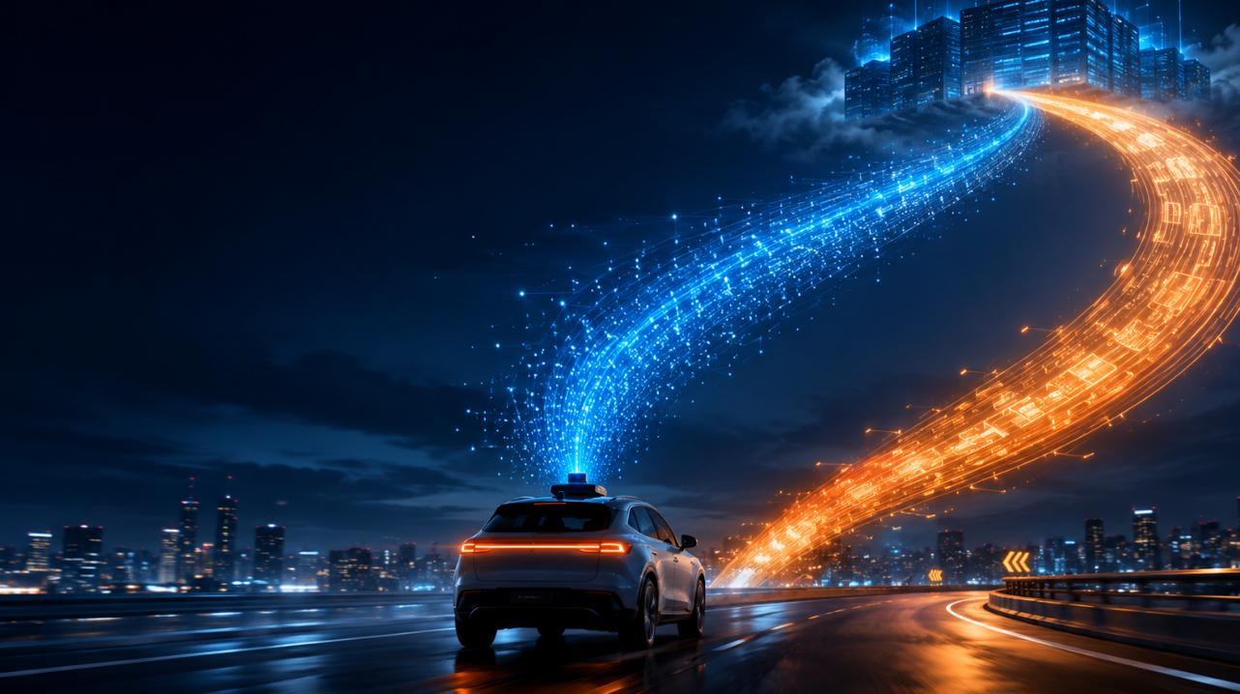
Global by design, sovereign in every region
Ship a product worldwide and you need
this everywhere at once:
Resilient - multiple carriers in every country
Sovereign - data stays where each region requires
One control plane - not a patchwork of roaming deals
4

Slide 5
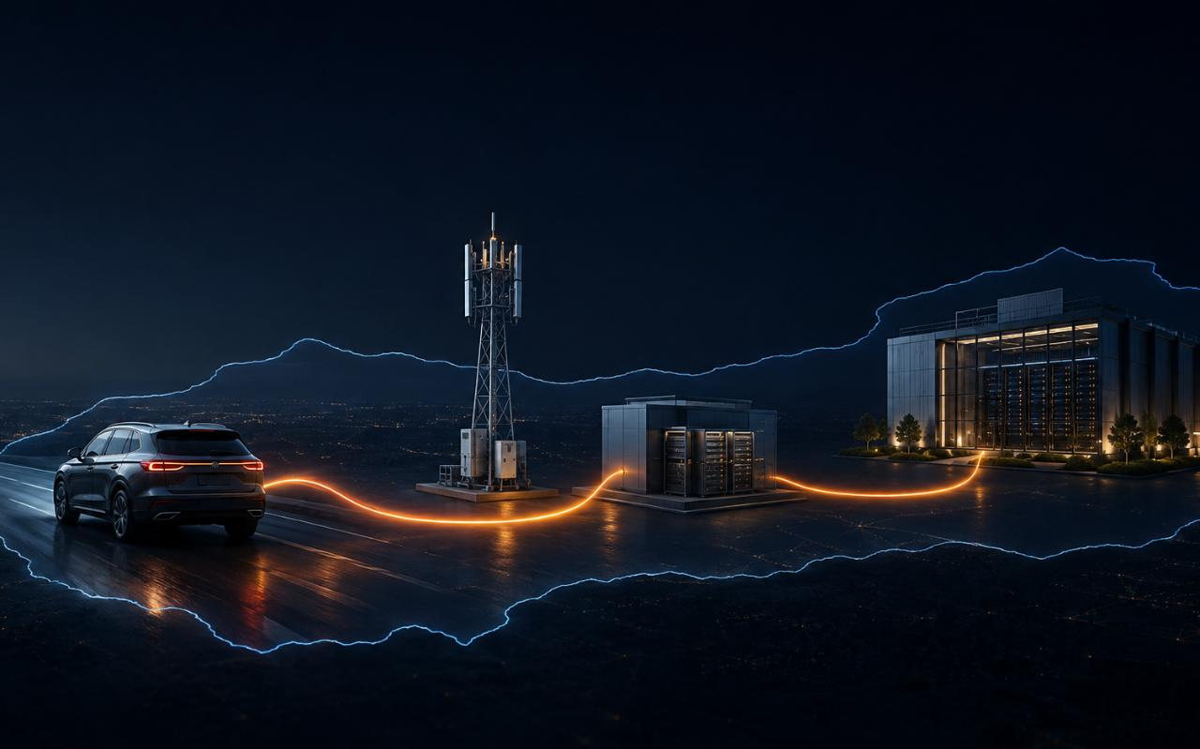
The network has no choice
but to be intelligent
Reach the right inference point
      In the right country
      At the right latency
With security — open a tunnel for minutes, then close it
5

Slide 6
An intelligent network, dedicated to all THINGS
NB-IOT and LTE_M
Low battery use, low data use,
very good (indoor) coverage.
4G and 5G
High bandwidth, high data,
low latency.
Smart meter
(E/G/W)
Environment monitoring
Smart
lighting
Digital signage
CCTV
Solar power
Smart Grid
Predictive
maintenance
Security /
alarming
Remote Patient
monitoring
Asset tracking
Mobility
AGV
API first Multi-IMSI
SGP.32 Hosted in NL
Global, Intelligent and flexible.
Notes:
Global
Sovereign
Intelligent

Slide 7

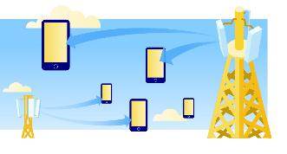
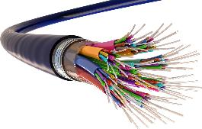
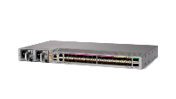
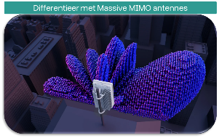
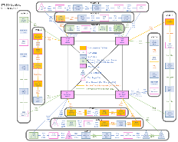
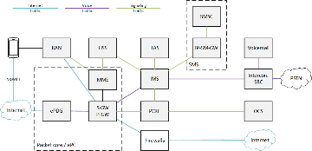
We upgraded our entire network.
RAN
Transport
Core

Slide 8
3 frequencies to fullfill the 5G promise
RAN
26 GHz
Ultra high reliability
Priority, Pre emption
Capacity/
Speed
3.5 GHz
Faster
More bandwidth
700 MHz
Better coverage
CAT-M & NB-IoT
Reach
Notes:
5G technology also implemented on
frequencies now used for 2G, 3G and 4G

Slide 9
Intelligent use of frequencies.
RAN
ACTIVE ANTENNAS → MASSIVE MIMO.
Odido 3.5 GHz
5G CAPACITY BOOST.
3.5 GHz
Capacity/
Speed
Replaced 4G on 2100 MHz for 5G.
1800/2100/2600 MHz
5G coverage
800/900 MHz
700 MHz
Reach

Slide 10
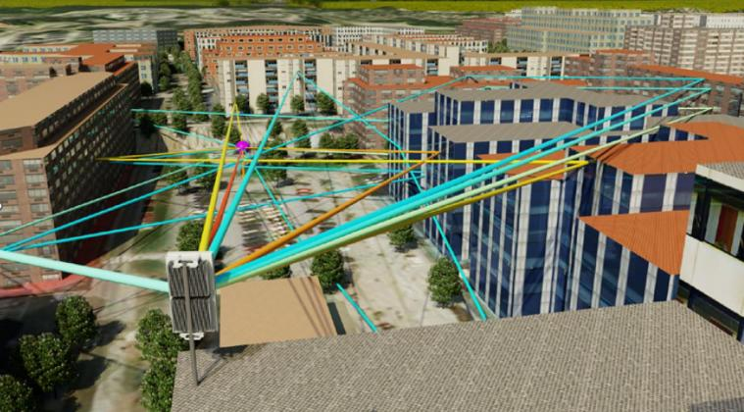
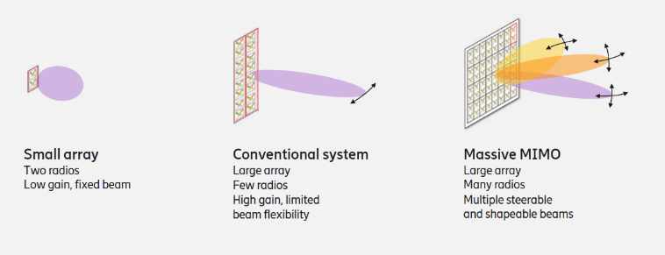
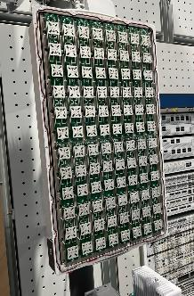
Your own beam via Massive MIMO.
RAN
Algorithm define antenna behavior
A user or group gets a beam assigned
Beamforming increases reach up and down
MU-MIMO Spatial multiplexing multiplies network capacity
The inside of a Massive MIMO antenna with 192 antenna units.

Slide 11
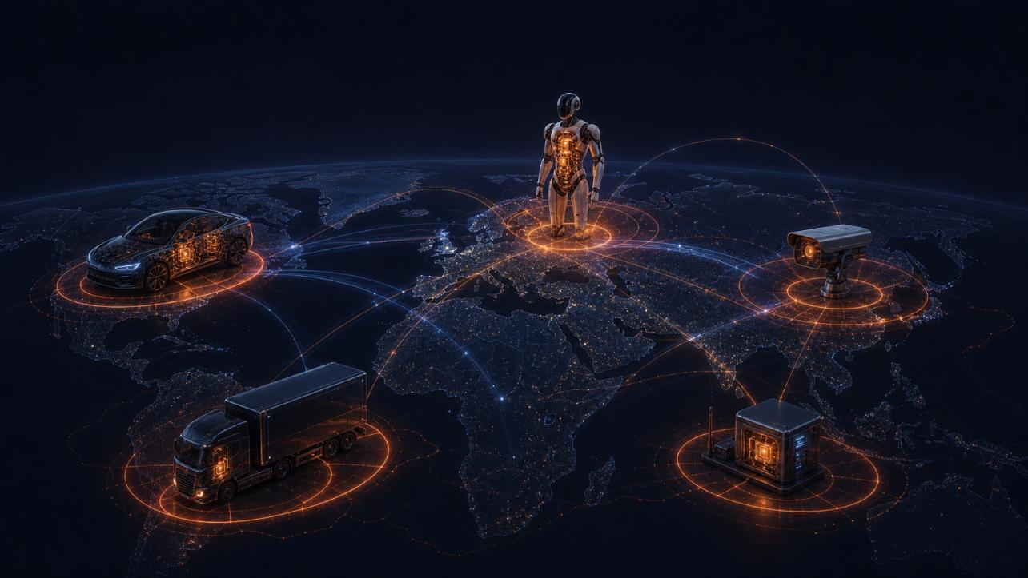
Odido's problem is everyone's problem
Global by design
Intelligent by necessity
the network adapts to the device
coverage beyond your own footprint
Sovereign by law
data stays where regulators require
11

Slide 12
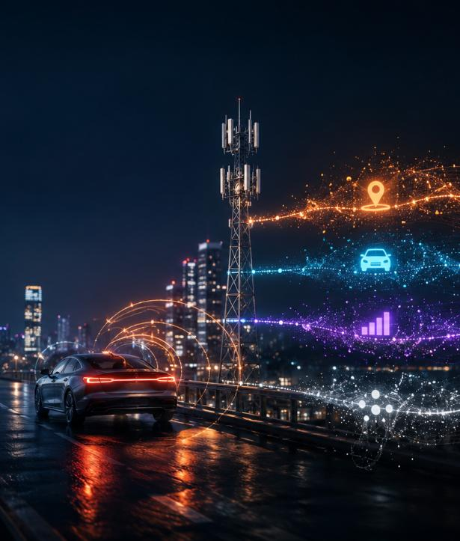
And that's not all
Smart routing - the network picks the path for latency & reach
Massive downstream - a modern car heads toward ~500 GB/yr of updates
Visibility - the network sees device status & patterns to pick the moment
By end-2027: a device requests a 15-sec VPN - set up, logged, torn down, no human
12

Slide 13
Global by design.
Sovereign by law.
Building a physical-AI device?
If you haven't thought about the network - data sovereignty, latency, the path - come talk to us.
Rony Cohen , FLOLIVE × Mario de Lijster ,Odido

