Slide 1

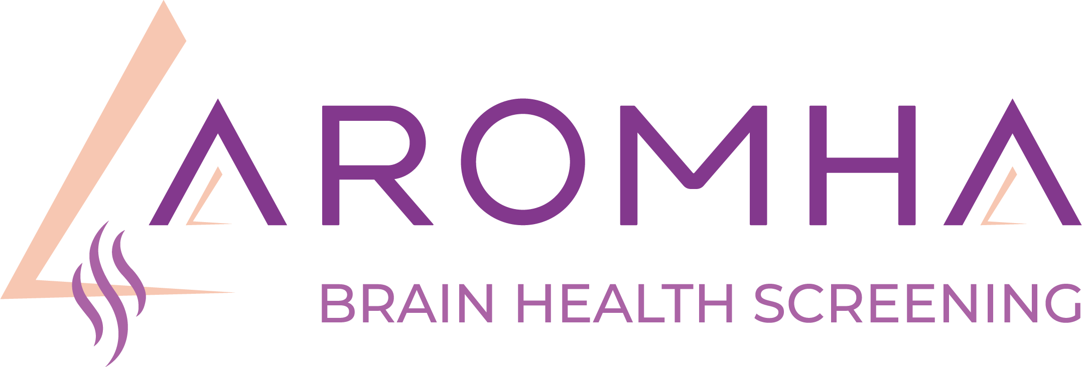




Your Brain Health Matters: Discover the Aromha Brain Health Test
An easy at-home screen for early cognitive change

Slide 2
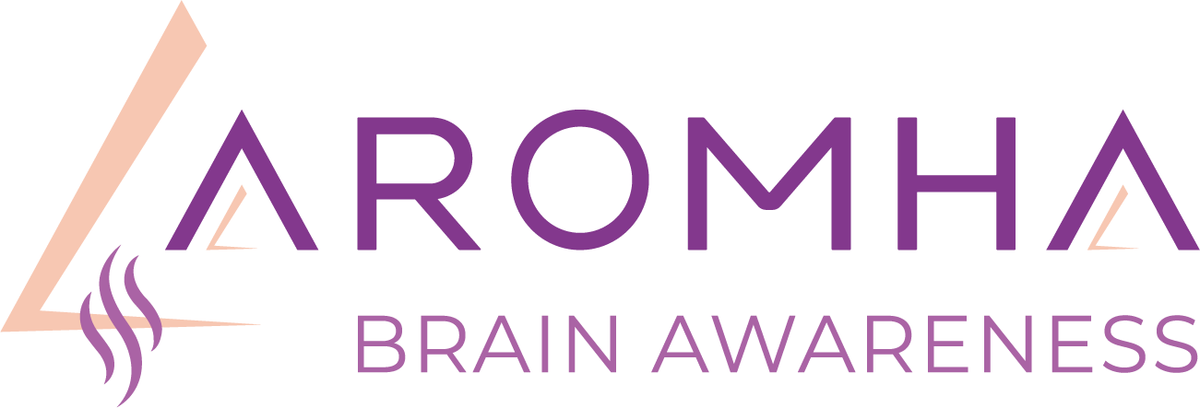
Aromha: Revolutionizing Brain Health Through Olfactory Screening
Empowering early detection to secure brighter futures.

Slide 3
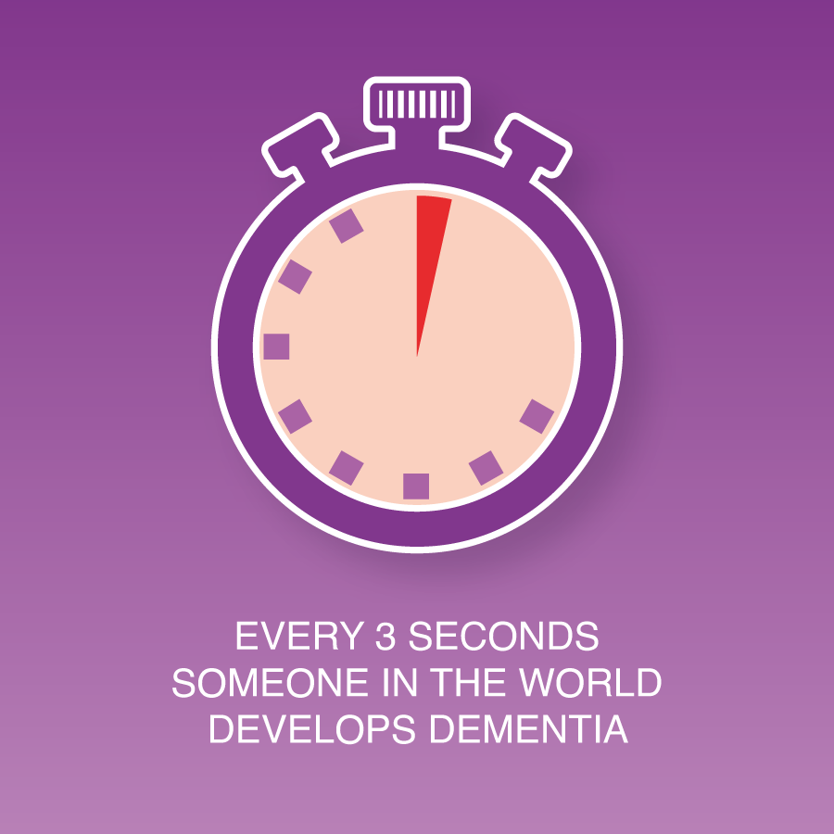
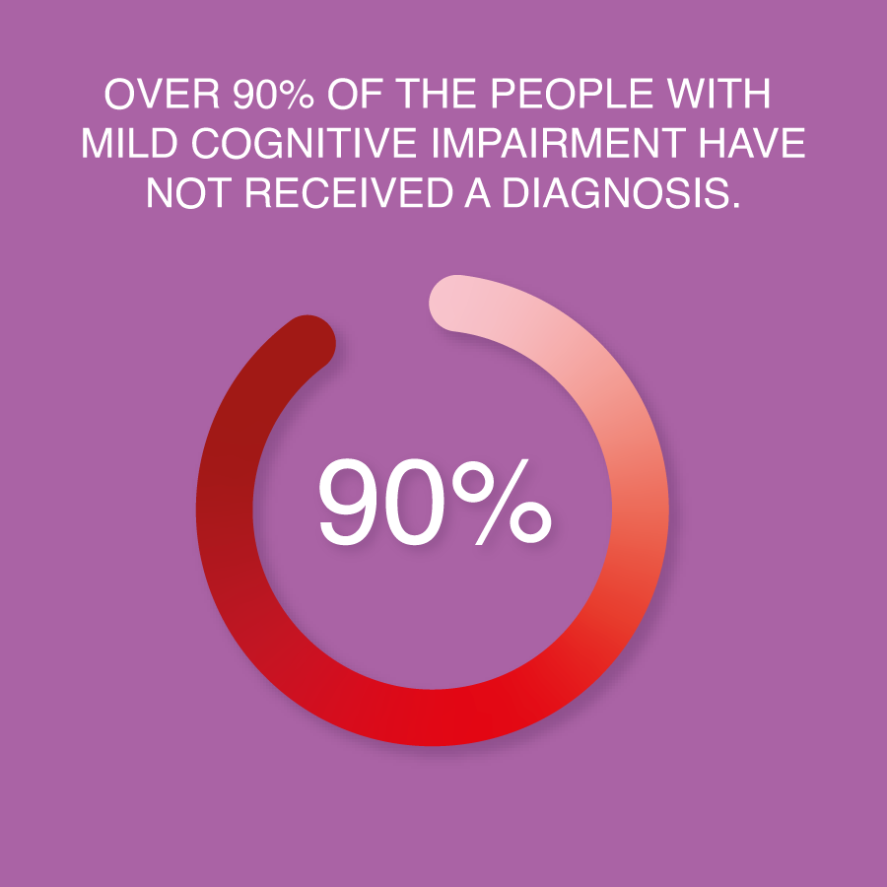
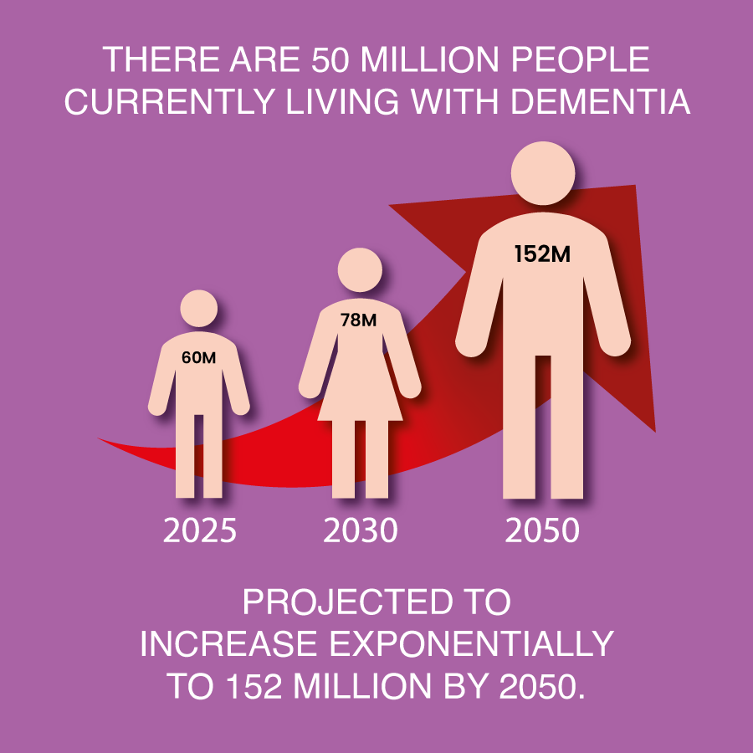
The Problem: Neurodegenerative diseases go unnoticed until it’s too late
Current detection methods (MRI, PET scans) are costly and invasive.
People only get diagnosed when symptoms become severe.
Current methods are the equivalent of detecting cancer in Stages 3 and 4,
instead of Stages 1 and 2.
No convenient at-home screening exists—until now!

Slide 4
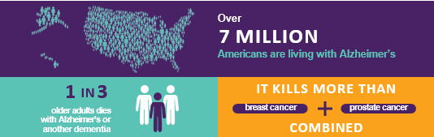
The Importance of Brain Health
.
Cognitive decline often begins 10–20 years before symptoms.
Early action offers the best chance to protect memory and independence.

Slide 5


Olfaction: Your Nose Knows
.
Your sense of smell is closely tied to brain health.
Smell loss is one of the earliest signs of Alzheimer’s and other diseases.
Studies show smell dysfunction is associated with:
- Increased mortality
- Future cognitive decline
- Over 139 medical conditions

Slide 6
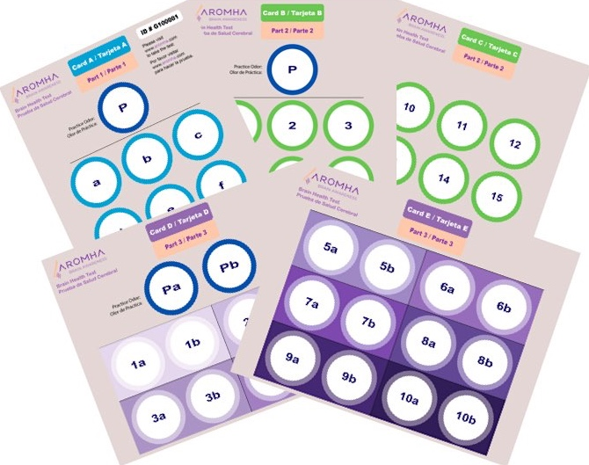
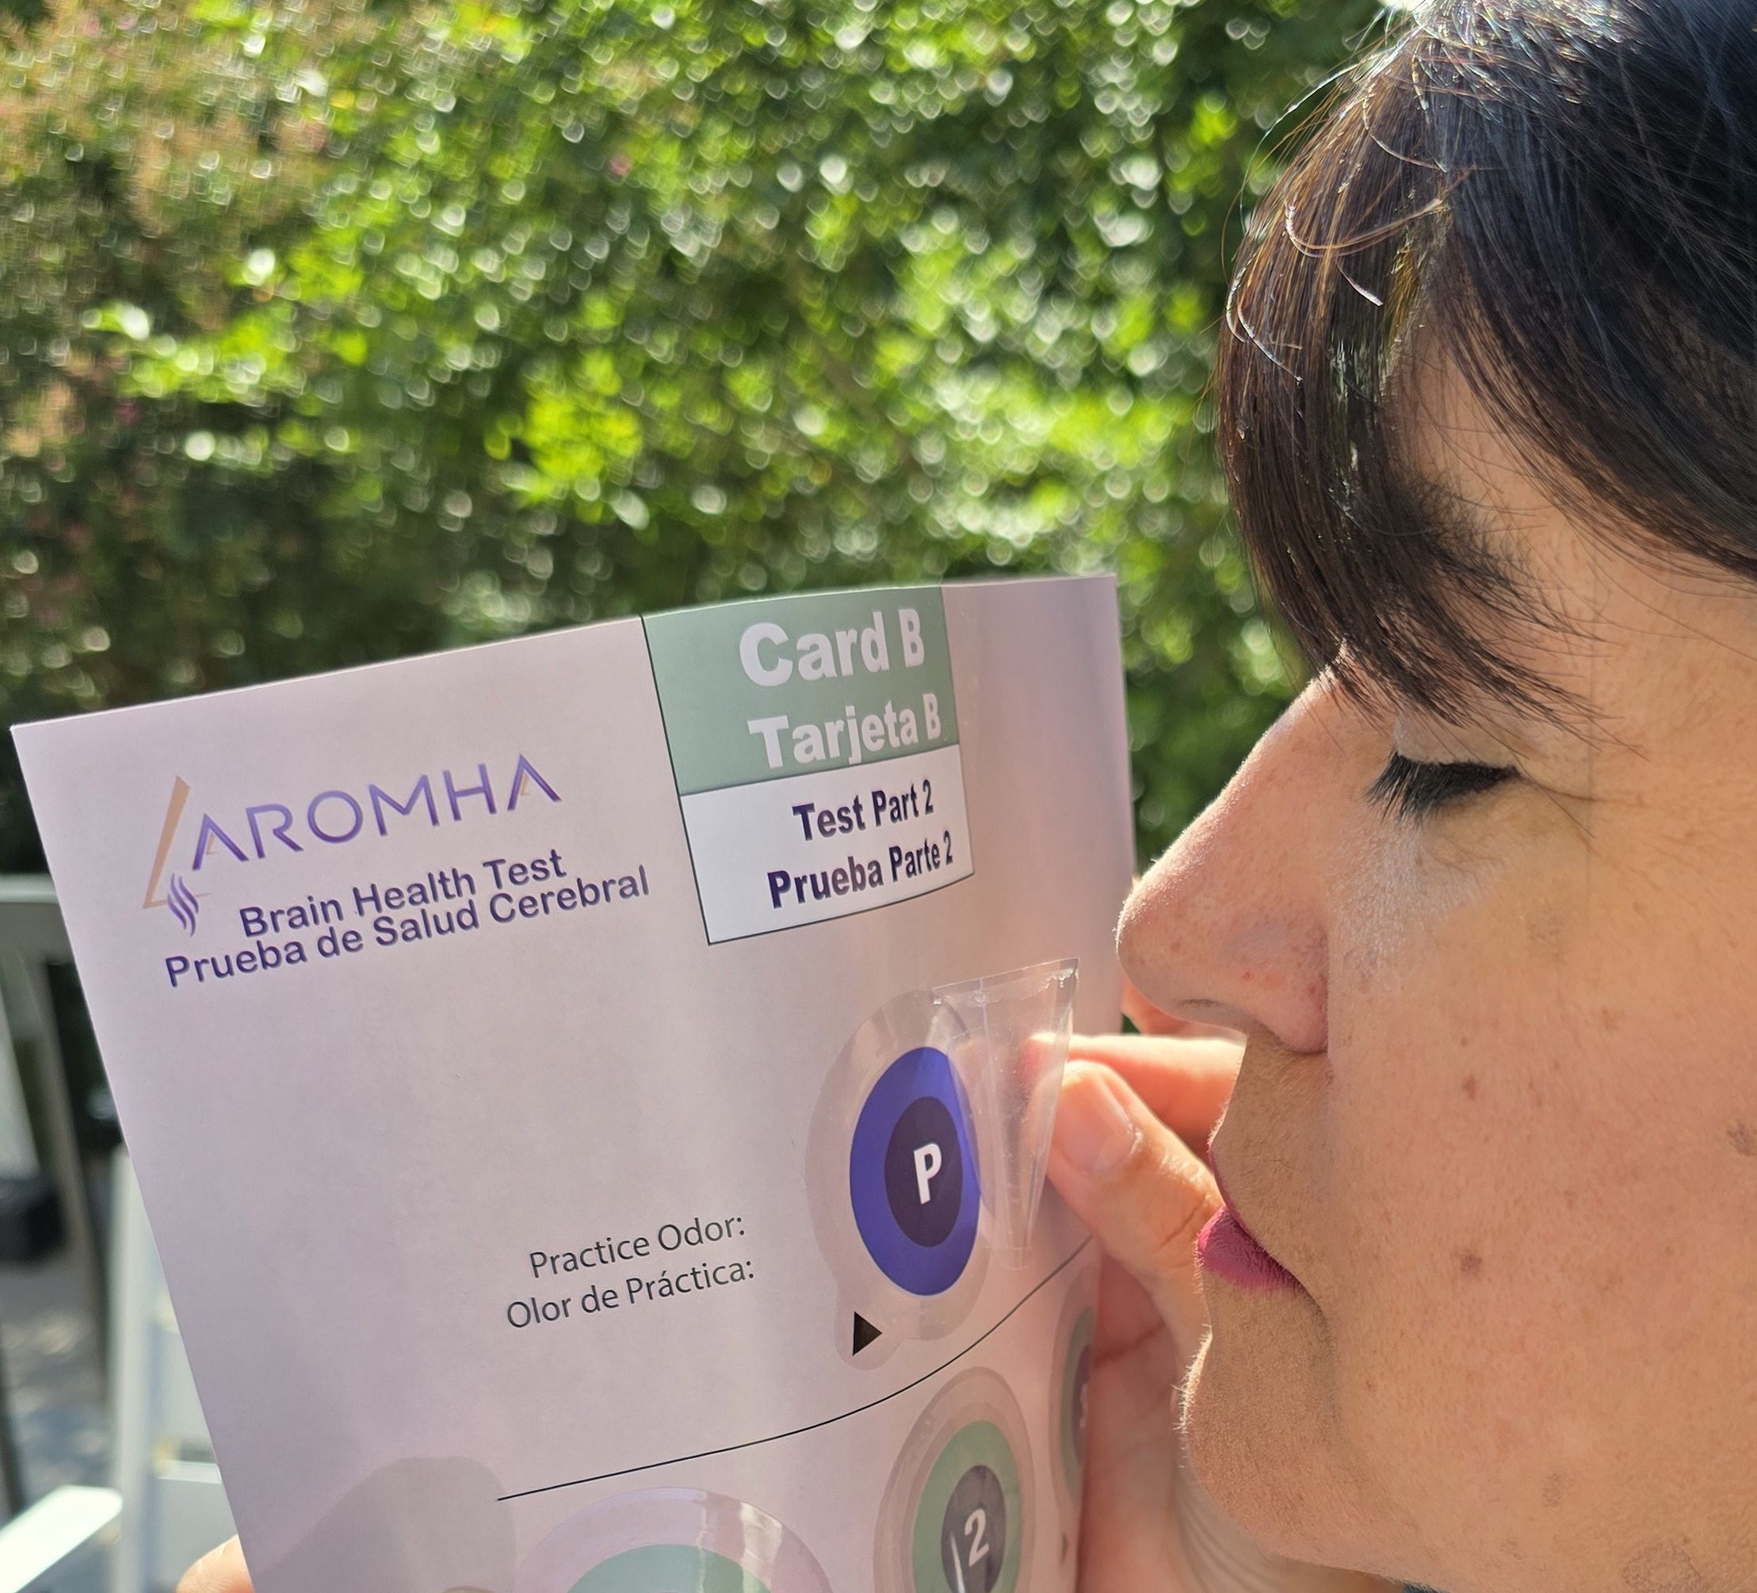
The solution:
The Aromha Brain Health Test - Early screening made accessible.
Non-invasive, affordable, and easy-to-use test designed for widespread adoption.
Provides early detection years before symptoms appear.
Uses olfactory screening + digital cognitive testing.
Backed by over 20 years of Harvard Medical/MGH research

Slide 7
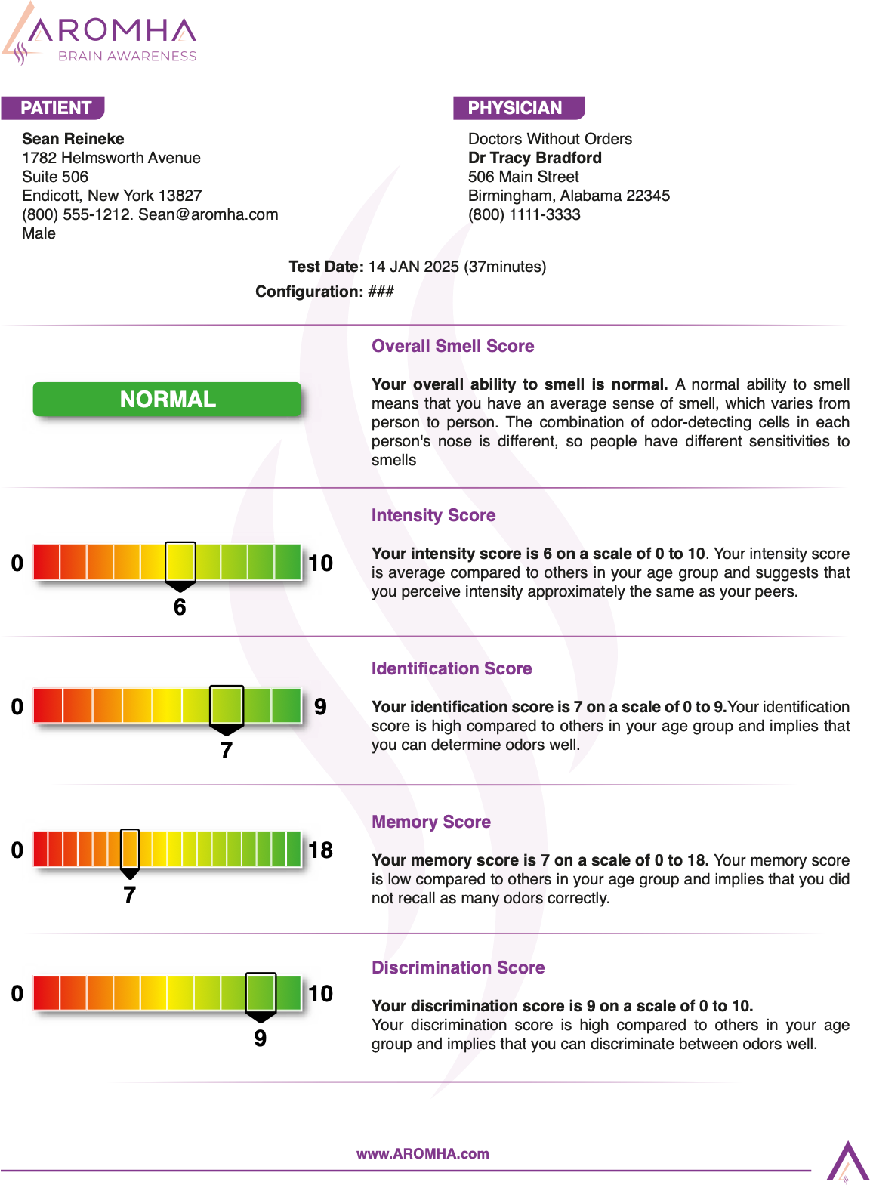
How It Works
Order your Aromha Brain Health Test.
www.aromha.com
Receive the test in the mail and complete it at home.
Use our web app to analyze your results instantly.
Get insights and recommendations for brain health.

Slide 8


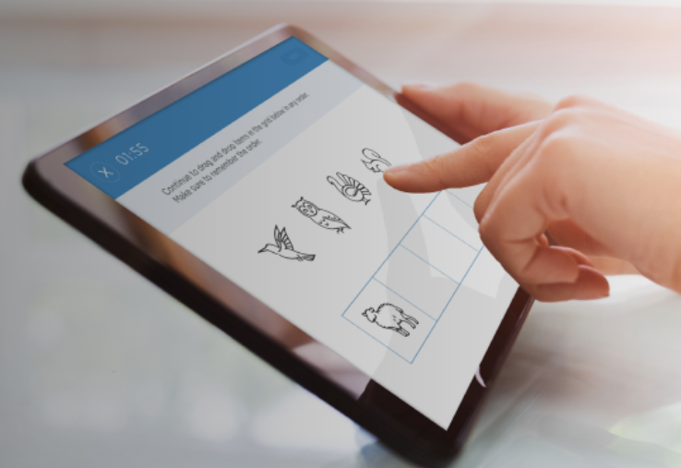

Olfactory Testing plus Digital Cognitive Testing
Start your Brain Health Journey Today!
Establish your Brain Health Baseline

Slide 9










The co-founders are leaders in neuroscience, olfactory research, technology, and business
Mark Albers, MD, PhD
Co-Founder
Chief Scientific Officer
Sean Reineke
Co-Founder
Chief Executive Officer
Scientifically validated.
20+ years of Harvard Medical / Mass General Hospital research.
>$8M in NIH grant funding.
Multiple peer-reviewed publications validating the science and the test.

Slide 10


Who Should Take the Test?
Adults aged 55+
Anyone concerned about the Brain Health of themselves or a loved one
Anyone with a family history of dementia
Those with:
- Memory Concerns
- History of concussion, depression, or COVID
- Smell loss or changes in appetite

Slide 11
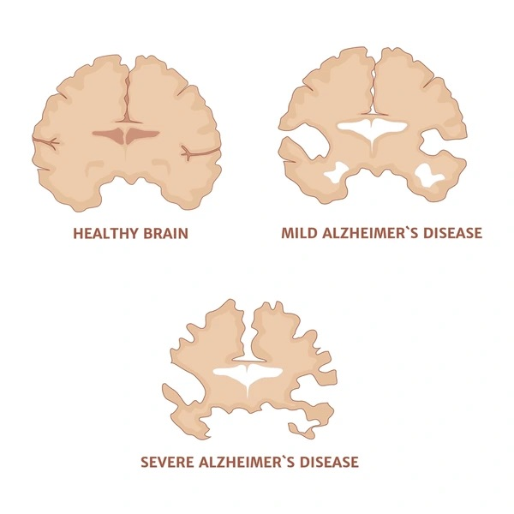
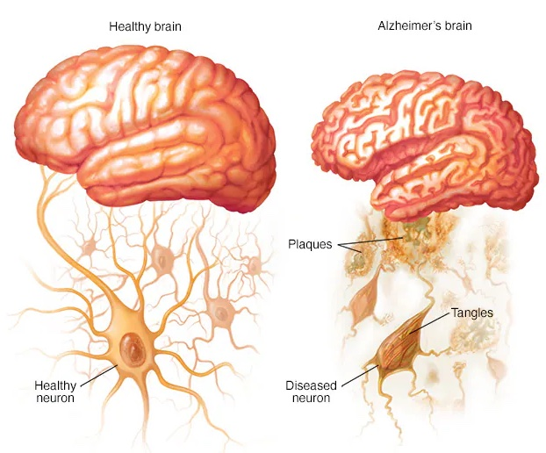
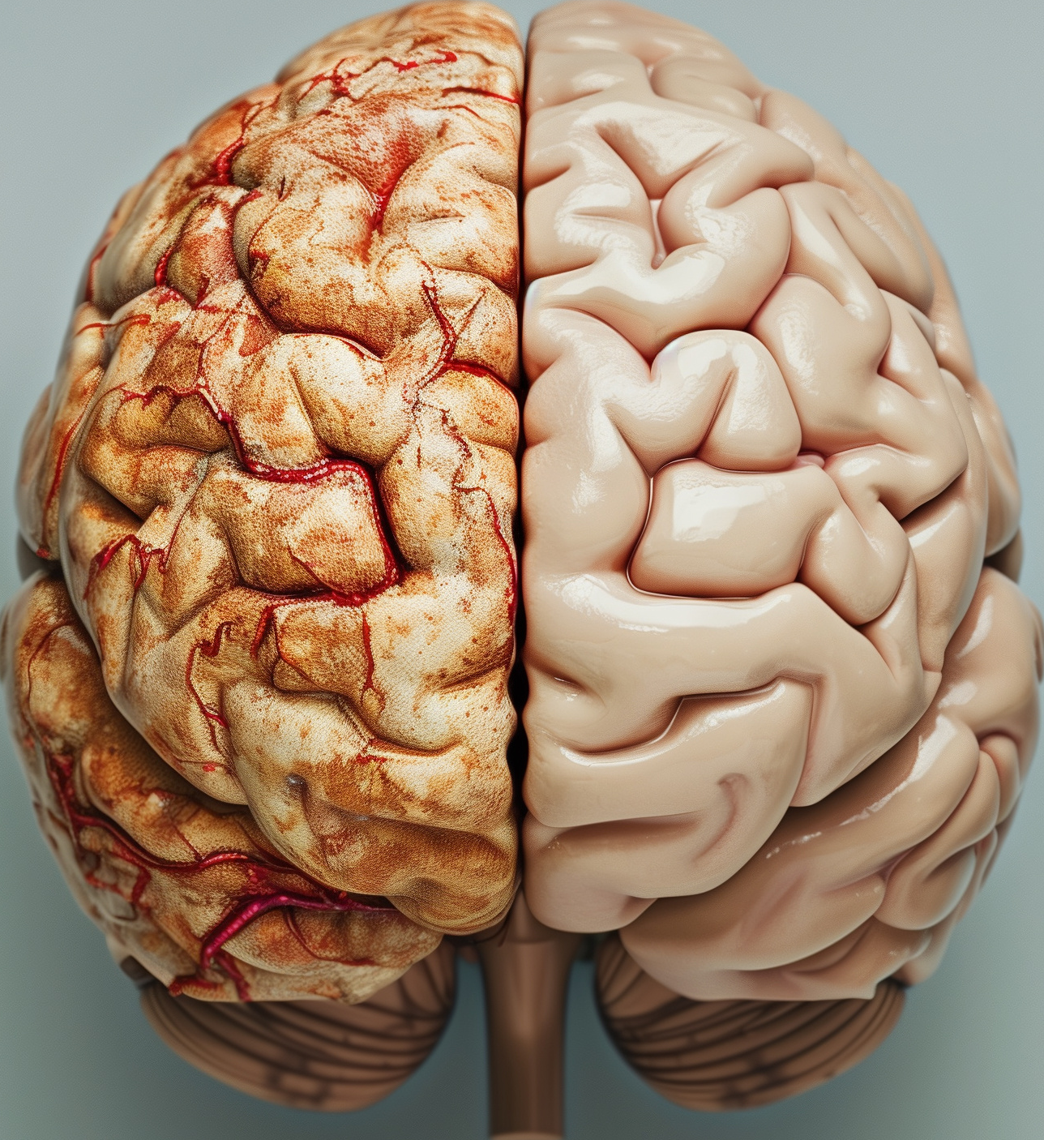
The Aromha Brain Health Test is recommended for ages 55 and older and can screen for neurodegenerative diseases and conditions such as:
- Alzheimer’s Disease (AD)
- Lewy Body Dementia (LBD)
- Parkinson’s Disease (PD)
- Traumatic Brain Injury (TBI)

Slide 12
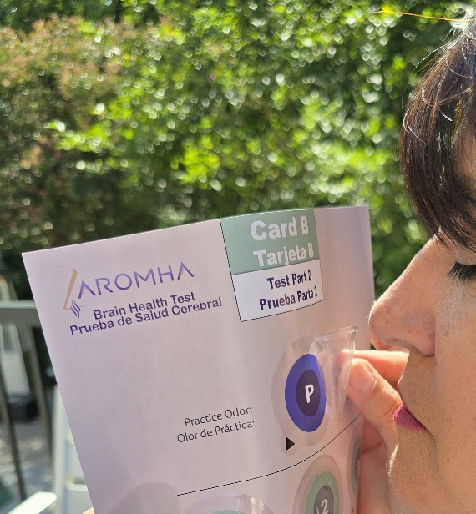

Benefits for You
Done from the comfort of your home
No doctor appointment needed
Scientifically validated insights in under an hour
Detects early signs long before traditional tests
Helps you and your family stay proactive

Slide 13



Why you should act now
Benefits of early detection
Psychosocial Benefits
Early Intervention
Enable Early-Stage
Clinical Trails
Advanced Planning
Start your Brain Health Journey Today!
Limited availability – The majority of tests are allocated to Florida!
All orders placed now will be shipped in June

Slide 14
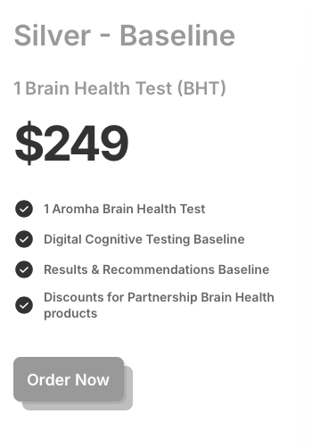
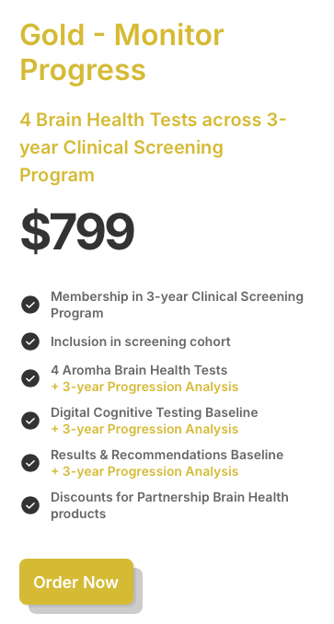
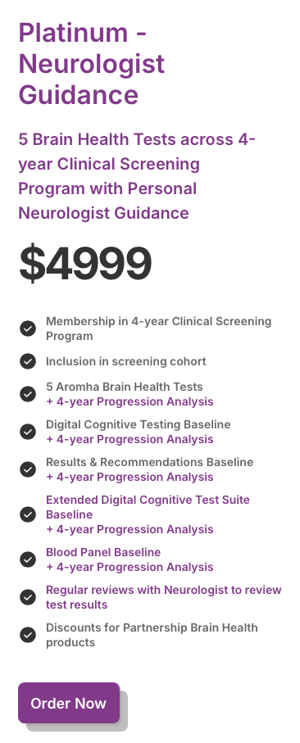
Choose Your Brain Health Program Now
All packages include olfactory testing, plus digital cognitive testing!

Slide 15
Join the Aromha Brain Health Program Today!
Order your Aromha Brain Health Test now.
www.aromha.com
Use Discount Code: RepName10
For 10% savings!
Secure your spot in the next screening cohort.
Invest in your brain health now for a brighter future.
Buy today – Limited availability!

Slide 16

Sean Reineke, CEO
301-466-2328
Sean.Reineke@aromha.com

Slide 17
Choose Your Brain Health Program Now
Special Group Discount
20%
All packages include olfactory testing, plus digital cognitive testing!

Slide 18
Join the Aromha Brain Health Program Today!
Order your Aromha Brain Health Test now.
www.aromha.com
Use Discount Code: RepName10
Special Group Discount
20%
Secure your spot in the next screening cohort.
Invest in your brain health now for a brighter future.
Buy today – Limited availability!

