Slide 1
The Cognitive Debt Crisis
A Data-Driven Forecast Analysis of AI’s Impact on Human Thinking

Slide 2
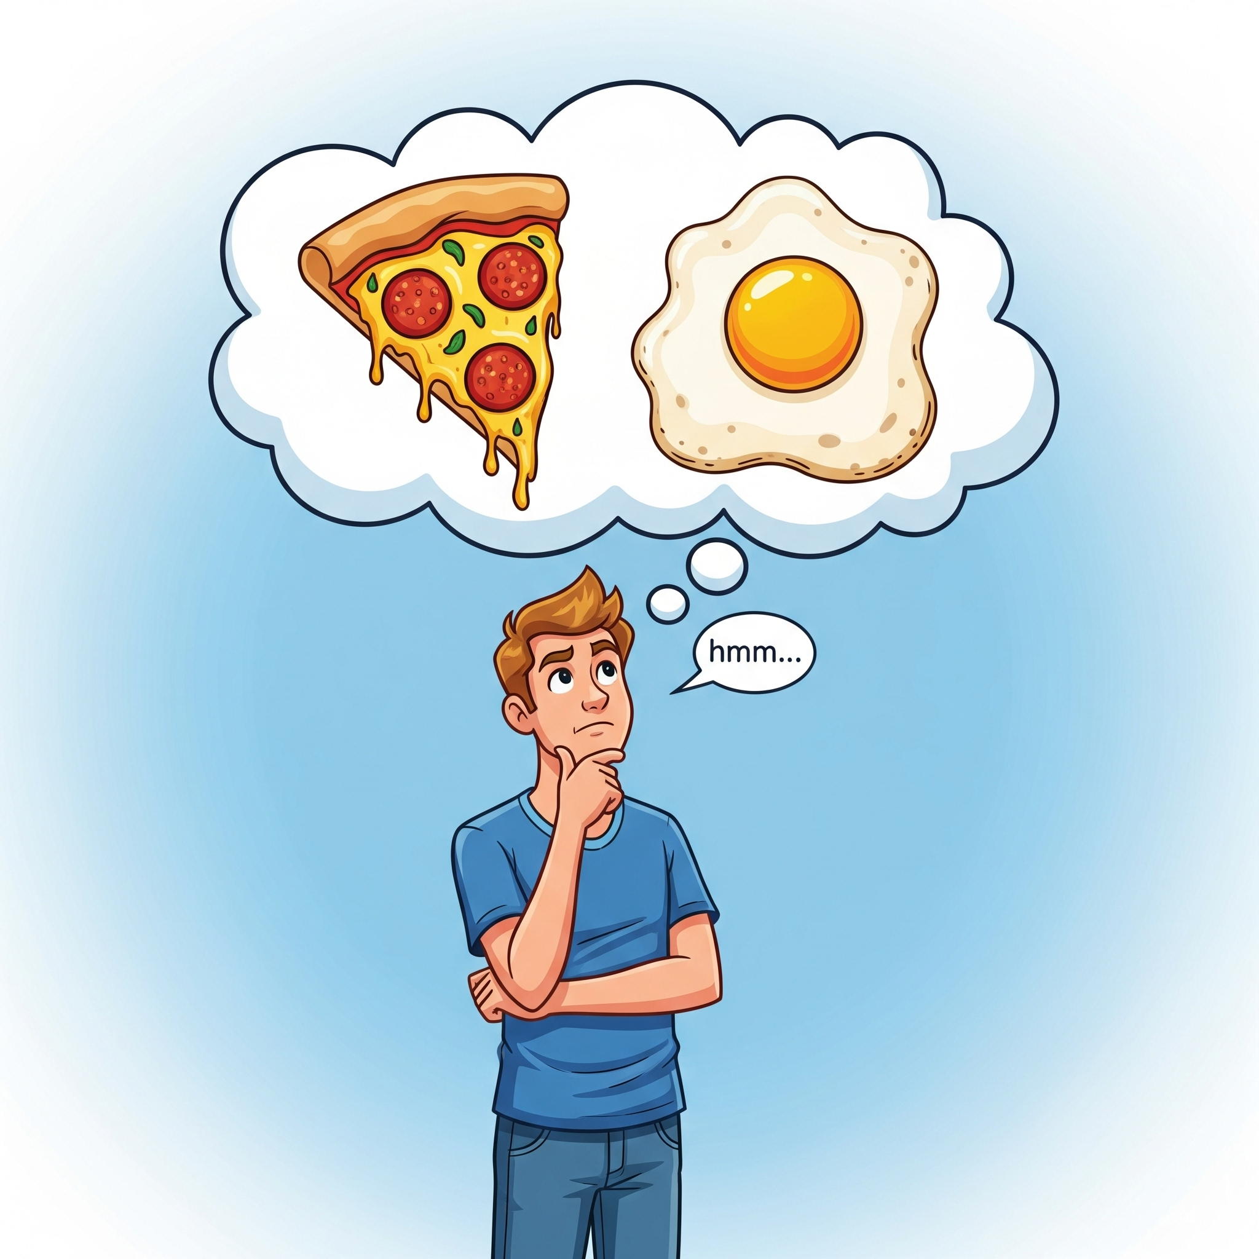
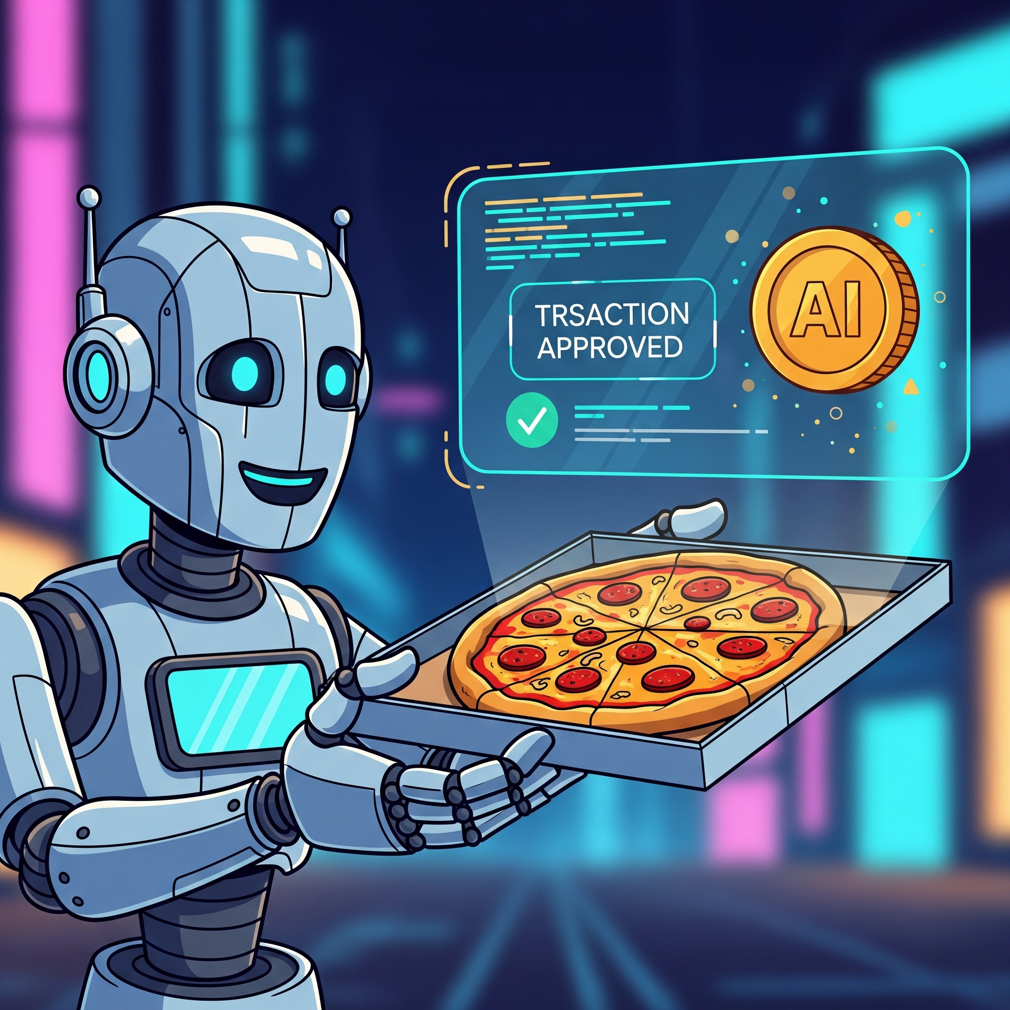
The Problem - We're Outsourcing Thinking Itself
Consider a simple moment: You're hungry
Your brain naturally does this:**
> "What do I want? Egg or pizza? Had pizza yesterday. Egg it is. But scrambled is boring... what about that egg topping combo I saw? Should I cook or order? I have eggs but I'm tired. Worth $15? No, I'll cook."
> This exercises critical pathways
WHAT IF AI DOES ALL THAT AND JUST GIVES YOU PIZZA ( This is an extreme extrapolation of where we are leading to )

Slide 3
Is this a real phenomena?
We are accumulating debt of cognition
Critical thinking capability decline or Productivity declined has been observed and confirmed as researches by microsoft, METR, stackoverflow surveys among others

Slide 4
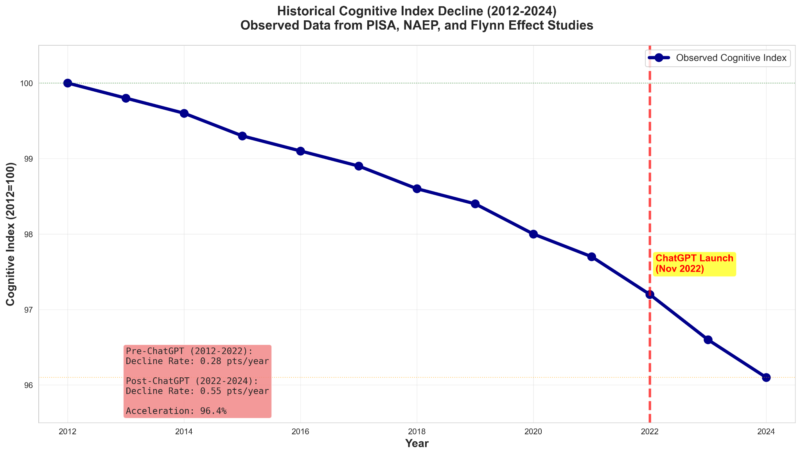

Slide 5
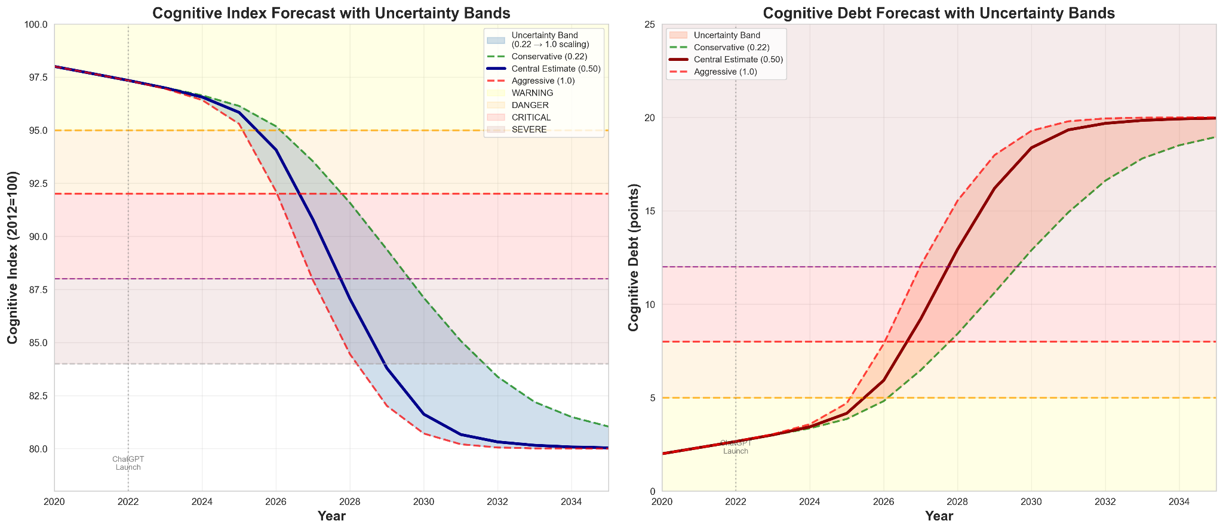

Slide 6
A Call for Collective Action
We have 2 years, till 2028 before entering the critical zone
This is not just an AI safety problem — it's a human flourishing problem.
Researchers · Neuroscientists · Educators · Developers · Policymakers · Communicators · Individuals - Everyone must come together
This is not a problem one group can solve alone.
It requires collective action from all stakeholders to:
Raise awareness
Design responsible AI
Develop interventions
Validate what works

Slide 7
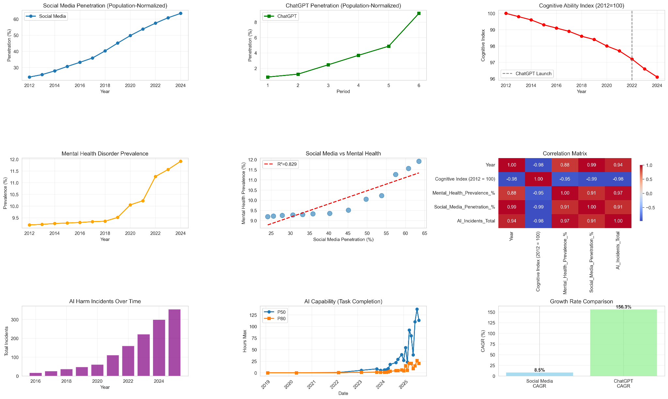
What do we solve

Slide 8
The Goal: Symbiosis
As our dependence on AI increases, and its inevitability we have a responsibility to build systems that enhance rather than replace human cognition.
The question is not whether we use AI.
The question is whether we design it to keep us thinking.

Slide 9
Thank you
Preetham Sathyamurthy & Varun Balakrishnan
Astroware Research

