Slide 1


Myopia Management
SCIENCE, SOLUTIONS & SUCCESS
Dr Ursula Vogt
MBBS MD PHD DOEBO FBCLA
Medical Ophthalmologist & Contact Lens Specialist
Hon. Treasurer European Society of Ophthalmologists
IMCLC Board Member

Slide 2
1. Introduction to Myopia
Myopia often starts in childhood and progressively worsens until early adulthood, when it stabilizes
Myopia is a lifelong condition and increases the risk of sight threatening conditions in later life, causing the World Health Organization to classify myopia as a global health concern.

Slide 3
Myopia is an epidemic that affects us all
Studies estimate that myopia will affect five billion people worldwide by 2050.
In Europe the myopic population will increase from 22% to 56% over the next 30yrs, i.e. one out of every two persons will have some level of myopia, which will pose a great challenge for the eye care sector & us!

Slide 4
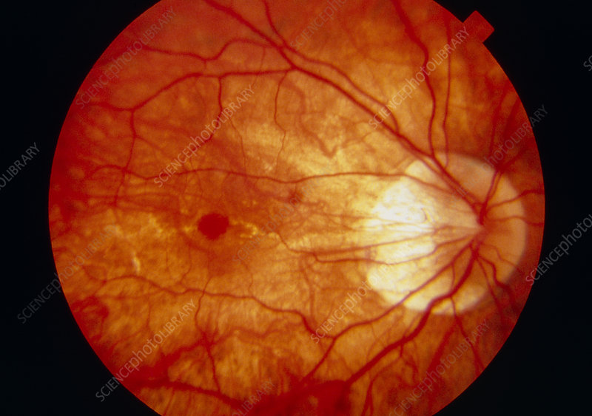
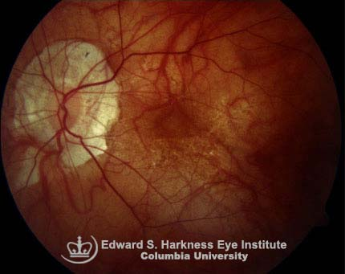
HIGH MYOPIA
is associated with
a high risk of permanent
vision loss
Myopic macular
degeneration
is a frequent cause of
vision impairment and
blindness

Slide 5
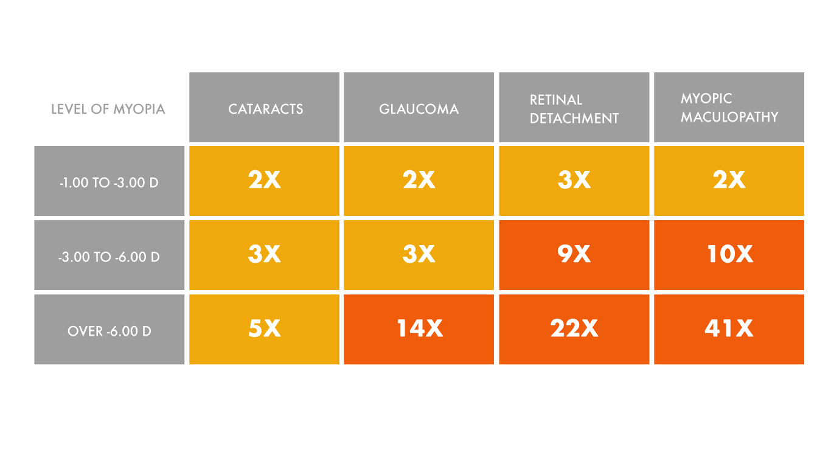
Myopia higher than -6.00D has an increased risk of cataract, glaucoma, retinal detachment and myopic maculopathy

Slide 6
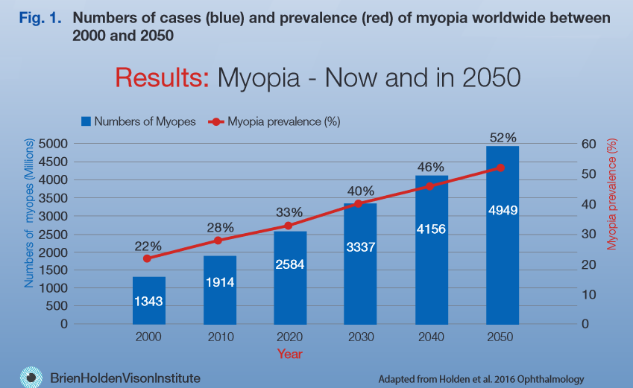
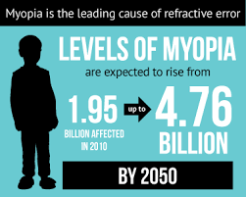
Myopia progression in children
Key Factors: genetic predisposition
Environment influences e.g., prolonged near work reduced outdoor time
Critical period:
Progression is most rapid during childhood and adolescence
Need for intervention:
slowing progression can reduce the risk of high myopia complication later

Slide 7
2. Mechanism for myopia management
Myopia management CLs are designed to slow the accelerated eye growth of childhood myopia based on how images are focused in the different parts of the retina
With single vision glasses or CLs the central part of the image is focused on the retina for clear vision, but the peripheral light rays focus behind the retina. Research indicates that this generates a “grow faster” signal for the eye, but the myopic eye in childhood is already growing too quickly.
The principle of myopia control spectacles and CLs is to create the opposite profile, by making the peripheral light rays focus in front of the retina. Vision is still clear centrally, but this type of peripheral optical profile generates a “slow down” signal for eye growth. This results in slowing of eye growth will slow progression of myopia.

Slide 8
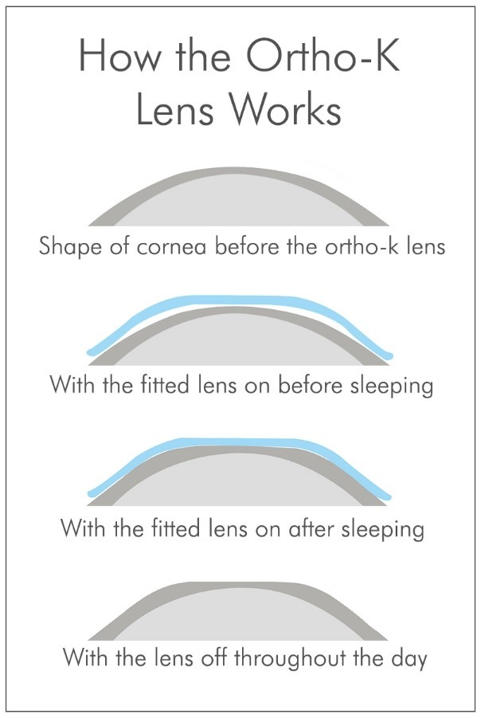
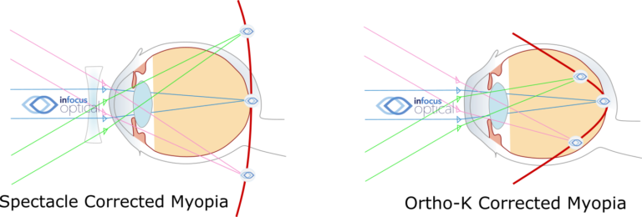
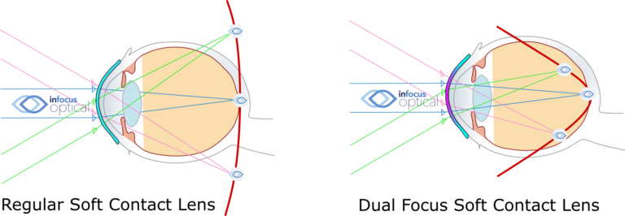
o

Slide 9
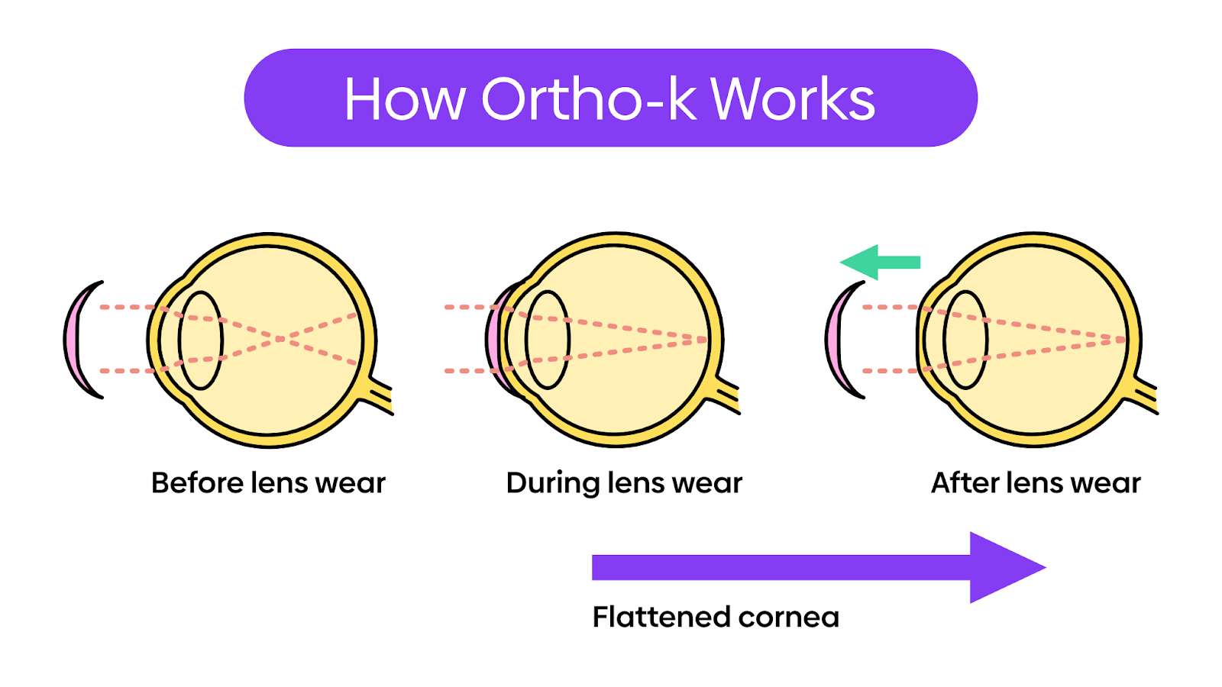

Slide 10
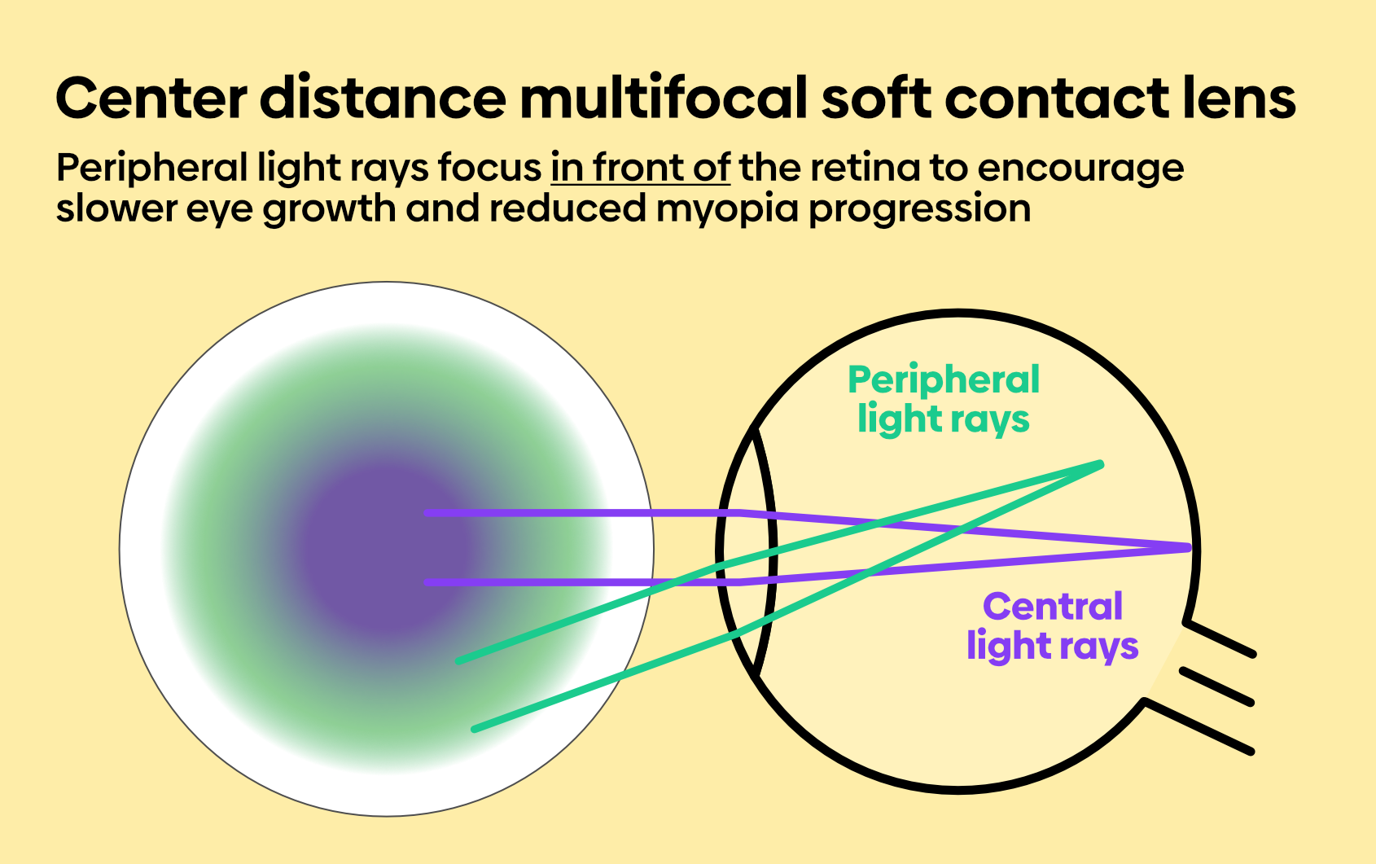
4. myopia management soft lens designs

Slide 11
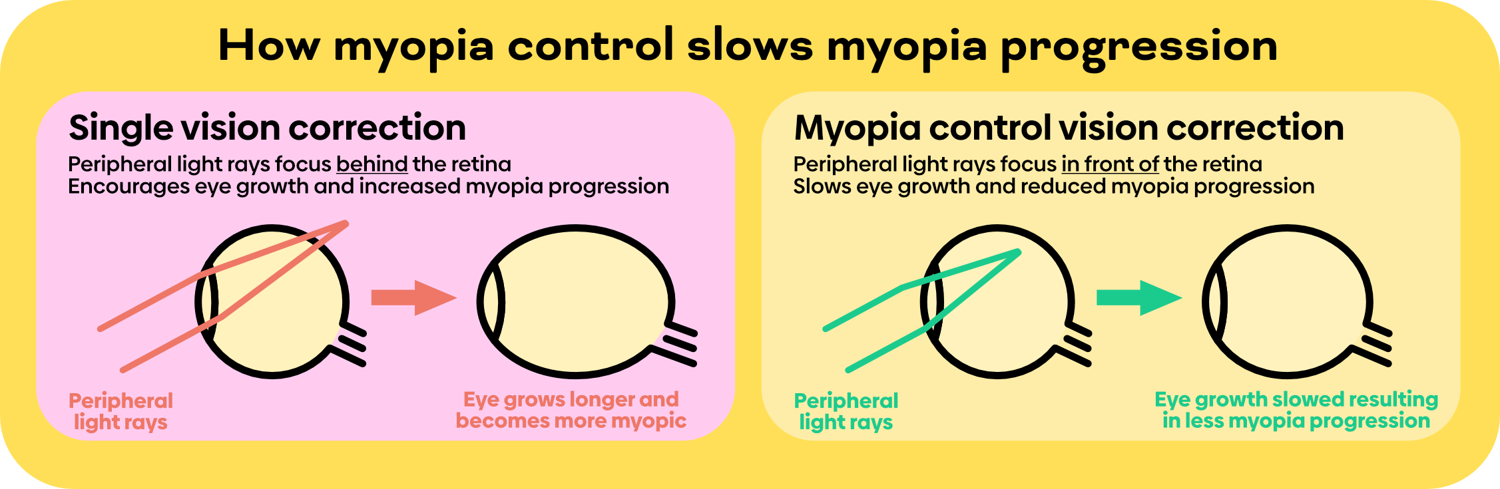
Standard single vision correction cause peripheral light rays to focus behind the retina, which encourages eye growth and increased myopia. Myopia control spectacles and CL are designed to focus peripheral light rays in front of the retina, to act as a stop signal to encourage slower eye growth and slow progression of myopia

Slide 12
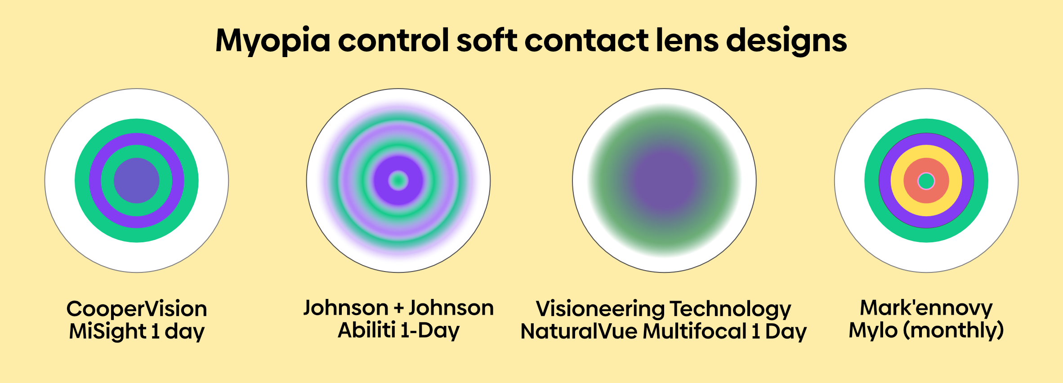
4
This image shows different myopia control soft contact lens designs. The different colours signify different zones of optical power within the contact lens, illustrating that each is a distinct design.
All are designed to focus peripheral light rays in front of the retina to act as a stop signal for myopia progression and optimizing vision correction for children.

Slide 13
3. Contact lenses for myopia management:
Orth0 K lenses
RGP lenses to be worn overnight to reshape the cornea temporally
Benefits: daytime freedom from CLs
Challenges: requires consistent use and proper care
2. Multifocal soft CLs
Daily or monthly disposable CLs with various concentric ring designs
Mechanism: simultaneous vision correction and peripheral defocus control
Extended depth focus lenses use continuous defocus zones
3. Custom made soft lenses offer tailored designs for specific refractions and
corneal shapes

Slide 14
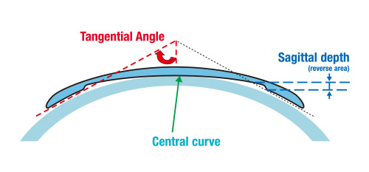
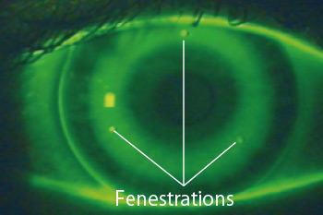
Menicon Z NighT
are worn at night to flatten the cornea into a more spherical shape
Myopia and/or astigmatism is corrected after the first night with stable vision
achieved within a week.
Menicon Z Night lenses are indicated in the following cases:
Menicon Z Night
Myopia ≤ -4.00 D
With-the-rule astigmatism ≤ 1.50 D
Against-the-rule astigmatism ≤ 0.75 D
Menicon Z Night Toric
Myopia ≤ -4.00 D
With-the-rule astigmatism ≤ 2.50 D
Against-the-rule astigmatism ≤ 1.50 D

Slide 15
4. Soft CLs popular products
As always CL manufacturers embarked on developing new types of multifocal CL to provide a myopia control effect to optimize vision correction in children and enhance myopia control effect compared to standard centre distance multifocal CLs.
Most myopia control lens designs have been shown to provide a better myopia control effect than traditional soft centre distance multifocal lenses.
These myopia control soft CL designs, include the CooperVision MiSight 1 day, Johnson & Johnson Acuvue Abiliti 1-Day, Visioneering Technologies NaturalVue Multifocal 1 Day (which can also be used for presbyopia) and Mark'ennovy Mylo monthly replacement lens.
Each of these contact lenses have some research evidence for myopia control, although some have more evidence than others. The CL with the most supportive data is MiSight 1 day, which has reported outcomes of a 6 year study.

Slide 16

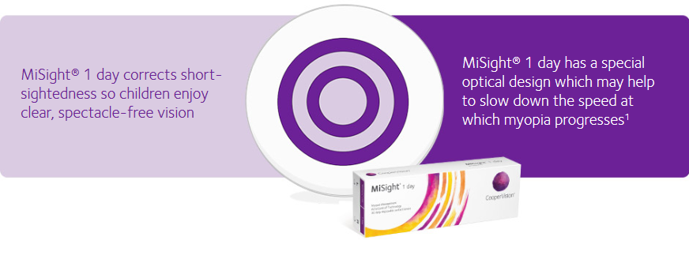
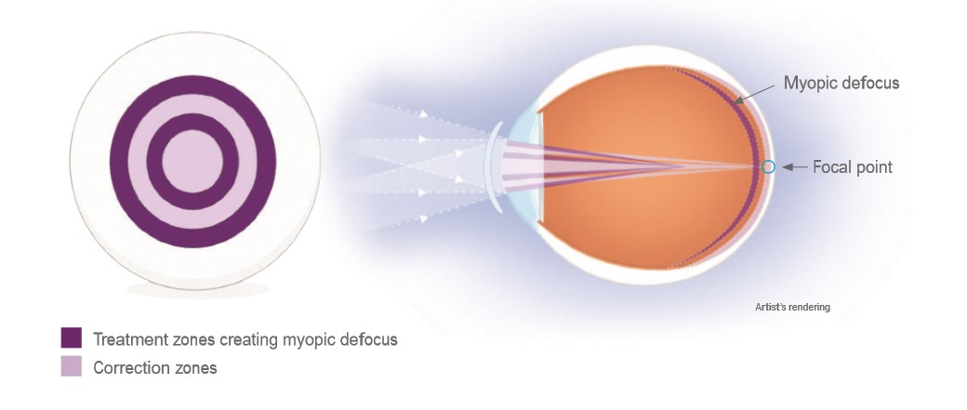
cooper Vision Choice of Lens material
Coopervision
Innovative optical design
MiSight® 1 day daily disposable contact lens with ActivControl® myopia management technology is as easy to ﬁt as a single-vision contact lens offering a simple convenient myopia management therapy compared with alternative treatment options.
MiSight® 1 day contact lenses control both axial length increase and myopia progression while fully correcting refractive error

Slide 17
COOPER ViSion Mysight 1day
Material/H20 Content
omafilcon A / 60%
Base Curve (mm)
8.7
Dia (mm)
14.2
Sphere Power
-0.50D to -7.00D (0.50D steps after -6.00D) No plano
FDA Group 2

Slide 18
Naturalvue mf 1day Vision technology
Daily disposable multifocal soft CL with Neurofocus Optics® Technology
Product Detail
Centre-distance, extended depth of focus multifocal soft contact lens, creating a 'virtual pinhole aperture' and peripheral defocus.
One single high add power.
Power Range +4.00D to -12.25D in 0.25 steps. Spherical powers only. Single, universal add power effective up to +3.00D.
Material Etafilcon A; hydrogel (58% water)
Diameter 14.5mm
Base curve 8.3mm

Slide 19
J&J Ability 1day
Product Type
Daily disposable contact lens with novel ring focus technology for myopia control
Product Detail
Novel ring focus soft contact lens containing a myopia correction zone and annular treatment zones producing a +7.00D non-coaxial plus power and a +10.00D zone co-axially.
Power Range
-0.25D to -8.00D in 0.25 steps. Spherical powers only.
Material
Senofilcon A: silicone-hydrogel (38% water), Class 1 UV blocker, Dk/t 121
Diameter 13.8
Basecurve 7.9

Slide 20
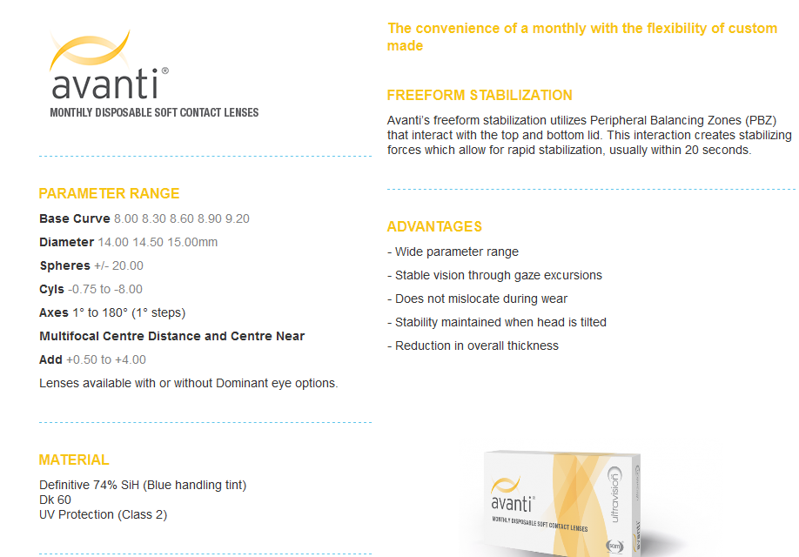
Ultravison Vision

Slide 21
WhicH CLs are the Best?
CLs are medical devises and: For any medical device, professional advice and supervision is needed.
Internet advertising does not substitute the advice of an eye care professional.
The best lens is the one which is most suitable to the patient and this will depend on a variety of individual factors such as refractive error, corneal curvature, eye health, patient’s wearing preferences, activities, time and financial situation.

Slide 22
5. Key milestones : Centre distance multifocal cLS for myopia Management
The first type of soft CL that were shown to provide a myopia control effect weren't actually designed for children but for presbyopic adults.
These centre distance multifocal soft CL offer distance vision correction at the centre of the CL and near vision correction in the outer peripheral areas of the CL.
It just happens that this CL design also moves peripheral light rays in front of the retina - a desirable outcome for myopia management because the peripheral light rays focusing in front of the eye should slow myopia progression.
Research indeed shows this to be the case.

Slide 23
6. Effectiveness und research
Ortho-K: CRAYON and LORIC studies
Reduction in axial elongation by 30-50% in children
2. Soft Multifocal CL studies:
25-50% reduction in myopia progression
(BLINK study Mi Sight 1day trial)
Comparative Effectiveness:
Multifocal and Ortho K lenses are similarly effective,
Choice depends on lifestyle and preference

Slide 24
Effectiveness and research
Defocus Incorporated Soft Contact (DISC) lens slows myopia progression in Hong Kong Chinese schoolchildren: a 2-year randomised clinical trial. Myopia control with bifocal contact lenses: a randomized clinical trial. Soft contact lenses with Randomized Trial of Soft Contact Lenses with Novel Ring Focus
www.ophthalmologyscience.org/article/S2666-9145(22)00121-X/fulltext
positive spherical aberration for myopia control. We can deduce that the control of myopia progression in both treatment groups was purely due to the slowdown of the axial elongation. Multistage +1.50D and Proclear +3.00D soft MFCL with center distance design controlled the progression of myopia by 38.6% and 66.6%, respectively, in comparison to the SVCL lens control group.
Myopia control with soft multifocal contact lenses: 18-month follow-up
www.ncbi.nlm.nih.gov/pmc/articles/PMC9266467/

Slide 25
Effectiveness and research
Zeri F, Durban JJ, Hidalgo F, Gispets J; Contact Lens Evolution Study Group (CLESG). Attitudes towards contact lenses: a comparative study of teenagers and their parents. Cont Lens Anterior Eye. 2010 Jun;33(3):119-23.
Bullimore MA. The Safety of Soft Contact Lenses in Children. Optom Vis Sci. 2017;94(6):638-646.
Yam JC, Zhang XJ, Zhang Y, Wang YM, Tang SM, Li FF, Kam KW, Ko ST, Yip BHK, Young AL, Tham CC, Chen LJ, Pang CP. Three-Year Clinical Trial of Low-Concentration Atropine for Myopia Progression (LAMP) Study: Continued Versus Washout: Phase 3 Report. Ophthalmology. 2022 Mar;129(3):308-321.
Cho P, Cheung SW. Discontinuation of orthokeratology on eyeball elongation (DOEE). Cont Lens Anterior Eye. 2017 Apr;40(2):82-87.
Ruiz-Pomeda A, Prieto-Garrido FL, Hernández Verdejo JL, Villa-Collar C. Rebound Effect in the Misight Assessment Study Spain (Mass). Curr Eye Res. 2021 Aug;46(8):1223-1226.

Slide 26
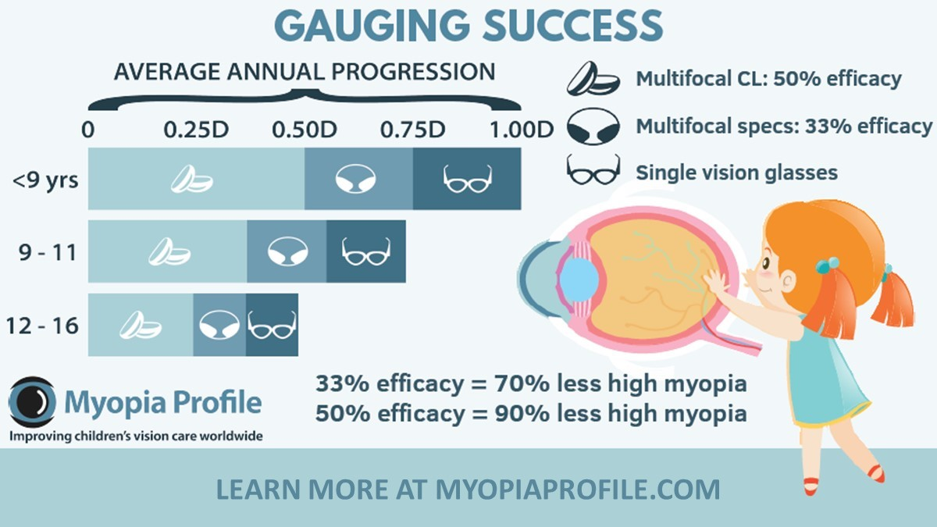

Slide 27
7. Challenges and considerations
CL practices (in Europe) are at critical juncture with some potential opportunities like CL to control myopia progression, multifocal lenses for presbyopia, specialty lenses etc. and few looming threats such as increasing competition from online businesses
Anecdotal discussions with eye care professionals have revealed different level of optimism regarding the future of CL practice.
Consensus surrounding myopia management (in Europe) has not been achieved yet

Slide 28
Childhood myopia
…is the most concerning, because it can progress quite rapidly as children grow, and the fast eye growth that causes it can stretch some of the eyes structures, which increases risk of eye disease in later life.
The aim to control myopia progression in children is to slow eye growth, to reduce myopia progression and also to lower the risk for eye problems in later life.

Slide 29
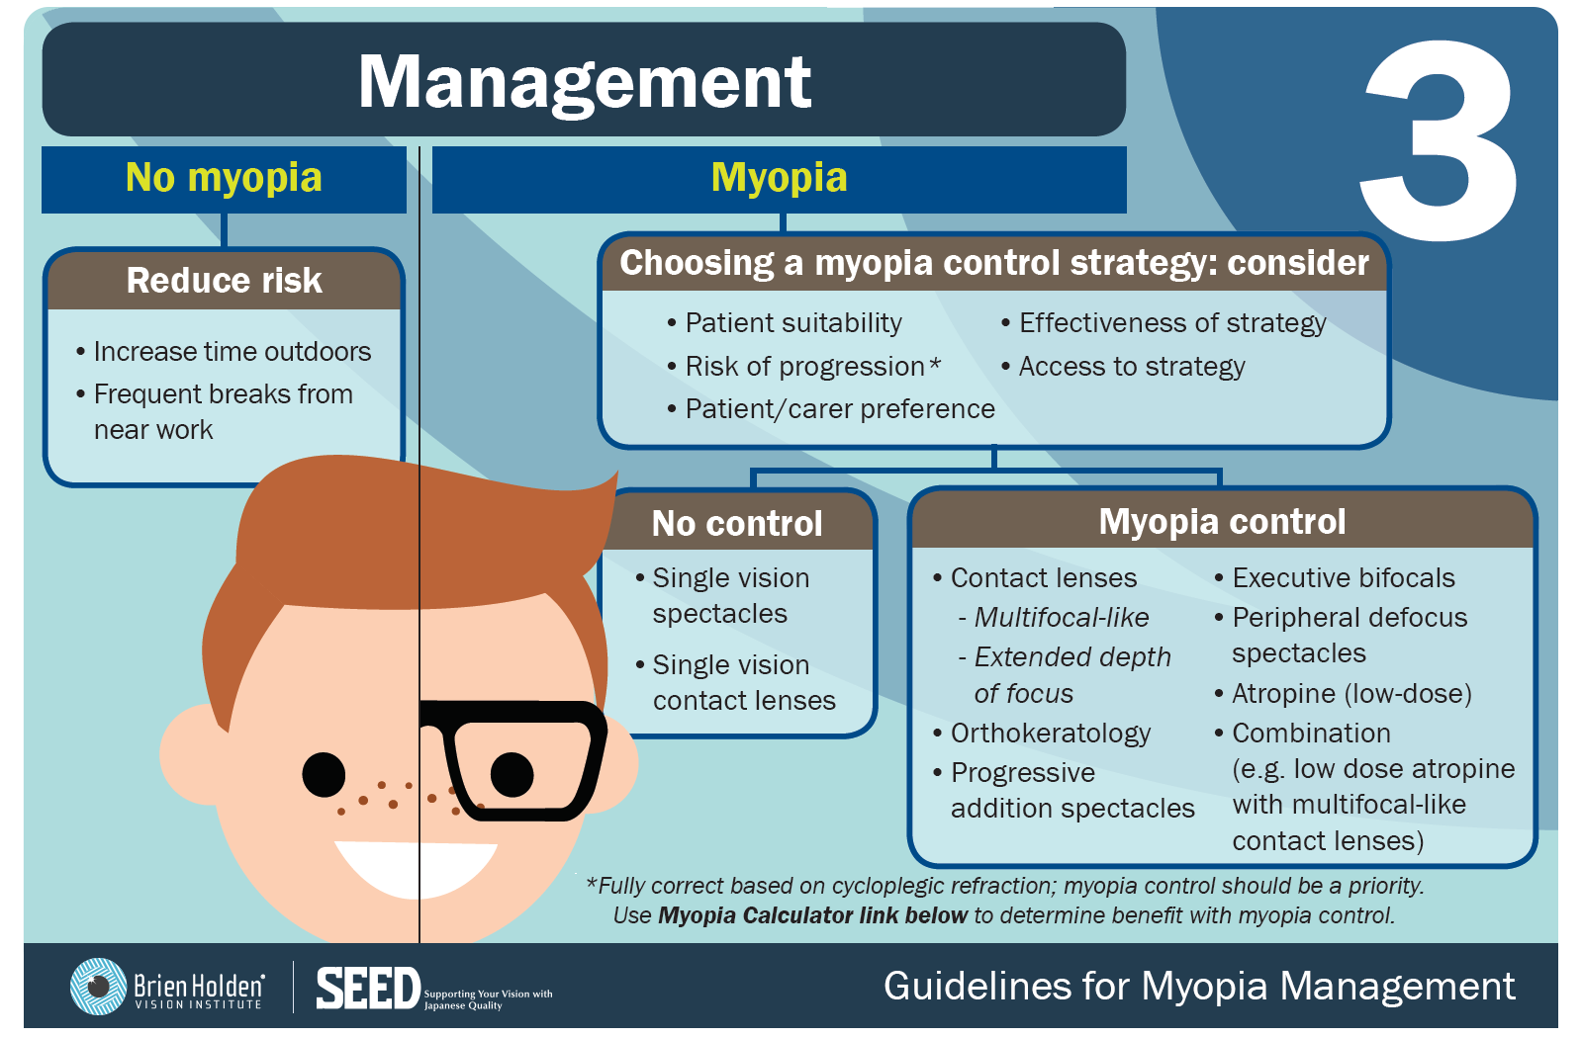

Slide 30
Why the Increase? Other factors include: light levels and specific wavelengths, time outdoors, Vitamin D and peripheral defocus in the myopic eye, stimulating axial elongation.
Different light levels, different wavelengths and duration of light have been shown to affect axial elongation in animal studies.
Trials conducted in Taiwan and China indicate time outdoors reduces risk of developing myopia, with less myopia progression seen in summer vs winter months.
The role of Vitamin D in myopia is unclear; some reports suggest it is linked with myopia, while others have found no association.
Investigators found diet was not associated with myopia in a group of healthy children in Singapore.

Slide 31

Contributing lifestyle factors
Research suggests that
children are subjected to
high- pressure educational systems from a young age.
Excessive use of electronic devices could also play a role.

Slide 32
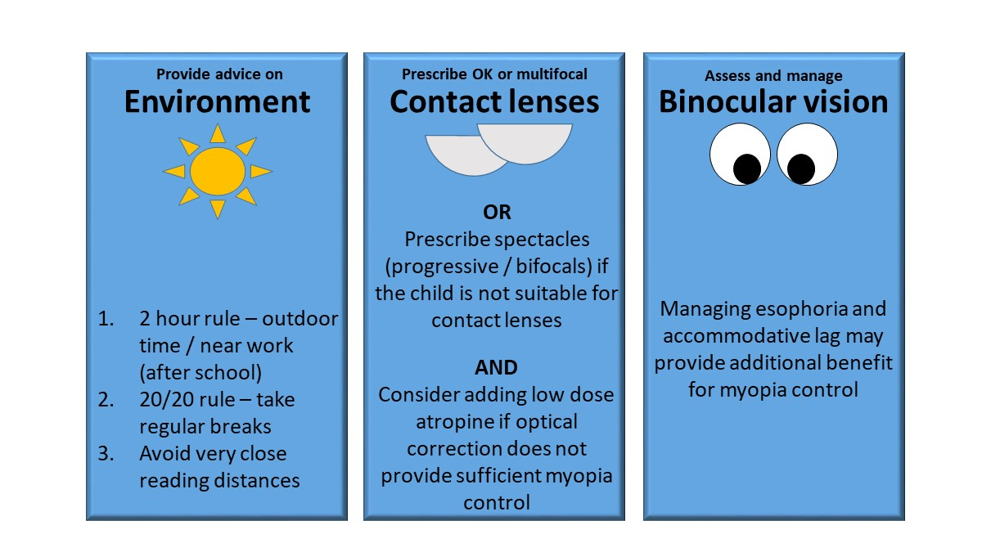

Slide 33
7. Conclusion – key take aways:
Myopia is a growing global challenge, particularly among children- it is our responsibility to manage
CLs offer an effective, evidence-based solution for managing myopia progression
They work by directing a portion of incoming light rays to focus in front of the peripheral retina and act as a stop signal for eye growth
Early intervention and education are critical for success

Slide 34
Contact lenses are essential
CLs are a valuable
tool in Ophthalmology
for the control of Myopia
Progression

Slide 35



Sensible MUMs and dads encourage Outdoor activities

Slide 36


