Slide 1



The Things Conference 2026 · Keynote
Cellular IoT didn't fail.
It just took a decade longer.
A decade after the hype: what took so long, an honest look at today's challenges and solutions, and where the trend goes next.
Martin Lesund
Technical Product Manager – Cellular IoT
Nordic Semiconductor
Copyright © 2026 Nordic Semiconductor ASA. All rights reserved.

Slide 2
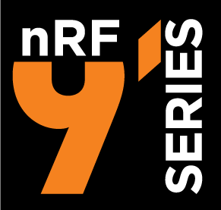
How it looked in 2018
We shipped a cellular IoT module with LTE-M (missing NB-IoT and GPS)
nRF9160 available, December 2018
SEVEN YEARS LATER
269 (+250%)
LTE-M only. GCF, FCC and CE in the box.
NB-IoT and GPS in limited sampling 3 months later
commercial NB-IoT and LTE-M networks
Billions
Roughly 77 commercial Mobile IoT networks worldwide
active connections
Nobody was ready. Not the silicon vendors, not the operators, not the SIM vendors, not the cloud vendors, not the certification labs.
So the technology worked.
The question worth this keynote is what filled those years, and why today is the best time in history to get started with cellular IoT
Copyright © 2026 Nordic Semiconductor ASA. All rights reserved.
2

Slide 3


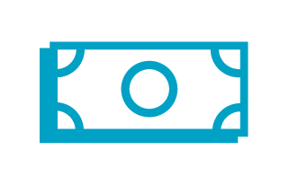
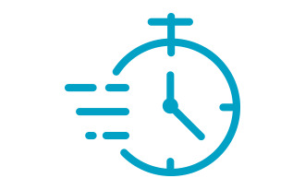
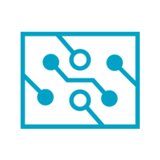

Every promise came with conditions nobody printed
What the industry marketed, and how it actually was
Promised | The conditions nobody mentioned
Ten-year battery life | If the network grants you eDRX/PSM, optimized cloud transport, SIMs ++
Global coverage | If your operator had rolled out the technology in your target market
Sub-five-dollar modules | In China
Plug and play | Nope, you would learn which specification module, operator, SIM silently ignores
Major issues was not with the radio module.
The challenges were in the “seams” between the all radio, the network's power-saving policy, the roaming agreements, the SIM card and the cloud endpoints.
Copyright © 2026 Nordic Semiconductor ASA. All rights reserved.
3

Slide 4
Four challenges
Where the decade actually went
1
Two technologies
2
Roaming is where the power budget dies
140 NB-IoT networks. 129 LTE-M. Barely overlapping where it mattered.
And technologies got switched off:
AT&T ran NB-IoT for about six years, then decommissioned it.
12 of 34 reporting NB-IoT operators did not grant eDRX to roamers. GSMA states it plainly: the network decides to enable none, one, or both.
3
SIM cards were never designed for low power
4
Missing the End-to-end support
30 to 60 µA of idle current, on a device budgeted in 2 microamps. Suspend and resume is specified. Most cards ship with it switched off. Different form factors
Device -> SIM -> network -> cloud (optimized transport layer)
Copyright © 2026 Nordic Semiconductor ASA. All rights reserved.
4

Slide 5

Three things we got wrong
1
2
3
We shipped before the networks were ready
We bet on one architecture
We made developers learn Zephyr
Then spent years discovering different implementation of the 3GPP specifications and politics.
E.g. Smart PSM performs a PSM-like sleep when the network does not allow normal PSM usage.
Application MCU and modem in one package while the industry ran modem-only with an external host.
Right decision long term. Wrong on day one for customers who already had a host and a modem.
The nRF Connect SDK curve was real and we underestimated it. The new RTOS approach where new for many, and had not fully matured.
Right decision long term, but challenging in the beginning.
Some of the power-saving features in our modem exist because networks and SIM cards would not do deliver on their promises.
Copyright © 2026 Nordic Semiconductor ASA. All rights reserved.
5

Slide 6
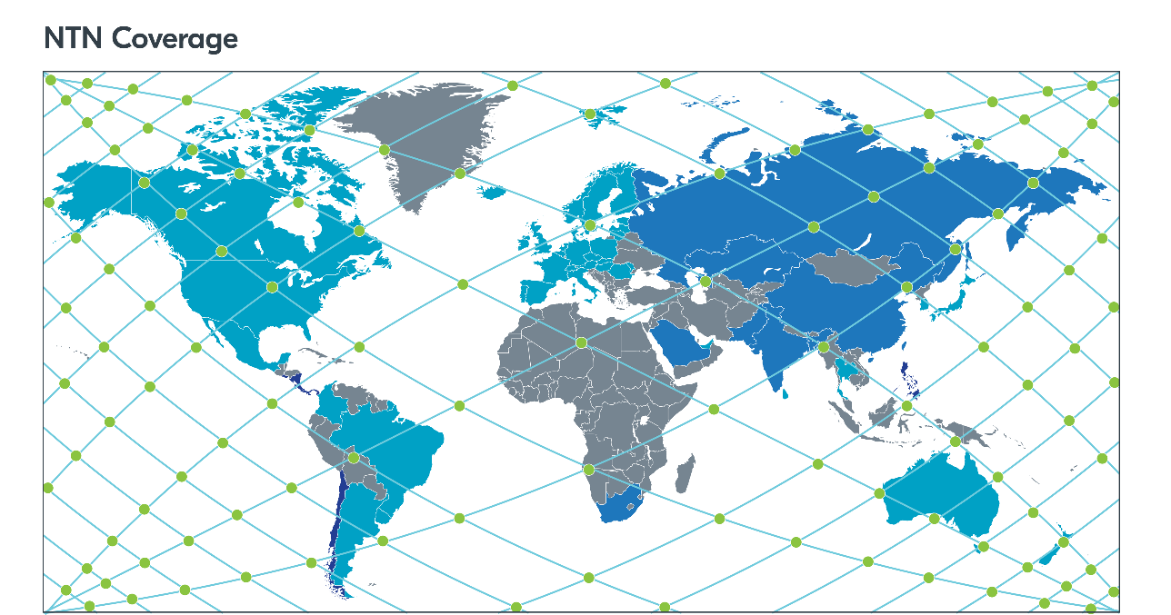




What the Cellular IoT landscape looks like today
269 commercial networks. Billions of active connections.
Cat-1bis for reach
Works wherever there is plain 4G, and inherits the roaming agreements built for phones.
LTE-M and NB-IoT for low power
Where the operators deployed them. The best battery life in cellular for typical IoT use cases.
NB-NTN for satellite coverage
Covering rest of the 85% of the globe where terrestrial cellular coverage does not reach
NTN coverage
LTE-M and NB-IoT
LTE-M only
NB-IoT only
Sources: Nordic Semiconductor; GSMA Mobile IoT launch tracker
There is still no single cellular technology built for IoT with global reach. You need a combo, E.g. LTE-M + NB-NTN
Copyright © 2026 Nordic Semiconductor ASA. All rights reserved.
6

Slide 7

Which of today's technologies has a 5G successor
And how much runway you actually have
LTE-M and NB-IoT (NB-NTN)
Part the 5G family. ITU affirmed them as a component of the 5G radio submission in November 2020.
No 4G switch-off date yet
LTE Cat-1bis
No operator has announced a date for switching off 4G on its own live, primary network.
4G only. 5G NR has no UE category system, so there is structurally nowhere for a 5G Cat-1bis to exist. Great solution today, no life after 4G
Meanwhile 174 operators in 67 markets have started 3G sunset, 102 completed.
On 2G sunset, 139 operators in 70 markets, 56 completed.
5G eRedCap
The intended successor for Cat-1bis. 10 Mbps both directions, single antenna. No eRedCap module exists today.
GSA, 2G and 3G Switch-Off, August 2026
Cat-1bis is safe for one product generation. It can be risky for a fifteen-year smart meter.
Copyright © 2026 Nordic Semiconductor ASA. All rights reserved.
7

Slide 8
What has actually changed since we started
Every reason 2018 was painful is now solved or documented. There has never been a better time to start.
Networks
Technology Coverage
SIM
Modules
Cloud
269 commercial networks. Billions of active connections. Roaming behavior is improved.
Cat-1bis, LTE-M and NB-IoT, and NB-NTN.
Integrated software SIM, or supporting “Suspend/resume" remove 30 to 60 µA of idle current from your budget.
Fully matured (Nordic) LTE stacks delivers a stable channel from the device to cloud
Matured and optimized cloud solutions with device management/FOTA and observerability possibilities.
The decade went into building the road while driving on it. The road is now built.
Copyright © 2026 Nordic Semiconductor ASA. All rights reserved.
9

