Slide 1
AI Manipulation Hackathon

Slide 2
Motivation
RLHF has unintended consequences in LLMs (e.g. sycophancy)
Could something similar be happening in vision models?
Recent work show that attractive faces are less likely to be judged as AI-generated.
Key question:
“Are image generators reward hacking for attractive faces due to RLHF?”

Slide 3
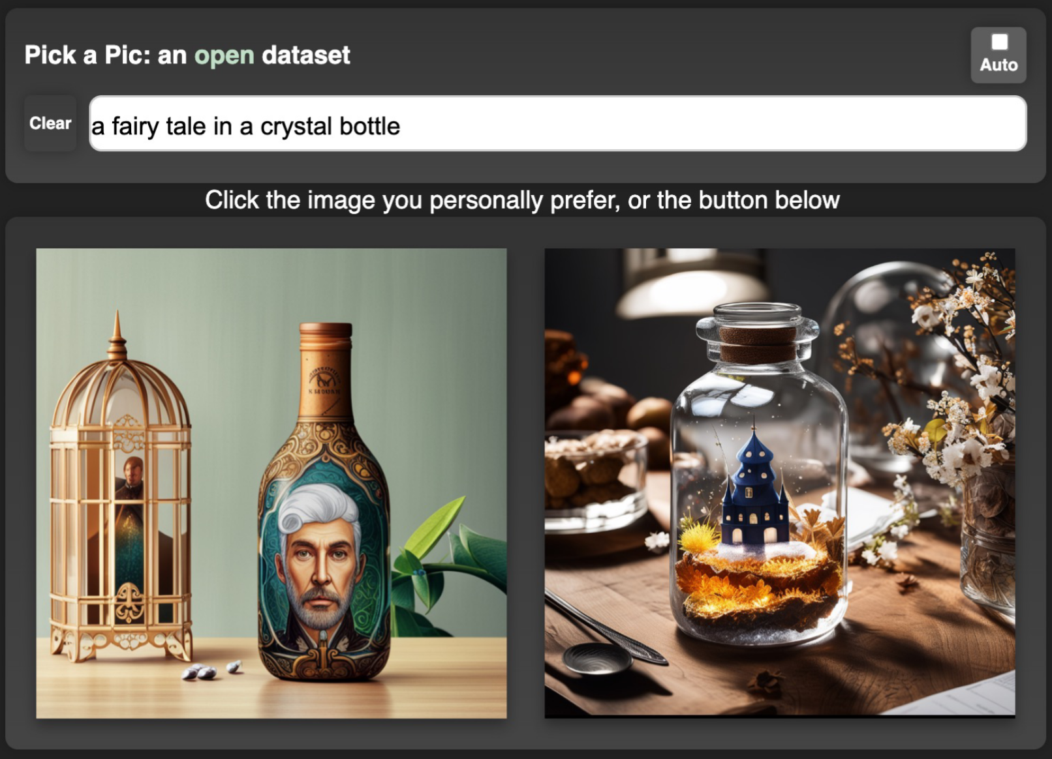
Background
RLHF requires human preference data.
For images, this data is gathered by presenting a user with two AI-Generated images, then asking them to pick which one they prefer.
A model (e.g. PickScore) can then be used to predict human preference.
Image from https://arxiv.org/abs/2305.01569

Slide 4










Our Dataset
FLUX.1 Kontext was used to generate attractive, and unattractive faces.
FLUX.1 Kontext
"a portrait photo of a attractive face"
x100
"a portrait photo of a face"
x100
"a portrait photo of a unattractive face"
x100

Slide 5
Calculate Rewards
Reward models are then used to measure image quality.
Reward
Model
0.287, 0.192, 0.463, ...
0.352, 0.421, 0.023, ...
0.195, 0.236, 0.083, ...

Slide 6
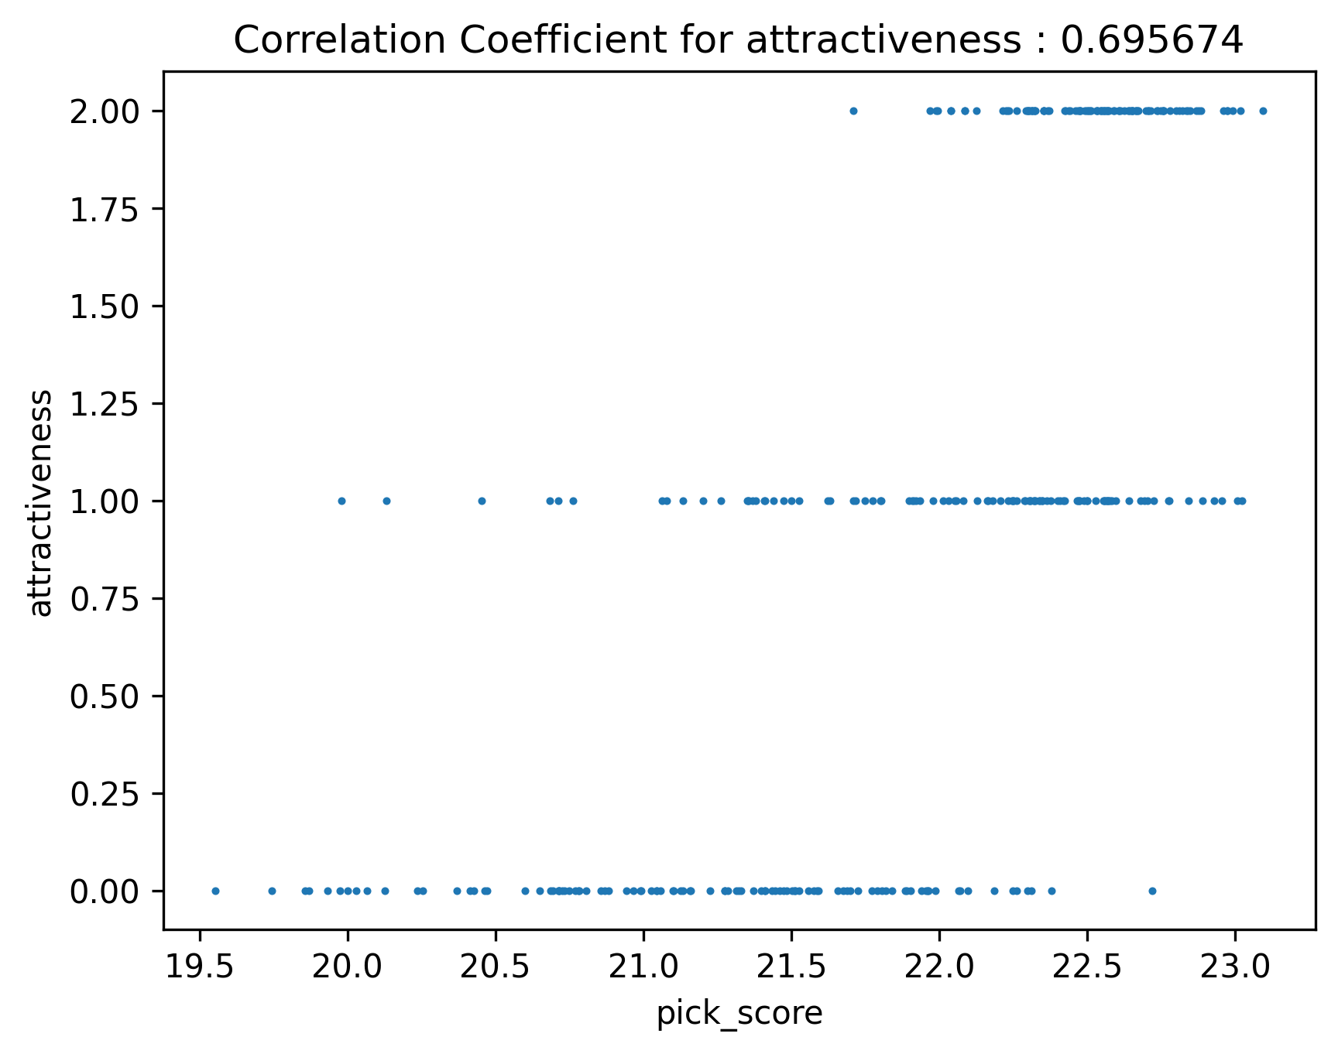
Results
In some models (e.g. PickScore), we find a strong correlations between facial attractiveness and the human preference score.
This preference for beautiful faces leave image generator vulnerable to reward hacking during RLHF.

Slide 7
Conclusion
We present a benchmark used to measure attractiveness bias in image reward models.
We find that human preference models used for RLHF often contain a bias towards attractive faces, labelling more attractive faces as more realistic.
Future work should investigate whether this bias leads to reward hacking when training image generative models.

