Slide 1


Inclusive Learning and
Student Agency
schooltalk.co.nz
Notes:
Internal doc: https://docs.google.com/document/d/1HrYbNnr6tqu_fa1p2JVDS0HtUaBJ4a5s4PFtA-eRSxw/edit#

Slide 2


Overview
This SchoolTalk module aims to build on the work that teachers do to differentiate and create an inclusive learning environment.
This module includes tips and tricks on how to use the functionality of SchoolTalks Calendar and the Design for Learning space to promote agency and support learners who may find reading or following text instructions challenging.

Slide 3
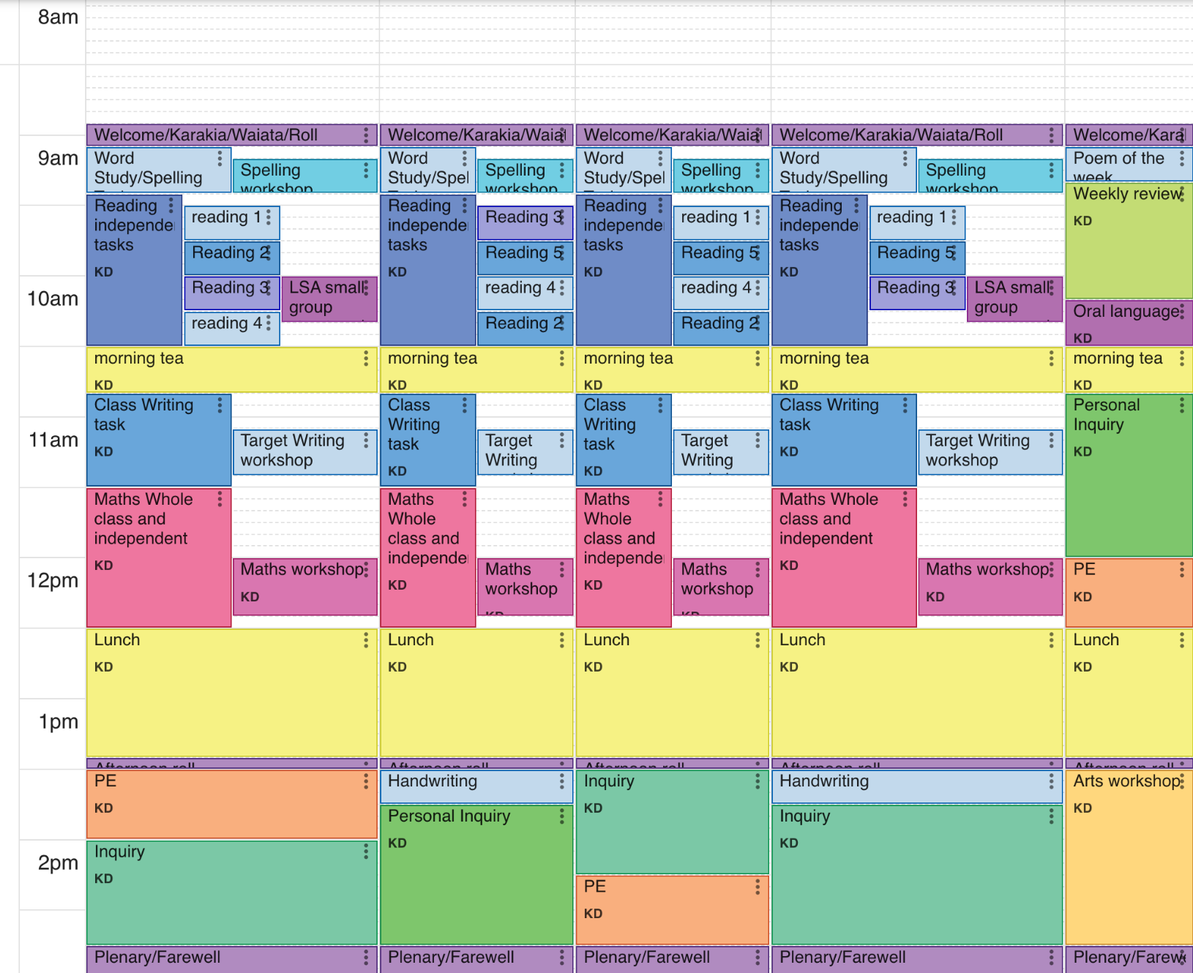
Tip 1: Colour coding
Calendar
In the calendar view use colour coding to help students of all ages and abilities recogonise what is happening during the day.
For example literacy across the school could be represented blue, maths pink etc.
Agreeing this at a school level (consistent through classrooms), can aid students as they move through the school.
We also recommend linking any colours used to wall displays for subjects.

Slide 4
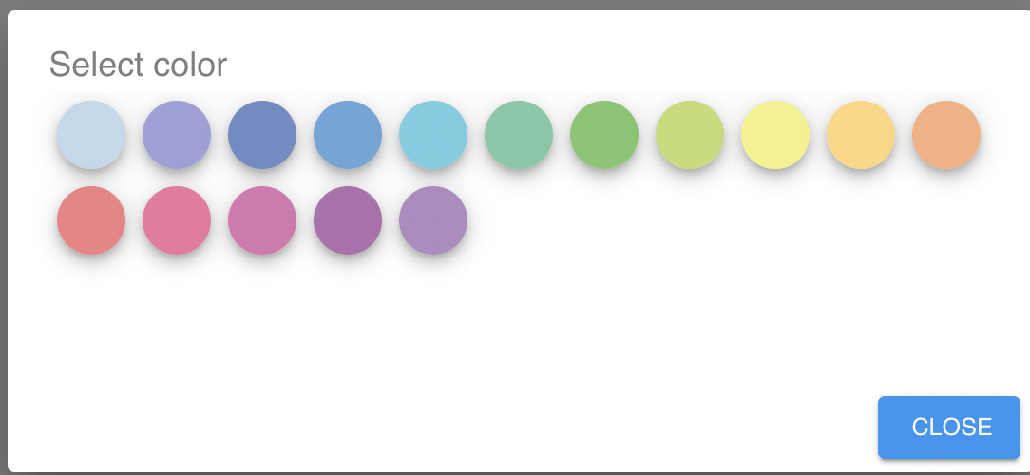
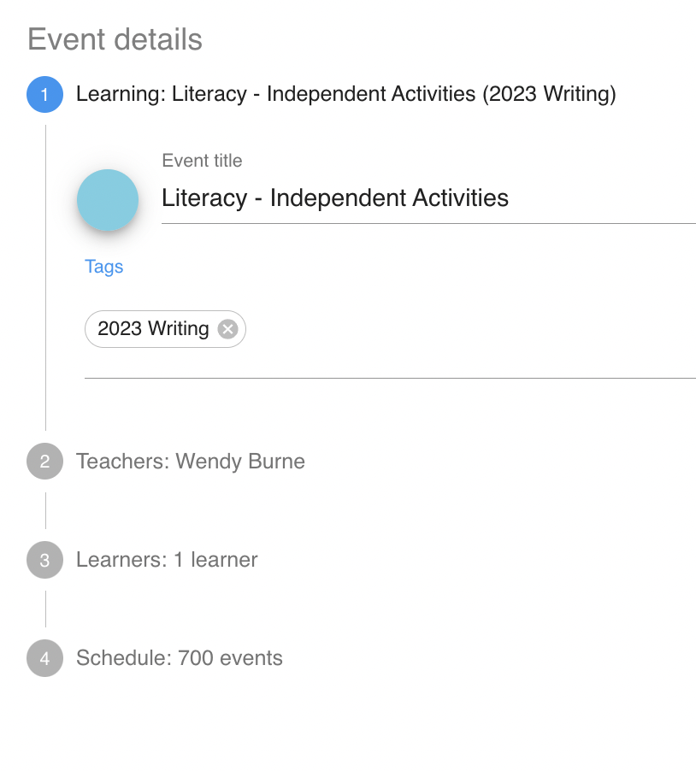
Tip 1: Colour coding
How to colour code an event
When creating an event from scratch
click on the circle next to the event title
A colour pallet will appear
Select the agreed colour for that subject/ activity

Slide 5
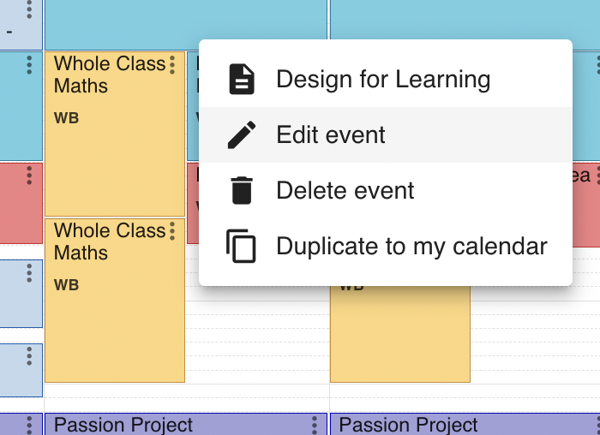
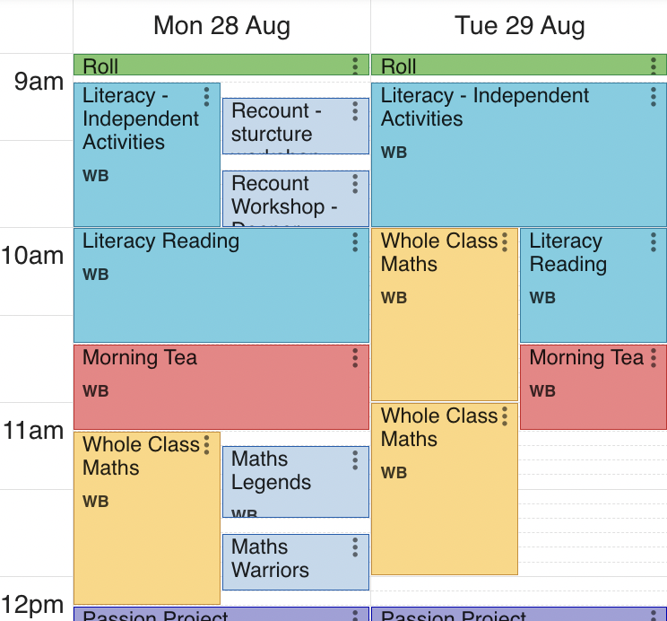
Tip 1: Colour coding
How to colour code an event
If an event has already been created and you wish to edit the colour.
Select the three dot menu within the event
Select edit event
Change colour as on previous slide

Slide 6
Tip 2: Design for learning
Suggested format in DFL
Use a set format to the DFL space
e.g. before, during, after / independent, teacher, followup
(consider agreeing this at syndicate/ school level for consistency).
Repeat this in all events so it becomes familiar.
Break the tasks into steps, clear manageable chunks. This includes text, visual and audio prompts and instructions.

Slide 7

Tip 2 : Design for learning
Audio files
Use an audio file to explain the content of a workshop.
Explain verbally the text or instructions shared in the event and any expectations you have.
Read the linked progressions out loud so students understand the focus of the lesson.
Encourage students to replay audio instructions when viewing an event to aid understanding.

Slide 8
Tip 2 : Design for learning
How to create an audio files and share via mobile
Make a recording on your mobile using the voice recorder/memo
(download from your device app store if need be).
Have google drive available on your mobile.
From within the audio recording select Share, Google Drive and a folder to save the audio file.
See slide 11 for instructions for how to load to SchoolTalk

Slide 9
Tip 2 : Design for learning
How to create an audio files and share via computer
Make an audio recording on your teacher laptop
e.g. Macs quicktime player, choose an app from Google Workplace Marketplace.
Save/ Share/Copy the audio file into Google Drive folder.

Slide 10
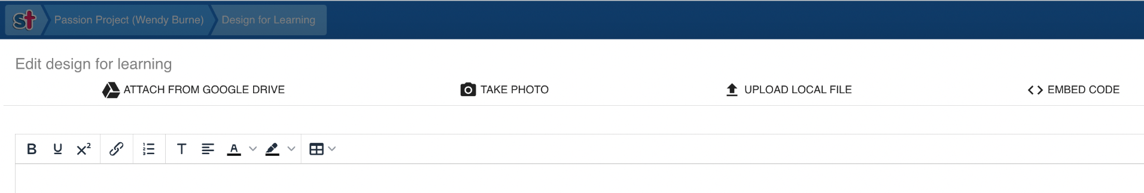
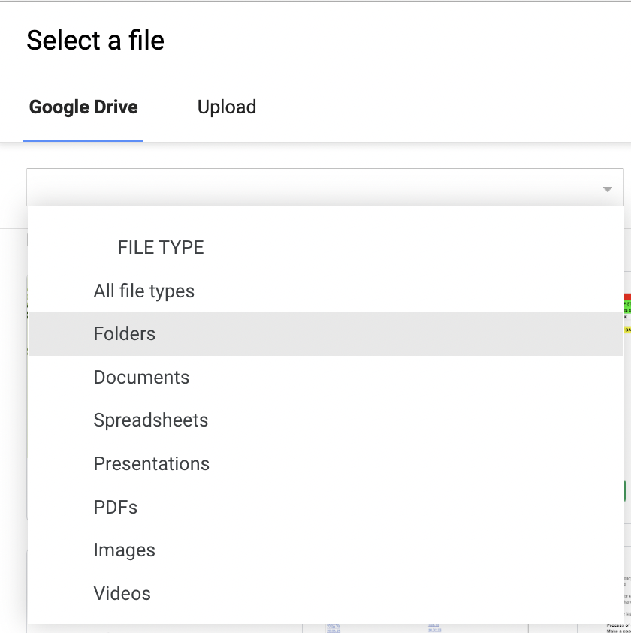
Tip 2 : Design for learning
Attaching an Audio file to SchoolTalk
Select Attach from Google Drive
Select your Google account if need be
Locate the audio file to attach to SchoolTalk
Tip: If you can not see the file you may need to select the folder, use the drop down arrow to select folders

Slide 11
Tip 3 : Include software reminders
Text to speech
Aid learner access to text to speech software by including direct links to software where possible
or
Include an image/icons to remind learners who need to, to make use of the software.

Slide 12
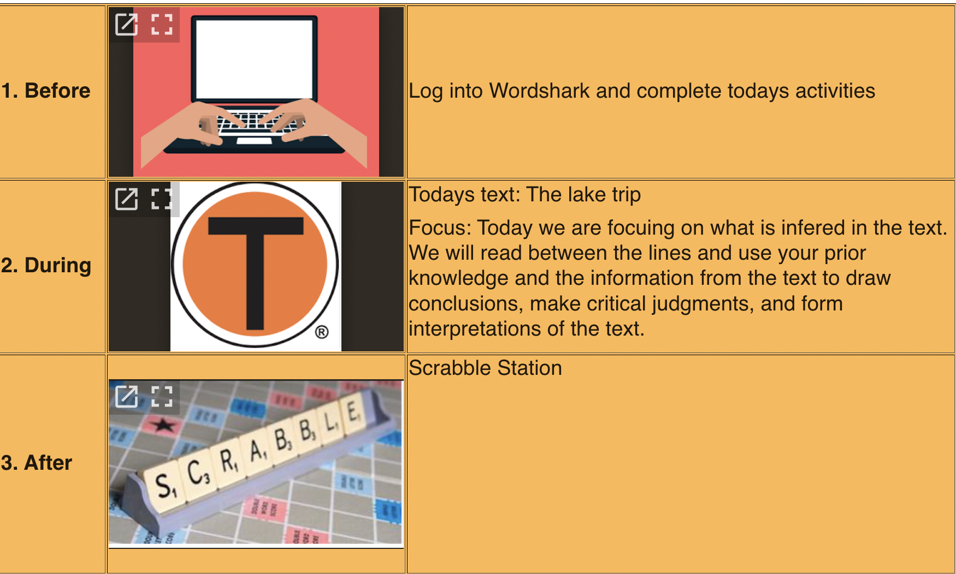
Tip 4: Images
Images as visual prompts
Create tables with images that represent activities.
Assign images to specific tasks.
Reuse for consistency and understanding.

Slide 13
Tip 5: Colour
Colours and background colours
Consider colours that support learners with Dyslexia.
Use dark coloured text on a light (not white) background.
Avoid green and red/pink, as these colours are difficult for those who have colour vision deficiencies (colour blindness).
Consider alternatives to white backgrounds. White can appear too dazzling.

Slide 14
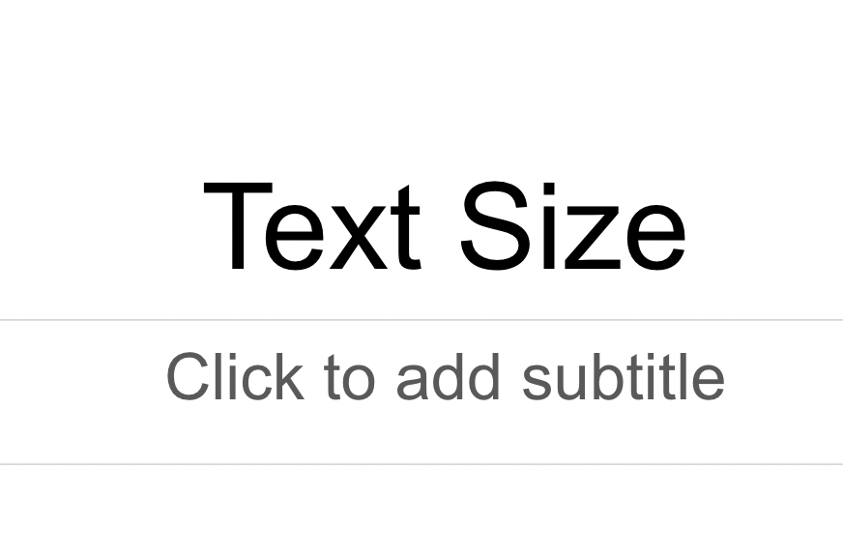
Tip 6: Size of text
Size of text and heading size
Consider the size of text to support learners with Dyslexia.
Text headings should be at least 20% larger than normal text to help make them more distinctive.

Slide 15
Tip 7: Text and Google Read and Write
Text and Google Read and Write
Consider how you write text.
Favour language that avoids anagrams to support students who use Google Read and Write.
i.e. when students highlight
WALT
google read and write will read it as individual letters
W A L T
Rather than We are learning to.

Slide 16
Tip 8: Slide decks
Differentiating slide decks
Follow the same rules for text, colour and images with slide decks.
Use audio or video to support.
Differentiate by having different versions of slides and using different leveled questions
Code appropriately, so that students know to look and what slide applies to them.
i.e. look for an image or word representing their group or level rather than spending time clicking in different links.

Slide 17
Tip 9: Include an example of a completed task
Exemplars/ completed tasks
Include an example of a completed task, this is particularly helpful for students who struggle with slow processing.

Slide 18
Tip 10: Self Assessment
Goal setting/ Self assessment/ Progress update
Consider how students could use the goal setting function or the self assessment slider to indicate how they are progressing with work and if they need assistance.
Some examples could be:
Goals - If students are struggling with something you have set them, they can indicate this by setting something as a goal.
Self Assessing 25% - if it is a goal they are working on, they could self assess to 25%.
Use of codes - assign/ agree a code that students can use to indicate they are struggling. When choosing Progress Update a student could add a code. This could be a simple word that students type in the comment box or an image such as a face expression that students attach. The use of this code would indicate that the student is struggling. The code appears in the teachers log and prompts the teacher to have a conversation with the student.

Slide 19
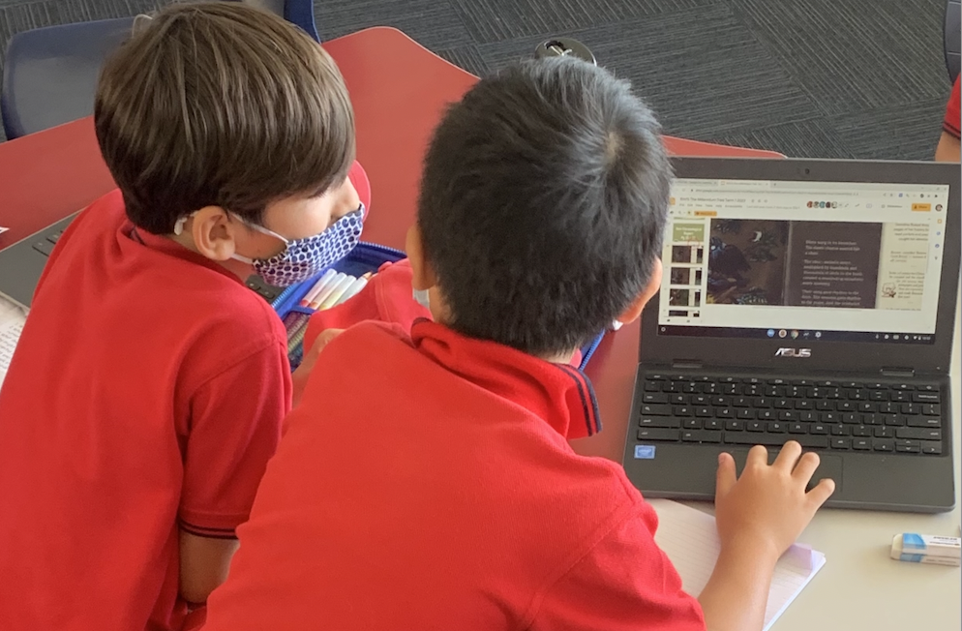
Tip 11: Create a culture of peer support
Peer support/ Roles
Encourage peer support.
Add support systems like student experts whose role is to support students use SchoolTalk.

