Slide 1
Connect Devices. Improve Lives.
Silicon Labs and the Future of Wireless IoT

Slide 2



We are the leading innovator in low-power wireless
  Merged cutting-edge technology into the
  highest integrated SoCs
  Unmatched breadth, depth, and focus on Wireless IoT
  Access to industry experts, development tools simplicity
  Driving alliance innovation, creating edge connectivity ecosystems
  Dedicated to connecting devices and improving lives
FOUNDED IN 1996
LISTED SLAB
~21,000
CUSTOMERS
>1,500 PATENT ASSETS
Solid Revenue Growth
Quarterly Revenue ($M)
$193
$206
$208
$214
$178

Slide 3





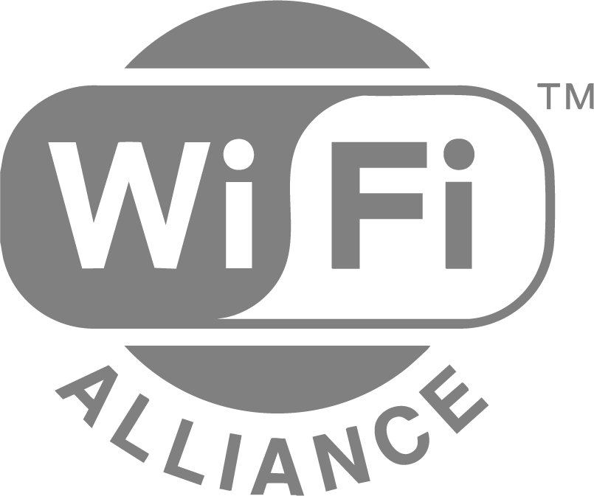



Leadership in
Wireless Alliances
Mesh WG Vice Chair Bluetooth Architectural Review Board
Executive Committee, Board of Directors
TCOC (Certification Oversight) Chair Security Steering Committee, MPSG Chair
Largest contributor among semi companies
MPSG Vice Chair Steering Committee
Founding Member
Board of Directors
IoT Market Segment Task Group
Executive Committee Board of Directors
Zigbee PRO Core Chair
Zigbee Direct Vice Chair
Founding Partner
Board of Directors
Technical WG Chair

Slide 4






Leadership in
Wireless Ecosystems

Slide 5




Diverse Market Segments Driving Growth
Home
Life
Industrial
Commercial
Leader in
Smart Home,
Key Contributors to
Matter & Thread
Market Leader
in CGM; PSA
Level 3 Security
Certification
Leader in Smart
Metering, Wi-SUN
Leader
in ESL and
Channel
Sounding

Slide 6
Complete Wireless Solutions, Engineered for Scale

Slide 7
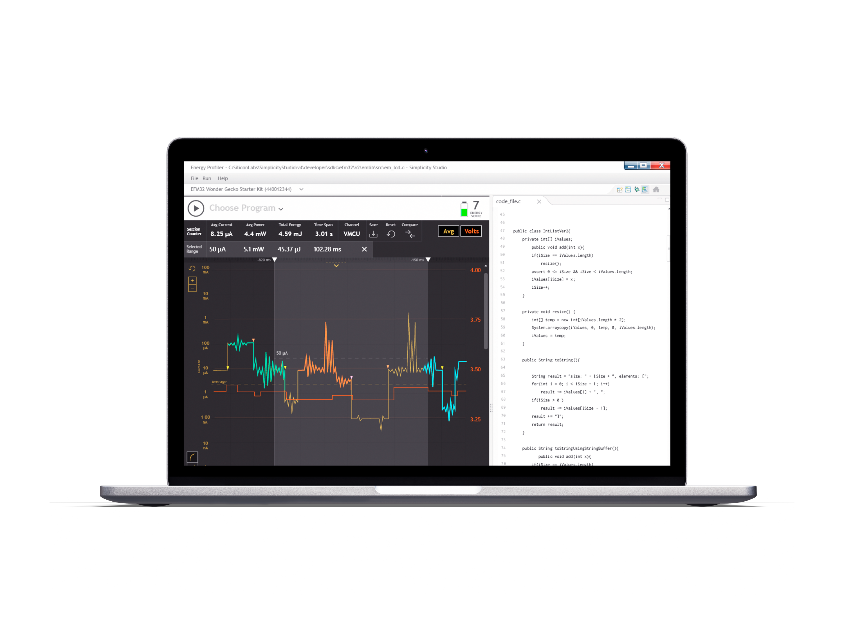
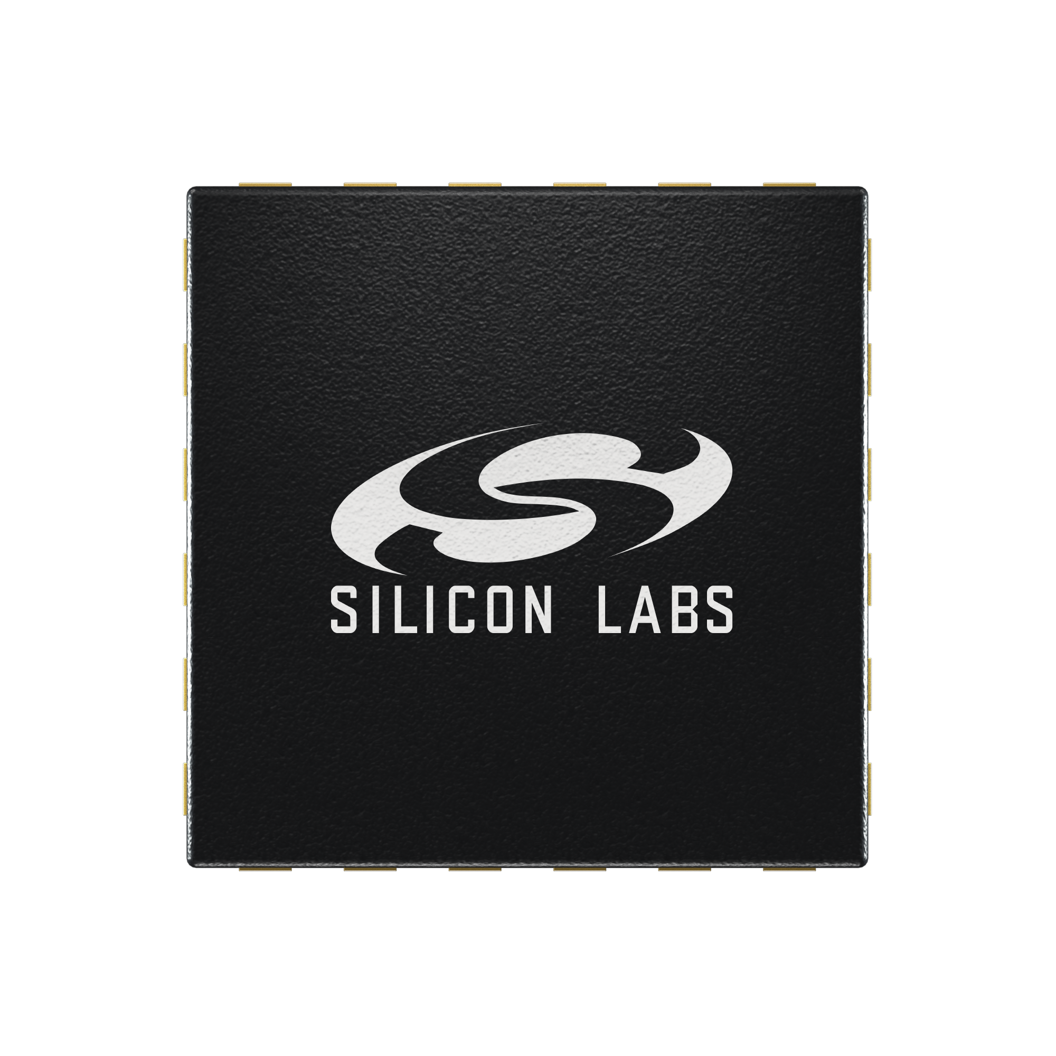
The Most Comprehensive Platform for Wireless Embedded Systems
Complete IoT Wireless Platform
 | Silicon & Modules Package, memory, RF, compute
 | Software Embedded, mobile, PC, cloud
 | Tools Application development / debug
 | Services Developer services, secure programming, certifications, network testing
Built to Scale
Same product, almost any application
High re-use across customer portfolio
Flexibility makes us faster to market
Secure | Long-Life | Low Power | Adaptive | Cost Sensitive | Safe | Rugged | Private

Slide 8
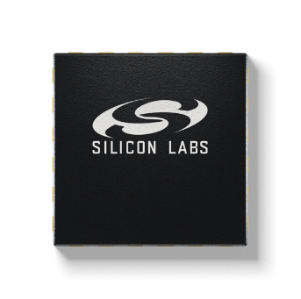
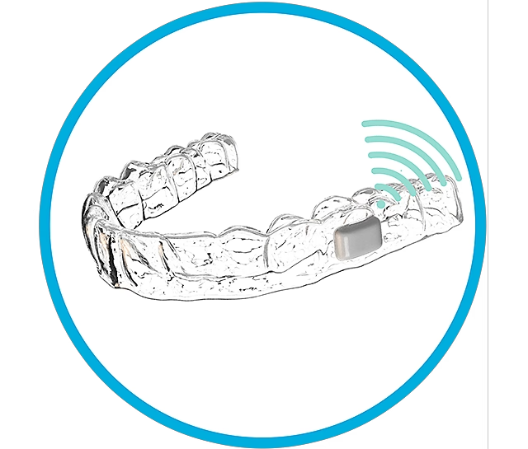
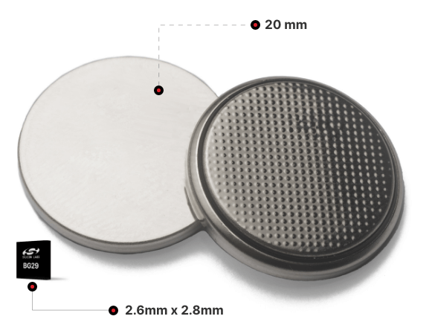





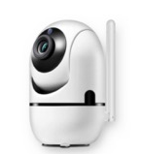

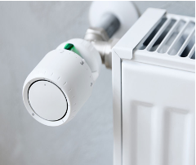
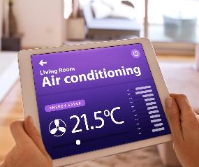


High-Performance, Low-Power Connectivity for IoT Devices
Ultra-LOW Power, Ultra-Small Bluetooth
Longest Range Sub-GHz for Smart Cities
BG29
xG25
Industry’s Lowest Power Wi-Fi
Industry leading 802.15.4 solutions
SiWx917
MG26

Slide 9
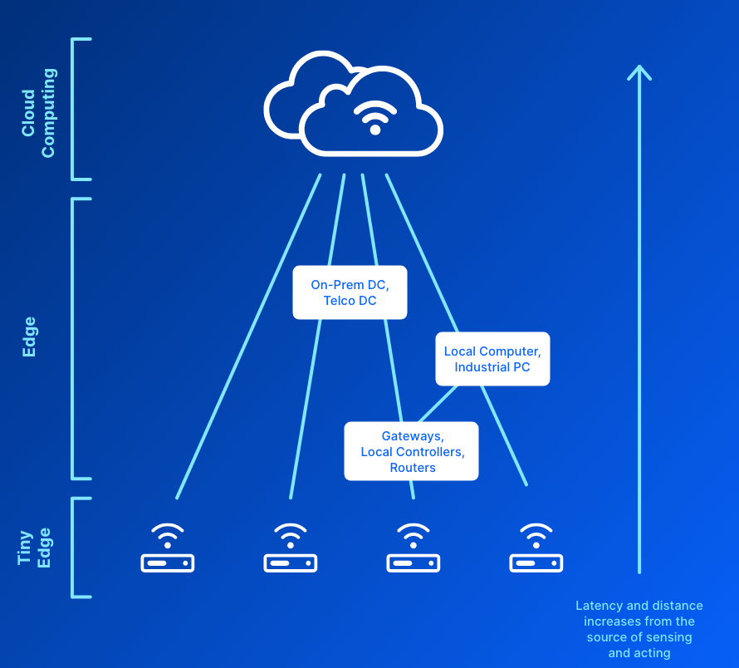
Artificial Intelligence(AI) and Machine Learning(ML) at the Tiny Edge
Cloud vs. Edge – ML applications getting closer to the source of the data
‘Edge’ is a broad term scaling from MCU sensor devices to local data centers
Industry Trend: Business Intelligence is moving closer to the Source of the Data
EdgeAI – TinyML – Smart IoT –
AIoT – TinyEdge – EdgeML
9
© 2022 Silicon Laboratories Inc.
Notes:
Several different factors are driving AI processing to the edge device. Privacy, security, cost, latency, and bandwidth are all being considered when evaluating data center versus edge processing needs. Applications like autonomous driving and navigation have sub-millisecond latency requirements that make edge processing mandatory. Other applications such as speech recognition on smart speakers generate privacy concerns. Keeping AI processing on the edge device circumvents privacy concerns while avoiding the bandwidth, latency, and cost concerns of cloud computing.

Slide 10
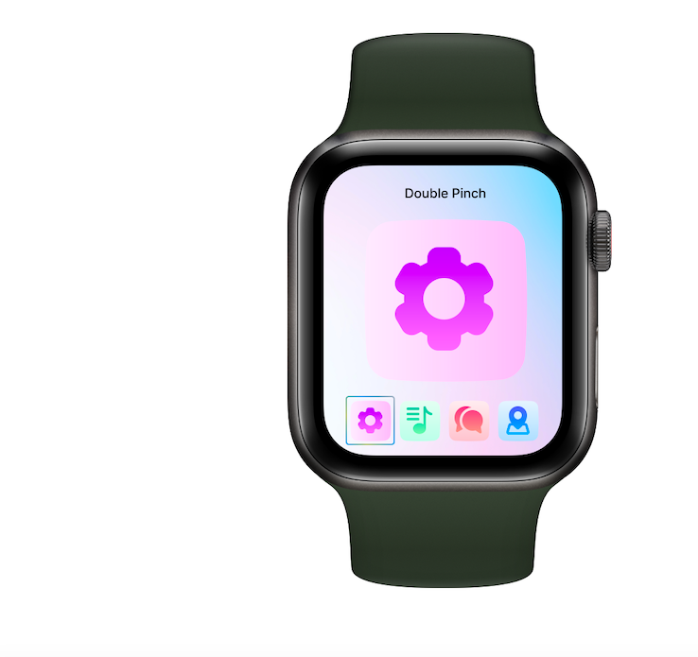

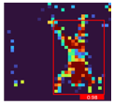

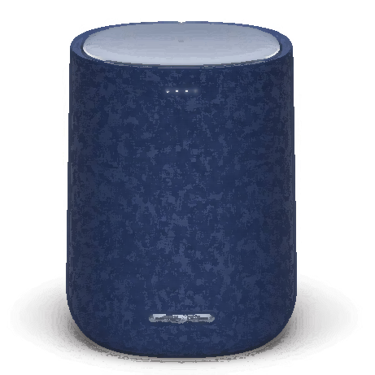
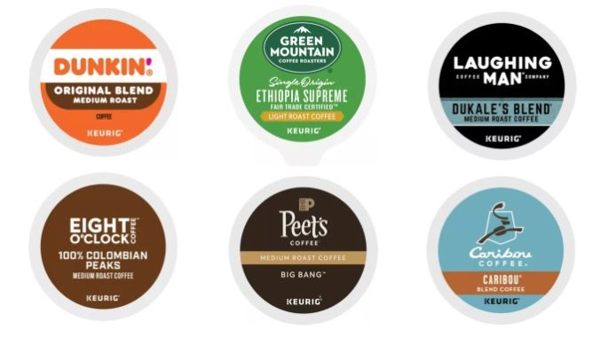
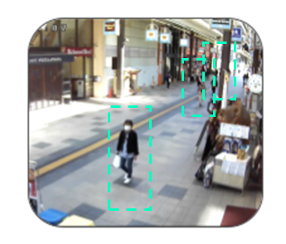
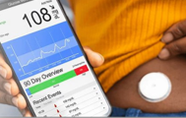


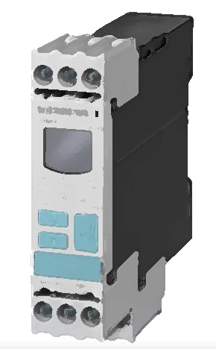
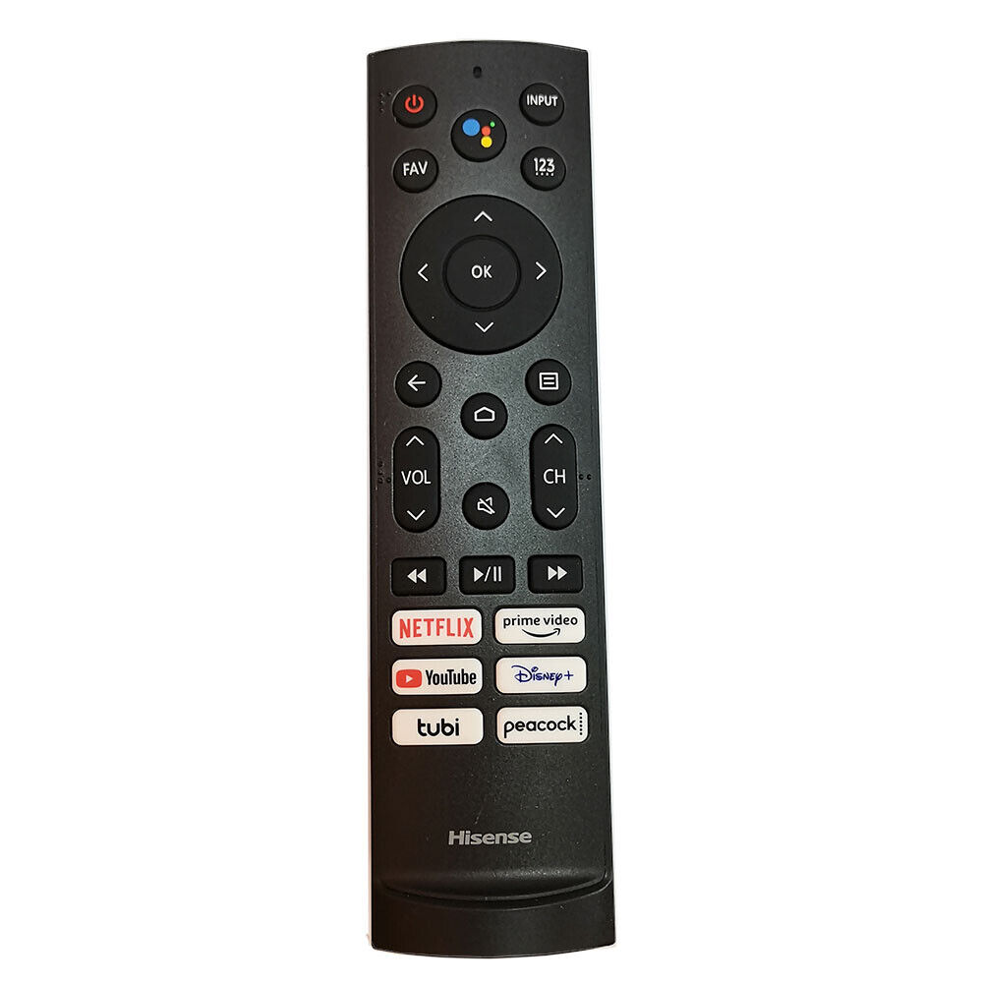
Current offering with use case examples
1D data
Audio data
2D data - vision
Ultra tiny ML use cases
Smart toothbrush, Gesture detection,
Industrial sensors, Parcel tracking
Low flash and RAM, from BG22 and up,
CortexM executes
Audio pattern matching
Sirene detection, fire alarm, shot, scream, baby cry detection, snore detection, Pet – dogbark detection, agricultural – animal noise
Partners: Sensory, AIZIP, EdgeImpulse
Low resolution IR/grayscale CAM
Fall detection with privacy, people flow counting, gesture detection
24X24 pixels, MG24, MVP is adder
Partners: AITAD, ModelCat AI
Wake- and key-word detection
Smart speakers, Home automation controllers, Lightbulbs, Doorlock, voice ID
MVP and performance is needed
Partners: Sensory, AIZIP
LOW-res Image classification (~80x80)
Petdoors, Small appliances like Kcaps label reading, well lit environment
MG24, MG26, x917; RAM needed,
MVP is must have
Partners: Edgeimpulse FOMO, ModelCat AI, Jabil, EmbedUR, AIZIP
sensors
Industrial sensors, pattern matching, device health analysis, predictive maintenance, anomaly detection, PIR sensors
Flash needed – bigger FC models, data store
MORE COMPUTE AND COMPLEXITY
AUDIO PATTERN MATCHING ON BATTERY
Glass break detection, voice activity detection
MVP and performance is needed to maximize battery life
Partners: AIZIP
Object detection (~120X120)
Human detection, people counting
MG26, x917; RAM needed, flash needed,
MVP is must have
Partners: Edgeimpulse FOMO, ModelCat AI, Jabil, EmbedUR, Capgemini, AIZIP
Battery powered sensors
Bio-signal analysis, pattern matching,, anomaly detection, agricultural use cases, animal sensors
MVP is important to increase battery life
Wake-word detection on battery
Smart TV remote, Smartwatch always-on,
Battery powered voice control
MVP+ and low power IP is needed to maximize battery life
Partners: SensiML, AIZIP
Higher-res (160x160) images and/or higher frame rate
Gesture detection, RT image classification, face detection, Fast object detectoin
MG26, x917; RAM+flash needed,
MVP is must have
Partners: Edgeimpulse FOMO, ModelCat AI, Jabil, EmbedUR, Capgemini, AIZIP
High sample rate data
Smart circuit breaker
Industrial sensors
MVP and performance is a must have
EFR32xG2x and SiWx917
MORE MEMORY

Slide 11

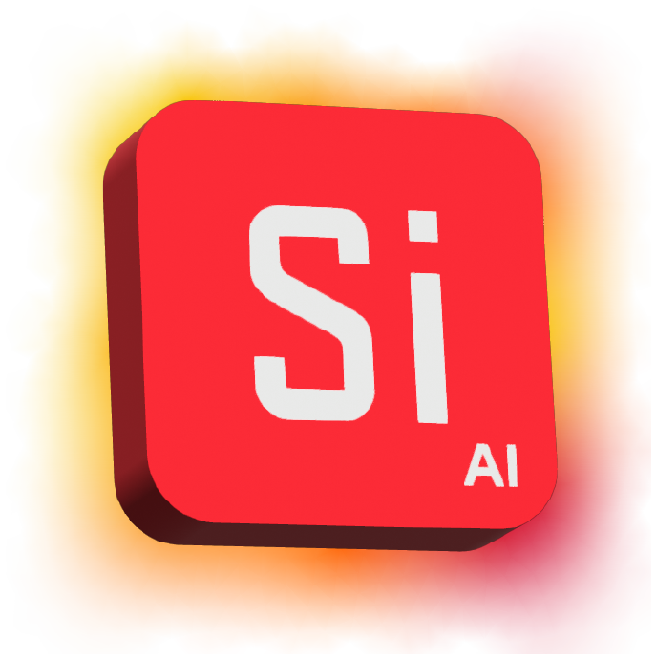
  Build embedded
  applications faster
  Simplicity AI SDK
  AI-assisted development grounded in
  Silicon Labs SDKs, tools, and project context.
Notes:
Last year at Works With, we introduced Simplicity AI Development and invited developers to request access to the closed alpha. Since then, we have been learning how AI can provide practical value in embedded development. The opportunity goes beyond generating code. An effective assistant needs to understand Silicon Labs software, development tools, connected hardware, and the developer's project context.
That work is taking shape as the Simplicity AI SDK. The goal is straightforward: help developers build embedded applications faster with AI-assisted development grounded in Silicon Labs SDKs, tools, and project context.
Today, I am sharing a brief preview of the direction and the experience we are building.

Slide 12
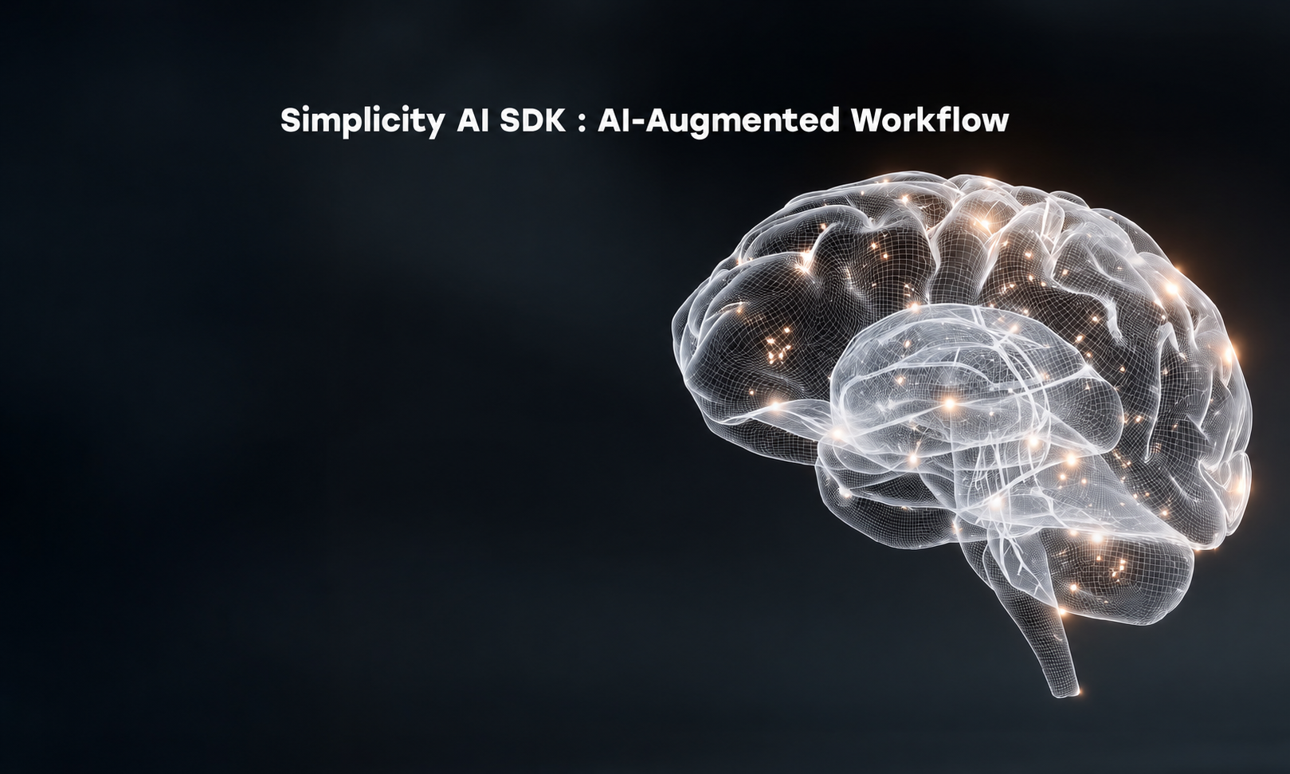
Notes:
This diagram shows how the Simplicity AI SDK supports an AI-augmented embedded development workflow.
Starting on the left, the developer remains in control of the work: planning the application, reviewing changes, debugging issues, and deploying to the target. The AI agent collaborates with the developer while receiving context from the Simplicity ecosystem.
That context comes from three areas. First, Silicon Labs knowledge provides authoritative information from current documentation, SDKs, and web content. Second, direct access to Simplicity tools allows the agent to help configure projects, build software, debug problems, and optimize an application. Third, project-specific context aligns its guidance with the actual hardware, wireless protocol, and application requirements.
Together, these inputs help the assistant provide grounded answers and embedded-aware guidance across more of the development workflow, from the initial idea through build, debug, and deployment.
We that we are truly excited with the progress and ask you to look out for the next major update at our Silicon Labs flagship event Works With in October.

Slide 13

Large, diverse, growing IoT opportunity Capitalizing on increased wireless adoption and predicted connected devices growth
Unmatched wireless portfolio, hardware & software platform “Works with” industry’s widest range of protocols, ecosystems for multitude of secure applications
Ecosystem leader defining future of IoT 10Ks of customers, 1Ks of applications, 100s of major technology partners
Proven track record of sustainable growth Value creation with attractive long-term target operating model/margin profile
Driven by customer success, ability to solve global challenges People, products and purpose help developers transform industries, grow economies, improve lives
The Leader in IoT Wireless Connectivity

Slide 14
Thank you

Slide 15
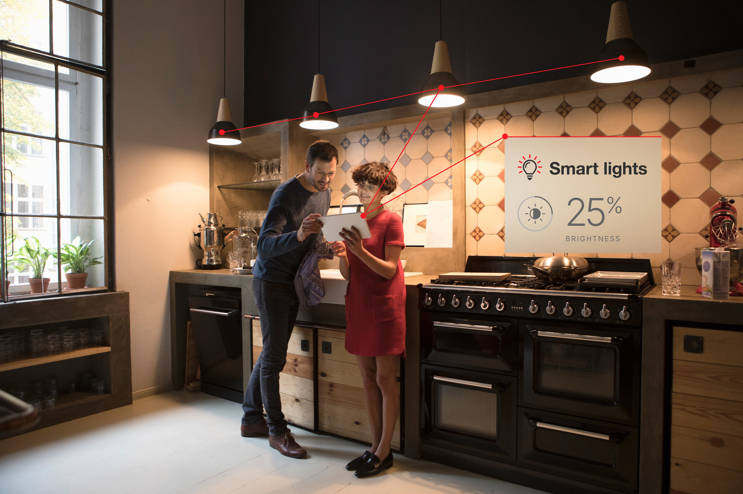
Home: Pioneering the Future of Smart Home Technology
Strong incumbency in smart home market
More than a decade shipping embedded wireless into home security and home automation applications
Leading 15.4 position in Lighting. Large Smart Home opportunity for Wi-Fi
Leader in Sub-GHz home applications with a 1-mile range on Z-Wave Long Range and Proprietary
19 out of the top 20 ISPs in NA and Europe use Silicon Labs IoT wireless
Highly integrated solutions that work across ecosystems
  Leadership position across today’s devices and IoT Ecosystems
  Relentless focus on simplicity and ease of use
  Matter will further remove complexity
  Enhanced AI & Security driving the next generation of use cases
Home Security
Home Automation
Smart Lighting
Service Providers
Source: Silicon Labs Analyst Day - March 2025

Slide 16
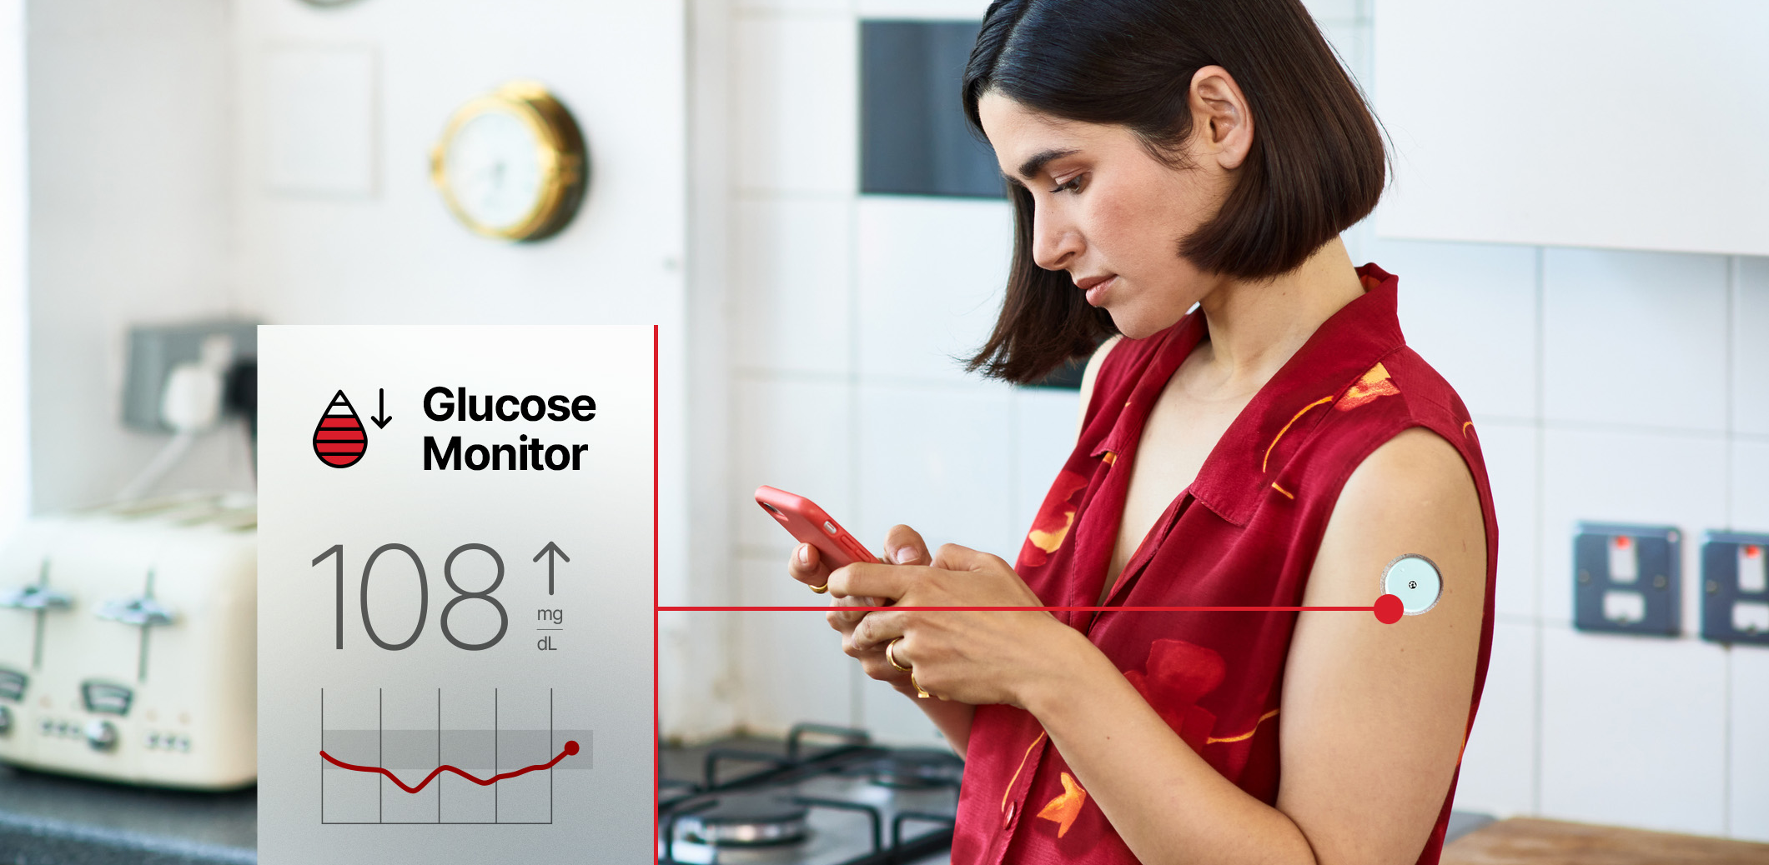
Life: Transforming Health and Personal Electronics
Healthcare expanding from hospital to home
Disposable medical patches now capable of measuring key health parameters and delivering life-saving medications
Increasing global diabetes population driving growth, now shipping to over 10 insulin management companies
We win with best-in-class security, ultra-low power, and application-optimized solutions
Increased connectivity in consumer electronics
Toothbrushes to TVs are incorporating wireless connectivity to increase consumer value
Fitness, health and wellness, asset tracking, and entertainment use cases fueling market growth
Our strengths include multi-protocol coexistence, outstanding battery life, and AI/ML at the tiny edge
Medical
Appliances
Wearables
Entertainment
Source: Silicon Labs Analyst Day - March 2025

Slide 17
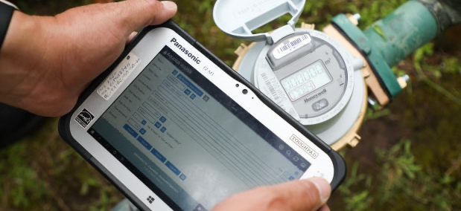
Industrial: A Legacy of Leadership
Strong ROI fuels market adoption
Energy efficiency and grid reliability
Electrification of everything
Industrial operational efficiency and big data feed for AI
Real world expertise from over a decade of deployments
Proven supplier for deploying massive scale networking
Established leader: WI-SUN, Matter, and long-range sub-GHz
Driving, influencing & implementing standards/ecosystems
Smart Metering
Industrial Automation
Renewable Energy
EV Chargers
Agriculture
Municipal Infrastructure
Source: Silicon Labs Analyst Day - March 2025

Slide 18

Commercial: Top Wireless Provider for ESL, Lighting and Enterprise IoT
Proven Success in Key Wireless Markets
Ultra low-power wireless and market leading software
#1 wireless market share in ESLs
#1 market share in Enterprise APs for Bluetooth and 15.4
Growth New Markets and Higher Value Solutions
Asset tracking well positioned for BLE and WI-FI
Wired to wireless transitions in lighting & buildings
Increased wireless & compute drive additional value
Electronic Shelf Labels
Commercial Lighting
Garage Door Openers
Access Control
Enterprise Access Points
Building Automation & Security
Power Tools
Asset Tracking
Source: Silicon Labs Analyst Day - March 2025

Slide 19

Series 2
1st
PSA Level 3 certification
1st
First integrated AI/ML hardware accelerator
Purpose-built for the IoT
1st
Complete connectivity support for Amazon Sidewalk
19
©Silicon Labs Inc. All rights reserved.
Notes:
Series 2 is Purpose-built for the IoT and has been in production for a few years.
I’d like to highlight a few Series 2 firsts
First PSA Level 3 certification, the highest level of security certification at the time, but the security journey continues as you’ll see on Series 3
First integrated AI/ML hardware accelerator on an embedded wireless device, speeding up AI/ML inferencing by 8x while using only 1/6th the energy
First end-to-end development platform with complete connectivity support for Amazon Sidewalk
We continue to bring to market industry-leading, innovative solutions on our Series 2 platform, with five new Series 2 SoCs and multiple modules released this year alone, with five new SoCs focused on BLE, 15.4, and Sub-GHz coming before the end of 2027.
Series 2 will continue to grow for years to come as we release devices that integrate new features, optimize for applications, improve performance and energy efficiency, and address the growing needs of machine learning.

Slide 20


Series 3
Next Gen platform
1st
PSA Level 4 certification, protecting the device against the most cutting-edge physical attacks
1st
To be included in the Connectivity Standards Alliance’s new Matter Platform Certification program
1st
SoCs built on 22nm, multi-foundry, multiple geographies, supply chain resiliency
22 nm
Notes:
Series 3 is our Next-Gen platform
While being Next-Gen, Series 3 does not replace series 2, it complements it. We see that some applications fit best on a 40nm Series 2 solution, while other applications with more compute and memory requirements fit better on a 22nm Series 3 solution.
Over the last year we have updated our foundry strategy, adding both 40nm and 22nm Foundries in new geographies because we see growth in both families beyond the next decade.

Slide 21
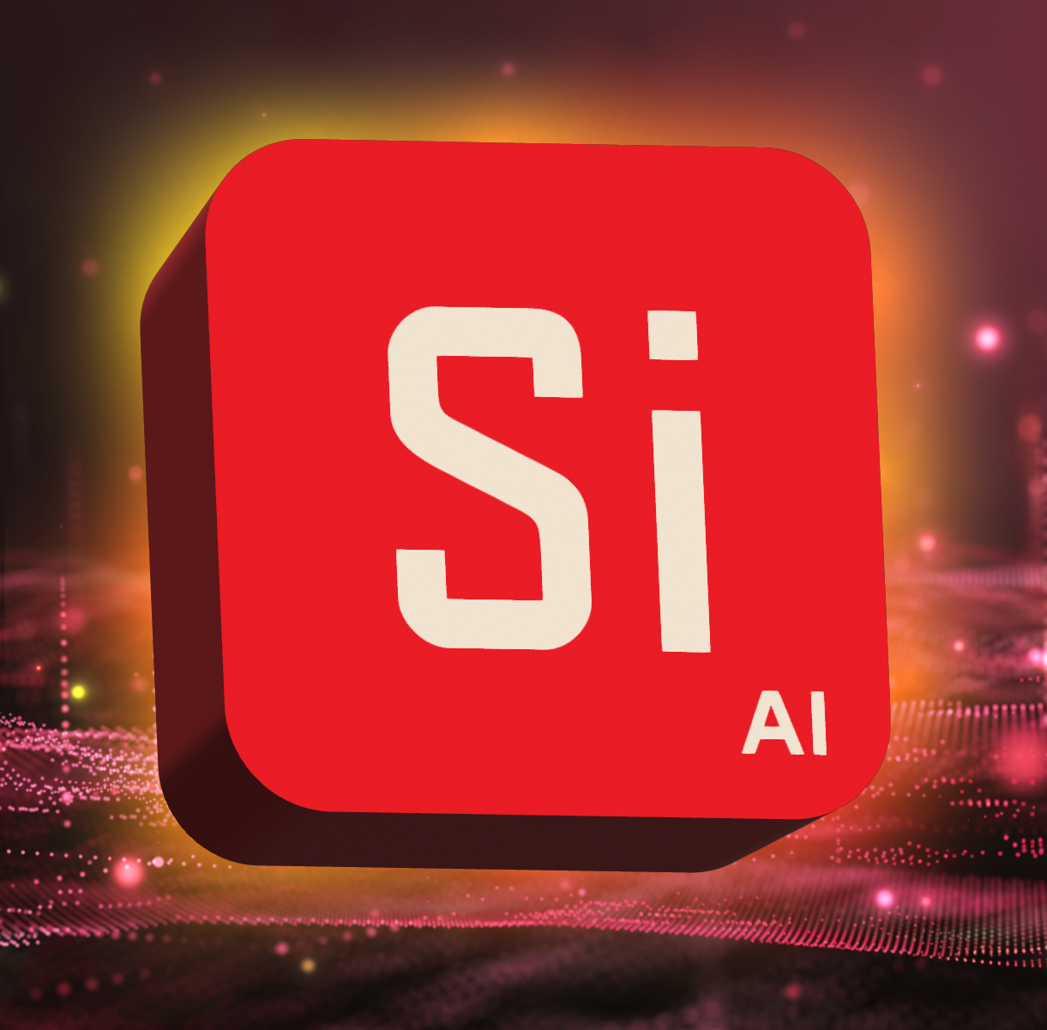
  Introducing
  Simplicity AI
  AI-enabled SDK
Notes:
And today, I’m excited to share a bold step forward for all developers who build on our platform. Our AI-enabled software development kit is here, and we're calling it Simplicity AI
For years, we’ve optimized our tools, documentation, and workflows to make development easier for humans. But now, something new has entered the scene. AI itself is becoming a developer. Agents and copilots are starting to code, debug, and integrate alongside humans. Our job is to build a platform that works just as well with these agents as it does with you.
That’s what Simplicity AI is about: a developer experience designed not only for people, but also for the AI agents working with them.
Dynamic context engineering is at the core. It means an AI agent has the right context, at the right time, so it can accelerate every part of the developer journey — from ideation, to project creation, to debugging and deployment.
This has required us to re-engineer every layer of our ecosystem, the SDK itself, the docs, the tools, so that they are structured, machine-readable, and agent-ready.
The outcome is powerful:
Faster development cycles.
Debugging that adapts and corrects errors automatically.
The ability to combine and extend sample application into new applications.
And perhaps most exciting, the potential for developers and their AI teammates to build applications that were never imagined before.
We all know that software development is one of the biggest pain points you, our customers, face. It’s time-intensive, requires deep expertise, and slows the path from idea to product. Today, for the first time, we’re going to show you a new way of working with our SDK – built not just for developers, but also for the AI agents now becoming part of your workflow.
Simplicity AI is on the horizon, and we’re building its roadmap with your input. It’s more than an experiment — it’s a long-term direction that will expand across our wireless technologies.
Now let me show you what this looks like in action.
*****TRANSITION TO DEMO; LIVE FIRST WITH MICHAEL, THEN PLAY VIDEO**************

Slide 22
  Introducing
  Simplicity AI
  AI-enabled SDK
Notes:
And today, I’m excited to share a bold step forward for all developers who build on our platform. Our AI-enabled software development kit is here, and we're calling it Simplicity AI
For years, we’ve optimized our tools, documentation, and workflows to make development easier for humans. But now, something new has entered the scene. AI itself is becoming a developer. Agents and copilots are starting to code, debug, and integrate alongside humans. Our job is to build a platform that works just as well with these agents as it does with you.
That’s what Simplicity AI is about: a developer experience designed not only for people, but also for the AI agents working with them.
Dynamic context engineering is at the core. It means an AI agent has the right context, at the right time, so it can accelerate every part of the developer journey — from ideation, to project creation, to debugging and deployment.
This has required us to re-engineer every layer of our ecosystem, the SDK itself, the docs, the tools, so that they are structured, machine-readable, and agent-ready.
The outcome is powerful:
Faster development cycles.
Debugging that adapts and corrects errors automatically.
The ability to combine and extend sample application into new applications.
And perhaps most exciting, the potential for developers and their AI teammates to build applications that were never imagined before.
We all know that software development is one of the biggest pain points you, our customers, face. It’s time-intensive, requires deep expertise, and slows the path from idea to product. Today, for the first time, we’re going to show you a new way of working with our SDK – built not just for developers, but also for the AI agents now becoming part of your workflow.
Simplicity AI is on the horizon, and we’re building its roadmap with your input. It’s more than an experiment — it’s a long-term direction that will expand across our wireless technologies.
Now let me show you what this looks like in action.
*****TRANSITION TO DEMO; LIVE FIRST WITH MICHAEL, THEN PLAY VIDEO**************

Slide 23


Simplicity AI: AI-Augmented Workflow
Simplicity AI
Dynamic Context Engineering
Project creation & development
SiSDK
Docs
Tools
Device Manager
AI Agent (Cursor, Windsurf, Copilot, etc.)
Customer Application
SLAB opensource community
MCP server
SDK + Docs + Tools + Opensource → Structured as AI Context (via MCP)
MCP: Model context protocol

