Slide 1


AIRLINEZ
August
2025
flightdeck@airlinez.io

Slide 2
AIRLINEZ turns chart trading into an eSport

Slide 3
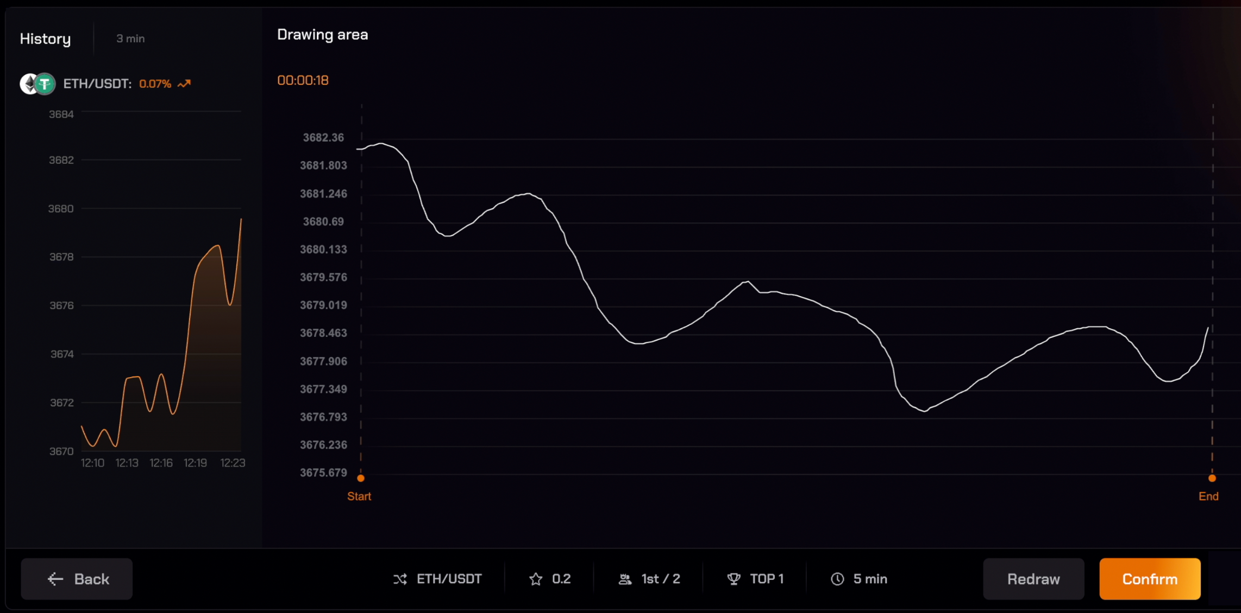
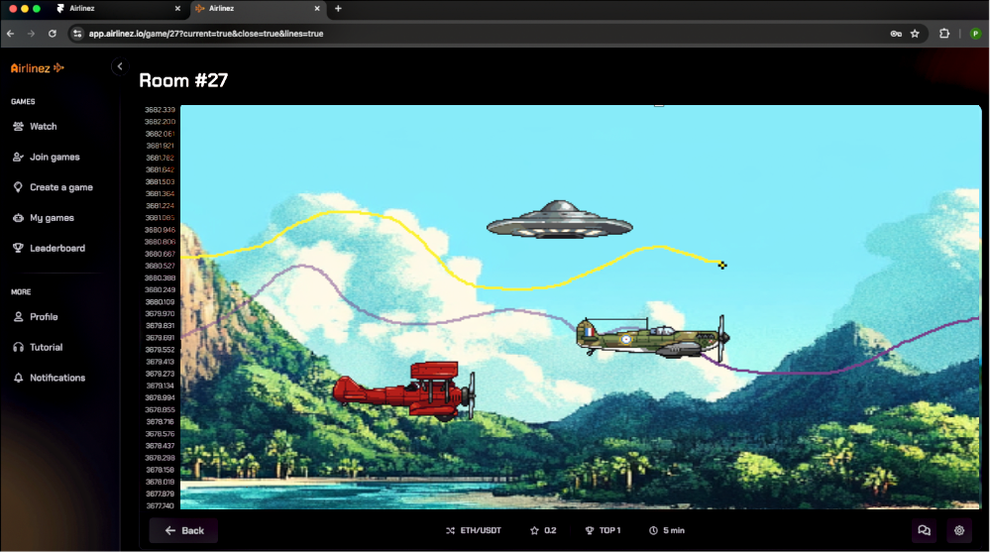
It’s very simple
Draw the chart with a
swipe of your hand
Compete against friends (and enemies)
then

Slide 4
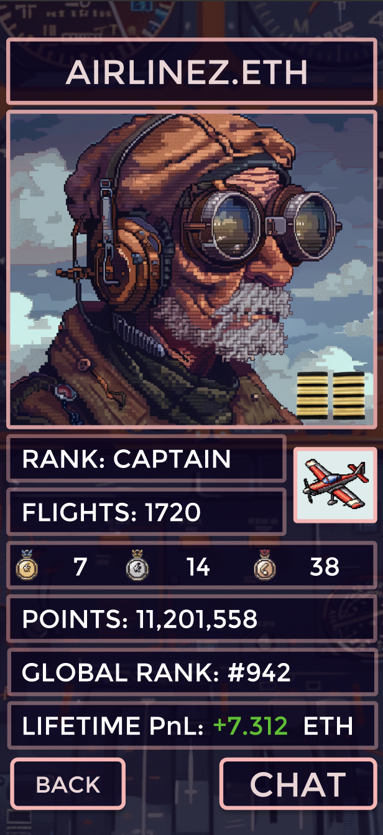
It’s TA, but gamified. That means:
Tournaments
In-game chat
Flagship games
Unlockable rare items (skins, aircraft, etc)
Ranks
Exclusive game access and content for higher ranks
and more
… all of the juicy incentives you can build around a game loop, now applied to TA.

Slide 5
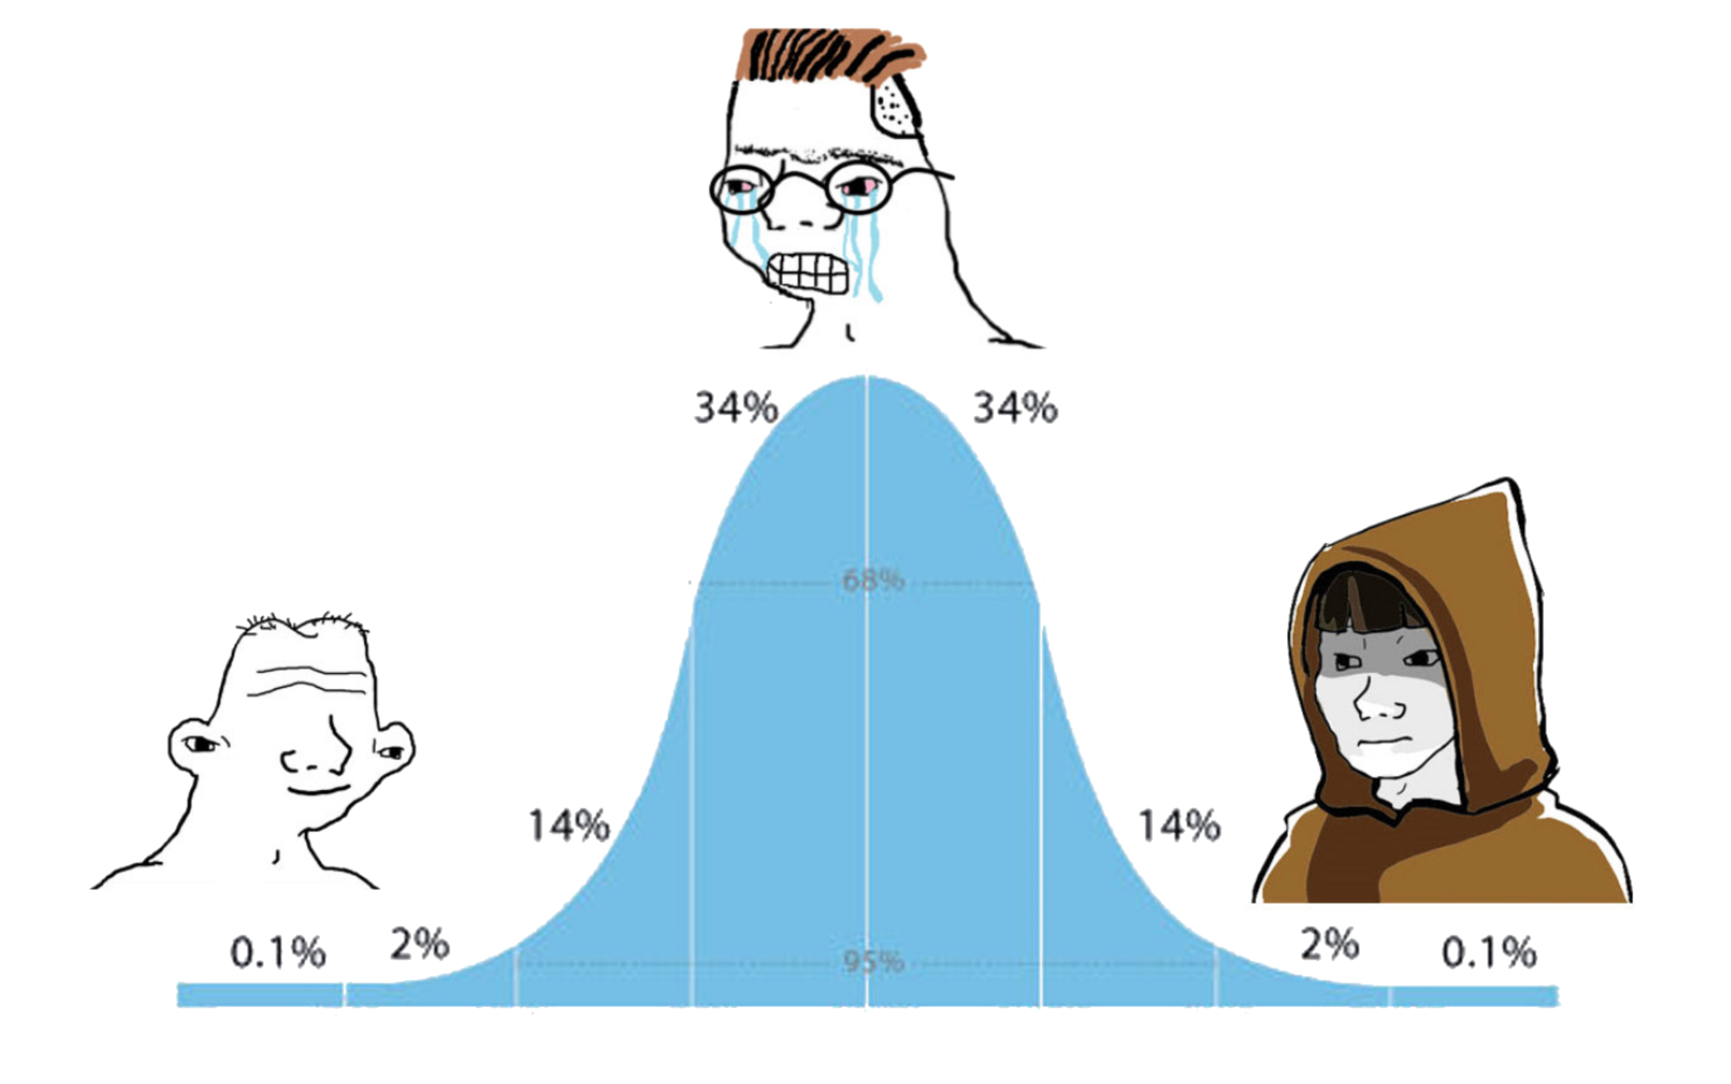
The Target Market:
“There’s nothing fun
to do in crypto”
Memecoins
PnDs
Getting scammed
MEV searchers
Node operators
Algorithmic traders

Slide 6


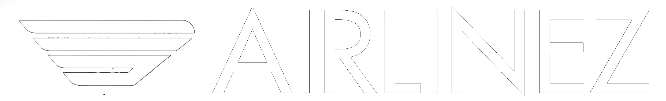

The Competition:
While nothing like AIRLINEZ currently exists, we are competing in the Web3 “attention economy” against other retail-facing products. Here’s how we stack up against some current leaders:
Is it… Product | Fun | Fair | Easy to Learn | Replayable | Built to last
 | Good | OK | Good | OK | Very Good
 | OK | Poor | Good | OK | OK
 | Very Good | Very Good | Very Good | Very Good | Very Good
 | OK | Good | OK | OK | Good

Slide 7

The Technology:
Airlinez is very proud to have early access to Chainlink Data Streams.
Low latency price feeds provide our users with certainty that Airlinez is running on fast, accurate and tamperproof price data.
The Airlinez token will also be built on the Chainlink Cross Chain Token standard. The Airlinez game contracts are being built on Arbitrum Anytrust, the high throughput, low cost blockchain from the most credible and innovative L2 team in the space.

Slide 8

Aetheling, the creative minds behind AIRLINEZ, are working with EvaCodes, experienced blockchain developers with a raft of existing Web3 and gamefi titles. Our alpha testnet MVP is now live, with main-net due later this year.
Who is building it?

Slide 9
Roadmap:
2024
Initial
conception
Early design and
technical development
MVP design and
Development
Q1
Q2
Q3
Q4
2025
MVP launch
“Pre-season”
Non-monetised
“Season 1” Monetised launch
Q1
Q2
Q3
Q4
Token launch, dNFT avatars, advanced game modes, and more…
2026

Slide 10

From the Founder:
As a full-time crypto native for the past eight years, I’ve been disappointed by the state of the retail app market, relative to the incredible technological advances that we have seen.
2025 is a high water mark in tools, wallets, regulatory goodwill, and general tailwinds for app-layer crypto developers, but we are yet to see these conditions bear serious fruit.
Airlinez takes the most fundamental “game” of Web3, which is reading charts and making money, and turns it into a completely seamless, fun, replayable and social experience.
I want every retail Web3 user to be logging on to Airlinez daily, to play in free satellite tournaments, watch their favorite TA influencers compete in elite games, and convert their chart intuition into gains.
-Pete

Slide 11
Interested?
We are fully committed to developing the most fun, intuitive, user friendly retail trading experience in Web3.
Our goal is to build something that people enjoy using daily, whether they are playing $1 games, $1000 games, or just free qualifiers for satellite tournaments.
If our vision excites you as much as it does us, get in touch!
Contact:
flightdeck@airlinez.io

