Slide 1

When Wireless Networks Become Sensors
Safety without surveillance
Elderly Care · Smart Buildings · Security · Critical Infrastructure
Notes:
⏱ 0:00 to 1:30
Let me start on a campsite, a few summers ago. My wife was pregnant and slept most afternoons in the tent.
I was testing a wireless network there, and I realised I could see exactly where the access point was, just from the signal.
And then a question came up that would not leave me alone. If I can see the access point, can the access point see me? Could it see her breathing, so I would know she was fine without opening the tent and waking her?
Then there is my grandfather. He is 97 and still lives on his own. Like many older people he wears an alarm button. But when he fell, and he fell more than once, he could not press it.
That is the moment everything fell into place. The curiosity from the campsite suddenly had a purpose.
We live surrounded by smart devices, smart homes and smart networks, and safety still depends on a button. If nobody presses it, nothing happens.
So why can the network not ask for help by itself?
RadioSense did not start from technology. It started from a question on a campsite and a person who could not reach a button.
For years we built networks to move data. Today I want to show you they can also keep people safe, without watching them.

Slide 2
Networks were built to connect. Now they can perceive.
The same radio waves that carry your data also carry a record of what moved through the room.
THEN
1997 to 2020
NOW
2020 to 2026
NEXT
2027 and beyond
Connectivity only
Sensing from the same signal
Perception as a network feature
Radio was optimised for one job, moving bits from A to B. Everything the signal picked up on the way was treated as noise to be filtered out.
That noise is information. Changes in the radio field reveal presence, motion and activity, with no camera, microphone or wearable involved.
Sensing moves into the standard itself, so any access point or base station can report what happens in the space it already covers.
Same infrastructure, a second function, nothing new in the walls.
Notes:
⏱ 1:30 to 2:00
So how do we get from a campsite to a network that asks for help? It comes down to a shift in what we think a wireless network is for.
For thirty years radio engineering had one goal: move bits from A to B. Everything the signal picked up along the way was noise, and we worked hard to filter it out.
Today we know that noise is information. It tells you about the room the signal passed through: who is there, whether they move, whether something has changed.
And next, the standards bodies are building this into the radio itself. Sensing becomes a feature of the network, not an add-on.
Same infrastructure, a second function, and nothing new in the walls. That is the whole talk in one sentence.

Slide 3
The problem today
“Today, the world’s wireless networks are blind — when no one presses the button.”
1 in 3
Europeans 65+ by 2050
1.8M Gap
Care worker shortage by 2030
€1B+
Fall costs in NL alone
GDPR
Cameras aren’t the answer
The Opportunity
Existing categories all break somewhere:
Cameras
→
Regulatory & adoption friction — GDPR blocks deployment
✘
Wearables
→
Situation dependent — users forget, refuse, or lose devices
✘
PIR Sensors
→
Unreliable detection — high false-positive rate
✘
Radar
→
Hardware heavy — expensive and complex at scale
✘
The category is fragmented. No dominant infrastructure layer exists.
That is the opportunity. No one has solved it cleanly.
Notes:
⏱ 2:00 to 2:30
My grandfather is not an exception.
In the Netherlands alone, more than 100,000 older people end up in emergency care after a fall every year. Many of them are found only hours later.
A single fall costs 10,000 euro or more per person. Nationally that adds up to over a billion euro a year, in a sector that is already short of people.
So why is this still unsolved? Cameras can see, but nobody wants to be filmed in their own living room. Wearables and alarm buttons only work if you wear them and can press them. Room by room sensors are simply too expensive to scale.
This is not a detection problem. It is a deployment problem. Everything that works technically fails on privacy, on cost, or on the willingness to wear something.
Sources: VeiligheidNL, Zorginstituut Nederland, Eurostat.

Slide 4
What a radio signal does in a room
Before any AI, physics does the work. A WiFi signal touches everything between transmitter and receiver.
ceiling
REFLECTION
Walls, floor and furniture bounce the signal. The receiver hears many copies of the same packet, each by a different route.
ATTENUATION
A body is mostly water and absorbs 2.4 and 5 GHz energy. Where someone stands in a path, the signal arrives weaker.
Router
Access point
MULTIPATH
All paths add up to a pattern unique to this room. Move one thing and the pattern shifts. That shift is the measurement.
floor
To the radio, a person walking through a room is a moving change in the channel.
Notes:
⏱ 2:30 to 3:10
Let me show you what actually happens when a router talks to an access point.
The router transmits, and the wave hits everything in the room. Part of it bounces off the ceiling, part of it bounces off the floor. Those are reflections.
The direct path runs straight through the person in the middle. A human body is mostly water, and water absorbs this energy. So that path arrives weaker. That is attenuation.
All these paths arrive together, and together they form a pattern that is unique to this room and to this moment. We call that multipath.
Move one thing in the room and the pattern changes. To the radio, a person walking through the room is simply a moving change in the channel. No AI yet. Pure physics.
Animation starts automatically. If not, press the arrow key once.

Slide 5
CSI, the signal behind the connection
Channel State Information is data your WiFi chip already computes, every few milliseconds, just to stay connected.
SUBCARRIERS
AMPLITUDE AND PHASE
DOPPLER
Hundreds, not one
Strength and timing
Motion has a signature
WiFi splits a channel into hundreds of narrow subcarriers, each measured separately. One packet returns many parallel views of the same room.
Amplitude shows how much energy was absorbed or scattered. Phase shows how far the wave travelled. Together they describe what changed, and where.
A moving body shifts frequency slightly. Breathing gives a slow, regular pattern; a sudden movement gives a sharp, short one. Different events look different.
No sensor is added. We read a measurement the network already makes.
Notes:
⏱ 3:10 to 3:45
If there is one technical term I want you to take home today, it is this one: CSI, Channel State Information.
Every WiFi chip computes it many times per second, purely to keep your connection stable. It describes, for every subcarrier, how much energy arrived and with what delay.
So we do not add a sensor. We read a measurement that already exists in the hardware you own today.
And because a moving body shifts the frequency slightly, the Doppler effect, motion has its own signature. Breathing is slow and regular. A sudden movement is sharp and short.
Different events look different in the data. That is what makes this real, and it is already present in every access point.

Slide 6
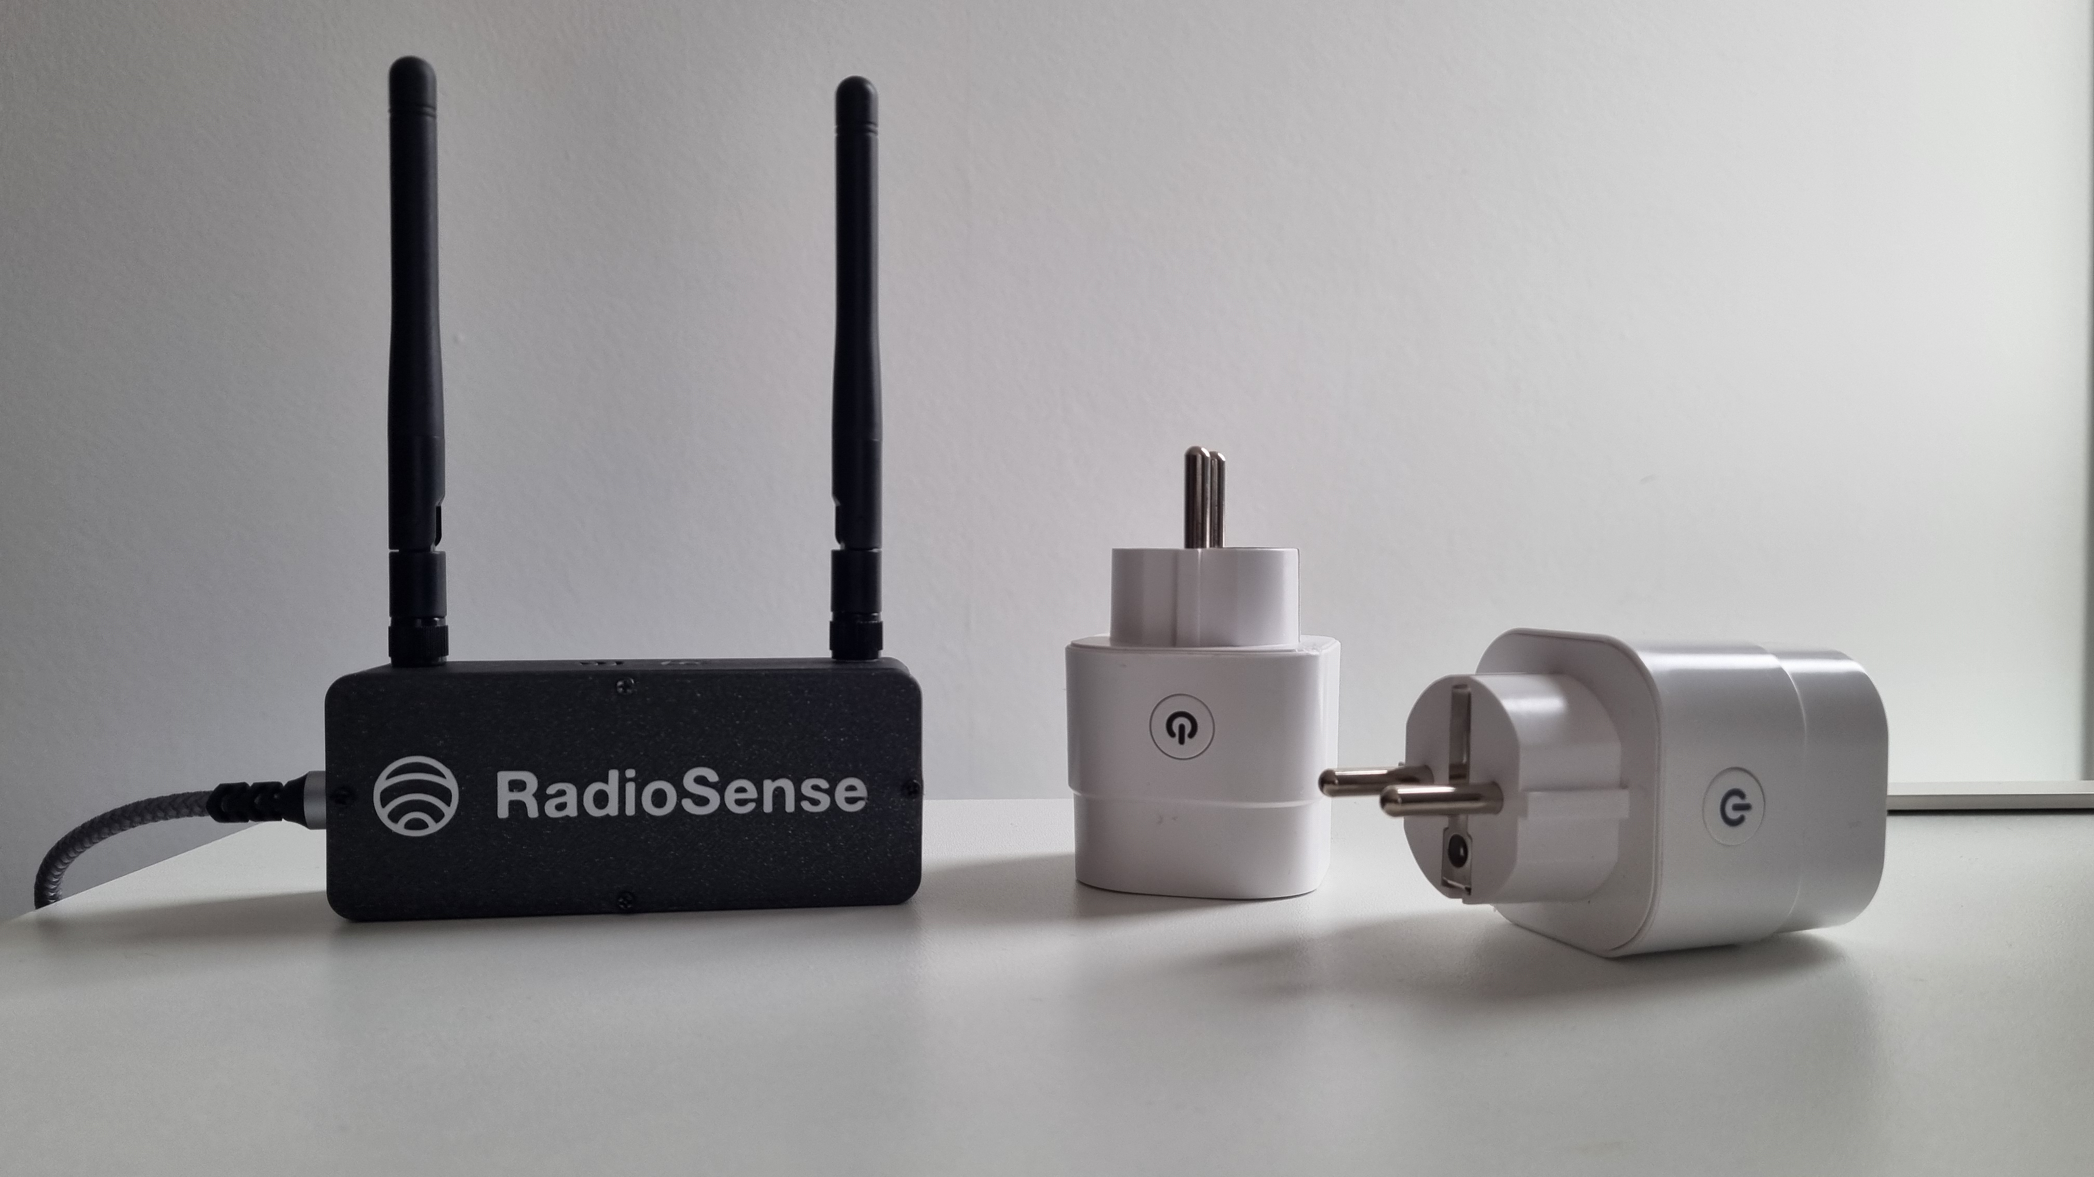
How it works
We turn ambient radio signals into a real-time motion sensor — without cameras or wearables.
WiFi Signals
Bounce through rooms
Signal Capture
CSI at PHY layer
AI Processing
Pattern recognition
Events & Alerts
Presence, anomalies
›
›
›
Extracting meaning from noise
We process raw CSI data to extract stable features from noisy WiFi signals.
We measure how people affect the radio field
Turning signals into behaviour
Signal changes become micro-movements, motion patterns, and activity states.
AI + temporal logic distinguish real events from noise
Context awareness
Detecting patterns: routine vs. deviation, normal activity vs. abnormal events.
Reduces false alarms — critical for real-world use
Starts as a plug-and-play device. Built to run on the network itself.
That transition is massively scalable.
Notes:
⏱ 3:45 to 4:20
So how does that become a product? Four steps.
First, the radio. Every human body reflects and blocks radio waves, so anyone moving through a room changes the signal between two radios.
Second, we read that change. We add no sensors; we take the channel information the network already produces.
Third, AI turns that channel pattern into something meaningful: presence, movement and activity patterns.
Fourth, everything runs at the edge, on the device itself. What leaves the device is a signal feature and an event. Never an image, never audio.
Think of it this way: the room already has an echo. We learned to read the echo instead of taking a picture.

Slide 7
Device-free is the whole point
Most indoor monitoring assumes the person carries something. Device-free sensing drops that assumption.
DEVICE BASED
DEVICE FREE
The person is the transmitter
The environment is the sensor
Phones, tags, wearables, pendants
Accurate when worn and charged
Useless when forgotten, refused or lost
Coverage depends on behaviour you cannot control
The person carries nothing
Detection comes from how a body perturbs radio waves already in the space
Nothing to forget, charge or refuse
Coverage depends on the network, not on compliance
VS
WHY IT MATTERS
Dementia, night-time falls, visitors, intruders. The cases where a wearable is absent are exactly the cases with the highest value.
Coverage stops depending on compliance and starts depending on the network.
Notes:
⏱ 4:20 to 4:50
There is one word in all of this that matters more than the others: device-free.
Most sensing today is device-based. The person is the transmitter: a phone, a tag, a pendant. It is accurate when worn and charged. It is useless when forgotten, refused or lost. My grandfather's alarm button was device-based.
Device-free flips it around. The environment is the sensor, and the person carries nothing. Coverage no longer depends on compliance. It depends on the network, and the network is always there.
Think about where a wearable is missing: someone with dementia, a fall at night on the way to the bathroom, a visitor, an intruder. The cases where a wearable is absent are exactly the cases with the highest value.

Slide 8
JCAS: one radio, two jobs
Joint Communication and Sensing, also called ISAC, is the formal name for what we have just described.
ONE WAVEFORM
COMMUNICATION
SENSING
Carries the data
Reads the environment
Moves bits from A to B. This is what every network was built for and still does.
The same transmission doubles as a radar-like probe of the room. Same packet, second reading.
No separate emitter
No extra spectrum
No dedicated sensor
Native in 5G and 6G
JCAS turns every access point and base station into a potential sensor.
Notes:
⏱ 4:50 to 5:20
What I have just described has a formal name: JCAS, Joint Communication and Sensing. In the mobile world you will also hear ISAC, Integrated Sensing and Communication. Same idea.
One waveform, two jobs. The same transmission that carries your data doubles as a radar-like probe of the room. No separate emitter, no extra spectrum, no dedicated sensor.
And here is the important shift. In 5G Advanced and 6G this is not an add-on. It is a native function of the network. Every access point and every base station becomes a potential sensor.
The difference with radar is simple: radar dedicates spectrum and hardware to sensing. JCAS reuses the communication signal. That reuse is what makes it cheap enough to be everywhere.

Slide 9
No longer research. It is in the standards.
Sensing has moved from university labs into the documents that vendors build products against.
2025
DEC 2025
2026 to 2027
2028 and beyond
IEEE 802.11bf
3GPP RELEASE 19
3GPP RELEASE 20
3GPP RELEASE 21
WiFi sensing is a published standard
ISAC enters the mobile spec
Architecture work is running now
First 6G specifications
Approved in May, published in September 2025. Defines how WLAN devices negotiate and report sensing measurements, sub 7 GHz up to 60 GHz.
Service requirements (TS 22.137), 30+ use cases (TR 22.837) and sensing channel models. Release 19 frozen in December 2025.
5G Advanced sensing architecture, plus 6G studies with 23 accepted ISAC use cases. Technical reports as outcome.
The first normative 6G specs. Sensing designed in from day one rather than retrofitted onto a communication system.
When sensing ships inside the standard, it ships inside every access point.
Notes:
⏱ 5:20 to 5:50
You may be thinking: this sounds like research. It is not. It is in the standards.
IEEE 802.11bf, WiFi sensing, was approved in May 2025 and published in September 2025. WiFi sensing is a published international standard, not a lab project.
On the mobile side, 3GPP Release 19 defined the service requirements and channel models for ISAC, and was frozen in December 2025. Release 20 is running right now: the architecture work for 5G Advanced, plus the first 6G studies. Release 21 will bring the first 6G specifications.
What this means for you: when sensing ships inside the standard, it ships inside every access point. Vendors will build it whether or not we exist.
The question is no longer whether networks will sense. The question is who owns the software and the service on top.
Sources: IEEE 802.11bf-2025; 3GPP TS 22.137, TR 22.837, TR 23.700-14; 3GPP Release 20 and 21 planning.

Slide 10
What it can do, and what it cannot
Being honest about the limits is what makes the capability credible.
THE PHYSICS ALLOWS
THE PHYSICS DOES NOT ALLOW
✓
Sensing presence and motion, room by room
✕
Identify who is in the room
✓
Telling motion types apart by their signature
✕
Capture an image, a face or a voice
✓
Learning what normal looks like in a space
✕
Read a screen, a document or a conversation
✓
Noticing change, including the absence of it
✕
Store anything a human could recognise
THE HONEST PART: ROOM LEVEL, NOT PIXEL LEVEL
Resolution depends on bandwidth, antennas and geometry. Calibration per environment matters, and false alarm management is the real engineering work.
The limit is also the feature. You cannot leak what you never measured.
Notes:
⏱ 5:50 to 6:20
Let me be very clear about what this technology can and cannot do, because that is what makes the rest of this talk believable.
It can tell you whether a room, a bed or a zone is occupied. Whether someone moves, and how much. Whether the pattern is normal for this person at this hour. And whether an event was followed by silence.
It cannot identify who is there. It cannot capture an image, a face or a voice. It cannot read a screen or a conversation. And it stores nothing a human being could recognise.
The honest part: this is room level, not pixel level. Resolution depends on bandwidth, antennas and geometry. Every environment needs calibration, and managing false alarms is where the real engineering work goes.
But the limit is also the feature. You cannot leak what you never measured.

Slide 11
Safety without surveillance
Most monitoring asks people to trade privacy for safety. This category does not have to.
NOTHING TO EXPOSE
EDGE FIRST
DIGNITY BY DEFAULT
Not human readable
Processed in the room
Works where cameras cannot
What leaves the sensor is signal features and events, not a recording. There is no footage to leak, subpoena, resell or accidentally publish.
Signal analysis runs locally on embedded hardware. Only events cross the network, which keeps bandwidth, latency and data exposure low at once.
The rooms with the highest risk are the rooms cameras can never enter. Device-free sensing clears residents and works councils there.
Not a softer camera. A different category, with a different social licence.
Notes:
⏱ 6:20 to 6:50
Which brings me to the title of this keynote: safety without surveillance. Three reasons why this is not a softer camera, but a different category.
One: there is nothing to expose. What leaves the sensor is signal features and events, not a recording. There is no footage to leak, to subpoena, to resell, or to publish by accident.
Two: edge first. The analysis runs locally on embedded hardware. Only events cross the network. Low bandwidth, low latency and low data exposure, all in one design decision.
Three: dignity by default. The rooms with the highest risk, the bedroom and the bathroom, are exactly the rooms a camera can never enter. This is what gets a yes from residents, from families and from works councils.
Not a softer camera. A different category, with a different social licence. So why did this only become possible now?

Slide 12
Why this is possible now
Three technical shifts turned an old physics effect into something a network can actually ship.
01
02
03
EDGE AI
EMBEDDED COMPUTING
NEXT GENERATION CONNECTIVITY
Inference fits in an access point
The measurement is already exposed
More bandwidth, more antennas
Models that needed a server five years ago now run on the embedded chip inside network gear. Raw signal never has to leave the room to be understood.
Commodity WiFi chipsets expose CSI to software. Sensing becomes a firmware and software question, not a hardware programme.
WiFi 6 and 7, 5G Advanced and 6G bring wider channels and MIMO arrays. Wider and more means finer resolution, from the same radios.
The demand side was always there. The supply side arrived in the last five years.
Together they make sensing a network function instead of a research project.
Notes:
⏱ 6:50 to 7:20
The physics has been known for decades. Three things changed in the last five years.
Edge AI. Models that needed a server five years ago now run on the chip inside an access point. The raw signal never has to leave the room to be understood.
Embedded computing. Commodity WiFi chipsets now expose channel information to software. That turns sensing into a firmware and software question, not a hardware programme.
Next generation connectivity. WiFi 6 and 7, 5G Advanced and 6G bring wider channels and more antennas. Wider and more means finer resolution, from the same radios.
The demand side, ageing, staff shortages, privacy pressure, was always there. The supply side arrived in the last five years. So what does it deliver today?

Slide 13
What we can detect today
Five live capabilities. One privacy-first platform. No cameras, no wearables.
01
02
03
Presence detection
Bed occupancy
Activity level
Know whether a room, bed or zone is occupied, in real time.
Detect when someone is in bed, has left, or has not returned. Critical for night care.
Classify low vs. high activity per space, continuously, across every room.
04
05
READY TODAY
Running with real customers.
Pattern deviation
Silence alert
Learn each person's baseline and flag deviations that may signal a problem.
Get notified when an event is followed by unusual silence. Our most actionable warning.
Live in real environments today.
Notes:
⏱ 7:20 to 7:50
This is what our system detects today, in real buildings, with real residents.
Presence and occupancy: is someone in the room, in the bed, in the zone. Activity levels, and abnormality detection: deviations from the normal pattern, and unusual stillness after an event.
Take the night-time case. Someone gets up at night and does not return to bed. The system sees a sharp change followed by stillness, in a place and at a time where stillness is not normal — an abnormal event. Within minutes a care worker gets an alert. Nobody had to press anything.
And notice what is not on this list. It does not identify who you are. It sees that a person is there and how they move. Not a face, not a name.

Slide 14
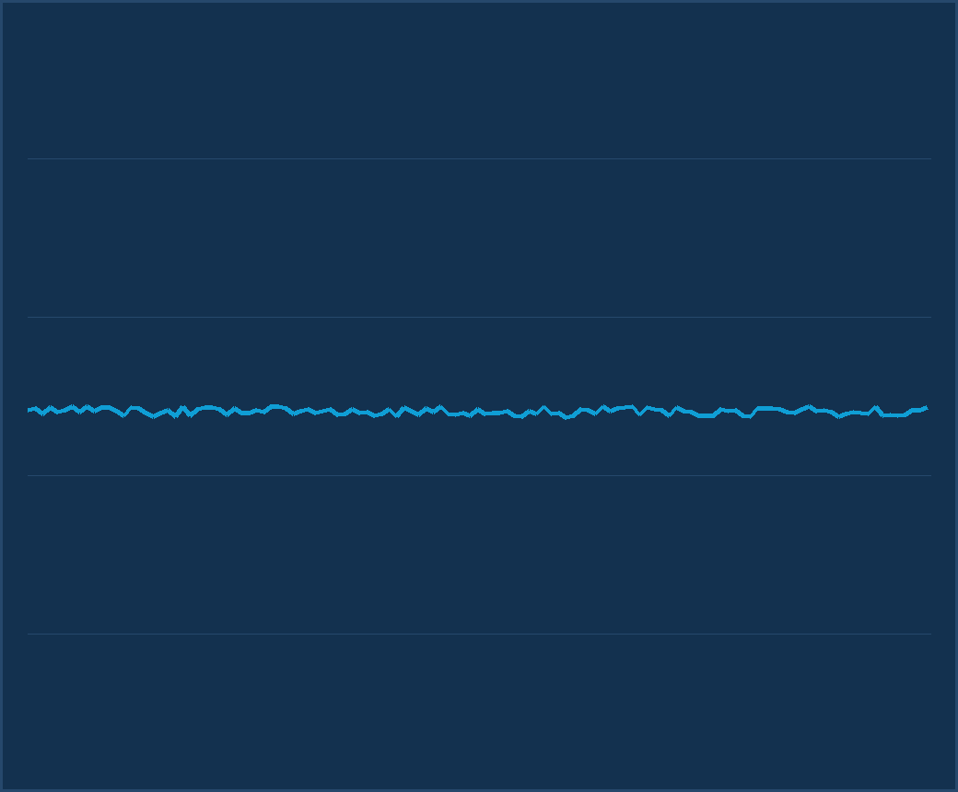
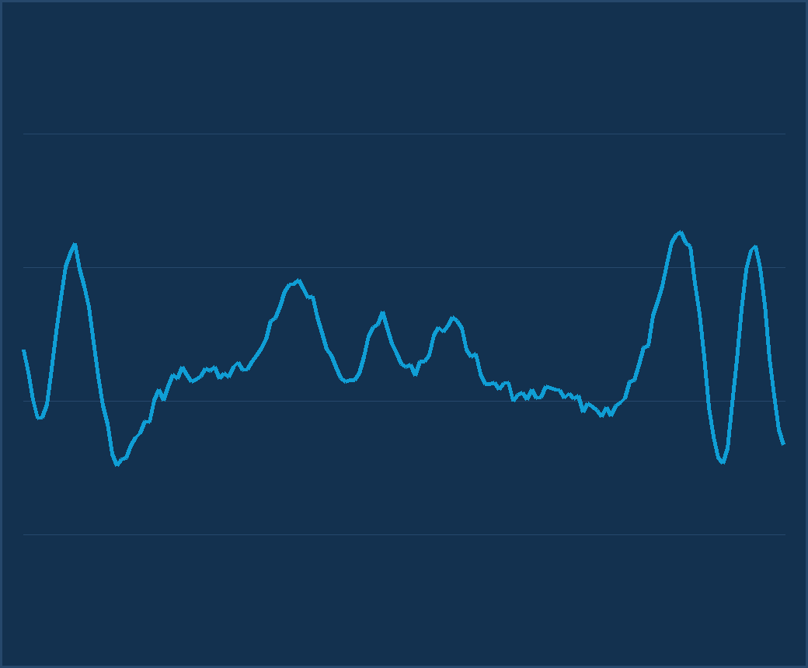
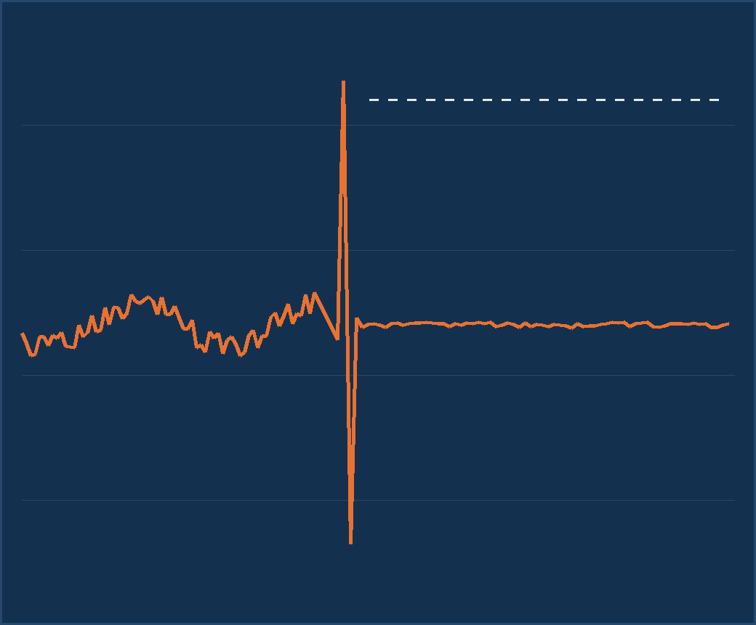
See it in action
One scenario, three moments: how an abnormal event becomes an alert. From WiFi alone.
EMPTY ROOM
A calm, flat signal. Nothing to report.
SOMEONE WALKS IN
The pattern comes alive. Presence flips within seconds.
ABNORMAL EVENT
A sharp change, then unusual stillness. That combination raises the alert.
WiFi sensing, no cameras, no wearables.
Notes:
⏱ 7:50 to 8:35
You have just heard what it detects. Now let me show you.
What you see here is an empty room. Nothing on the screen but a flat signal. Now a person walks in, and presence flips. You can see the movement in the pattern.
The person sits down. The movement settles, but the presence stays. This is what a quiet evening looks like.
And now an abnormal event. A sharp change, followed by stillness, in a place where stillness is not normal. That combination is what triggers the alert.
Look at the screen once more. There is nothing on it that could tell you who this person is. No image, no face, no voice. Only the fact that someone is there and what happened to them.
Everything you just saw runs on an ordinary access point. The hard part is not detection. The hard part is what real environments demand of it.
Walk the three panels left to right; end on the alert combination.

Slide 15
What real environments demand
Detection is the easy part. These three decide whether a pilot ever becomes a deployment.
01
PRIVACY BY DESIGN
Data minimisation in the architecture, a DPIA ready on day one. Retrofitting this later is what stalls projects.
Documented before the first pilot
02
RELIABILITY
Stable across layouts, furniture and people. False alarms managed and measured, not accuracy claimed in a lab.
Trustworthy in real, messy rooms
03
INTEROPERABILITY
API first and event driven. Vendor neutral across nurse call, SOC and building management.
Fits the platforms in place
Privacy, reliability and integration decide adoption, not detection demos.
Notes:
⏱ 8:35 to 9:05
This is the slide that separates a demo from a product. Three gates every deployment has to pass.
Privacy by design. You have heard why. Here it is a checklist item: data minimisation built into the architecture, and a data protection impact assessment ready before the first pilot. Retrofitting this later is what stalls projects.
Reliability. A lab number means nothing. Real rooms have furniture that moves, doors that open, pets, visitors. The metric that matters to an operator is false alarms per week, not accuracy in a paper.
Interoperability. Nobody buys another dashboard. Events have to land in the care platform, the security operations centre or the building management system that is already in use.
Privacy, reliability and integration decide adoption. Not detection demos.

Slide 16
One platform. Three high-impact sectors.
One sensing platform, tailored to environments where privacy and reliability are non-negotiable.
01
02
03
HEALTHCARE
SECURITY
FACILITY MANAGEMENT
Silent, dignified monitoring
See movement where cameras can't
Occupancy you can actually trust
Presence and bed occupancy in care rooms
Abnormality detection without cameras or wearables
Deviation alerts from daily patterns
Intrusion detection through walls, in low light
No blind spots from lens coverage or placement
Zero imagery stored, GDPR-friendly by design
Real-time room and zone utilization
Data-driven cleaning, HVAC and space planning
No hardware per room, uses existing WiFi
Different environments, same platform, one partner.
Notes:
⏱ 9:05 to 9:40
Same platform, three very different buyers. The technology travels.
Elderly care. Dignity is the selling point. Nothing worn, nothing filmed, and a family that hears about an abnormal situation in minutes instead of hours. This is where my grandfather would have been found the same evening, not the next morning.
Smart buildings. Real occupancy instead of badge data. Cleaning, heating and space planning follow actual use, and the payback shows up in square metres and energy.
Security. Presence detection where cameras are not allowed or not effective: in the dark, behind partitions, without blind spots. And for critical infrastructure and defence sites, perimeter and interior monitoring without optics is exactly what they ask for. Same signal, stricter rules.
Three markets, one platform. That is why the business model matters more than the demo.

Slide 17
Critical infrastructure and dual use
The capability that keeps a resident safe at night also protects a substation at three in the morning.
01
UNMANNED SITES
Substations, pumping stations, data halls, telecom huts. Detection through walls and in darkness, on the network already there for telemetry.
Presence where no one should be
02
RESILIENCE
No lens to blind, cover, fog or spray. Sensing degrades differently from cameras, which is exactly why it works as a second, independent layer.
It does not fail like optics
03
RESPONSIBLE DUAL USE
Defence and public safety interest is real, and so is the duty to define acceptable use, export posture and oversight before the technology scales.
Capability with guardrails
Dual use is an opportunity and a governance question.
Notes:
⏱ 9:40 to 10:10
I want to address dual use openly, because the same capability that protects a resident also protects a substation.
Critical infrastructure means presence where no one should be. At night, in unmanned locations, inside buildings where cameras are blind or banned. Perimeter tools stop at the fence. This works inside.
And that is where dual use begins. The technology is neutral. The deployment is not. We choose our partners and use cases deliberately, and we say no when the purpose is monitoring people against their own interest.
Dual use is an opportunity and a governance question. Both belong on the same slide.

Slide 18
From dedicated deployments to a network feature
Three revenue models, in the order the market will reach them. Each step needs less hardware and reaches more sites.
03
02
01
EMBEDDED IN NETWORKS
SOFTWARE LICENSING
Shipped inside the hardware, as sensing silicon arrives
SENSING AS A SERVICE
Licensed to platform owners, as the ecosystem opens
Subscription per site, today
Dedicated sensing device per zone, live in days
Fastest route to revenue, proves the use case
Same software on enterprise access points
Margin without hardware risk, broader coverage
Routers, access points, 5G and 6G base stations
Sensing becomes a standard network feature
VALUE CAPTURED PER DEPLOYMENT
One platform, sold as a service, then a licence, then a built in capability. The investment compounds, it does not reset.
Notes:
⏱ 10:10 to 10:50
So how does this become a business? In three steps.
Today: sensing as a service. A dedicated device per zone, a subscription per site, live within days. It proves the use case and it pays for itself. But it does not scale to millions of rooms.
Next: software licensing. The same software runs on enterprise access points that are already on the ceiling. Margin without hardware risk, coverage without installers.
Then: embedded. Sensing ships inside routers, access points and base stations as a standard feature, the way WiFi once shipped inside laptops.
Service, then licence, then built-in capability. Every step needs less hardware and reaches more sites. The investment compounds.

Slide 19
Who wins in the sensing value chain
Every layer of the wireless value chain can add a revenue line. Our view of where the value lands.
NETWORK OPERATORS
HARDWARE MAKERS
INTEGRATORS AND SERVICES
Sensing bundled with connectivity
Sensing as a product feature
Vertical solutions and response
More value per managed site
Differentiation beyond bandwidth
Software value on shipped silicon
In line with 802.11bf and 3GPP ISAC
Care, buildings, security delivery
Recurring service contracts
ONE PLATFORM, MANY BENEFICIARIES
No new infrastructure needs building. The value chain already exists.
Notes:
⏱ 10:50 to 11:20
Who earns from this? Let me walk the chain.
Network operators own the access points and the customer relationship. Sensing turns connectivity into a service they can charge for, and it lowers churn, because a network that keeps people safe is a network you do not switch away from.
Hardware manufacturers get a new reason to refresh the estate. Sensing becomes a line on the data sheet and a differentiator against boxes that all look the same.
Integrators and service providers turn events into outcomes: care response, security response, building operations. That is where the recurring margin lives.
And nobody in this chain has to build new infrastructure. The sensors are already on the wall. We are unlocking them.
This is RadioSense's own view of the value chain, not third-party market data. Standards references: see slide 9.

Slide 20
Fits into your stack, not around it
Alerts and events flow straight into the tools your team already uses.
YOUR INFRASTRUCTURE
RADIOSENSE
YOUR TOOLS
Existing infrastructure
Edge + API
Your stack
Standard access points
Your current network gear
No new hardware per room
Privacy-first signal processing
Events, anomalies and alerts
Days to integrate, not months
Care platforms
SOC dashboards
BMS and facility apps
Sensing is a new input for the systems you already operate, not a new system to operate.
Nurse call, SOC and building management keep their workflows; they simply gain a signal they never had.
Notes:
⏱ 11:20 to 11:40
One more practical point. We do not replace the platform you already run.
Events go out over standard interfaces into the nurse call system, the building management system or the security system that is already on the wall. Your people keep working in the tools they know.
So what should you remember when you walk out of here?

Slide 21
Three things to take away
If you remember nothing else from this session, remember these.
1
The infrastructure is already there.
Billions of access points are deployed, powered and connected. Sensing is software on hardware someone else already paid for.
2
The standards have landed.
802.11bf is published and ISAC sits inside the 3GPP roadmap. Sensing becomes a feature vendors ship, not a project researchers run.
3
Privacy is the wedge.
The winning products never collect what they do not need. That is a design decision taken now, not a policy bolted on later.
The network you already own is the sensing layer you have not switched on yet.
Notes:
⏱ 11:40 to 12:40
Three things to take with you.
One. The infrastructure is already there. Billions of access points, powered and connected. Sensing is software on hardware that someone else has already paid for.
Two. The standards have landed. 802.11bf is published, ISAC is on the 3GPP roadmap. Sensing becomes a feature that vendors ship, not a project that researchers run.
Three. Privacy is the wedge, not the obstacle. The winning products never collect what they do not need. That is a design decision you take now, not a policy you bolt on later.
The network you already own is the sensing layer you have not switched on yet.

Slide 22

Want to see it live in action? Get in touch.
www.radiosense.tech
SCAN TO CONNECT
+31 6 2170 4137
Fabian@radiosense.tech
Rotterdam, The Netherlands
Privacy-first WiFi sensing for healthcare, security and facility management.
Notes:
⏱ 12:40 to 13:30
Let me come back to where I started.
I began with a question on a campsite: could the network see my wife sleeping safely? And with my grandfather, 97 years old, still living on his own, who fell several times without being able to press a button.
That is the company in one sentence: a curiosity that met a reason.
For him, and for millions of people like him, we build RadioSense. Technology should protect people without taking away their dignity or their privacy.
If you want to be part of that, there are three ways to start: a pilot site, an access point partnership, or an integration into the care or security platform you already run. My details are on the screen. And if you want to see it live in action, get in touch: we will show it running in your own environment.
The networks around us are already there. It is time they start protecting us. Thank you.

