Slide 1
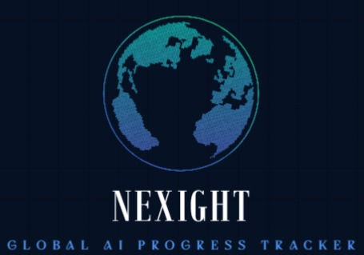
Notes:
Greetings everyone! We’re excited to introduce NEXIGHT, its a live dashboard that tracks the heartbeat of Artificial Intelligence globally.

Slide 2

GLOBAL AI PROGRESS TRACKER
Tracking the heartbeat of Artificial Intelligence in real time.
Tagline: The Race of Intelligence Has Begun
Built with Base44
Notes:
AI is advancing at a pace faster than most of us can follow. Our goal is to give everyone — researchers, policymakers, and the public — a real-time lens into AI progress.

Slide 3

Problem Statement – The Blind Spot in AI Progress Tracking
Current AI monitoring relies on static reports and expert opinions.
No real-time global system tracks AI model performance, research velocity, or compute growth.
Policymakers and researchers are flying blind into an AI-driven future.
Visual: Graph showing AI capabilities rising vs. tracking flatlined.
Notes:
Here’s the problem: AI is moving faster than society can track it. Right now, monitoring relies on static reports or expert guesses. There’s no live system showing which AI fields are accelerating, how models are improving, or when transformative milestones might occur. This creates blind spots that affect AI safety, governance, and preparedness.

Slide 4
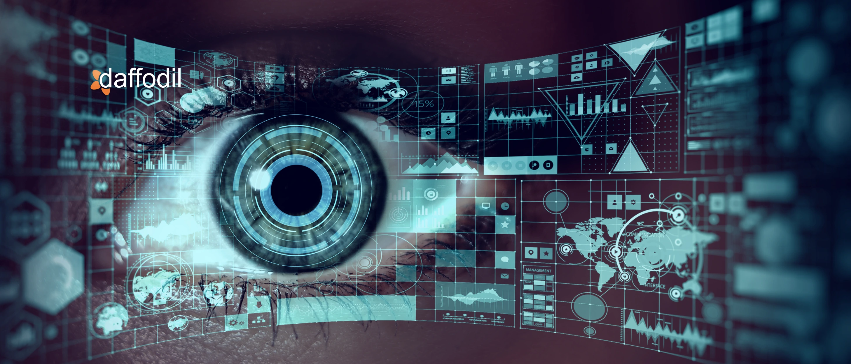
Solution — NEXIGHT
Nexight is a live dashboard that tracks, analyzes, and forecasts global AI progress using open data and interpretable models.
Features:
AI Acceleration Score (0–100)
Trend graphs for research, compute, and performance
Forecasts for next capability jumps
Policy insight summaries
Visual: Dashboard mockup
Notes:
Our solution is NEXIGHT— a real-time dashboard that tracks, analyzes, and forecasts AI progress. It aggregates data from research publications, model benchmarks, compute estimates, and industry activity. Then, it gives an AI Acceleration Score, predicts upcoming capability jumps, and even issues early warnings for breakthroughs

Slide 5

Technologies Used
• Frontend: Base44 (interactive web app framework)
• Data Sources: arXiv, HuggingFace, PapersWithCode, EpochAI, SemiAnalysis
• Data Layer: CSV/API ingestion for research, compute, benchmarks
• Forecasting Models: Trend extrapolation, scaling laws, anomaly detection
• Visualization: D3.js or Base44 built-in charts
Visual: Data → Engine → Dashboard flow diagram
Notes:
Here’s how it works:
First, the Data Aggregation Layer collects info from sources like arXiv, HuggingFace, and PapersWithCode.
Second, the Forecasting Engine uses trend extrapolation, scaling laws, and anomaly detection to estimate AI growth rates.
Finally, our interactive dashboard, built in Base44, visualizes trends, forecasts, and early-warning alerts, all in one place. Optional policy insights can guide decision-makers using these forecasts

Slide 6
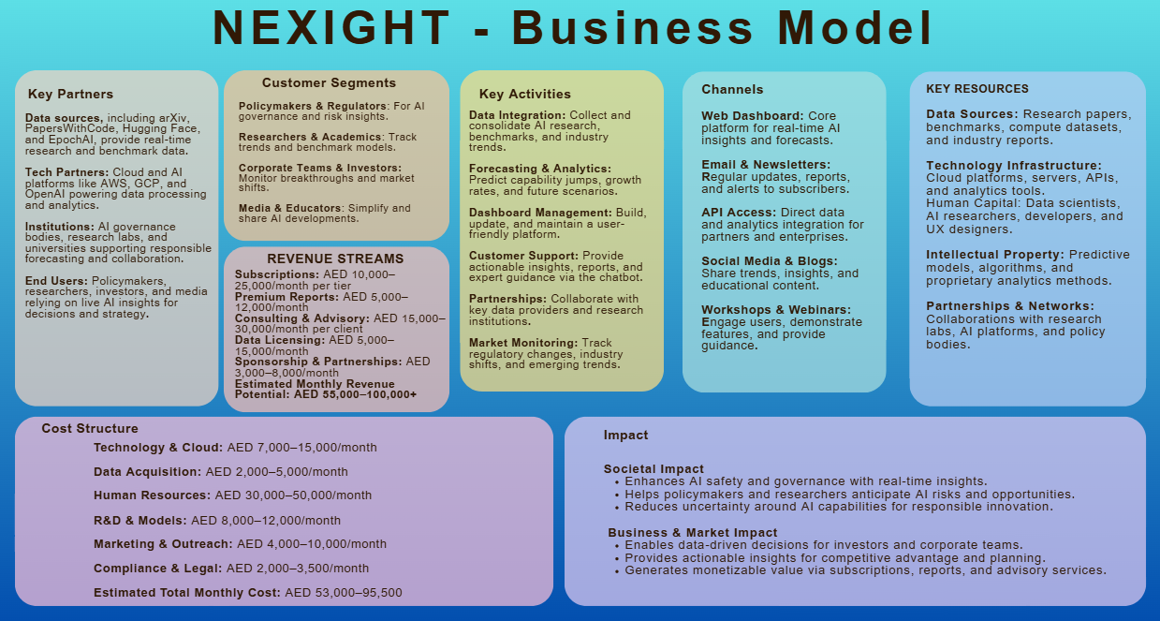
Notes:
From Hackathon Prototype to Global AI Observatory"
Script: Looking beyond the hackathon, AI Pulse can grow into a Global AI Observatory. We envision a freemium model with free data access and premium analytics for enterprises and governments. We can also provide API access, scenario forecasting consulting, and partnerships with AI labs and research organizations.

Slide 7
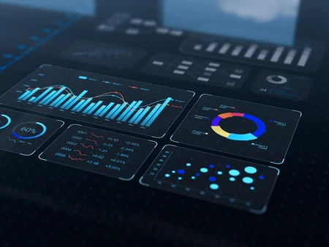
The Future of AI Monitoring
AI Pulse will evolve into a Global AI Observatory — a trusted platform merging real-time data, forecasting, and policy insights to keep humanity aligned with the pace of Artificial Intelligence.
Visual: Futuristic skyline, AI horizon, glowing neural network path
Notes:
In the future, NEXIGHT will become a trusted platform combining real-time data, forecasting, and policy insights. It will help humanity stay aligned with the pace of AI, anticipate transformative events, and make informed, responsible decisions. Think of it as a compass in the AI revolution.

Slide 8

Join the Mission to Keep AI Accountable.
AI is rewriting the world — let's ensure we understand every chapter.
We can’t slow down AI but we can increase awareness
Notes:
AI is rewriting the world — let’s make sure we understand every chapter. We can’t slow down AI, but we can increase awareness, build transparency, and guide progress responsibly. Join us on this mission. Thank you!

Slide 9

project ParaDOX

