Slide 1


Connected Intelligence at the Edge: Making AI Work Beyond the Cloud
Adam Cousin
Sales & Business Development Manager, IoT Solutions, EMEA
Notes:
Good morning everyone.
My name is Adam Cousin, and I am the Sales & Business Development Manager IoT Solutions EMEA at Telit Cinterion.
Today I would like to talk about a topic that is becoming increasingly important as artificial intelligence leaves the laboratory and enters real-world products: how to make AI work when the cloud is not the perfect answer.
When we talk about artificial intelligence, we often assume that connectivity is always available, bandwidth is abundant, and data can be sent to the cloud whenever needed.
That assumption has shaped a large part of the AI ecosystem. We collect data, we send it to centralized infrastructure, we process it, and we turn it into decisions, recommendations, alerts, or predictions. In many contexts, this architecture works extremely well. It has enabled remarkable progress, and it will continue to be essential.

Slide 2





A Full IoT Stack
Secure Solutions for Real-World Applications
IoT Modules
IoT Solutions
IoT Connectivity
IoT Platforms
Broad portfolio of secure, bespoke, cellular IoT modules
Enable manufacturers to design and launch IoT devices in multiple markets and geographies
Covers 5G, 4G, LPWA, GNSS, WiFi and Bluetooth
Supports customers through the design, certification and production processes
Integrated industry-focused IoT solutions incorporating cellular connectivity, including cellular gateways and data cards
Software and hardware R&D, design and engineering expertise
Regulatory approvals and carrier certifications
Scalable, outsourced manufacturing
Operates as a Mobile Virtual Network Operator (MVNO)
Unlimited secure access to over 600 mobile carriers in over 200 countries
Comprehensive SIM management tools
2G, 3G, 4G and 5G (inc. Cat-M, NB-IoT and VoLTE)
Global distribution of SIM cards and eSIMs with dynamic multi-profiles
Software platforms used to manage IoT deployments - used in factories for industry 4.0 applications
Integrates equipment to MES, ERP, SCADA etc – over 100 native drivers
Enables real-time quality control, preventative/predictive maintenance and AI integrations
Customer base includes 30 Fortune 100 companies
OPTIMIZED FOR A BROAD RANGE OF USE CASES
SMART BUILDING
SMART ENERGY & UTILITIES
SECURITY & SURVEILLANCE
HEALTHCARE
AGRICULTURE
SMART FACTORY
SMART CITIES & TRANSPORTATION
RETAIL
INDUSTRY 4.0
SMART HOME
¹Source: Counterpoint. Market share data excluding China market, Automotive and PC OEM markets
Notes:
We offer a secure, comprehensive IoT stack: modules, connectivity, platforms, and solutions.
Our portfolio covers 5G, 4G, LPWA, GNSS, WiFi, and Bluetooth.
We support customers through design, certification, and production.
Our solutions are optimized for a broad range of real-world applications.

Slide 3
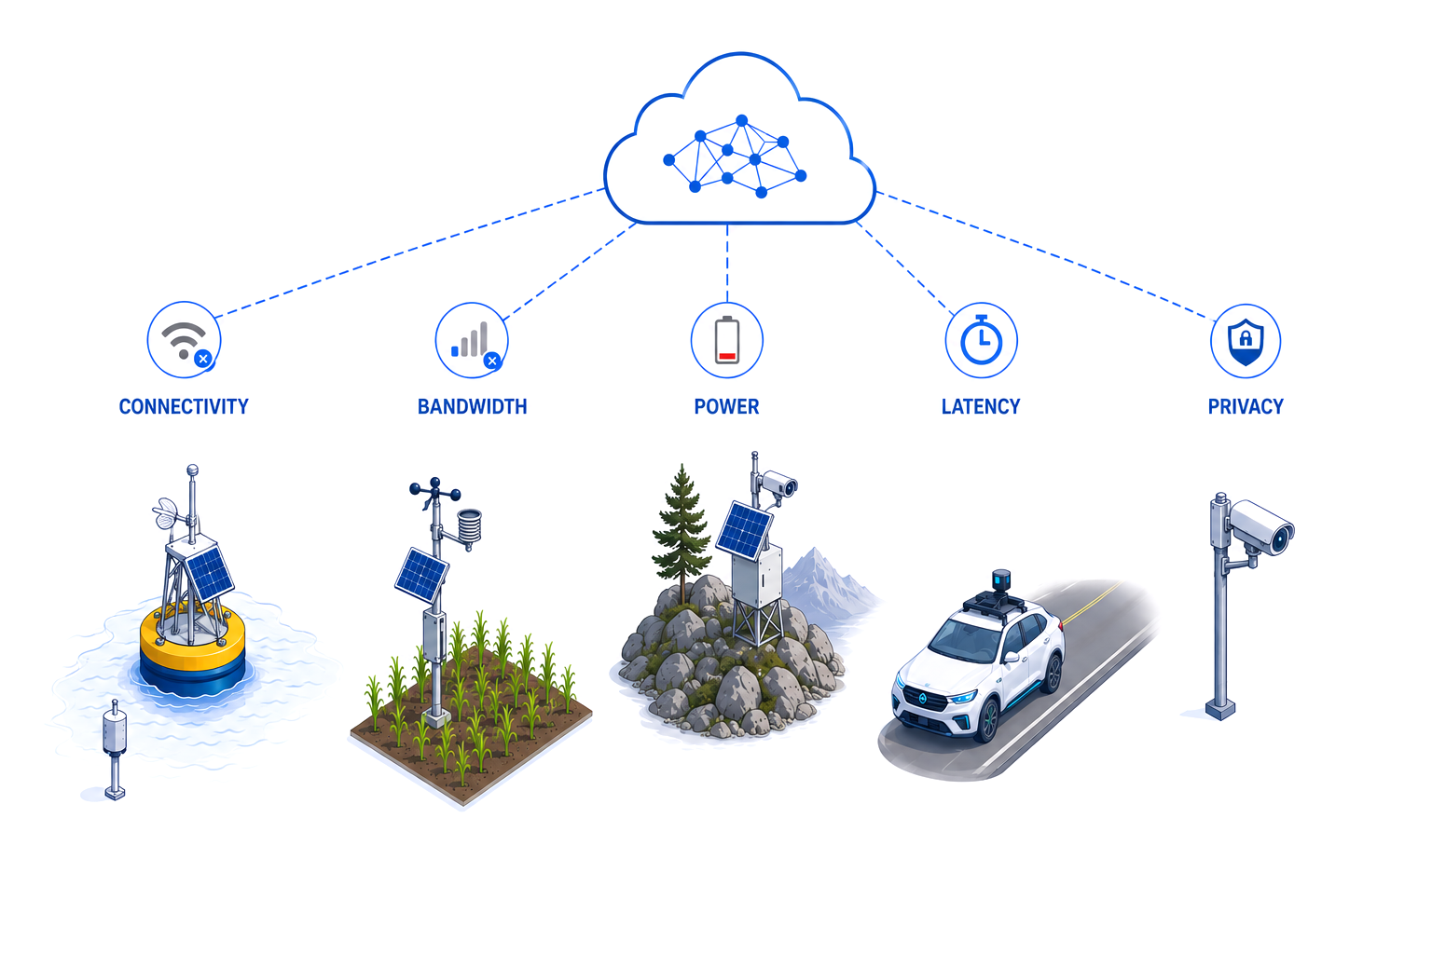
When Reality Challenges Cloud-First AI
Remote Offshore Deployment
Rural Infrastructure
Battery-powered
Systems
Real-Time
Decisions
Privacy Regulated
Data
Notes:
Yet for a large part of the world, this assumption does not hold.
In many real-world scenarios, cloud-centric AI systems are not viable due to latency, bandwidth, cost, or infrastructure constraints.
There are environments where connectivity is intermittent. There are locations where high-speed networks are unavailable. There are applications where waiting for a round trip to the cloud is simply not acceptable. And there are communities where connectivity remains a scarce resource that must be used carefully. Power may be constrained.
In those environments, a cloud-centric AI architecture can quickly become fragile.
If a system depends on sending every measurement, every image, every signal, or every event to a remote infrastructure before it can act, then the quality of the decision is tied to the quality of the connection. And in many applications, that is not acceptable.
A delayed response may reduce the value of the information, or make it useless.
Continuous streams of data can be technically impractical or economically unsustainable. Think about what Brad Smith from Microsoft said on Tuesdays openings about AI adoption in the global south and its relation with electricity infrastructure. I would argue, that reliable high bandwidth connectivity is another main missing block. As someone said the same day, 2.2 billion of people are offline at the moment.
Power consumption matters, and guess what, communication if often one of the most expensive operations for a small device deployed in the field, especially when the network does not behave as expected.
This reality forces us to rethink not only where intelligence runs, but also how information moves across a system.
Rather than seeing the edge as a smaller version of the cloud, I prefer to consider it a different engineering environment, with its own constraints, opportunities, and design choices.

Slide 4
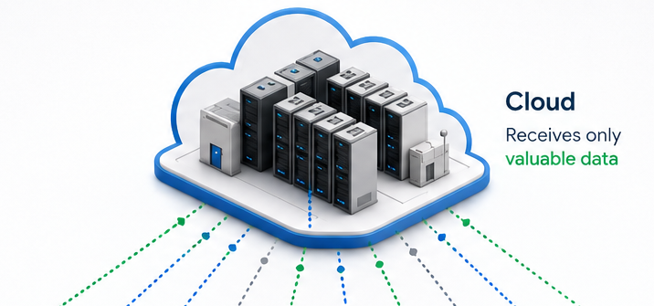
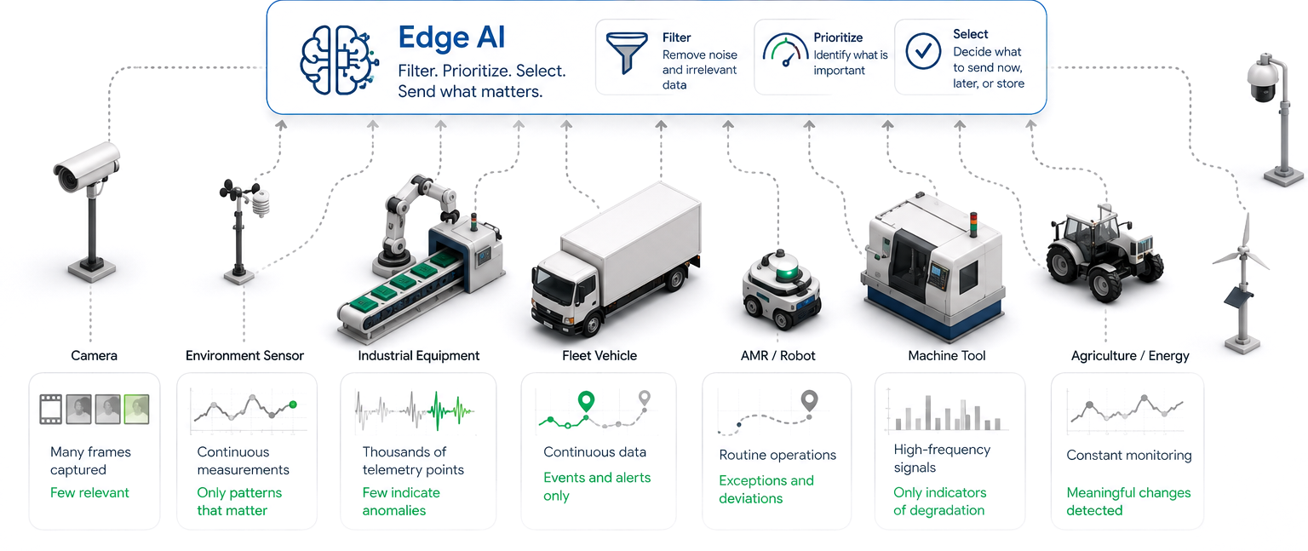

Edge AI Filters The Noise
Notes:
Over the last decade, we have witnessed tremendous progress in both AI and connectivity technologies. At the same time, these domains have often been considered independently.
Today, I want to discuss with you how communication, computation, and intelligence must be balanced to build effective systems.
The point is not to move everything away from the cloud. That would be an oversimplification.
The cloud remains critical for large-scale analytics, coordination, long-term storage, fleet management, model improvement, and integration with broader enterprise or public systems.
The real question is different.
Which decisions need to be made locally?
Which data needs to be transmitted immediately?
Which information can be summarized, compressed, delayed, or discarded?
Which events are important enough to justify communication when connectivity is limited or costly?
Traditionally, connected systems were designed with a simple idea in mind: collect data and move it somewhere else for analysis. Today, however, sensors are everywhere.
A camera installed in a remote location may generate continuous video, but only a few frames may contain relevant information. An environmental sensor may record measurements every few seconds, but only certain patterns may indicate a meaningful change. Industrial equipment may produce thousands of telemetry points, while only a small number of combinations may signal degradation, abnormal behavior, or the need for intervention.
You can see here that the challenge is identifying what matters, because not every measurement requires a transmission.
Not every image needs to be uploaded.
Not every event deserves a connection to the cloud.
In this context, Edge AI becomes a mechanism for filtering, prioritizing, and selecting information, to determine which information is valuable enough to communicate. It can distinguish routine behavior from anomalies. It can reduce noise before the data reaches the network. It can decide that some information should be transmitted immediately, while other information can be stored locally, aggregated, or sent later.
An intelligent system may observe thousands of events while transmitting only a handful of meaningful ones; instead of continuously sending raw data, it can transmit insights.
The edge gives the system local awareness. The cloud gives it a broader view.

Slide 5
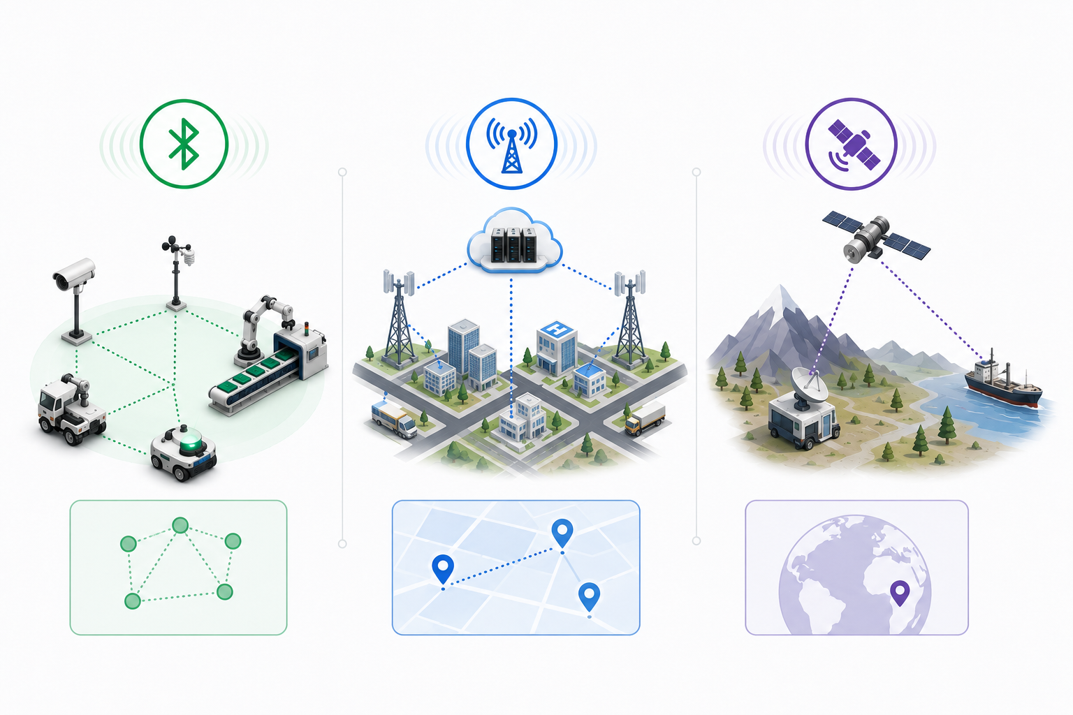
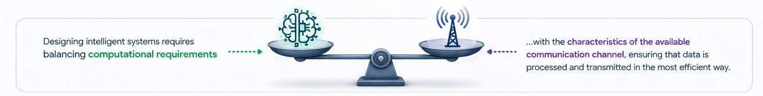
Different Communication Strategies
Notes:
Now, different environments require different communication strategies.
Short-range technologies play a fundamental role when devices need to collaborate locally with minimal energy consumption and limited infrastructure requirements. In these scenarios, intelligence can be distributed across nearby devices that exchange only the information necessary to coordinate their actions.
Cellular technologies provide a different capability. They enable large-scale deployments across cities, regions, and countries. They allow systems to remain connected over wide geographic areas while supporting the movement of relevant information between edge devices and centralized services.
More recently, non-terrestrial networks extended connectivity to remote locations where terrestrial infrastructure may be unavailable, although bandwidth and communication costs often require a more selective approach to data transmission.
Each communication channel introduces different costs, bandwidth limitations, latencies, and energy requirements.
Because of this, AI architectures cannot be designed independently from connectivity architectures.
The amount of local computation should be influenced by the characteristics of the available communication channel.
If communication is expensive, more intelligence should remain on the device.
If communication is abundant, additional processing may be offloaded elsewhere.
The objective is not to maximize local processing or cloud processing.
The objective is to find the balance that delivers the desired outcome with the available resources.
An effective intelligent system must avoid wasting bandwidth on low-value data. It must avoid draining power for unnecessary transmissions. It must preserve operational reliability even when communication is delayed, intermittent, or degraded.

Slide 6
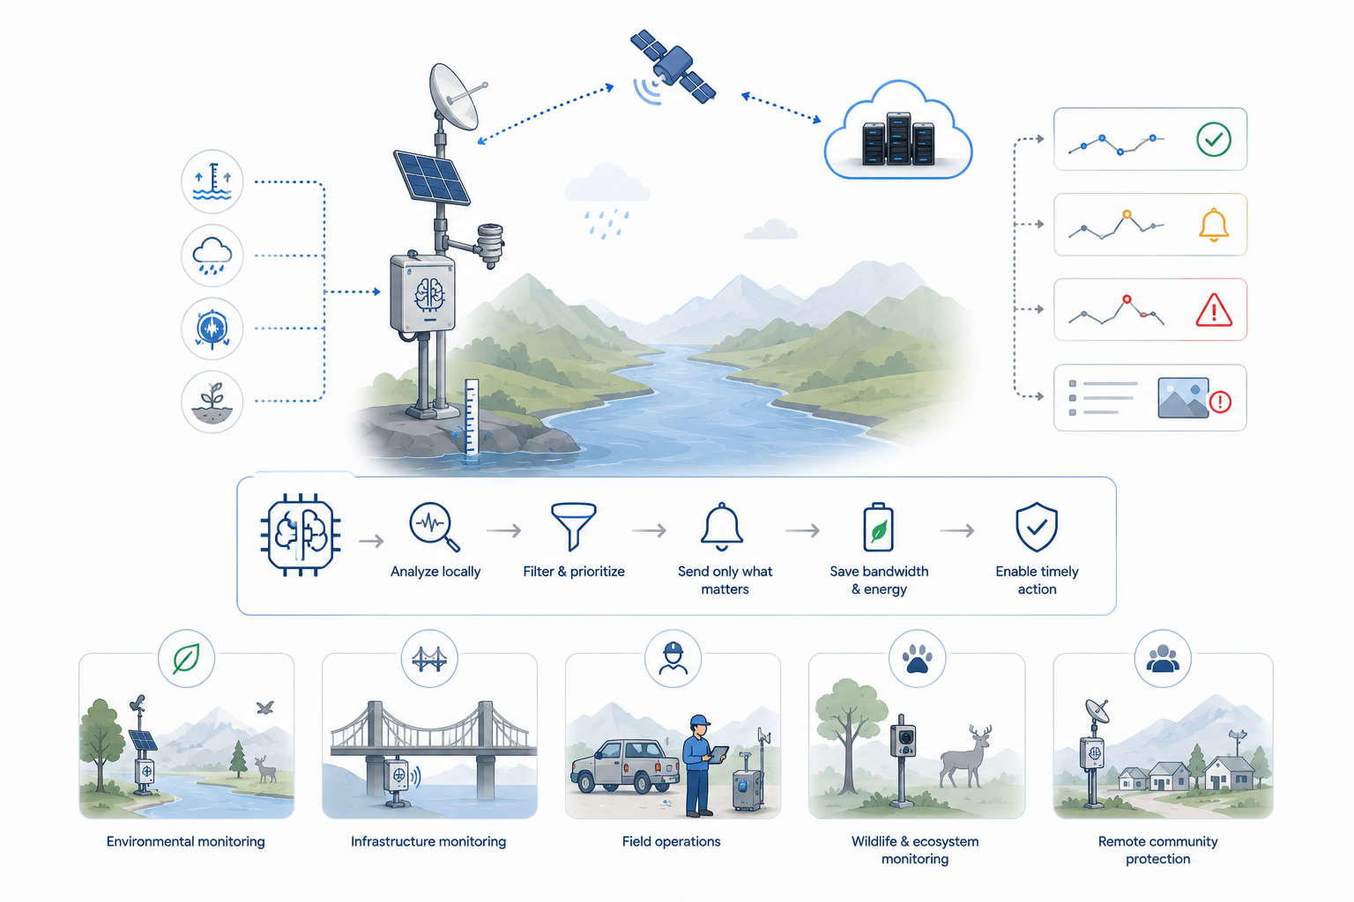
Deploy AI Anywhere
Notes:
This perspective is particularly relevant when we think about the goals of AI for Good.
For many applications with social, environmental, or operational value, the real question is whether intelligence can be deployed where it is needed. Can it work in constrained environments? Can it remain reliable when infrastructure is limited? Can it support decisions in places where data has traditionally been sparse, delayed, or difficult to collect? If the answer is no, then the technology remains distant from the problem it is meant to address.
Consider the monitoring of rivers, embankments, and flood-prone areas.
Many of these locations are remote and difficult to reach, with limited or no access to terrestrial communication infrastructure. In such environments, relying on cellular coverage or local network deployments is often not feasible. Yet timely awareness of changing conditions can have significant consequences for public safety.
An intelligent edge device can continuously analyze local measurements. It can observe water levels, rainfall, vibration, soil conditions, or other relevant parameters, depending on the application. It can detect trends, anomalies, and threshold crossings. It can distinguish between routine fluctuations and patterns that may require attention. Most of the time, the device may transmit only compact summaries. When something changes, it can send a higher-priority alert. If the situation becomes critical, it can increase the level of detail, include context, or trigger additional measurements.
In these scenarios, where bandwidth is limited and communication costs remain significant, Edge AI plays a critical role by reducing the amount of transmitted data and prioritizing only the information that requires attention.
The same approach can be extended to environmental monitoring, wildlife protection, critical infrastructure management, and many other domains where resources are limited but reliable information is essential.
In remote infrastructure monitoring, an edge device can analyze vibration, temperature, acoustic signals, or electrical parameters locally, and communicate only when patterns suggest degradation or abnormal operation.
In field operations, mobile or battery-powered systems may need to support workers in areas where connectivity is unstable. Local intelligence can provide immediate support, while selected information is synchronized when the connection becomes available.
In wildlife or ecosystem monitoring, cameras and sensors may be deployed in isolated areas for long periods. Sending continuous raw data may be unrealistic. Local classification can help prioritize relevant events and reduce the amount of information that needs to be transmitted.
In all these examples, the objective is not simply to deploy more AI but to keep it useful under real-world constraints.
Systems that continue to operate when connectivity is imperfect.
Systems that make efficient use of limited resources.
Systems that bring intelligence closer to the people, communities, and environments that can benefit from it but for now are cut off from.
Another important aspect is scalability.
When devices process data locally, infrastructure requirements grow much more slowly.
Instead of continuously expanding cloud processing capacity, intelligence is distributed across thousands of devices.
This creates systems that are often more resilient, more efficient, and easier to scale geographically.

Slide 7
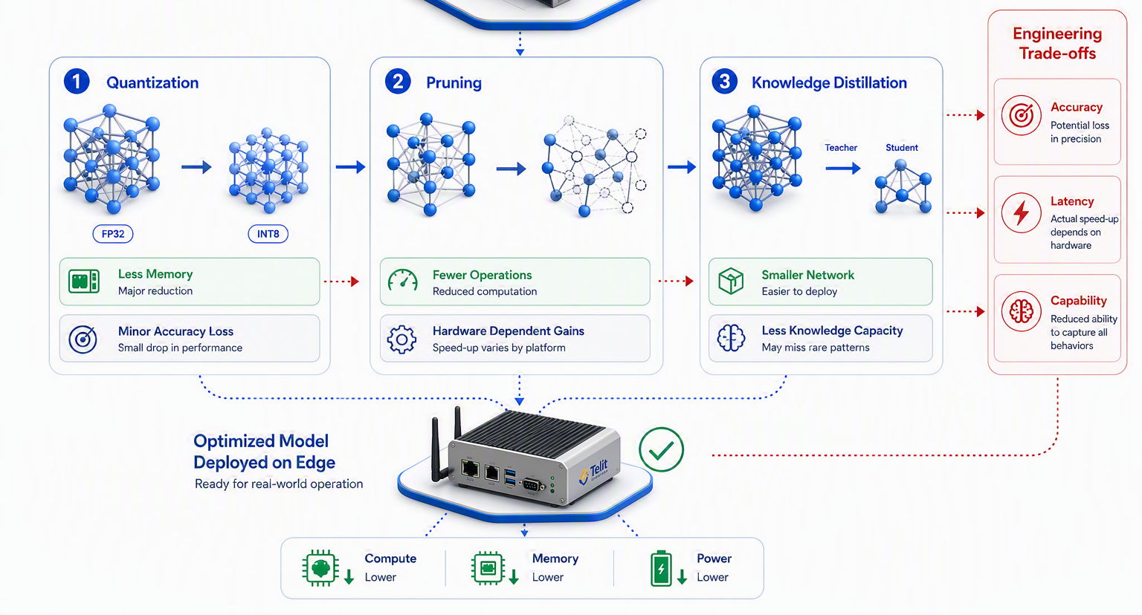
Compression Techniques
Notes:
But we should be careful not to romanticize the edge.
Edge AI is not a magic solution. It introduces its own challenges.
Models must fit within limited memory and compute resources.
Because of these limitations, we don’t deploy the same model that we train in the laboratory.
Instead, we spend a significant amount of effort making models smaller and more efficient.
One common technique is quantization, where model parameters are represented with lower numerical precision, for example moving from 32-bit floating point values to 8-bit integers. This dramatically reduces memory usage and computational cost, often with only a small loss in accuracy.
Another approach is pruning, where we remove weights or even entire neurons that contribute very little to the final prediction. The model becomes lighter and faster, although the actual speed-up depends on how well the hardware supports sparse computation.
We can also use knowledge distillation, where a large and highly accurate model teaches a much smaller model to approximate its behavior. The smaller model is easier to deploy, even if it cannot capture every detail learned by the original network.
But every optimization introduces a trade-off.
Reducing precision may decrease accuracy. Compressing a model may reduce its ability to recognize rare events. Increasing local processing may reduce communication costs but increase energy consumption. Communicating less frequently saves battery life but also delays information reaching the operator.
And these are only the model-related trade-offs.
In a real deployment we also have to think about software updates, monitoring model performance over time, detecting data drift, securing the device against attacks, protecting sensitive data, and ensuring that the system continues to operate safely even when communication is unavailable.

Slide 8
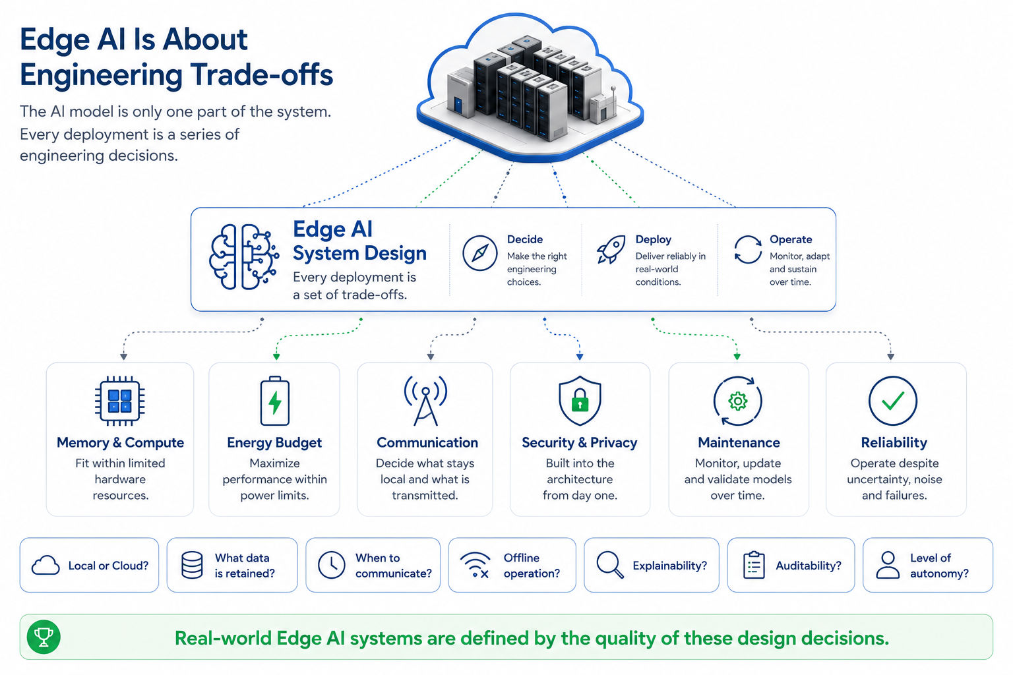
Edge AI Is About Engineering Trade-Offs
Notes:
Now, as I said, models must fit within limited memory and compute resources.
But it just one piece of the story…
Devices may have strict energy budgets.
Hardware must operate reliably in uncontrolled environments.
Models may need to be updated, monitored, and maintained over time.
Security and privacy must be designed from the beginning.
The system must be robust enough to handle uncertainty, noise, and failure.
This is why real-world deployment is so different from a laboratory demonstration.
The deployment architecture matters.
The communication strategy matters.
The maintenance model matters.
The cost structure matters.
The operational environment matters.
In practice, successful Edge AI systems are defined by the quality of the trade-offs it introduces.
How much processing should happen locally? How much data should be retained? How often should the system communicate? What happens when the connection is unavailable? What information is critical? What can wait? What must be explainable to an operator? What must be auditable later? What level of autonomy is acceptable for the application?
These are engineering questions, but they are also strategic questions.
Ultimately, Edge AI is not only a machine learning problem.
It is a systems engineering problem, where the model, the hardware, the communication infrastructure, and the operational environment all have to be designed together.
That balance, more than the AI model itself, is what determines whether an intelligent system succeeds outside the laboratory.

Slide 9

Thank you
Visit us at booth M6
Stop by to talk with our team.

