Slide 1


Tips and Tricks for teachers
schooltalk.co.nz
Notes:
Internal doc: https://docs.google.com/document/d/1HrYbNnr6tqu_fa1p2JVDS0HtUaBJ4a5s4PFtA-eRSxw/edit#

Slide 2


Tips and Tricks
This module covers:
1. Evidence
- What it is
- How - types of evidence
- Strategies to gather evidence
2. How to add Grammarly
3. Gap Analysis tips
4. Overview of all progressions
5. Fine-tuning progress after backfilling

Slide 3
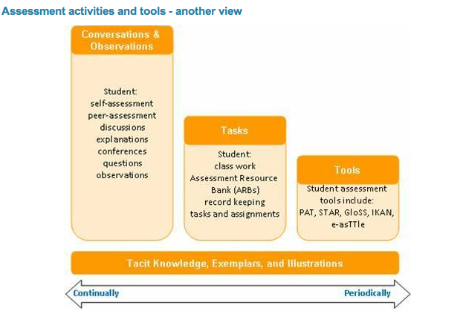
What Evidence?
NOTE: Formal assessments have only ever been one puzzle piece

Slide 4
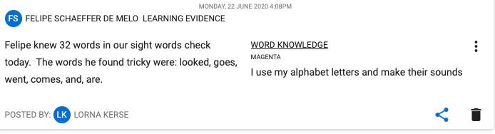
How - Types of evidence
Annotation - get across what you need to by annotating; efficiency!

Slide 5
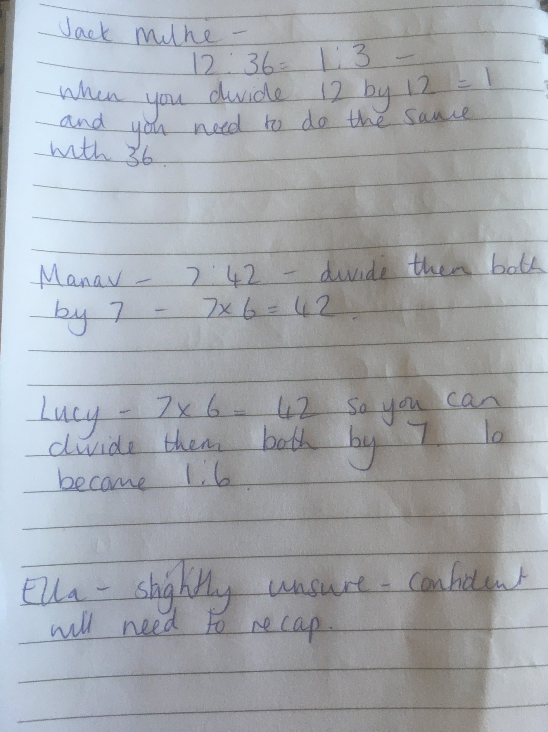
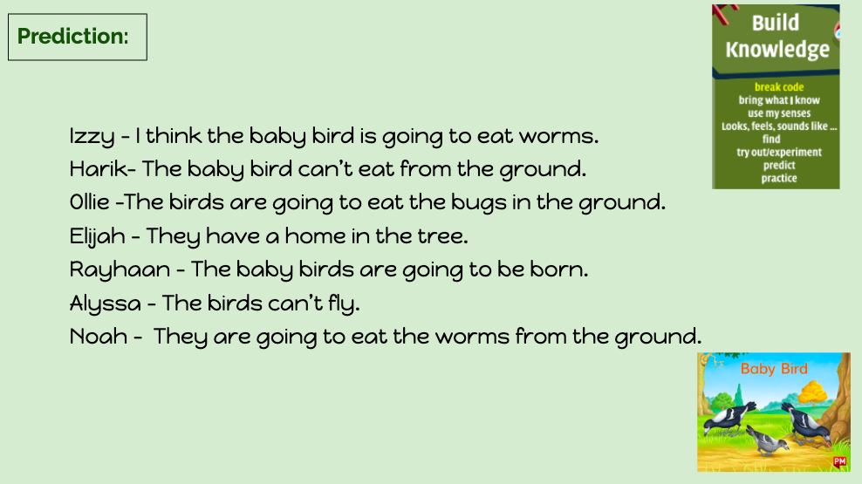

How - Types of evidence
Anecdotal notes - Observing the learners whilst they complete an activity

Slide 6
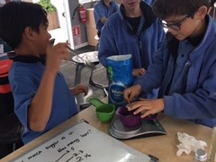
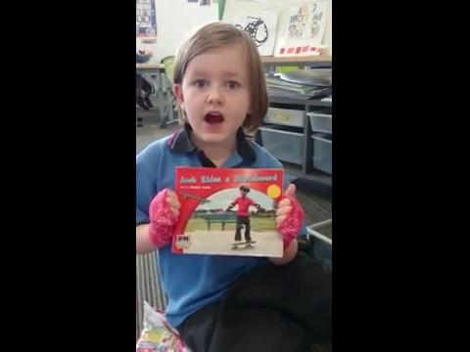
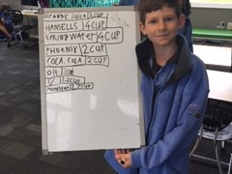
How - Types of evidence
Anecdotal notes - Observing the learners whilst they complete an activity

Slide 7
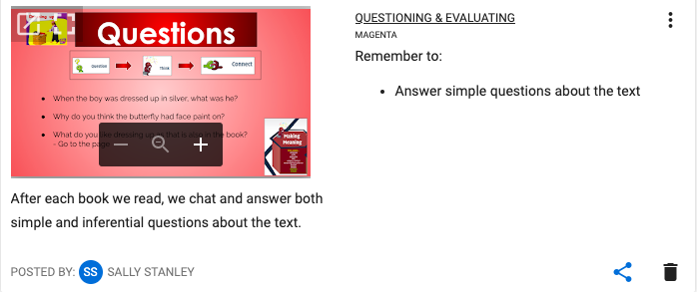
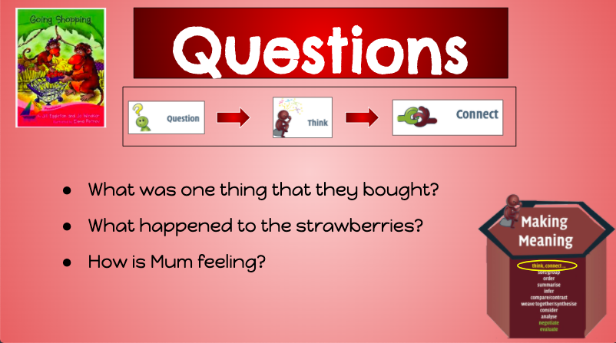
How - Types of evidence
Notes:
Group anecdotal notes and evidence

Slide 8
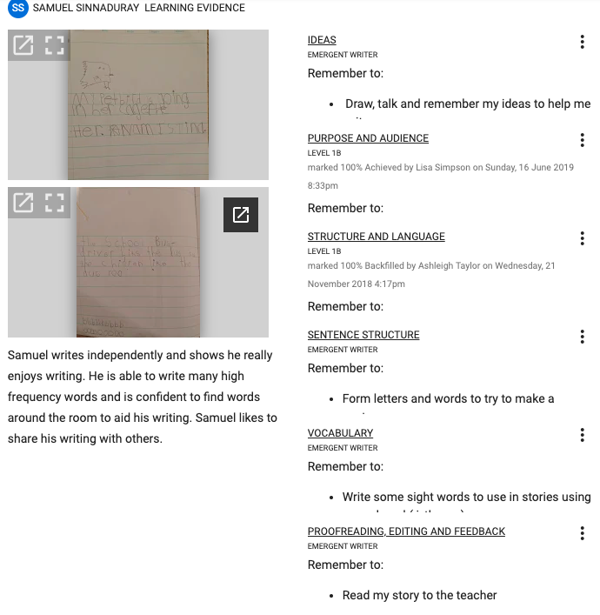
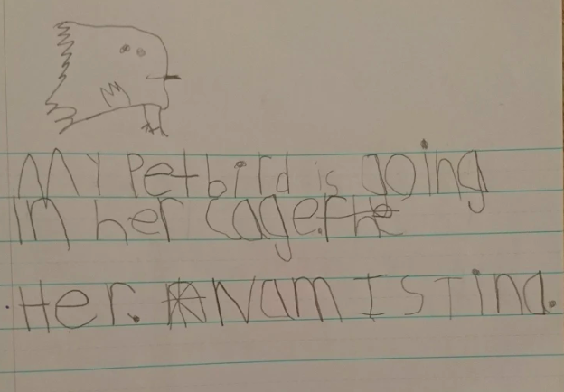
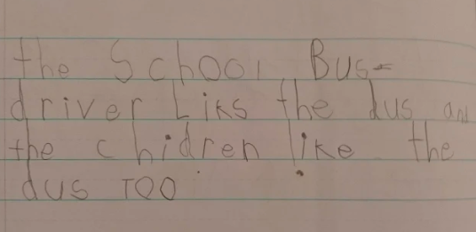
How - Types of evidence across many progressions
Test user learner evidence
Types ofevidence acrossmany progressions
Notes:
Tagging a piece of evidence to multiple progressions from the DFL page - Progress section

Slide 9
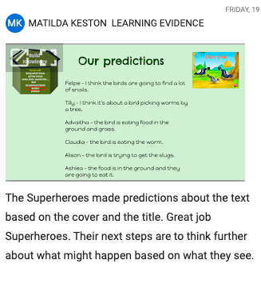
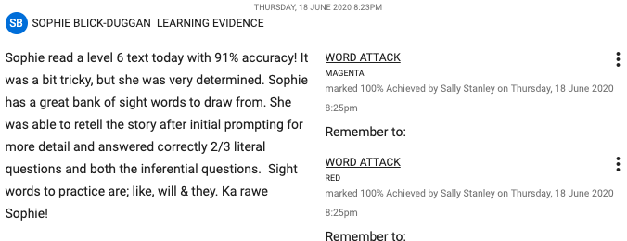
How - Types of evidence
Ongoing - It’s a process, next steps are important

Slide 10
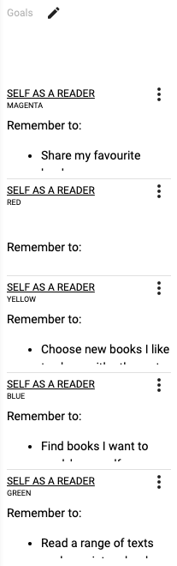
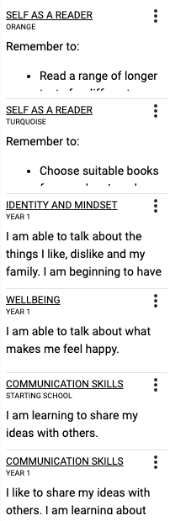
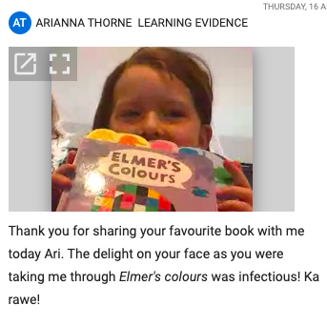
xxx
xxx
Test User
Notes:
Example of a personalised evidence post.

Slide 11
Strategies for gathering evidence - Scheduling
Anecdotal Notes - Scheduling time to write notes about different learners - How can you weave in other curriculum areas and soft skills?
Week | Monday | Tuesday | Wednesday | Thursday | Friday
1 | Reading group A comments/evidence/evidence | Reading group B comments/evidence | Reading group C comments/evidence | Reading group D comments/evidence | Soft skills/inquiry comment group A
2 | Maths group A comments/evidence | Maths group B comments/evidence | Maths group C comments/evidence | Maths group D comments/evidence | Soft skills/inquiry comment group B
3 | Writing group A comments/evidence | Writing group B comments/evidence | Writing group C comments/evidence | Writing group D comments/evidence | Soft skills/inquiry comment group C
4
Types ofevidence acrossmany progressions

Slide 12
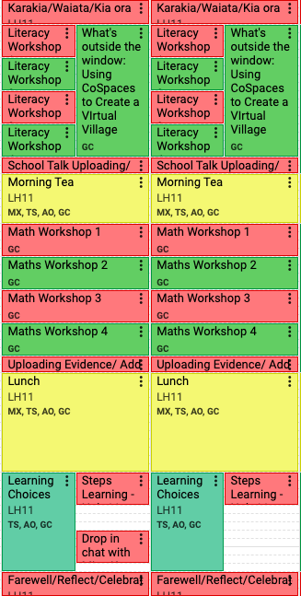
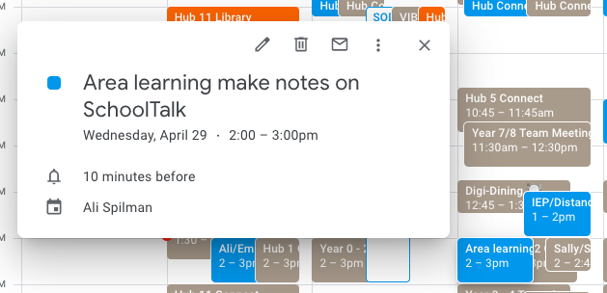
Strategies for gathering evidence - Scheduling
Calendar time - Google Calendar or SchoolTalk Calendar
Scheduling time to add evidence
Make it a workshop

Slide 13
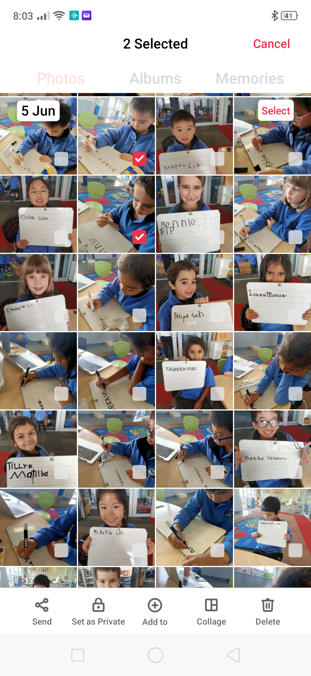
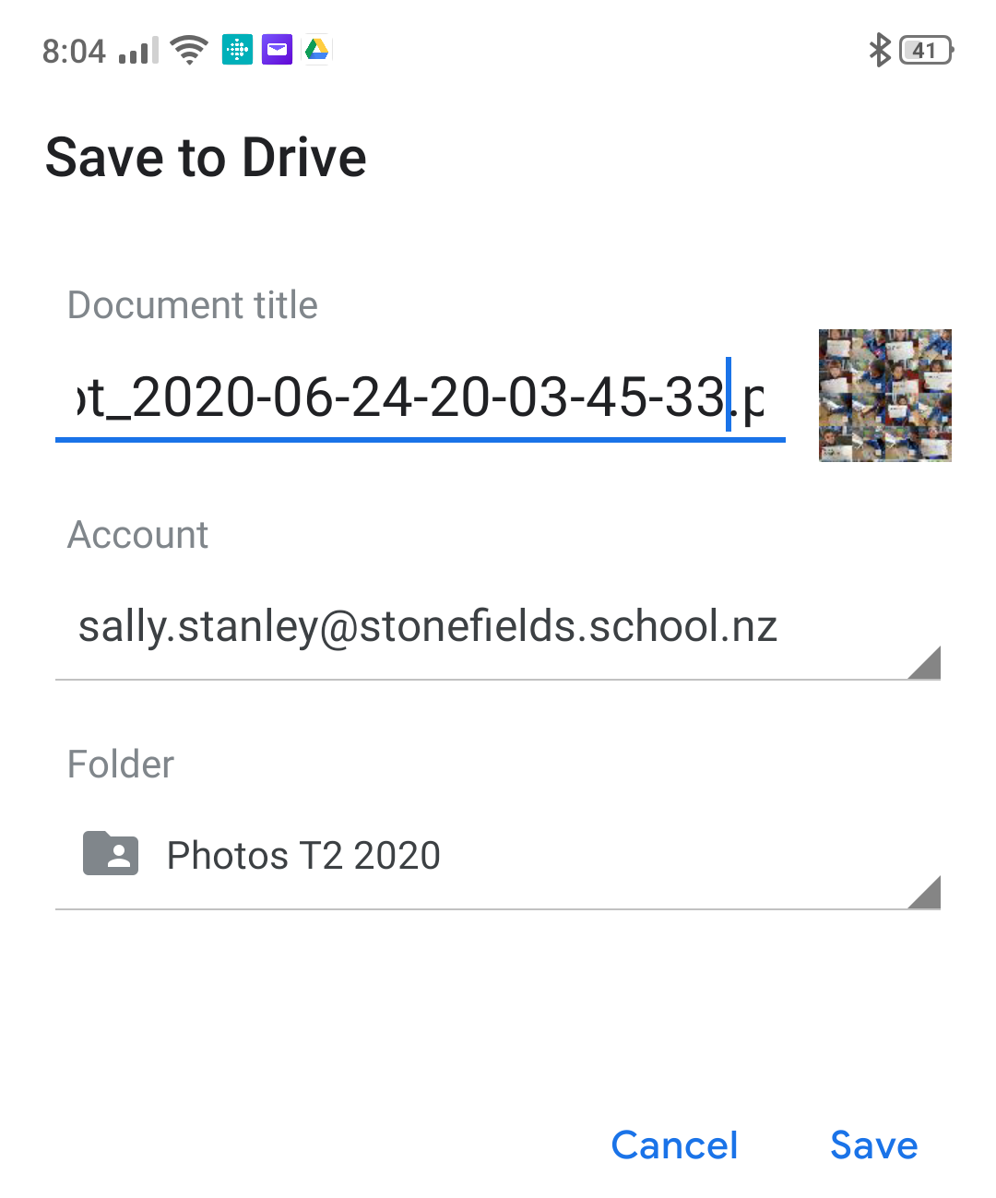

Strategies for gathering evidence - device set up
Have the Drive app
on your phone
Once in the school Drive you can delete from your phone!
Top Tip: If you upload onto SchoolTalk straight away your photos will be right there and quick and easy to find!
Useremail@gmail.com
Save to the School Drive into your photos folder
with open sharing settings
Select the photos on your phone.

Slide 14
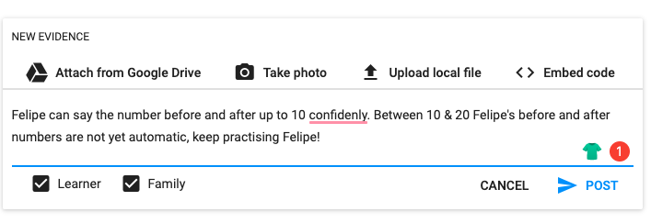

How to add Grammarly
Notes:
Google: Grammarly for chrome
Add as extension

Slide 15
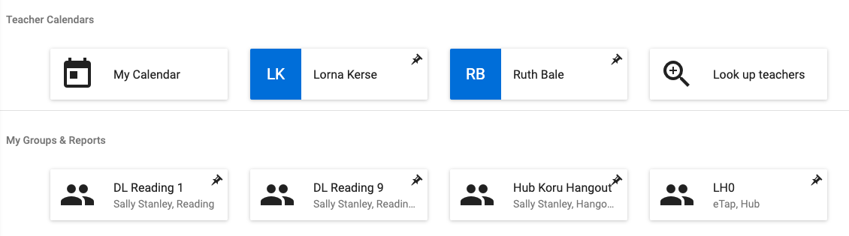
Gap Analysis - using an existing one
Teacher A
Teacher B
Choose the group you want to do the gap analysis on.

Slide 16
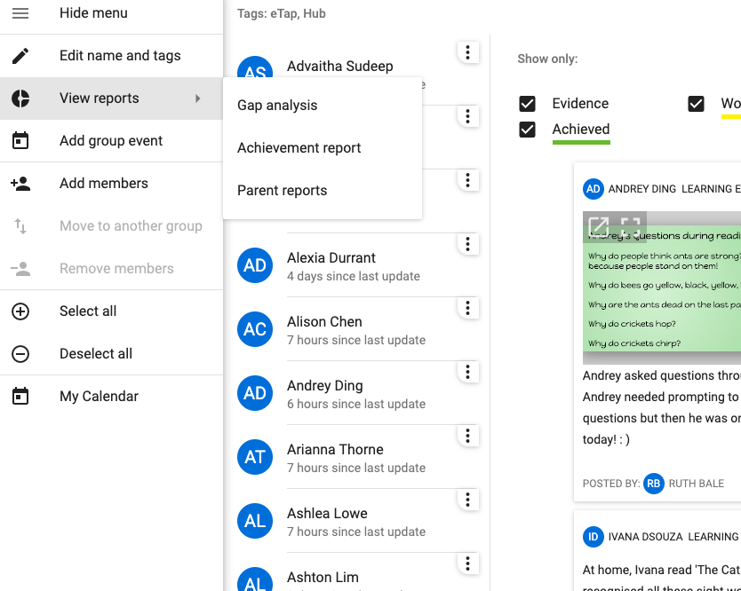
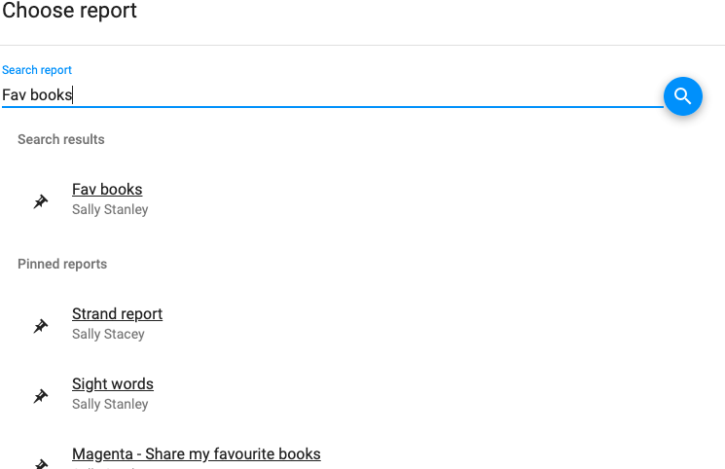
Gap Analysis - using an existing one
You can search the gap analysis you want to use with your learners, then save it as new.

Slide 17
Gap Analysis - Summative Assessment
Use Gap Analysis to gather notes from summative assessments:
Have assessment groups set up & pinned - Testing commences & as you’re testing you add notes to appropriate progressions on the gap analysis.
Have summative assessments set up for the school that all teachers can use eg. GLOSS, IKAN, e-asttle writing, PM

Slide 18
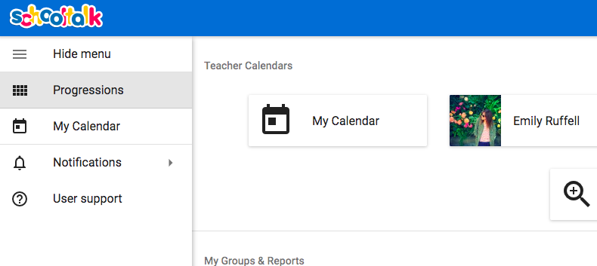
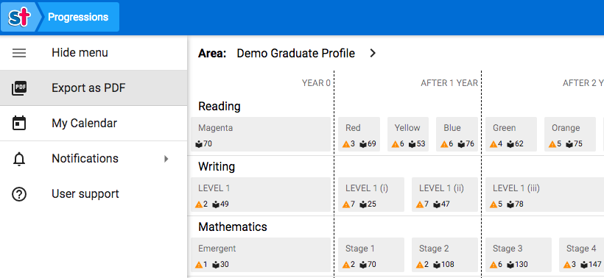
Overview of all progressions
To get a printable overview of all of the progressions, click into Progressions in the sidebar menu.
To export this to a printable PDF, click the Export as PDF button in the sidebar menu.
Teacher A

Slide 19
Fine-tuning backfilled progressions
To change some backfilled progressions from light green to working towards (ie. they had not demonstrated that they could yet do that progression so you did not want it to show as achieved), follow these steps:
1. Access the progression in question (either through the learners own progressions or from the achievement report.
2. Click Progress
3. Click Achieved
4. Move the percent bar to 0% and click mark
5. You will see the update show in the learning log
6. Click Working towards to make it yellow

