Slide 1
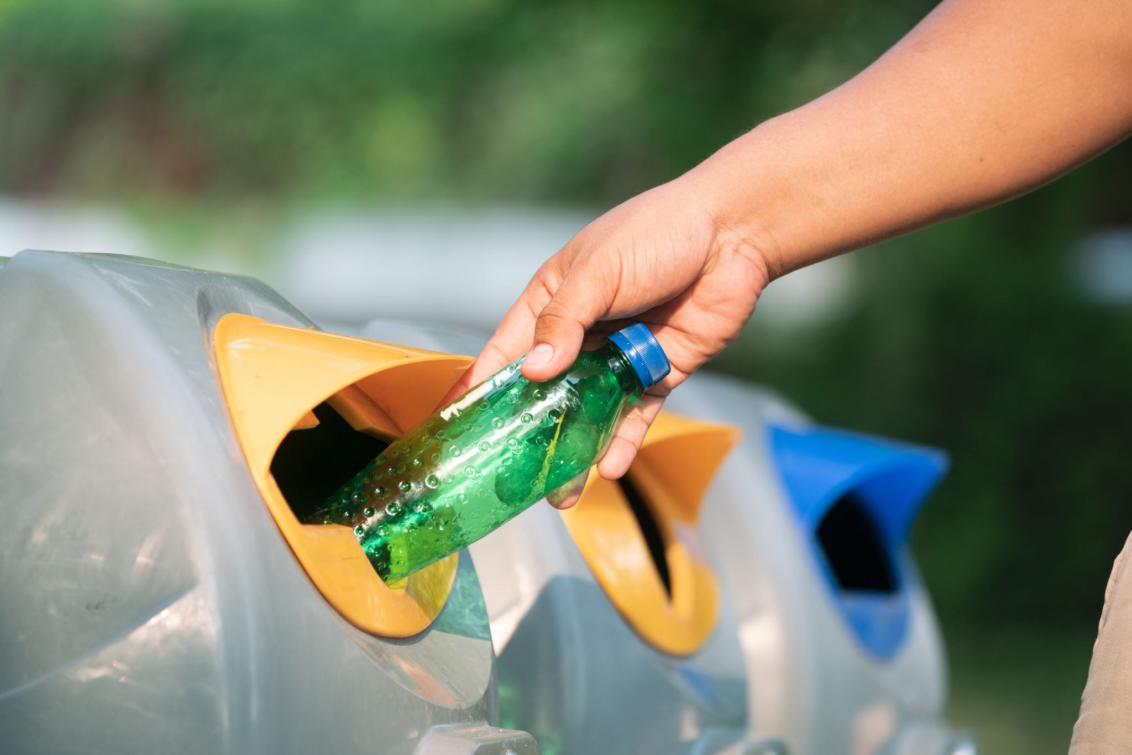
Recycling
Go to Learn Recycling | A Grade 7 Student Guide to Waste Sorting for more explained details.

Slide 2
What Is Recycling?
- Recycling is the process of turning waste into reusable materials.
- It reduces the need for extracting raw materials.
- Commonly recycled items: paper, plastic, metal, glass.

Slide 3
Positive Impacts
Recycling is one of the best ways to protect our planet. It helps us:
Save Habitats: By recycling paper and cardboard, we reduce the need for logging, ensuring we don't lose animal homes.
Reduce Pollution: Proper sorting prevents waste from piling up and reduces the release of gases that harm our atmosphere.
Save Energy: Using recycled materials to make new products uses much less electricity than makinh fro raw materials from the earth.

Slide 4
Why Recycling Matters
- Reduces pollution and greenhouse gases.
- Conserves natural resources.
- Protects wildlife.

Slide 5
The MRF Process
Your truck picks up the trash
01
The Facility: Your recyclables go to a Material Recovery Facility.
02
machines use magnets for metal and motors for paper to separate everything into clean piles.
03

Slide 6
Sorting Methods
newspapers, magazines, cardboard.
Plastic:
bottles, containers (check symbols).
Metal:
cans, foil
- Glass:
bottles and jars.

Slide 7
Negative Impacts
-Plastics: Items like plastic bags, hoses, and wires wrap around the spinning machinery. This causes dangerous clogs that workers have to cut out by hand.
Contamination: This happens through "wishcycling“ which means putting trash in the bin hoping it's recyclable. One greasy pizza box or half-full soda bottle can soak a whole load of paper, making it useless trash.

Slide 8
More Negative Impacts
Machine damage from incorrect items.
Rejected loads increase waste.
Higher costs for recycling facilities.

Slide 9
The 3Rs
Reduce
- Reduce: Buy only what you need.
Reuse
- Reuse: Use items again instead of throwing away.
Recycle
- Recycle: Sort waste properly.

Slide 10
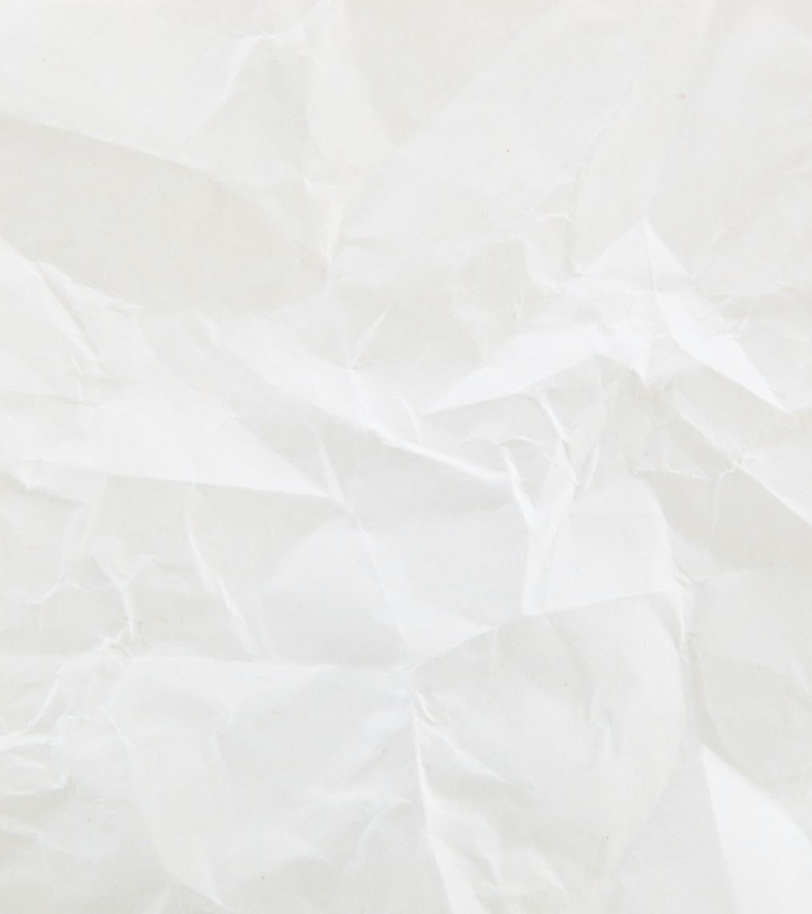
Solutions & Prevention
To make recycling work, we have to follow the three rules of Prevention:
Empty and Rinse. A 5-second rinse ensures that food and liquids don't ruin clean paper and cardboard.
Check Before You Toss. If you aren't 100% sure an item belongs in the bin, put it in the trash. This protects the rest of the recyclables from being ruined.

Slide 11
How to Recycle Better
Rinse containers.
Check local rules.
Avoid plastic bags.
Keep recyclables clean and dry.

Slide 12
Thank you

