Slide 1

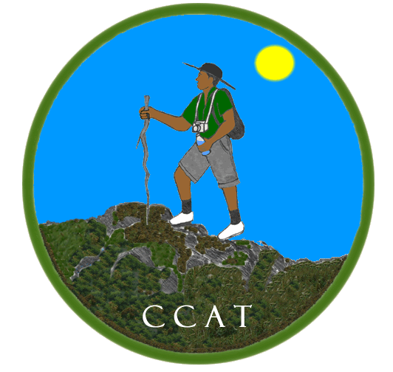
Southern Trelawny Environmental Agency
Mission
To promote development in Cockpit Country, through environmental conservation and economic opportunity projects

Slide 2
Projects Mission
To enhance the capacity of communities within the Cockpit Country buffer zone to actively contribute to the conservation of this vital Jamaican landscape.

Slide 3
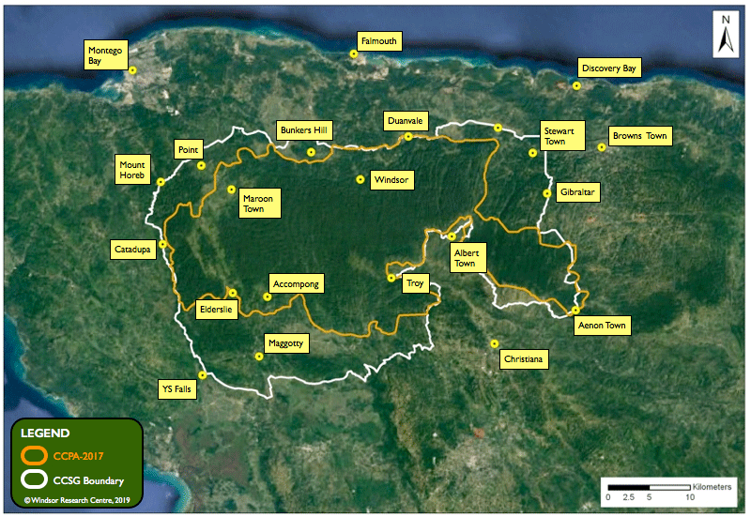
Cockpit
Country

Slide 4
Project Goals
•1. To provide continuous training and orientation to upscale the core groups to become knowledgeable environmentalists and community-based organizations (CBOs) in three specific Cockpit Country communities.
•2. To implement a comprehensive intervention program that builds the individual, and institutional capacity of new community-based organizations (CBOs) in three target communities for environmental conservation.
•3. Update the documentation of the intervention strategy to include additional lessons learned into the replication toolkit.

Slide 5
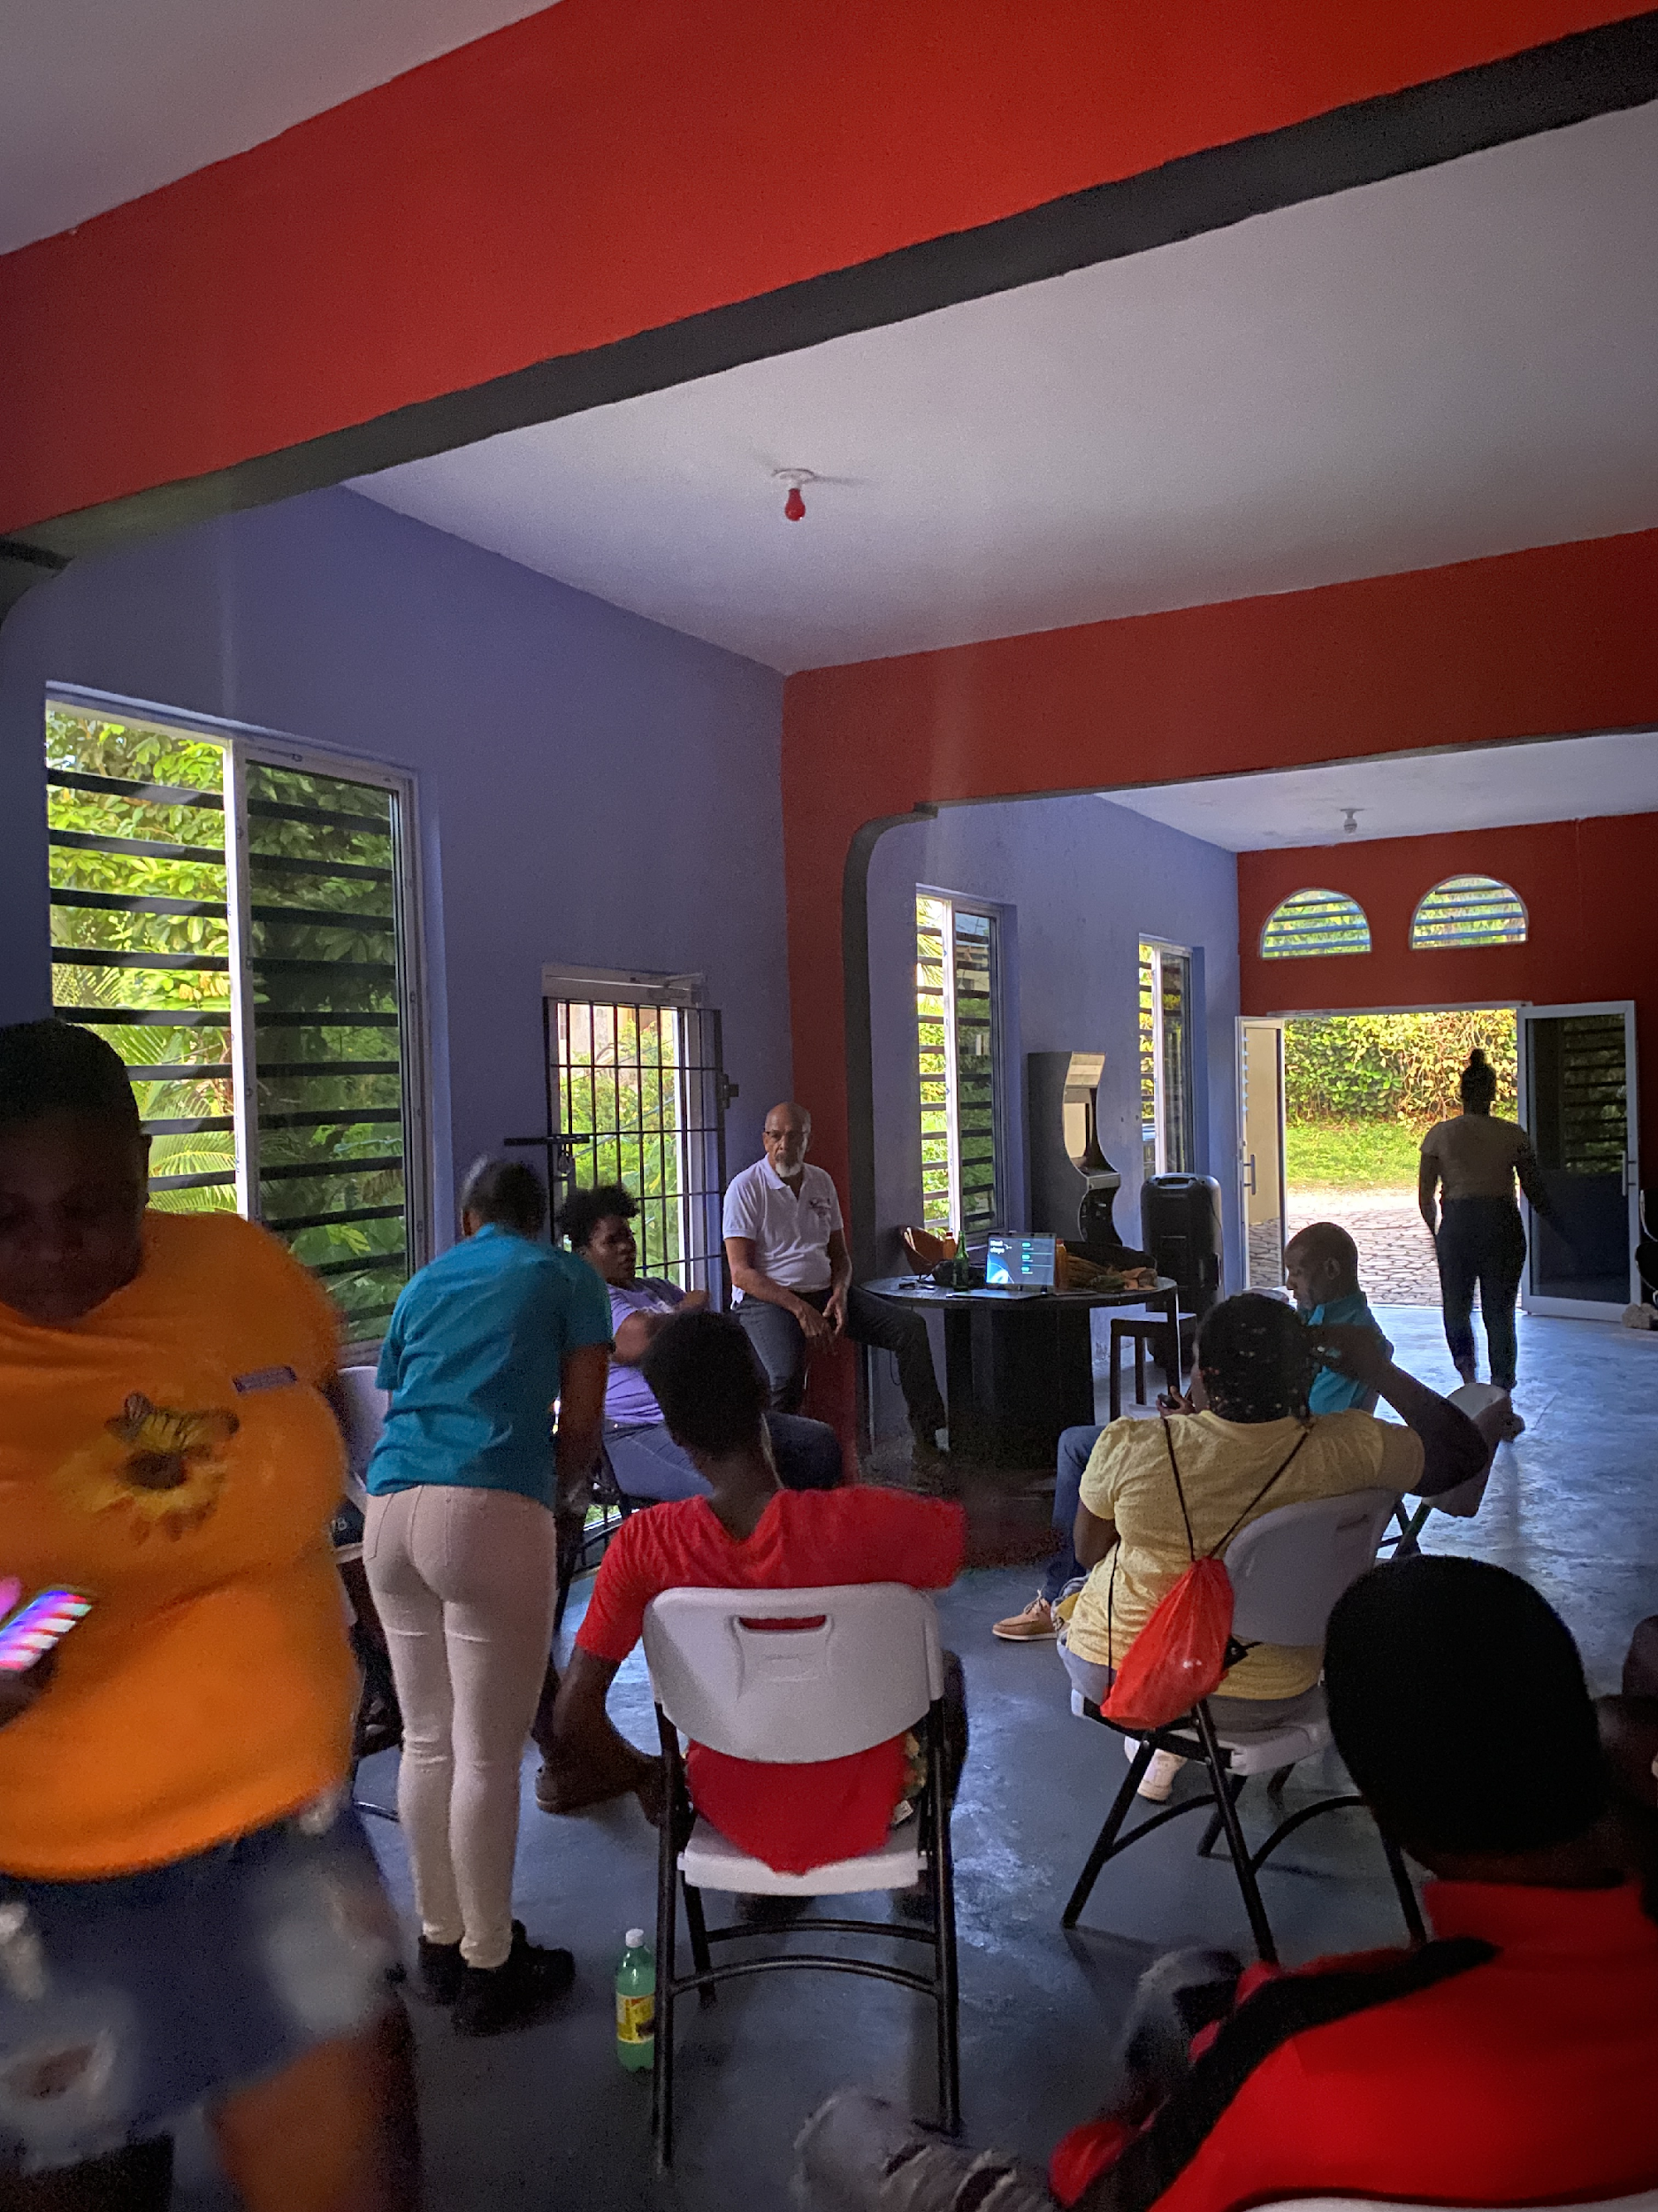
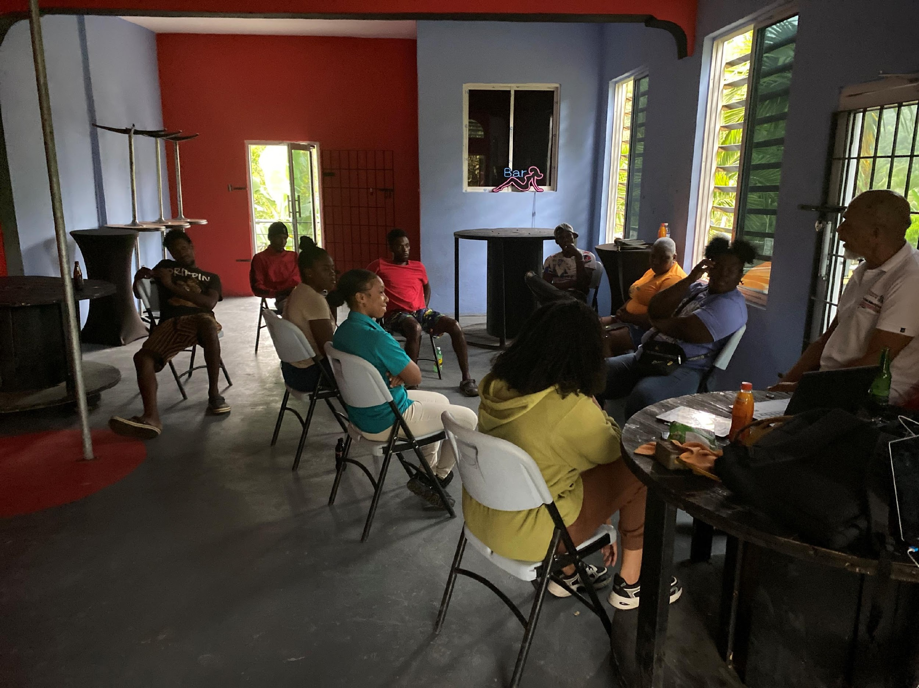
1. To provide training, orientation to upscale knowledge of core groups of environmentalists, and community-based organizations (CBOs) in three specific Cockpit Country communities.

Slide 6
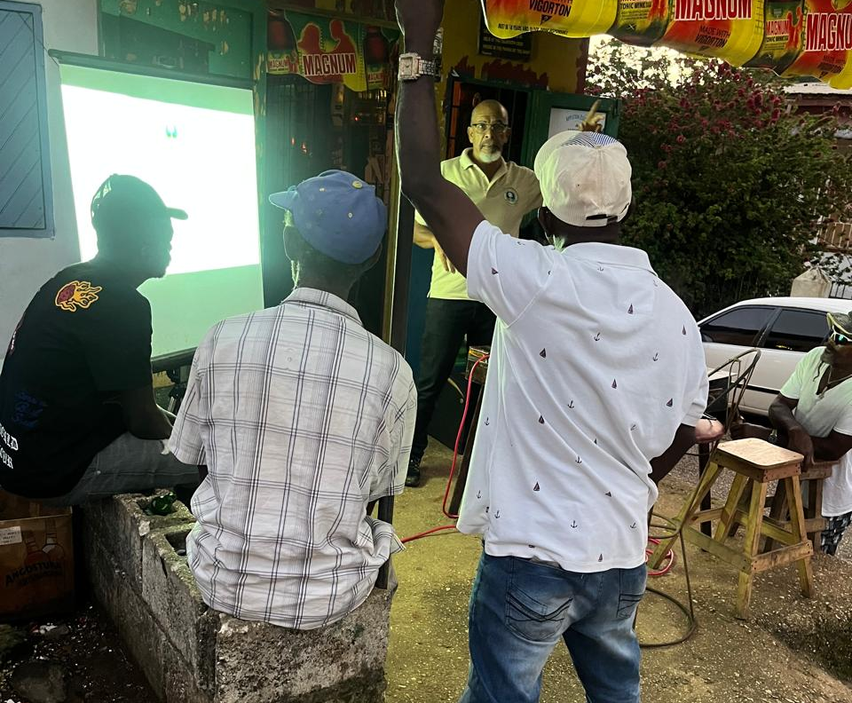


Slide 7
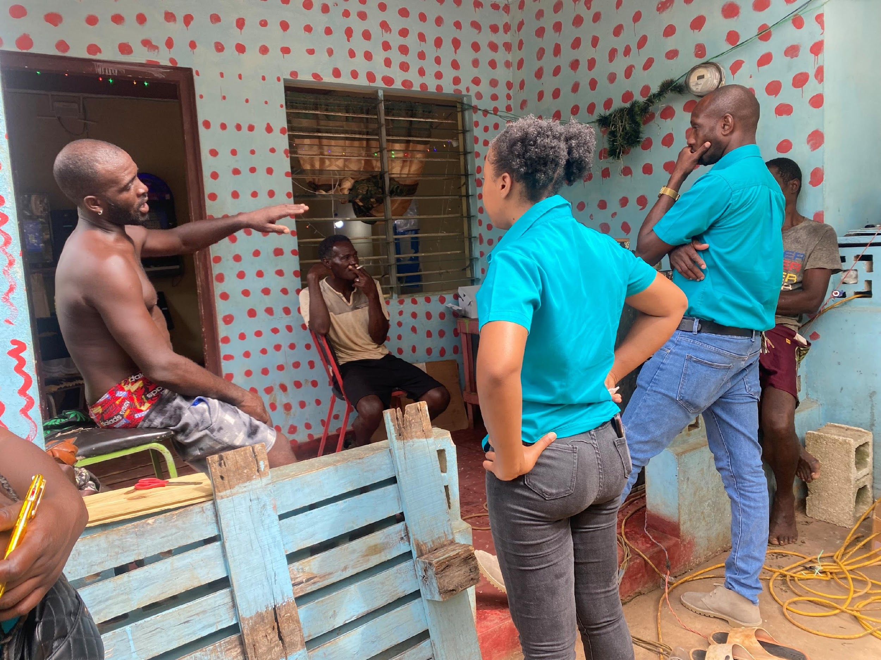
  2. To implement a comprehensive intervention program that builds the individual and institutional capacity of new community-based organizations (CBOs) in three target communities for environmental conservation.

Slide 8
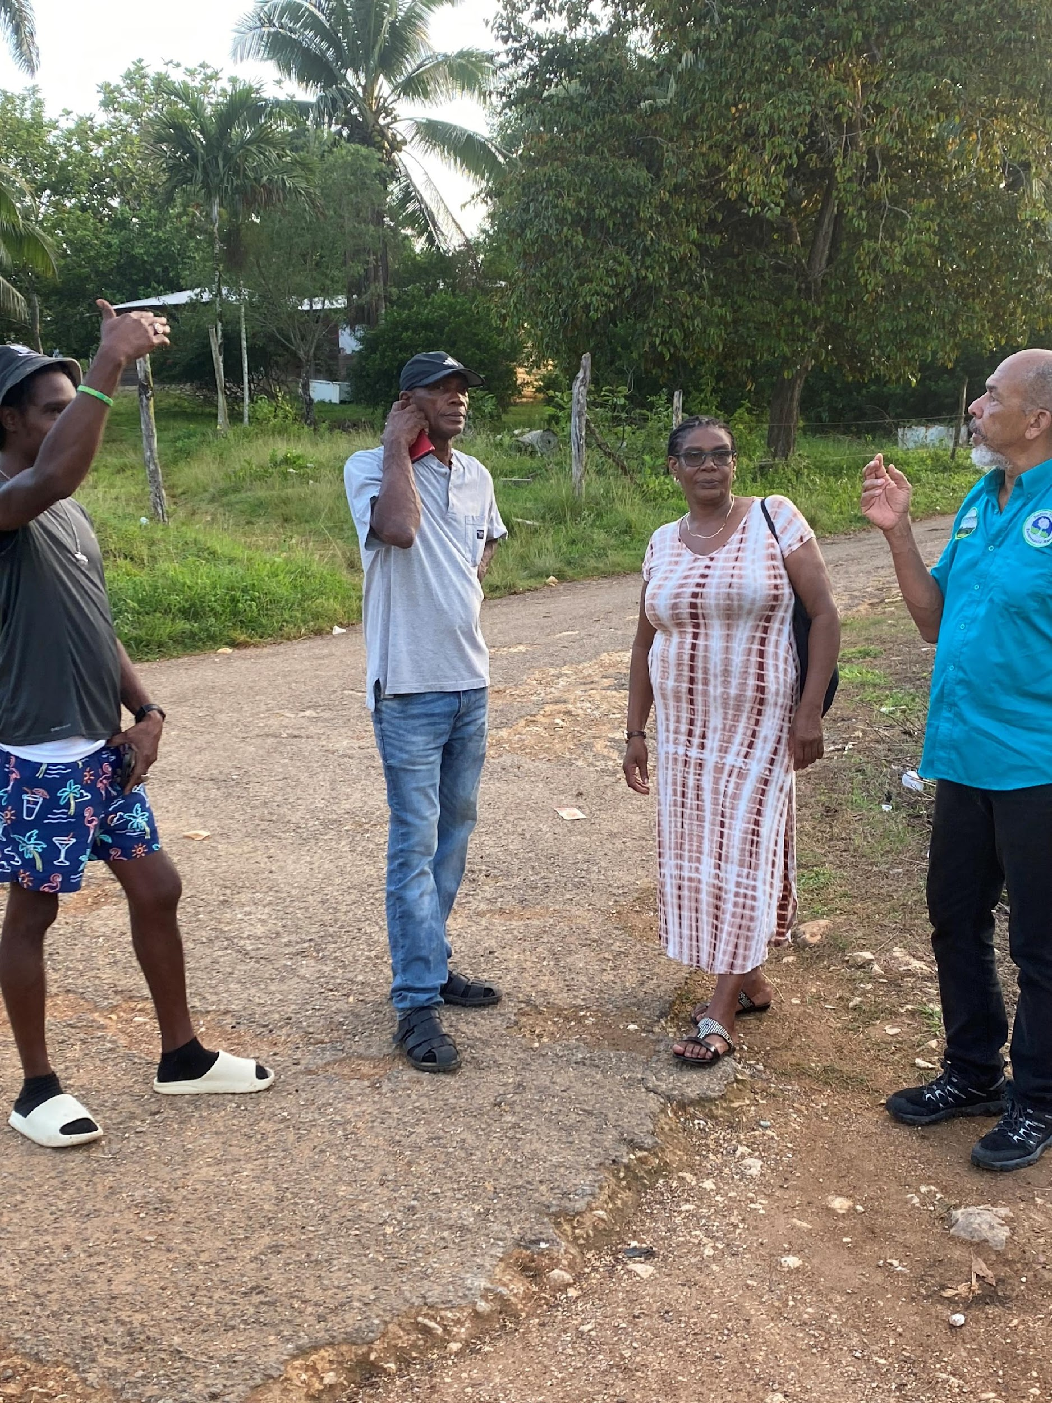
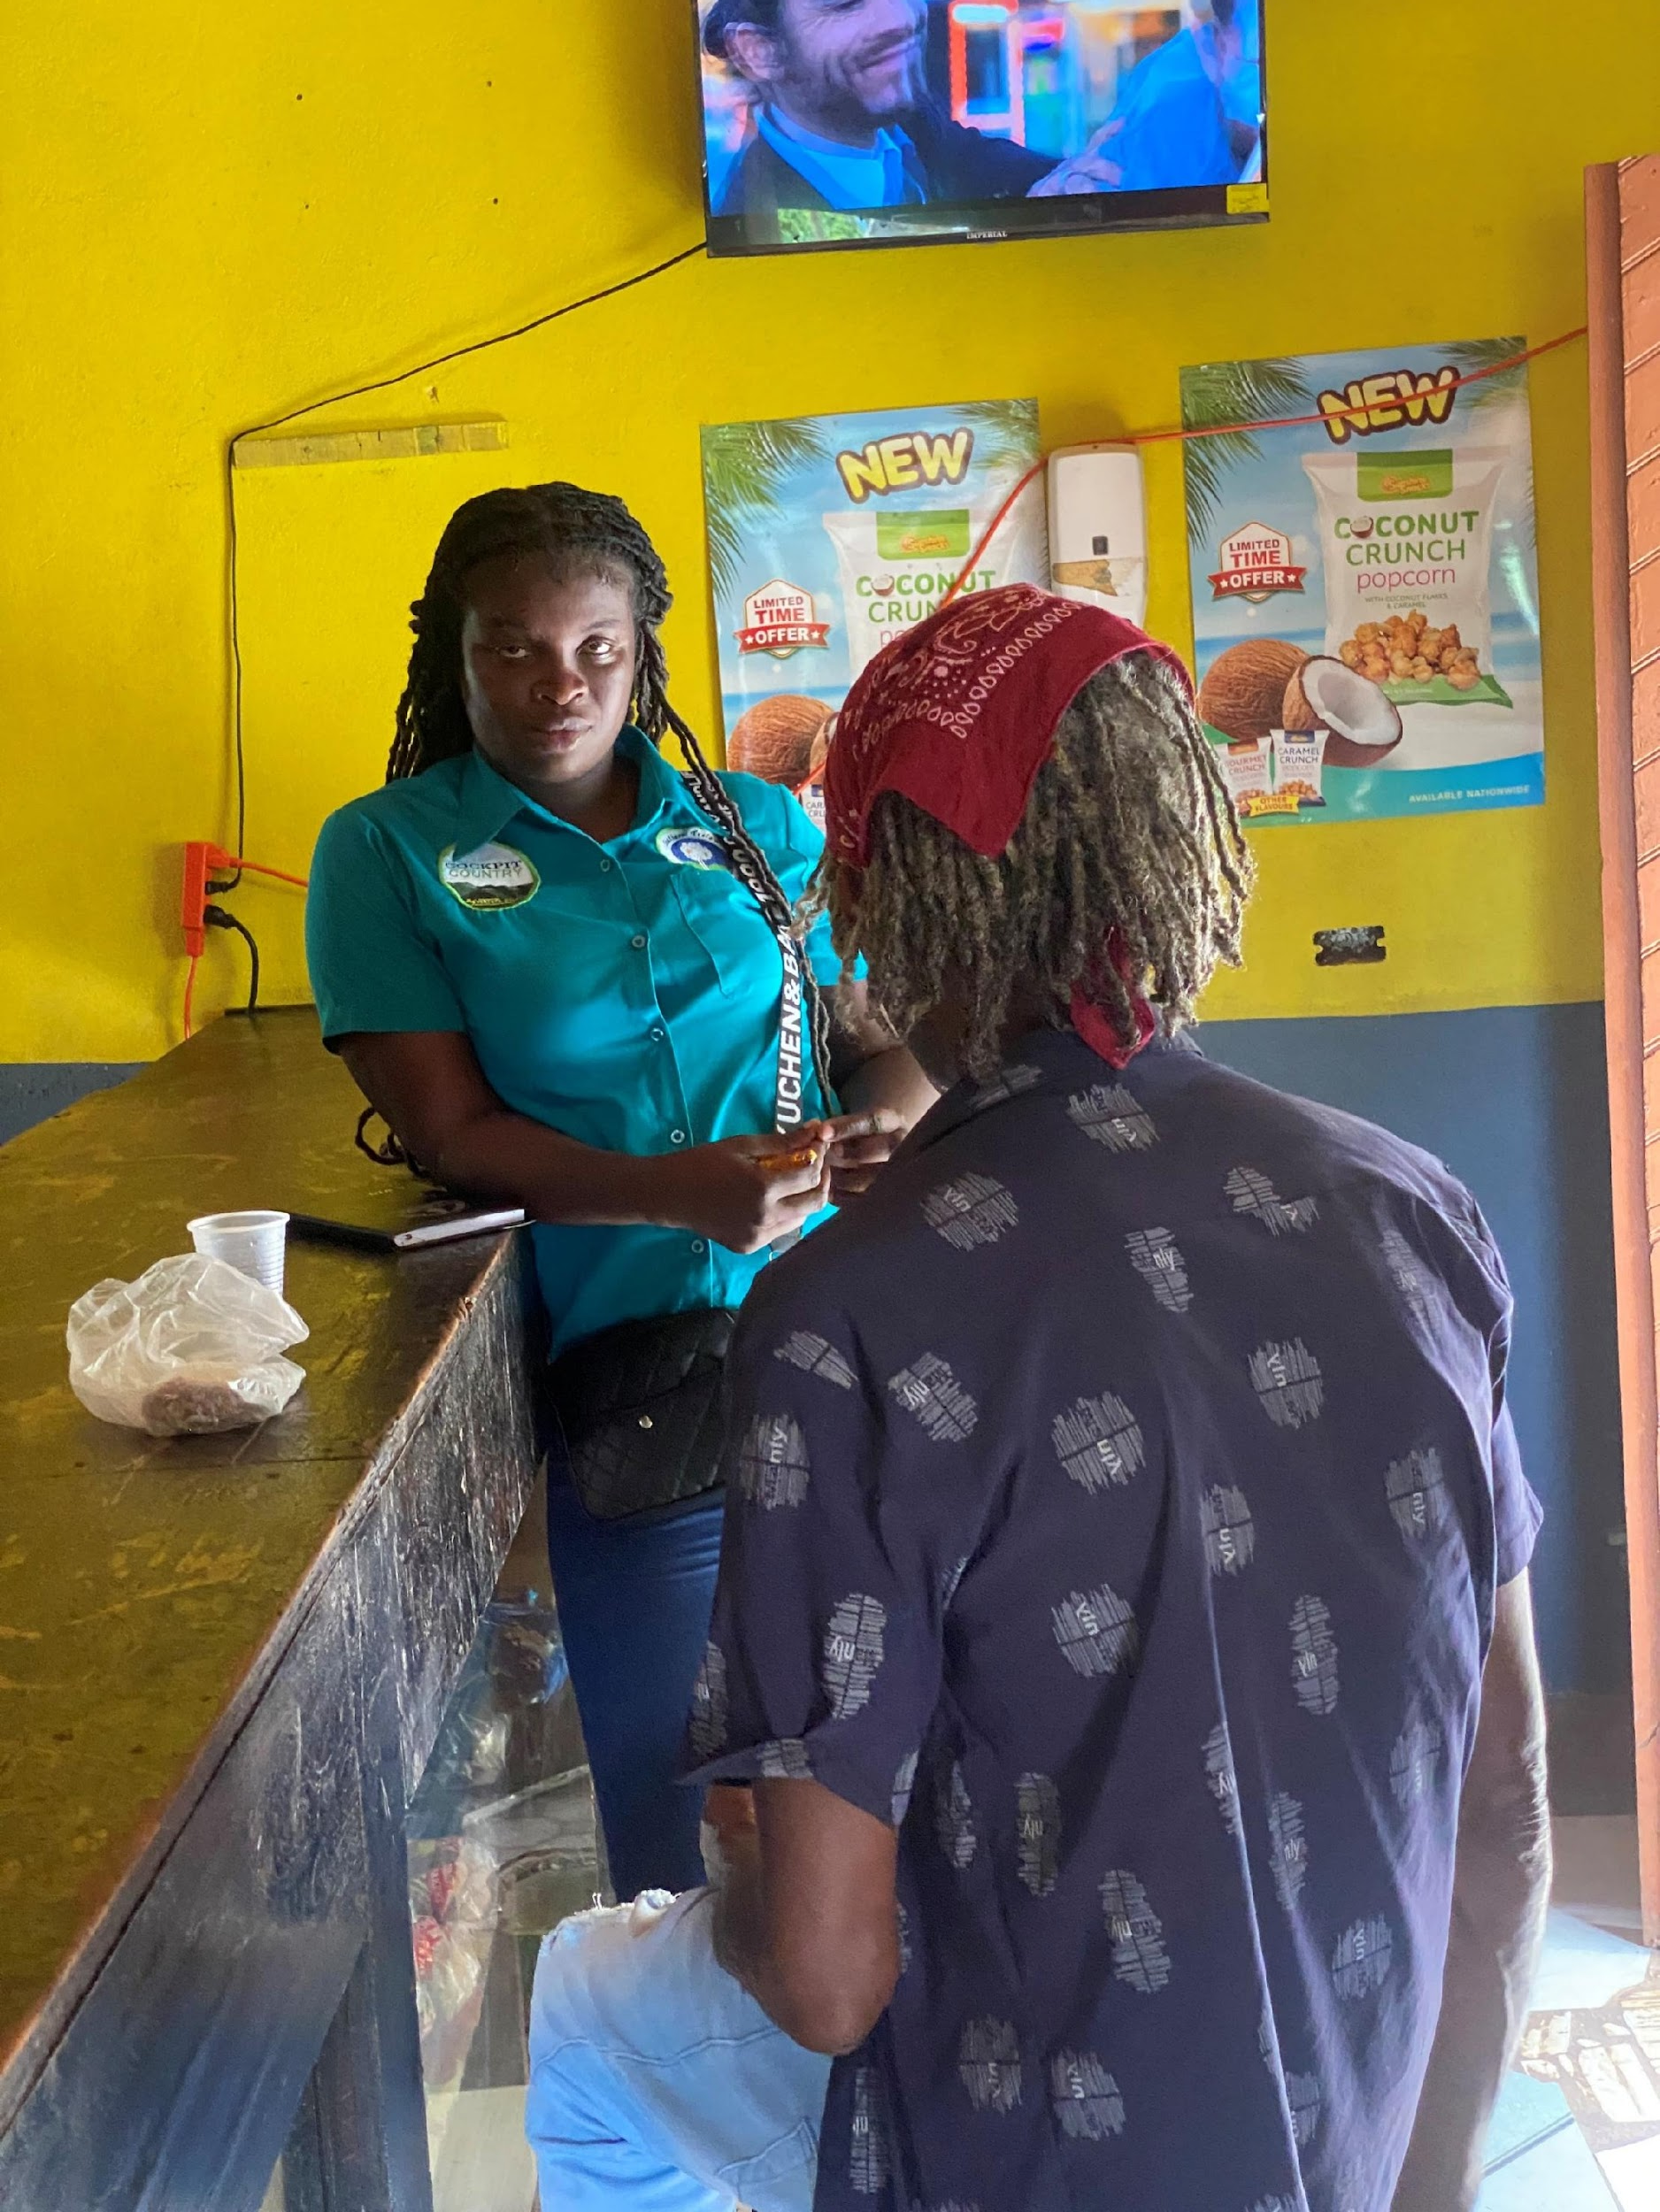
2. To implement a comprehensive intervention program that builds the individual and institutional capacity of new community-based organizations (CBOs) in three target communities for environmental conservation.

Slide 9
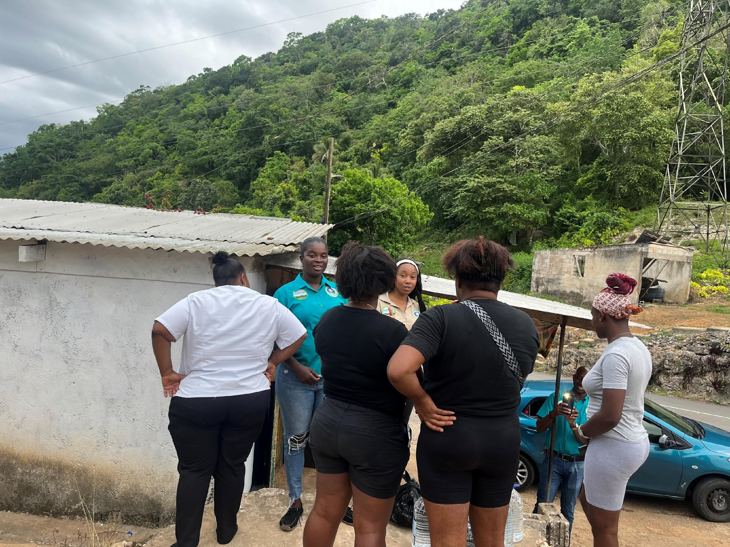
2. To implement a comprehensive intervention program that builds the individual and institutional capacity of new community-based organizations (CBOs) in three target communities for environmental conservation.

Slide 10
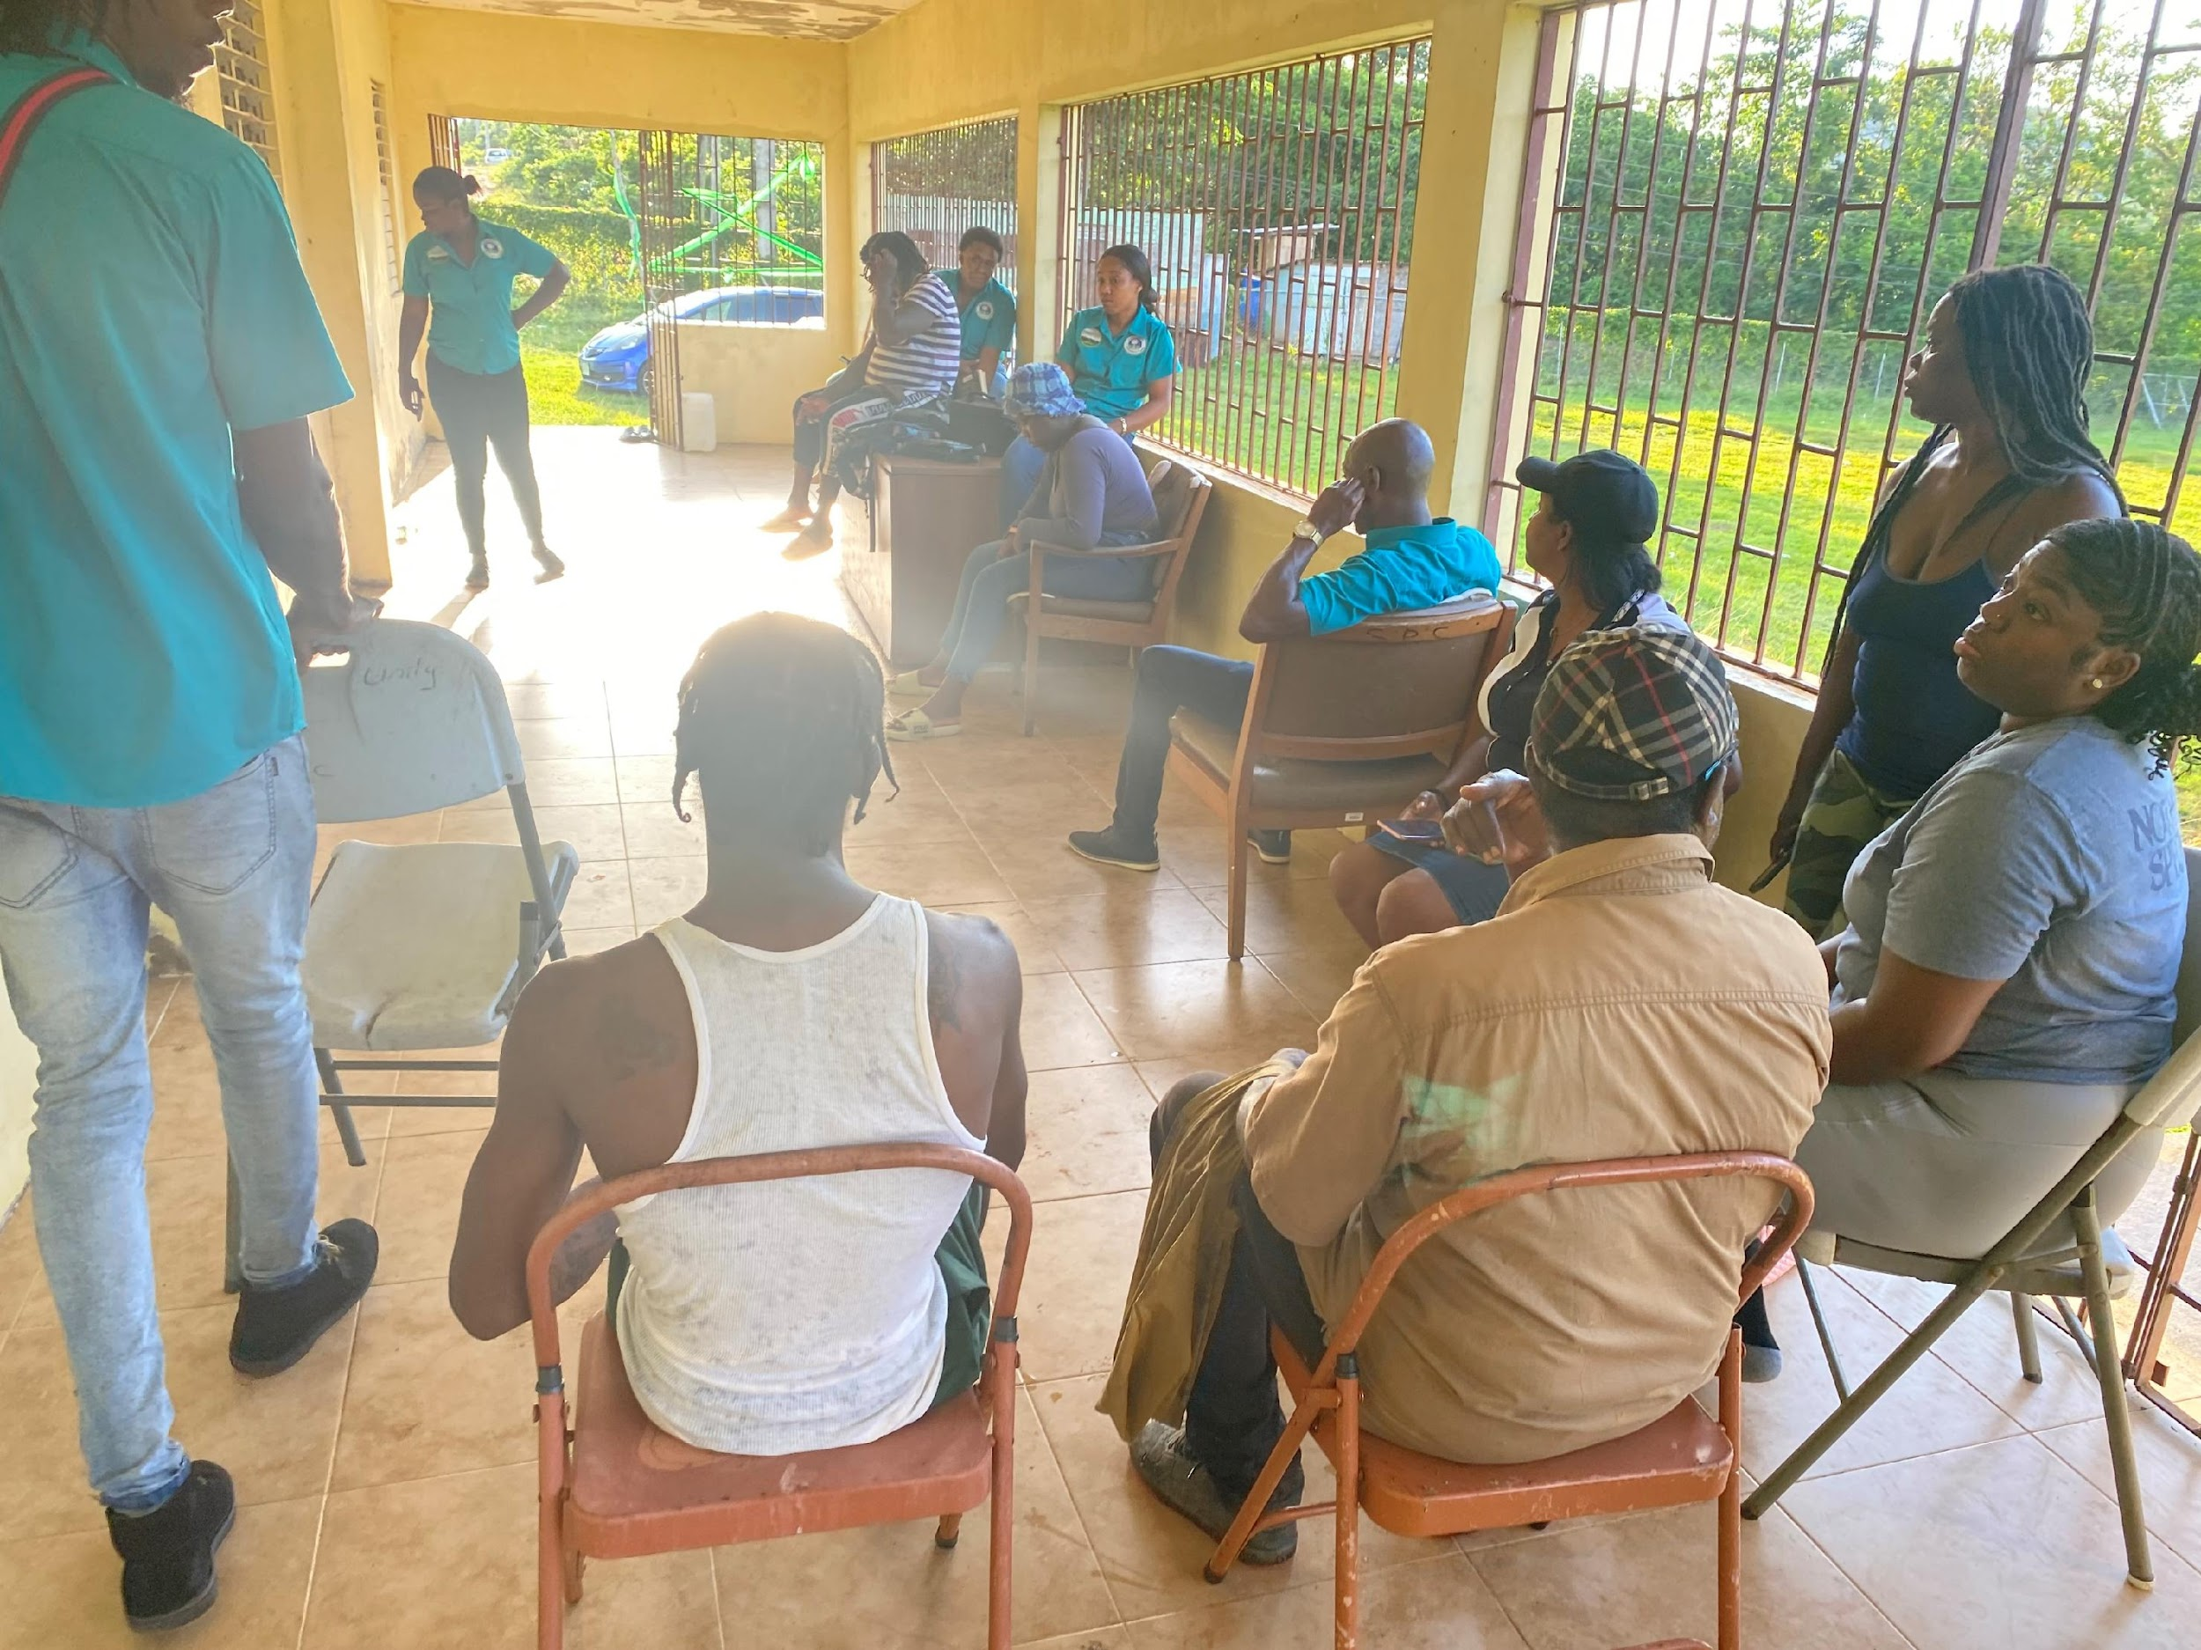
2. To implement a comprehensive intervention program that builds the individual and institutional capacity of new community-based organizations (CBOs) in three target communities for environmental conservation.

Slide 11
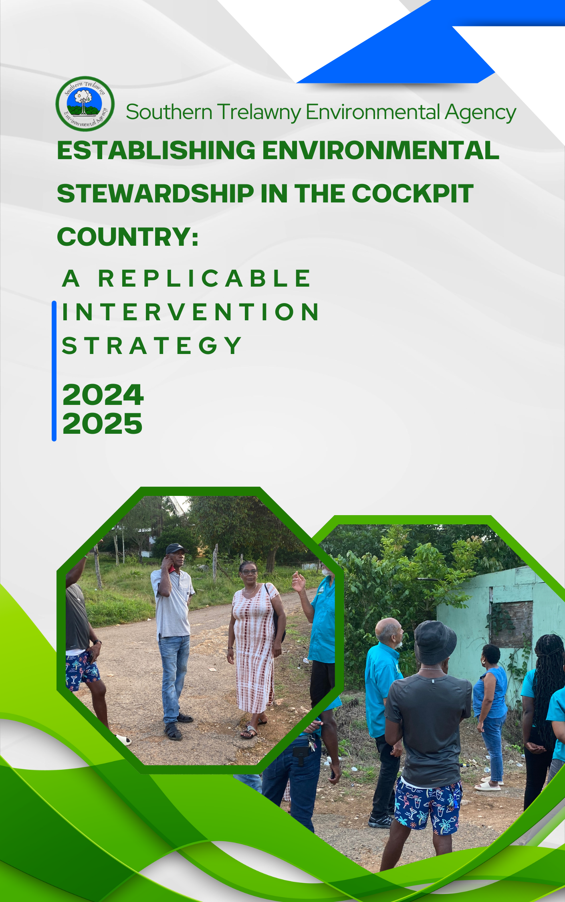
3. Update the documentation of the intervention strategy to include additional lessons learned into the replication toolkit.

Slide 12
Projects Key Milestones
•Identifying and developing key individuals to become robust network of environmentalist across the Cockpit Country
•Mobilizing individuals and framing institutions that can undertake environmental conservation work
•Assembling case studies that serves as a tool to guide communities for effective intervention to advance environmental conservation.

Slide 13
Proposed Use of the Grant Funds (Priorities)
Activity | Details |  |  | $150.00
Project Staff Salaries & Benefits | STEA's technical Outreach team emoluments | 8 project team members engaged in field implementation, data gathering, training, and processing work | $5,100,000.00 | $34,000.00
Leaders Training & Mobilisation | Environmental Leadership Training Creation of Implementation Toolkit | Community development specialist meeting content preparation and presentation and training | $810,000.00 | $5,400.00
Admin | Telecom Printing Supplies | Telecommunications and subscriptions | $501,000.00 | $3,340.00
Transportation & Insurance |  | Project Vehicle, maintenance and petrol over 2 years | $1,439,000.00 | $9,593.33
Materials & Equipment | 3 ipads for fieldwork, Camera | 3 iPads for fieldwork = x 3 Camera - $150,000 | $550,000.00 | $3,666.67

