Slide 1
Website
Building blocks
Marketing
August 2026

Slide 2
Building blocks (overview)
# | Folds | Sub-sections
1 | Intro | 1 | Hero
 |  | 2 | Sub-text
 |  | 3 | Optional - Dynamic announcement / Ticker
2 | Area of work | 1 | Enterprise challenge
 |  | 2 | Enterprise solution
3 | Our solutions - high level | 1 | Infographics / Frameworks: Title
 |  | 2 | Accelerators / Solutions: Title
4 | Outcomes | 1 | Impact areas
 |  | 2 | Success stories / Case studies
5 | Our solutions - details | 1 | Product demos / Videos
 |  | 2 | Specialized tools / Use cases
 |  | 3 | Partners and alliances
6 | Recognitions | 1 | Logos
 |  | 2 | Client testimonials
 |  | 3 | Awards and Recognitions
7 | Visibility / Awareness | 1 | Events, webinars
 |  | 2 | In media
 |  | 3 | Social media posts
8 | Thought Leadership | 1 | Analysts research mentions
 |  | 2 | Whitepapers, articles, blogs
 |  | 3 | Related Reads
9 | Team and connect | 1 | Leadership
 |  | 2 | CTA - Request for consultation

Slide 3
Building blocks (detailed with character count)
# | Folds | Sub-sections |  | Character count
1 | Intro | 1 | Hero | 60
 |  | 2 | Sub-text | 150
 |  | 3 | Optional - Dynamic announcement / Ticker | 60 to 75
2 | Area of work | 1 | Enterprise challenge: Title | 30
 |  |  | Enterprise challenge: Introduction | 80
 |  |  | Enterprise challenge bullet point (upto 6) | 75/point
 |  | 2 | Enterprise solution: Title | 30
 |  |  | Enterprise solution: Subtitle | 50
 |  |  | Enterprise solution: Intro text | 80
3 | Our solutions - high level | 1 | Infographics / Frameworks: Title | 60
 |  | 2 | Accelerators / Solutions: Title | 35
 |  |  | Accelerators / Solutions: Sub-title | 60
 |  |  | Accelerators / Solutions: Points (upto 4) | 85/point
4 | Outcomes | 1 | Impact areas: Title | 35
 |  |  | Impact areas: Subtitle | 55
 |  |  | Impact stats: upto 6 | 90/point
 |  | 2 | Success stories / Case studies | 80/point
5 | Our solutions - details | 1 | Product demos / Videos: Title | 30
 |  |  | Video title | 75
 |  | 2 | Specialized tools / Use cases: Title | 45
 |  |  | Sub-section title (upto 4) | 25/point
 |  |  | Bullet point | 70/point
 |  | 3 | Partners and alliances: Title | 15
6 | Recognitions | 1 | Logos | NA
 |  | 2 | Client testimonials | 250
 |  | 3 | Awards and Recognitions: Title | 40
 |  |  | Recognition: Subtitle | 40
7 | Visibility / Awareness | 1 | Events, webinars | 55
 |  | 2 | In media | 20
 |  | 3 | Social media posts | NA
8 | Thought Leadership | 1 | Analysts research mentions | NA
 |  | 2 | Whitepapers, articles, blogs | NA
 |  | 3 | Related Reads | NA
9 | Team and connect | 1 | Leadership | NA
 |  | 2 | CTA - Request for consultation | ?

Slide 4

1.1 Intro fold
# | Folds | Sub-sections |  | Option 1 character count | Option 2 character count
1 | Intro | 1 | Hero | 60
 |  | 2 | Sub-text | 150
 |  | 3 | Dynamic announcement / Ticker (optional) | 60 to 75
1
2
3

Slide 5
1.2 Intro fold – variant 2
Sr. no |  | Character count
1 | Hero | 60
2 | Sub-text | 150
3 | Optional - Dynamic announcement / Ticker

Slide 6
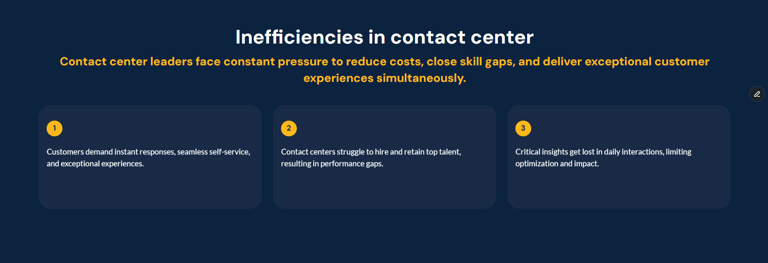
2.1 Area of work – Enterprise challenge
# | Folds | Sub-sections |  | Character count
2 | Area of work | 1 | Enterprise challenge: Title | 30
 |  | 2 | Enterprise challenge: Introduction | 80
 |  | 3 | Enterprise challenge bullet point (upto 6) | 75/point
1
2
3
Variations: Variation 1, Variation 2

Slide 7
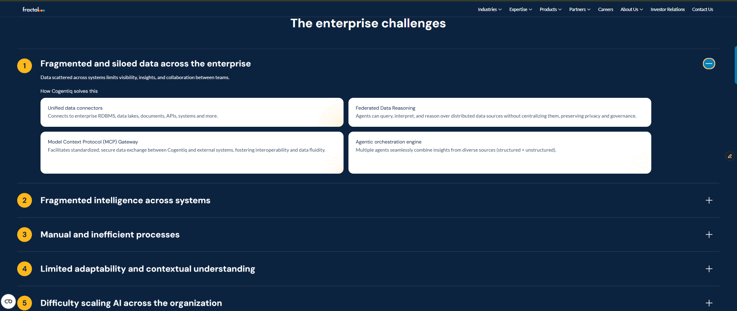
Variation 2.2 Area of work – Enterprise challenge
# | Folds | Sub-sections |  | Character count
2 | Area of work | 1 | Enterprise challenge: Title | 30
 |  | 2 | Enterprise challenge: Introduction | 80
 |  | 3 | Enterprise challenge bullet point (upto 6) | 75/point
1
2
3

Slide 8
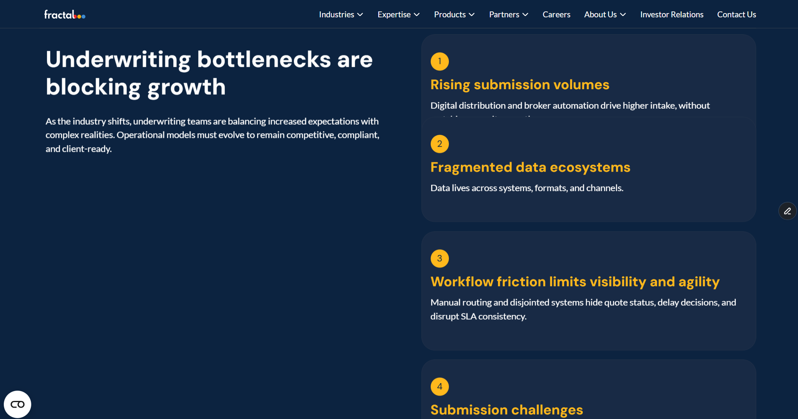
Variation 2. Area of work – Enterprise challenge (Variation)
# | Folds | Sub-sections |  | Character count
2 | Area of work | 1 | Enterprise challenge: Title | 30
 |  | 2 | Enterprise challenge: Introduction | 80
 |  | 3 | Enterprise challenge bullet point (upto 6) | 75/point
1
3
2

Slide 9
2.2 Area of work – Enterprise challenge
# | Folds | Sub-sections |  | Character count
2 | Area of work | 1 | Enterprise challenge: Title | 30
 |  | 2 | Enterprise challenge: Introduction | 80
 |  | 3 | Enterprise challenge bullet point (upto 6) | 75/point
Practice team to provide input.

Slide 10
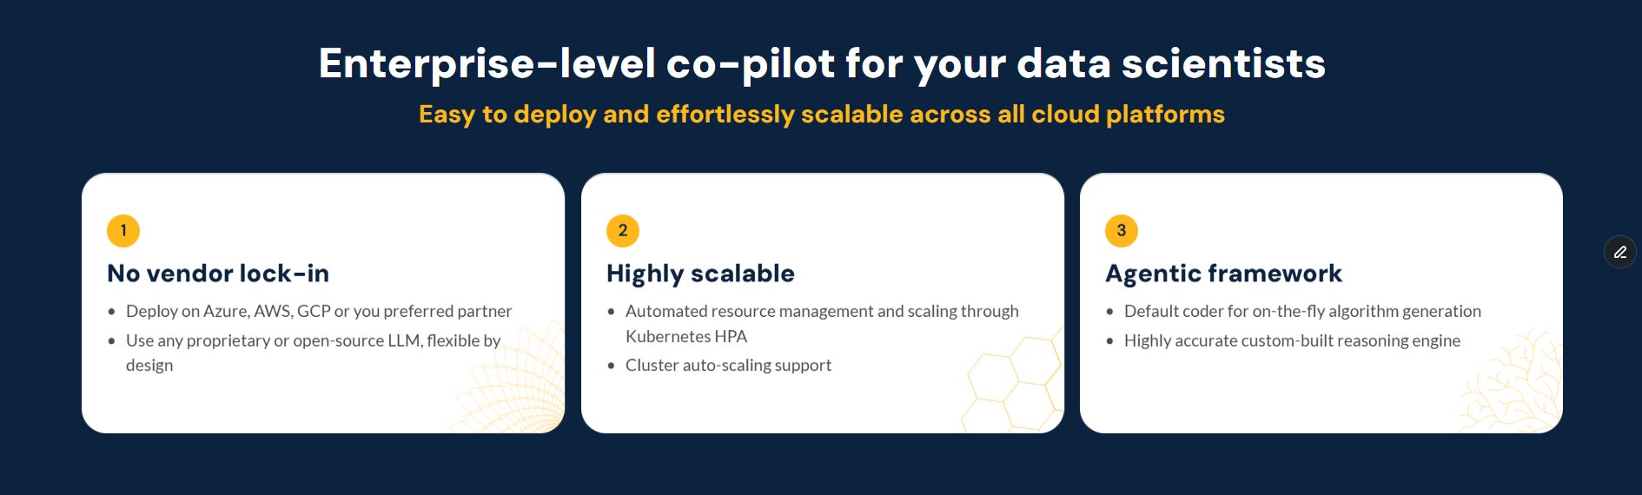
2.3 Area of work – Enterprise Solution
# | Folds | Sub-sections |  | Character count
2 | Area of work | 1 | Enterprise solution: Title | 30
 |  | 2 | Enterprise solution: Subtitle | 50
 |  | 3 | Enterprise solution: Intro text | 80
1
2
3
Variations: Variation 1

Slide 11
2.4 Area of work – Enterprise Solution
# | Folds | Sub-sections |  | Character count
2 | Area of work | 1 | Enterprise solution: Title | 30
 |  | 2 | Enterprise solution: Subtitle | 50
 |  | 3 | Enterprise solution: Intro text | 80
Practice team to provide input.

Slide 12
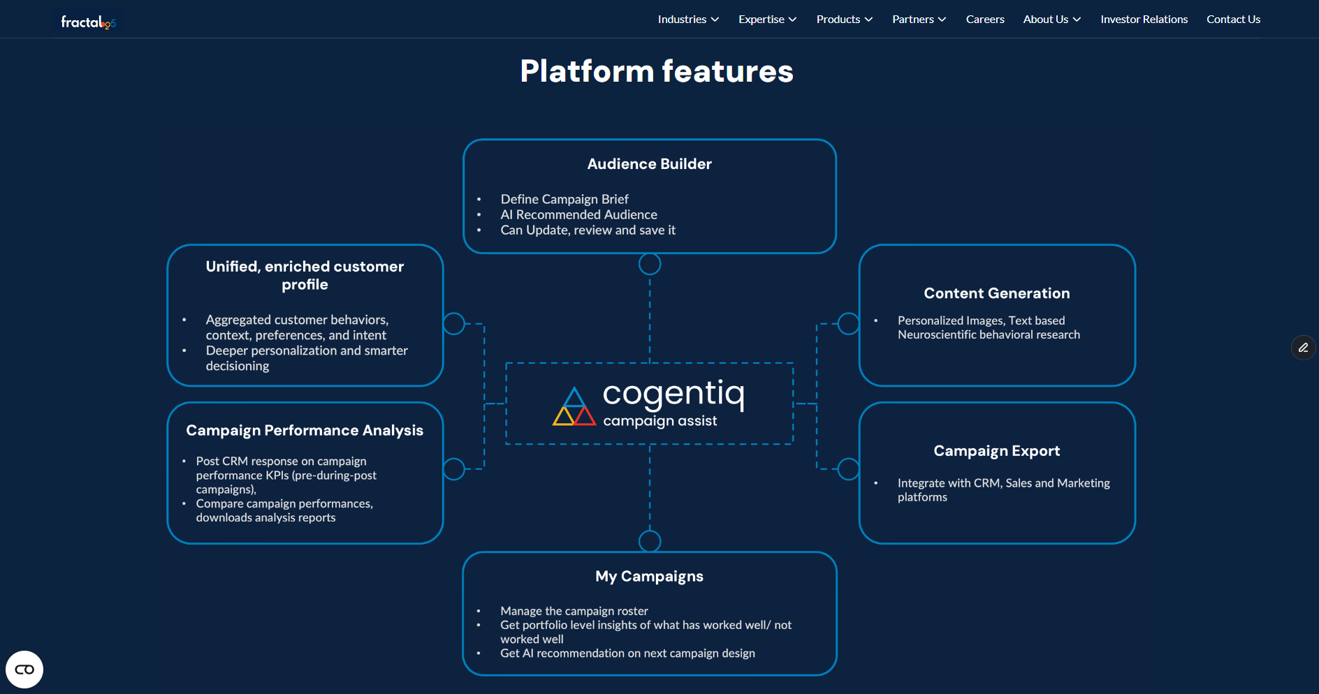
3.1 Our solutions - high level
# | Folds | Sub-sections |  | Character count
3 | Our solutions - high level | 1 | Infographics / Frameworks: Title | 60
 |  | 2 | Accelerators / Solutions: Title | 35
 |  |  | Accelerators / Solutions: Sub-title | 60
 |  |  | Accelerators / Solutions: Points (upto 4) | 85/point
* SME to provide the diagram, marketing to translate per the website design

Slide 13
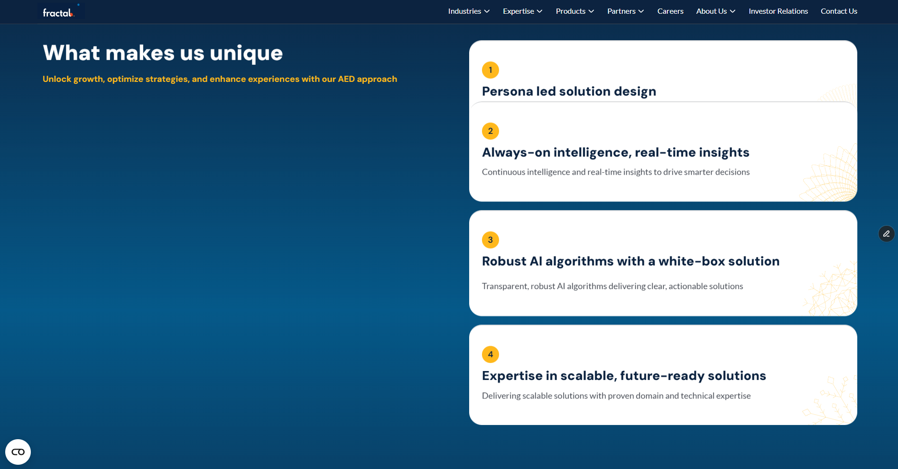
3.2 Our solutions - high level
# | Folds | Sub-sections |  | Character count
3 | Our solutions - high level | 1 | Infographics / Frameworks: Title | 60
 |  | 1 | Accelerators / Solutions: Title | 35
 |  | 2 | Accelerators / Solutions: Sub-title | 60
 |  | 3 | Accelerators / Solutions: Points (upto 4) | 85/point
1
3
2

Slide 14
3.3 Our solutions - high level
# | Folds | Sub-sections |  | Character count
3 | Our solutions - high level | 1 | Infographics / Frameworks: Title | 60
 |  | 1 | Accelerators / Solutions: Title | 35
 |  | 2 | Accelerators / Solutions: Sub-title | 60
 |  | 3 | Accelerators / Solutions: Points (upto 4) | 85/point
Practice team to provide input.

Slide 15
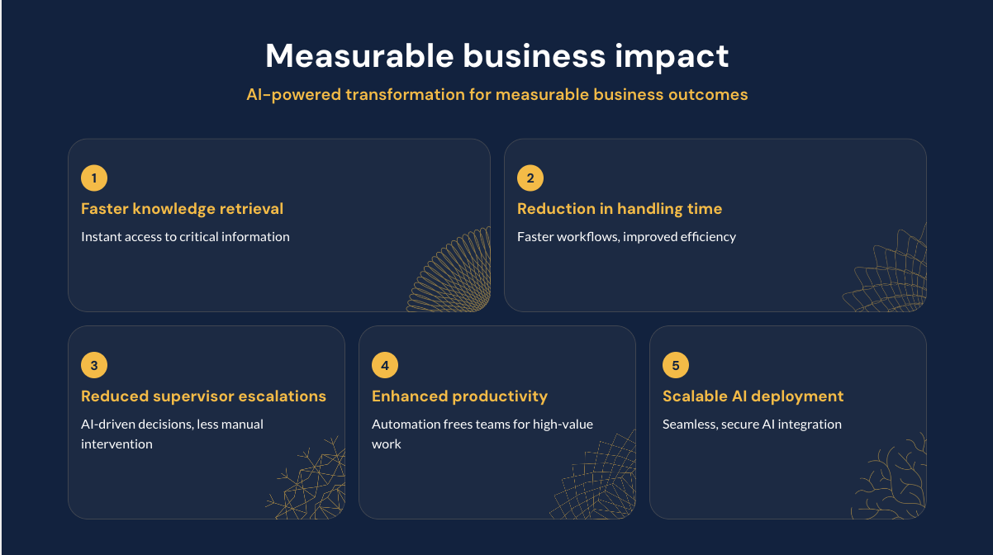
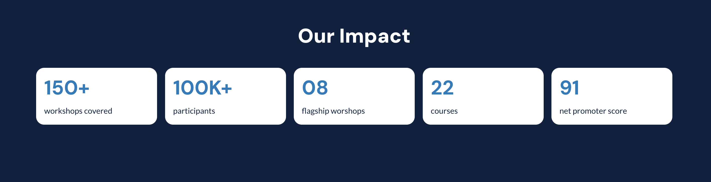
4.1 Outcomes
# | Folds | Sub-sections |  | Character count
4 | Outcomes | 1 | Impact areas: Title | 35
 |  | 2 | Impact areas: Subtitle | 55
 |  | 3 | Impact stats: upto 6 | 90
 |  | 1 | Success stories / Case studies | 80/point
Option 1
Option 2
1
1
2
3
3

Slide 16
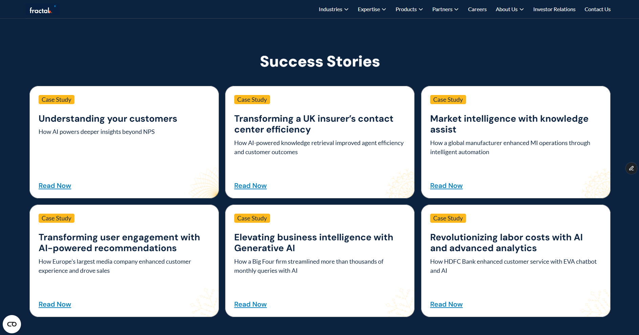
4.2 Outcomes
# | Folds | Sub-sections |  | Character count
4 | Outcomes | 1 | Impact areas: Title | 35
 |  | 2 | Impact areas: Subtitle | 55
 |  | 3 | Impact stats: upto 6 | 90
 |  | 1 | Success stories / Case studies | 80/point

Slide 17
4.3 Outcomes
# | Folds | Sub-sections |  | Character count
4 | Outcomes | 1 | Impact areas: Title | 35
 |  | 2 | Impact areas: Subtitle | 55
 |  | 3 | Impact stats: upto 6 | 90
 |  | 1 | Success stories / Case studies | 80/point
To add a new case study, here’s what we will need:
Fill out all inputs in this case study template
Validate inputs via this content validation form

Slide 18
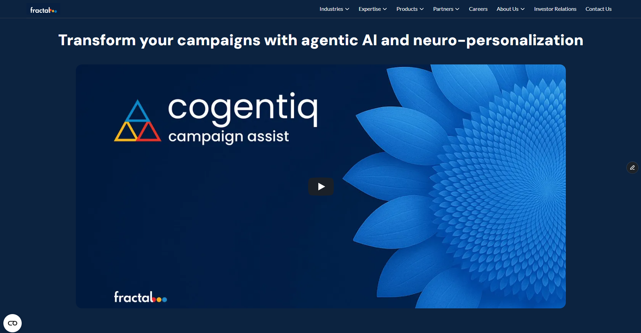
5.1 Our solutions - details
# | Folds | Sub-sections |  | Character count
5 | Our solutions - details | 1 | Product demos / Videos | 30
 |  |  | Video title | 75
 |  | 2
 |  | 1 | Specialized tools / Use cases: Title | 45
 |  | 2 | Sub-section title (upto 4) | 25/point
 |  | 3 | Bullet point | 70/point
 |  | 1 | Partners and alliances: Title | 15
 |  | 2 | Partner description | 250
1
2

Slide 19
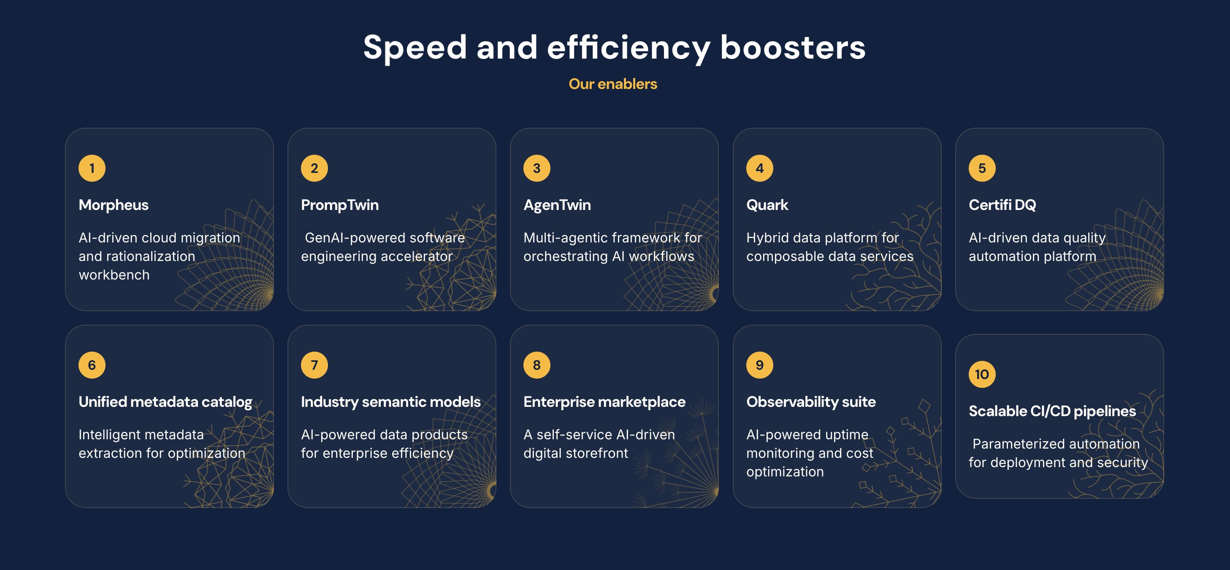
5.2 Our solutions - details
# | Folds | Sub-sections |  | Character count
5 | Our solutions - details | 1 | Product demos / Videos | 30
 |  |  | Video title | 75
 |  | 2
 |  | 1 | Specialized tools / Use cases: Title | 45
 |  | 2 | Sub-section title (upto 4) | 25/point
 |  | 3 | Bullet point | 70/point
 |  | 1 | Partners and alliances | 15
1
2
3

Slide 20
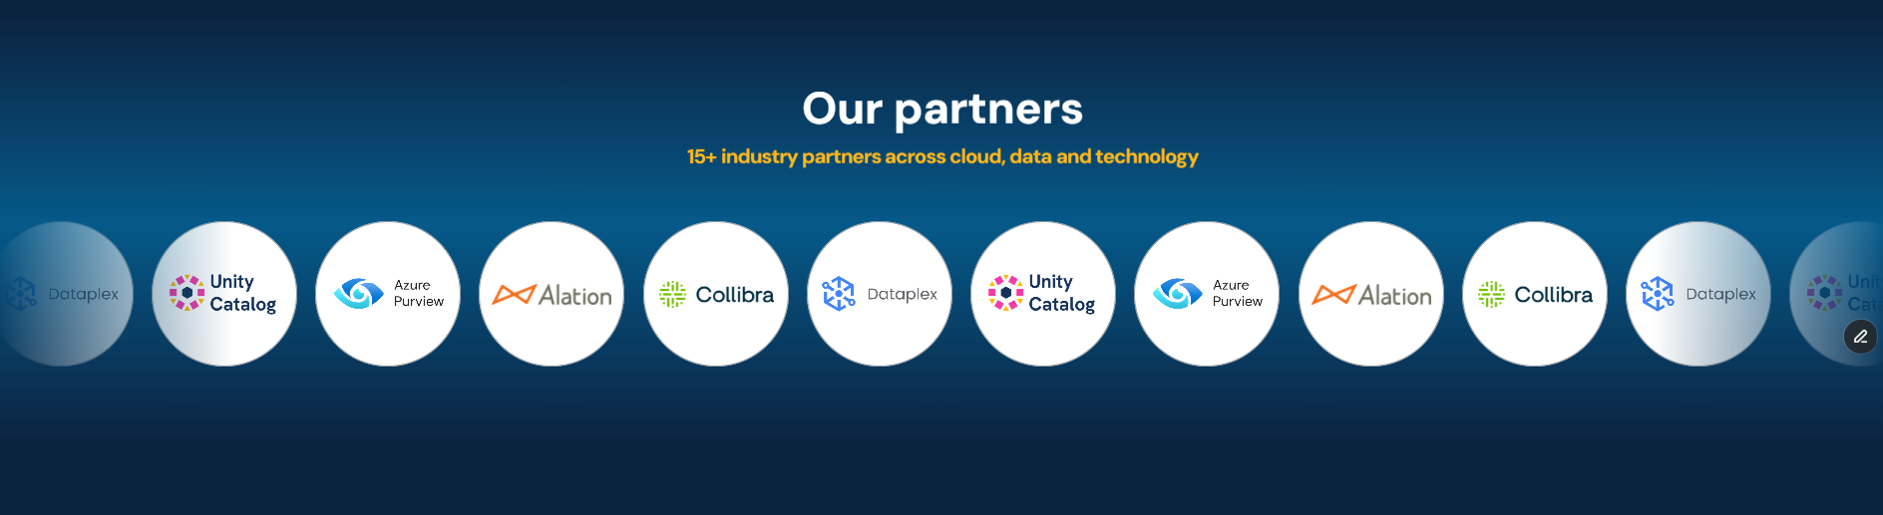
5.3 Our solutions - details
# | Folds | Sub-sections |  | Character count
5 | Our solutions - details | 1 | Product demos / Videos | 30
 |  |  | Video title | 75
 |  | 2
 |  | 1 | Specialized tools / Use cases: Title | 45
 |  | 2 | Sub-section title (upto 4) | 25/point
 |  | 3 | Bullet point | 70/point
 |  | 1 | Partners and alliances | 15

Slide 21
5.4 Our solutions – details
# | Folds | Sub-sections |  | Character count
5 | Our solutions - details | 1 | Product demos / Videos | 30
 |  |  | Video title | 75
 |  | 2
 |  | 1 | Specialized tools / Use cases: Title | 45
 |  | 2 | Sub-section title (upto 4) | 25/point
 |  | 3 | Bullet point | 70/point
 |  | 1 | Partners and alliances | 15
Practice team to provide input.

Slide 22
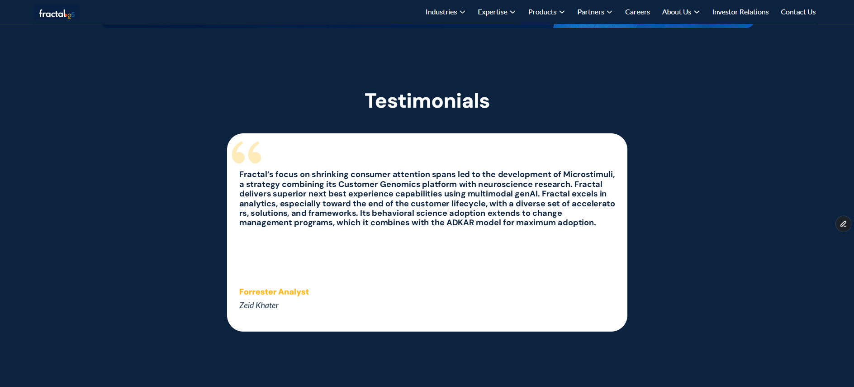
6.1 Recognitions
# | Folds | Sub-sections |  | Character count
6 | Recognitions | 1 | Logos | 0
 |  | 2 | Client testimonials | 250
 |  | 1 | Awards and Recognitions: Title | 40
 |  | 2
 |  |  | Recognition: Subtitle | 40

Slide 23

6.2 Recognitions
# | Folds | Sub-sections |  | Character count
6 | Recognitions | 1 | Logos | 0
 |  | 2 | Client testimonials | 250
 |  | 1 | Awards and Recognitions: Title | 40
 |  | 2 | Recognition: Subtitle | 40
1
2

Slide 24
6.3 Recognitions
# | Folds | Sub-sections |  | Character count
6 | Recognitions | 1 | Logos | 0
 |  | 2 | Client testimonials | 250
 |  | 1 | Awards and Recognitions: Title | 40
 |  | 2 | Recognition: Subtitle | 40
Practice team to provide input.

Slide 25
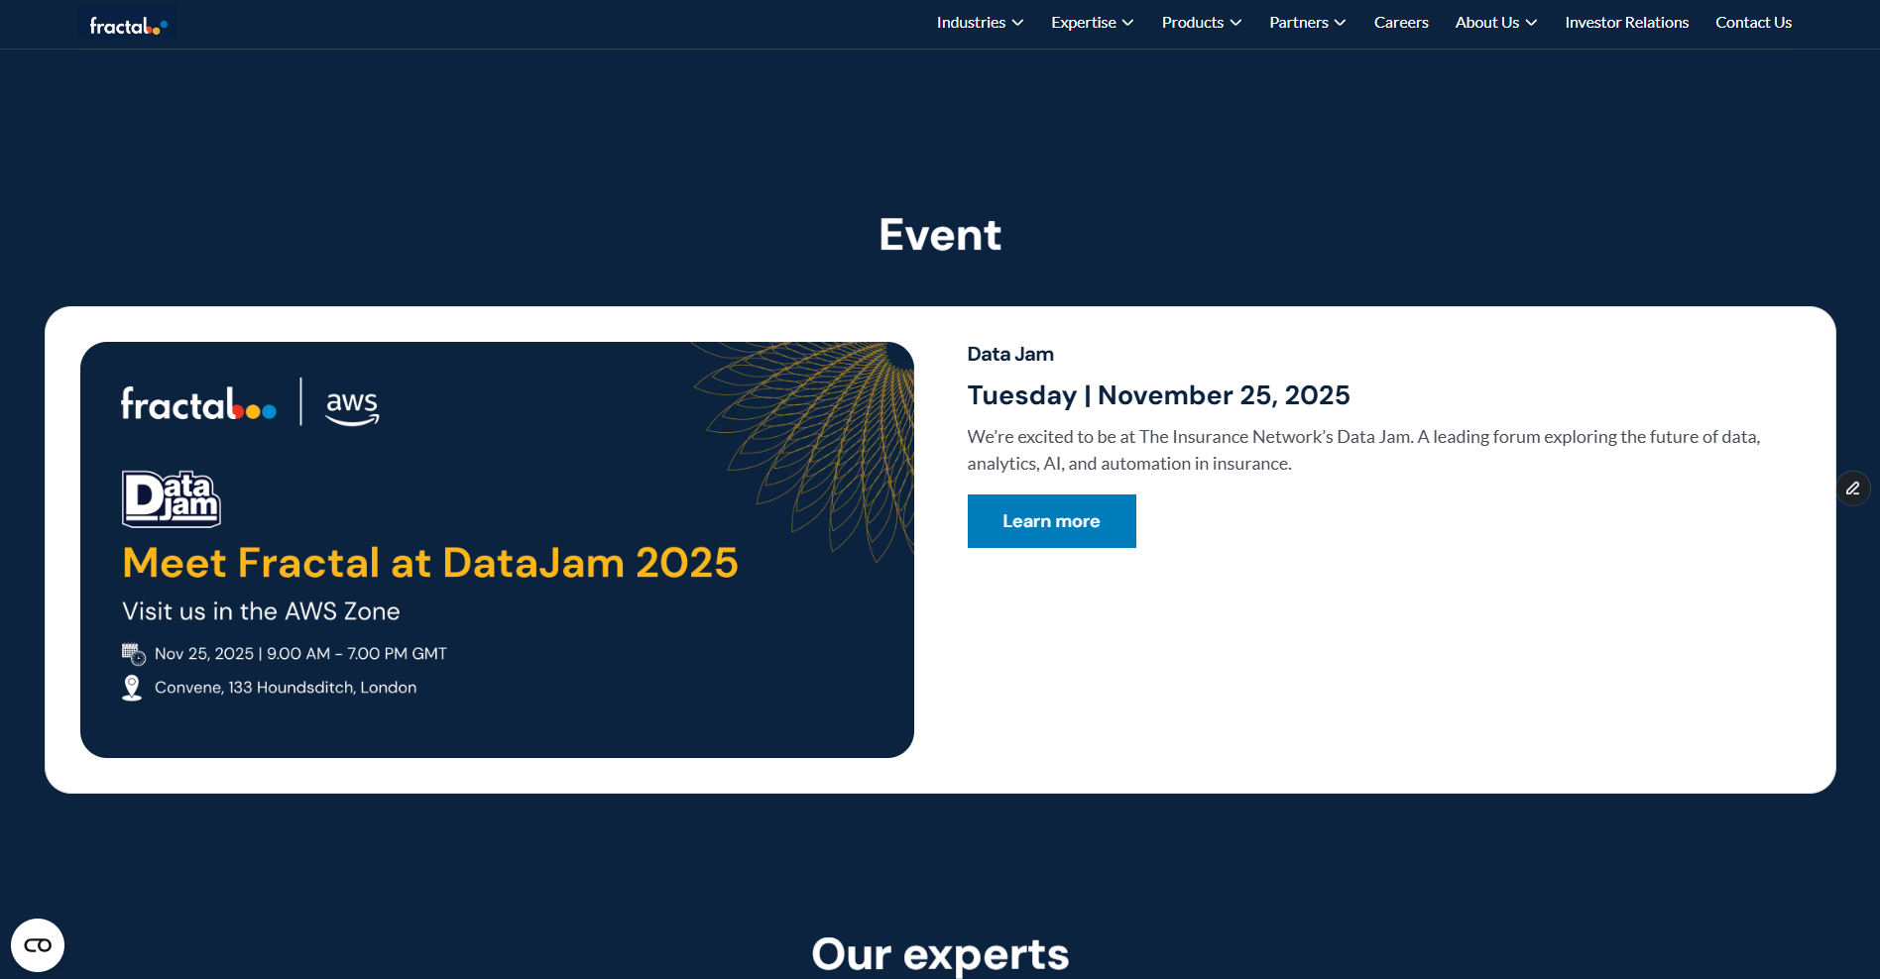
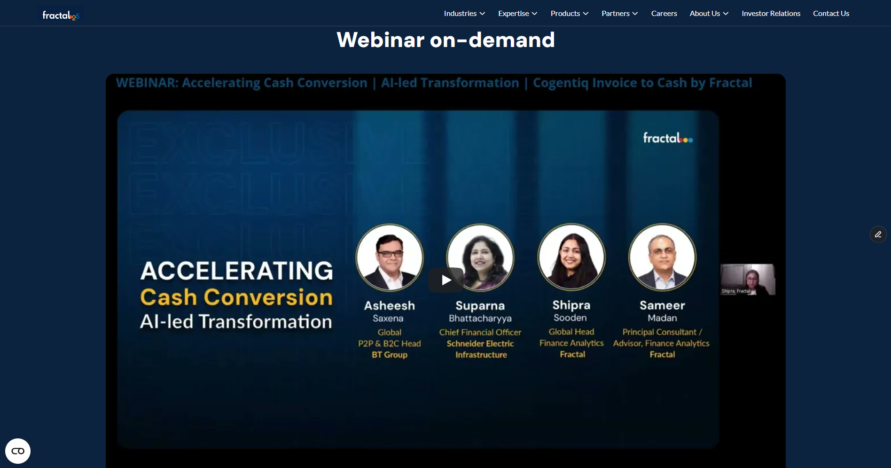
7.1 Visibility / Awareness
# | Folds | Sub-sections |  | Character count
7 | Visibility / Awareness | 1 | Events, webinars | 55
 |  | 2 | In media | 20
 |  | 3 | Social media posts
Event / Webinar
Post event / webinar

Slide 26
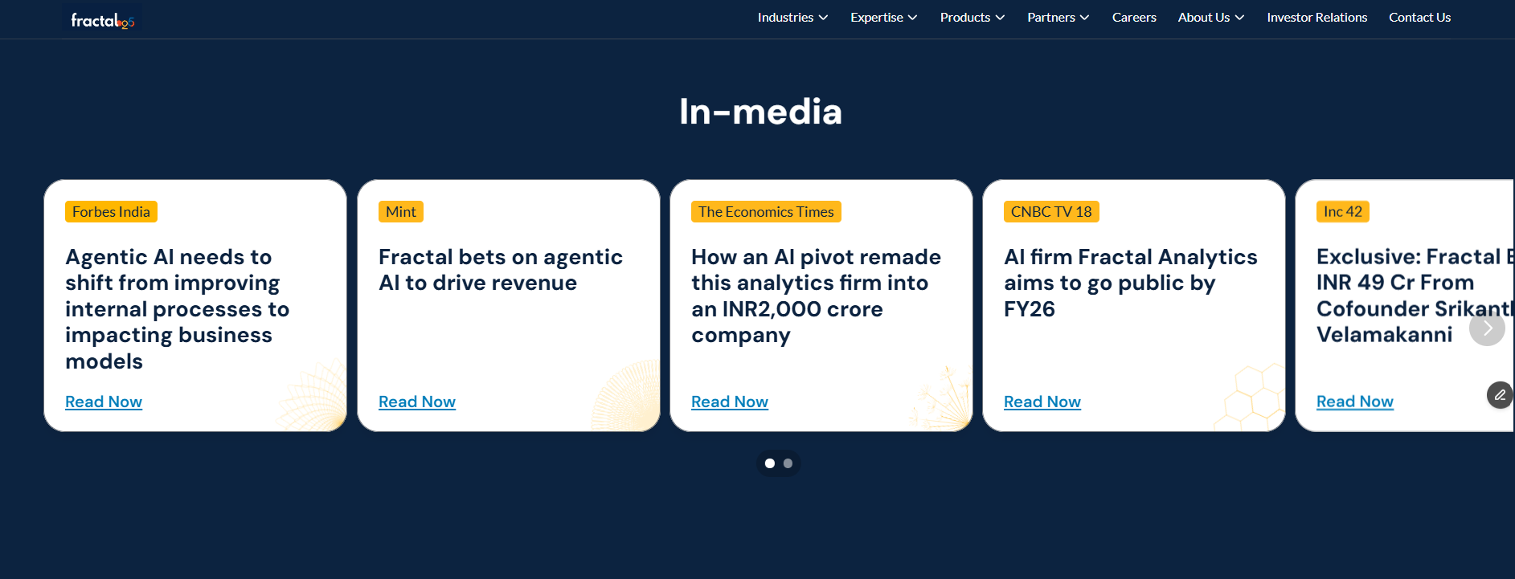
7.2 Visibility / Awareness
# | Folds | Sub-sections |  | Character count
7 | Visibility / Awareness | 1 | Events, webinars | 55
 |  | 2 | In media | 20
 |  | 3 | Social media posts

Slide 27
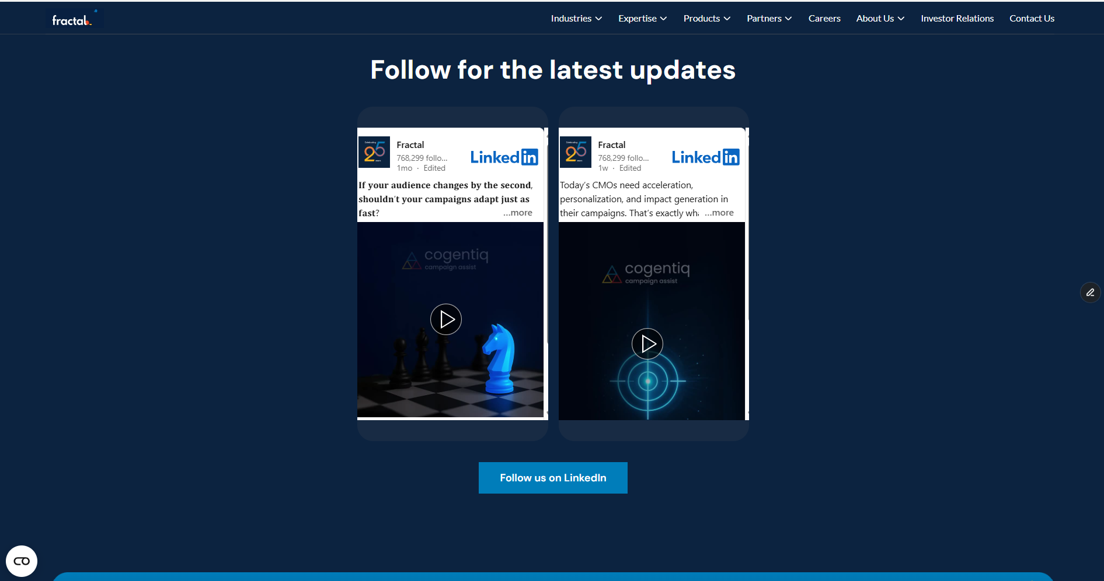
7.3 Visibility / Awareness
# | Folds | Sub-sections |  | Character count
7 | Visibility / Awareness | 1 | Events, webinars | 55
 |  | 2 | In media | 20
 |  | 3 | Social media posts

Slide 28
7.4 Visibility / Awareness
# | Folds | Sub-sections |  | Character count
7 | Visibility / Awareness | 1 | Events, webinars | 55
 |  | 2 | In media | 20
 |  | 3 | Social media posts
Practice team to provide input.

Slide 29
8.1 Thought Leadership
# | Folds | Sub-sections |  | Character count
8 | Thought Leadership | 1 | Analysts research mentions
 |  | 2 | Whitepapers, articles, blogs
 |  | 3 | Related Reads

Slide 30

8.2 Thought Leadership
# | Folds | Sub-sections |  | Character count
8 | Thought Leadership | 1 | Analysts research mentions
 |  | 2 | Whitepapers, articles, blogs
 |  | 3 | Related Reads

Slide 31
8.3 Thought Leadership
# | Folds | Sub-sections |  | Character count
8 | Thought Leadership | 1 | Analysts research mentions
 |  | 2 | Whitepapers, articles, blogs
 |  | 3 | Related Reads
* Applicable only on article pages and blogs.

Slide 32
8.4 Thought Leadership
# | Folds | Sub-sections |  | Character count
8 | Intro | 1 | Analysts research mentions
 |  | 2 | Whitepapers, articles, blogs
 |  | 3 | Related Reads
Practice team to provide input.

Slide 33
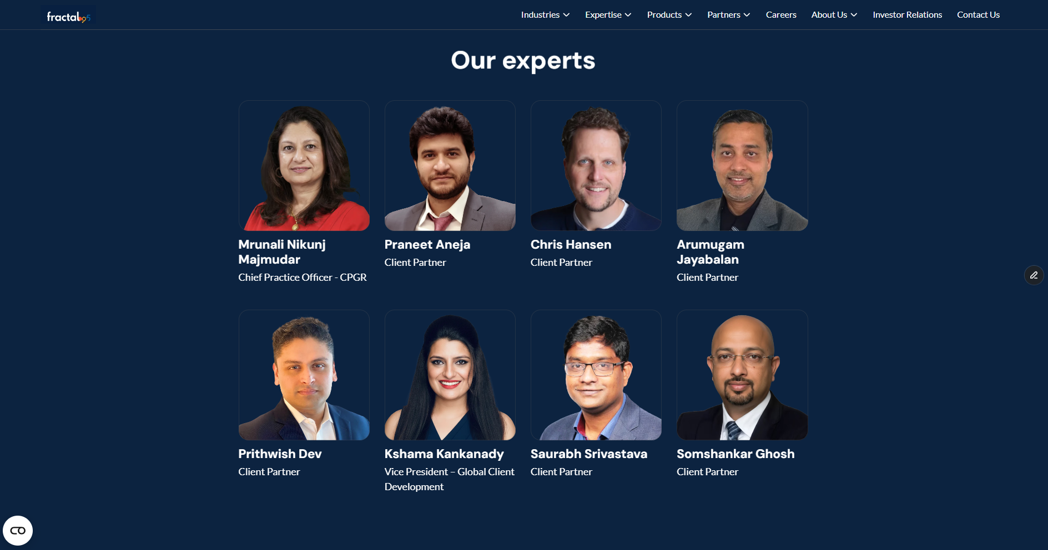
9.1 Thought Leadership
# | Folds | Sub-sections |  | Character count
9 | Team and connect | 1 | Leadership
 |  | 2 | CTA - Request for consultation

Slide 34
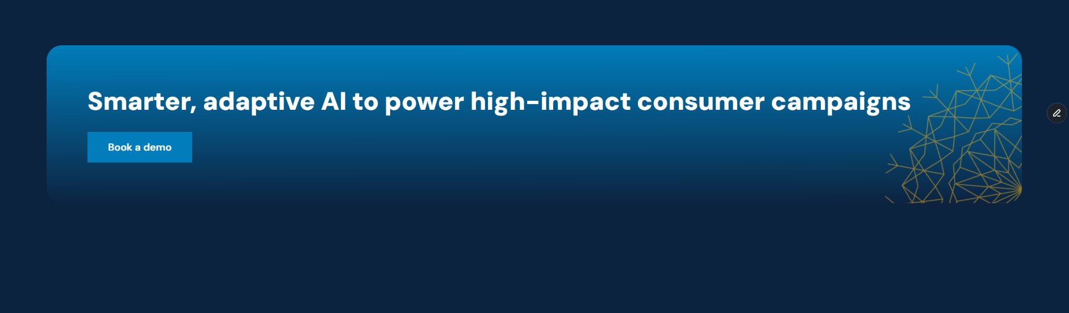
9.2 Thought Leadership
# | Folds | Sub-sections |  | Character count
9 | Team and connect | 1 | Leadership
 |  | 2 | CTA - Request for consultation

Slide 35
9.3 Thought Leadership
# | Folds | Sub-sections |  | Character count
9 | Team and connect | 1 | Leadership
 |  | 2 | CTA - Request for consultation
Practice team to provide input.

Slide 36
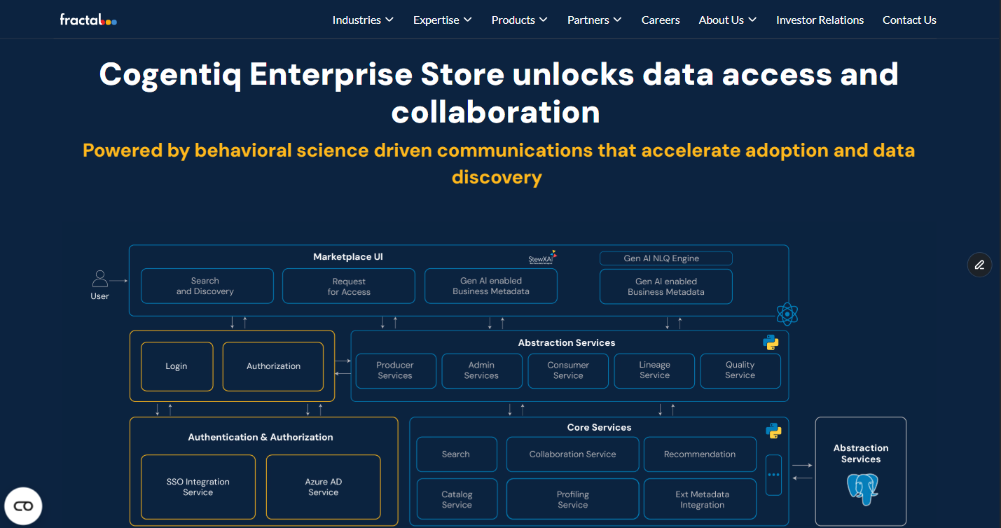
Variation 1 - Area of work – Enterprise Solution
# | Folds | Sub-sections |  | Character count
2 | Area of work | 1 | Enterprise solution: Title | 30
 |  | 2 | Enterprise solution: Subtitle | 50
1
2

Slide 37
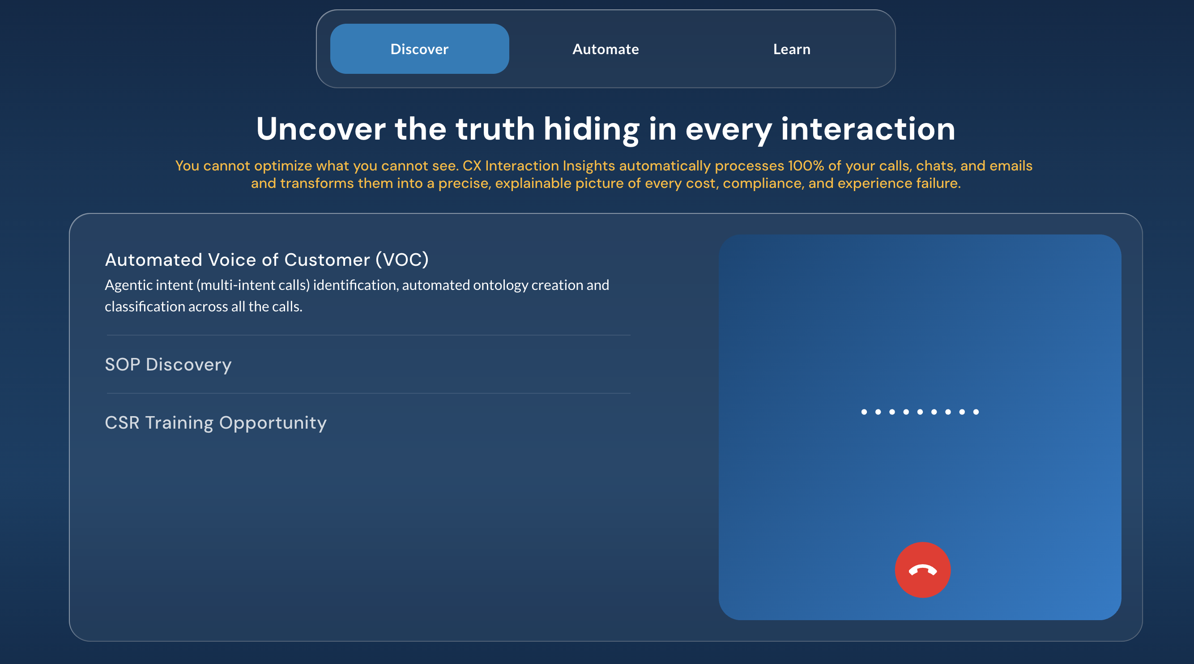
3. Our Solutions – details
# | Folds | Sub-sections |  | Character count
2 | Area of work | 1 | Enterprise solution: Title | 30
 |  | 2 | Enterprise solution: Subtitle | 50

Slide 38

3. Our Solutions
# | Folds | Sub-sections |  | Character count
2 | Area of work | 1 | Enterprise solution: Title | 30
 |  | 2 | Enterprise solution: Subtitle | 50

Slide 39
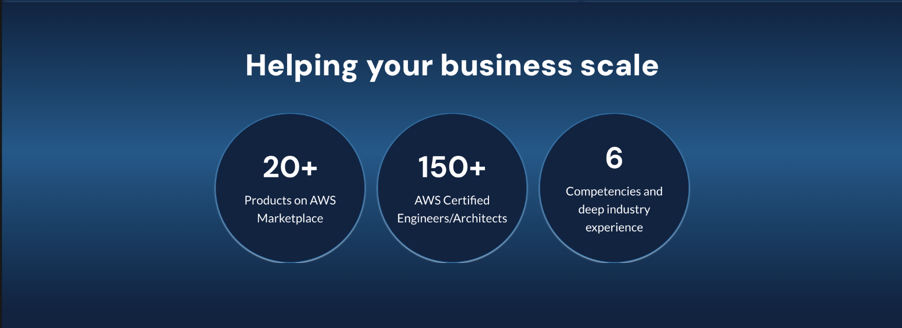
6. Recognitions
# | Folds | Sub-sections |  | Character count
2 | Area of work | 1 | Enterprise solution: Title | 30
 |  | 2 | Enterprise solution: Subtitle | 50

Slide 40
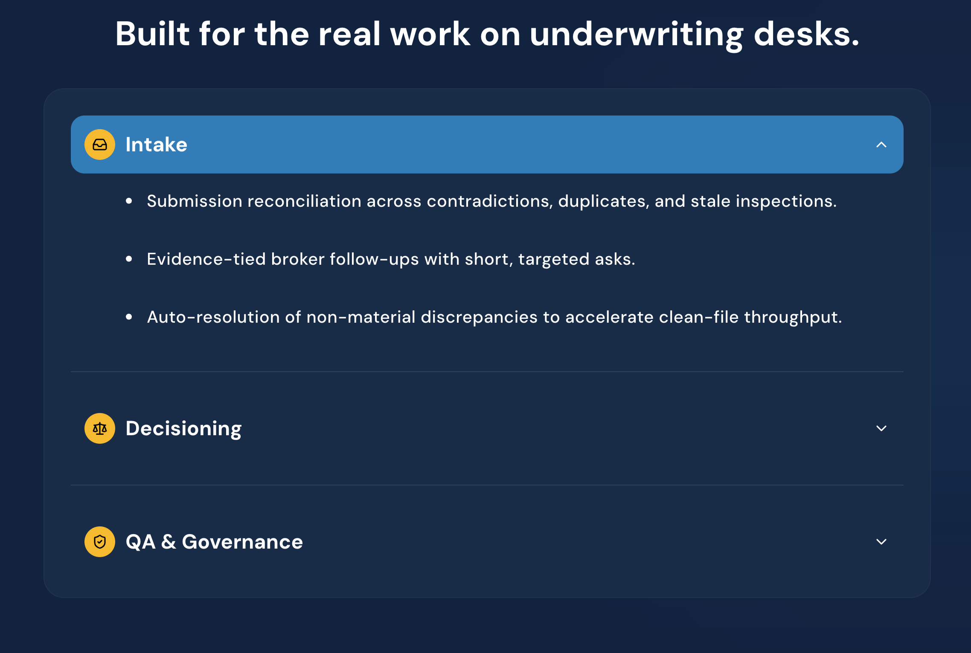
3. Our Solutions
# | Folds | Sub-sections |  | Character count
2 | Area of work | 1 | Enterprise solution: Title | 30
 |  | 2 | Enterprise solution: Subtitle | 50

Slide 41
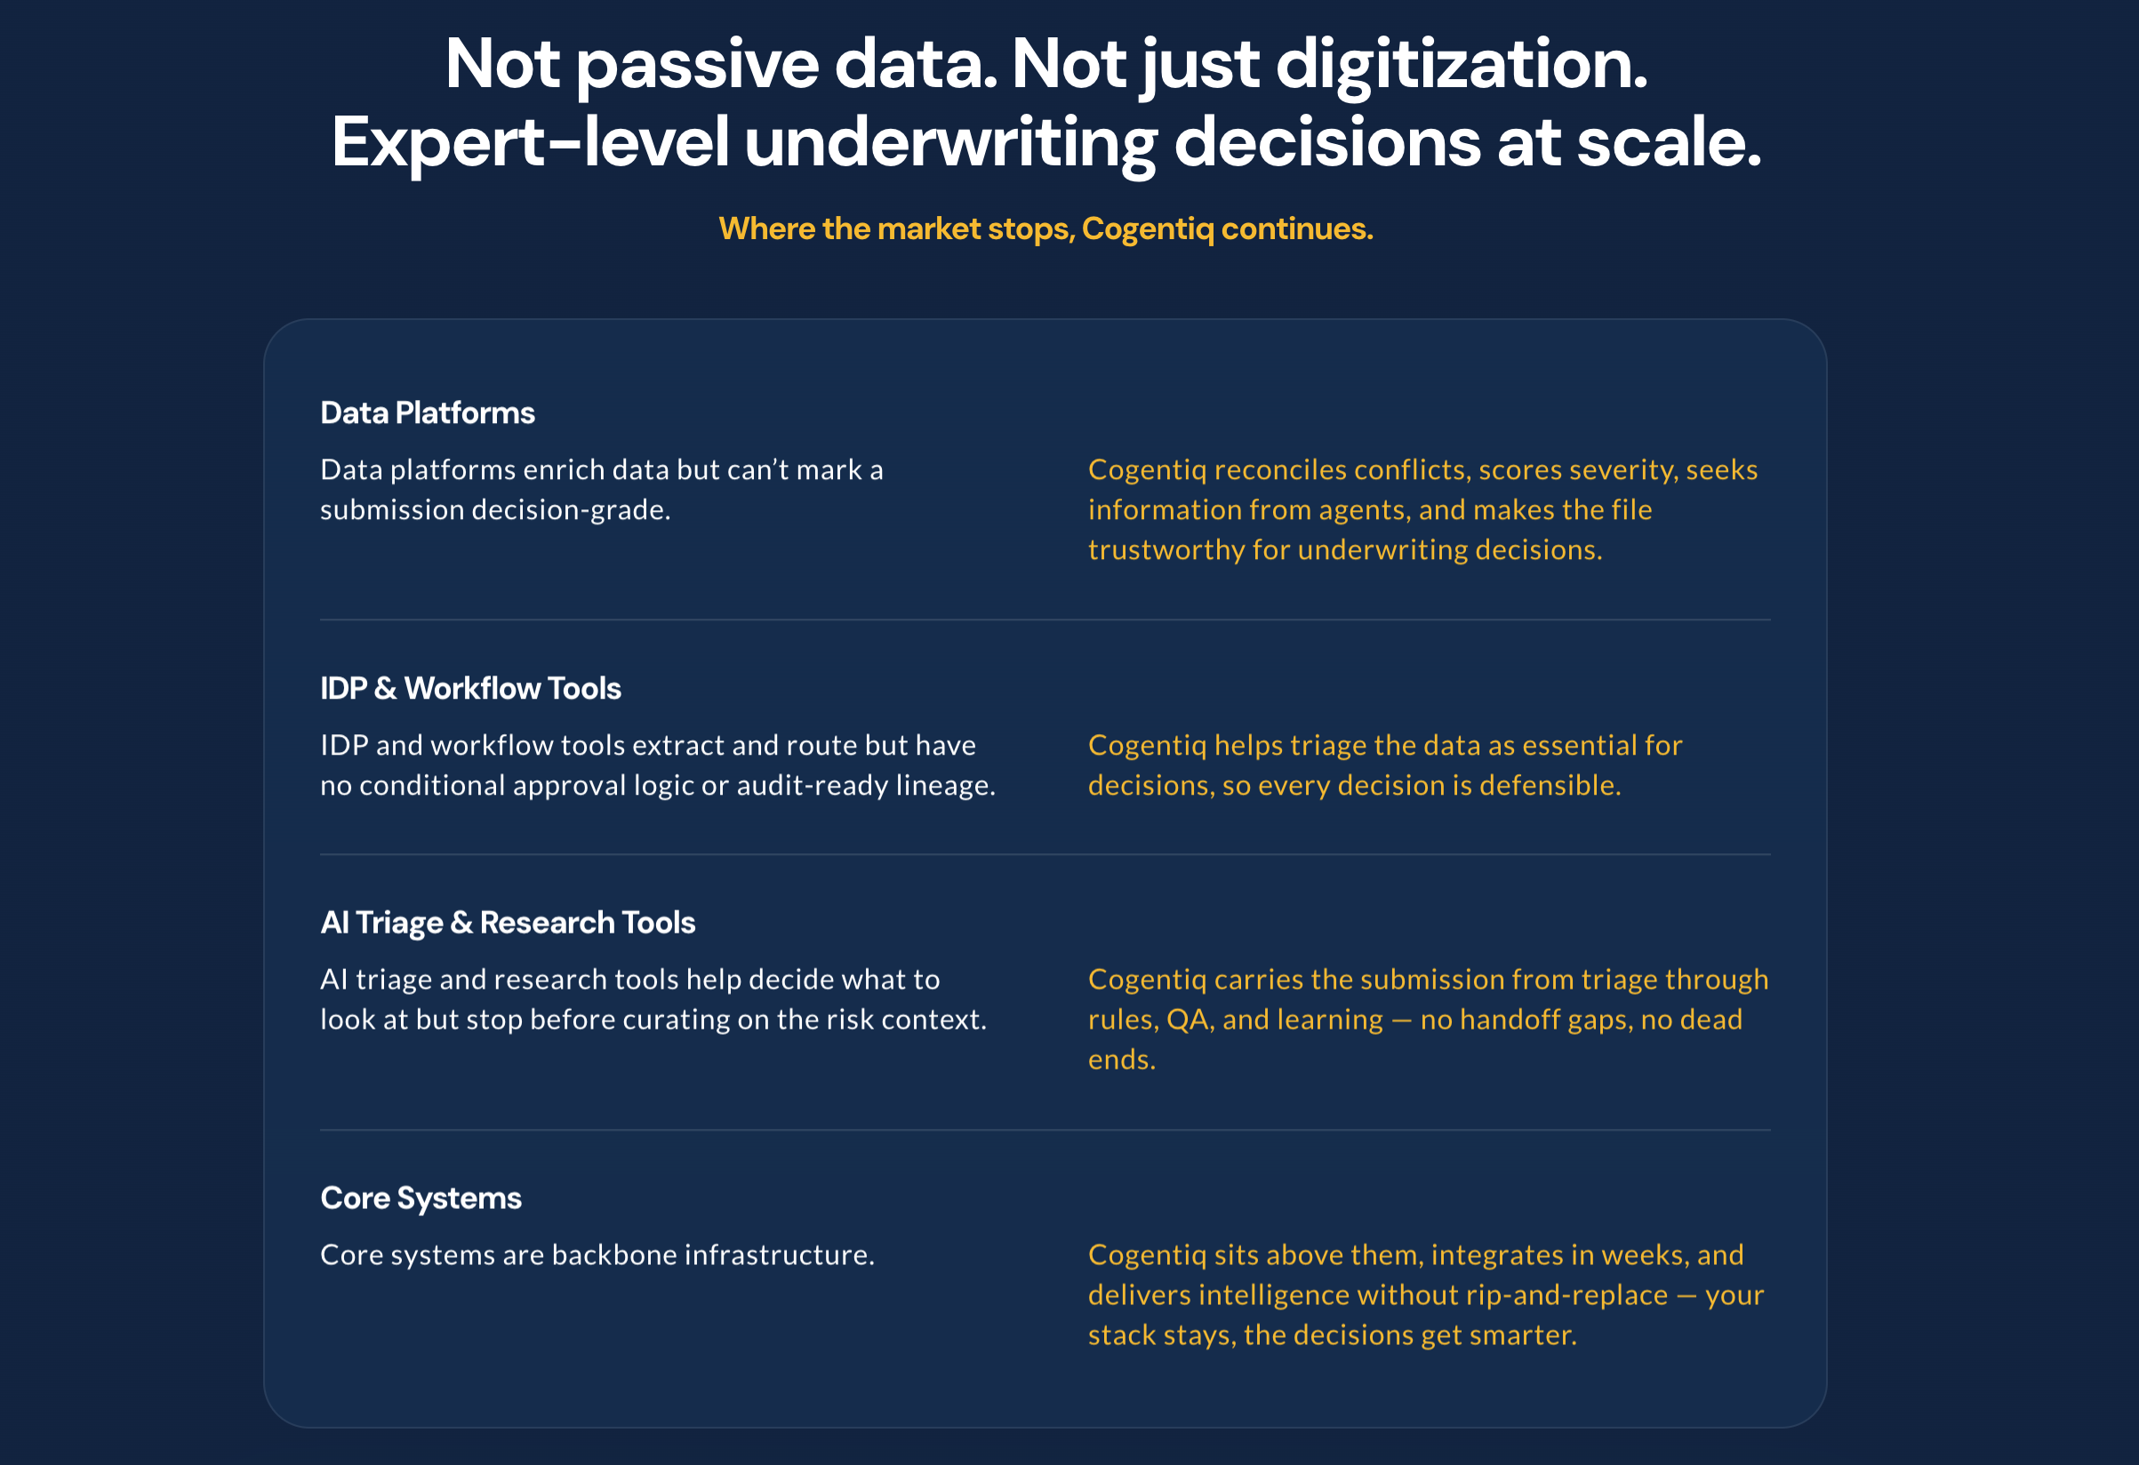
3. Our solutions - details
# | Folds | Sub-sections |  | Character count
2 | Area of work | 1 | Enterprise solution: Title | 30
 |  | 2 | Enterprise solution: Subtitle | 50

Slide 42
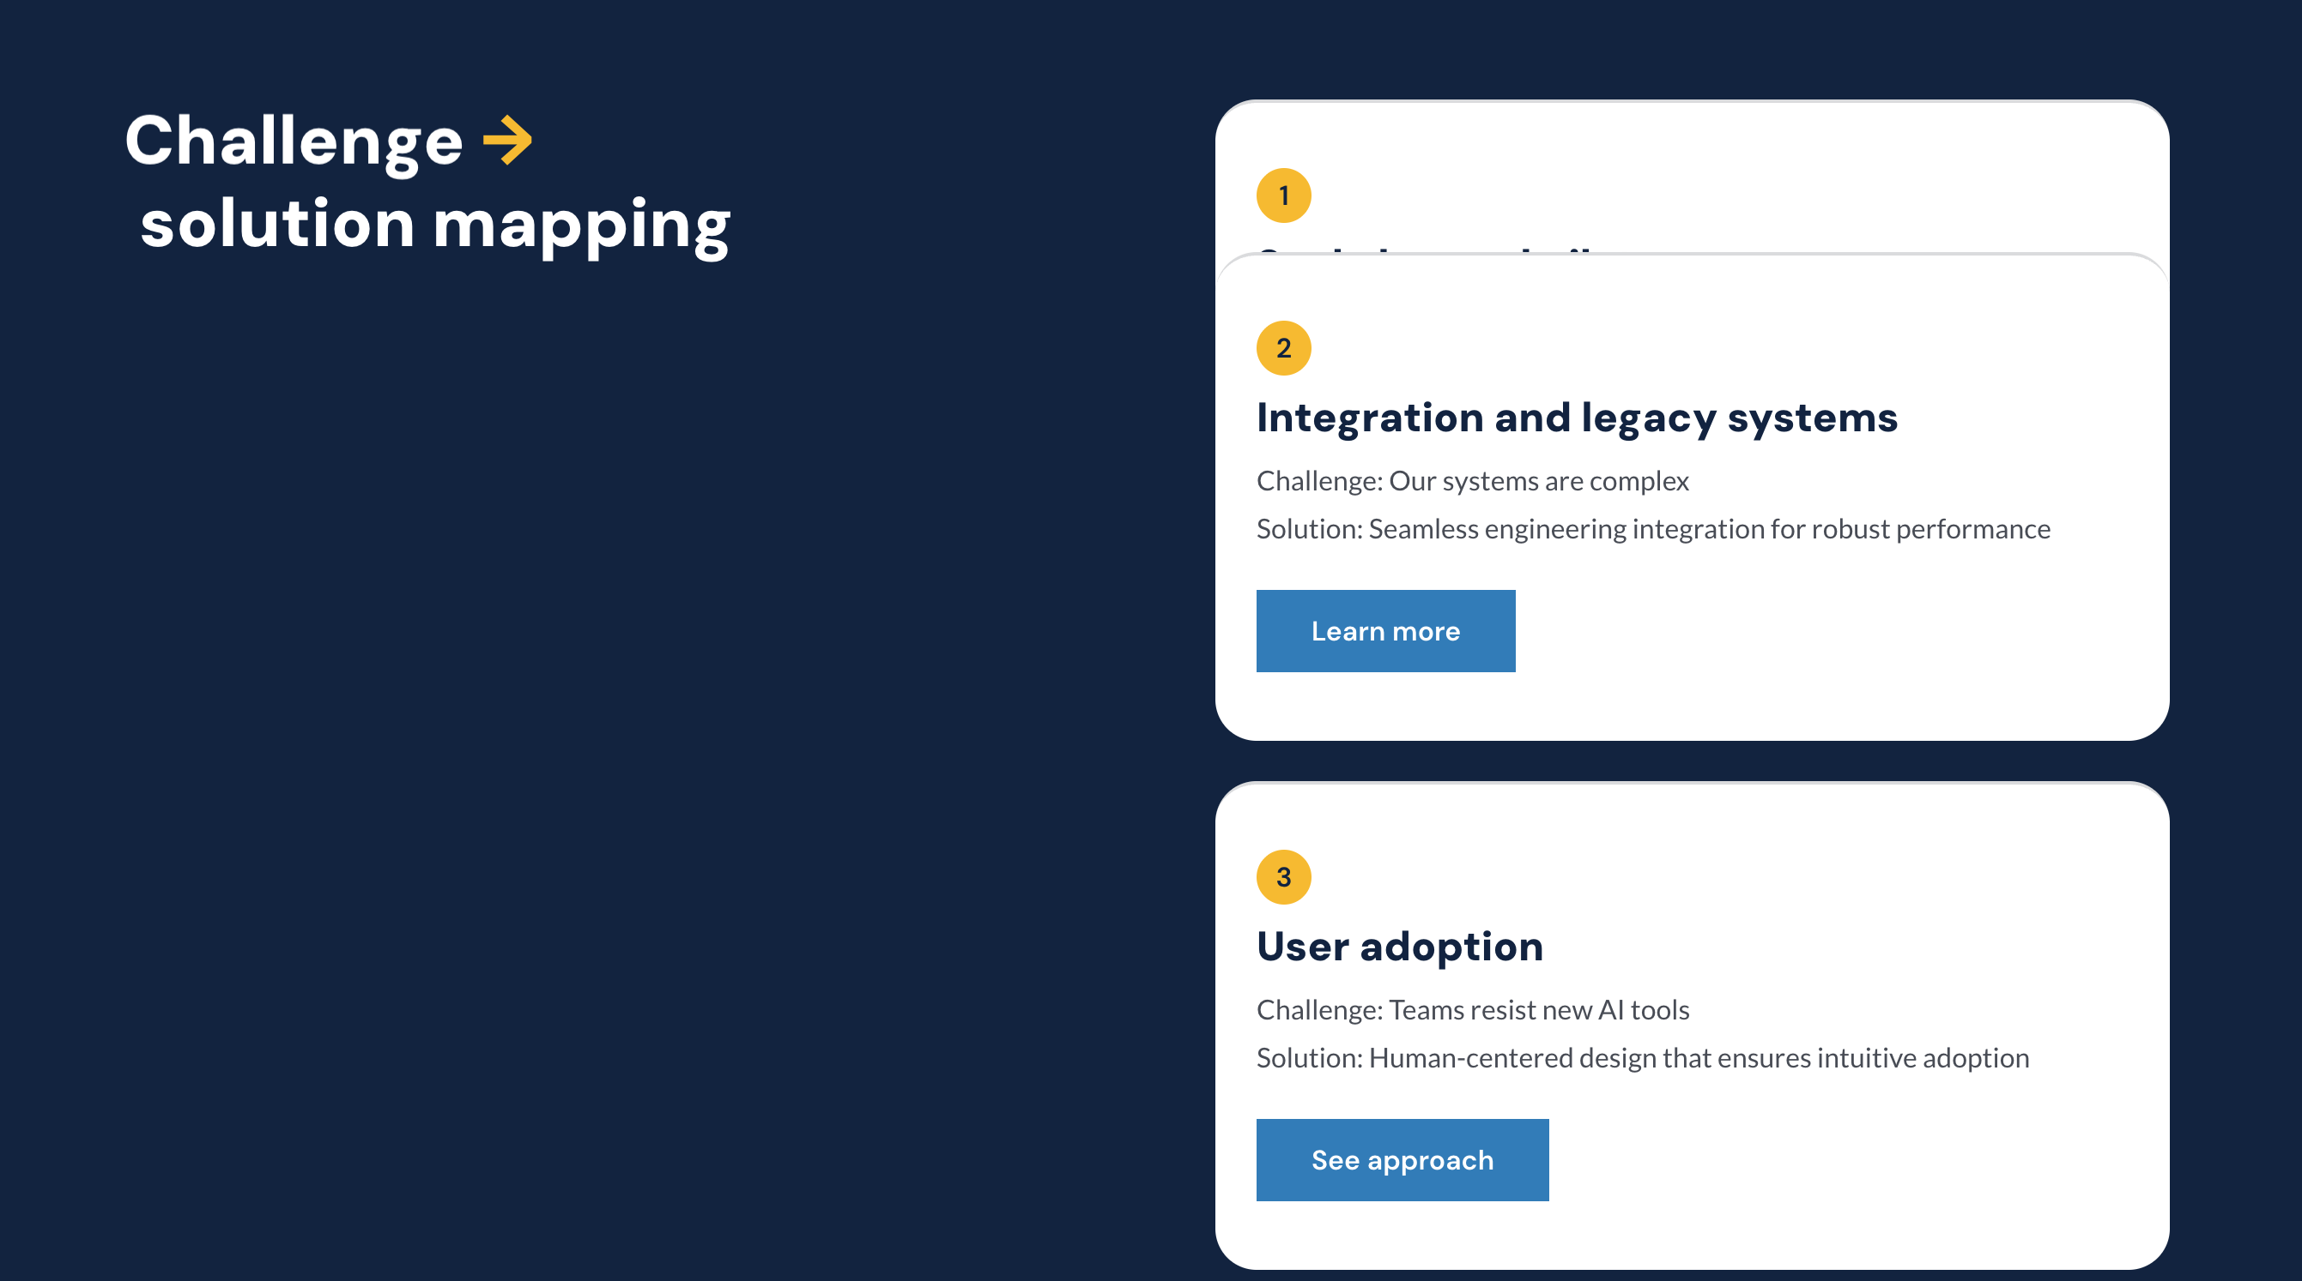
2. Area of work - Challenge
# | Folds | Sub-sections |  | Character count
2 | Area of work | 1 | Enterprise solution: Title | 30
 |  | 2 | Enterprise solution: Subtitle | 50

Slide 43
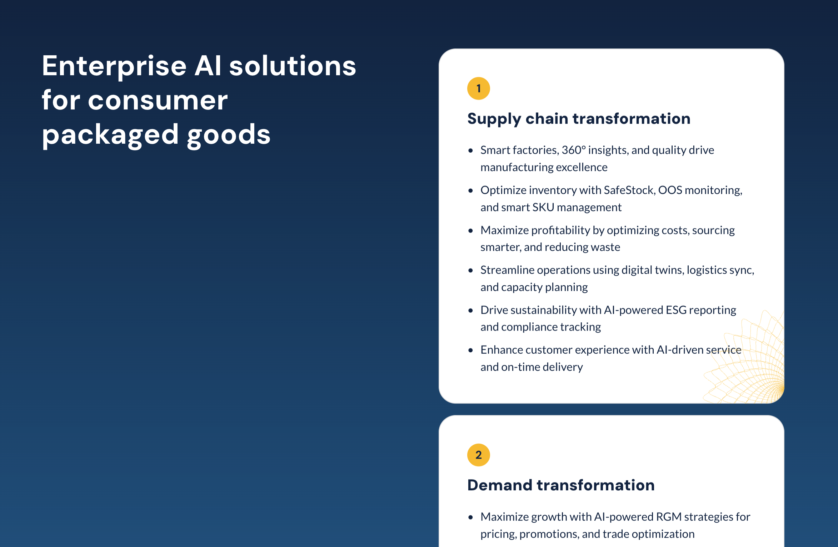
3. Our solutions - high level
# | Folds | Sub-sections |  | Character count
2 | Area of work | 1 | Enterprise solution: Title | 30
 |  | 2 | Enterprise solution: Subtitle | 50

Slide 44

2. Our solutions - high level
# | Folds | Sub-sections |  | Character count
2 | Area of work | 1 | Enterprise solution: Title | 30
 |  | 2 | Enterprise solution: Subtitle | 50

Slide 45
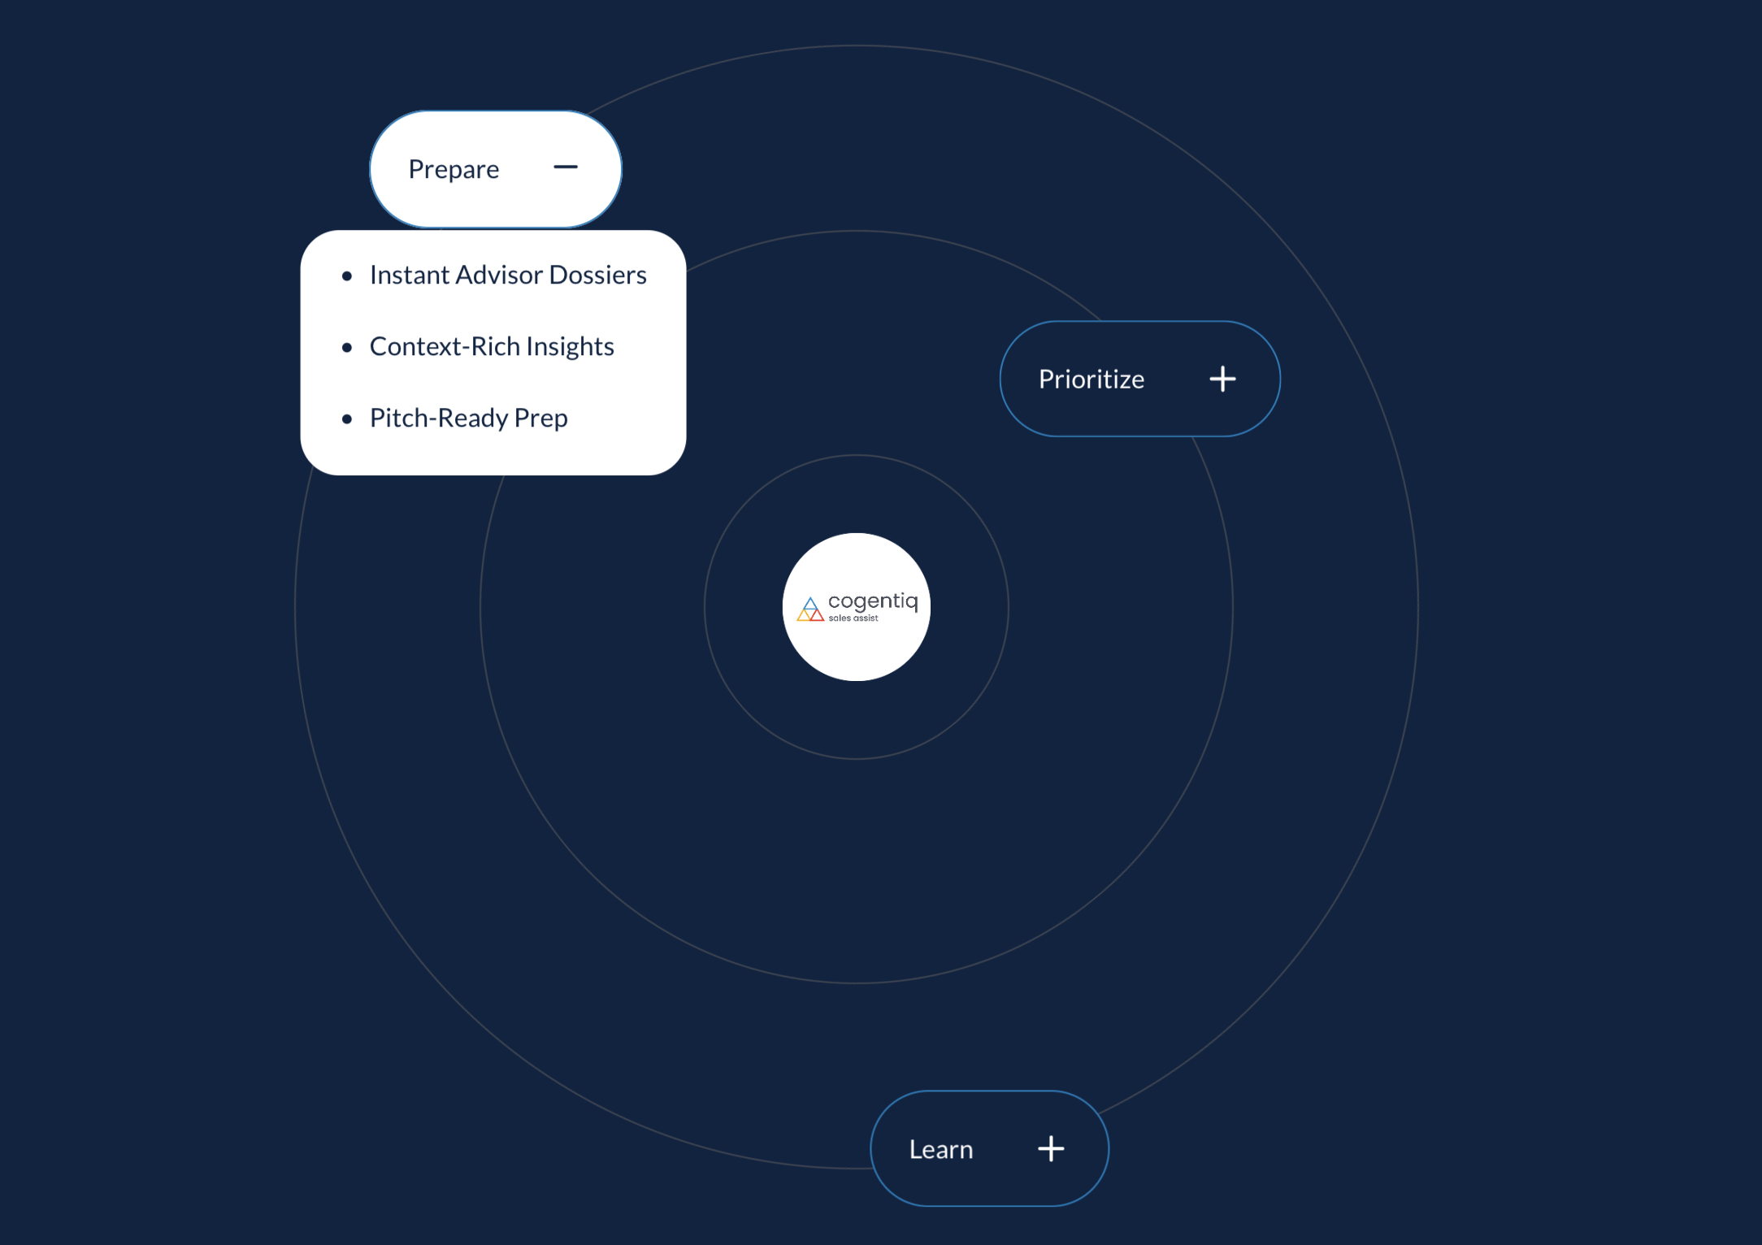
2. Enterprise - Solution
# | Folds | Sub-sections |  | Character count
2 | Area of work | 1 | Enterprise solution: Title | 30
 |  | 2 | Enterprise solution: Subtitle | 50

Slide 46

7. Webinar
# | Folds | Sub-sections |  | Character count
2 | Area of work | 1 | Enterprise solution: Title | 30
 |  | 2 | Enterprise solution: Subtitle | 50

Slide 47
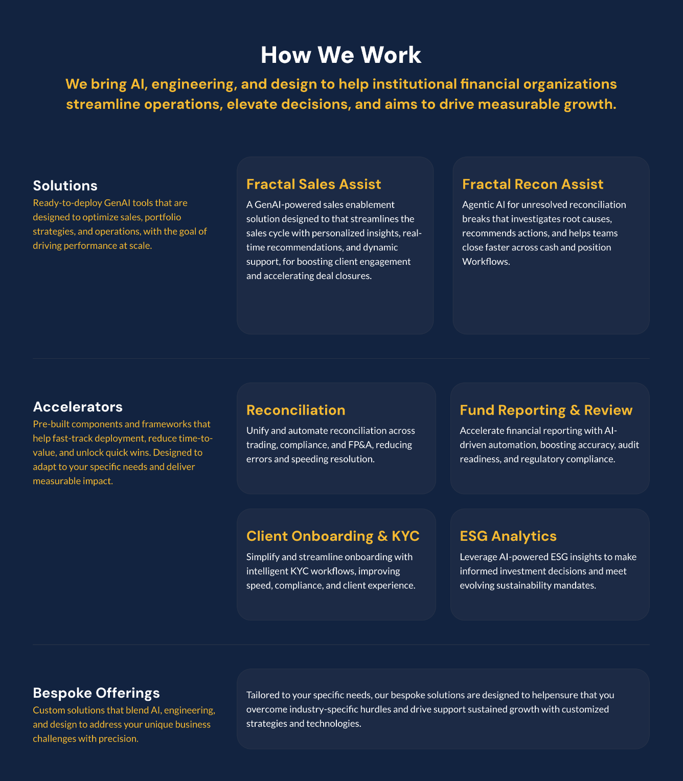
3. Solutions - How we work
# | Folds | Sub-sections |  | Character count
2 | Area of work | 1 | Enterprise solution: Title | 30
 |  | 2 | Enterprise solution: Subtitle | 50

Slide 48

6. Recognitions - Testimonials
# | Folds | Sub-sections |  | Character count
2 | Area of work | 1 | Enterprise solution: Title | 30
 |  | 2 | Enterprise solution: Subtitle | 50

Slide 49
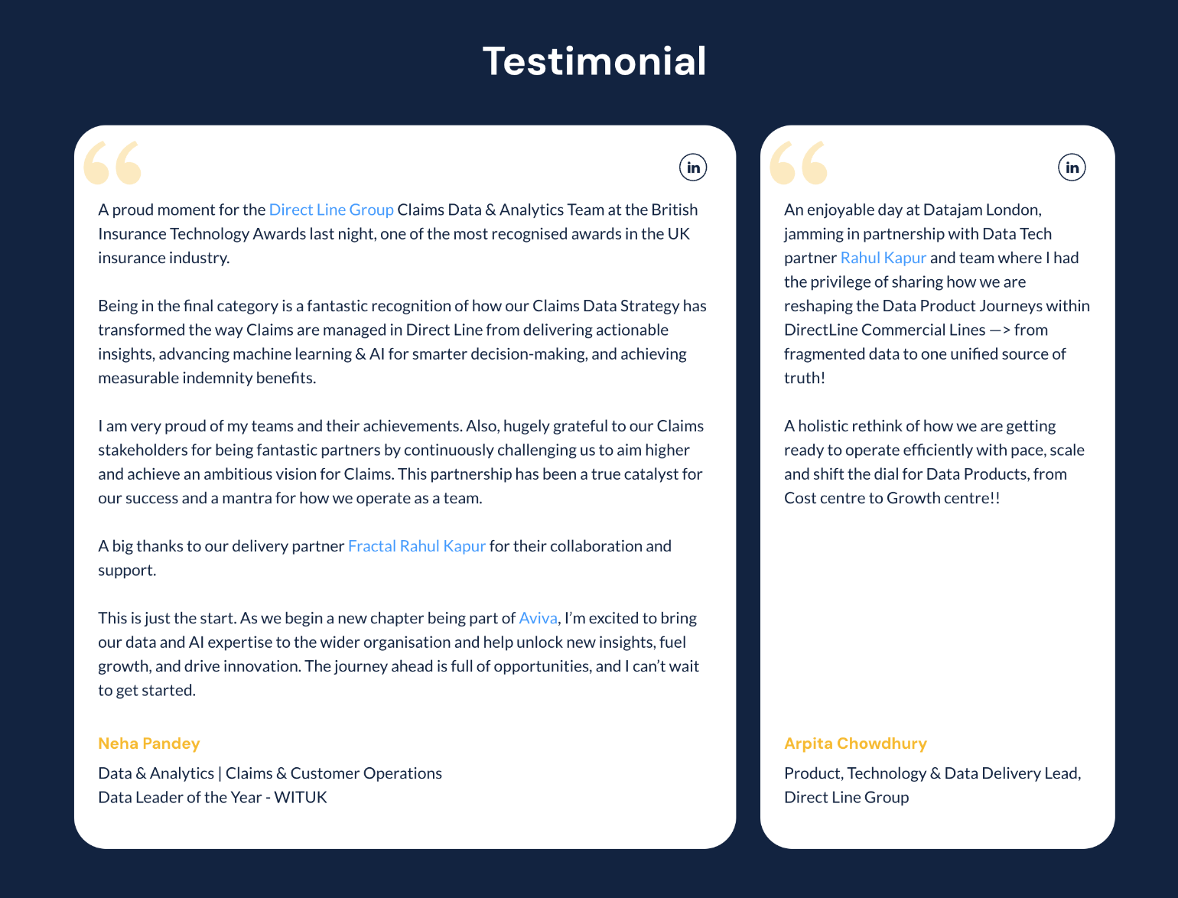
6. Recognitions - Testimonials
# | Folds | Sub-sections |  | Character count
2 | Area of work | 1 | Enterprise solution: Title | 30
 |  | 2 | Enterprise solution: Subtitle | 50

Slide 50
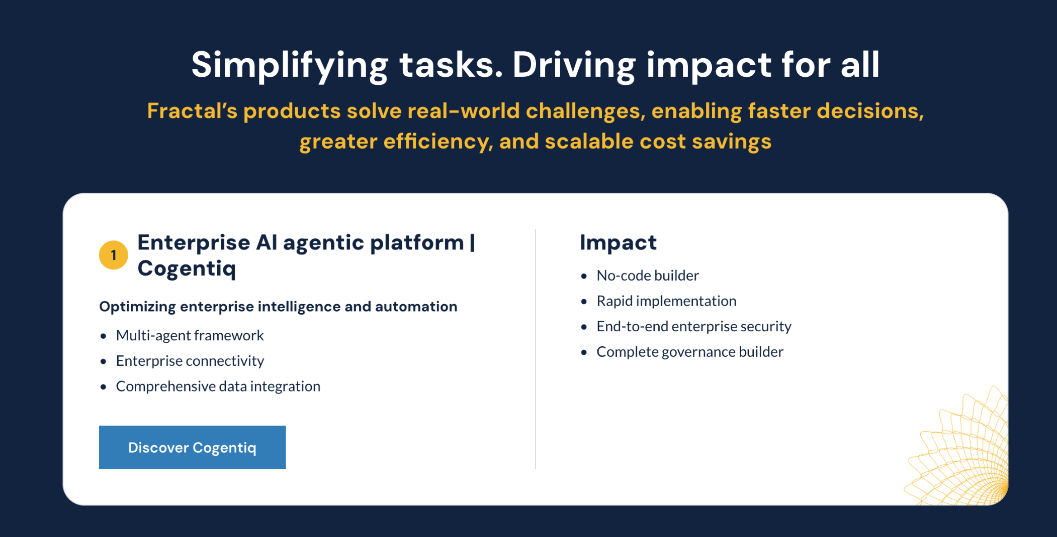
5. Our solutions - high level
# | Folds | Sub-sections |  | Character count
2 | Area of work | 1 | Enterprise solution: Title | 30
 |  | 2 | Enterprise solution: Subtitle | 50

Slide 51
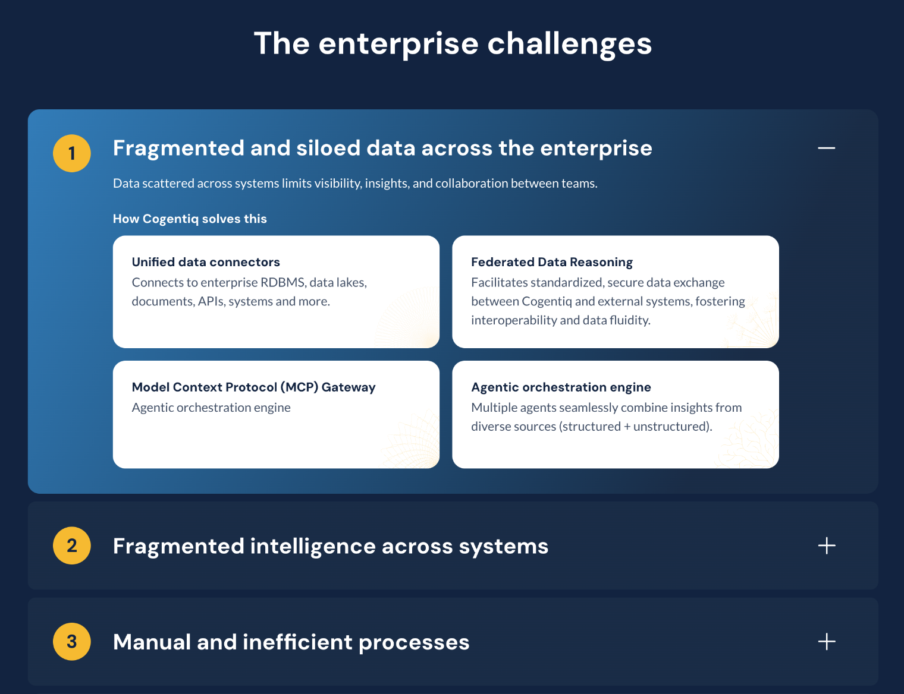
2. Enterprise Challenge
# | Folds | Sub-sections |  | Character count
2 | Area of work | 1 | Enterprise solution: Title | 30
 |  | 2 | Enterprise solution: Subtitle | 50

Slide 52
Thank you
Marketing
November 2025

