Slide 1

From Physical to Digital SIM Logistics with SGP.32: The New OEM Operating Model for IoT Connectivity
September 22, 2026

Slide 2







Speaker
Joseph Johnson
Senior Solutions Engineer
Ballybunion Castle
Paulw62 / Wikimedia Commons / CC BY-SA 4.0

Slide 3
Introduction
From a Linear Process to a Managed System
The Last SIM You’ll Ever Need
Getting Started

Slide 4

emnify IoT SuperNetwork
195+
23M+
Countries & territories
Active SIMs
550+
98.5%
Carriers – 4G, 5G
Enterprise CSAT score 2025
3,500+
99.9%
Active customers
Platform uptime 2025
27
Local and regional hyper scalable cloud storage and break-outs
7
Distributed mobile core regions – low latency routing
4

Slide 5
From a Linear Process to a Managed System

Slide 6
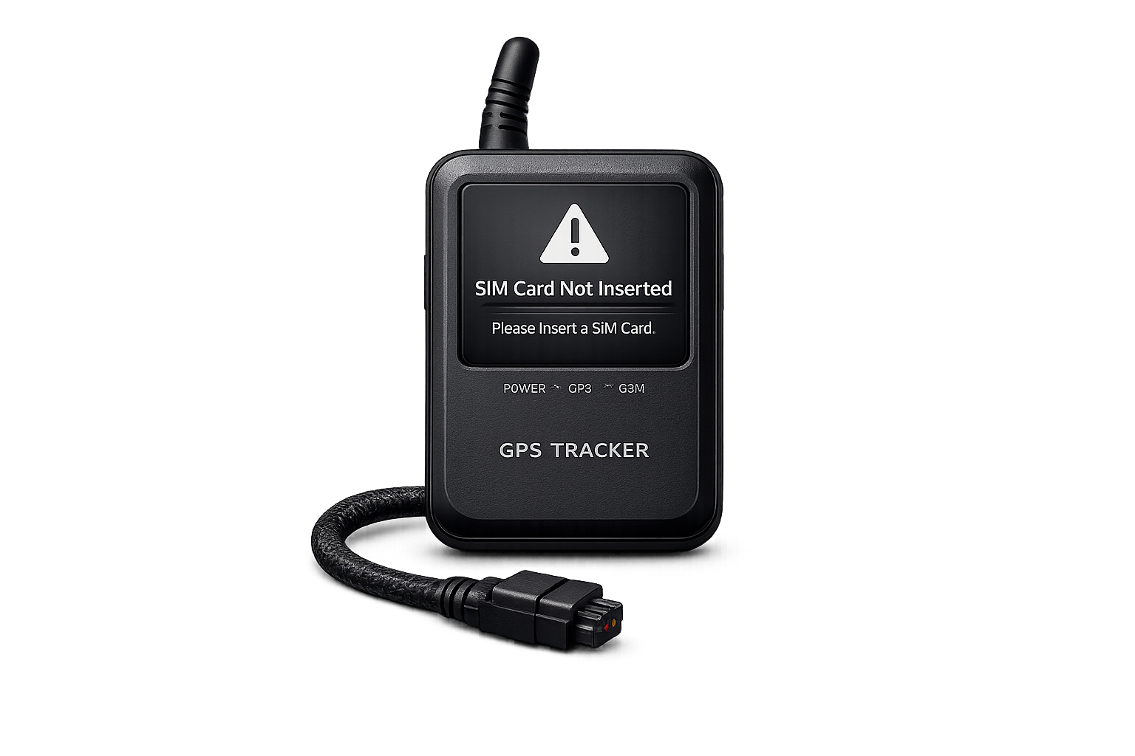
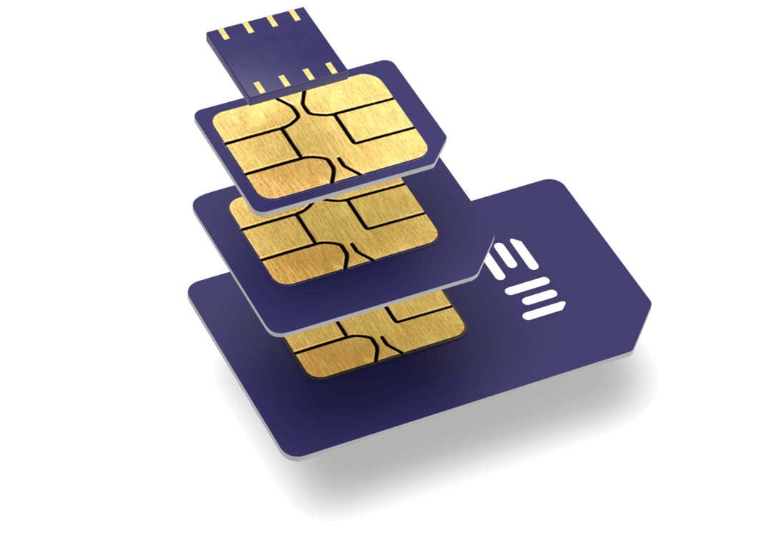
Linear process
Order Hardware (Device, SIM card)
Insert/install SIM, activate
Rarely revisited
6

Slide 7

SGP.32 – managed system
Device with embedded SIM
Bootstrap connectivity
Manage operational profile, adapt to changing needs
7

Slide 8
Digital SIM logistics with SGP.32
eUICC – embedded/SIM Card
Connectivity Management
Global bootstrap connectivity
Profile provisioning
Fallback configuration
Orchestration across platforms
Lifecycle management
If these elements fall out of sync, the system breaks down.

Slide 9
Software-defined connectivity
Flexibility
Complexity
Single SKU
Instant connectivity
Connectivity as a service
Adaptable
Solution that works for all devices
Integrating vendors
Global scalability & reliability

Slide 10

The last SIM card you’ll ever need

Slide 11

Instant-on Connectivity
Embed connectivity at source
One SKU. Global from day one
11

Slide 12
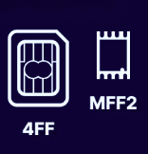
Stay flexible over time
Manufacturer
Device
emnify platform
with eIM
Manufacturers’
Device management
Portal
End
customer
eUICC API
API
IPAe
eUICC API documentation
Integrates eSIM management in Portal
Online customization of device connectivity
emnify Advanced IoT eSIM
12

Slide 13
Getting Started

Slide 14
How to Start?
Go to emnify.com/bootstrap and get a Test SIM
Plan, test and validate solution architecture with emnify
Integrate API
eUICC API Documentation
14

