Slide 1
BUSINESS PROFILE
Internal Locus of Control (Pty) Ltd

Slide 2
OUR MISSION
To offer Capacity, Capability and expertise that unlock overall Value for Sustained Business Growth

Slide 3



Our People Strategy
Solutions
People Strategy, Culture and Change
Aligning your people agenda with business goals to drive performance and transformation.
Organisational Effectiveness
Enhancing structures, systems, and processes to make your business fit for purpose.
End-to-End HR Advisory, Outsourcing and Tools Development
Providing comprehensive HR solutions and tools tailored for compliance and competitiveness.
Talent Management Strategies
Attracting, retaining, and engaging talent through robust, evidence-based strategies.
Facilitating Effective Teams
Building cohesive, high-performing teams that collaborate and deliver results.

Slide 4
Our Talent, Effective Teams & Inclusion Solutions
Targeted Executive Search
Sourcing top-tier and scarce talent using deep networks and research-driven methods.
Facilitating Effective Teams
Enabling teams to live values, collaborate, and execute through curated team Cook-Off experiences.
End-to-End Recruitment Solutions
Managing the full recruitment process from sourcing (including all checks) to onboarding with excellence.
Diversity, Equity, Inclusion and Belonging Solutions and Training
Creating inclusive environments and strategies that go beyond compliance to transformation.
Facilitating Effective Teams
Empowering teams with shared purpose and execution capability through dynamic facilitation.

Slide 5
Our Leadership and Change Solutions
Public Speaking and Thought Leadership
Sharing expertise and insights that inspire action and shape perspectives.
Leadership Facilitation + Coaching
Unlocking leadership potential through structured development, facilitation and personalized coaching.
Change Management
Guiding individuals and teams through smooth transitions to new ways of working.
Leadership and Team Coaching
Strengthening leadership impact and team synergy through proven coaching frameworks.
Change Management
Enabling successful organizational change with structured tools and communication.

Slide 6



Our Values
Ownership
Accountability
Collaboration
Empowerment that ignites passion & commitment
Instill purpose with integrity for increased output
Support growth for sustainable development

Slide 7
Our Approach
Our structured approach involves a careful planning, efficient organization, clear communication, and effective management of resources
Project Inception
Client Communication and engagement
Change management / Project close
Proposal
Execution and Monitoring
Kickoff meeting with the client to review project objectives, scope, and expectations. Clarify roles and responsibilities, and confirm the project's alignment with the client's goals.
Articulation of the jobs to be done with time frames, resources and costs breakdown for client review and approval
Develop a communication plan and ways of work / rules of engagement
Execution of the project in line with outcomes and timelines.
Continued progress monitoring and performance management
Assess impact of changes and communicate.
Finalise project and compile final report for approval.
Documentation of artifacts / evaluation of value and skills transfer

Slide 8
Why Us
100% Black Female and seasoned HR Director owned and run
An Accredited South African Supplier Diversity Council (SASDC) supplier.
Extensive Corporate experience serving clients
Rich networks in the continent and globally
Diverse and experienced pool of consultants to tackle any assignment
Track record of delighted clients
We have built a reputation of successful project delivery for our clients
Our services are cost effective, impactful, sustainable and value-adding
We are dependable and ethical

Slide 9





Contact Us
+27 784228308
: Disebo@internallocusofcontrol.com
: info@internallocusofcontrol.com
: linkedin.com/in/disebo-ramonyalioa-aa790412
: https://internallocusofcontrol.com
:https://www.instagram.com/letsbreakbread1

Slide 10














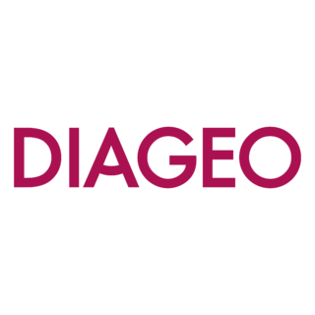


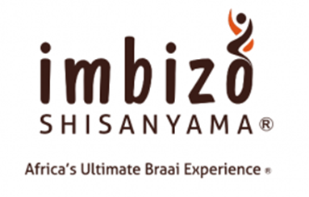

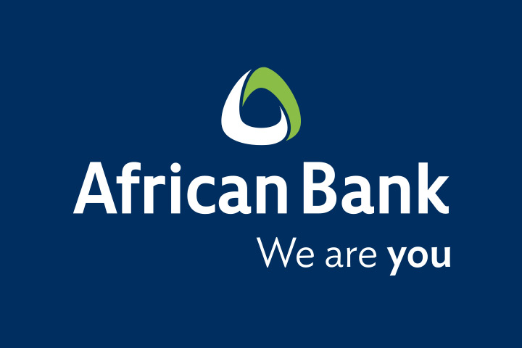
Our Clients – we adopt a partnership approach with our clients

Slide 11



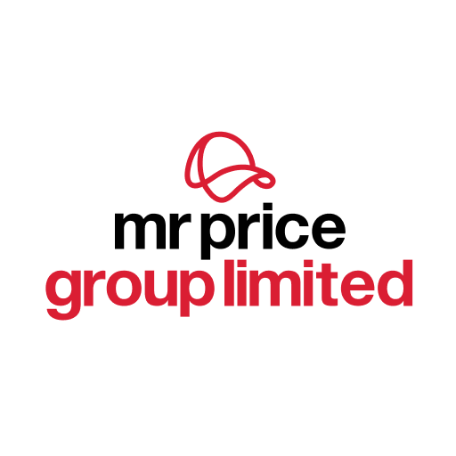

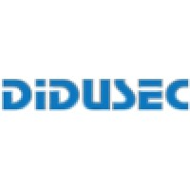

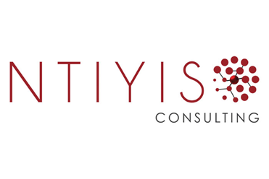
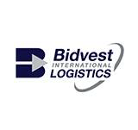
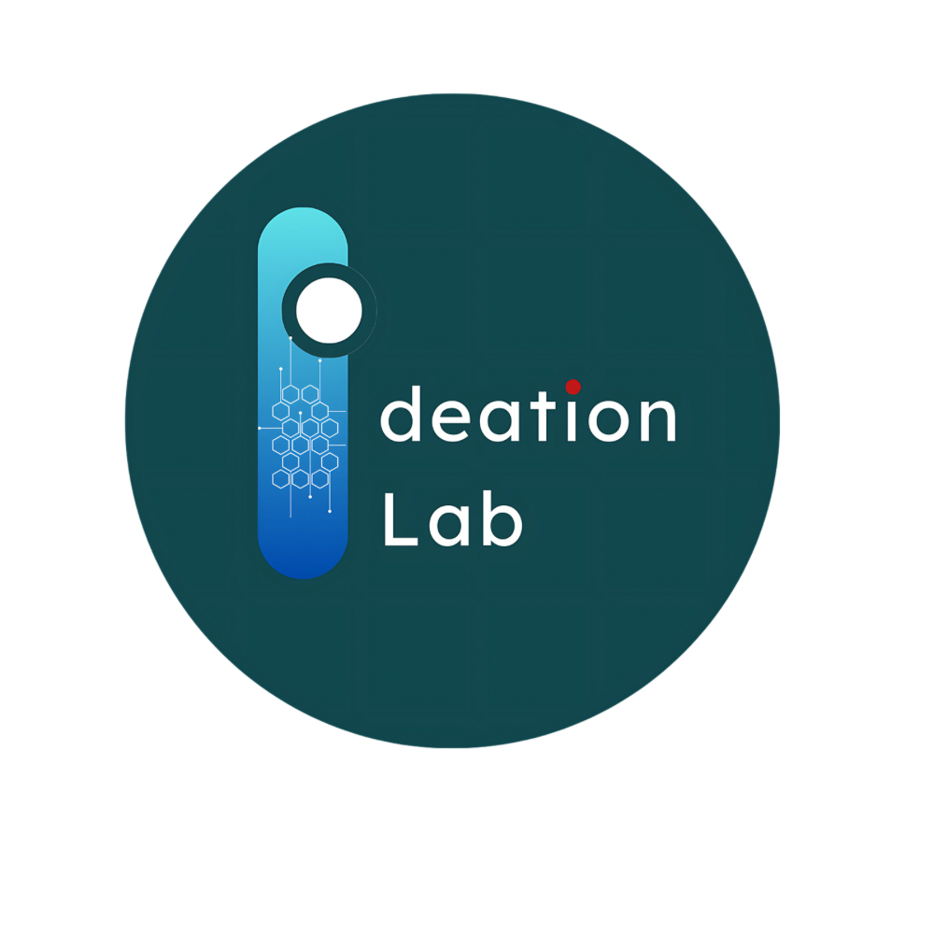


Our Clients – we adopt a partnership approach with our clients

Slide 12
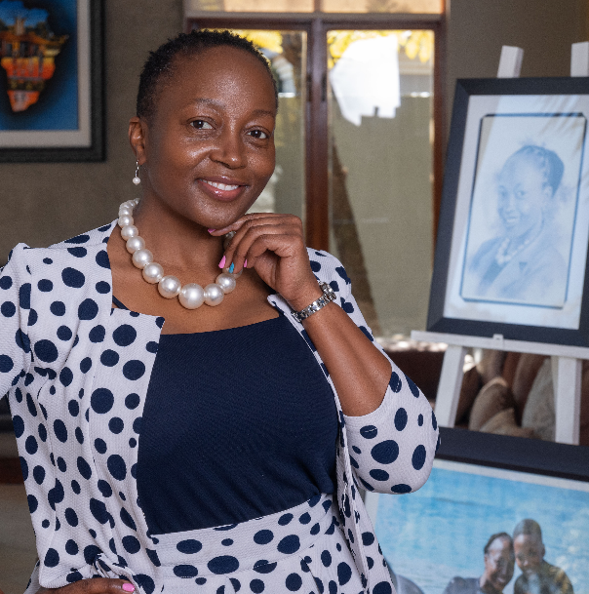
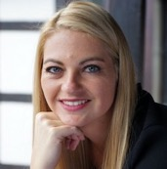
Disebo Ramonyalioa, Johannesburg, South Africa
Founder and CEO of iLOC, Strategic Human Capital Professional, Leadership / Team Coach and Facilitator, Talent catalyst
What characterizes me:
I am a business professional that believes in immersing self in any business to understand the levers for tailor made sustainable solutions. My passion for talent cuts across individuals, teams and levels.
Professional Experience:
Over 15 years as an HR Executive partnering CEOs in building and aligning leadership teams
Sharp eye for talent which started from graduate recruitment portfolio at Unilever over 2 decades ago
Have shaped and led the Diversity and Inclusion agenda at various Corporates
Coaching and mentoring both the youth, young professionals and leaders
Experience operating in various geographies in the African continent and driving global agendas
Part of the African team responsible for the enrolment and change management of the then new Unilever Vitality brand and logo.
Board member for various organisations
Education and Qualification:
HR postgraduate University studies - UKZN
Global Executive Development Programme - GIBS
Unilever Leadership Development Programme
Various certificates in Change Management, Diversity and Inclusion
HBS online Business studies
Various LInkedIn certificates around Leadership, Team dynamics, Strategy, etc.
References:
Facilitation of the Operating Model for SA Tourism
Strategic Human Capital consultant for Ntiyiso Consulting
Facilitation of the various Teams of the Africa Finance division at Unilever
ExCos and leadership alignment and coaching (Aon SA, SABS, Tsebo Group, Infrastructure Specialist Group)
Design and Implementation of the Graduate programmes (Ntiyiso Consulting, Ogilvy SA)
Industrial Relations advisory and wage negotiations for various corporates
Business Transformation projects for various clients (ISG, SABS)
SA legislated Transformation (BBBEE) project lead and Champion (Aon, Tsebo Group and Unilever SA)
Business Transformation and Org Design – African Bank / MHSC
Change Management skills transfer sessions – Services SETA HR
Executive Search – Diageo SA / Thokoman SA
ExCo/ Leadership facilitation – Vodacom Africa/Diageo
Languages:
English / Afrikaans / Sesotho / Tswana / Sepedi / isiZulu / Xhosa
Focus Areas:
Org Design & Effectiveness
Talent Management
Executive Search
Diversity and Inclusion
Effective Teams facilitation
Leadership Development
Coaching
Public speaking
Change, Transformation and Team Dynamics

