Slide 1
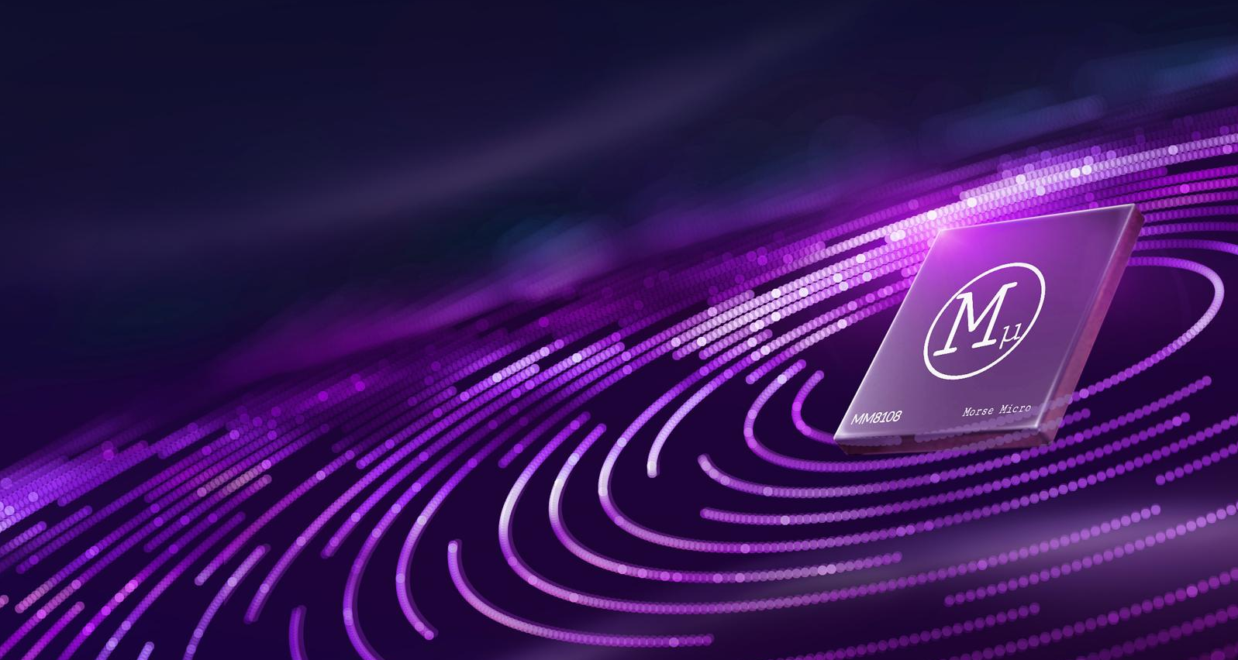

Wi-Fi HaLow: Enabling untethered intelligence (aka Edge AI)
Andy McFarlane
VP Marketing, Morse Micro

Slide 2


Slide 3


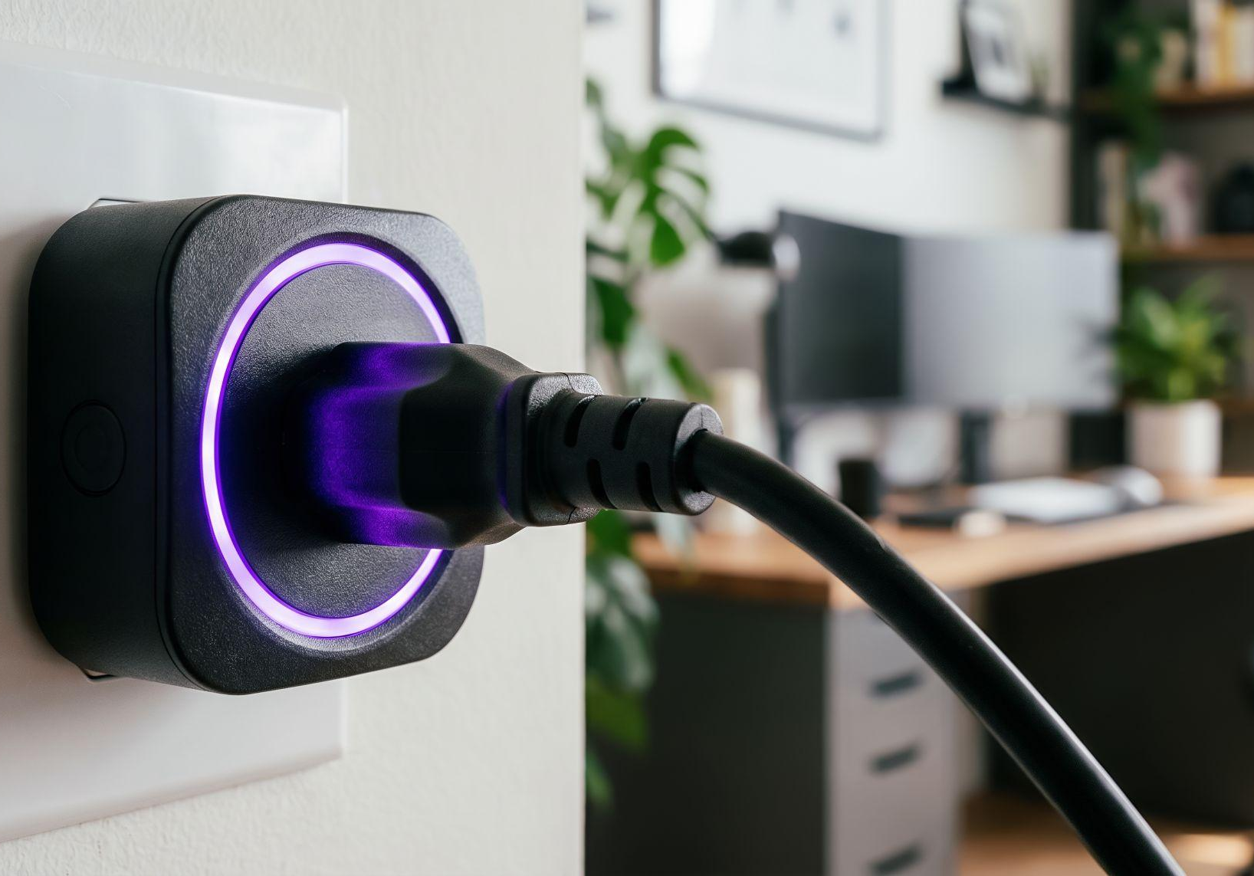




The fundamentals
Edge AI is moving intelligence out of the cloud and into the world, onto devices in fields, factories, buildings, and infrastructure.
BUT
AI has a power and range problem.
The most powerful intelligence ever built, can’t ever be too far away from a wall socket.
We need a wireless layer that can reach far enough, draw little enough power, and carry enough bandwidth to support real AI workloads!

Slide 4

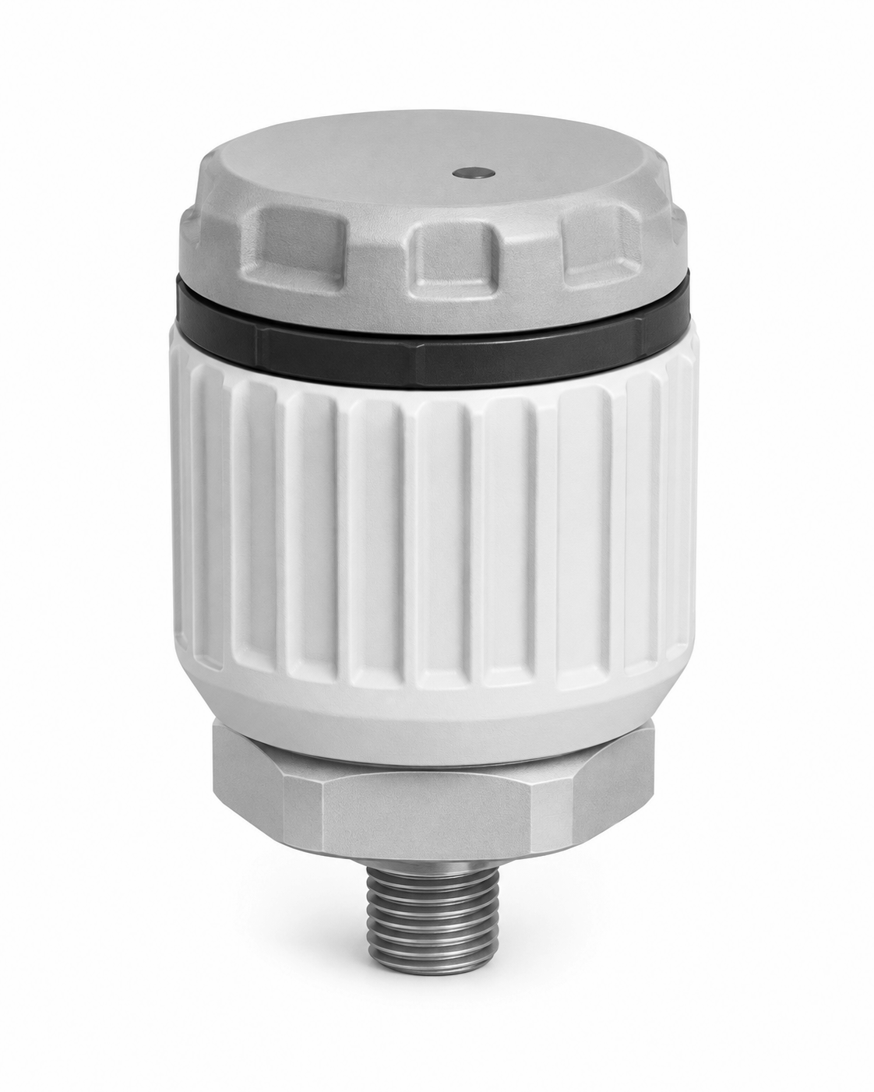
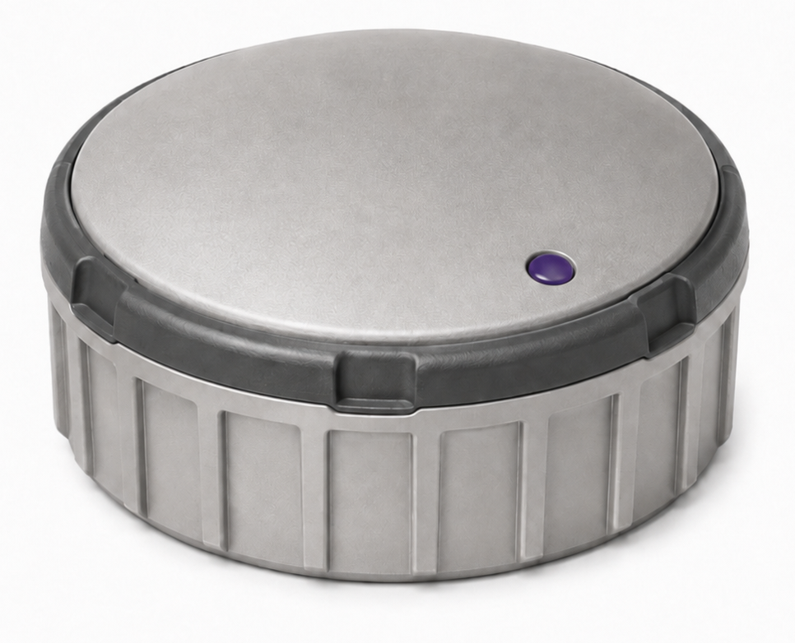
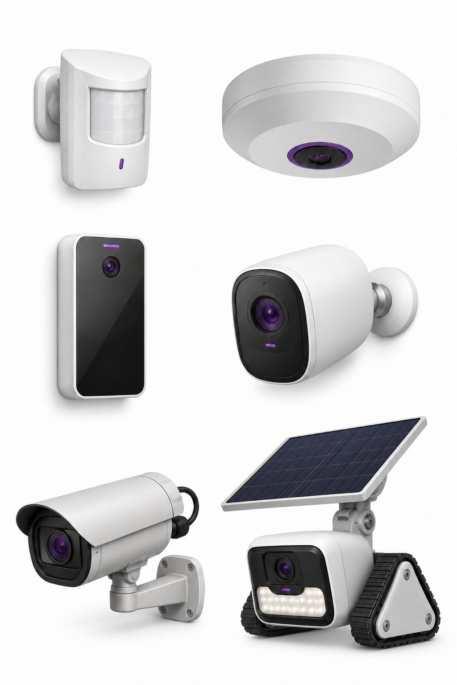
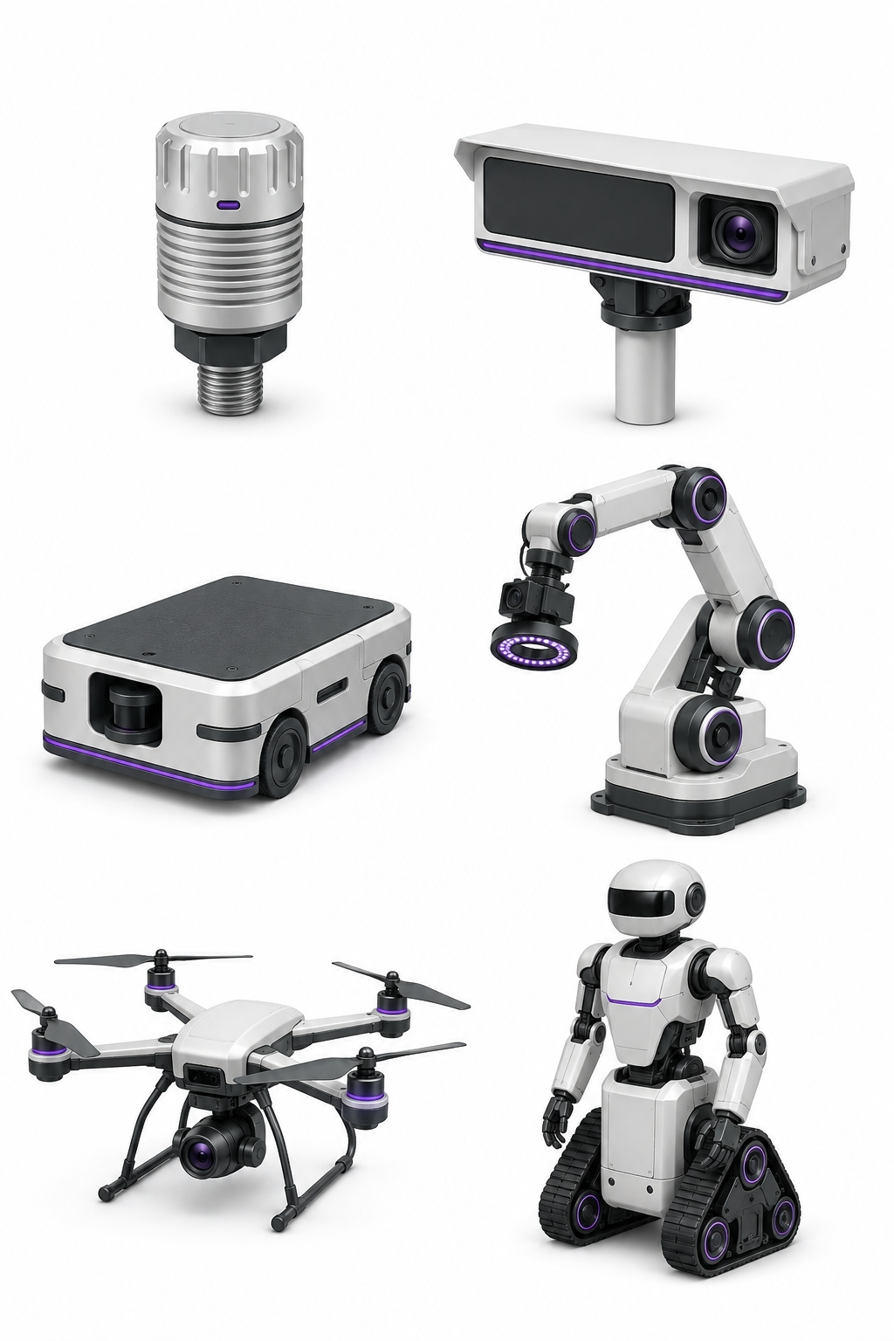
How much data do you need to be intelligent?
20 B
200 B
1 KB
50 KB
500 KB
5 MB
Sensor event
Detection metadata
Feature embedding
Verification snapshot
Full-resolution keyframe
Event clip or OTA update
Basic sensor data. Specific readings with set detail, class ID, confidence, timestamp.
Multiple detected objects with class, confidence, bounding box, device ID and timestamp details.
Detection metadata plus a 512-dimension INT8 embedding, 512 bytes. Lets cloud match an scene changes across views without sending full image.
AI triggered capture of a 640×480 JPEG on new event and passes on details to local or cloud AI review.
A 1080p JPEG or two seconds of 720p H.265.
at review quality, sent when a cloud model does the assessment and needs detailed pixels.
Ten seconds of 1080p H.265 at 4 Mbit/s, including buffered pre-event footage. Also OTA model update pushed down to the device.
Example IoT device:
Industrial vibration sensor
Example Edge AI device:
Kerbside parking sensor
Example Edge AI device:
Overhead occupancy sensor
Example Edge AI device:
Access control camera
Example Edge AI device:
Factory floor robots
Example Edge AI device:
Site monitoring drone

Slide 5
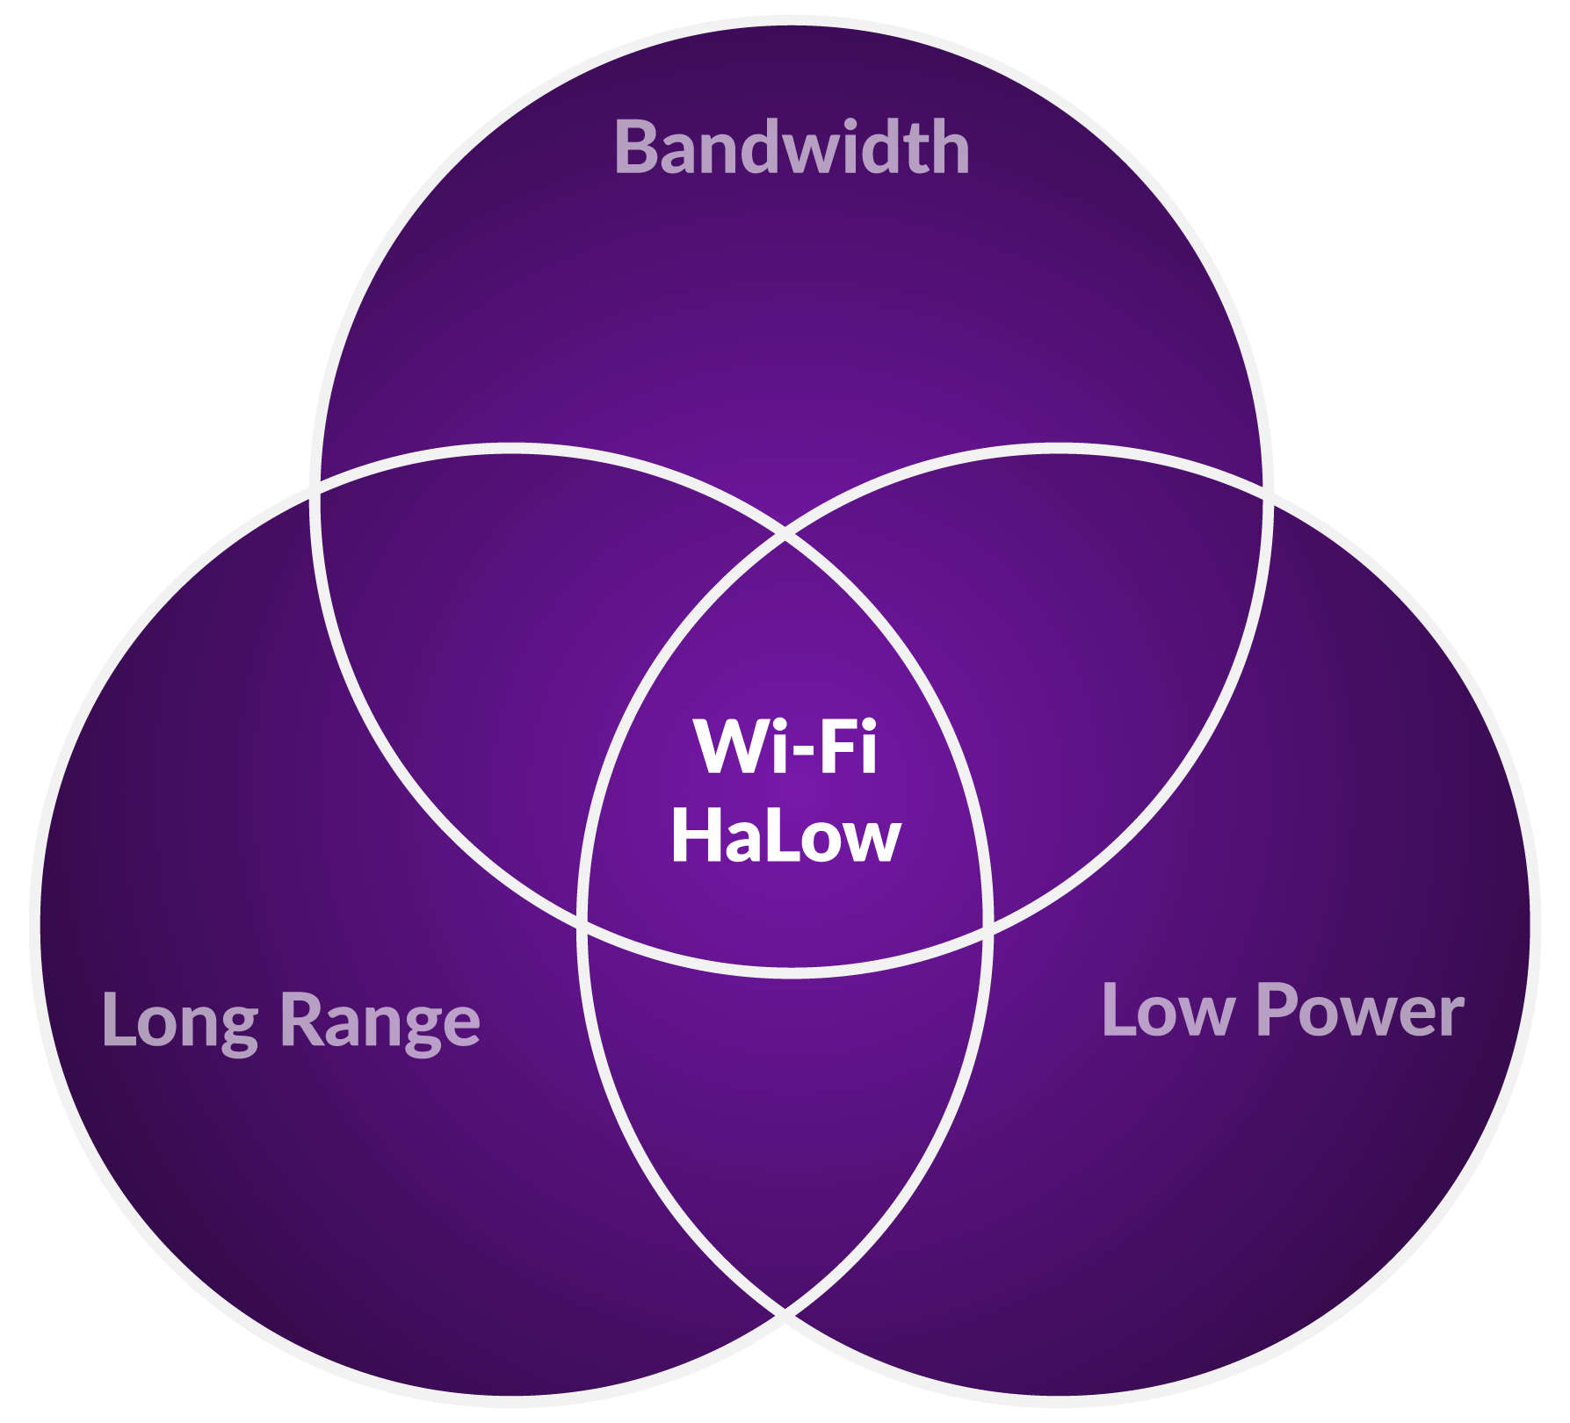
The key 3 for untethered intelligence

Slide 6
Where Wi-Fi HaLow is untethering intelligence
Wi-Fi 4 / 5 / 6 / 7
40 Mbps
Wi-Fi HaLow
by Morse Micro
30 Mbps
PHY throughput
20 Mbps
Others (Bluetooth,
Zigbee, Thread)
10 Mbps
LoRa
0 Mbps
100m
200m
300m
400m
500m
600m
700m
800m
900m
1 km+
Range

Slide 7
How much data do you need to be intelligent?
20 B
200 B
1 kB
50 kB
500 kB
5 MB
Sensor event
Detection metadata
Feature embedding
Verification snapshot
Full-resolution keyframe
Event clip or OTA update
Basic sensor data. Specific readings with set detail, class ID, confidence, timestamp.
Multiple detected objects with class, confidence, bounding box, device ID and timestamp details.
Detection metadata plus a 512-dimension INT8 embedding, 512 bytes. Lets cloud AI match a scene changing across views without sending full image.
AI triggered capture of a 640×480 JPEG on new event and passes on details to local or cloud AI review.
A 1080p JPEG or two seconds of 720p H.265.
at review quality, sent when a cloud model does the assessment and needs detailed pixels.
Ten seconds of 1080p H.265 at 4 Mbit/s, including buffered pre-event footage. Also OTA model update pushed down to the device.
Example IoT device:
Industrial vibration sensor
Example Edge AI device:
Kerbside parking sensor
Example Edge AI device:
Overhead occupancy sensor
Example Edge AI device:
Access control camera
Example Edge AI device:
Factory floor robots
Example Edge AI device:
Site monitoring drone

Slide 8
Power consumption by packet size
Technology
Power consumption to deliver packet
200 B
Zigbee sub-GHz
LoRaWAN (SF7)
LoRa Plus FLRC
NB-IoT
1 kB
Zigbee sub-GHz
LoRaWAN (SF7)
LoRa Plus FLRC
NB-IoT
50 kB
Zigbee sub-GHz
LoRaWAN (SF7)
LoRa Plus FLRC
NB-IoT
500 kB
Zigbee sub-GHz
LoRaWAN (SF7)
LoRa Plus FLRC
NB-IoT
5 MB
Zigbee sub-GHz
LoRaWAN (SF7)
LoRa Plus FLRC
NB-IoT

Slide 9
Power consumption by packet size
Technology
Power consumption to deliver packet
Airtime (TX)
200 B
Zigbee sub-GHz
9.4 mJ
9.4 mJ
43.8 ms
LoRaWAN (SF7)
132 mJ
132 mJ
338.2 ms
LoRa Plus FLRC
247 µJ
247 µJ
655 µs
NB-IoT
451 mJ
451 mJ
10.1 ms
1 kB
Zigbee sub-GHz
LoRaWAN (SF7)
LoRa Plus FLRC
NB-IoT
50 kB
Zigbee sub-GHz
LoRaWAN (SF7)
LoRa Plus FLRC
NB-IoT
500 kB
Zigbee sub-GHz
LoRaWAN (SF7)
LoRa Plus FLRC
NB-IoT
5 MB
Zigbee sub-GHz
LoRaWAN (SF7)
LoRa Plus FLRC
NB-IoT

Slide 10
Power consumption by packet size
Technology
Power consumption to deliver packet
600 mJ cutoff
Airtime (TX)
200 B
Zigbee sub-GHz
9.4 mJ
9.4 mJ
43.8 ms
LoRaWAN (SF7)
132 mJ
132 mJ
338.2 ms
LoRa Plus FLRC
247 µJ
247 µJ
655 µs
NB-IoT
451 mJ
451 mJ
10.1 ms
1 kB
Zigbee sub-GHz
47.1 mJ
47.1 mJ
219.2 ms
LoRaWAN (SF7)
661 mJ
1.69 s
LoRa Plus FLRC
1.2 mJ
1.2 mJ
3.2 ms
NB-IoT
475 mJ
475 mJ
50.6 ms
50 kB
Zigbee sub-GHz
2.34 J
10.91 s
LoRaWAN (SF7)
32.27 J
82.58 s
LoRa Plus FLRC
60.0 mJ
60.0 mJ
161.7 ms
NB-IoT
1.98 J
2.53 s
500 kB
Zigbee sub-GHz
23.43 J
109.02 s
LoRaWAN (SF7)
323 J
825.69 s
LoRa Plus FLRC
600 mJ
1.62 s
NB-IoT
15.84 J
25.32 s
5 MB
Zigbee sub-GHz
234 J
1090.20 s
LoRaWAN (SF7)
3,226 J
8256.57 s
LoRa Plus FLRC
6 J
16.17 s
NB-IoT
154 J
53.16 s

Slide 11
Power consumption by packet size
Technology
Power consumption to deliver packet
600 mJ cutoff
Airtime (TX)
200 B
Zigbee sub-GHz
9.4 mJ
9.4 mJ
43.8 ms
LoRaWAN (SF7)
132 mJ
132 mJ
338.2 ms
LoRa Plus FLRC
247 µJ
247 µJ
655 µs
NB-IoT
451 mJ
451 mJ
10.1 ms
1 kB
Zigbee sub-GHz
47.1 mJ
47.1 mJ
219.2 ms
LoRaWAN (SF7)
661 mJ
1.69 s
LoRa Plus FLRC
1.2 mJ
1.2 mJ
3.2 ms
NB-IoT
475 mJ
475 mJ
50.6 ms
50 kB
Zigbee sub-GHz
2.34 J
10.91 s
LoRaWAN (SF7)
32.27 J
82.58 s
LoRa Plus FLRC
60.0 mJ
60.0 mJ
161.7 ms
NB-IoT
1.98 J
2.53 s
500 kB
Zigbee sub-GHz
23.43 J
109.02 s
LoRaWAN (SF7)
323 J
825.69 s
LoRa Plus FLRC
600 mJ
1.62 s
NB-IoT
15.84 J
25.32 s
5 MB
Zigbee sub-GHz
234 J
1090.20 s
LoRaWAN (SF7)
3,226 J
8256.57 s
LoRa Plus FLRC
6 J
16.17 s
NB-IoT
154 J
53.16 s

Slide 12
Power consumption by packet size
Technology
Power consumption to deliver packet
600 mJ cutoff
Airtime (TX)
200 B
Wi-Fi HaLow
650 µJ
650 µJ
320 µs
Zigbee sub-GHz
9.4 mJ
9.4 mJ
43.8 ms
LoRaWAN (SF7)
132 mJ
132 mJ
338.2 ms
LoRa Plus FLRC
247 µJ
247 µJ
655 µs
NB-IoT
451 mJ
451 mJ
10.1 ms
1 kB
Wi-Fi HaLow
706 µJ
706 µJ
480 µs
Zigbee sub-GHz
47.1 mJ
47.1 mJ
219.2 ms
LoRaWAN (SF7)
661 mJ
1.69 s
LoRa Plus FLRC
1.2 mJ
1.2 mJ
3.2 ms
NB-IoT
475 mJ
475 mJ
50.6 ms
50 kB
Wi-Fi HaLow
4.6 mJ
4.6 mJ
11.2 ms
Zigbee sub-GHz
2.34 J
10.91 s
LoRaWAN (SF7)
32.27 J
82.58 s
LoRa Plus FLRC
60.0 mJ
60.0 mJ
161.7 ms
NB-IoT
1.98 J
2.53 s
500 kB
Wi-Fi HaLow
40.8 mJ
40.8 mJ
111.4 ms
Zigbee sub-GHz
23.43 J
109.02 s
LoRaWAN (SF7)
323 J
825.69 s
LoRa Plus FLRC
600 mJ
1.62 s
NB-IoT
15.84 J
25.32 s
5 MB
Wi-Fi HaLow
404 mJ
404 mJ
1.11 s
Zigbee sub-GHz
234 J
1090.20 s
LoRaWAN (SF7)
3,226 J
8256.57 s
LoRa Plus FLRC
6 J
16.17 s
NB-IoT
154 J
53.16 s

Slide 13
The key 3 for untethered intelligence

Slide 14
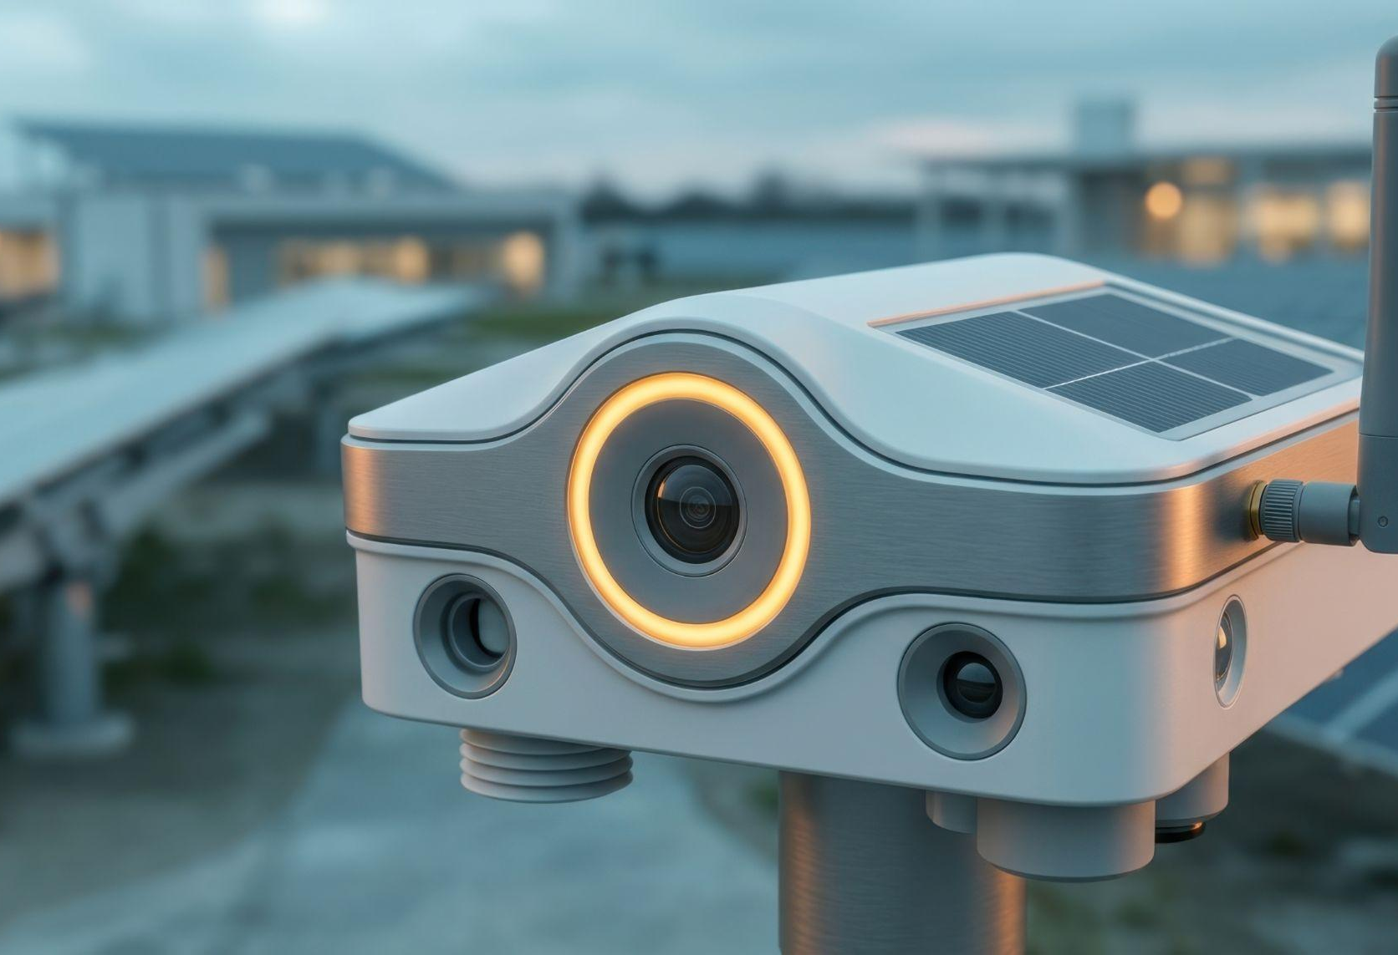
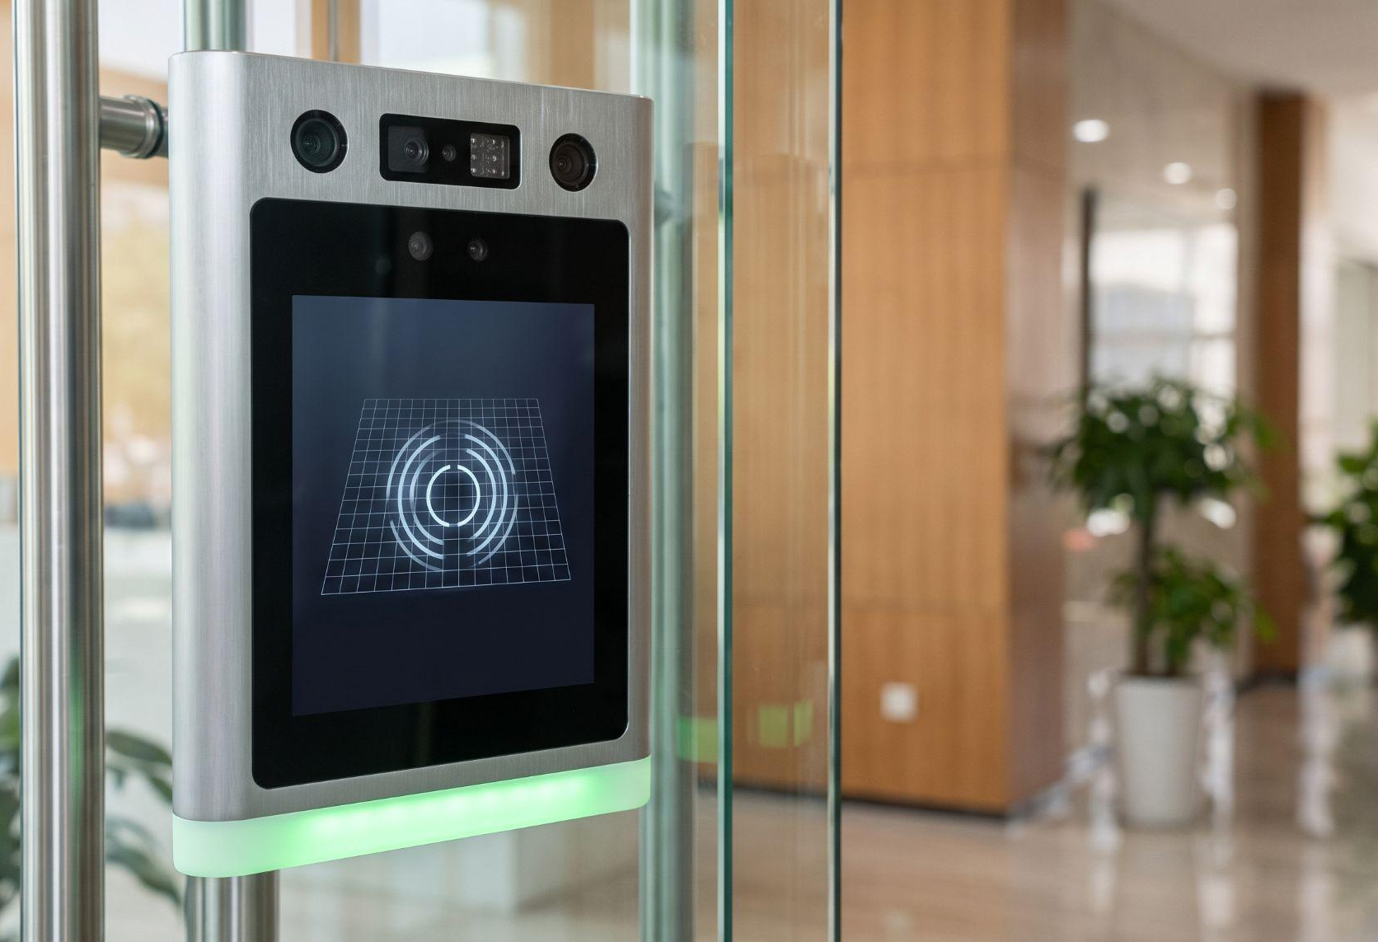

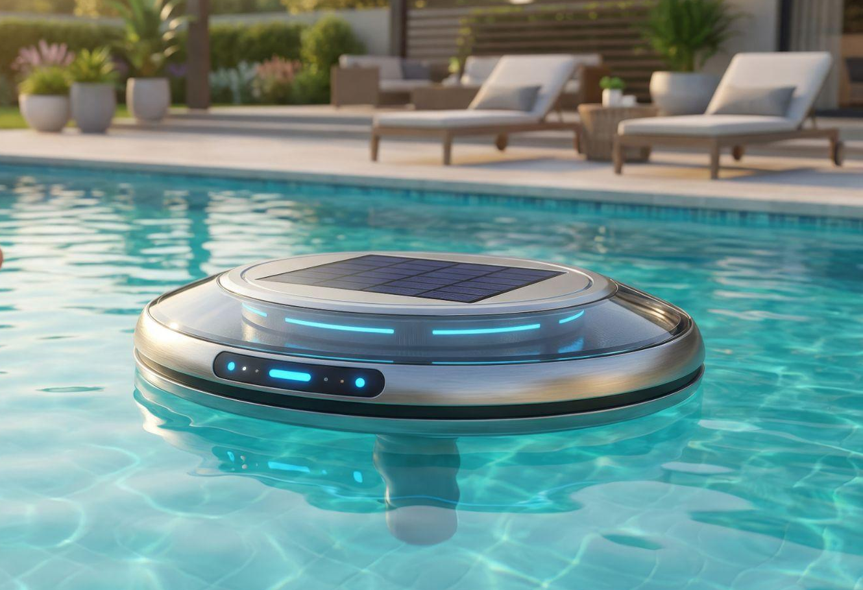
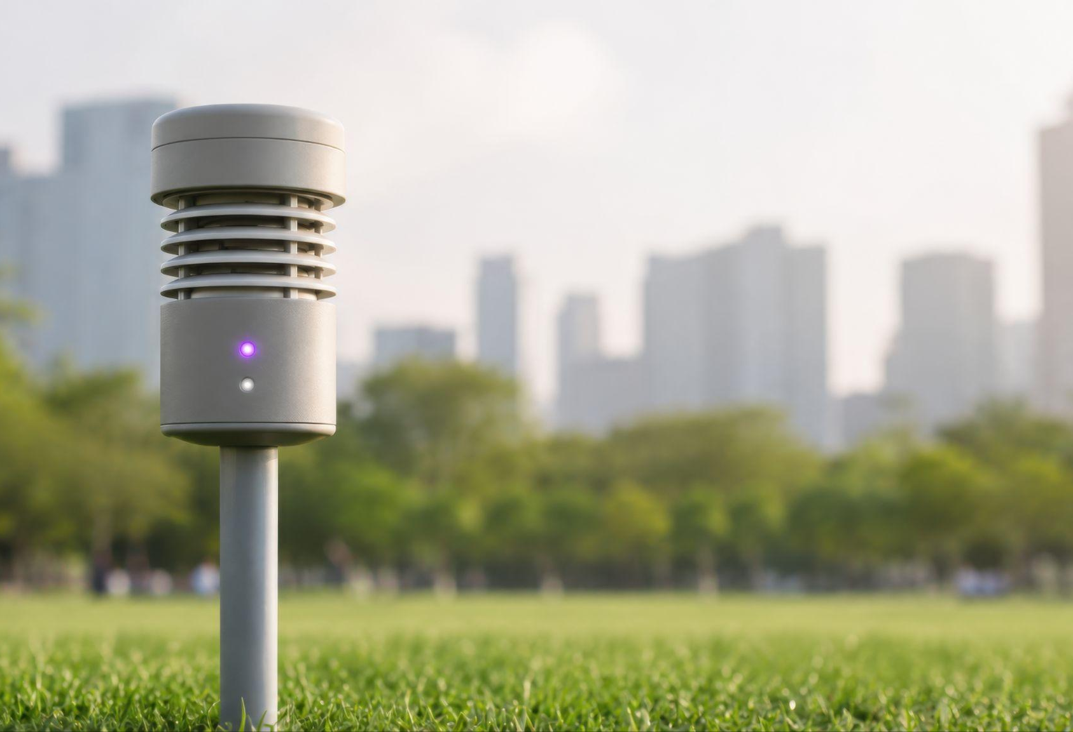
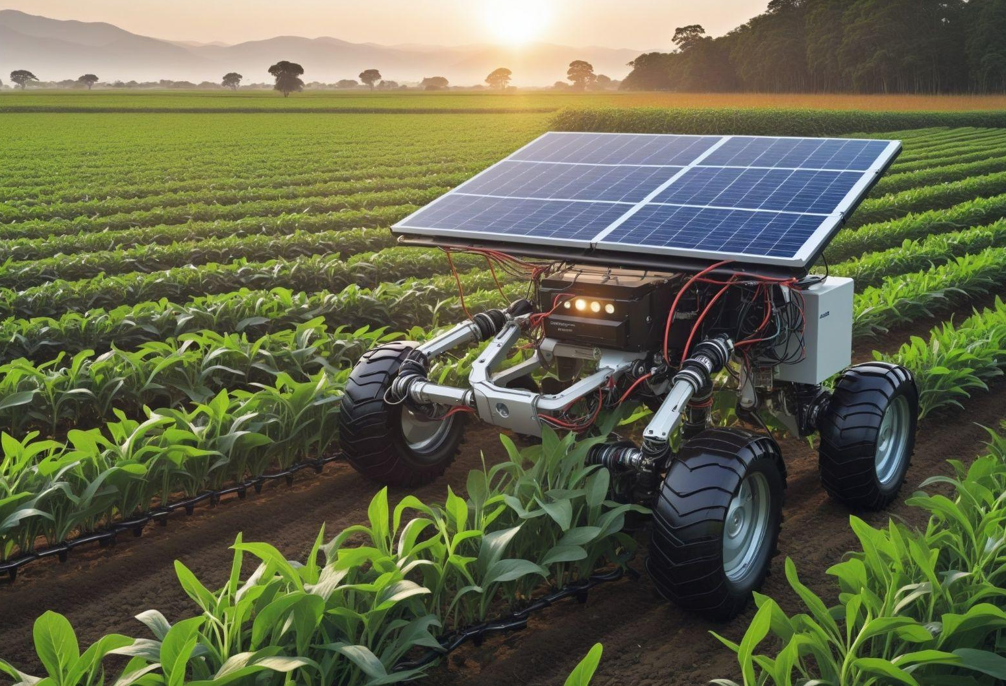
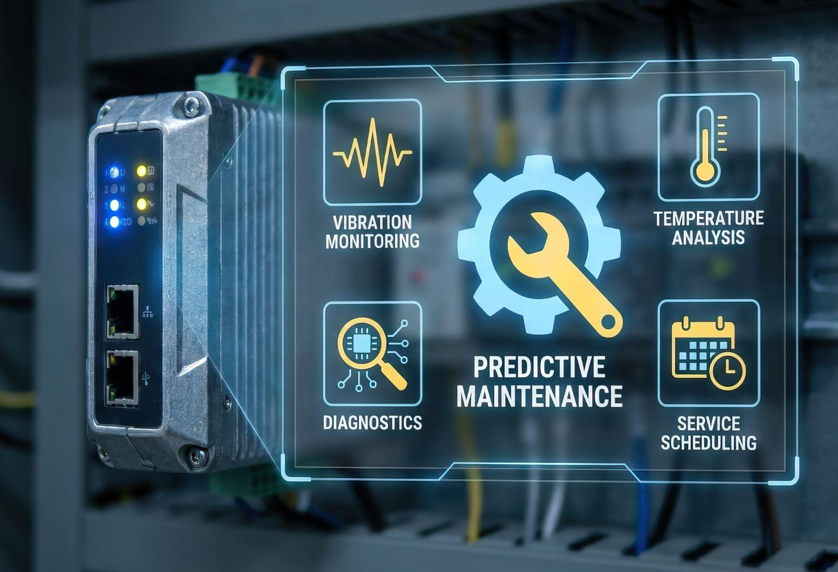
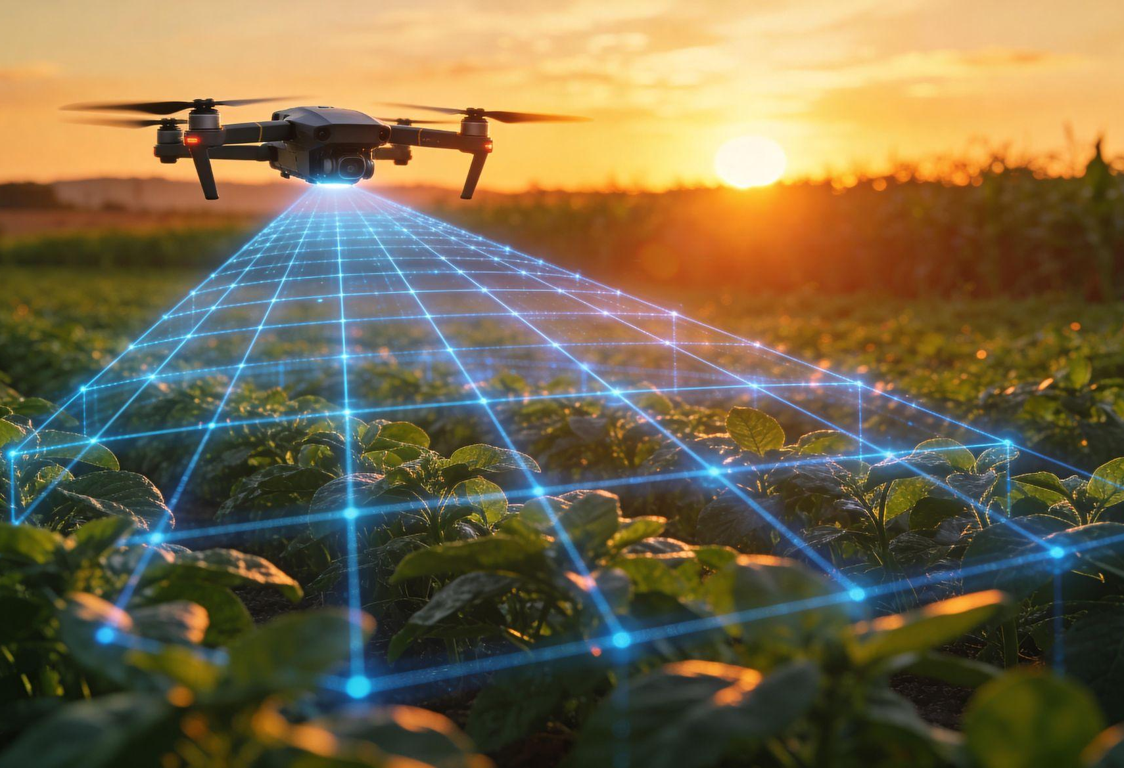
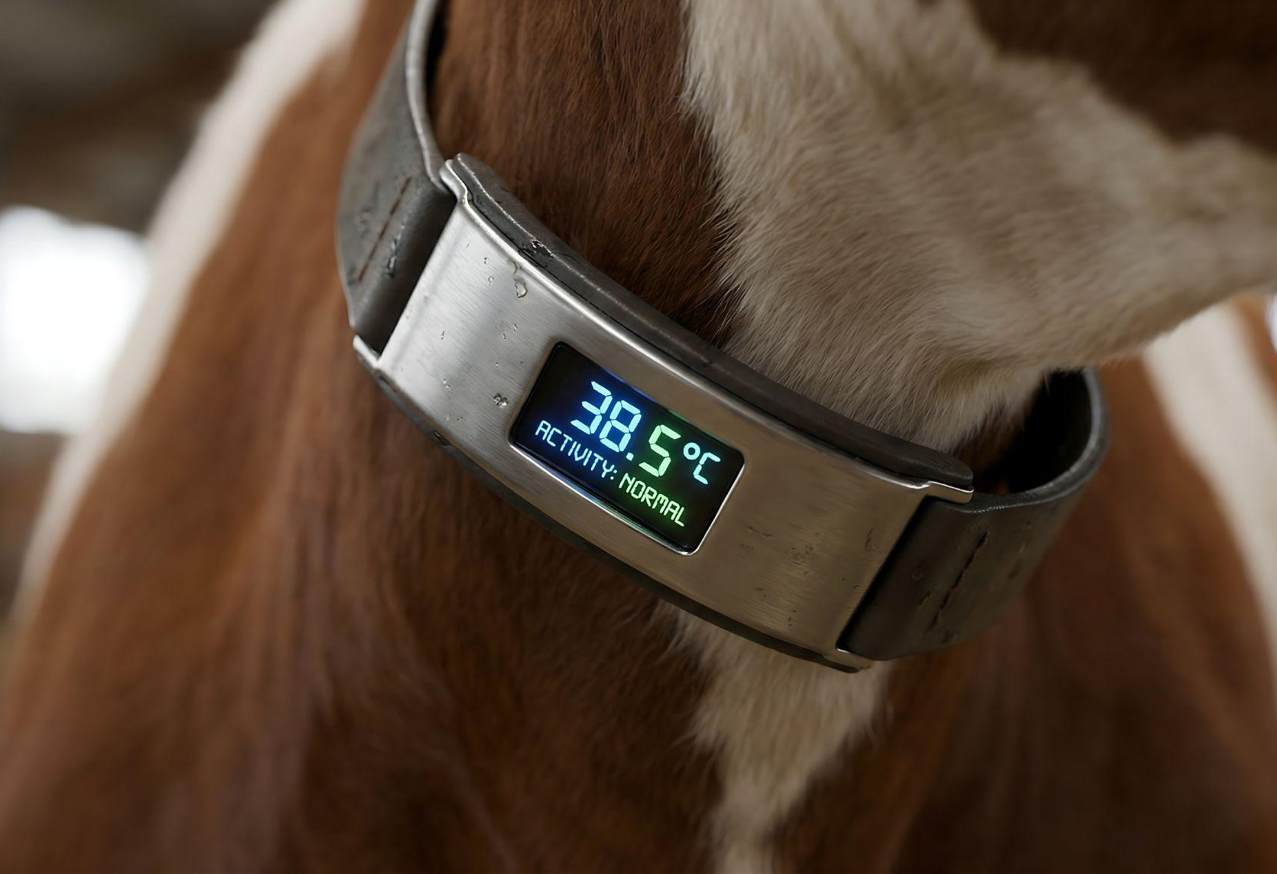
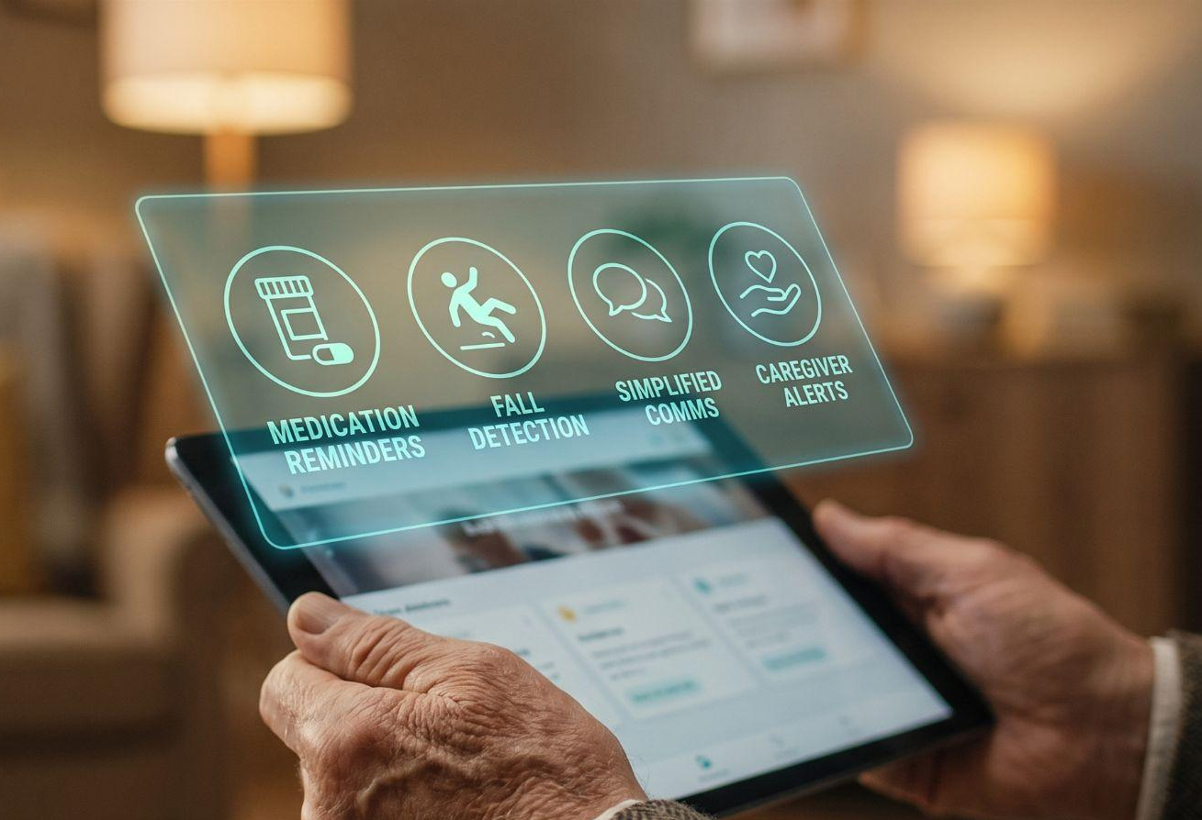
Examples of where untethered intelligence can do better that the best current alternative
Security Cameras
Access control and entrance monitors
Autonomous mobile robots (AMRs)
Water quality monitor
Environment monitors
Autonomous AI tractors
Predictive maintenance
Crop health, pest and weed monitoring
Livestock monitors
Assisted living sensors and monitors

Slide 15

“
The ChatGPT moment for physical AI is here.
When machines begin to understand, reason, and act in the real world.”
Jensen Huang
CEO, NVIDIA - CES 2026
Frontier models are extraordinary – and blind
With Wi-Fi HaLow we can now deploy it anywhere:
untethered AI that sees, thinks and acts

Slide 16

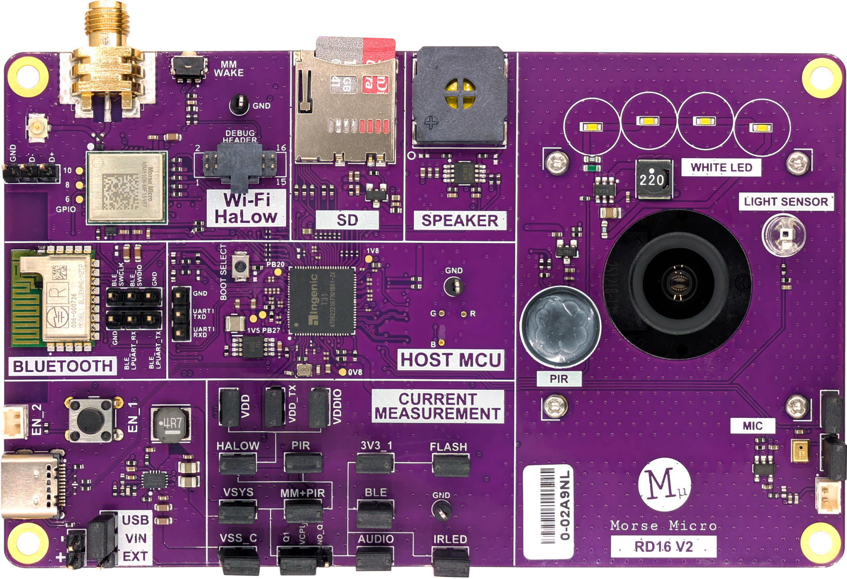
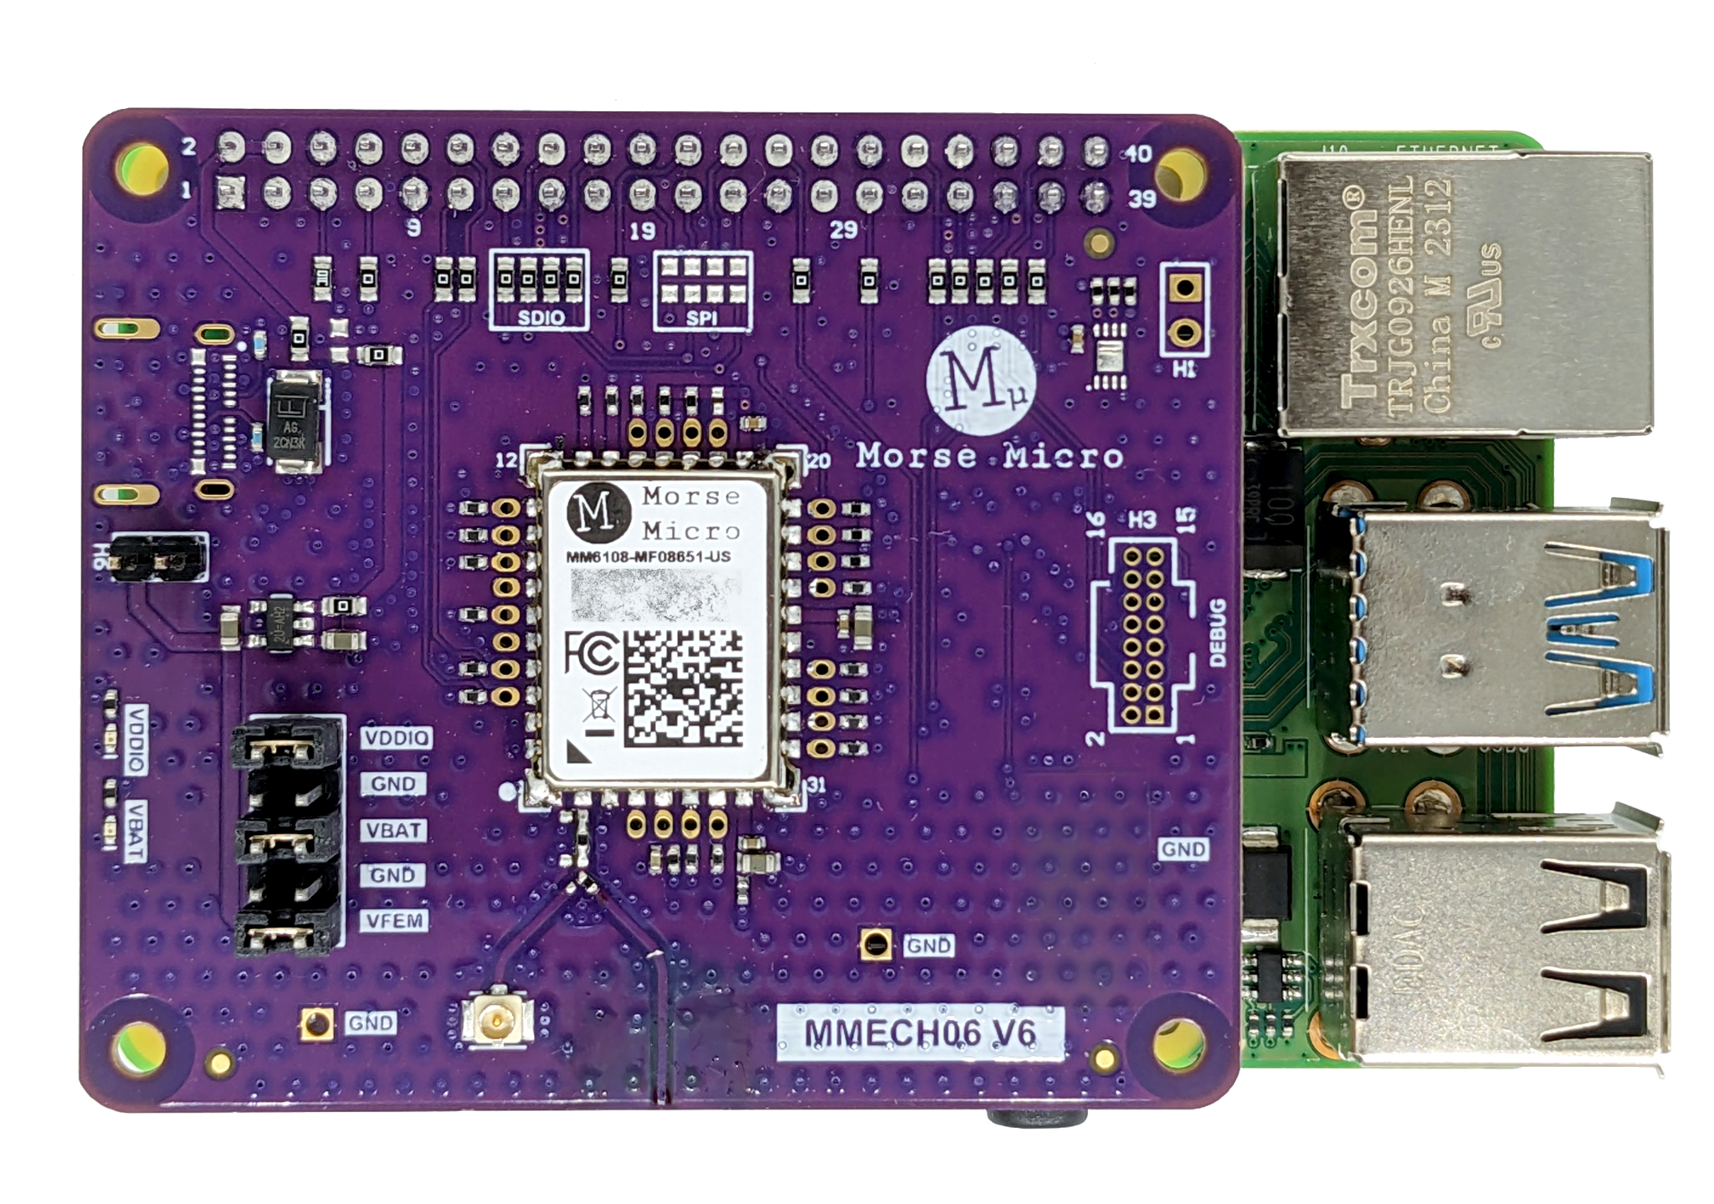
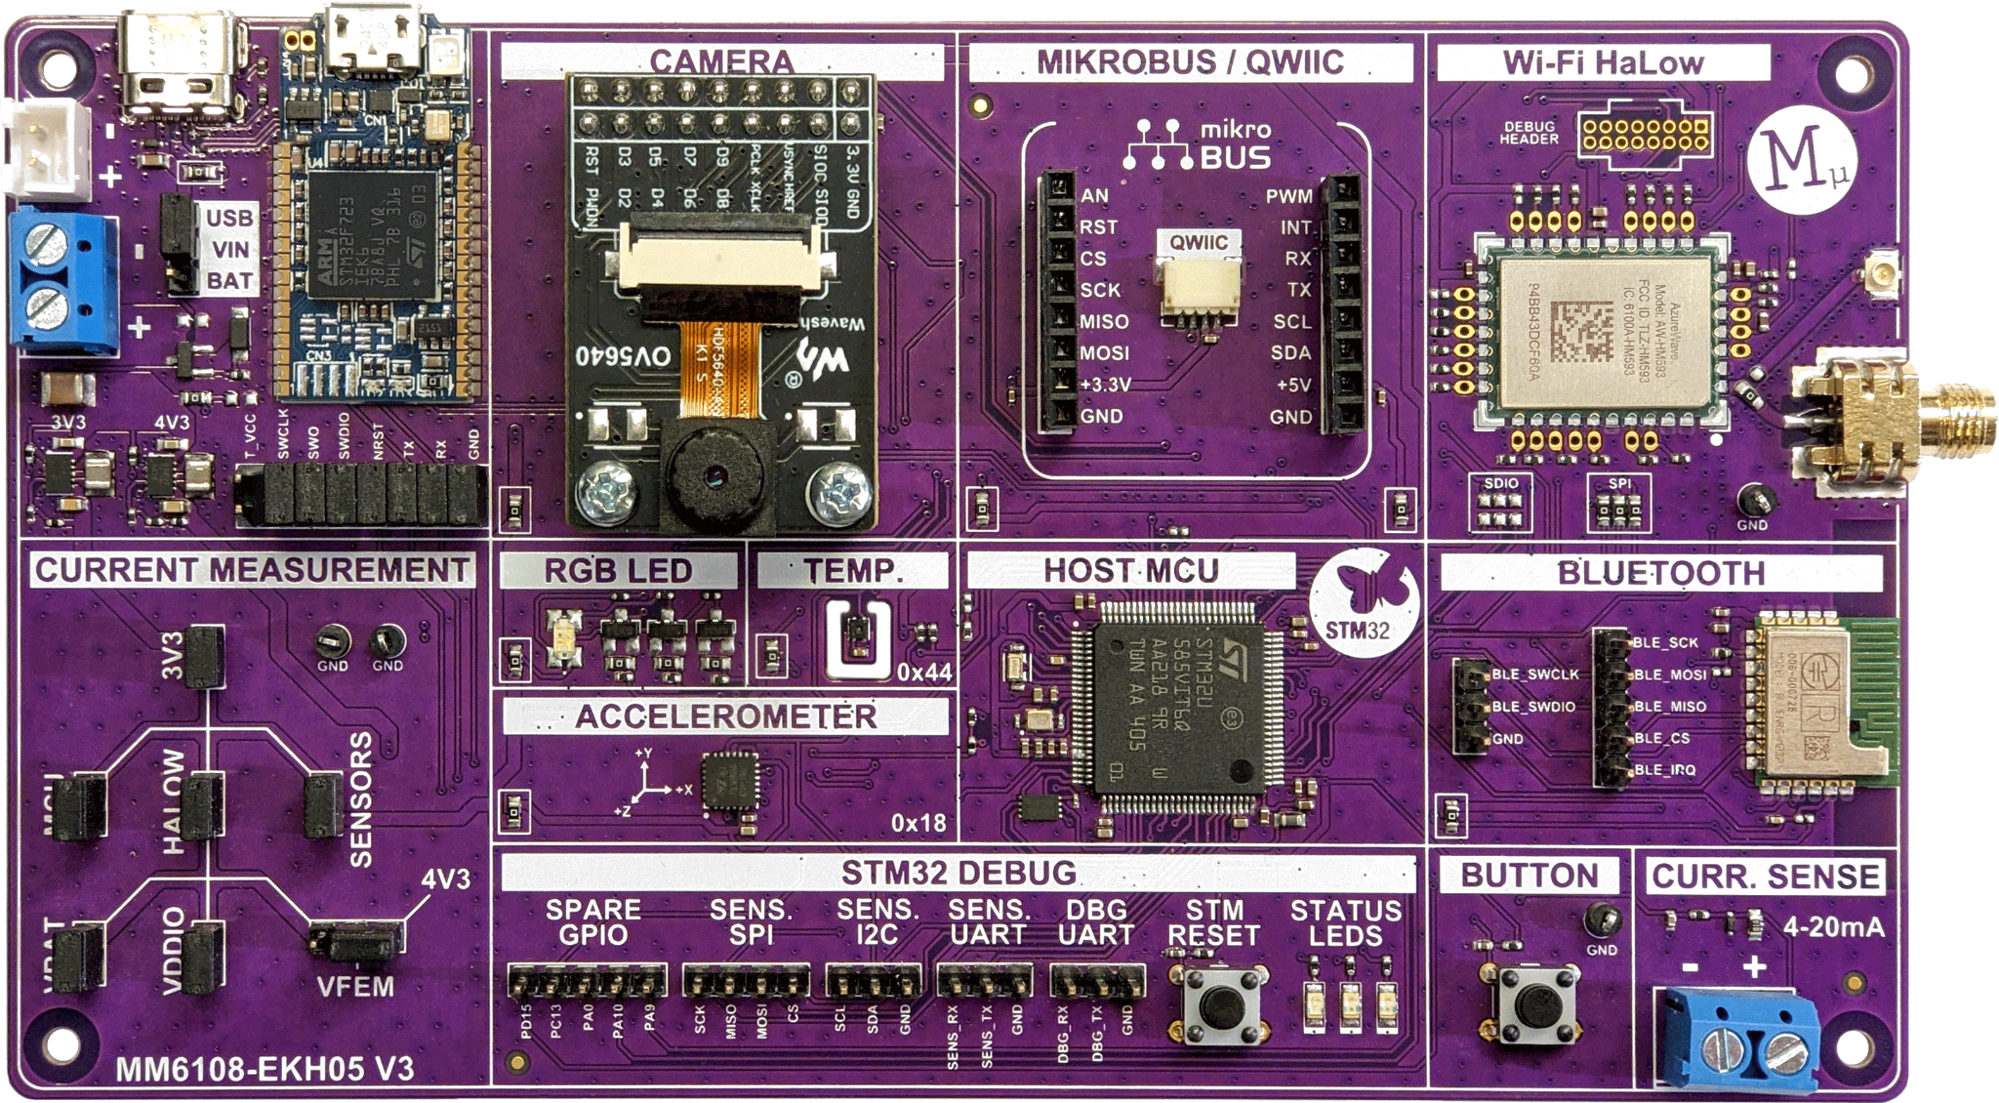
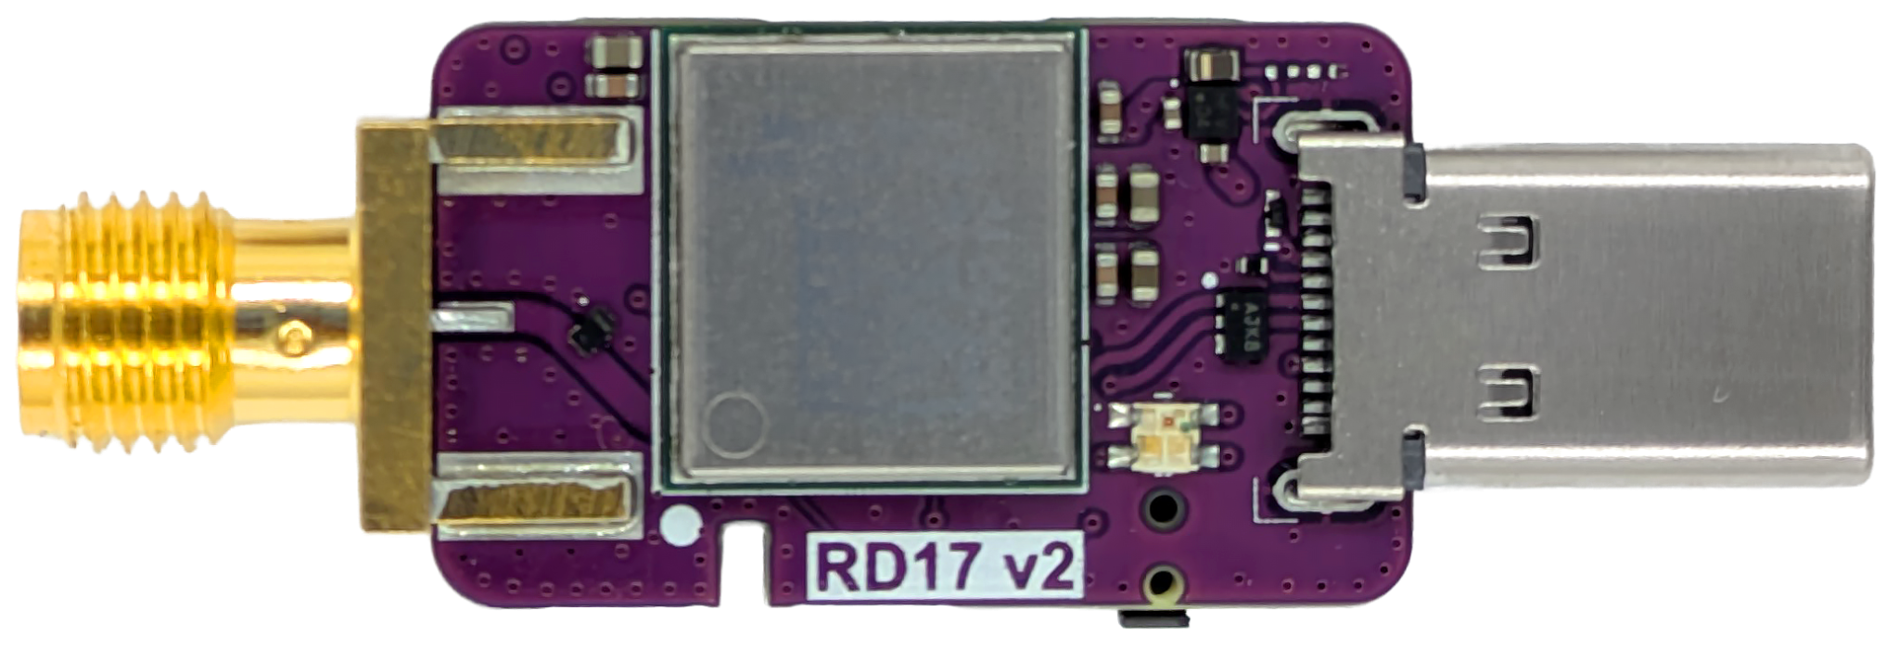
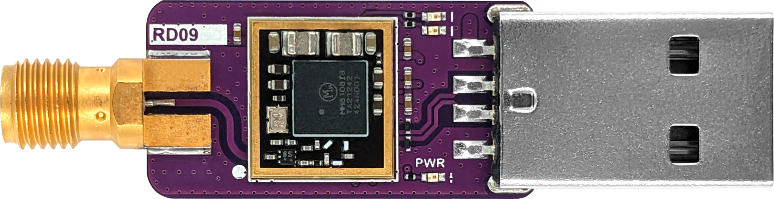


Get your hands on our dev kits!
Morse Micro’s Wi-Fi HaLow evaluation kits are available through leading electronics distributors

Slide 17


Join our
Design Partner Program
Find out more at
morsemicro.com/ design-partners

Slide 18

Wi-Fi HaLow
Enabling untethered intelligence
Thank You
Notes:
Maybe change the title of this slide…

