Slide 1

INTERIM results presentation
Six months ended 30 September 2025
DECEMBER 2025
James Dickson
Sarah Bentham
Chairman & CEO
CFO

Slide 2




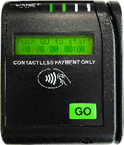
















Enabling customers to transform business performance
Enhancing customer outcomes by cutting waste and shrinkage, whilst improving quality, user experience, and sales.
UNATTENDED RETAIL DIVISION – c. 37,000 MACHINES
HOSPITALITY DIVISION – c. 9,600 VENUES (UK & US)
Integrated vending connectivity
Cashless payment solutions
Market leading beverage
and bar management system
SAAS business model with long term client commitment (3 to 5 Year contracts)

Slide 3
Strong financial results in a challenging economic environment
Solid foundation for continued growth
£7.67m GROSS REVENUE
ERP WITHDRAWAL ~ £0.2m
(H1 2025: £7.69m)
PROFIT BEFORE TAX £0.39m – up £0.37m
(H1 2025: £0.02m)
£6.44m RECURRING REVENUE
84% OF TURNOVER
(H1 2025: £6.44m, 84%)
£1.72m OPERATIONAL CASH GENERATION
£2.6m CASH
POST-WORKING CAPITAL (H1 2025: £1.92m)
NET DEBT REDUCED TO £0.5m
POST £0.25m SHARE BUYBACKS & £0.29m DIVIDEND
(H1 2025: £1.0m)
68% GROSS MARGIN
(H1 2025: 67%)
£1.86m ADJ. EBITDA – up 20.6%
(H1 2025: £1.55m)
EPS 0.79p
(H1 2025: 0.06p)
INTERIM DIVIDEND UP 33% TO 0.4p
(H1 2025: 0.3p)
£1.58m ADJ. OPERATING PROFIT – up 10.2%
(H1 2025: £1.43m)

Slide 4
Resilient Unattended Division performance despite market disruption
4G transition and operational focus driving footprint growth and recurring revenue despite impact of strategic ERP exit
DEVICE MANAGEMENT FOCUS
52 NEW CONTRACT WINS
ON MULTI YEAR TERMS
(H1 2025: 48)
ESTATE 36,957
(FY 2025: 35,955)
Maximising device uptime and user experience
Alarms, alerts, sales data
Mobile App – data on the go
Expanding fully connected vending estates and footprint
2,700 NEW 4G CASHLESS DEVICES
INCLUDING 125 3G UPGRADES
HIGHER VALUE CASHLESS FOOTPRINT NOW OVER 26,000
75% RECURRING REVENUES
£2.23m
(H1 2025: 70%)
ADJ. OP £0.91m
(H1 2025: £0.98m)
CUSTOMER CASE STUDIES
DRIVING SALES PIPELINE GROWTH
18% Customer Revenue Uplift

Slide 5
Growth in device footprint driven by 4G transition and cashless adoption
Connected base and pipeline expanding post Covid, WFH and MNO 2G / 3G withdrawal. Focus on device management & uptime, user experience and leading transaction rates is delivering contracts
Actual
Forecast
Cashless as a % of total connections
41%
48%
53%
59%
61%
67%
71%
72%
72%
WFH hits Vending contract profitability – contracts ended
3G & 2G to 4G Investment. Individual Machine analysis Machine removals.
C19 Lockdowns

Slide 6
Hospitality Division delivers profitable growth
Strong performance underscores customer value and validates continued investment in innovation
UK INSTALLED BASE c.9,522 PUBS
229 new system sales (vs.159 YoY), offsetting 210 pub closures
Plus 40 additional BBG installations
Long-term earnings visibility with 6 new and 3 significant renewals
BMI EXTENDS SECTOR & GEOGRAPHICAL REACH
Fast Scan Inventory Platform
Till Variance Analysis
Draught Beer quality
Productivity optimisation
TURNOVER
UP 5.6% AT £4.70m
(H1 2025: £4.45m)
ROBUST RECURRING REVENUE AT 91%
UP TO £4.21m
(H1 2025: £4.19m, 94%)
OPERATING PROFIT
UP 10.2% £2.15m
(NET OF £0.14M US LOSSES)
(H1 2025: £1.95m, net of £0.25m US losses)
BEVERAGE METRICS MOMENTUM
>30 NEW MANAGED SITES
INVENTORY PLATFORM UK LAUNCH

Slide 7

Well-Positioned for significant U.S. hospitality growth
Fintech partnership and new contract wins accelerating momentum
382,000 licensed U.S. venues across four key hospitality segments
Fintech.com used by 5,000 distributors and 240,000 retailers – including 90% of national hospitality chains
Fintech partnership provides direct access to key decision makers and 90,000 fragmented independents
Full P2P and supply chain efficiencies enabled through Fintech integration
Customer breakeven achieved within six months based on one pint per day uplift
Existing contracts include Chilis, Margaritaville, and Marriott franchisees
Growing pipeline supported by pilot success and advanced commercial discussions
Significant loss reduction by year end as momentum continues to build

Slide 8
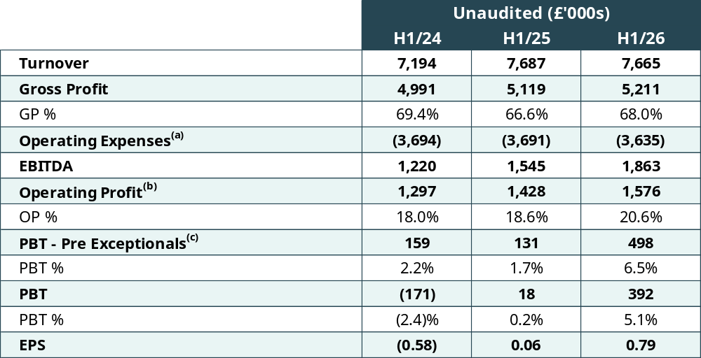
Momentum building across all key profitability metrics
Earnings growth accelerating despite broader economic uncertainty
Exceptionals: H1/24 - £330k cost, H1/25 - £113K cost, H1/26 - £106K cost
Pre amortisation, share based payments and exceptional items
Pre exceptional post amortisation
Source: Company at 30 September 2025 Standard: IFRS

Slide 9
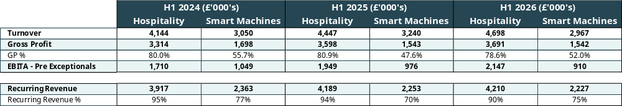
Consistently high recurring revenue in both divisions
Good growth in hospitality; Smart Machines slightly lower due to strategic ERP exit and hardware pricing adjustments to secure future recurring revenue growth
Source: Company at 30 September 2025 Standard: IFRS

Slide 10
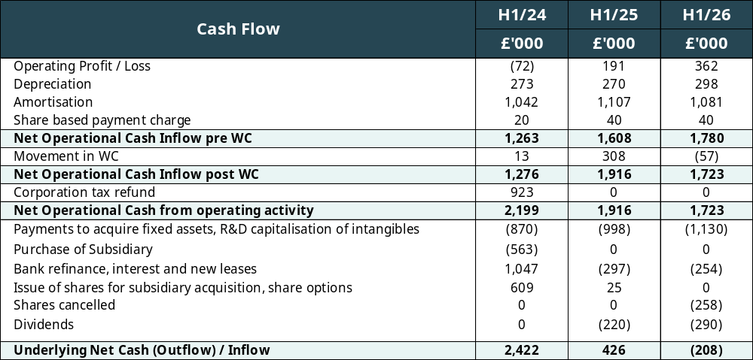
Strong cash generation and working capital management supports capital returns
Funding increased dividend payments, share buybacks, and investment in inventory to support growth
Source: Company at 30 September 2025 Standard: IFRS

Slide 11
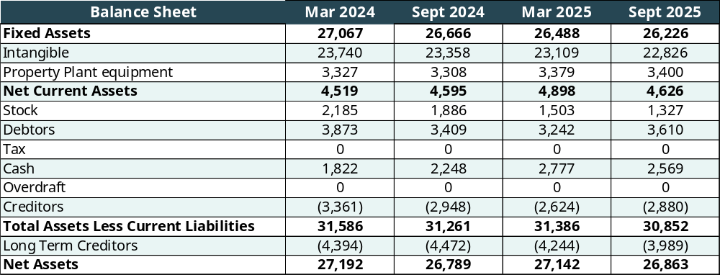
Strong balance sheet and debt repayment profile underpins future growth
HSBC refinanced with RCF, term loan and mortgage at rates between Base + 2.3%, and Base + 2.52%
RCF now recommitted to 30th April 2028 at Base +2.2%
Source: Company at 30 September 2025 Standard: IFRS

Slide 12









Well positioned for sustained growth
Strong foundations, growing demand, and strategic alignment across key markets
HEALTHY RECURRING REVENUES AND STRONG PIPELINE SUPPORTS GROWTH
ALIGNED WITH LARGE-SCALE USA / UK
MARKET OPPORTUNITIES
SALES PIPELINE ACCELERATING
DATA DRIVING CONNECTIVITY
NEW CONTRACTS
FORECOURT ENTRY
NEW VERTICALS
HIGH DEMAND FOR DATA AND INSIGHTS UNLOCKING NEW COMMERCIAL OPPORTUNITIES
CASHLESS PAYMENTS ADOPTION CONTINUES TO ACCELERATE
WELL-POSITIONED TO DRIVE GROWTH ACROSS ALL KEY AREAS

Slide 13
QUESTIONS?

