Slide 1
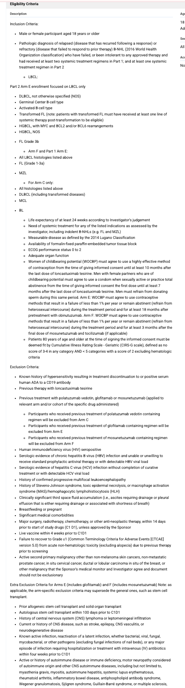
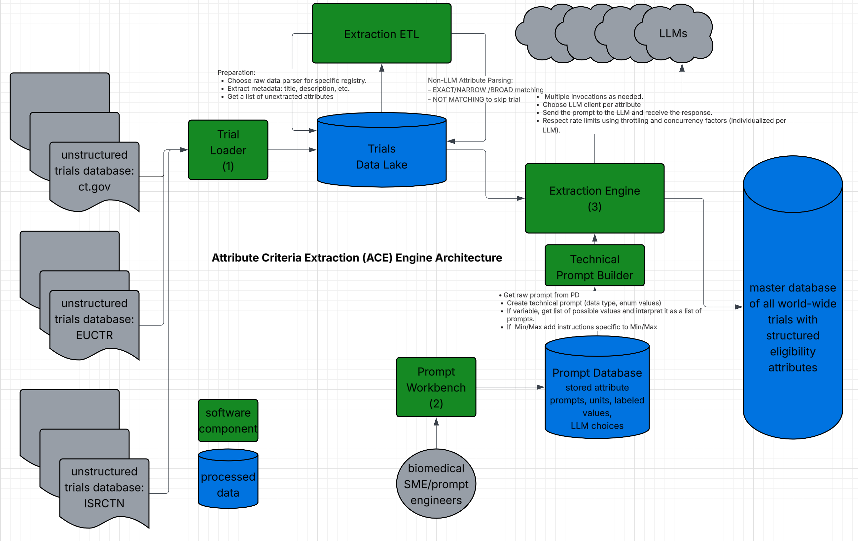
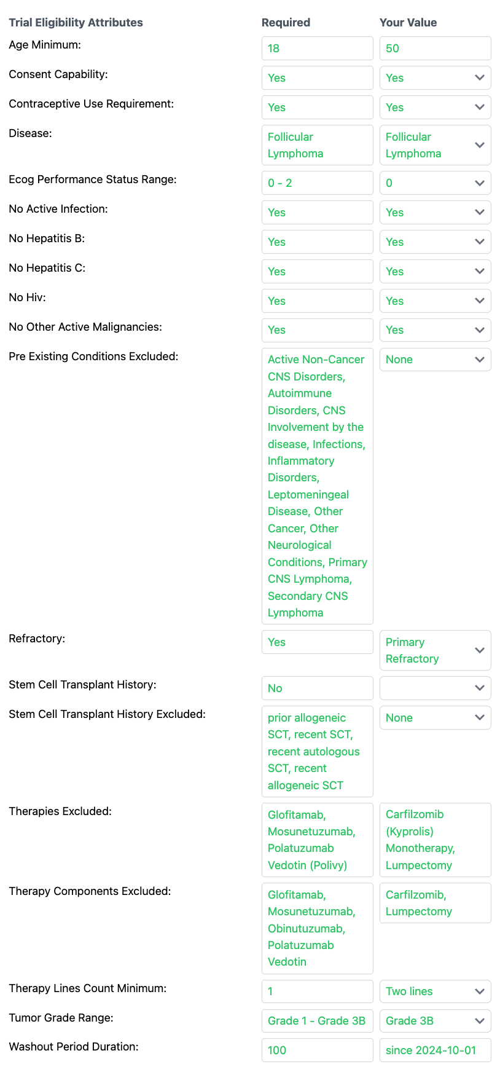
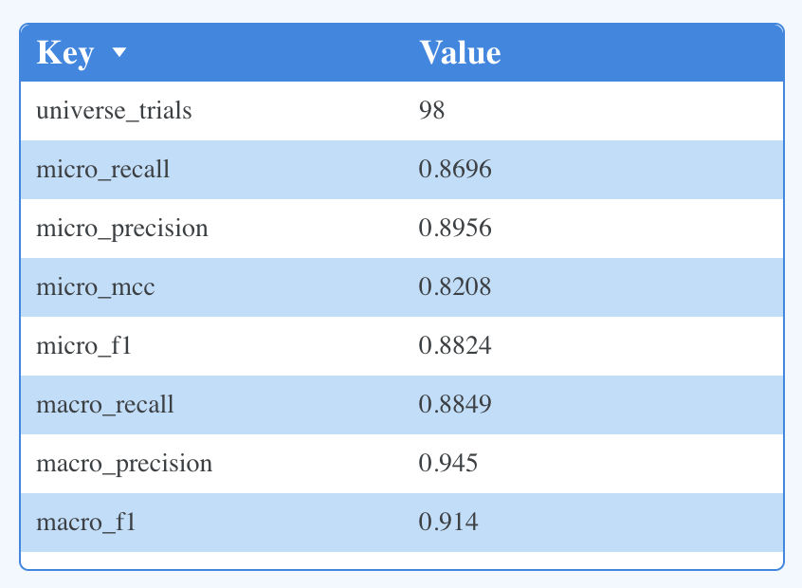
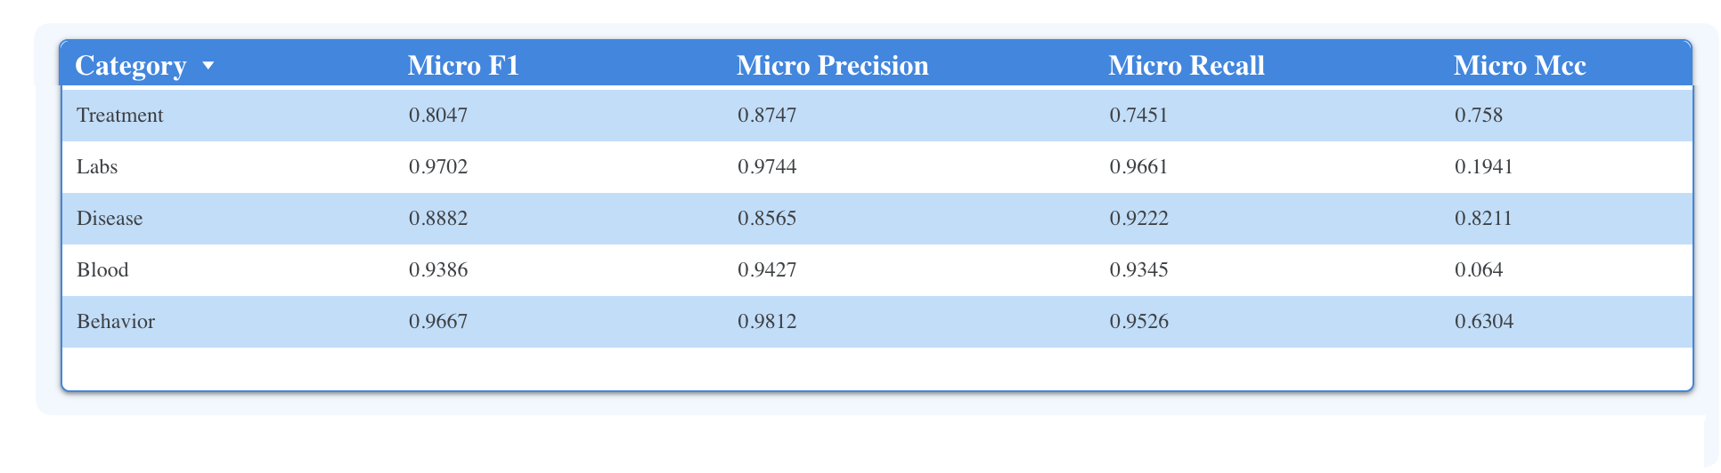

EXACT SYSTEM FOR PRECISION Clinical Trial MATCHING: CASE STUDY OF Accuracy wiTH Multiple Myeloma TRIALS
A. BLUM ¹ and J. FITZGIBBON²
1 CancerBot
2 Queen Mary University of London
* EXACT (EXtracting Attributes from Clinical Trials) is the underlying open source software behind CancerBot, which also supports follicular lymphoma, mantle cell lymphoma and many more blood cancers to come
INTRODUCTION
AIM
METHOD
Accurate trial matching is a major barrier to trial enrolments. Other trial matchers have merely ranked trials for suitability to the patient: no true eligibility assessment is performed. The EXACT system uses a novel LLM-based Attribute Criteria Extraction (ACE) engine which converts free text from trials to true structured criteria across 79 patient attributes used in MM trials..
Assess overall accuracy (precision, recall, F1) of extracting patient eligibility attributes from MM clinical trials.
Analyze accuracy by criteria category (labs, blood, behavior, treatment).
Performance was evaluated using the most recent 98 MM trials (out of 2979 actively recruiting open MM trials) from ISRCTN (50 British trials from this registry), EUCTR, and clinicaltrials.gov manually annotated by experts across 79 core patient attributes spanning previous treatment, labs, disease, blood and behaviour domains.
Biomedical Subject Matter Experts label each of the 79 attributes for MM. The values are compared against those extracted by the Attribute Criteria Extraction engine.
SYSTEM ARCHITECTURE
CANCERBOT’S EXACT SYSTEM
ORIGINAL TRIAL
EXTRACTED TRIAL
BENCHMARKS
Table 1 - Overall
Table 2 – By Category
Accuracy of extracted attributes is generally very high across all attribute categories (above 90%). An ongoing area of development is recall (finding all criteria) of criteria related to previous treatment. The EXACT Prompt Workbench allows biomedical subject matter experts to continue to refine the LLM prompts to increase such recall.
CONCLUSIONS
REFERENCES
HOW TO USE
With accurate ACE extraction of attribute criteria, patients and doctors can view clearly expressed and exact eligibility criteria for the most complex clinical trials and quickly determine whether they are eligible.
With these results EXACT holds promise as a foundational infrastructure for real-time patient trial matching in precision oncology.
The EXACT software is made available freely to patient support organizations and cancer foundations
1) Jin Q. Matching patients to clinical trials with large language models. Nature Communications. 2024;15:9074. doi:10.1038/s41467-024-53081-z. PMC
(2) Meystre SM Piloting an automated clinical trial eligibility surveillance and provider alert system based on artificial intelligence and standard data models. BMC Medical Research Methodology. 2023;23:88. doi:10.1186/s12874-023-01916-6. BioMed Central
(3) Gupta S Patient Records Interpretation for Semantic Clinical Trial Matching using Large Language Models. arXiv [Preprint]. 2024 Apr 27; arXiv:2404.15549. arXiv
(4) Ferber D,. End-to-End Clinical Trial Matching with Large Language Models. arXiv [Preprint]. 2024 Jul 18; arXiv:2407.13463. arXiv
(5) Gao J. COMPOSE: Cross-Modal Pseudo-Siamese Network for Patient Trial Matching. arXiv [Preprint]. 2020 Jun 15; arXiv:2006.08765
Sign up at cancerbot.org as physician/navigator
Add record your patient
Answer brief questions on the patient’s disease and previous treatment
You will see potential trial match list
Click on trial of interest
Enter more attribute values on right side to become more eligible
Click I’m Interested button to express interest in trial
CONTACT
support@cancerbot.org

