Slide 1
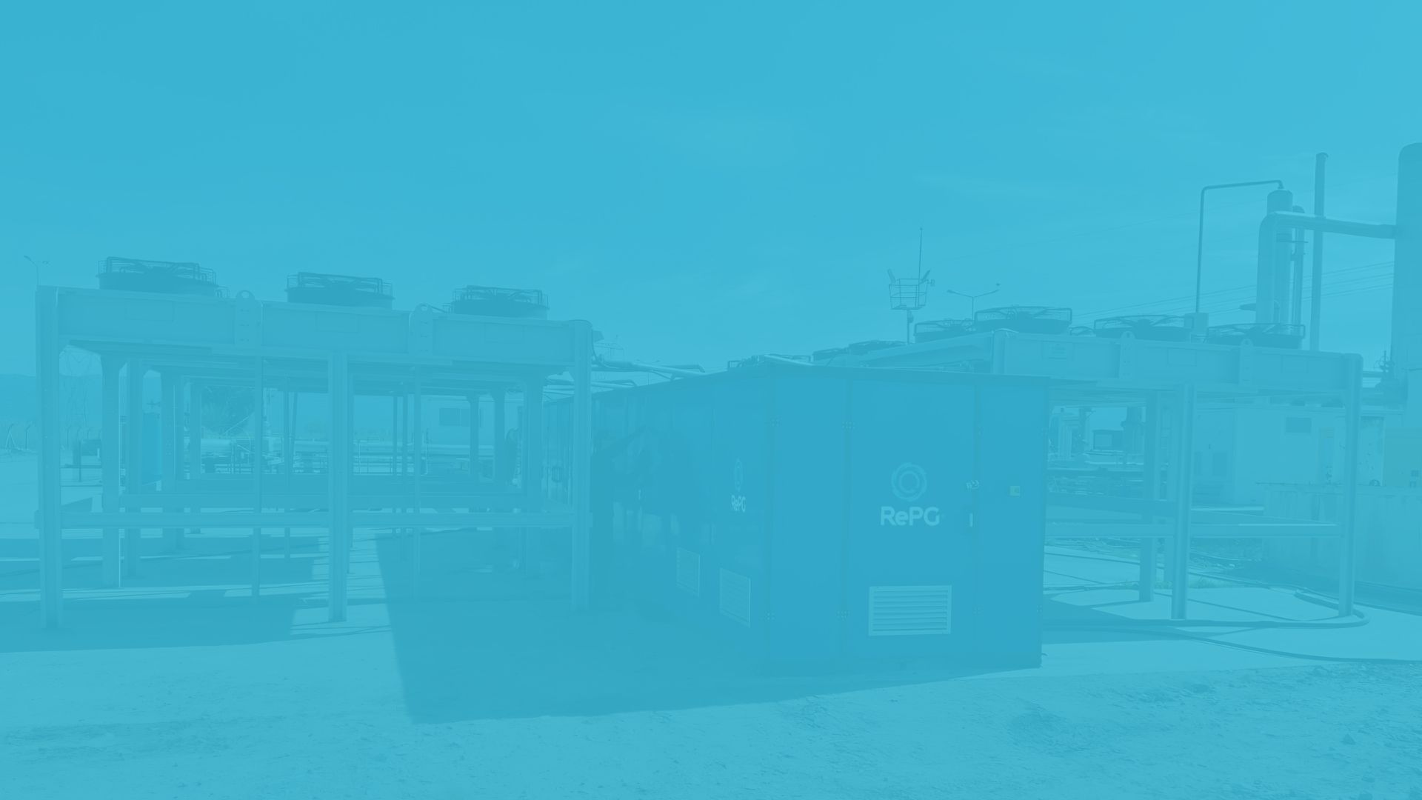

Clean Energy from Airborne Humidity and Heat
www.repg.com.tr
RePG
Energy
Patented Deep Technology converts ambient humidity and waste heat into clean electricity and water.

Slide 2
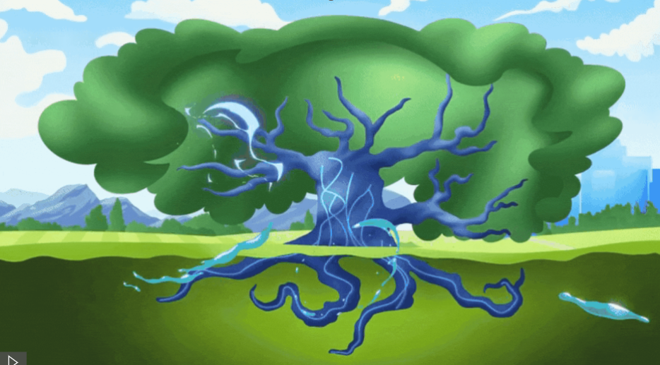
The Big Idea
What if the air around us and waste heat could power the world?

Slide 3
Unique Technology
The world's most efficient technology, field-tested and commercially proven, that uses the principle of osmosis and diffusion to convert waste heat and humidity into energy and water.
31 Patent | 22 Trademark | 4 Design

Slide 4
Product Portfolio
RePG Industry
25kW–1MW
RePG- Homes & Buildings
0.1–25kW
RePG Aqua
10L–25kL
/day water
RePG -Vehicle,
HVAC, Data Center
Ongoing R&D

Slide 5
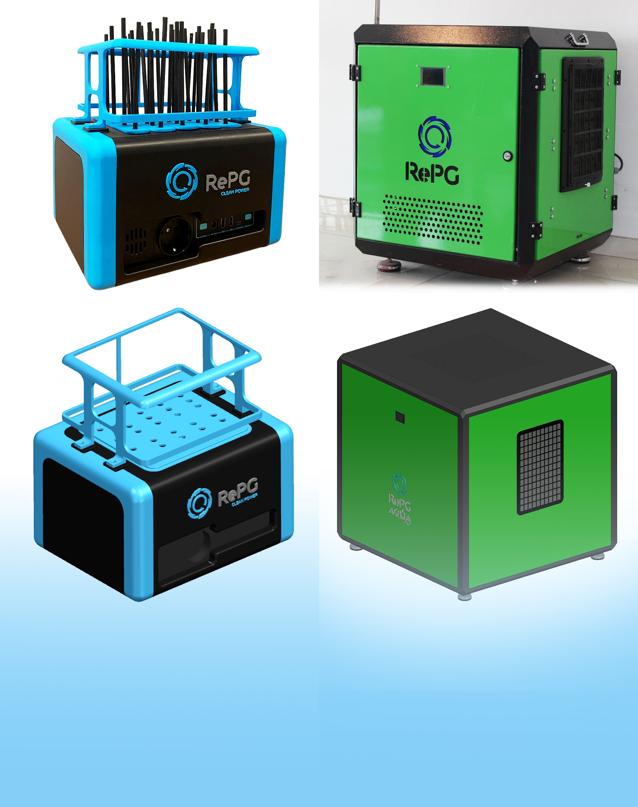
Product Varieties
RePG Industry
25kW–1MW
RePG Homes & Buildings
0.1–25kW
RePG Aqua
10L–25kL
/day water
RePG Vehicle, HVAC, Data Center
Ongoing R&D
RePG Homes & Buildings
0.1–25kW
RePG Homes & Buildings brings energy independence to residential and commercial buildings by converting ambient heat and humidity into usable power. It is ideal for homes, apartments, offices, and small hotels. It enables lower energy bills and greater sustainability without relying on fossil fuels.

Slide 6

No external fuel required
Low initial investment, <
3 year return on investment.
Core Advantages
Zero CO2, zero waste heat
Grid-ready
Modular and Redeployable
Flexible next-generation renewable systems

Slide 7
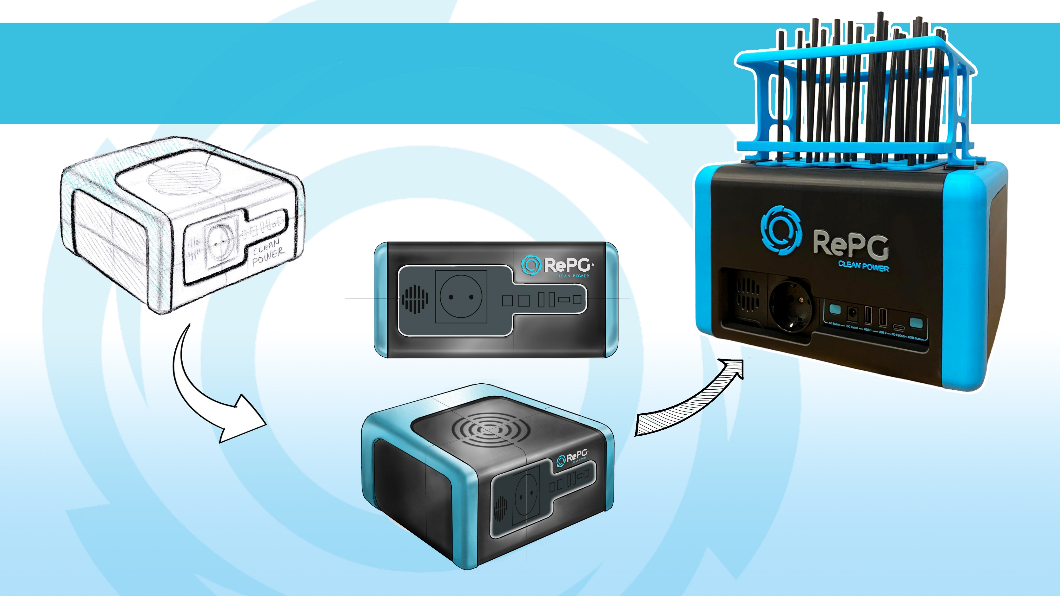

RePG Clean Power- Industrial Design Process
Colorization &
Design Revision Process
Sketchs
Render View

Slide 8
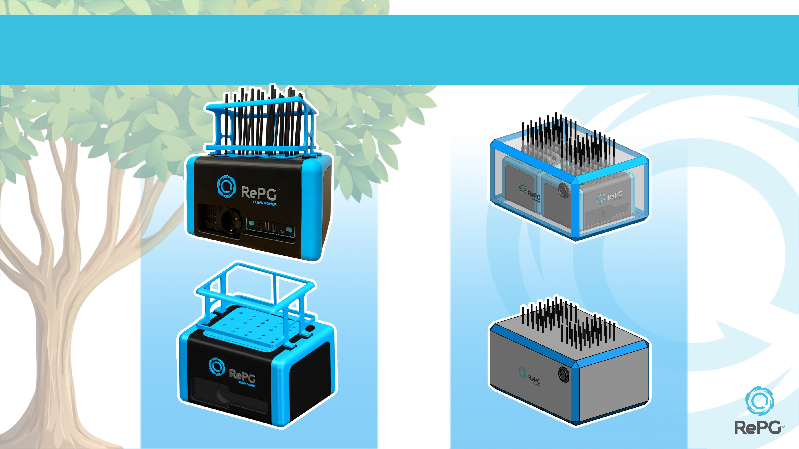
LOW CAPACITY NATURAL CIRCULATION (STATIC)
HUMIDITY DEVICE
INTERNAL VIEW
PROTOTYPE
100 Wh- day
200 Wh- day
VISUALIZATION & RENDER
25x20x25 cm
30x45x25 cm

Slide 9
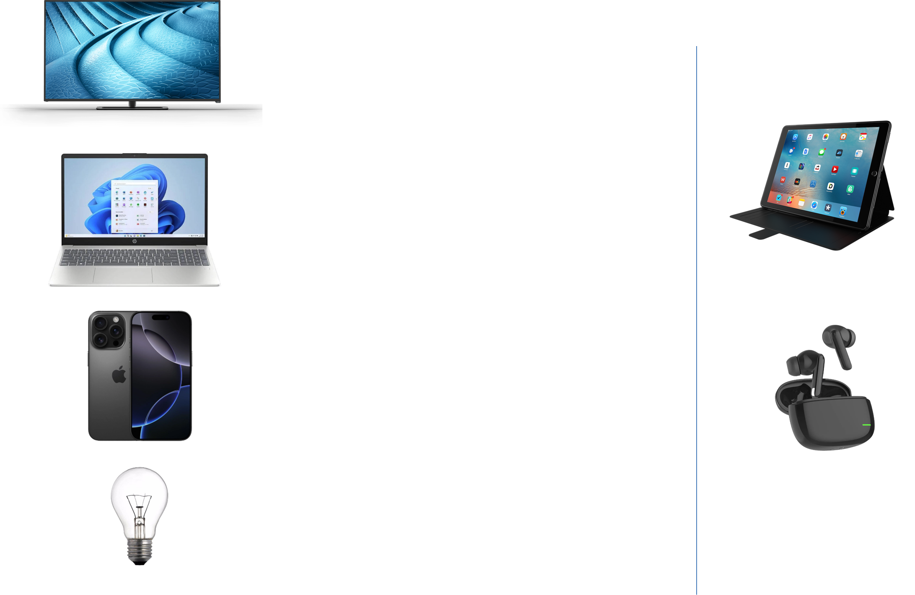

What can be done with 100 Wh ?
Small portable LED TV (20-30 W):
Commonly used for camping. Can be used for 3-5 hours.
Medium LCD/LED TV (60–100 W):
Typical home 32–40 inch. Can be used for 1-2 hours.
Tablet (typical 25–30 Wh battery)
You can fully charge a tablet 3–4 times.
Laptop (typical 50–60 Wh battery)
You can fully charge a laptop 1–2 times, depending on its size.
Example:
MacBook Air (50 Wh) → about 2 charges,
Gaming laptops (80–90 Wh) → about 1 charge.
A standard headphone case :
can be charged 25 to 40 times.
An iPhone mobile phone → can be charged 5-6 times.
A 60W incandescent bulb → can operate for 1.5 hours.

Slide 10
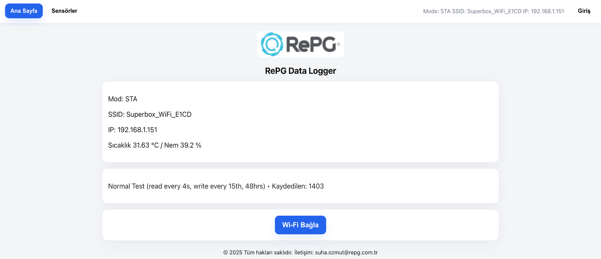
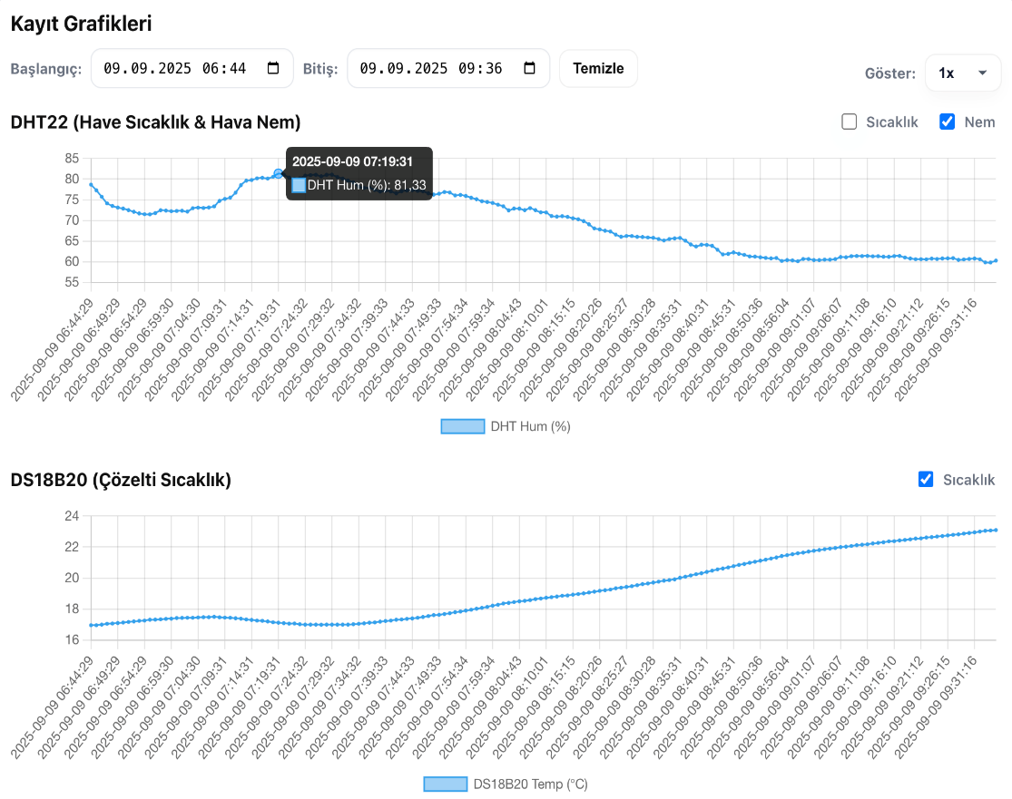
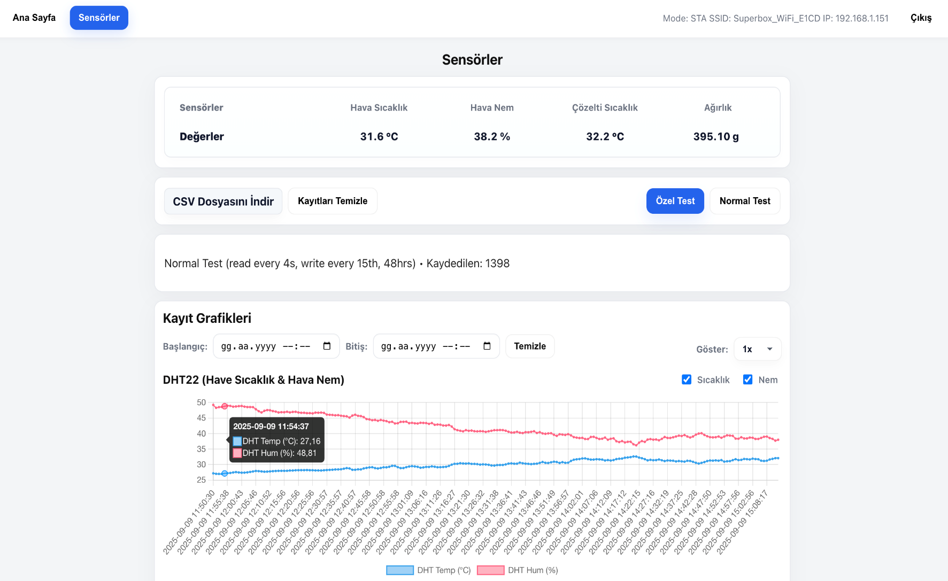
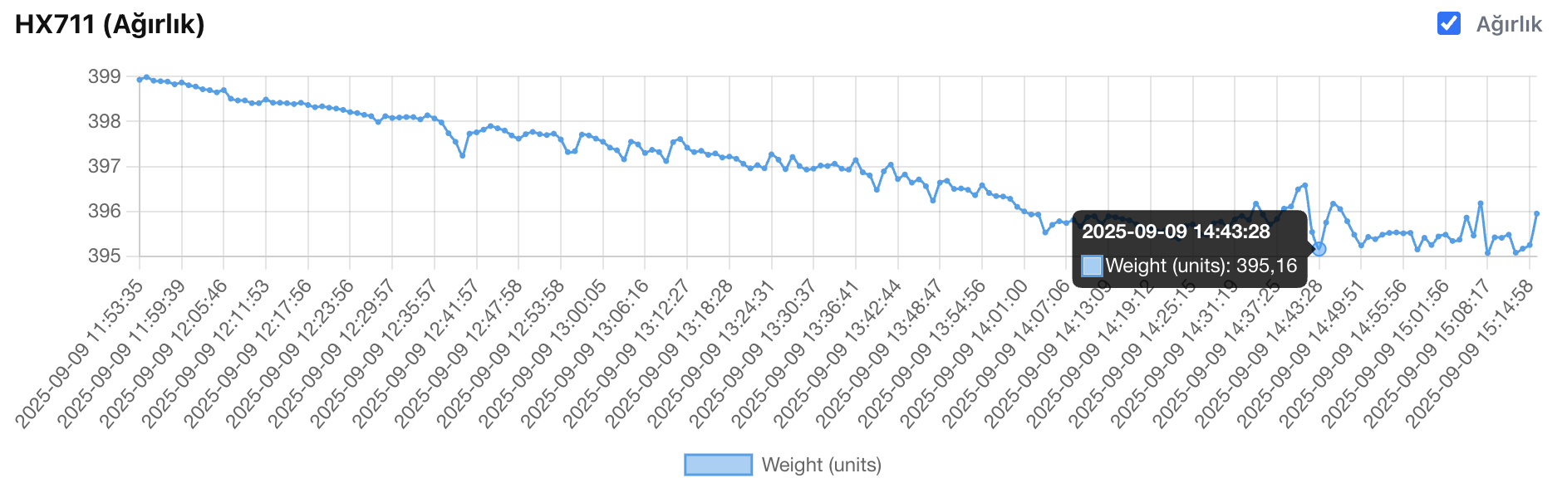
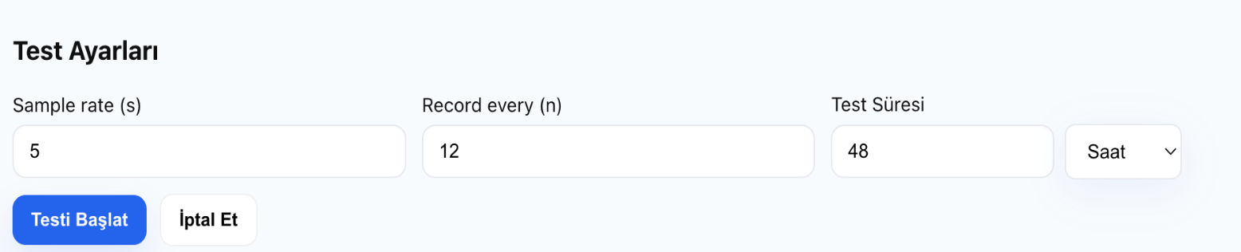
LOW-CAPACITY NATURAL CIRCULATION (STATIC)
HUMIDITY DEVICE - WEB INTERFACE APPLICATION
Web Interface Home Page
Sensor Page

Slide 11
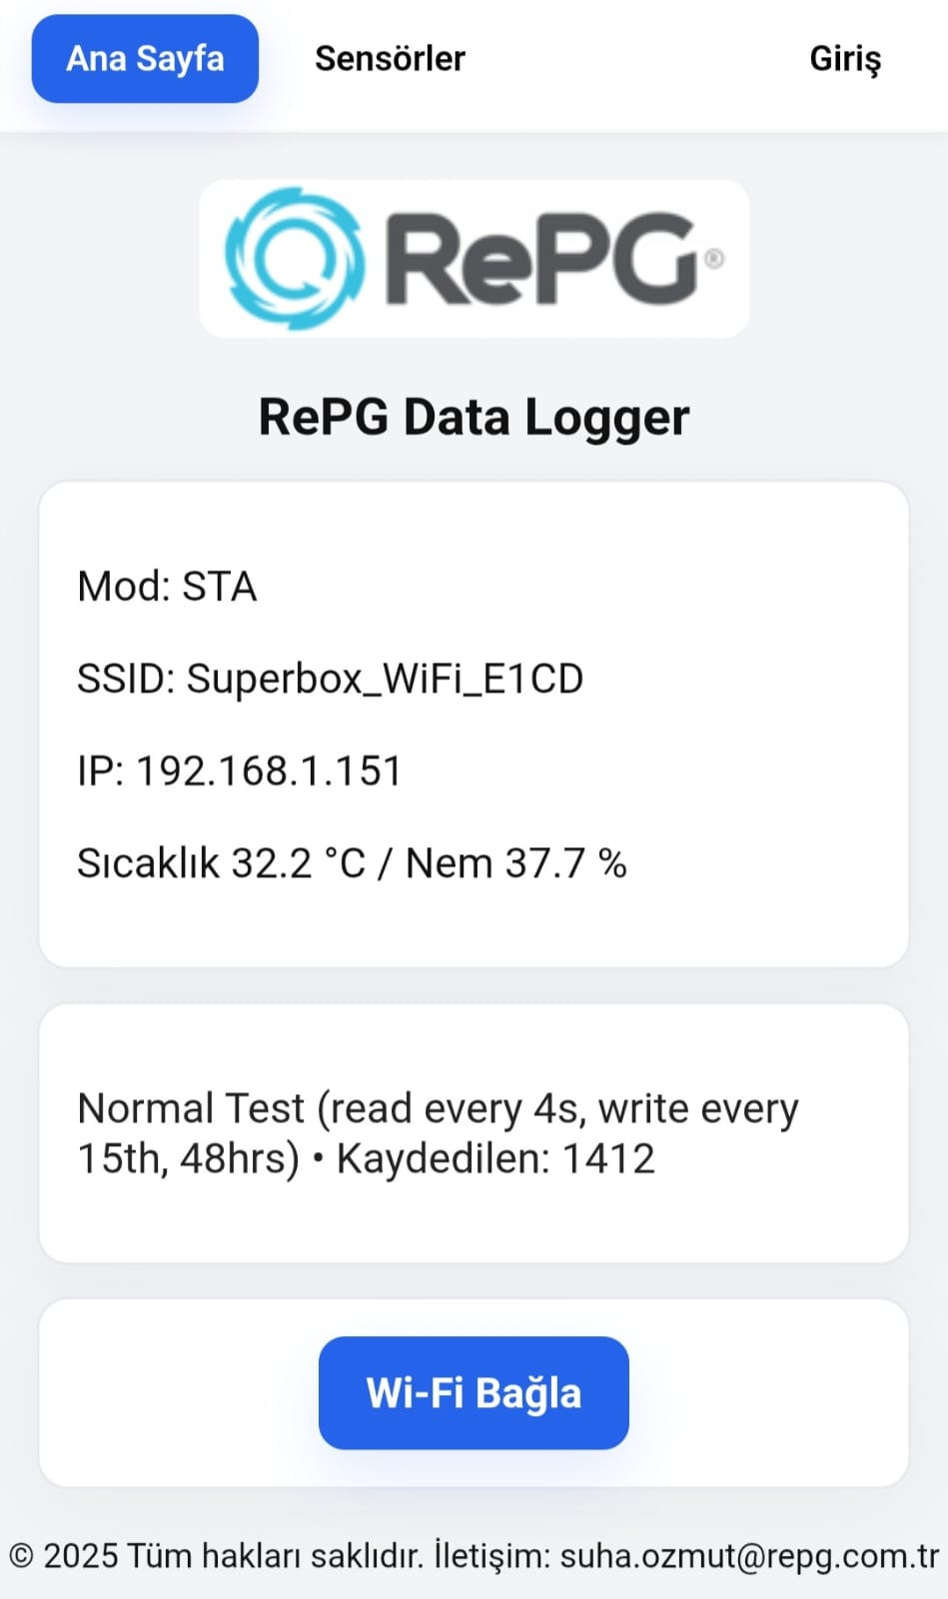
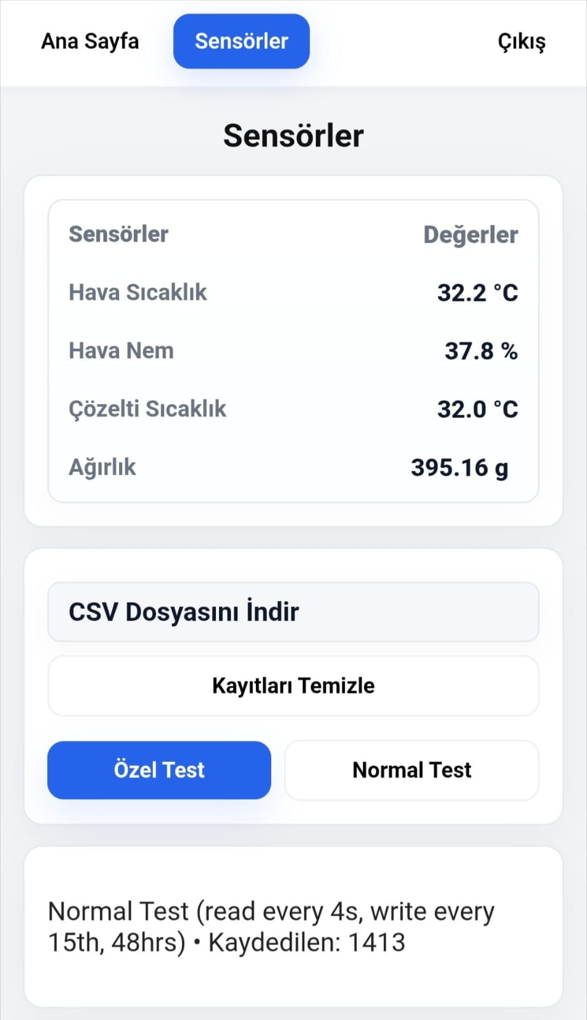
LOW-CAPACITY NATURAL CIRCULATION (STATIC)
HUMIDITY DEVICE - MOBILE INTERFACE APPLICATION
MOBILE INTERFACE
HOME PAGE
MOBILE INTERFACE
SENSORS PAGE

Slide 12
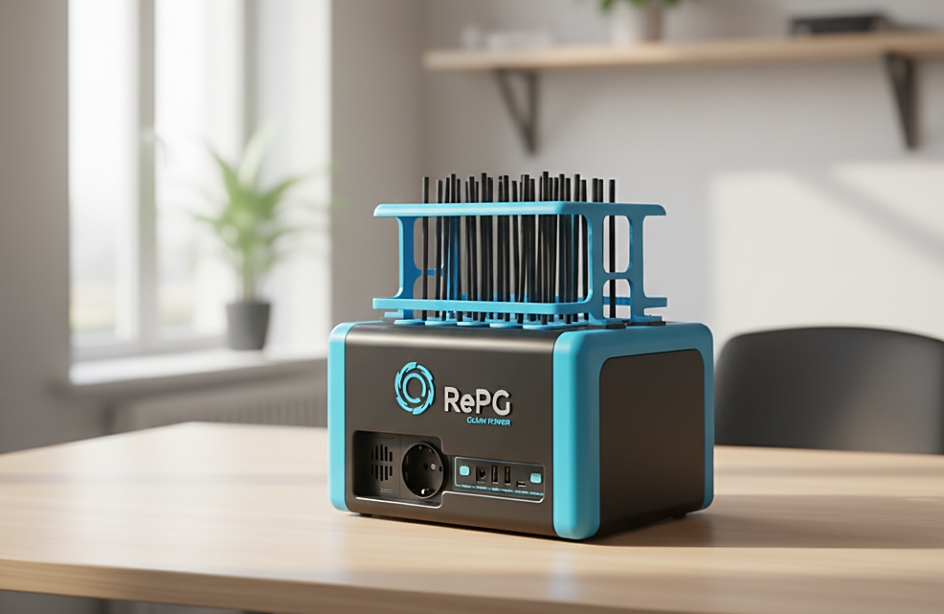
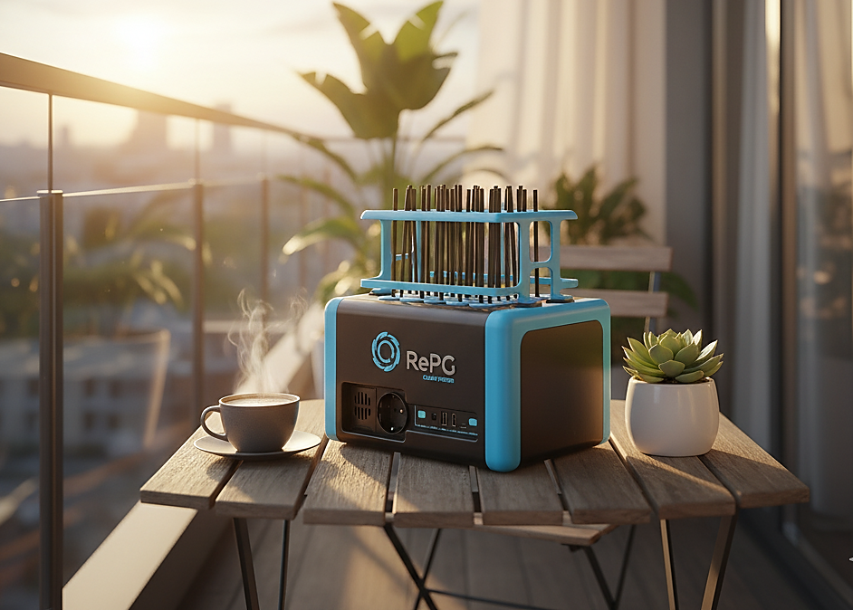
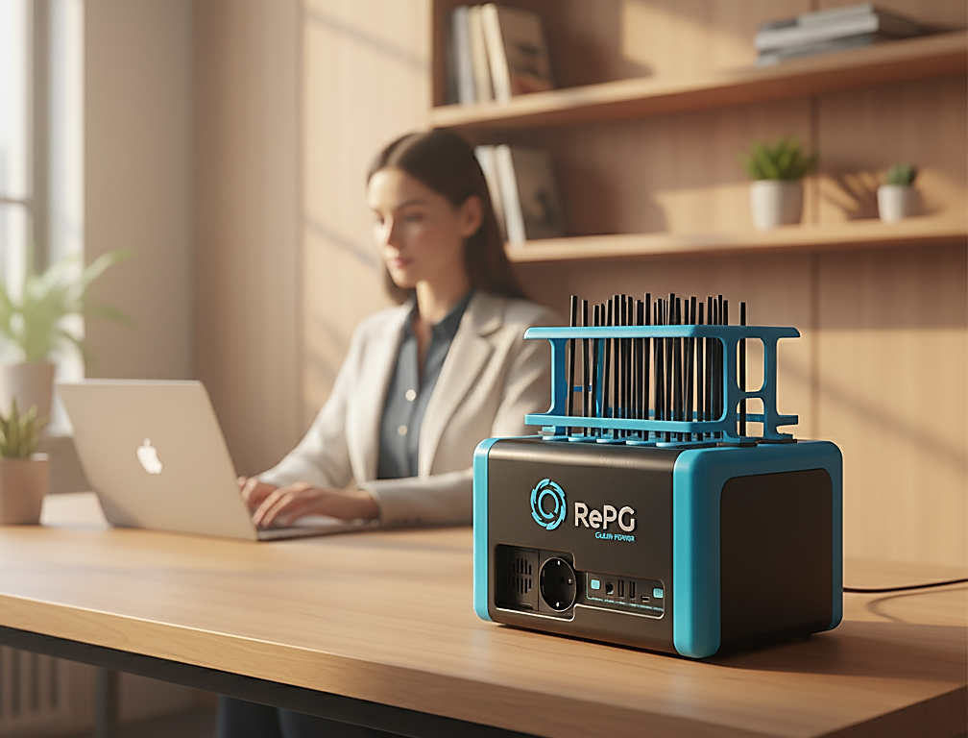
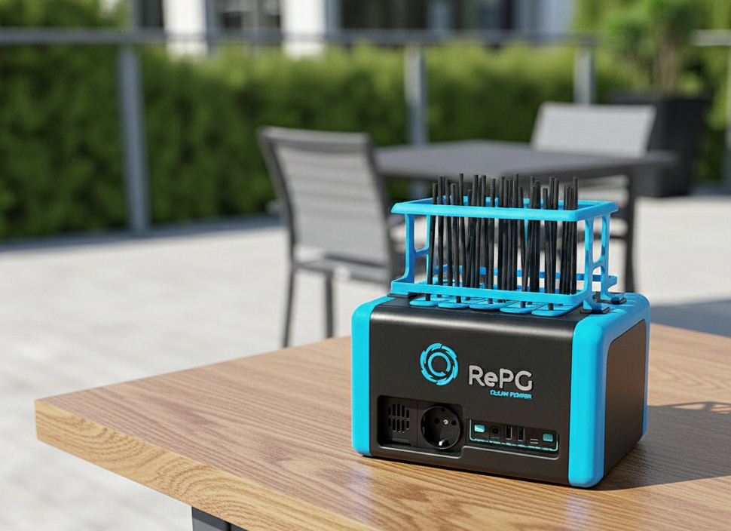
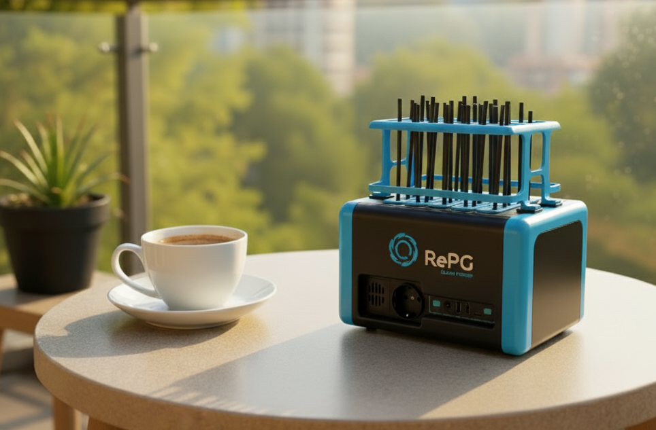
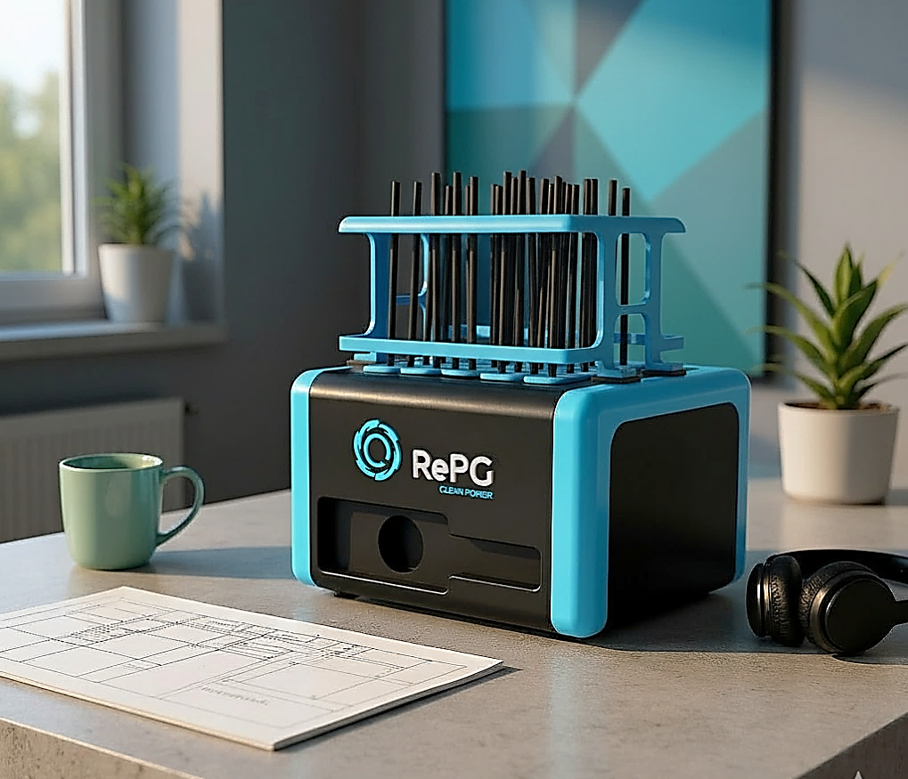
LOW-CAPACITY NATURAL CIRCULATION (STATIC)
APPLICATION AREAS
HOME
TERRACE, BALCONY
OFFICE
GARDEN

Slide 13
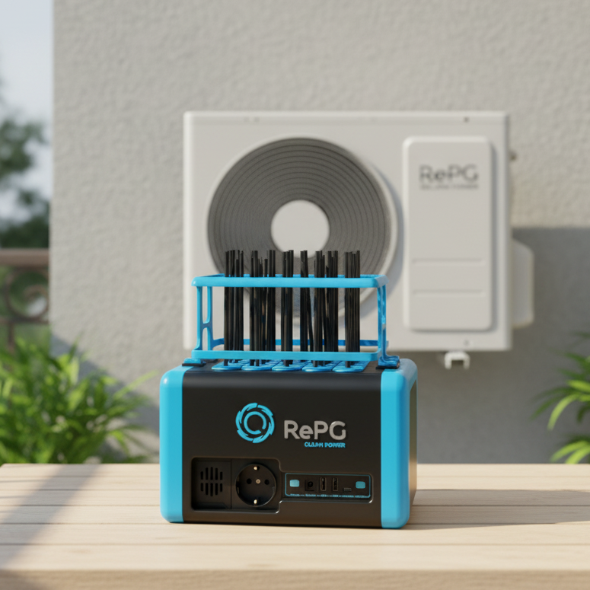
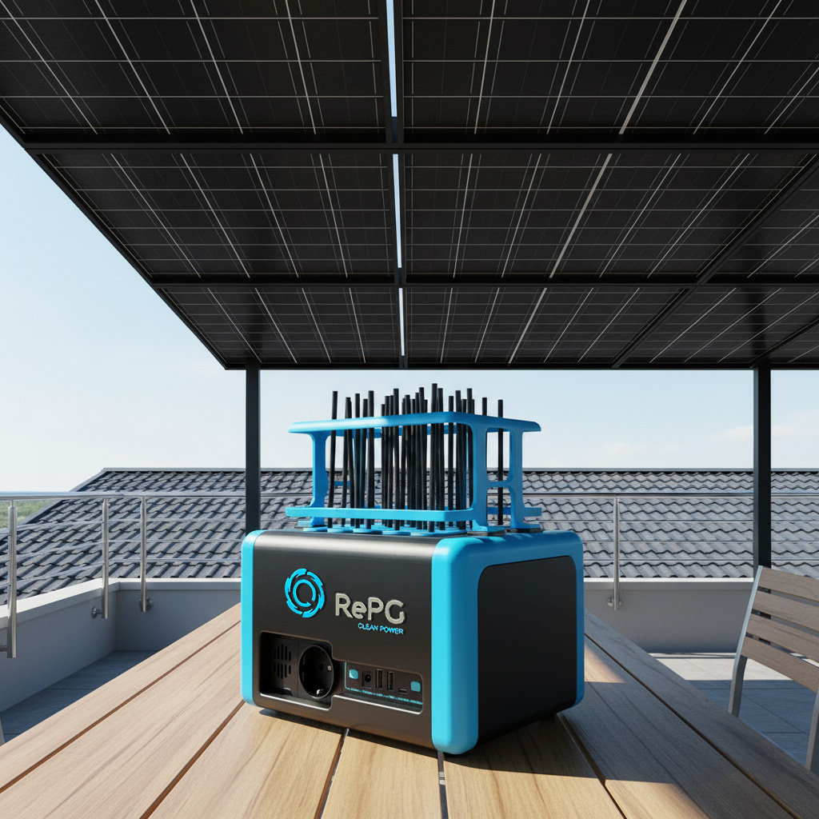
LOW-CAPACITY NATURAL CIRCULATION (STATIC)
APPLICATION AREAS-2
HOME
TERRACE, BALCONY
GARDEN,PARK

Slide 14
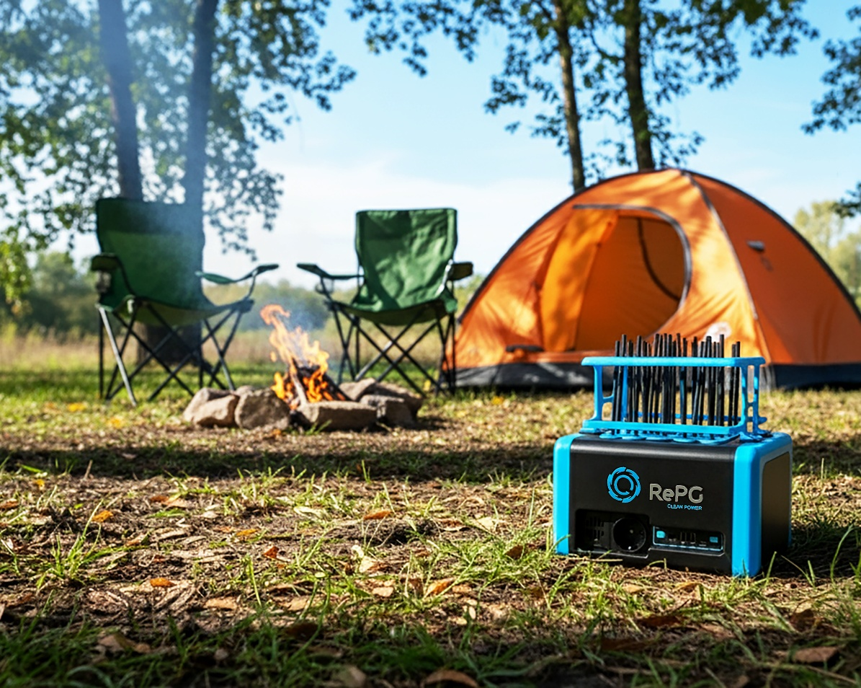
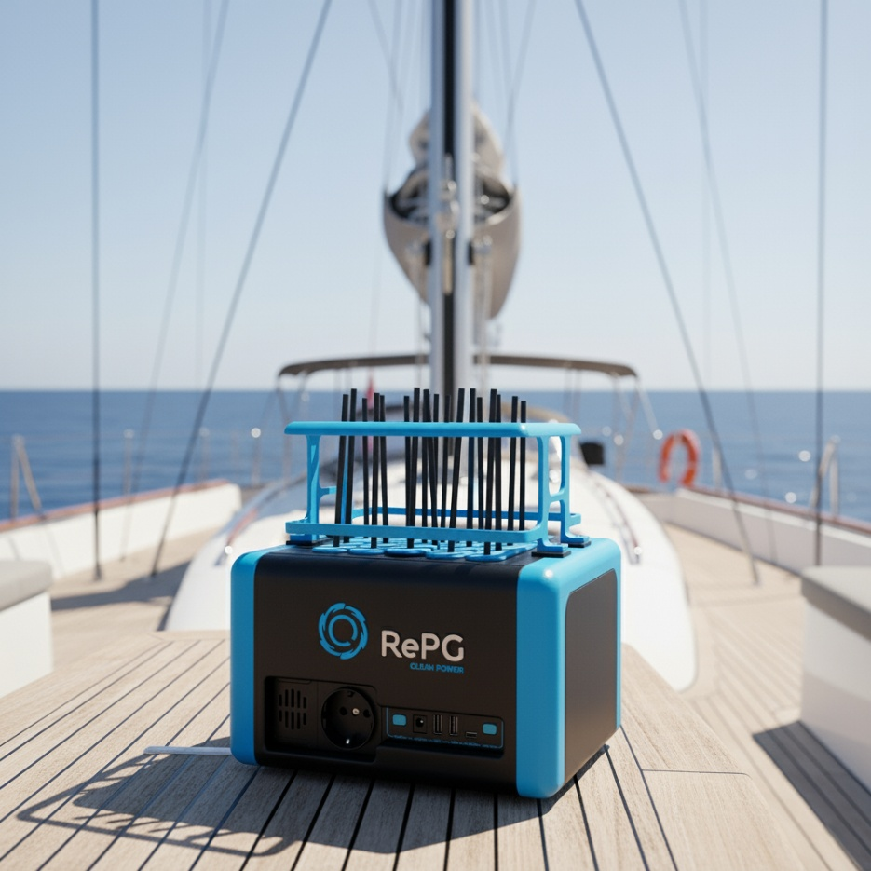
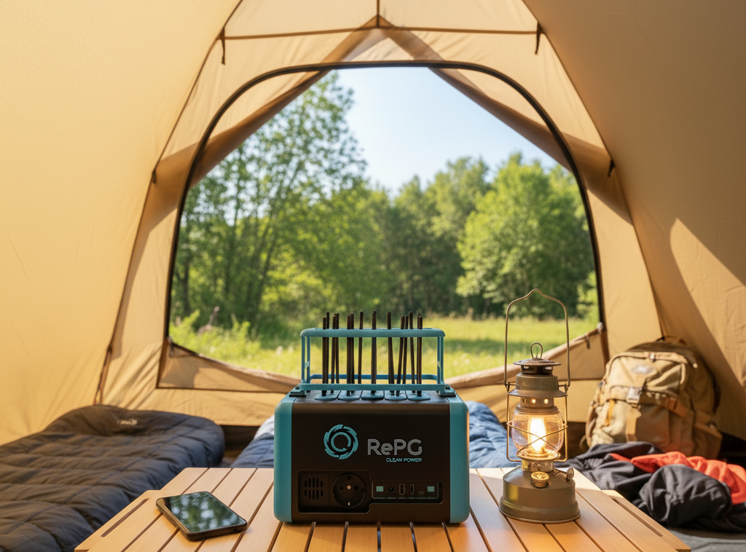
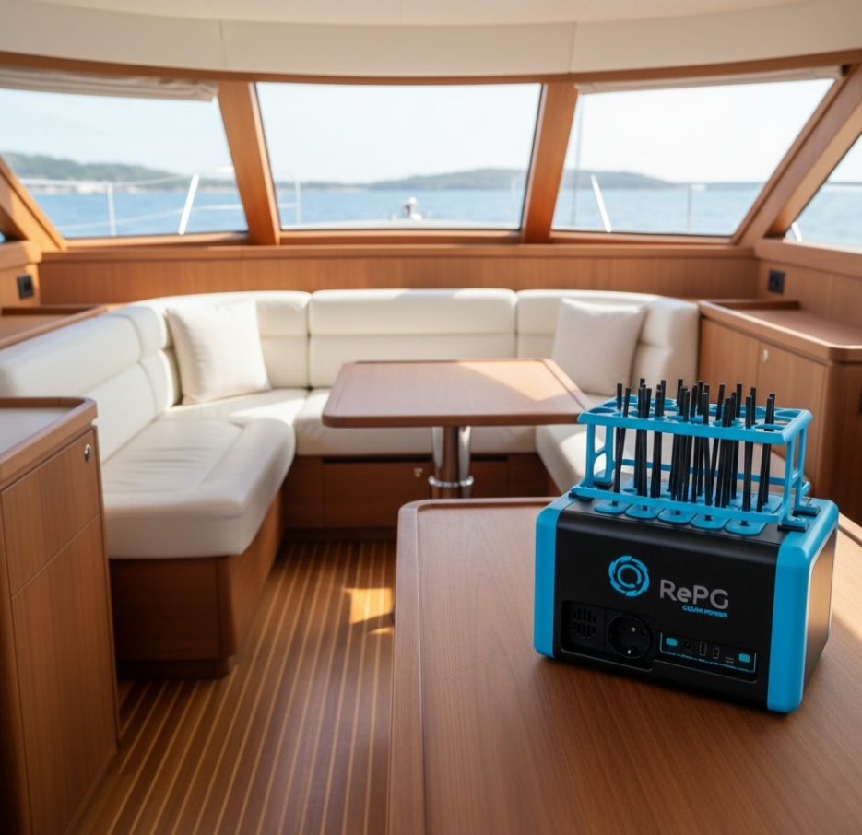
LOW-CAPACITY NATURAL CIRCULATION (STATIC)
APPLICATION AREAS-3
YATCHS
BOATS
KÜÇÜK KAPASİTELİ DOĞAL SİRKÜLASYON (STATİK)
KULLANIM ALANLARI
SHIPS
PORTS
CAMP AREAS

Slide 15
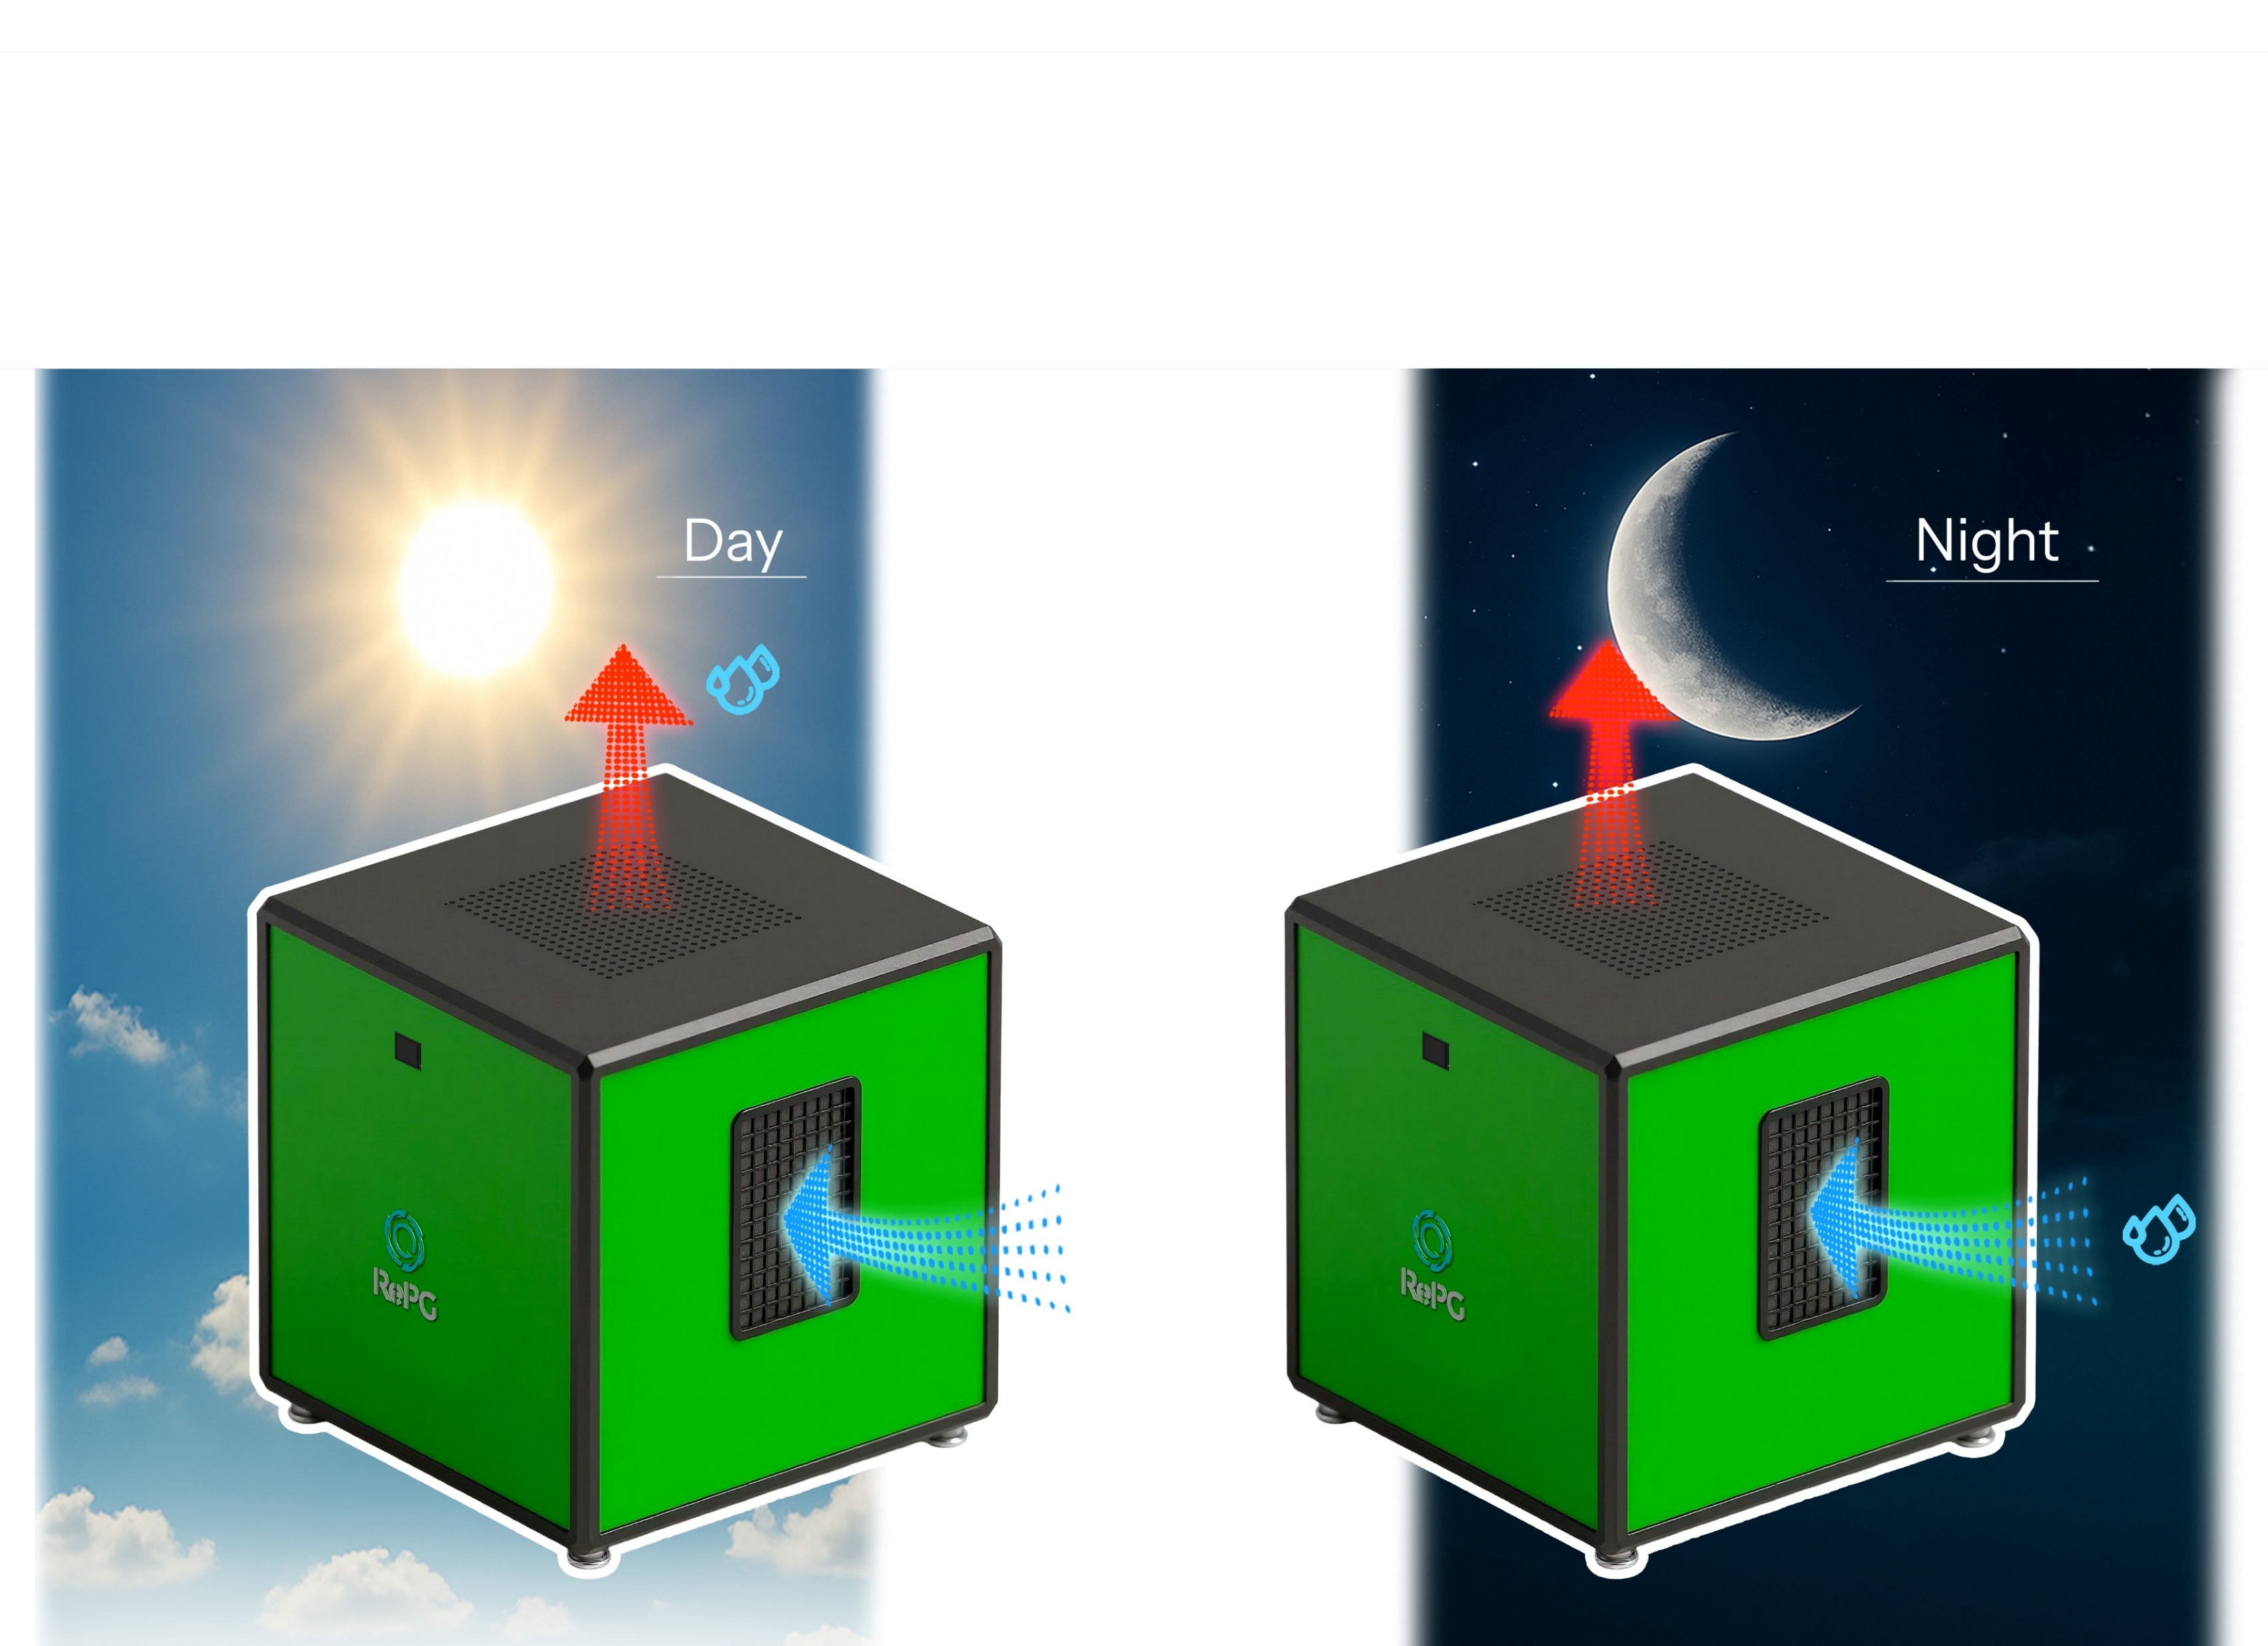
HIGH-CAPACITY SYSTEMS FORCED CIRCULATION
HUMIDITY DEVICE
AIR OUT
AIR OUT
AIR IN
AIR IN

Slide 16
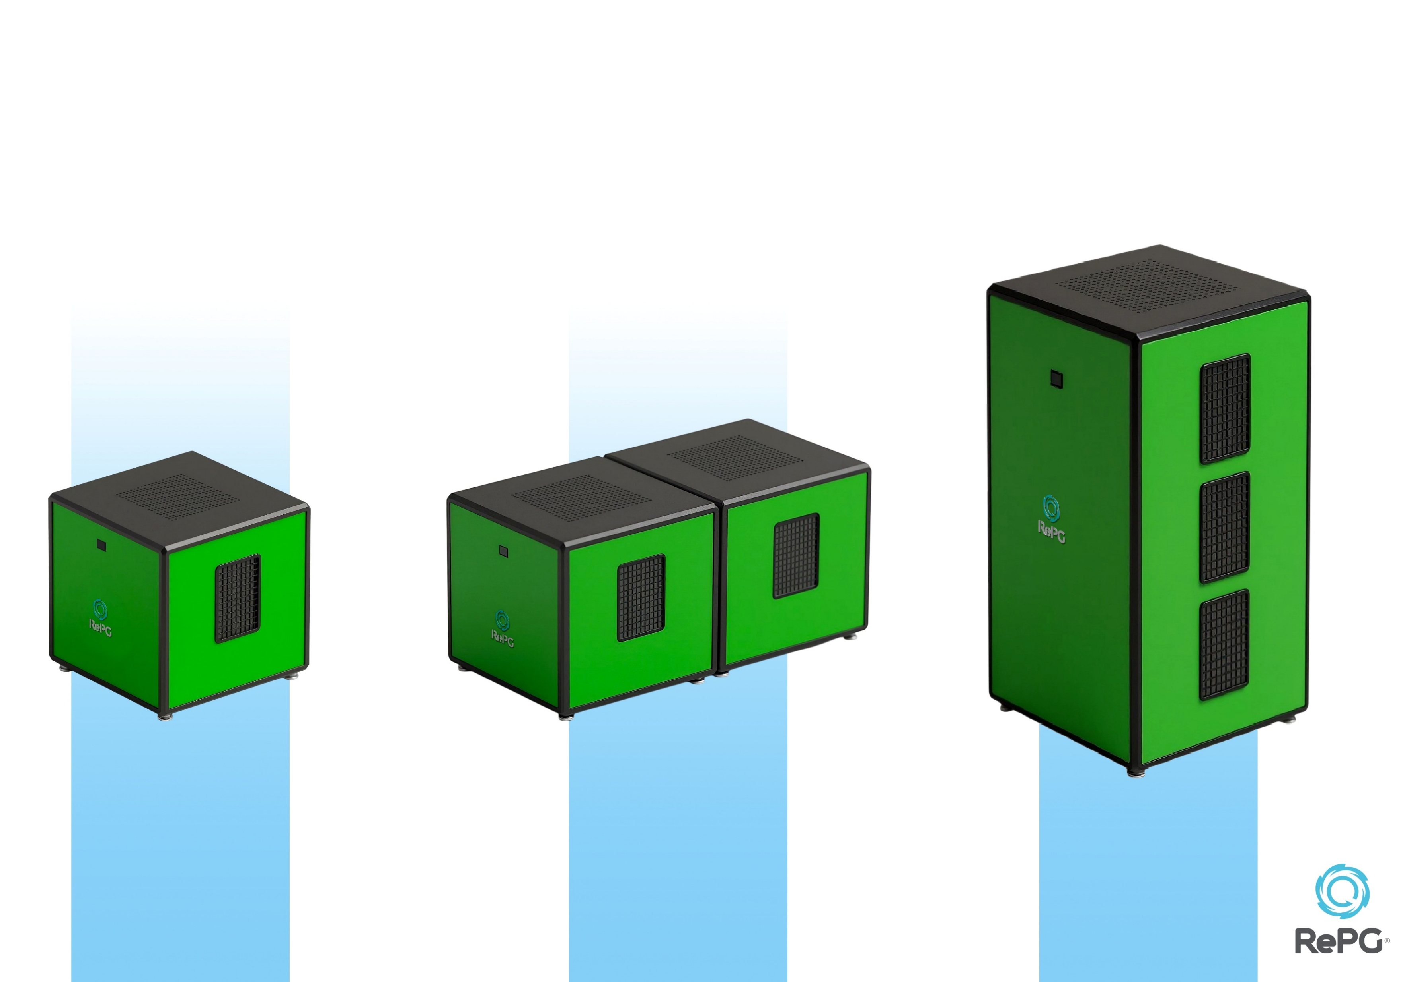
HIGH-CAPACITY SYSTEMS FORCED CIRCULATION
HUMIDITY DEVICES
Installed Power: 1 kWh
Net Power: 0.9 kWh
Installed Power: 2 kWh
Net Power: 1.8 kWh
Installed Power: 3 kWh
Net Power: 2.7 kWh
100 x100 x 90 cm
100 x200 x 90 cm
100 x100 x 250 cm

Slide 17
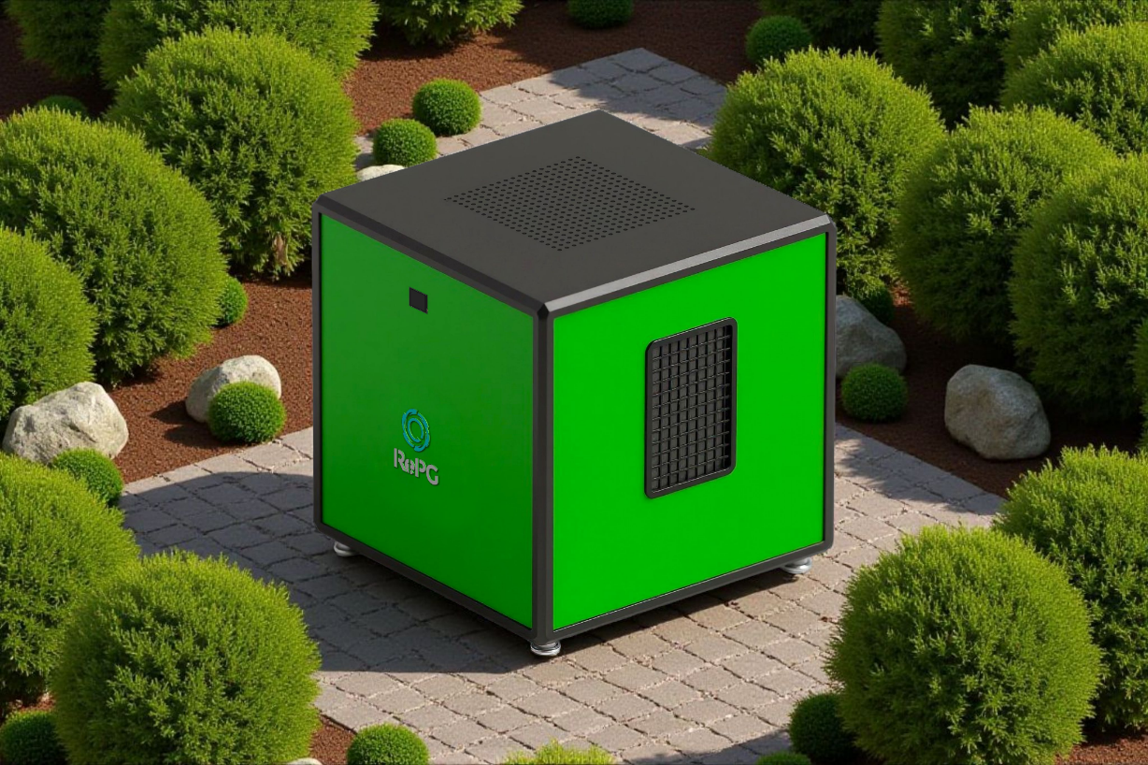
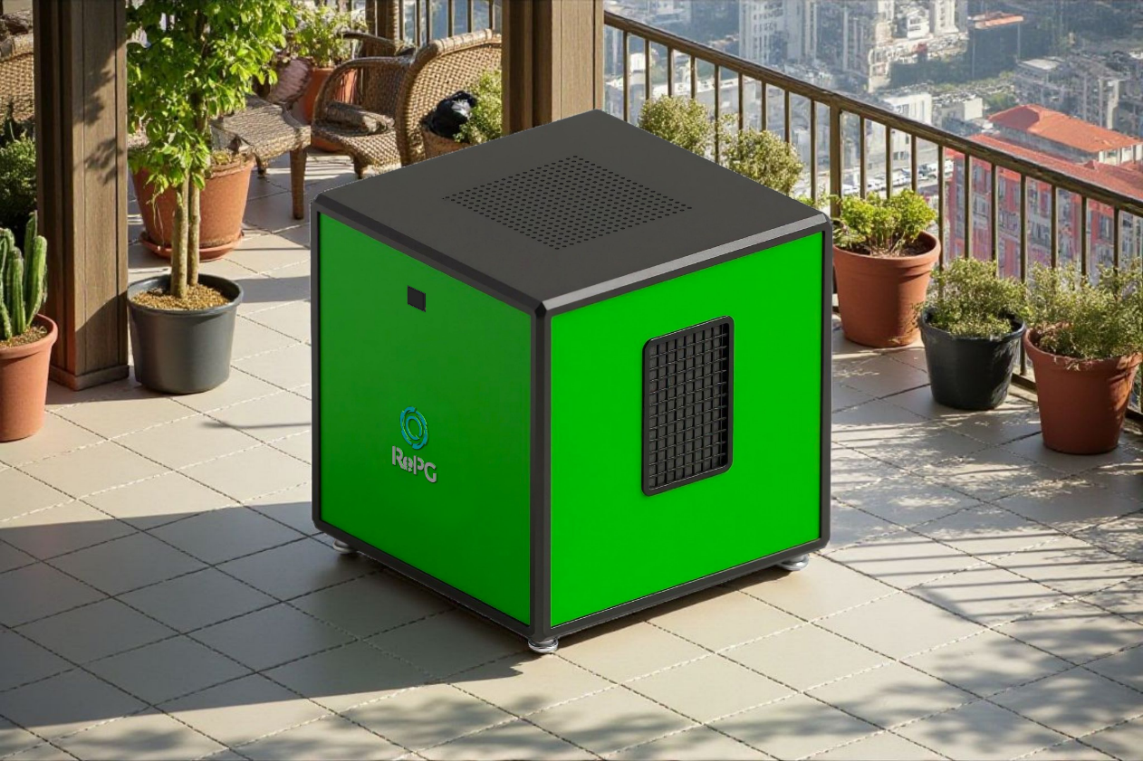
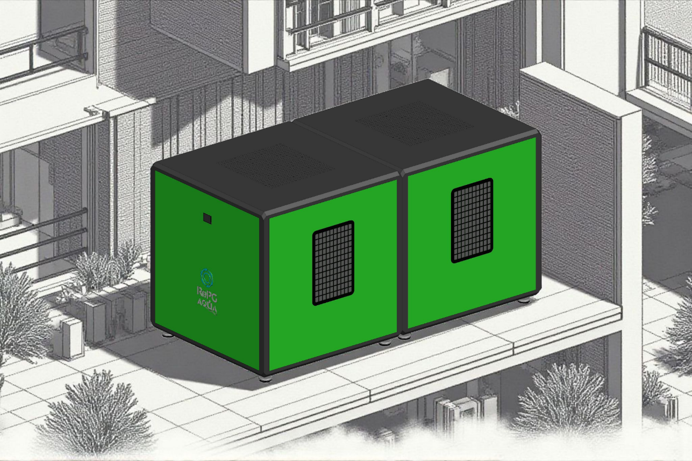
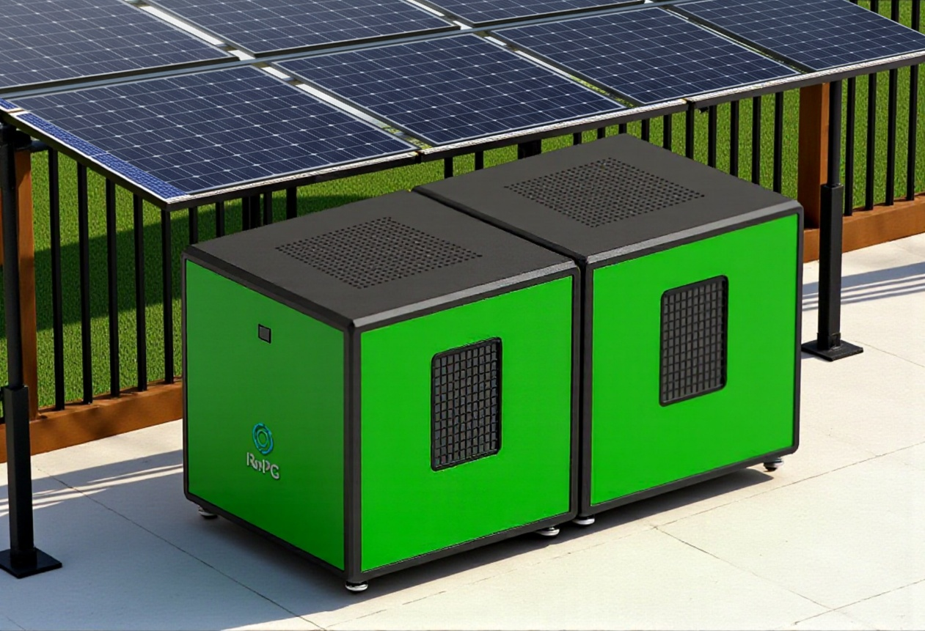
HIGH CAPACITY SYSTEMS FORCED CIRCULATION
HUMIDITY DEVICES – APPLICATION AREAS
TERRACES
BALCONIES
GARDENS
PARKS

Slide 18
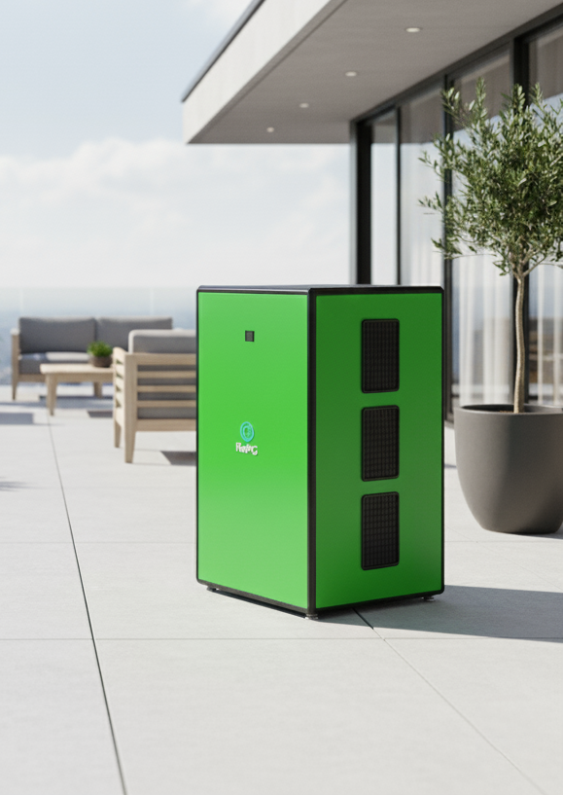
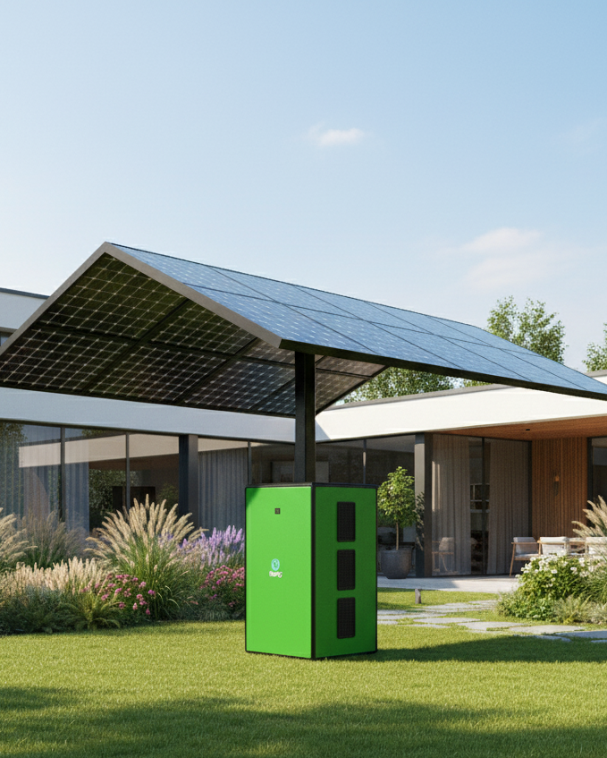
HIGH CAPACITY SYSTEMS FORCED CIRCULATION
HUMIDITY DEVICES – APPLICATION AREAS 2

Slide 19
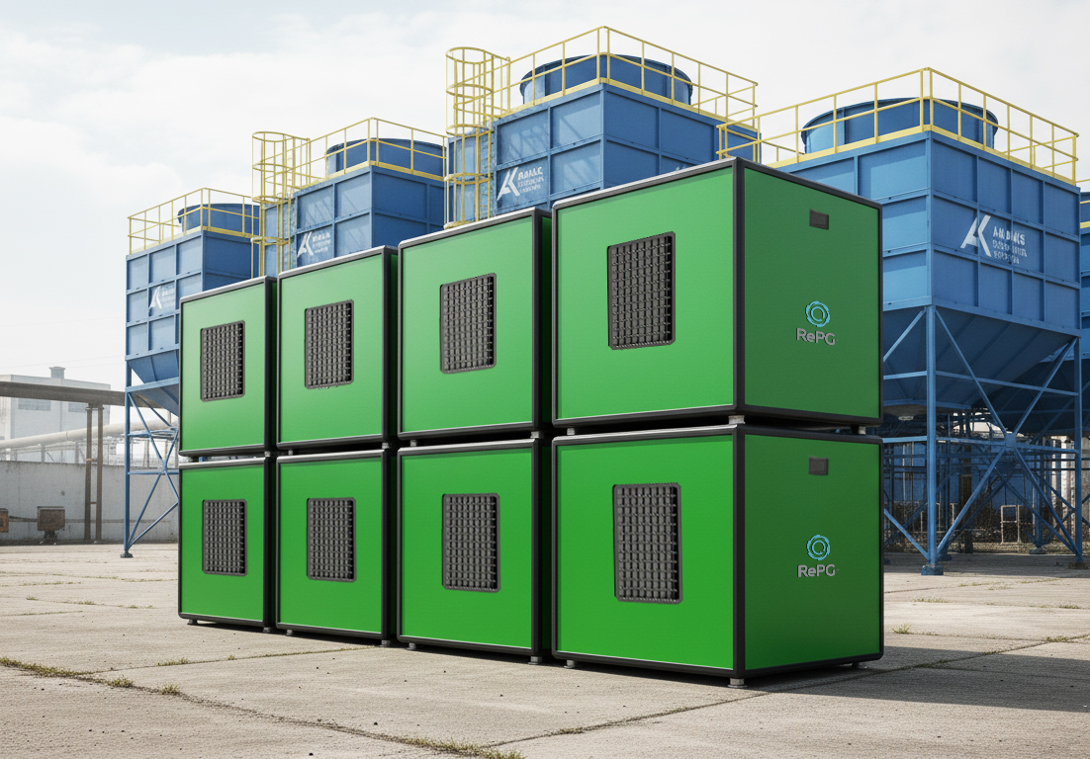
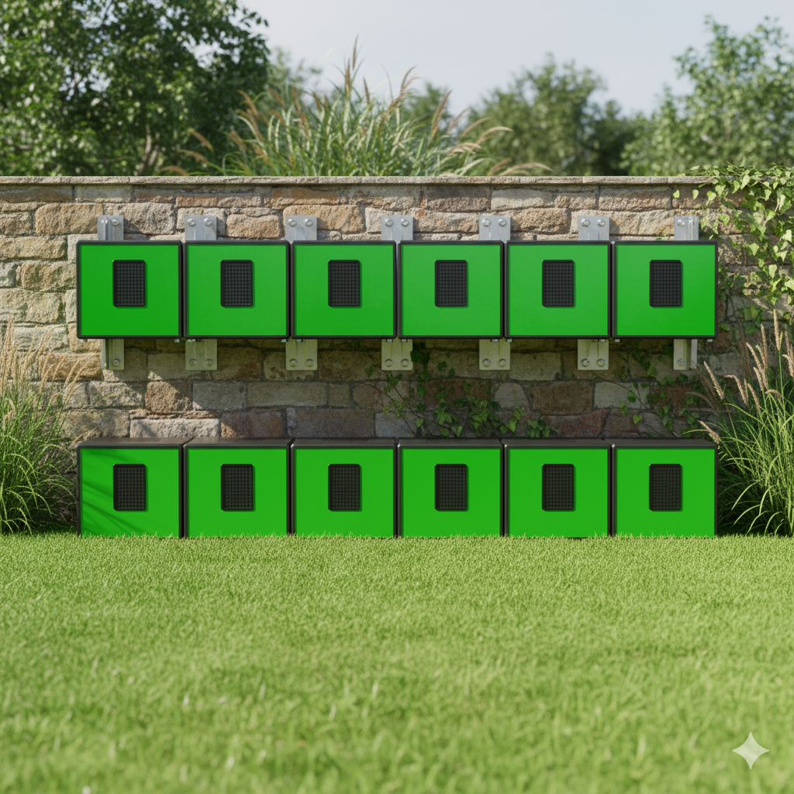
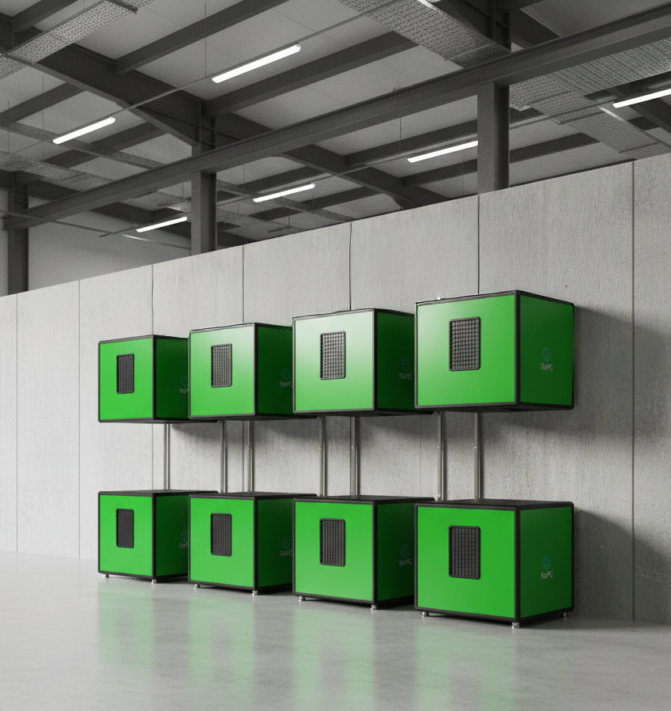
Factory Exterior Area-Multi Modular Layout
House Outdoor, Garden
Multi Modular Layout
Factory Interior Area Multi Modular Layout

Slide 20
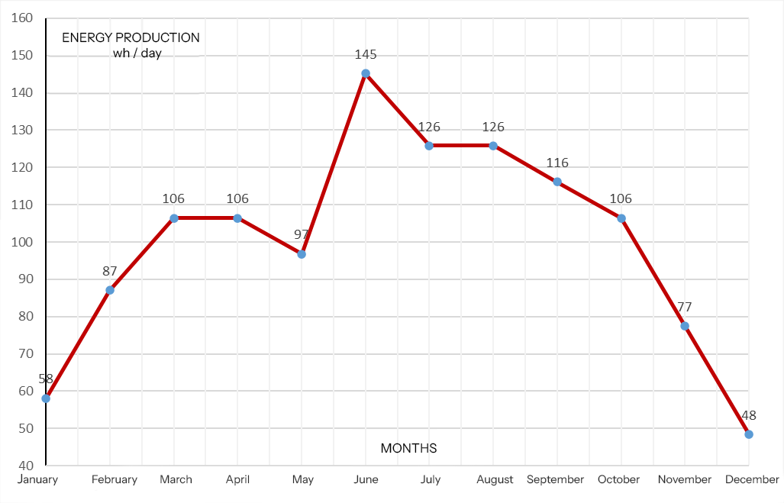
Monthly Energy Production Chart for Istanbul

Slide 21

Useful Links
RePG Home Page
Water Applications
Energy Applications
Documents
Investor Relations
Youtube Channel

Slide 22














Investors/References
Featured References

