Slide 1

The Agent-Ready Edge
Rethinking Tools for the Age of Agent Developers
Magnus Gedda, CTO at Imagimob, an Infineon Technologies company
2026-09-22

Slide 2
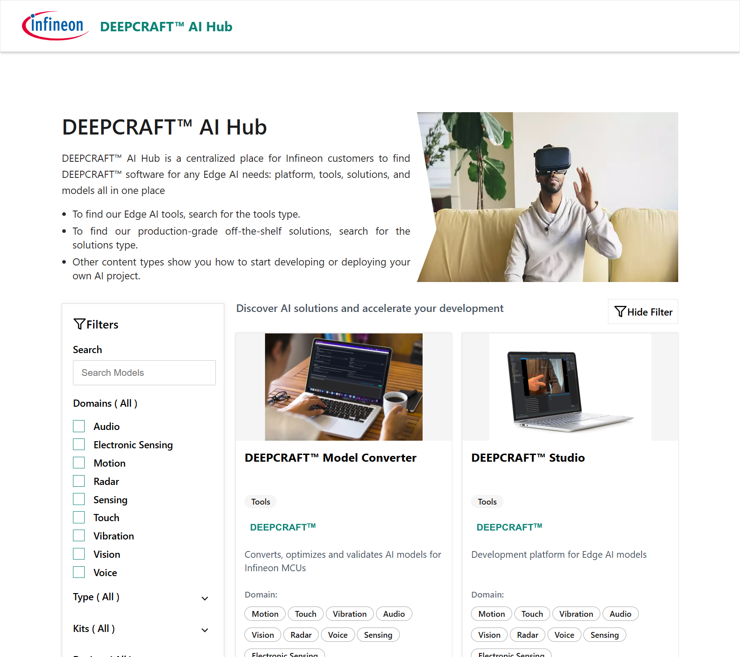
Imagimob
We enable developers to solve problems with Edge AI on Infineon hardware
Notes:
We are a fairly small company that got acquired by Infineon in 2023.
We enable developers to solve problems with Edge AI on Infineon hardware.

Slide 3



Agents are already here
Agents are used today on existing data, code and documents
Tools are not built for agents – frustrating workflows
Slows down the industry
Notes:
Agentic development of edge ML is already here.
People put their data, code, and documents into tools like Claude and get a working ML model on real hardware.
But the tooling is not built for agents. So results differ from person to person, and it is hard to use well.
This slows down the whole industry. We’re not using agents to their full potential.

Slide 4
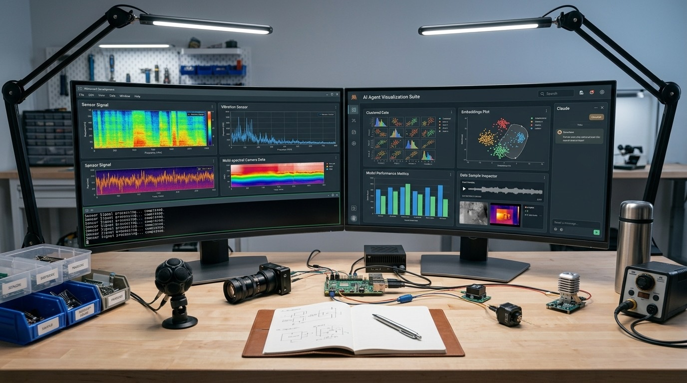
Good with software dev – but ML?
ML is different
Data and results from various modalities – need human eyes and ears
Agentic ML cannot be command-line only – GUIs are necessary
Notes:
AI agents already work very well for developing software. Mostly text and command-line. Humans do not need to check every step.
ML is different. The data and the results come from various modalities. Time series, sound, images, video, etc. Need human eyes and ears to check.
Agentic egde AI development cannot be command-line only The graphical interface is not something old-fashioned. It is necessary.

Slide 5
Software Development vs Edge ML Development
Software Development
Write code
Compile
Test
Release
Edge ML Development
Data collection
Data ingestion
Data cleaning
Data augmentation
Data labelling
Data validation
Model/pipelne design
Model training
Model evaluation
Model optimization
Model/pipeline compilation
Model/pipeline deployment
IoT device management
Model monitoring
Notes:
Software development cycle. Text only, even front-end testing is using various markup languages.
Edge ML development cycle much more complex. Many steps include tasks that require human-level cognition.
Data cleaning: what does bad data look like, sound like, feel like? Also, domain-specific and depends on context. Need physical modeling skills to understand.
Same arguments hold for the other highlighted steps.

Slide 6
Edge ML Pipeline
Edge ML pipeline
Sensor input
Pre- processing
Feature extraction
Model inference
Post- processing
Output redirection
Transformations
Filtering
Resampling
Windowing
Statistics
etc
Bounding boxes
Non-max suppression
Morphological operations
Geofencing
Aggregation
Visualization
etc
Notes:
Look closer at the full edge ML pipeline.
The pipeline deployed to the device need more than just the model. Complete directed graph with multiple steps, like data acquisition, pre- and post-processing.
Highlighted steps contain computations that require human cognition for validation.
Has agent made the correct image transformations? Does the pre-processing output look properly filtered.

Slide 7

Finding the right mix
Command-line for workflow – GUI for human validation
Easy handover between human and agent
Cannot be CLI-only – need transparency and accountability
Notes:
So how do we adapt to the hybrid agent-human setup? Finding the right mix.
Command-line and text run the main workflow: create project, load data, build the pipeline, generate code, flash to device.
The GUI is for human validation: look or listen at the input, check the inference results, get visual feedback on the agent’s work.
This is not GUI against command-line. The GUI is where the human fills the agent’s cognitive gaps. Vital for transparency and accountability.

Slide 8
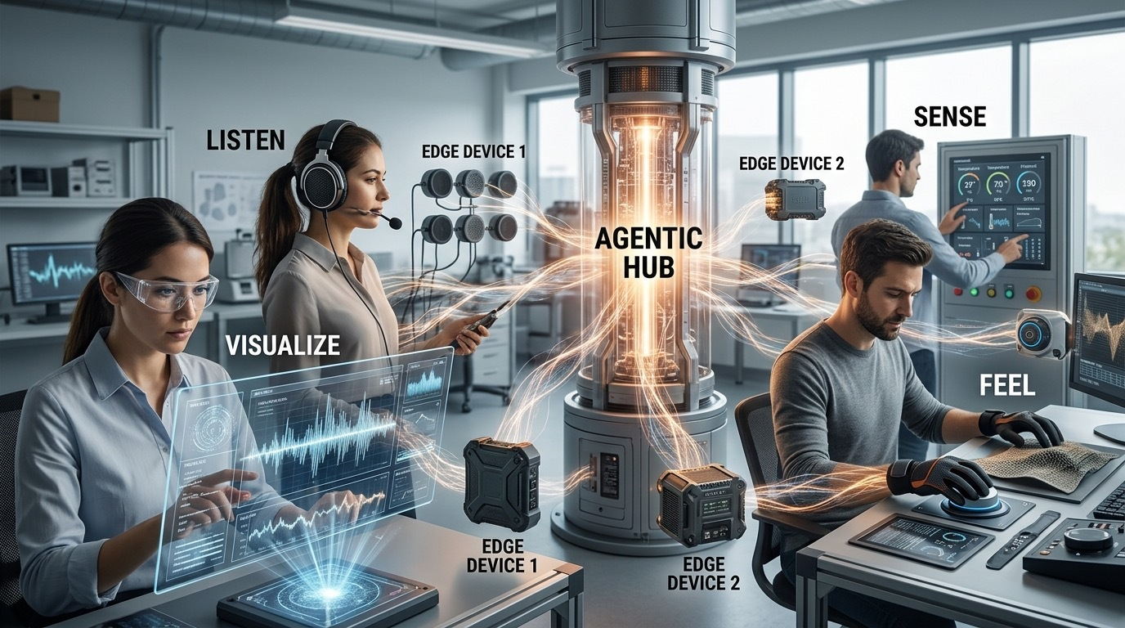
The future
Agents can already reason about image, video, and audio contents (to some degree)
Need to improve ”agentic senses” to consume and reason about content from all sensor modalities
Until agents have full multi-modal reasoning, GUIs will be critical
Notes:
Agents can already reason about contents in photos or analyze moods from audio recordings.
Need to improve ”agentic senses” to consume content from various sensor modalities: sound, images, vibrations, radar, and the context around it.
Until agents have full multi-modal reasoning, the GUI stays crucial.
Closing message:
We need to build our tools command-line first, but keep the GUI as the place where humans validate the work.
Develop models that can help agents reason about different sensor modalities.
That is what an "agent-ready edge" looks like.

Slide 9
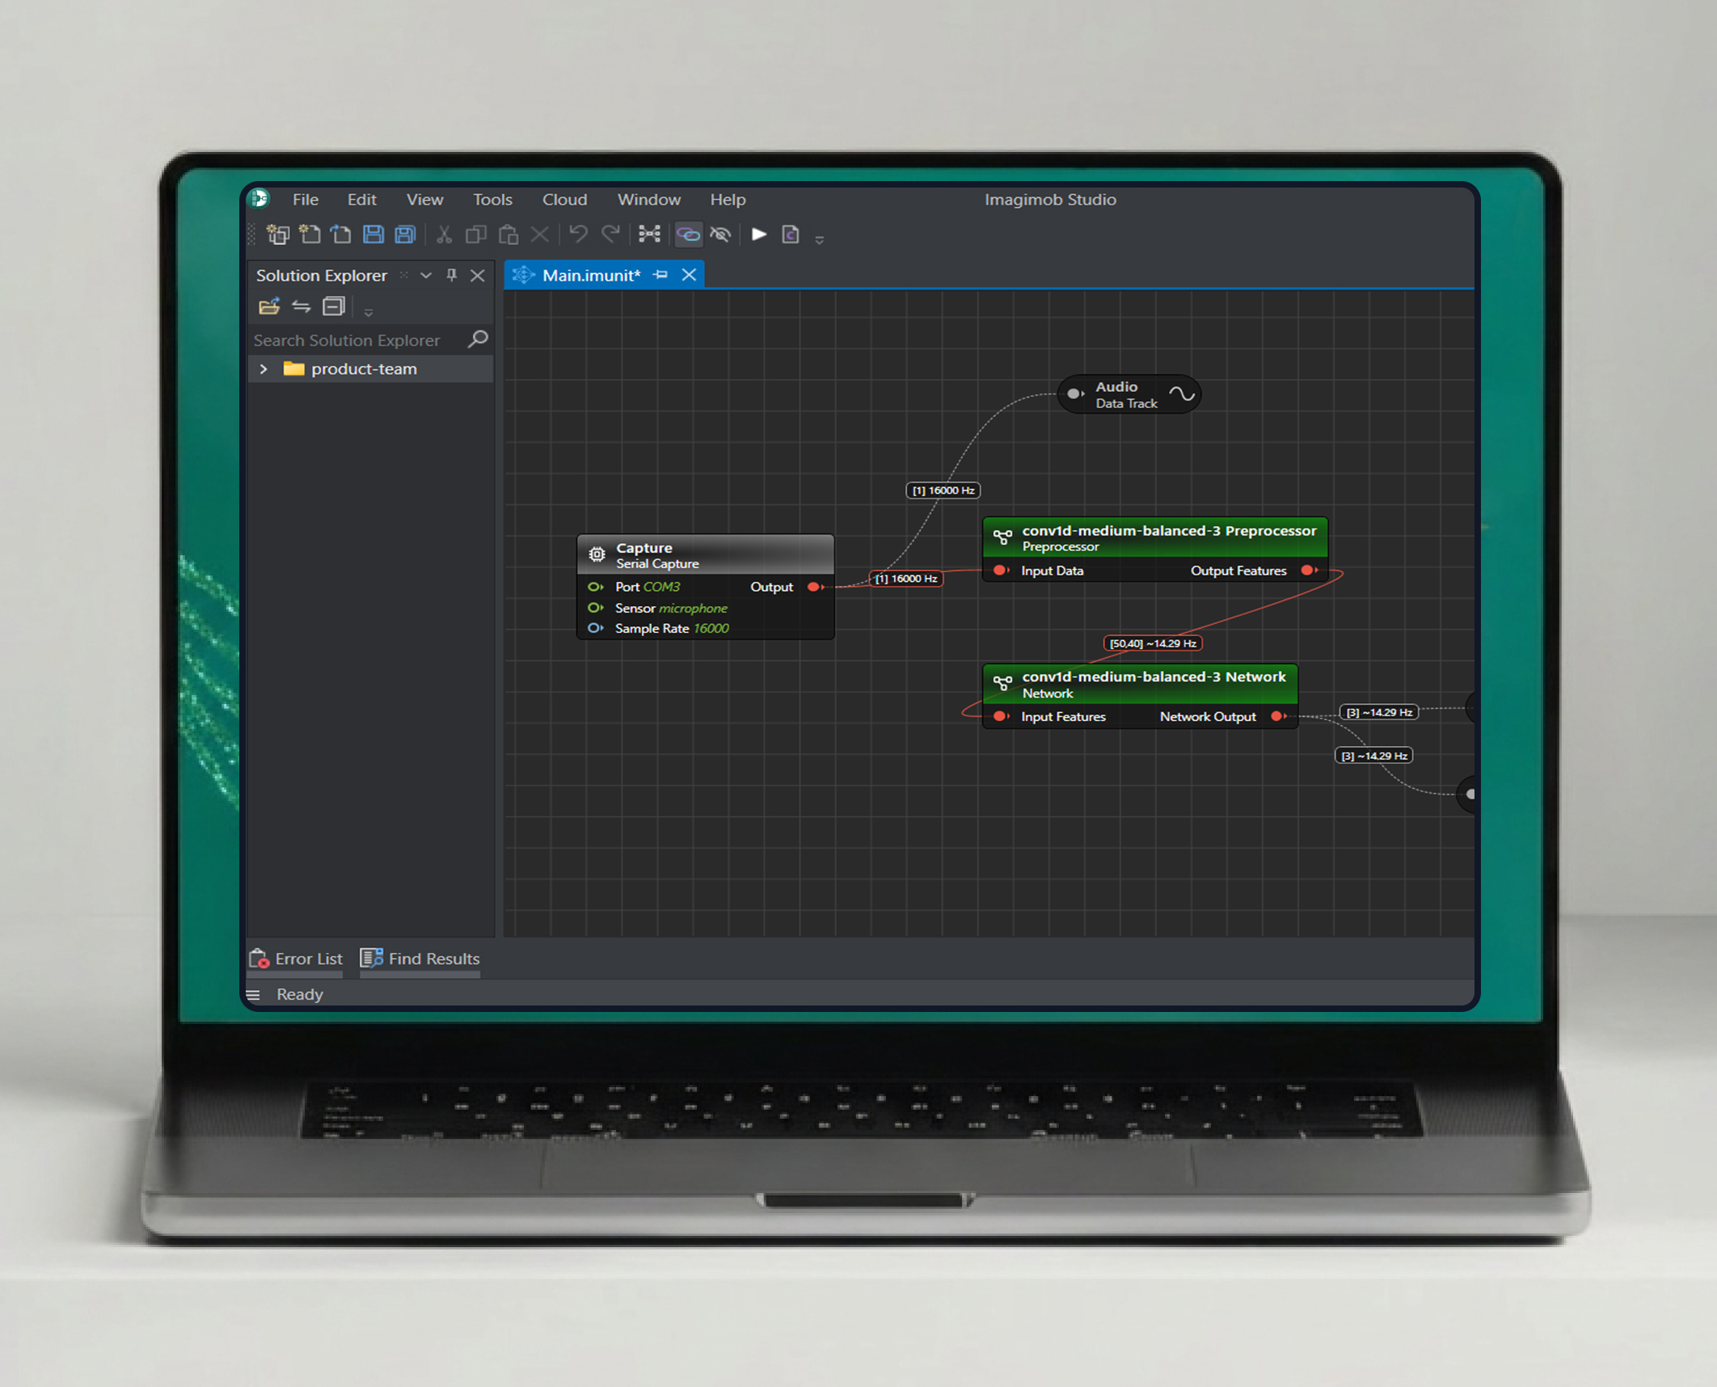
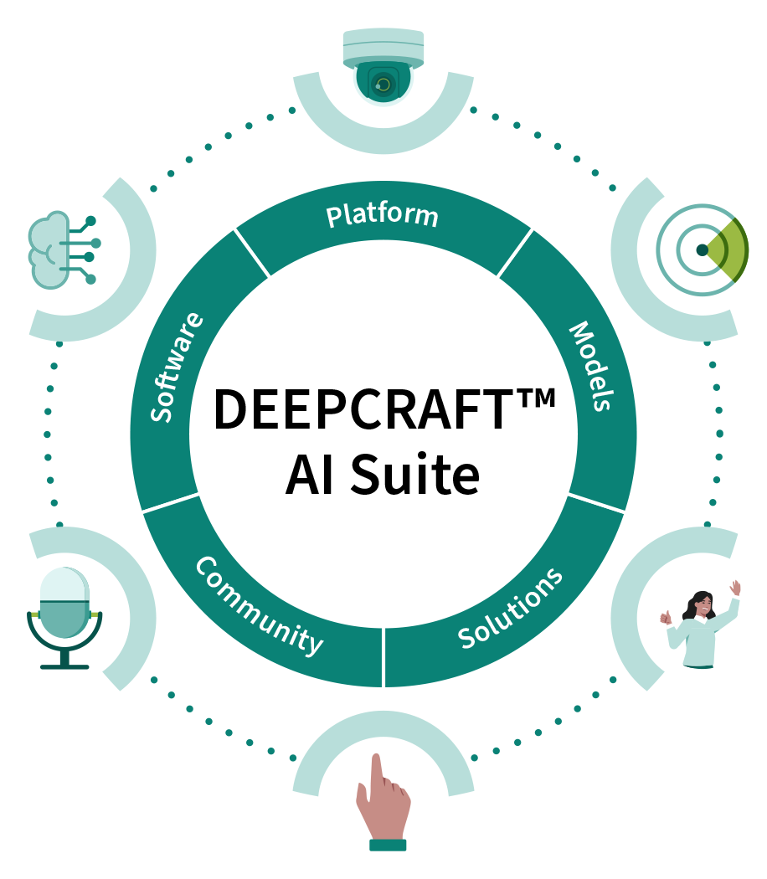
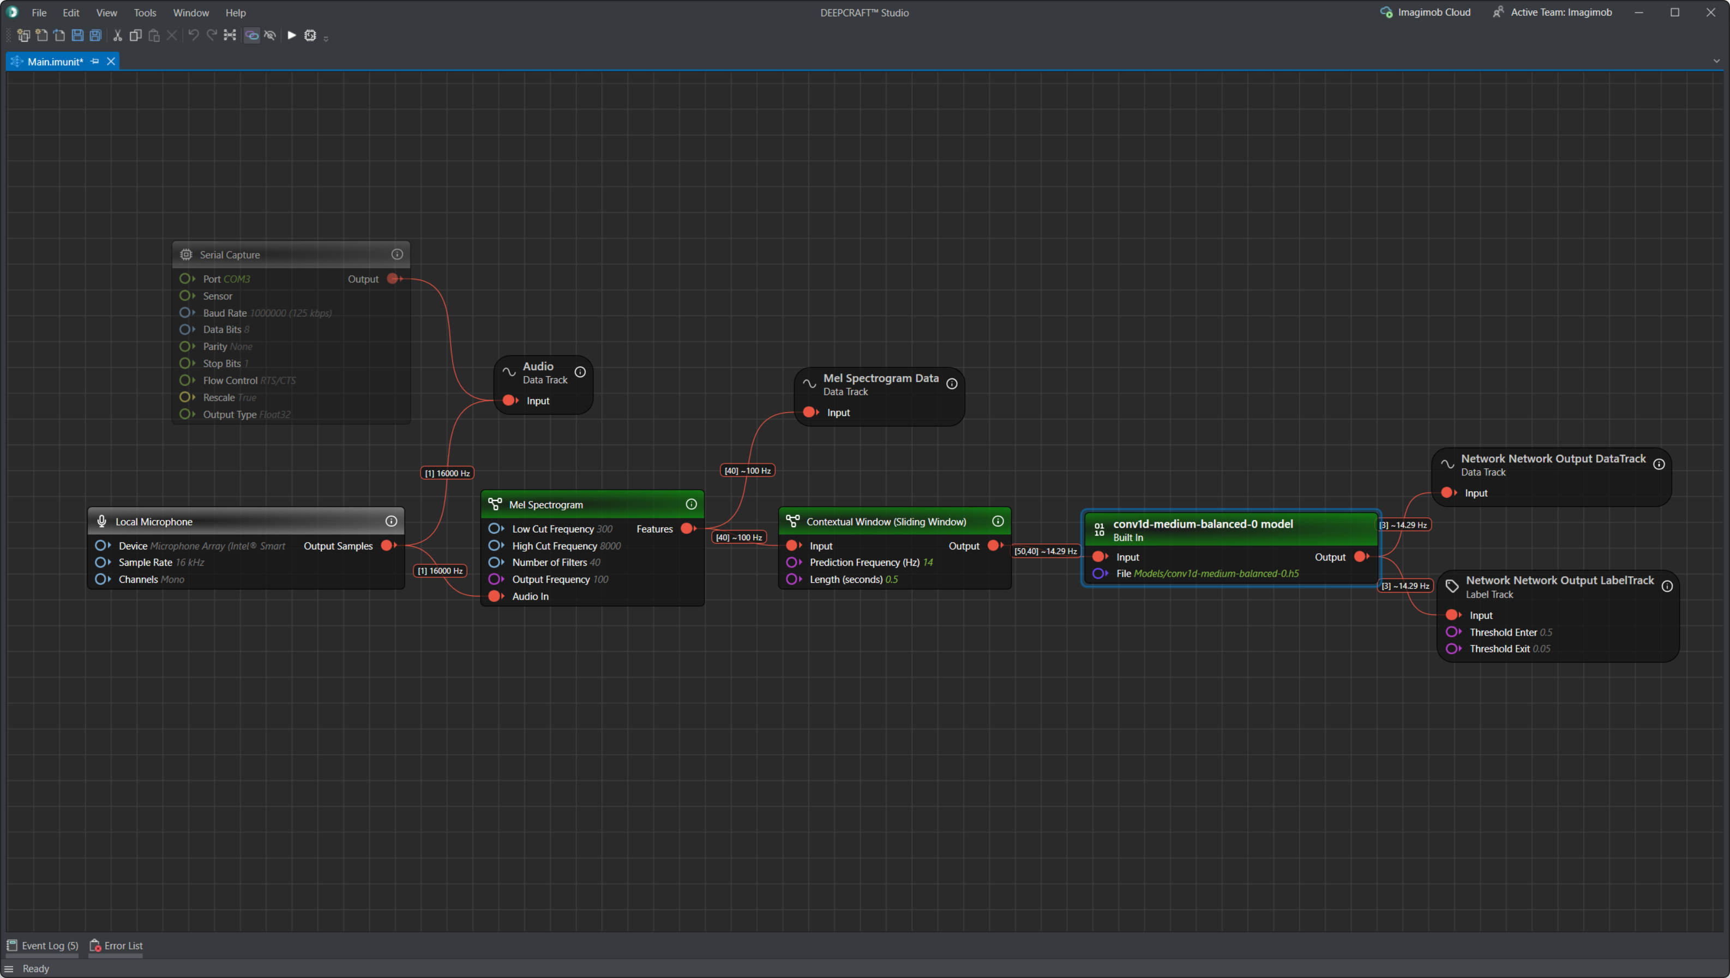
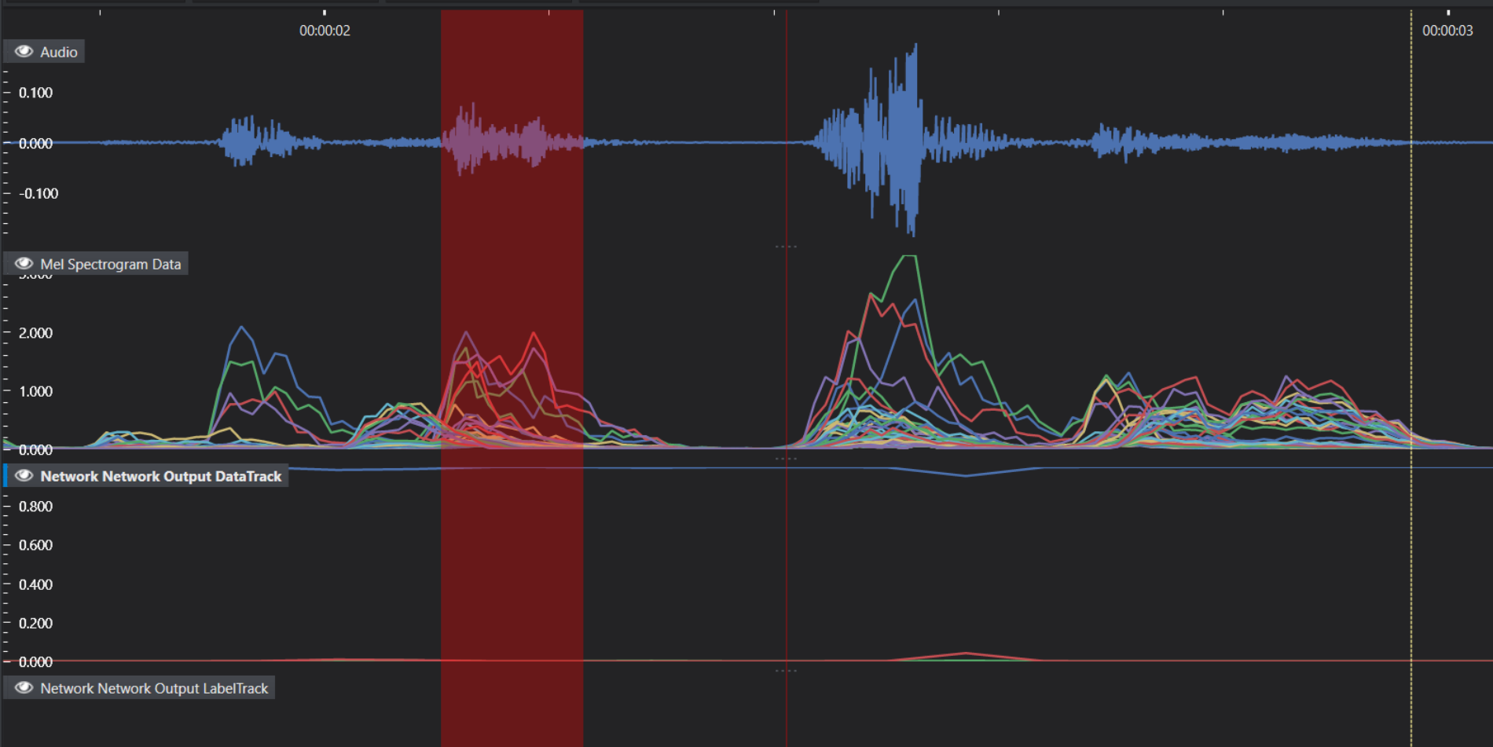
DEEPCRAFTTM AI Suite
Notes:
Finish with a shameless plug
DEEPCRAFT Studio – GUI platform, part of our DEEPCRAFT AI Suite
If you want to move into Edge AI on microcontrollers, this is a perfect tool to start with.

Slide 10
Notes:
I will be walking around at the conference, just grab me if you see me and want to talk about edge AI.
So thank you for listening and see you on the floor.

