Slide 1

Making the Move to Iken Cloud
Supporting your team’s future with secure, connected, modern legal technology

Slide 2






Why This Matters Now
Avoiding Risk, Building Resilience.
Iken Desktop is approaching end-of-life
Public sector legal teams are under pressure to do more with less
Security, accessibility, and digital transformation
are now non-negotiable
Iken Cloud offers a future-ready foundation
that meets these needs

Slide 3
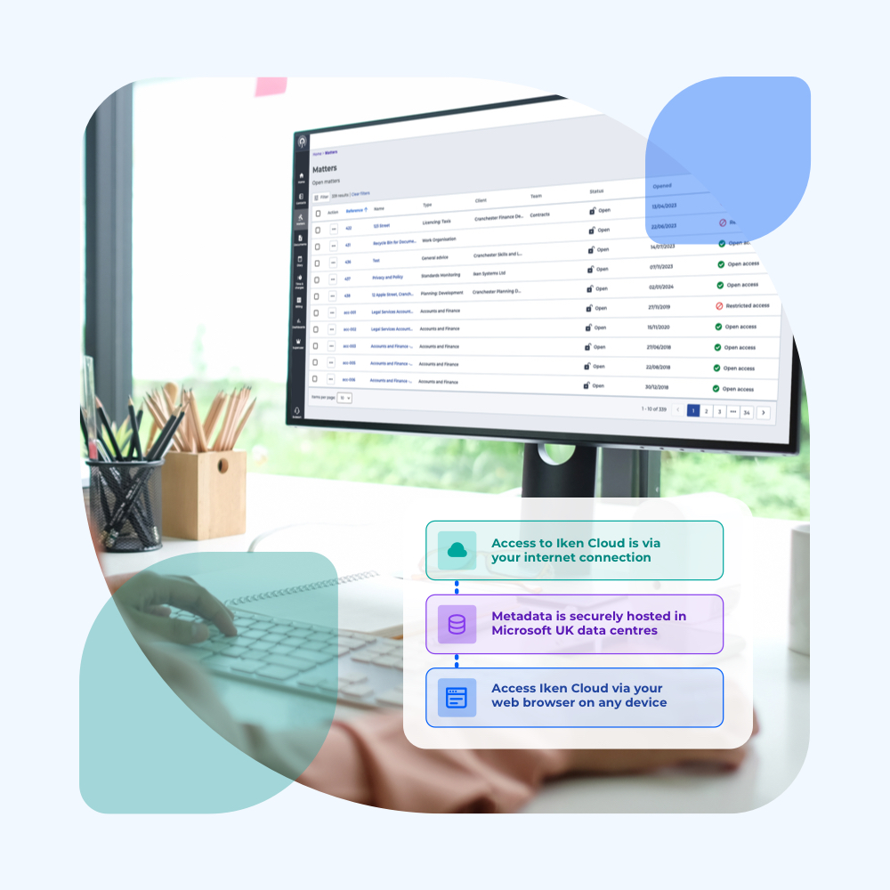



What is Iken Cloud?
A Modern Case Management System.
Secure, browser-based access so your legal team can stay productive, wherever they’re working.
Share updates, documents and progress instantly across teams, departments and locations.
Configurable tools help you automate tasks and reduce time spent on manual processes.
Stay audit-ready with permission controls, secure storage and automated record-keeping.
Beginners Guide to Iken Cloud

Slide 4


Why Iken Cloud?
Key Benefits for Our Organisation.
Challenges
Iken Cloud Delivers
Limited access
IT dependency for updates
Siloed document storage
Compliance and audit complexity
Manual workflows
Secure access from anywhere
Fully managed and continuously updated
Centralised case and document management
Built-in audit trails and compliance monitoring
Automated folder structures and task alerts
Watch the Iken Cloud Demo

Slide 5
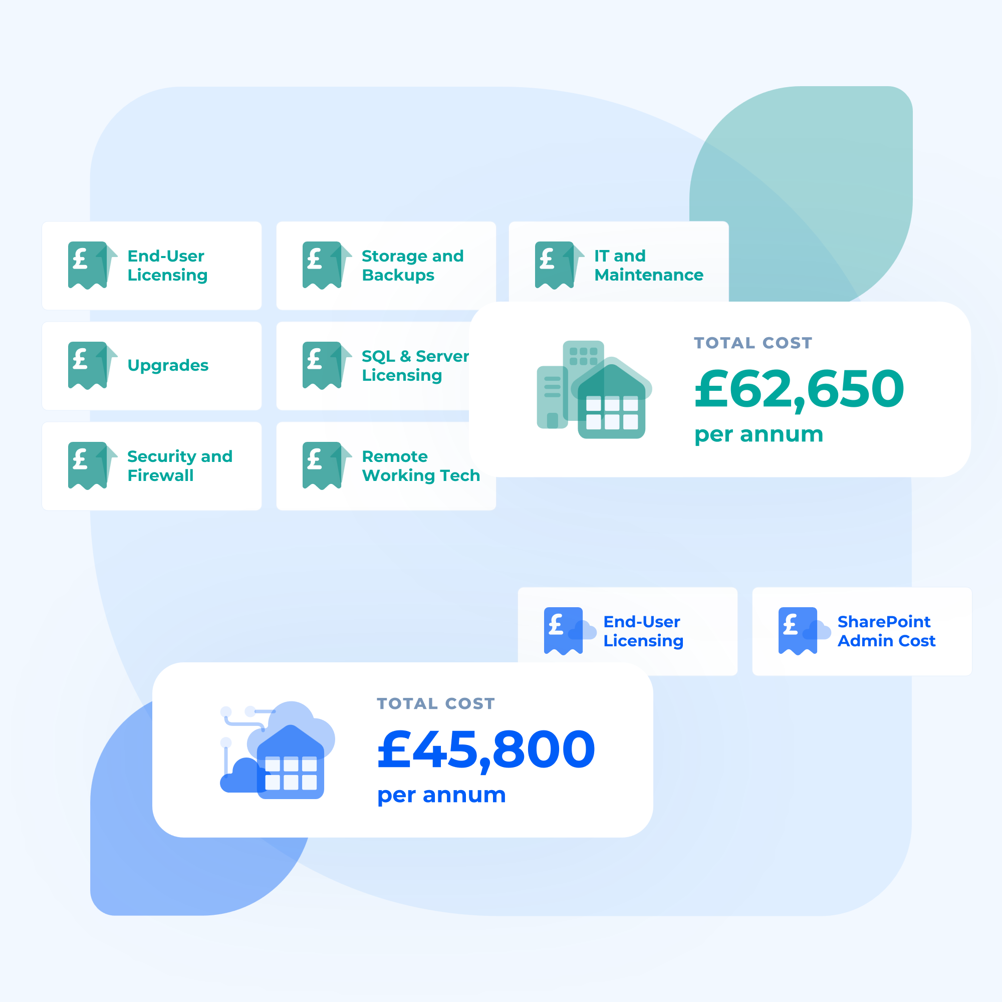
What You’re Really Paying For
Financial & Strategic Fit.
Reduces IT burden and infrastructure costs
Aligns with Cyber Essentials, DDaT, and G-Cloud requirements
Scalable licensing that matches team structure and needs
Supports our digital transformation strategy.
Helps build a modern, productive legal service
Understand True Cost of Ownership

Slide 6

Real Stories. Real Results.
What’s Possible with Iken Cloud.
Productivity gains, seamless integration
“It’s removed a layer of admin from our day-to-day. We’ve had fantastic feedback.”
Greater visibility, flexible access
“The transition from desktop to cloud was seamless.”
Stronger engagement, staged roll-out
“Migration was seamless and well-supported. We’re already seeing results.”
Smooth transition, unified service
"We’ve seen huge benefits in productivity, user management, and system reliability.”
Read our Case Studies

Slide 7
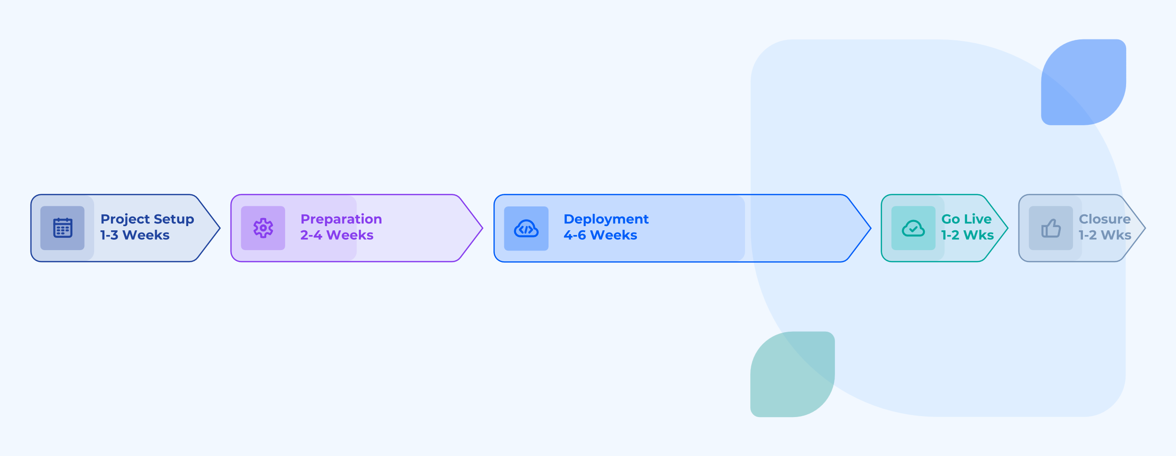
What to Expect
Your Migration Timeline.
View the Full Project Lifecycle

Slide 8
What Next?
What We Need from Stakeholders.
Support in aligning with strategic and operational goals
Engagement from IT, procurement and legal leadership
Input into migration planning and internal timelines
Book our Migration Planning Call
Book Planning Call

Slide 9
+ 44 (0) 117 373 0790
info@iken.co.uk
iken.co.uk

