Slide 1
DATA ANALYTICS PROJECT
AI and the global labour market
How generative AI may transform work worldwide - and what the evidence can responsibly claim
Tsepo Tsolo-Mohlakwana | August 2026
Notes:
Opening: the project now studies the whole global labour market. Exposure means potential task change, not automatic job loss.
[Sources]
- /Users/tsepotsolo-mohlakwana/Downloads/Research files/Research project Material/Tsepo_TsoloM_Final_Project/Refined_Project/AI_Job_Exposure_Analysis_Refined.ipynb
- /Users/tsepotsolo-mohlakwana/Downloads/Research files/Research project Material/Tsepo_TsoloM_Final_Project/Refined_Project/reports/AI_Job_Exposure_Analysis_Refined.pdf
- https://doi.org/10.54394/HETP0387

Slide 2
How the global analysis works
1. Score tasks
Use ILO-NASK ratings for 3,265 tasks in 427 occupations.
2. Classify occupations
Place ISCO-08 occupations in four exposure gradients.
3. Weight employment
Apply categories to harmonised data for more than 140 countries.
4. Keep definitions separate
Use IMF and WEF only as labelled global benchmarks.
2
Notes:
Explain the four steps without jargon: score tasks, classify ISCO occupations, apply the categories to harmonised employment, and keep unlike global benchmarks separate.
[Sources]
- /Users/tsepotsolo-mohlakwana/Downloads/Research files/Research project Material/Tsepo_TsoloM_Final_Project/Refined_Project/AI_Job_Exposure_Analysis_Refined.ipynb
- /Users/tsepotsolo-mohlakwana/Downloads/Research files/Research project Material/Tsepo_TsoloM_Final_Project/Refined_Project/outputs/tables/global_source_catalog.csv

Slide 3
One in four jobs is exposed - not automatically replaced
Transformation is the main global story.
Most occupations still contain tasks that require human input.
24%
838M
3.3%
global employment exposed
potentially exposed jobs
in highest exposure gradient
3
Notes:
ILO-NASK estimates that 24% of global employment, about 838 million jobs, has some potential GenAI exposure; 3.3% is in the highest gradient.
[Sources]
- /Users/tsepotsolo-mohlakwana/Downloads/Research files/Research project Material/Tsepo_TsoloM_Final_Project/Refined_Project/outputs/tables/global_employment_exposure_2025.csv
- https://doi.org/10.54394/HETP0387

Slide 4
Exposure, transformation, and displacement are different
Potential exposure
AI could perform or assist some current tasks if adopted.
Highest exposure
Many tasks score highly and task variability is relatively low.
Transformation
The occupation remains, but tasks, skills, or staffing change.
Displacement
A job is removed. Exposure alone does not establish this outcome.
4
Notes:
Exposure is a technical signal. Transformation changes tasks or skills; displacement removes a job. The project never treats these as synonyms.
[Sources]
- /Users/tsepotsolo-mohlakwana/Downloads/Research files/Research project Material/Tsepo_TsoloM_Final_Project/Refined_Project/reports/AI_Job_Exposure_Analysis_Refined.pdf
- /Users/tsepotsolo-mohlakwana/Downloads/Research files/Research project Material/Tsepo_TsoloM_Final_Project/Refined_Project/reports/VALIDATION_REPORT.md

Slide 5
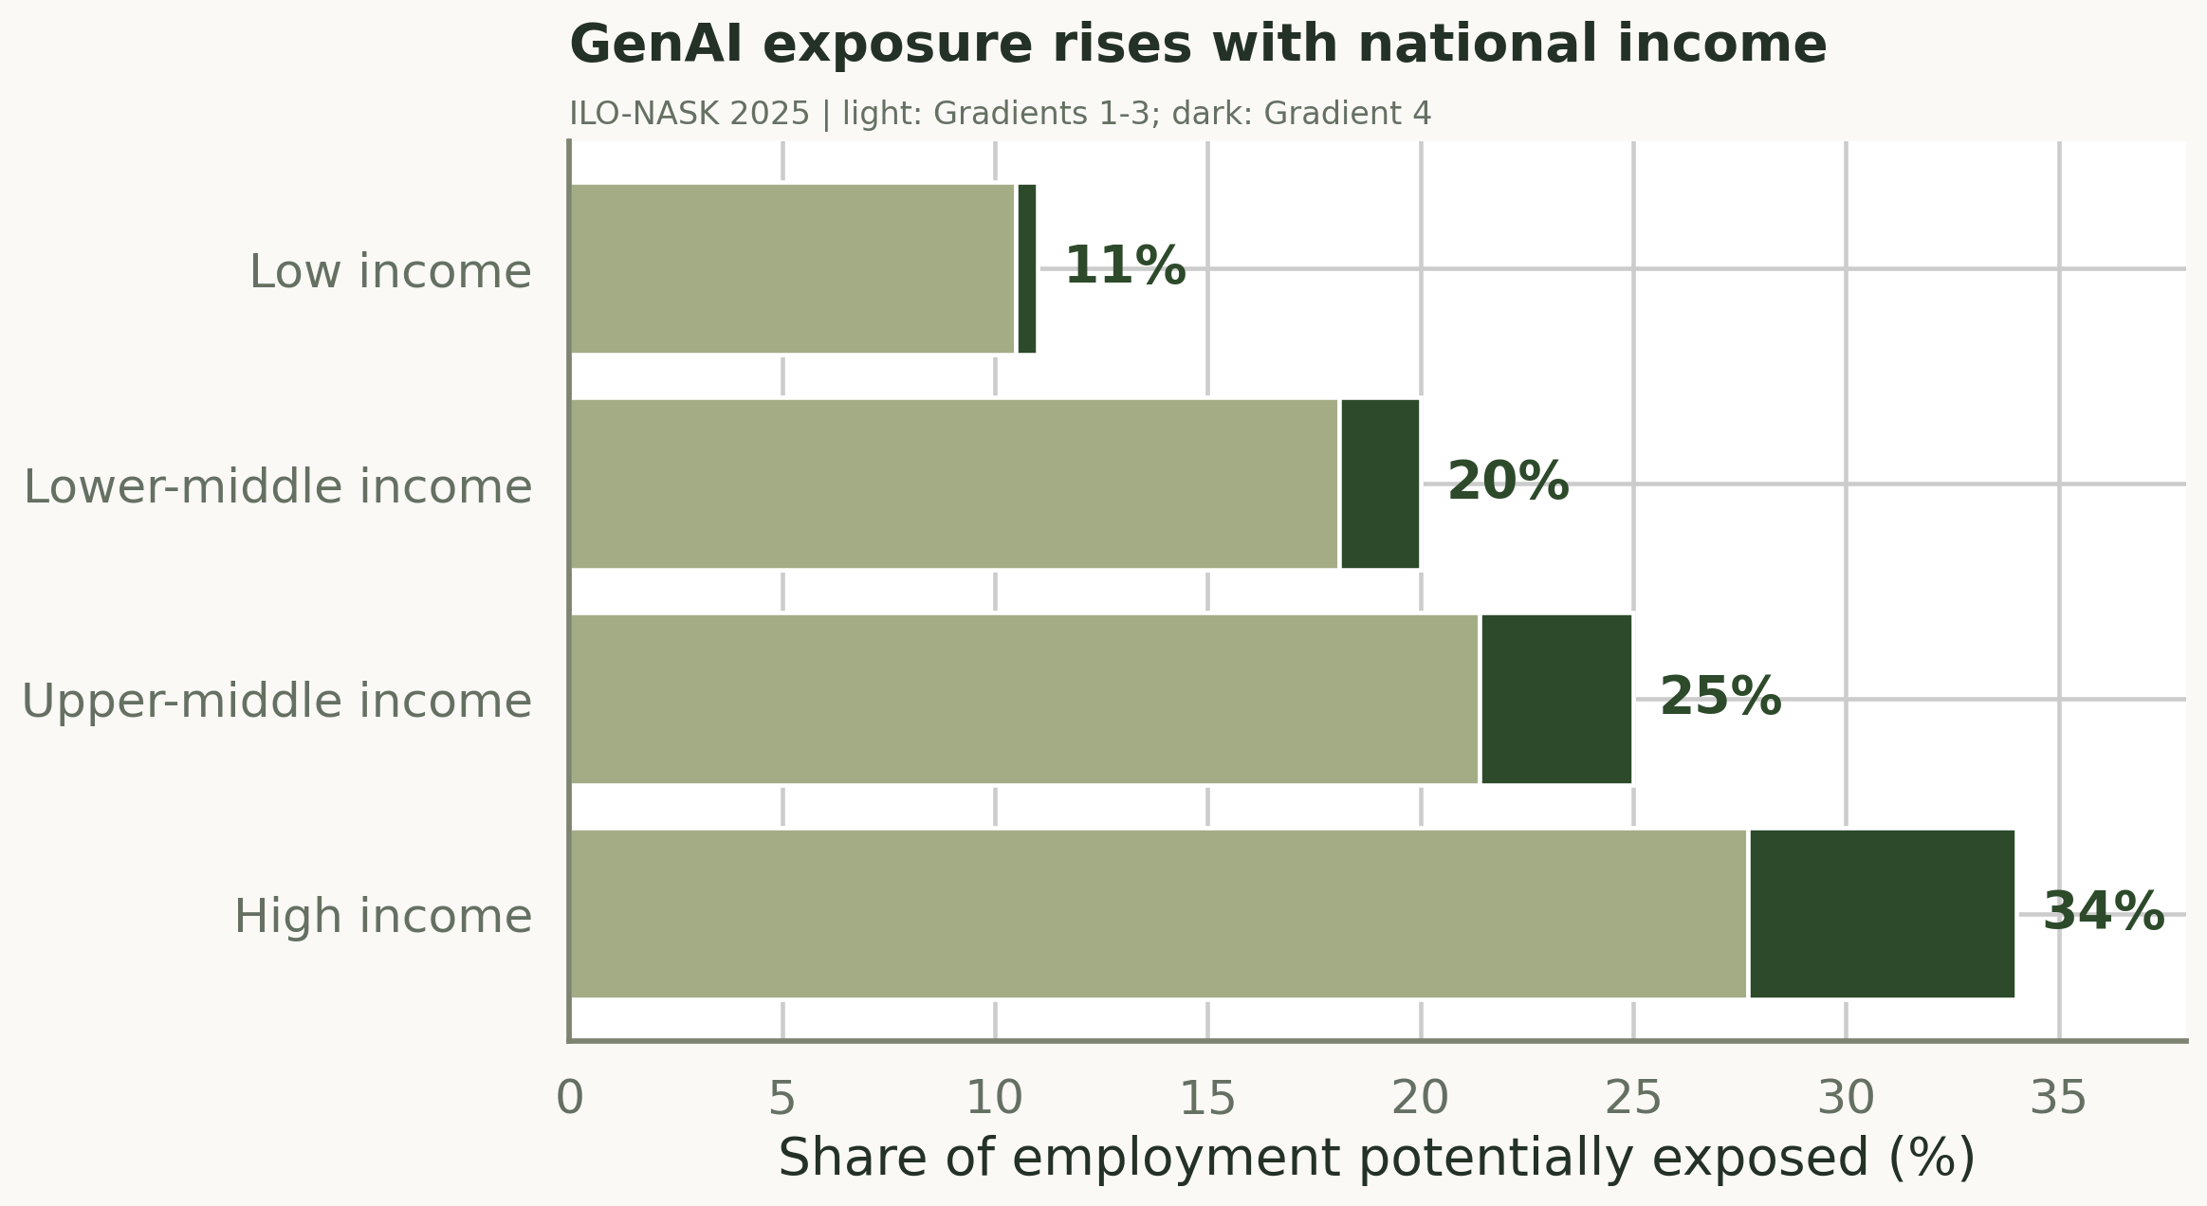
Exposure rises with income
34% vs 11%
High-income economies face more immediate exposure than low-income economies.
5
Notes:
Potential exposure rises from 11% in low-income economies to 34% in high-income economies. High exposure also means greater opportunity to use AI productively.
[Sources]
- /Users/tsepotsolo-mohlakwana/Downloads/Research files/Research project Material/Tsepo_TsoloM_Final_Project/Refined_Project/outputs/tables/global_employment_exposure_2025.csv
- /Users/tsepotsolo-mohlakwana/Downloads/Research files/Research project Material/Tsepo_TsoloM_Final_Project/Refined_Project/outputs/figures/global_income_exposure.png
- https://doi.org/10.54394/HETP0387

Slide 6
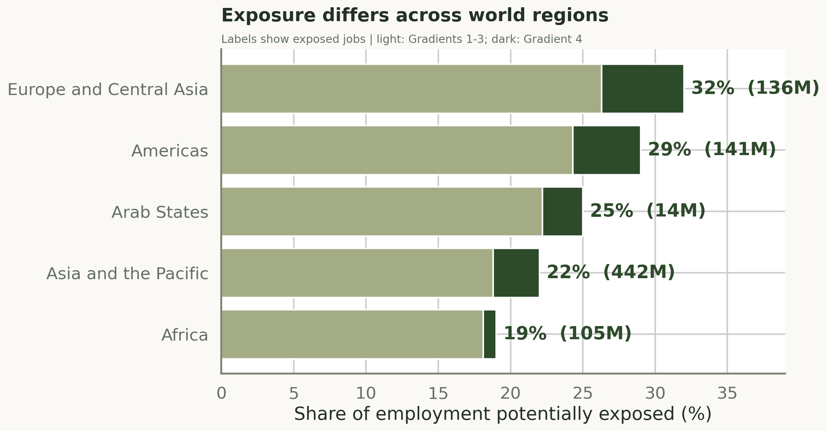
Global regions differ
442 million jobs
Asia-Pacific has the largest exposed count; Europe and Central Asia the highest share.
6
Notes:
Europe and Central Asia has the highest exposed share, while Asia and the Pacific has the largest absolute exposed count at about 442 million jobs.
[Sources]
- /Users/tsepotsolo-mohlakwana/Downloads/Research files/Research project Material/Tsepo_TsoloM_Final_Project/Refined_Project/outputs/tables/global_employment_exposure_2025.csv
- /Users/tsepotsolo-mohlakwana/Downloads/Research files/Research project Material/Tsepo_TsoloM_Final_Project/Refined_Project/outputs/figures/global_region_exposure.png
- https://doi.org/10.54394/HETP0387

Slide 7
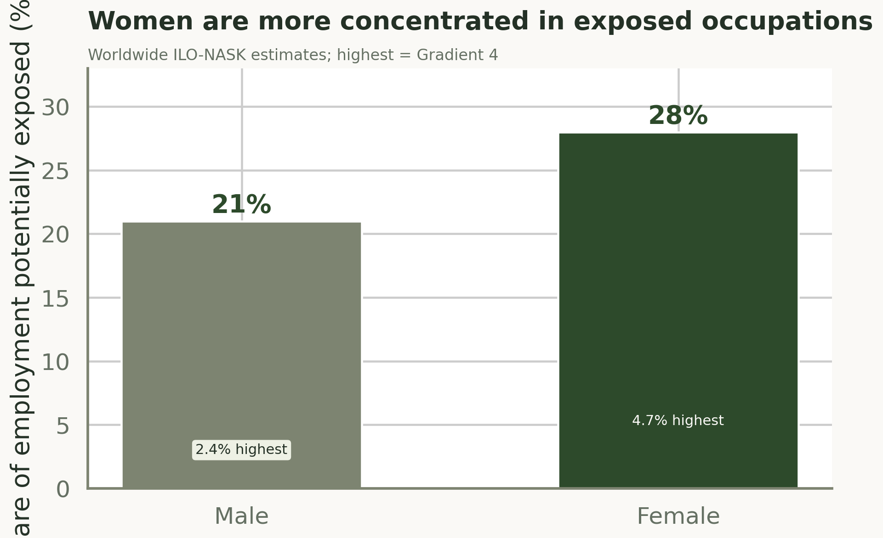
Exposure is not gender-neutral
28% vs 21%
Women's employment is more concentrated in exposed clerical and administrative roles.
7
Notes:
Worldwide, 28% of women's employment is exposed versus 21% of men's; the difference reflects occupational concentration.
[Sources]
- /Users/tsepotsolo-mohlakwana/Downloads/Research files/Research project Material/Tsepo_TsoloM_Final_Project/Refined_Project/outputs/tables/global_employment_exposure_2025.csv
- /Users/tsepotsolo-mohlakwana/Downloads/Research files/Research project Material/Tsepo_TsoloM_Final_Project/Refined_Project/outputs/figures/global_gender_exposure.png
- https://doi.org/10.54394/HETP0387
- https://doi.org/10.54394/00033798

Slide 8
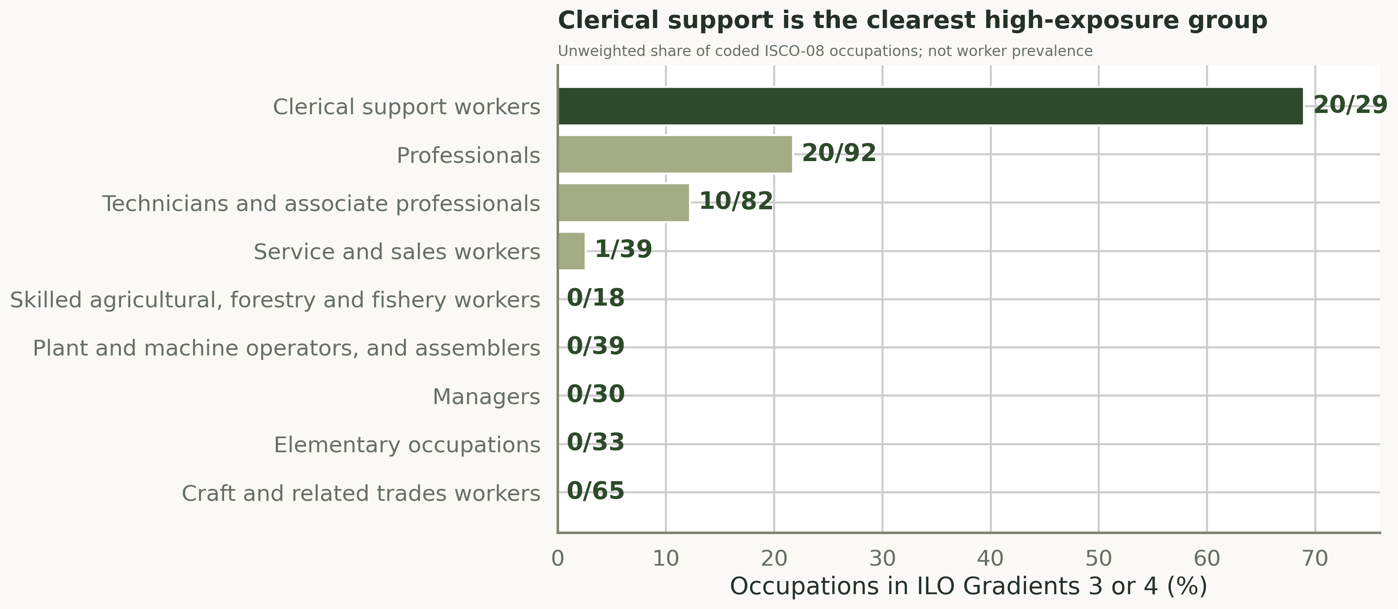
Clerical work leads globally
69.0% of clerical occupations
20 of 29 are in ILO-NASK Gradients 3 or 4. Counts are not worker shares.
8
Notes:
Clerical support has the strongest higher-exposure concentration: 20 of 29 coded occupations are in Gradients 3 or 4. Counts are not employment shares.
[Sources]
- /Users/tsepotsolo-mohlakwana/Downloads/Research files/Research project Material/Tsepo_TsoloM_Final_Project/Refined_Project/outputs/tables/global_major_group_exposure_2025.csv
- /Users/tsepotsolo-mohlakwana/Downloads/Research files/Research project Material/Tsepo_TsoloM_Final_Project/Refined_Project/outputs/figures/global_major_group_exposure.png
- https://doi.org/10.54394/HETP0387

Slide 9
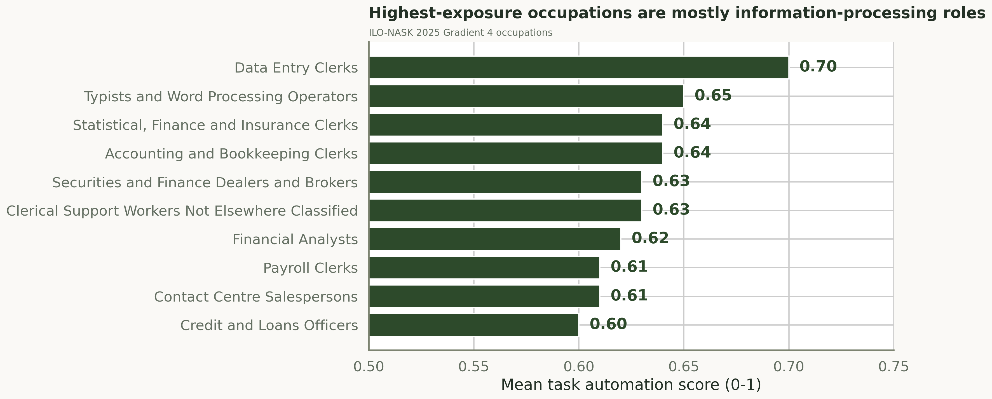
Which jobs face the strongest pressure?
13 Gradient 4 occupations
Data entry, bookkeeping, office, finance, payroll, and contact-centre work dominate.
9
Notes:
Gradient 4 is dominated by information-processing roles in data entry, bookkeeping, office administration, finance, payroll, and contact centres.
[Sources]
- /Users/tsepotsolo-mohlakwana/Downloads/Research files/Research project Material/Tsepo_TsoloM_Final_Project/Refined_Project/outputs/tables/global_occupation_exposure_2025.csv
- /Users/tsepotsolo-mohlakwana/Downloads/Research files/Research project Material/Tsepo_TsoloM_Final_Project/Refined_Project/outputs/figures/global_top_exposed_occupations.png
- https://doi.org/10.54394/HETP0387

Slide 10
Where industry pressure is most likely
Business & administration
Office, data-entry, payroll, personnel, and bookkeeping functions.
Finance & insurance
Analysts, brokers, credit officers, accounting and finance clerks.
Information, media & software
Digitised language, web, multimedia, programming, and content tasks.
Contact centres & retail services
Customer information, scripted sales, scheduling, and transaction work.
10
Notes:
Industry pressure is inferred from exposed occupations and functions, not from a fabricated universal industry ranking. Local occupation mixes and adoption determine the actual result.
[Sources]
- /Users/tsepotsolo-mohlakwana/Downloads/Research files/Research project Material/Tsepo_TsoloM_Final_Project/Refined_Project/outputs/tables/global_occupation_exposure_2025.csv
- /Users/tsepotsolo-mohlakwana/Downloads/Research files/Research project Material/Tsepo_TsoloM_Final_Project/Refined_Project/reports/AI_Job_Exposure_Analysis_Refined.pdf

Slide 11
Turn the findings into action
Employers
Redesign tasks with workers and define human review.
Workforce teams
Build digital fluency, judgment, communication, and mobility.
Governments & educators
Expand access, retraining, portable support, and complementary skills.
Communicators
Say exposure and transformation - not 'jobs replaced.'
11
Notes:
Convert the evidence into worker-led task redesign, complementary-skill training, infrastructure and transition support, outcome monitoring, and careful communication.
[Sources]
- /Users/tsepotsolo-mohlakwana/Downloads/Research files/Research project Material/Tsepo_TsoloM_Final_Project/Refined_Project/reports/AI_Job_Exposure_Analysis_Refined.pdf
- /Users/tsepotsolo-mohlakwana/Downloads/Research files/Research project Material/Tsepo_TsoloM_Final_Project/Refined_Project/reports/VALIDATION_REPORT.md

Slide 12
TAKEAWAY
Managed change
Exposure is widespread
Outcomes differ
Redesign | protect | upskill
Notes:
Close on managed transformation: exposure is widespread, outcomes differ, and policy and workplace choices will shape who benefits.
[Sources]
- /Users/tsepotsolo-mohlakwana/Downloads/Research files/Research project Material/Tsepo_TsoloM_Final_Project/Refined_Project/reports/AI_Job_Exposure_Analysis_Refined.pdf
- /Users/tsepotsolo-mohlakwana/Downloads/Research files/Research project Material/Tsepo_TsoloM_Final_Project/Refined_Project/AI_Job_Exposure_Analysis_Refined.ipynb

