Slide 1
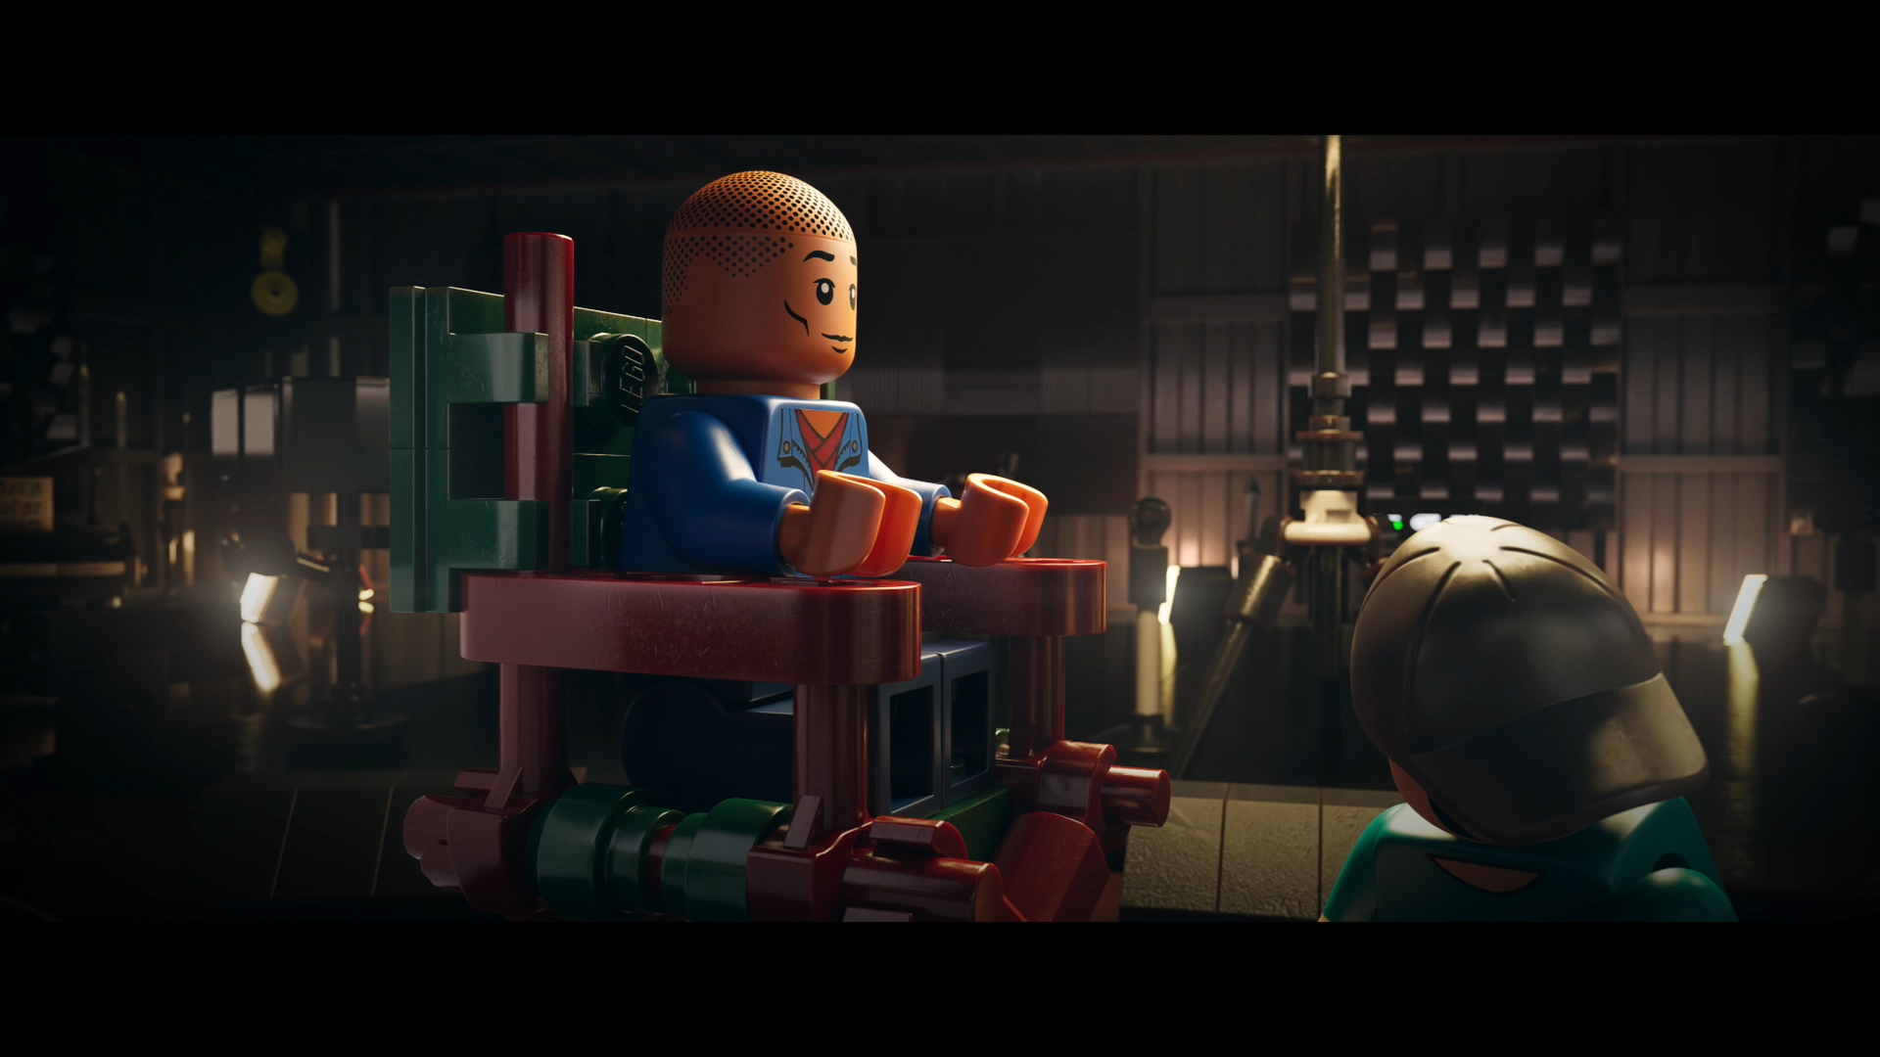

FINAL PROJECT · AUGUST 2026
A story becomes
a word. A word
becomes a voice.
LEGO Story English turns family viewing into contextual learning—and gives children a confident way to perform what they learned.
COCO YIN · PRODUCT DESIGN
01
Notes:
Open with the promise: the experience moves from shared story to personal understanding to confident performance.
[Sources]
- User-provided LEGO Story English project assets: public/tv/piece-by-piece-player.png
- User-provided final-project assignment brief
[/Sources]
[TALK TRACK · 20 SEC]
Hi everyone. This is LEGO Story English, an experience that turns family TV viewing into contextual learning and confident speaking. The journey begins with a shared story, moves through one meaningful word, and ends with the child making the scene their own.
[/TALK TRACK]

Slide 2
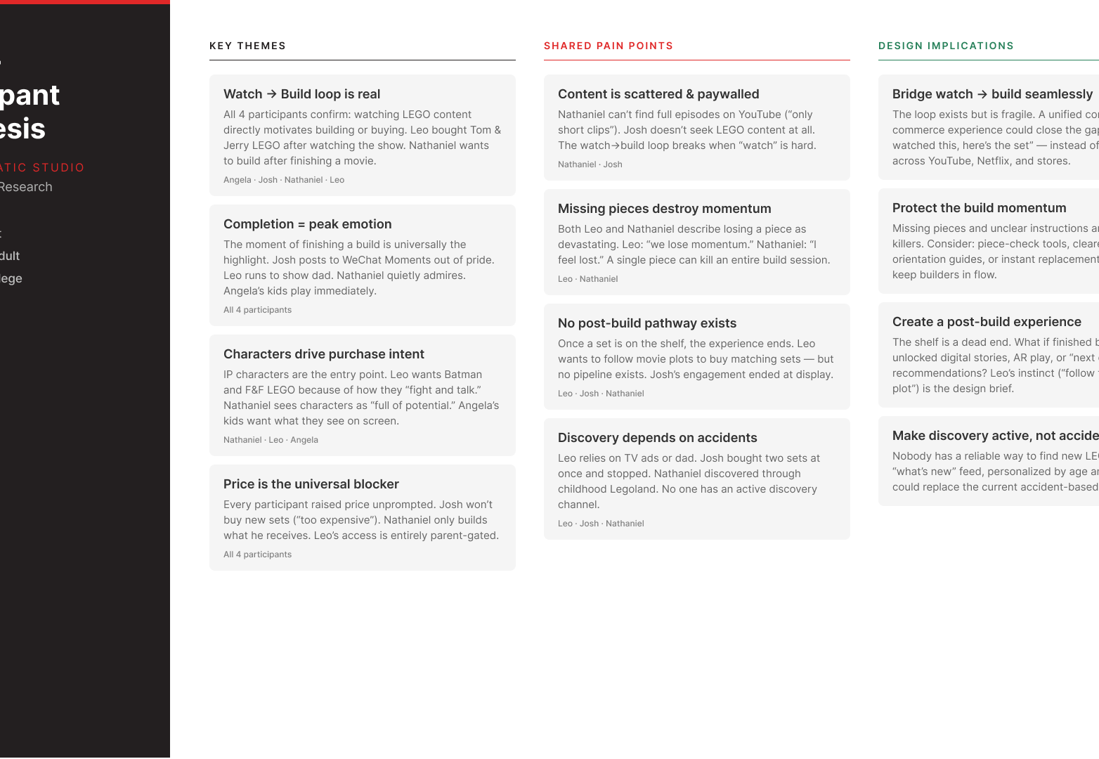
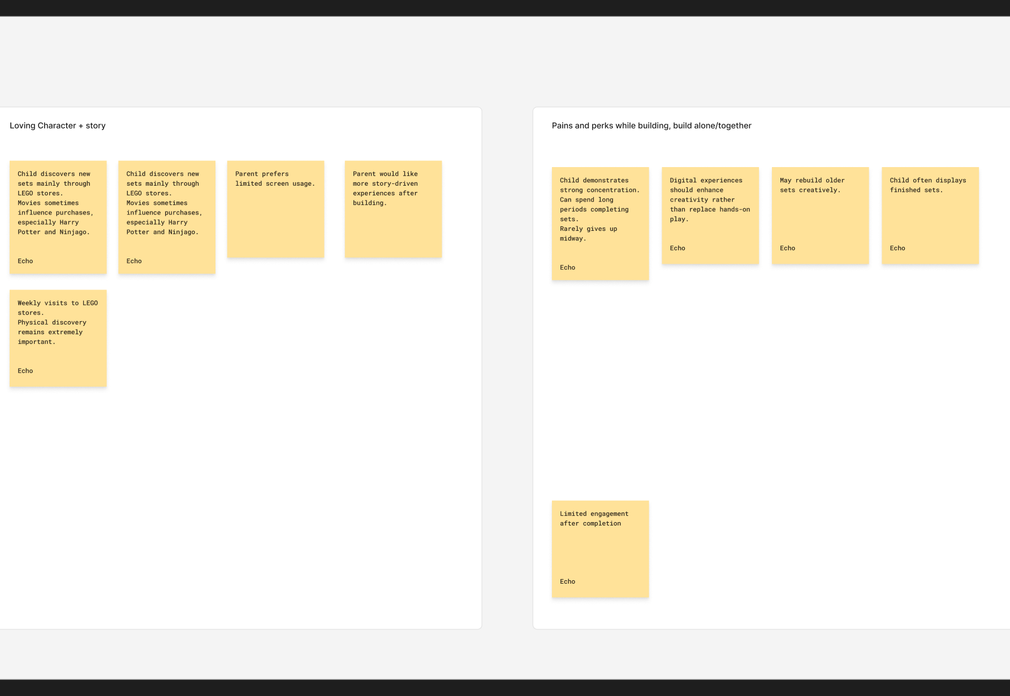
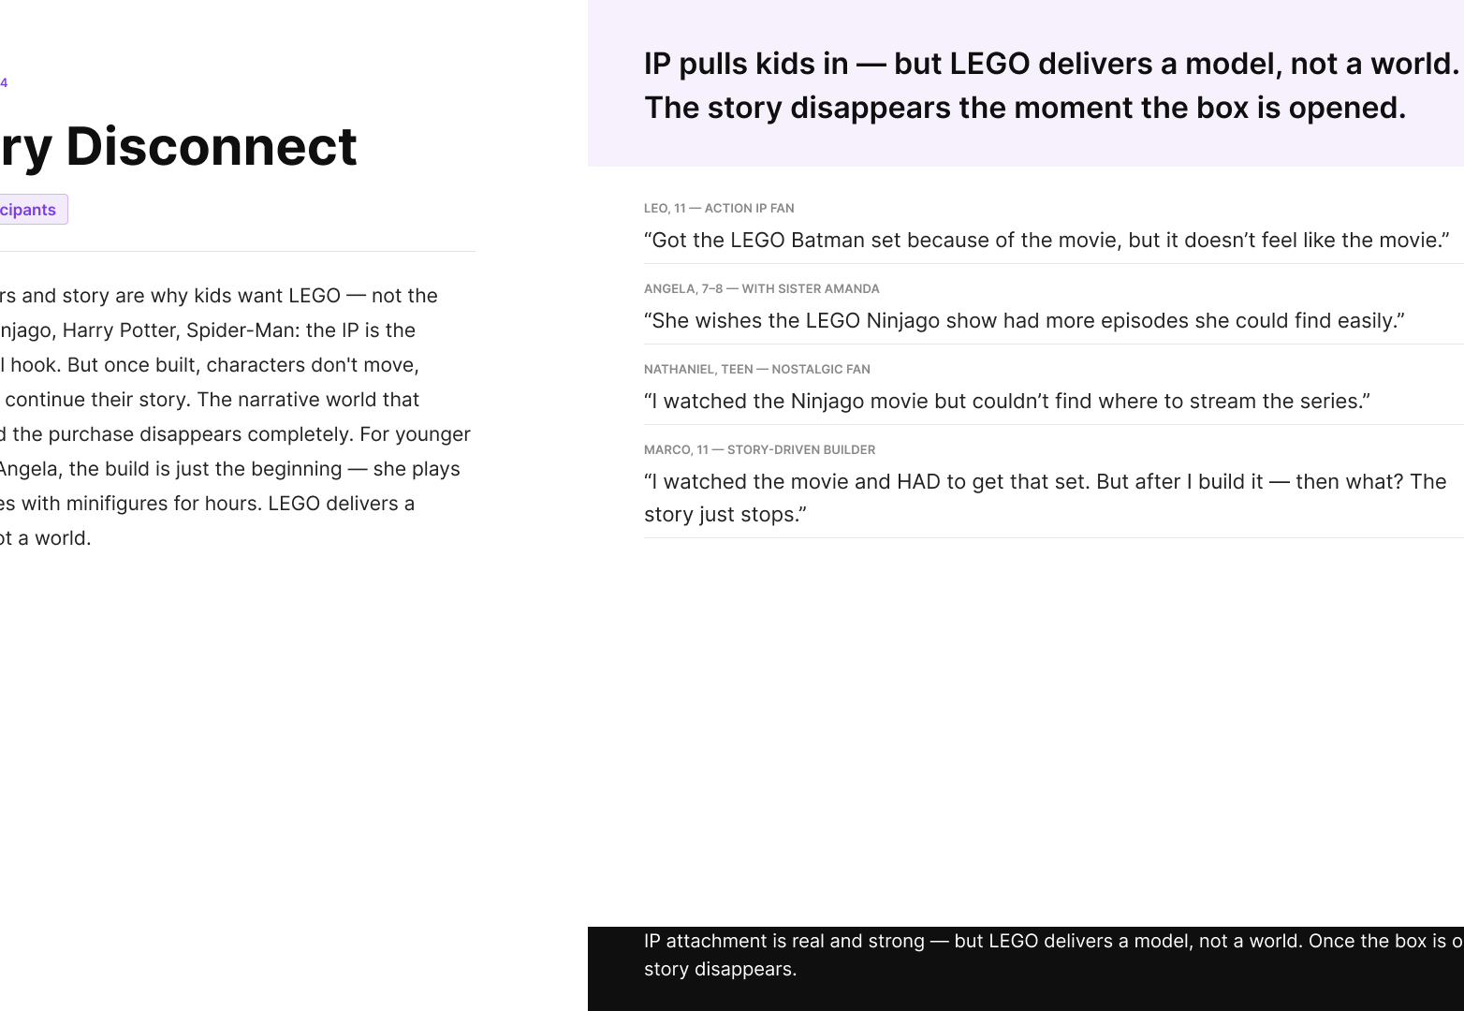
RESEARCH · INTERVIEWS + AFFINITY MAPPING
Stories start the action. Family makes it matter.
Three recurring patterns shaped the opportunity.
01 · BIG TV CREATES IMMERSION
02 · CHARACTERS TRIGGER ACTION
03 · COMPLETION WANTS RECOGNITION
Children prefer the large screen for story and action.
The story motivates building, collecting and play.
The payoff becomes meaningful when family sees it.
Research validated story motivation and family behavior. English learning remains the product hypothesis to test.
02
Notes:
Establish the evidence before introducing the persona or solution.
[Sources]
- Cinematic Studio cross-participant synthesis, node 630:2
- LEGO Affinity Mapping board, family learning theme, section 38:2111
- Cinematic Studio Story Disconnect, node 796:1881
- Research sample-size caveat: artifact totals are inconsistent, so the deck uses broad wording
[/Sources]
[TALK TRACK · 32 SEC]
I began with interviews and affinity mapping, and three patterns repeated. The big TV creates immersion, familiar characters motivate children to act, and finishing becomes more meaningful when the family sees it. These findings validate story motivation and family behavior—not English learning itself. That distinction leads to the opportunity I explored next.
[/TALK TRACK]

Slide 3
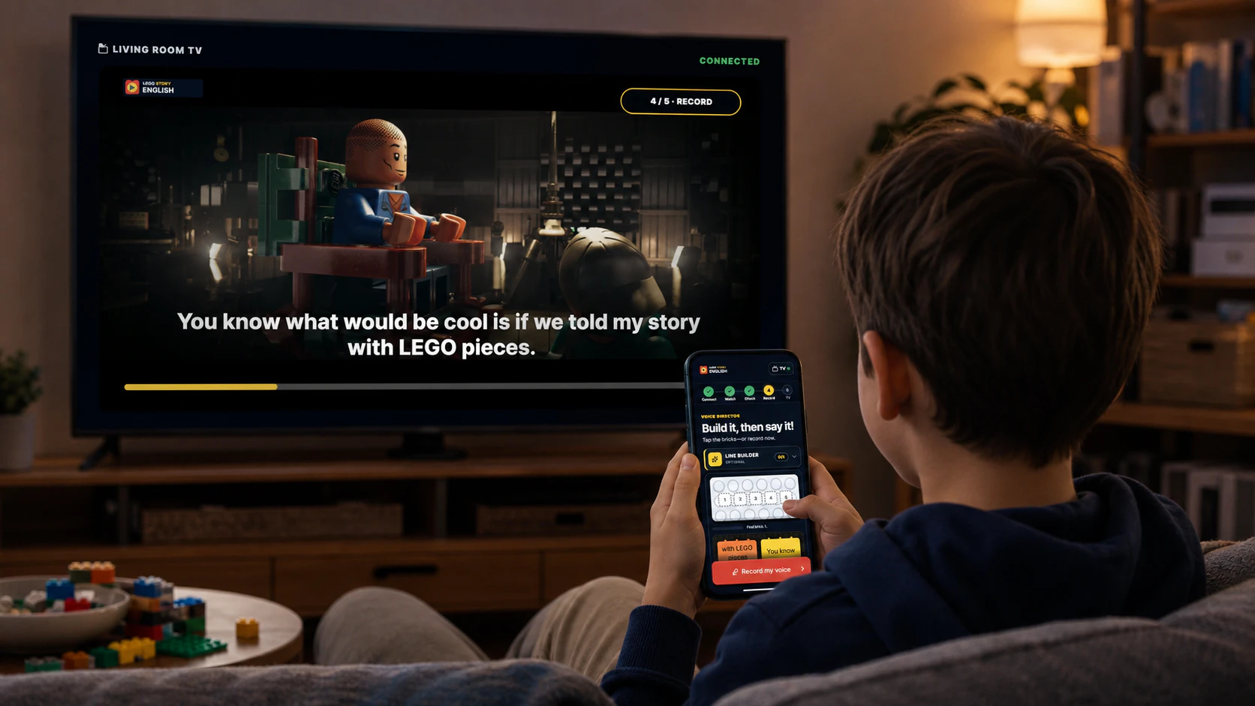
PRIMARY PERSONA · SYNTHESIZED
Meet the story-led family viewer.
Ages 8–11 · Big-screen viewer · Story-driven · Family-oriented
GOAL
Keep a favorite LEGO story going through watching, learning and sharing.
NEEDS
Big-screen context · one clear action · time to try · a visible family payoff
FRICTION
Unfamiliar words · confusing instructions · pressure to perform before feeling ready
ANGELA, 8
LEO, 11
TV feels more real; watching and building happen with family.
The favorite moment is finishing—and showing Dad.
SYNTHESIZED PERSONA · ENGLISH PRACTICE IS A PRODUCT HYPOTHESIS
03
Notes:
Introduce one child archetype, then anchor the synthesis in two short participant observations.
[Sources]
- Cinematic Studio interview summaries: Angela, node 604:2; Leo, node 621:2
- Cinematic Studio cross-participant synthesis, node 630:2
- Scenario image is a project illustration used to communicate the TV and phone context
[/Sources]
[TALK TRACK · 32 SEC]
I synthesized the research into a story-led child viewer between eight and eleven. Angela described TV as feeling more real and connected watching and building with family, while Leo valued finishing something and showing it to his dad. This persona needs clear actions, time to try, and a visible family payoff. The English-learning behaviors shown here are design hypotheses that still need testing.
[/TALK TRACK]

Slide 4
LEGO PAIN POINT · WHY THIS THEME
LEGO stories spark action—but the experience stops at the credits.
WHY LEGO
Characters and stories already motivate watching, building and sharing with family.
“Got the LEGO Batman set because of the movie, but it doesn’t feel like the movie.”
THE PAIN POINT
That emotional momentum disappears when the story ends; there is no meaningful next chapter.
LEO · AGE 11
DESIGN HYPOTHESIS
Carry one lyric from watching → understanding → speaking, without leaving the story world.
04
Notes:
Do not claim that research directly asked for English learning; claim the continuity opportunity it actually supports.
[Sources]
- Cinematic Studio Story Disconnect artifact, node 796:1881
- Quote attributed in the research artifact to Leo, age 11
[/Sources]
[TALK TRACK · 32 SEC]
LEGO is a strong context because its characters already move children from watching into building and play. But Leo’s comment shows the disconnect: the physical set did not preserve the feeling of the movie. My design hypothesis is that carrying one story line from watching, to understanding, to speaking can create a meaningful next chapter.
[/TALK TRACK]

Slide 5
HOW MIGHT WE
How might we help a child make one LEGO story line their own—without breaking the family viewing moment?
01
KEEP THE CONTEXT
02
MAKE SUPPORT OPTIONAL
03
END WITH A SHARED PAYOFF
Start with the exact scene and lyric.
Let the child choose help or record now.
Return the child’s voice to the family TV.
ONE STORY MOMENT → ONE REPEATABLE LEARNING LOOP
05
Notes:
Pause here. This is the single question the rest of the design answers.
[Sources]
- Cinematic Studio cross-participant synthesis, node 630:2
- HMW reframes the validated story-continuity gap as a testable English-learning opportunity
[/Sources]
[TALK TRACK · 25 SEC]
This became my central design question: how might we help a child make one LEGO story line their own without interrupting the family viewing moment? Three principles guide the answer: preserve the exact story context, make support optional, and end with a shared payoff. The rest of the presentation shows how those principles became interactions.
[/TALK TRACK]

Slide 6
WHY ENGLISH · BUSINESS NEED
Use one story line to extend engagement—not another endless feed.
Research revealed a missing next chapter. Scene-linked English practice is the product hypothesis for filling it.
1
2
3
4
WATCH
UNDERSTAND
PRACTICE
PERFORM
Hear it in the story
Learn one word in context
Say the same line
Return it to the story
USER VALUE
BUSINESS VALUE
One short, contextual learning win.
Test lesson starts, saved words and return-to-story sessions.
06
Notes:
Name the value without inventing metrics.
[Sources]
- Research synthesis: watch-to-build loop, completion as peak emotion and lack of post-completion pathway, node 630:2
- Business value statements are proposed outcome directions, not measured results
[/Sources]
[TALK TRACK · 30 SEC]
The goal is not to add more content or screen time. The proposed loop uses one line the child already heard: watch it, understand it, practice it, and perform it. Scene-linked English practice is a design hypothesis, not a research finding; its potential value is one short learning win for the child and a testable return-to-story behavior for the product.
[/TALK TRACK]

Slide 7
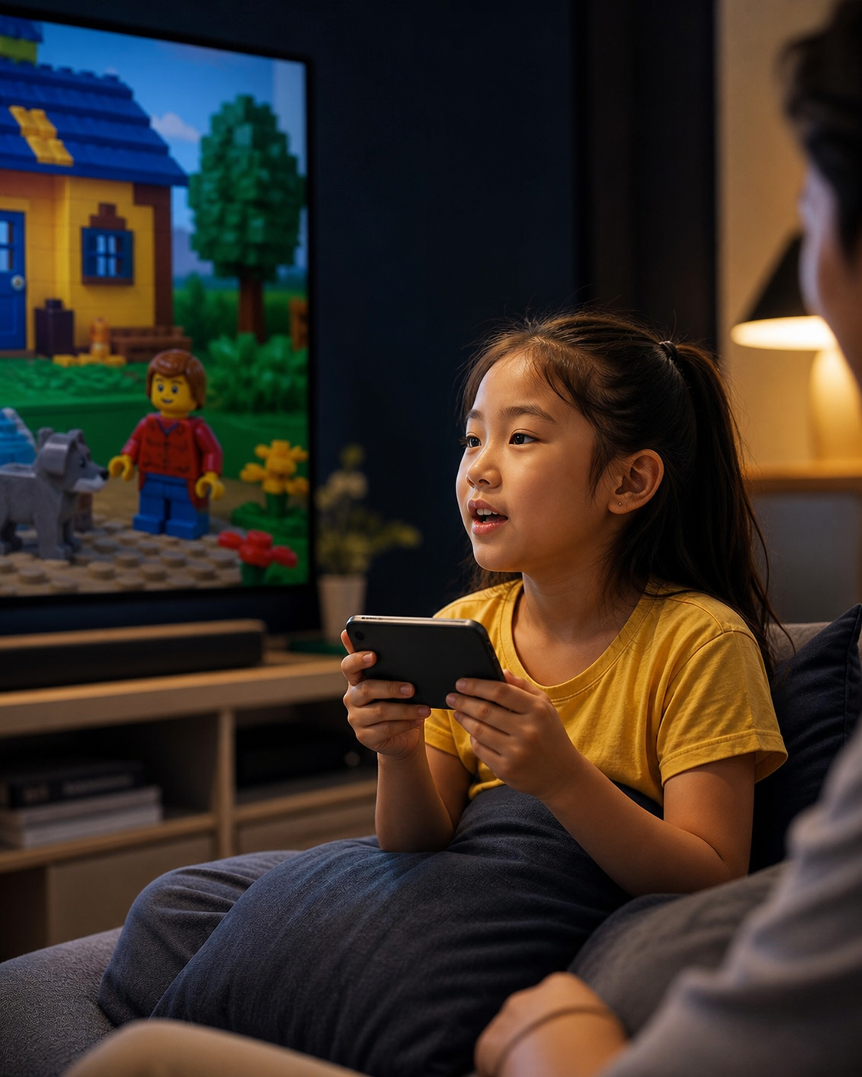
THE CONCEPT
Watch together.
Learn in the story.
Perform with confidence.
USER STORY
As an 8-year-old English learner, I want to understand a story line in context and practice before sharing, so I can join the family moment with confidence.
Design hypothesis derived from story, family and completion patterns.
07
Notes:
State the user story clearly, then be transparent about the hypothesis boundary.
[Sources]
- Original concept image created for this presentation; illustrative scenario, not a research participant
- User story is a design hypothesis; research did not directly validate English learning or private voice recording
[/Sources]
[TALK TRACK · 35 SEC]
This image represents the child and viewing context I designed for: an eight-year-old English learner watching with family. The child wants to understand a line without leaving the story, practice before anyone hears them, and then confidently share it. This user story translates the research patterns into a testable concept rather than claiming an already-proven learning need. To make that concept usable, I first designed specifically for television.
[/TALK TRACK]

Slide 8
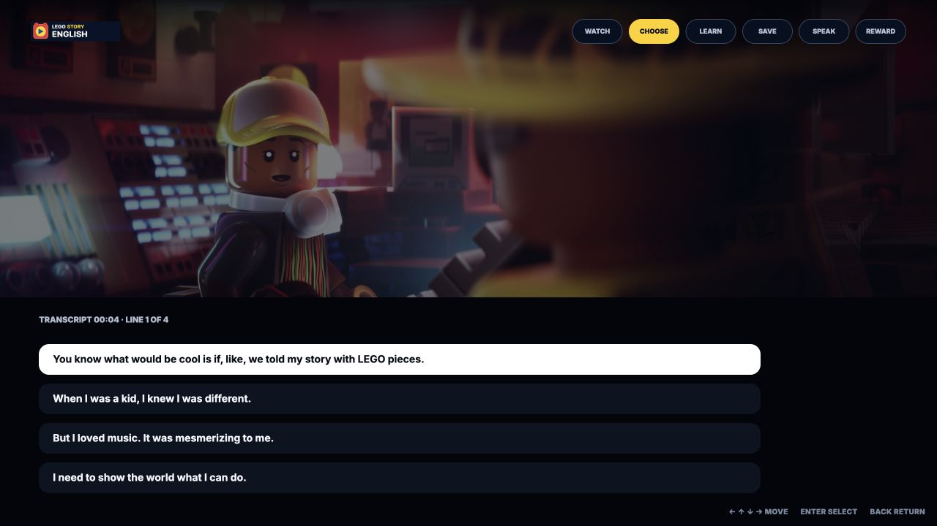
TV INTERACTION MODEL
Designed for ten-foot viewing, not a website on a television.
D-pad navigation · visible focus · one clear next action
1
Story first
Video stays full screen; lyrics appear only when the child pauses.
2
Remote-native
Arrow keys move focus. Enter selects. Space pauses. Back closes.
3
Context preserved
The selected line and film scene remain visible throughout learning.
NO INITIAL FOCUS · LARGE TYPE · CLEAR YELLOW RING
08
Notes:
Show that the TV UI was designed around remote behavior and viewing distance.
[Sources]
- Current TV prototype capture: local /tv?demo=transcript
- User-provided Figma TV presentation and prototype interaction model
[/Sources]
[TALK TRACK · 25 SEC]
The TV experience is story-first, remote-native, and designed to preserve context. Lyrics appear only when the child pauses, arrow keys move a large visible focus ring, and the selected scene remains on screen during learning. With that interaction model established, here are the three TV flows.
[/TALK TRACK]

Slide 9
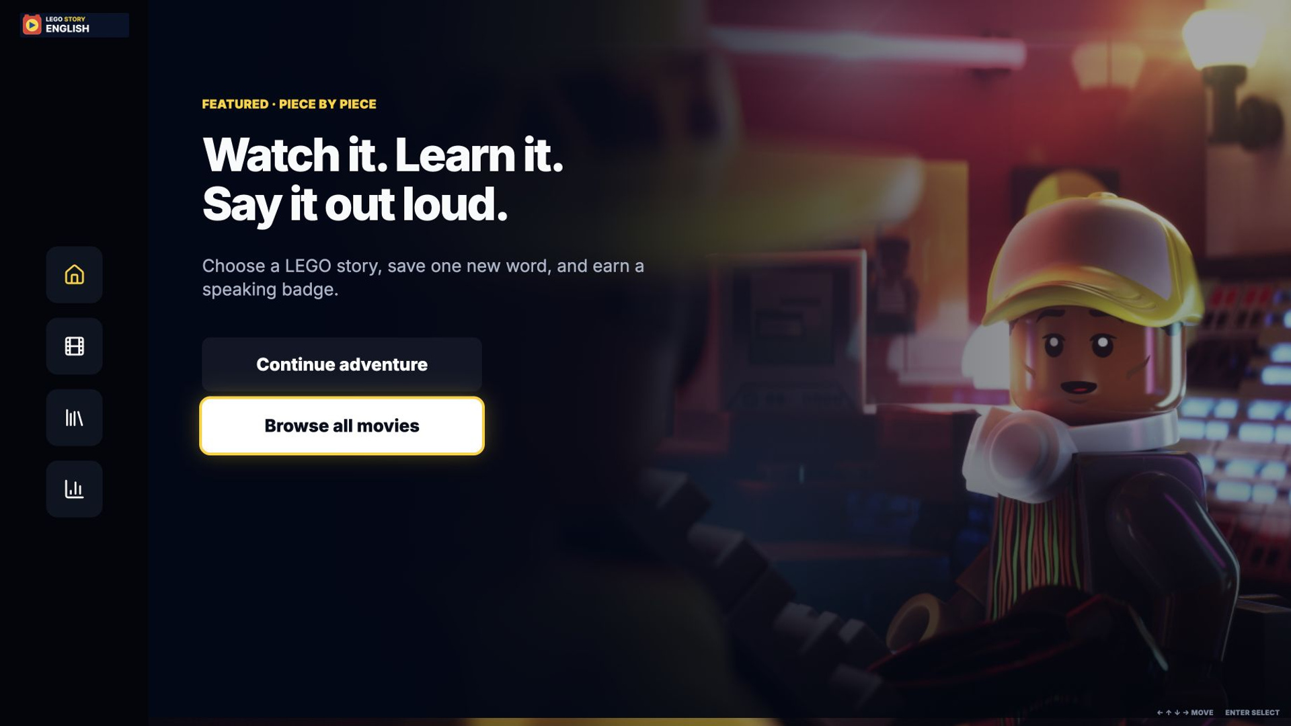
TV FLOW 01 · DISCOVER
Choose a LEGO story and start watching.
REMOTE FLOW
1
Browse stories
2
Choose Piece by Piece
3
Start the lesson
4
Watch with lyrics
WHY IT MATTERS
The lesson begins inside the story.
AUTO DEMO · 8 SEC
09
Notes:
Let the video run. The yellow focus advances automatically and Enter confirms; no pointer appears.
[Sources]
- Current TV prototype captures: local /tv?demo=home, library, detail and watch
- Remote-native D-pad and Enter walkthrough generated from current high-fidelity prototype states
[/Sources]
[TALK TRACK · 26 SEC]
In the first flow, the child browses stories, chooses Piece by Piece, starts the lesson, and watches with synchronized lyrics. Notice that there is no mouse on TV—the yellow focus moves through remote controls and Enter confirms the choice. Most importantly, learning begins inside the story rather than in a separate lesson screen.
[/TALK TRACK]

Slide 10
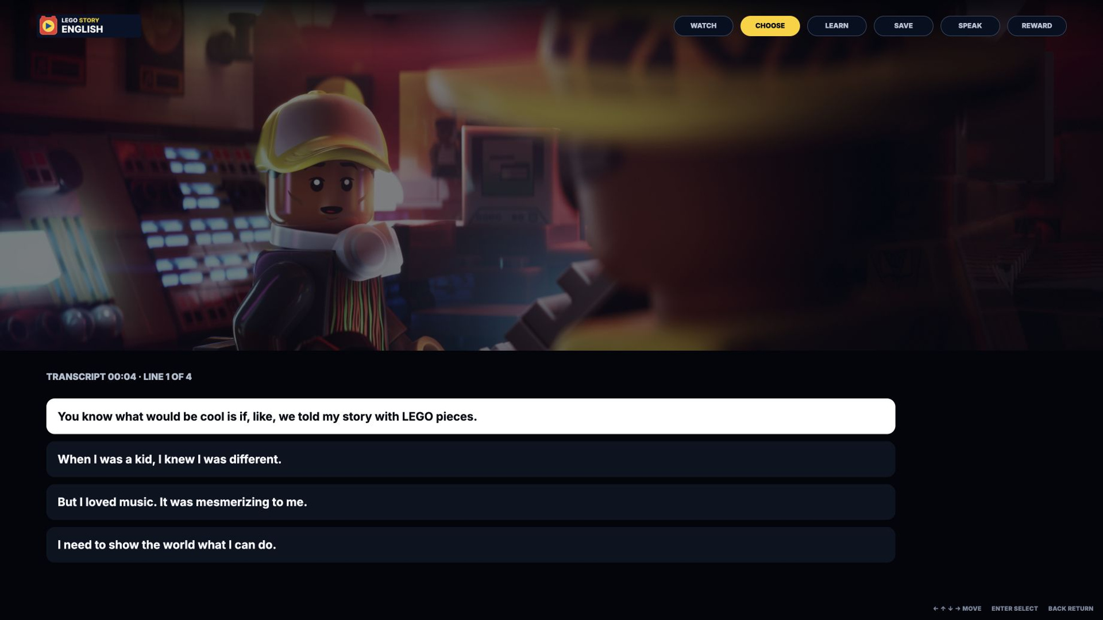
TV FLOW 02 · LEARN
Turn one lyric into a word worth keeping.
REMOTE FLOW
1
Pause the story
2
Select one lyric
3
Learn in context
4
Save the word
WHY IT MATTERS
Context becomes a reusable word.
AUTO DEMO · 7 SEC
10
Notes:
Emphasize that learning begins from a line the child actually heard.
[Sources]
- Current TV prototype captures: local /tv?demo=watch, meaning and saved
- Remote-native D-pad and Enter walkthrough generated from current high-fidelity prototype states
[/Sources]
[TALK TRACK · 26 SEC]
In the second flow, the child pauses on a line they just heard and selects the unfamiliar lyric. The meaning appears beside the original scene, and the child can save the word for later. This keeps language attached to a character, action, and moment instead of presenting it as an isolated flashcard.
[/TALK TRACK]

Slide 11
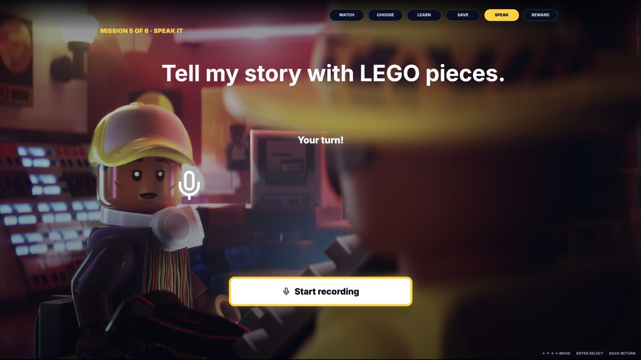
TV FLOW 03 · SPEAK
Say one line, get feedback, and continue.
REMOTE FLOW
1
Record one line
2
Hear feedback
3
Claim a badge
4
Choose the next story
WHY IT MATTERS
Speaking success becomes visible.
AUTO DEMO · 16 SEC
11
Notes:
Let the task run, then explain how one badge and one next action keep the child oriented.
[Sources]
- Current TV prototype captures: local /tv?demo=practice, recording, feedback, complete, badges, Clear Speaker detail and library
- Remote-native D-pad and Enter walkthrough generated from current high-fidelity prototype states
[/Sources]
[TALK TRACK · 32 SEC]
The third TV flow moves from understanding into speaking. The child records one line, receives simple strengths-based feedback, earns one badge, and chooses what to watch next. The reward makes progress visible, while one clear next action prevents the ending from becoming another complicated menu.
[/TALK TRACK]

Slide 12
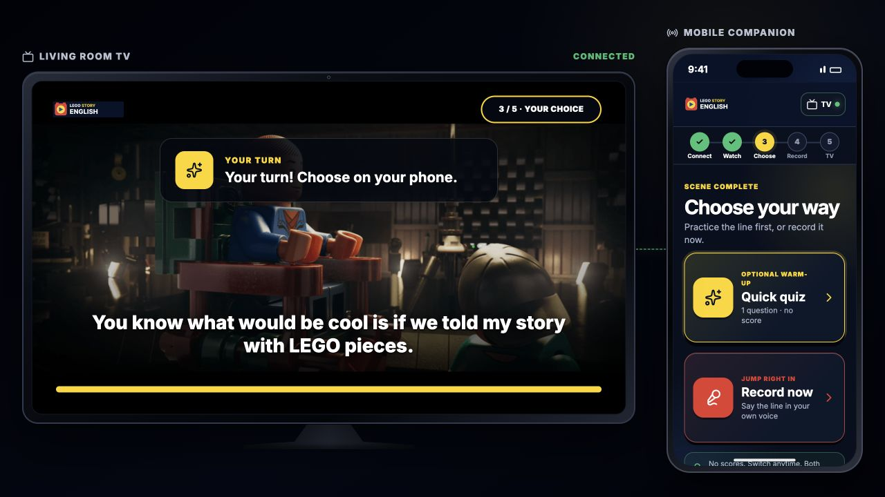
DESIGN EVOLUTION
Critique removed friction without removing play.
Each revision removed one decision or moved it to the right device.
SCRIPT COMPETED WITH VIDEO
SUPPORT FELT FORCED
RECORDING FELT PUBLIC
Pause reveals the lyric.
Quiz or record now—both are valid.
Review stays private until Send.
12
Notes:
Use this slide to demonstrate learning and iteration, not just polish.
[Sources]
- Individual critique feedback and current prototype iterations documented throughout the semester
- Current TV transcript and connected choice captures
[/Sources]
[TALK TRACK · 28 SEC]
Critique helped me simplify the experience in three important ways. The lyric now appears only after pausing, support is optional rather than required, and recordings remain private until the child actively sends them. These revisions remove decisions at the wrong moment while preserving the playful payoff.
[/TALK TRACK]

Slide 13
TV → MOBILE EXPERIENCE
One shared story. One private choice. One family premiere.
The phone supports a short learning task, then attention returns to TV.
TV · SHARED STORY
MOBILE · PRIVATE CHOICE + PRACTICE
TV · SHARED PAYOFF
1
2
3
4
5
PAIR
WATCH
CHOOSE
RECORD
PREMIERE
TV shows code
Scene + lyric
Quiz or record
Private take
Send to TV
CHILD CHOOSES
Quick quiz OR Record now
Only explicit Send moves the approved voice to TV.
13
Notes:
Explain only the five-stage spine and the one optional choice. Do not narrate every screen here.
[Sources]
- https://story-english-voice-director.cocoy2.workers.dev/ — current connected experience architecture
- Final experience state model: Connect, Watch, Choose, Record and TV premiere
[/Sources]
[TALK TRACK · 32 SEC]
The connected experience gives each device one clear role. TV holds the shared story and final payoff, while the phone provides private choice and practice. The five-stage spine is Pair, Watch, Choose, Record, and Premiere, but the quiz is optional. Only an explicit Send moves the approved recording back to the television.
[/TALK TRACK]

Slide 14
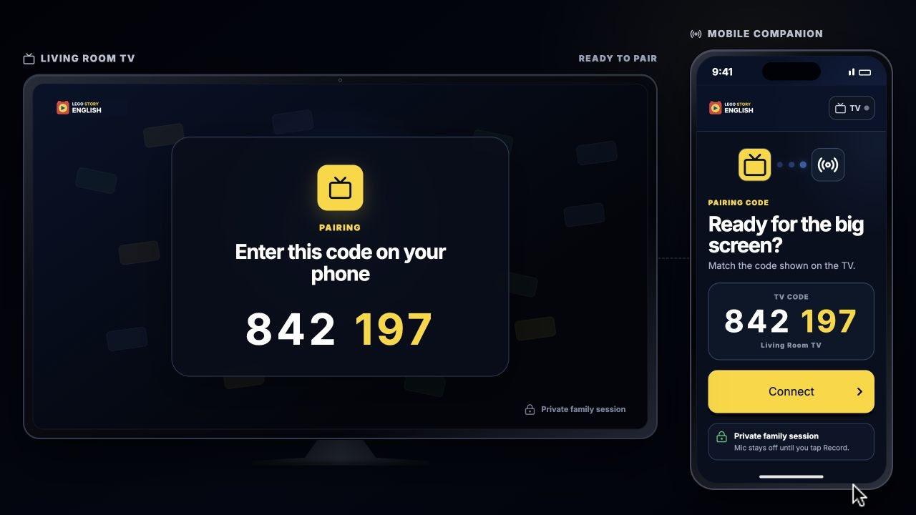
TASK 04A · TV + MOBILE
Pair the phone and choose a story.
CONNECTED TASK
1
Enter TV code
2
Connect the phone
3
Choose a story
4
TV starts playing
WHY IT MATTERS
The phone acts; the TV shows the result.
AUTO DEMO · 7 SEC
OPEN LIVE PROTOTYPE →
14
Notes:
Let the task play. Name the active device, then point to the synchronized response on the other screen.
[Sources]
- https://story-english-voice-director.cocoy2.workers.dev/ — clean public connected prototype
- Embedded self-moving cursor walkthrough generated from current connected TV and mobile states
[/Sources]
[TALK TRACK · 26 SEC]
First, the child enters the code shown on TV and connects the phone to the living-room screen. They choose a LEGO story on the phone, and the selected scene immediately loads on TV. The phone performs the action while the television clearly confirms the result.
[/TALK TRACK]

Slide 15
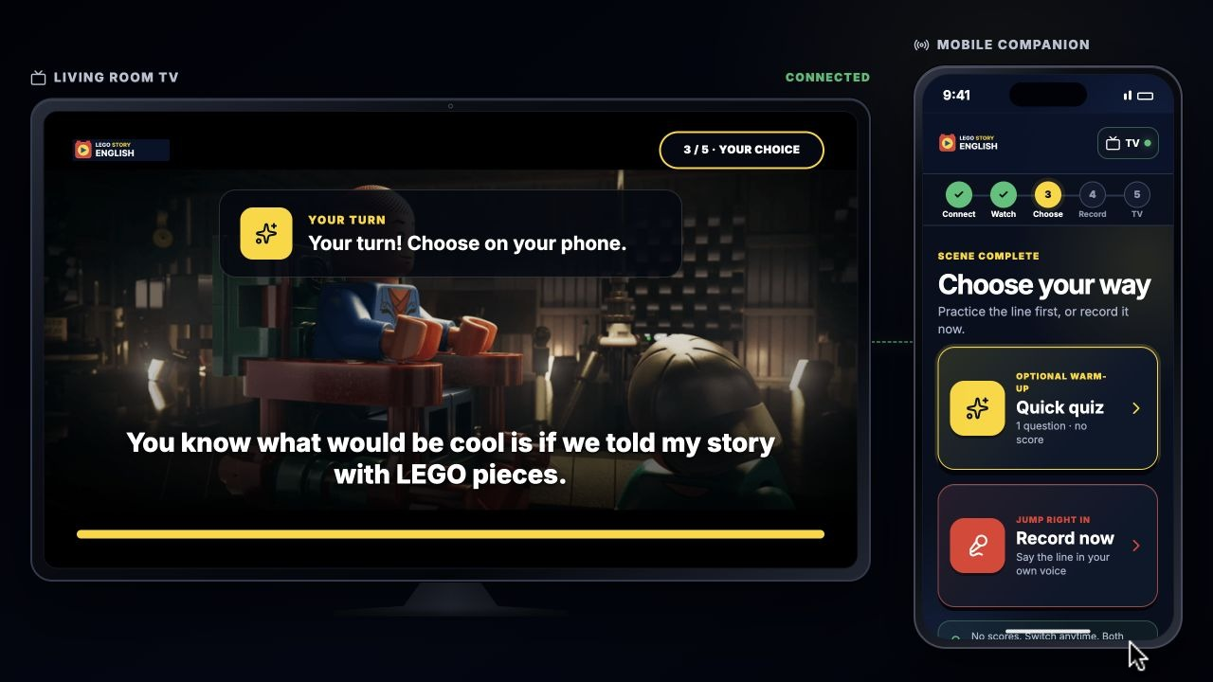
TASK 04B · TV + MOBILE
Choose how much support you need.
CONNECTED TASK
1
Scene ends
2
Choose support
3
Quick check or skip
4
Practice privately
WHY IT MATTERS
Relearning is available, never forced.
AUTO DEMO · 7 SEC
OPEN LIVE PROTOTYPE →
15
Notes:
Let the task play. Name the active device, then point to the synchronized response on the other screen.
[Sources]
- https://story-english-voice-director.cocoy2.workers.dev/ — clean public connected prototype
- Embedded self-moving cursor walkthrough generated from current connected TV and mobile states
[/Sources]
[TALK TRACK · 26 SEC]
When the scene ends, the child chooses what they need next. They can take a quick meaning check, or skip it and record immediately if they already feel ready. This makes relearning available without forcing every child through the same extra steps.
[/TALK TRACK]

Slide 16
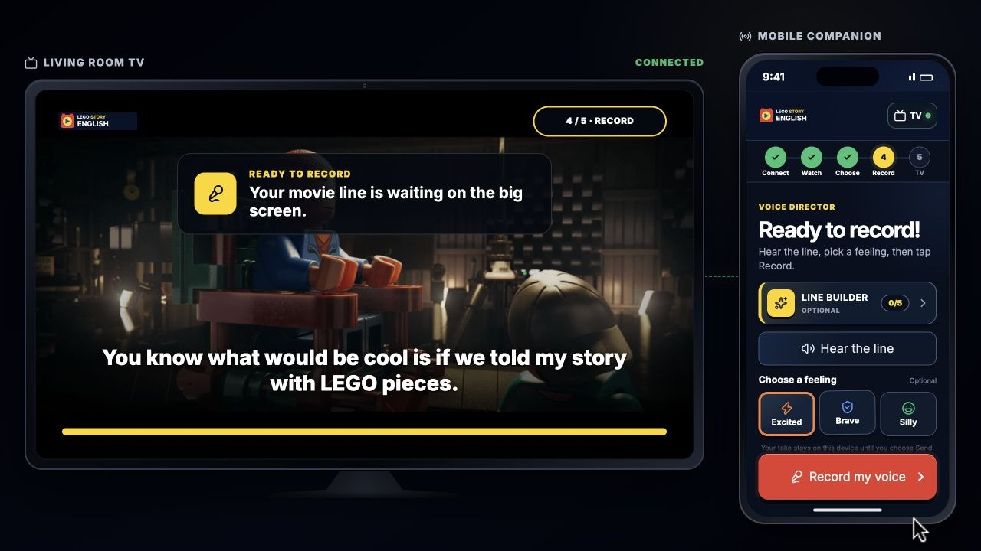
TASK 04C · TV + MOBILE
Record privately, then premiere on TV.
CONNECTED TASK
1
Record a take
2
Replay privately
3
Send to TV
4
Premiere + badge
WHY IT MATTERS
The child controls when the family hears it.
AUTO DEMO · 18 SEC
OPEN LIVE PROTOTYPE →
16
Notes:
Let the task play. Name the active device, then point to the synchronized response on the other screen.
[Sources]
- https://story-english-voice-director.cocoy2.workers.dev/ — clean public connected prototype
- Embedded self-moving cursor walkthrough generated from current connected TV and mobile states
[/Sources]
[TALK TRACK · 36 SEC]
The child records the line and replays it privately on the phone. Nothing reaches the shared screen until they intentionally tap Send to TV. Then the movie plays with the child’s approved voice and ends with a visible badge. This handoff turns private practice into a family celebration while keeping the child in control.
[/TALK TRACK]

Slide 17
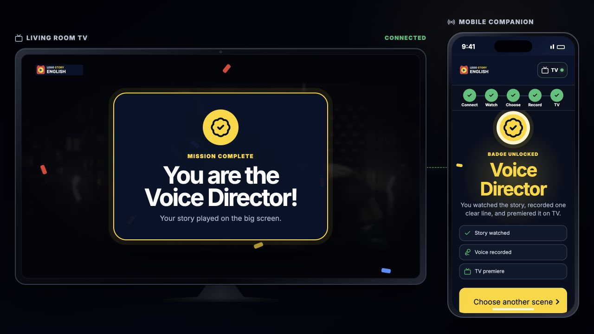
THE OPPORTUNITY
Keep the story going—until the child can make it their own.
CONNECTED PROTOTYPE →
TV PROTOTYPE · PLAY SLIDES 09–11
story-english-voice-director.cocoy2.workers.dev
COCO YIN · LEGO STORY ENGLISH
17
Notes:
Resolve the opening: story → word → voice → shared payoff, then move to the testing plan.
[Sources]
- https://story-english-voice-director.cocoy2.workers.dev/ — clean public connected prototype
- TV and connected prototypes are demonstrated in the embedded walkthroughs on slides 9–11 and 14–16
[/Sources]
[TALK TRACK · 28 SEC]
The final opportunity is not simply adding vocabulary to television. It is extending the emotional momentum of one story until the child can understand, practice, and confidently perform part of it. LEGO Story English connects a shared viewing moment, a private learning choice, and a meaningful family payoff.
[/TALK TRACK]

Slide 18
NEXT STEPS
Test the learning loop—not more features.
Prototype → Observe → Simplify again
01
02
03
UNDERSTAND
COMPLETE
TRUST
Can the child explain and reuse the word?
Can they finish TV → phone → TV without adult help?
Do children and parents understand that the voice stays private until Send?
SUCCESS SIGNALS
Accurate recall · Independent completion · Recording comfort · Another story started
18
18
Notes:
End with three testable questions, not a new feature backlog.
[Sources]
- Cinematic Studio cross-participant synthesis, node 630:2
- Angela and Leo interview summaries, nodes 604:2 and 621:2
- Future-test areas respond to the unvalidated English-learning and private-practice hypotheses
[/Sources]
[TALK TRACK · 36 SEC]
The next step is to test the core loop with children and parents before adding more features. I would examine three questions: can the child explain and reuse the word, can they complete the TV-to-phone-to-TV journey independently, and do both child and parent understand that recording stays private until Send? I would measure recall, independent completion, recording comfort, and whether the child chooses another story. Those results would show what to simplify, strengthen, or remove in the next iteration.
[/TALK TRACK]

