Slide 1




When great ideas take shape
Your swiss specialist for high-precision pattern and mould making as well as CNC machining
Client presentation – new customer acquisition
Formbar AG, Kirchdorf (CH) · July 2026

Slide 2





Who We are
When great ideas take shape – Your vision is our promise
High-precision
Highest dimensional accuracy across all materials and formats
Formbar AG is your professional and reliable partner for pattern and mould making – one of the industry-leading companies in Switzerland
Our core expertise is the manufacture of moulds and prototypes. Precise craftsmanship and state-of-the-art technology ensure we meet the highest standards for tolerances, on-time delivery, and surface quality.
From design and manufacturing to the test report
– everything from a single source, at a single location.
High-efficient
Short lead times as a result of well-designed processes
High-comitted
Personal Commitment to every single project
High-quality and on-time delivery
Precise machining of metal and plastic components for the highest dimensional accuracy
SwissMade since 1911

Slide 3
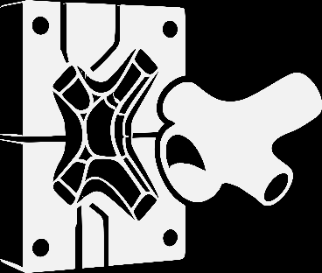
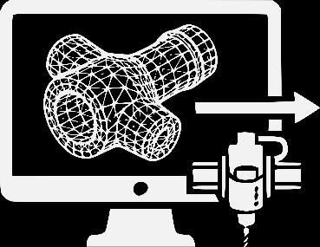
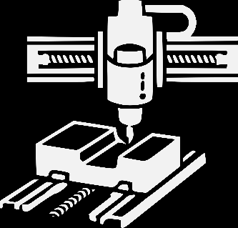
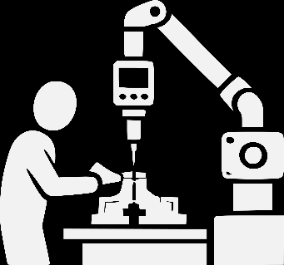
What We do for You
From the preliminary draft to the measured part
Construction (CAD/CAM)
Engineering (partner)
Advice on feasibility, materials
and manufacturing processes
Inspection and Measurement
Quality assurance with measurement
report prior to delivery
Mould & Die Making
Plastic and Aluminium Moulds
From very small to large
Fixture/JIG Construction
CNC Milling Technology/
Mechanical Machining
From small to large
Machining of CFRP/GFRP, Aluminium,
Plastics/Foams
Trimming of CFRP and GFRP laminates

Slide 4
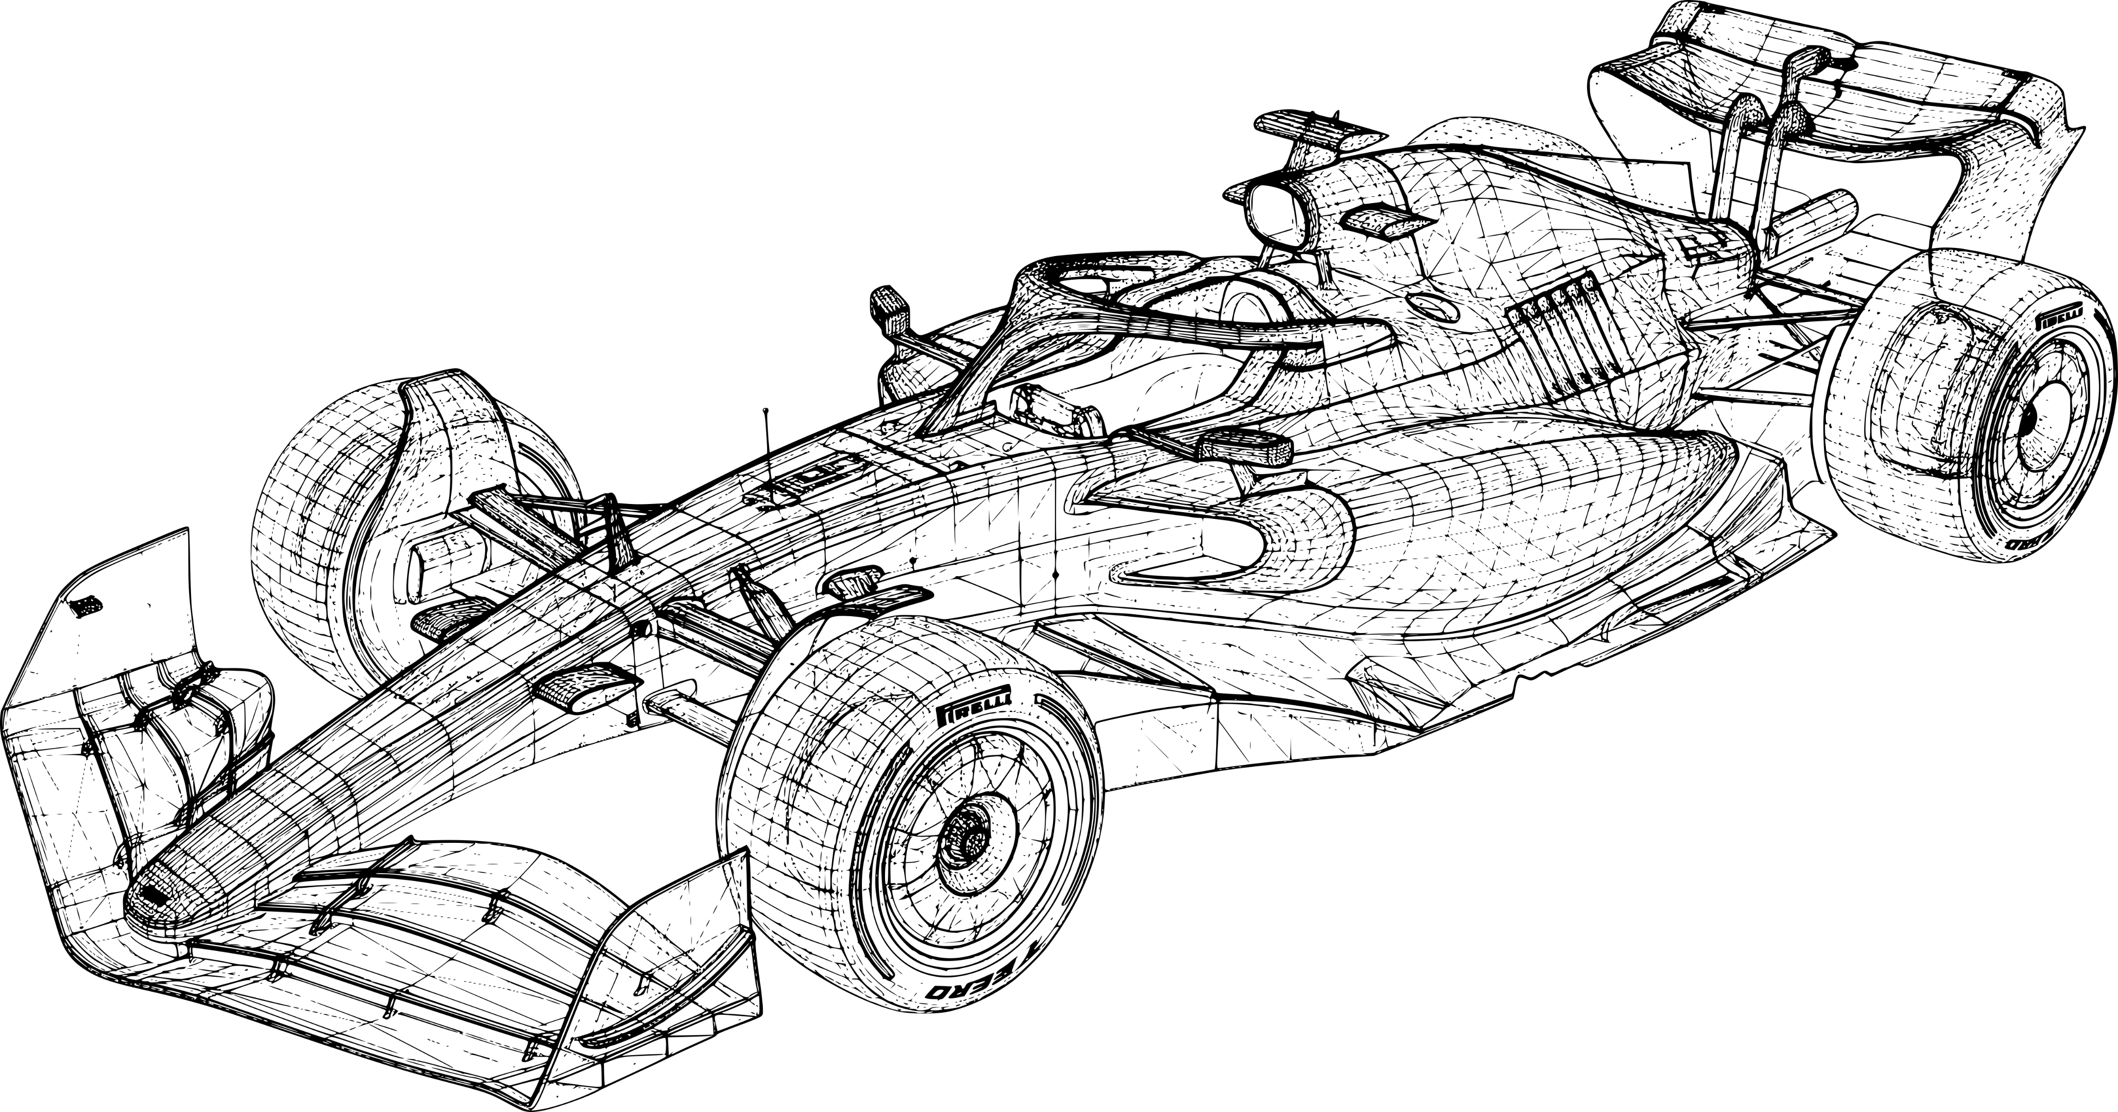
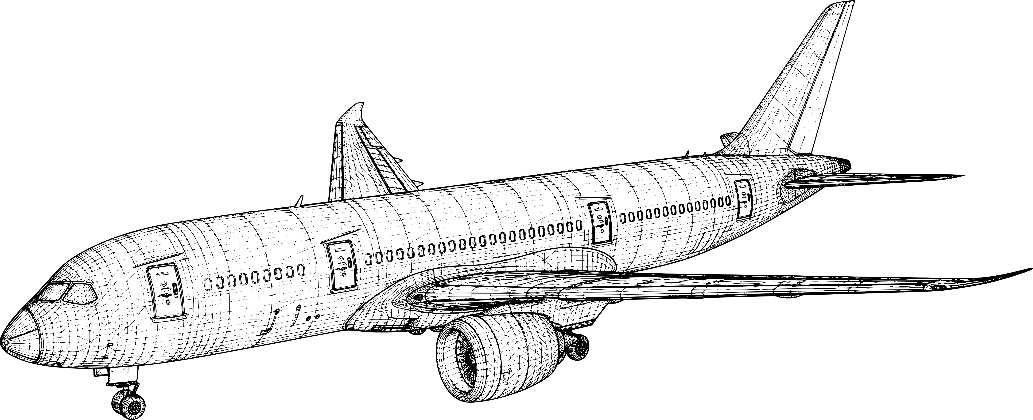
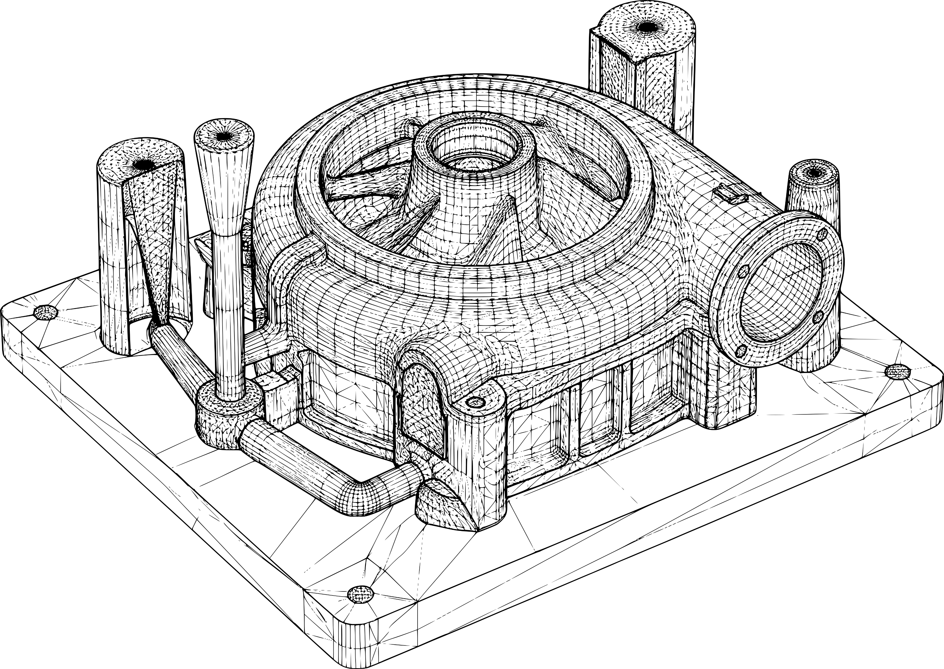
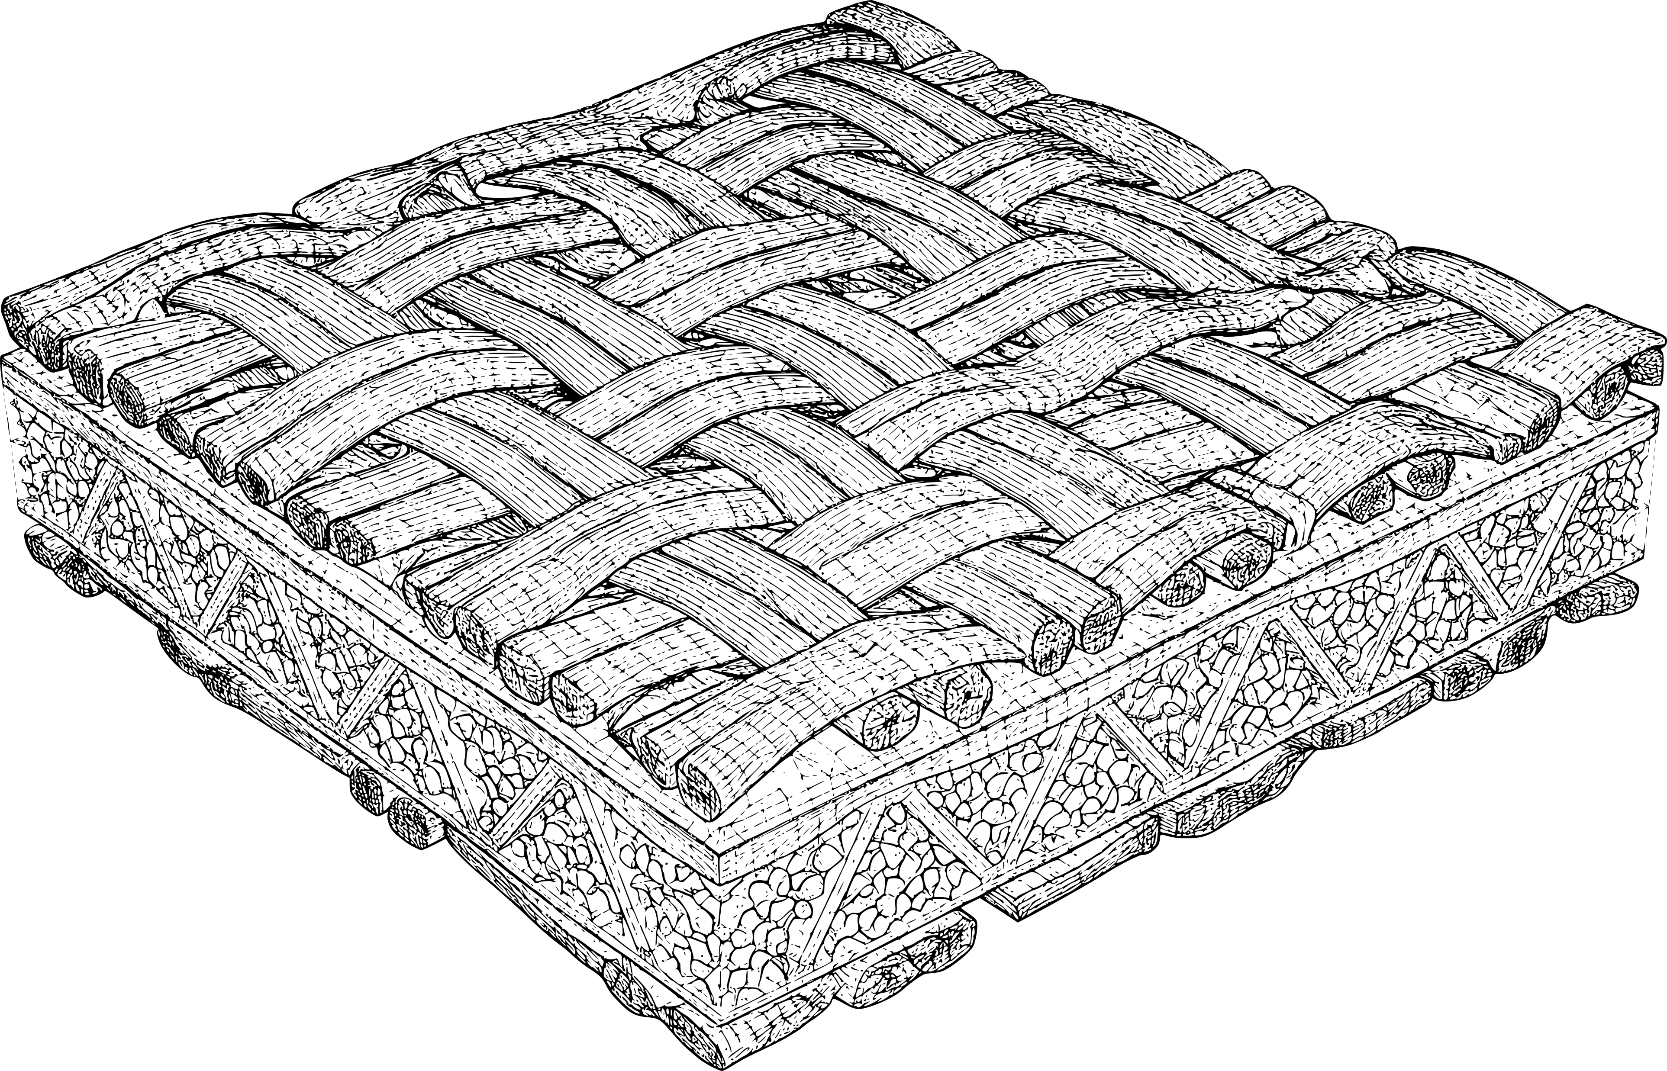
Our Experience
Selected Areas of Expertise – the highest standards of precision and on-time delivery
Automobil & Motor Sport
«Moulding for
maximum speed»
Precision for Centrifugal
Force and Vibration!
Long-term production
for Formula 1
Aviation and Space
«To get your visions off
the ground»
Safety at high-altitude
enviroments and under
extreme strain!
Projects for
Aviation and Space Programs
Composite Industry
«Moulding for the Future
of Materials»
Reliability under high pressure
and high temperatures!
Projects for Aerospace
and Defense
Pattern Making
«Passionate about your projects»
Quality that withstands
heat and melt flow!

Slide 5
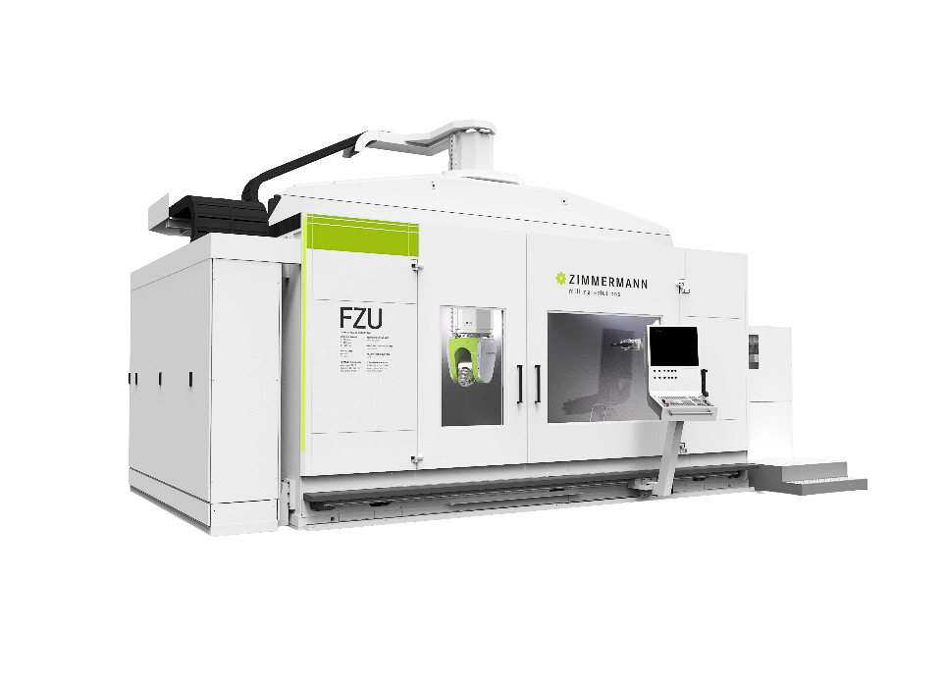
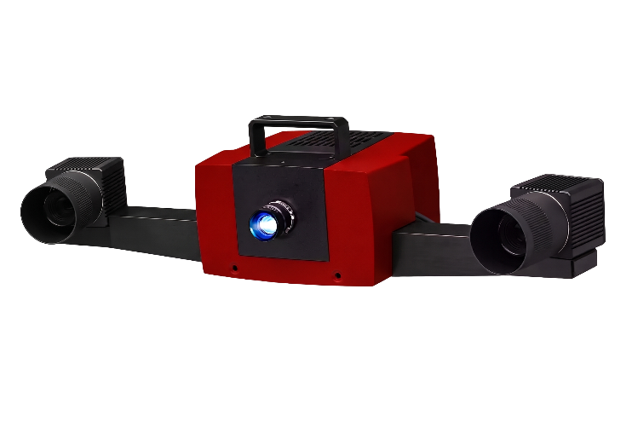
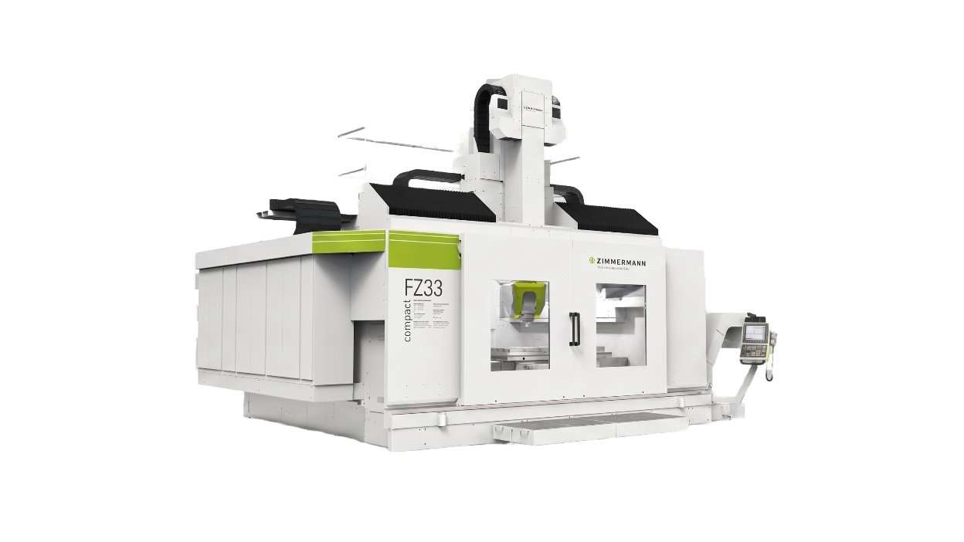
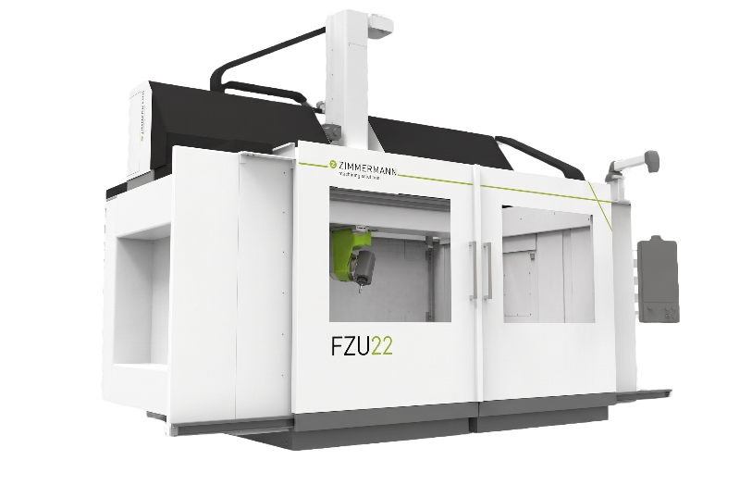
Our Machinery
State of the Art – Our modern machinery is second to none in Switzerland
FZU - Zimmermann
CNC – 5-Axis Gantry Milling Machine
Machining Area:
X-Axis: 4000mm
Y-Axis: 3000mm
Z-Axis: 1500mm
FZ33c - Zimmermann
CNC – 5-Axis Gantry Milling Machine
Machining Area:
X-Axis: 2500mm
Y-Axis: 4000mm
Z-Axis: 1500mm
ATOS Compact Scan
3D Scanner
CAD to part comparison
FZU22 - Zimmermann
CNC – 5-Axis Gantry Milling Machine
Machining Area:
X-Axis: 1800mm
Y-Axis: 3000mm
Z-Axis: 1250mm

Slide 6
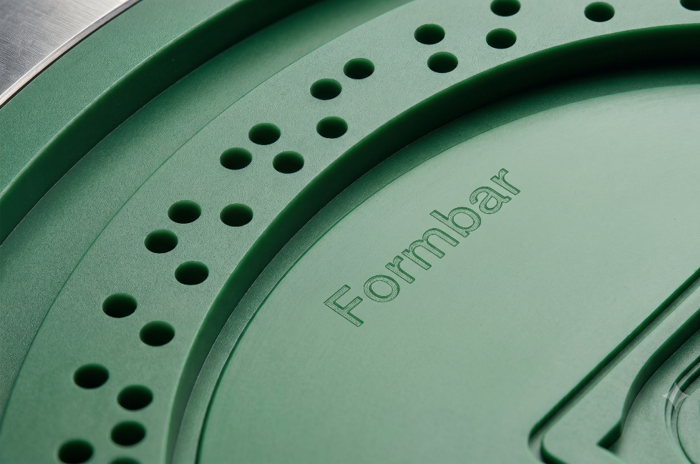
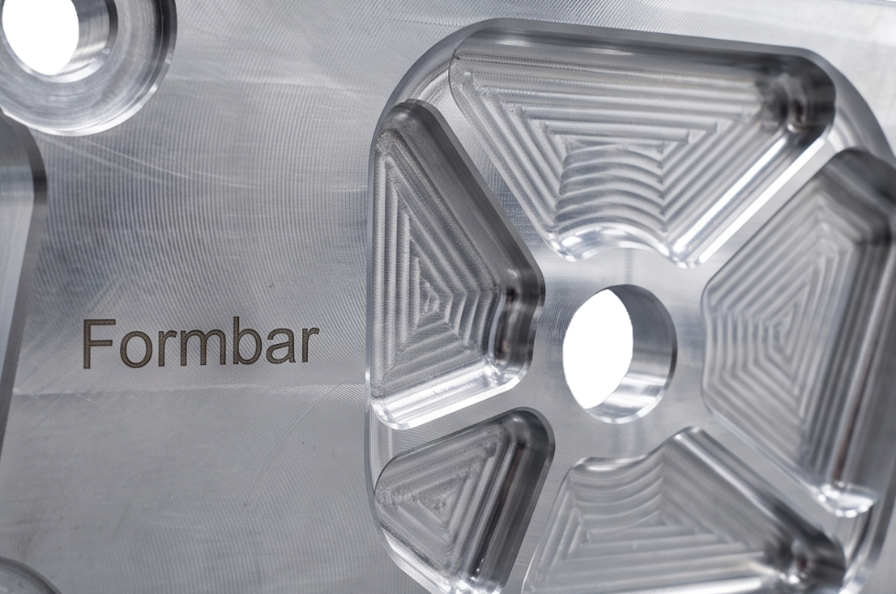
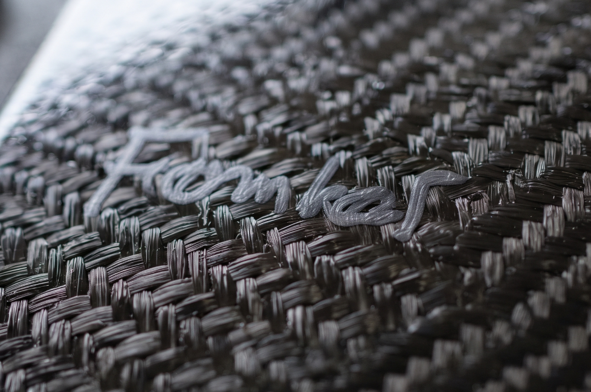
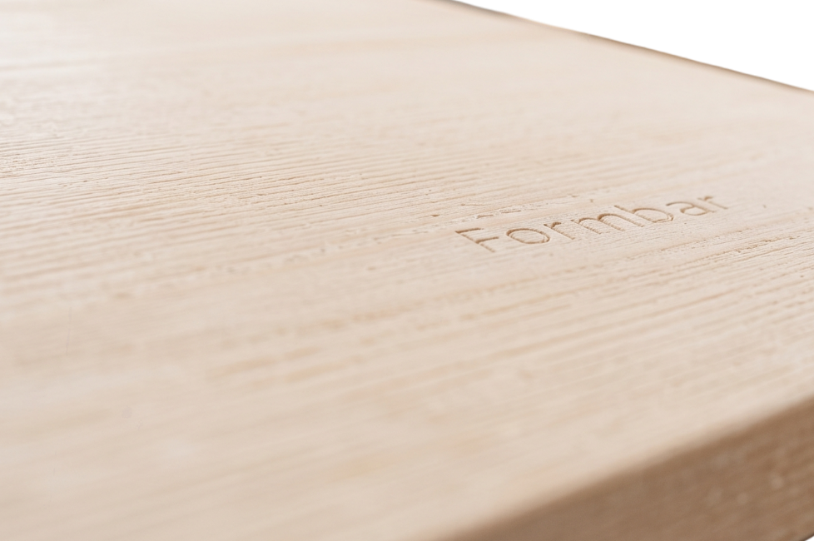
Our Materials
All known materials – both small and large dimensions
Plastics
Varios types of plastic for
moulds and prototypes
PU-/Epoxy block materials, POM-C,
PA6, PMMA, various plastics, EPS/EPP
Aluminium
Precision, durable moulds
for demanding production runs
Any alloys up to Aluminium 7075
Composite / Prepreg
High-performance composites
for Motor Sport & Aerospace
CFRP prepreg, GFRP,
glass-fiber-reinforced resin fabric (EP GC)
Nomex, Rohacell, other fillers
Wood
Traditional pattern and
Mould making

Slide 7
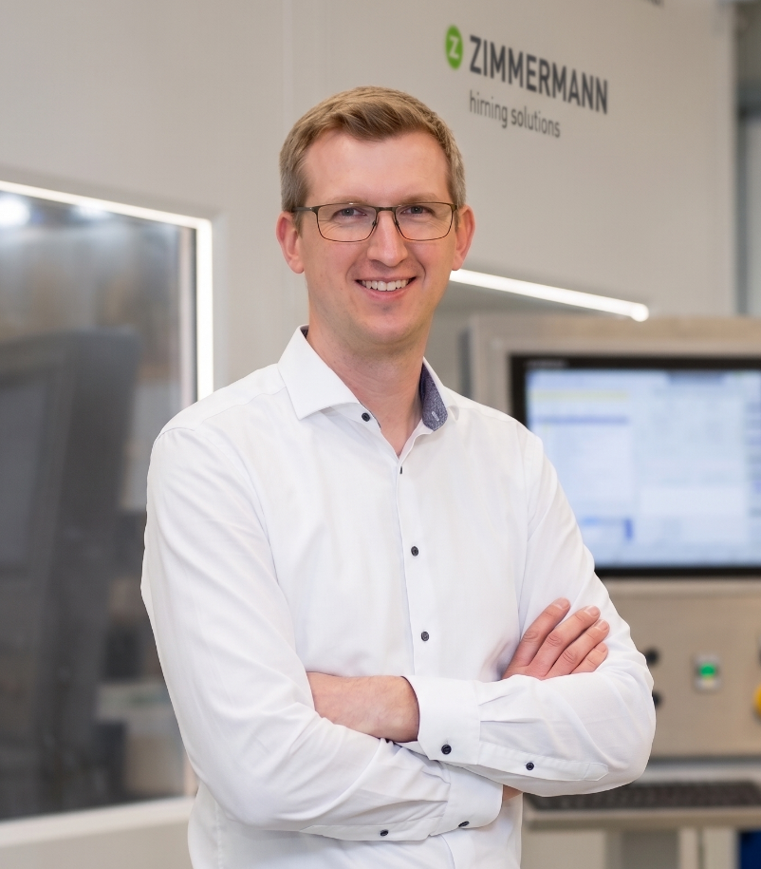
Location and Contact Person
Centrally located in Switzerland
N
≈ 60 km radius
Basel
49 km
Winterthur
48 km
Solothurn
43 km
Zurich
35 km
Kirchdorf
Headquarters
Formbar AG
Michael Hilpert
Managing Director
Petra Kern
Office Managerin/
Internal Sales Service
Bern
62 km
+41 56 296 10 03
+41 56 296 10 00
S
michael.hilpert@formbar.ch
petra.kern@formbar.ch
Sagiweg 2, CH-5416 Kirchdorf

