Slide 1
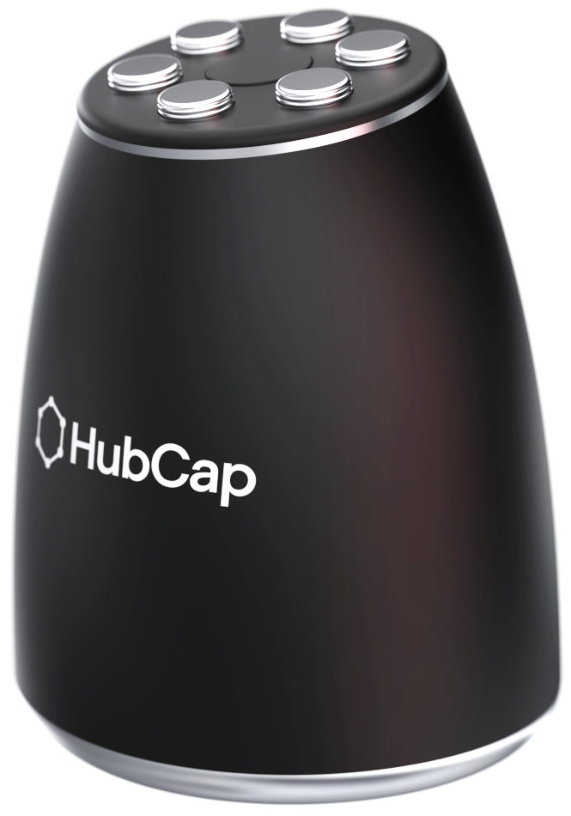
HubCap
The Communal Pen Solution
By TechnicPin
Sophia Santos
Samuel Thanopoulos
Deema Arraf
Daniel Neirinckx-Parker

Slide 2
“How might we promote sustainable and inclusive practice in workplaces that utilise communal stationary?”

Slide 3
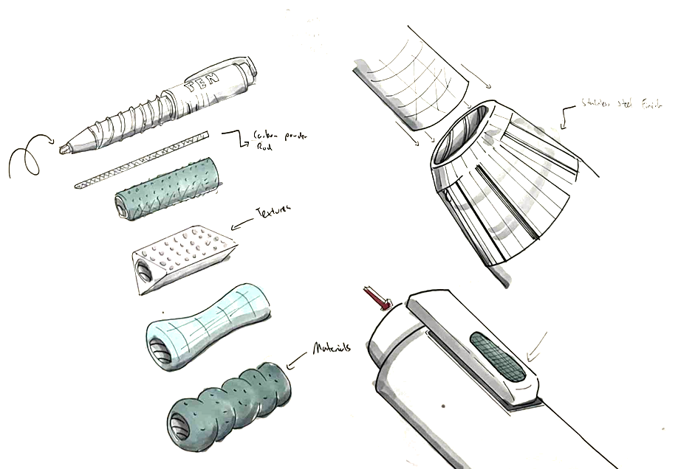
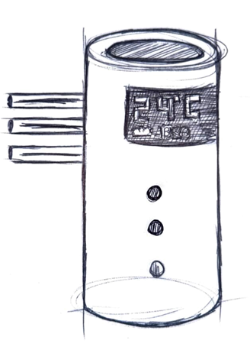
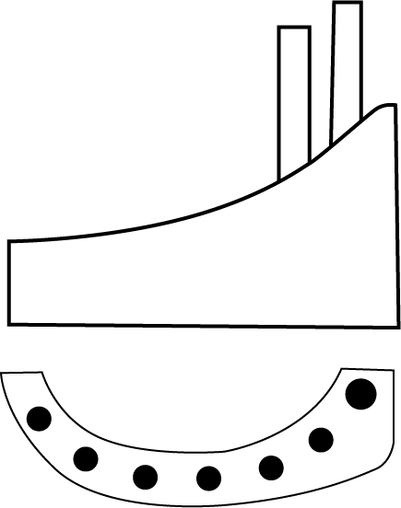
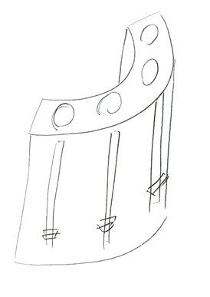
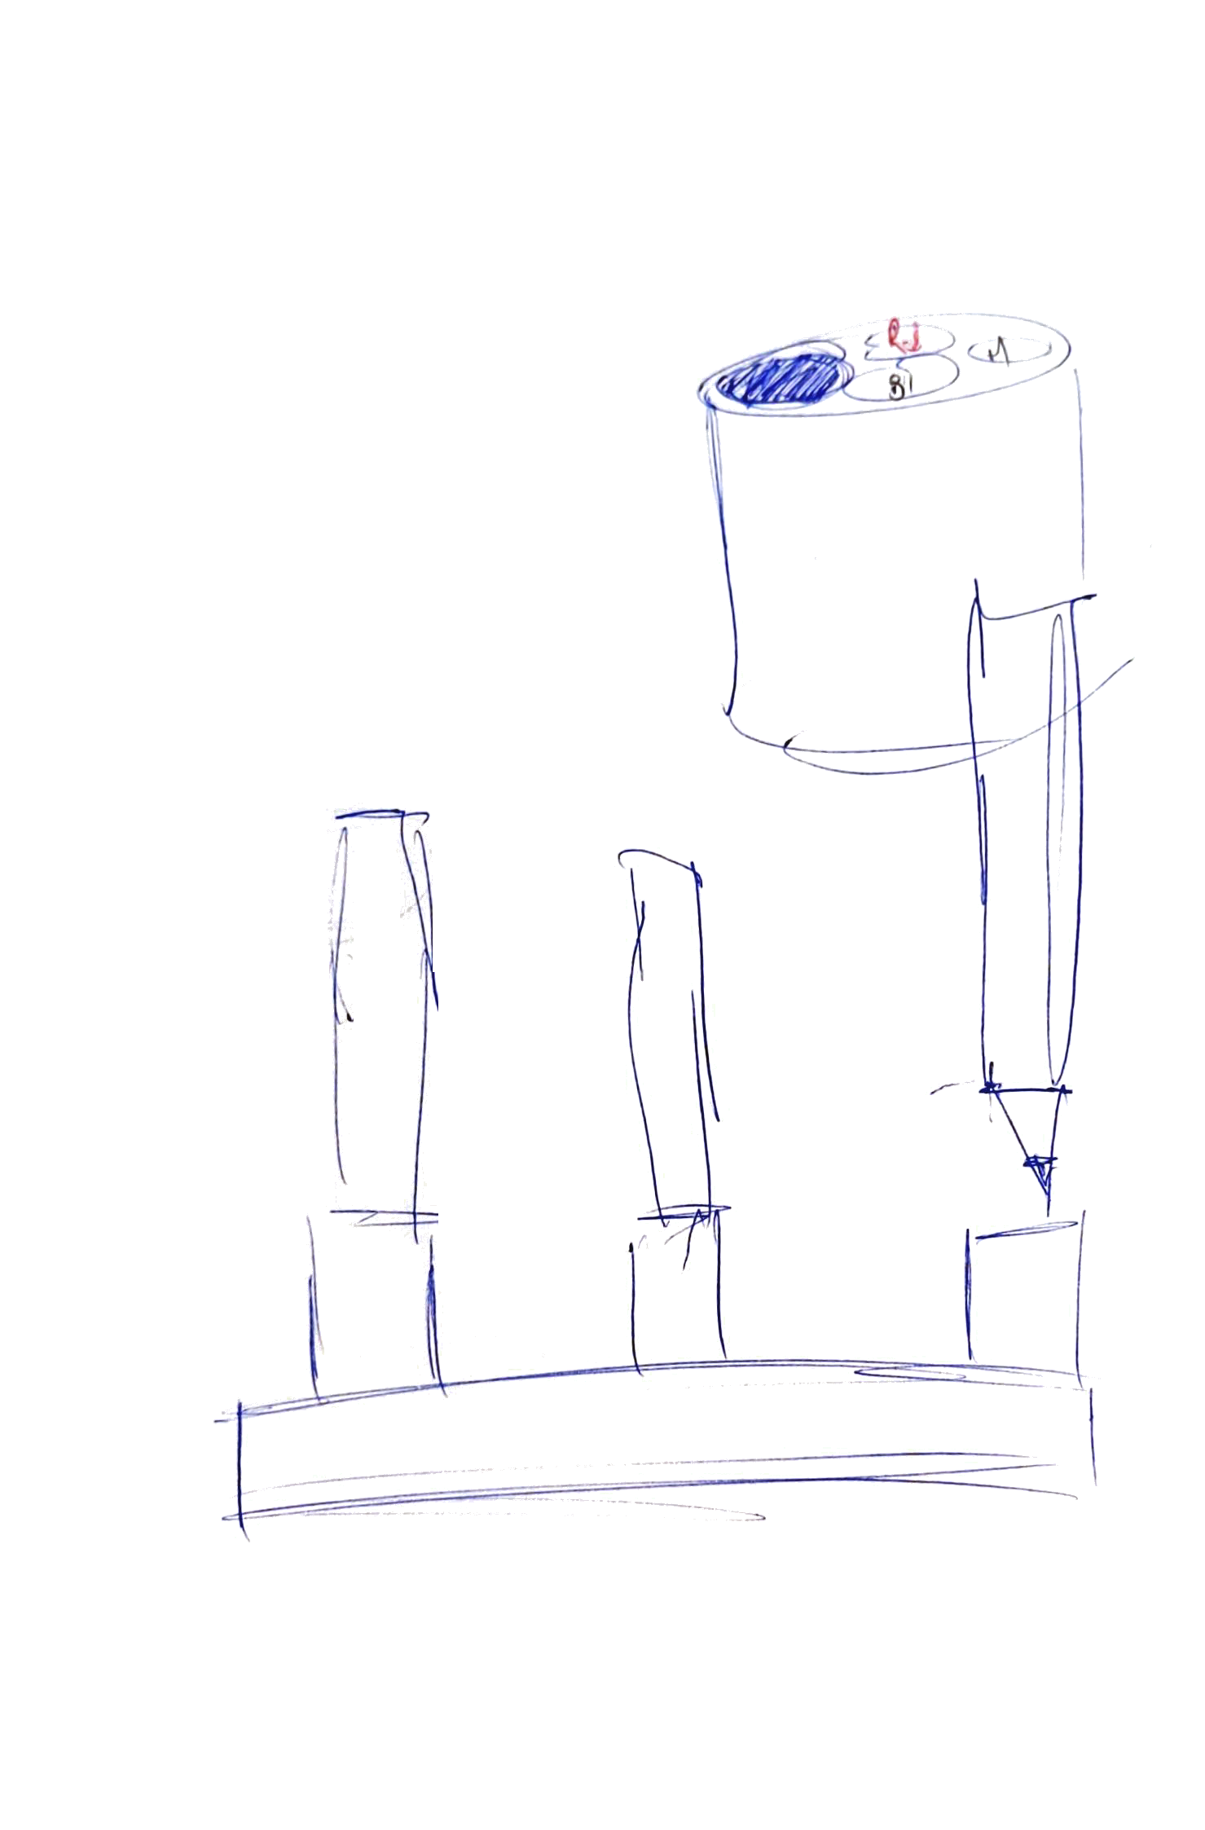

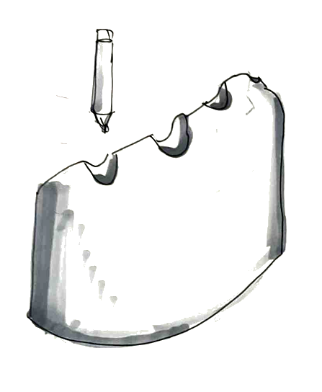
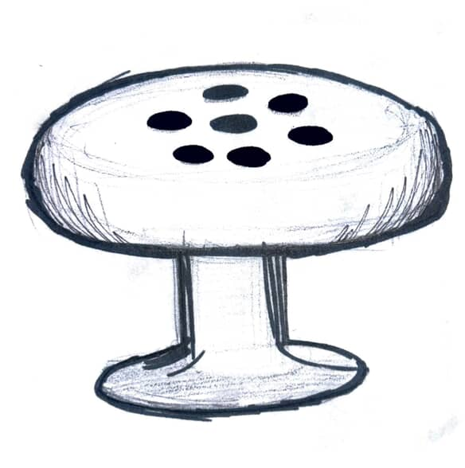
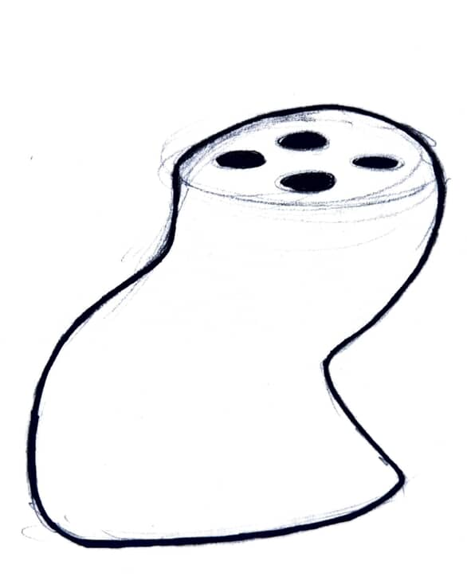
Rapid Ideation

Slide 4
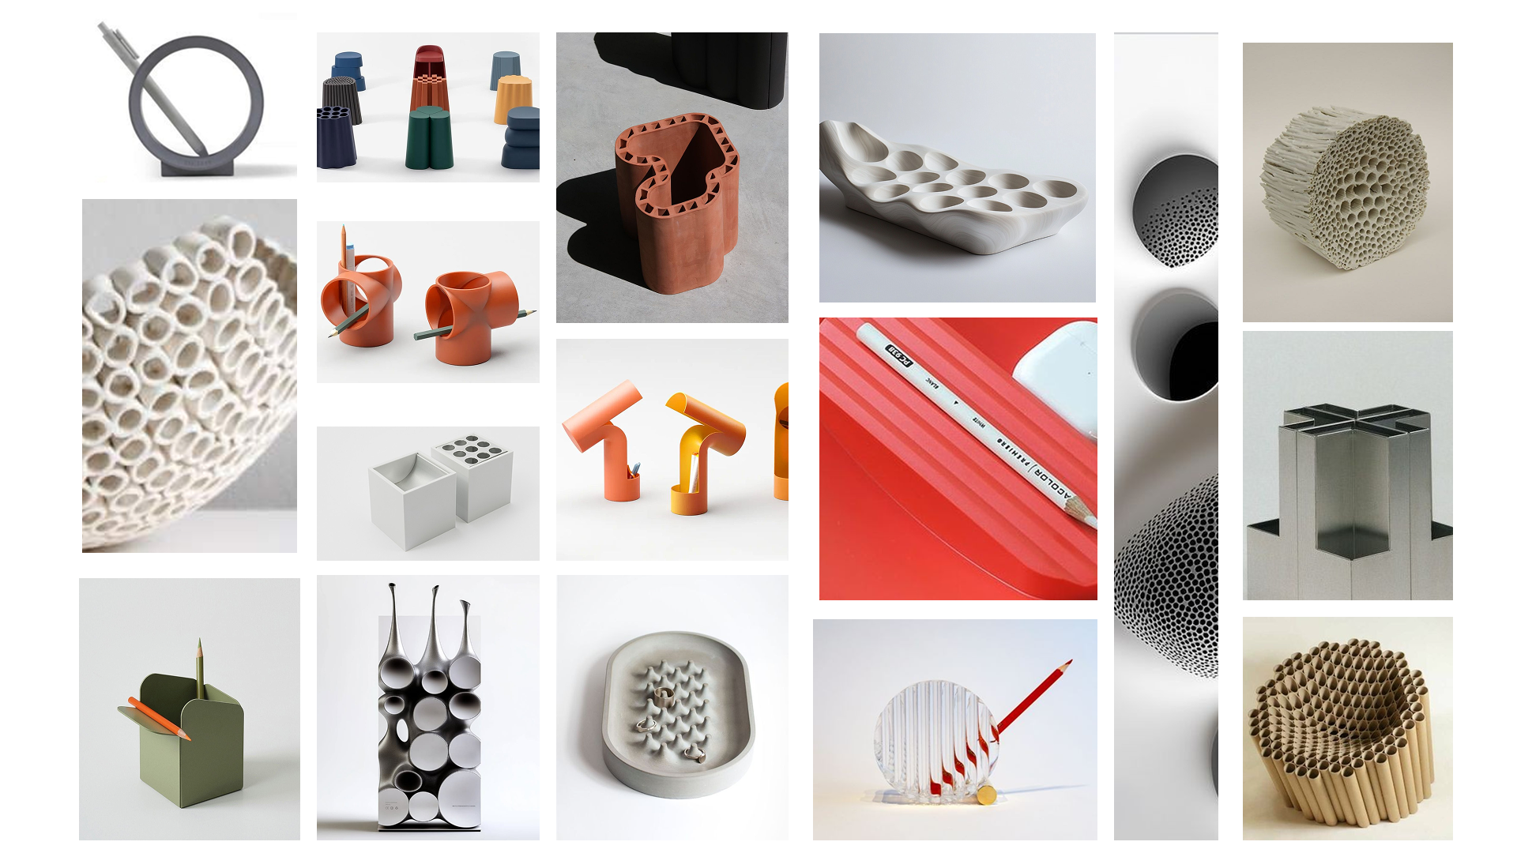
MOOD BOARD

Slide 5
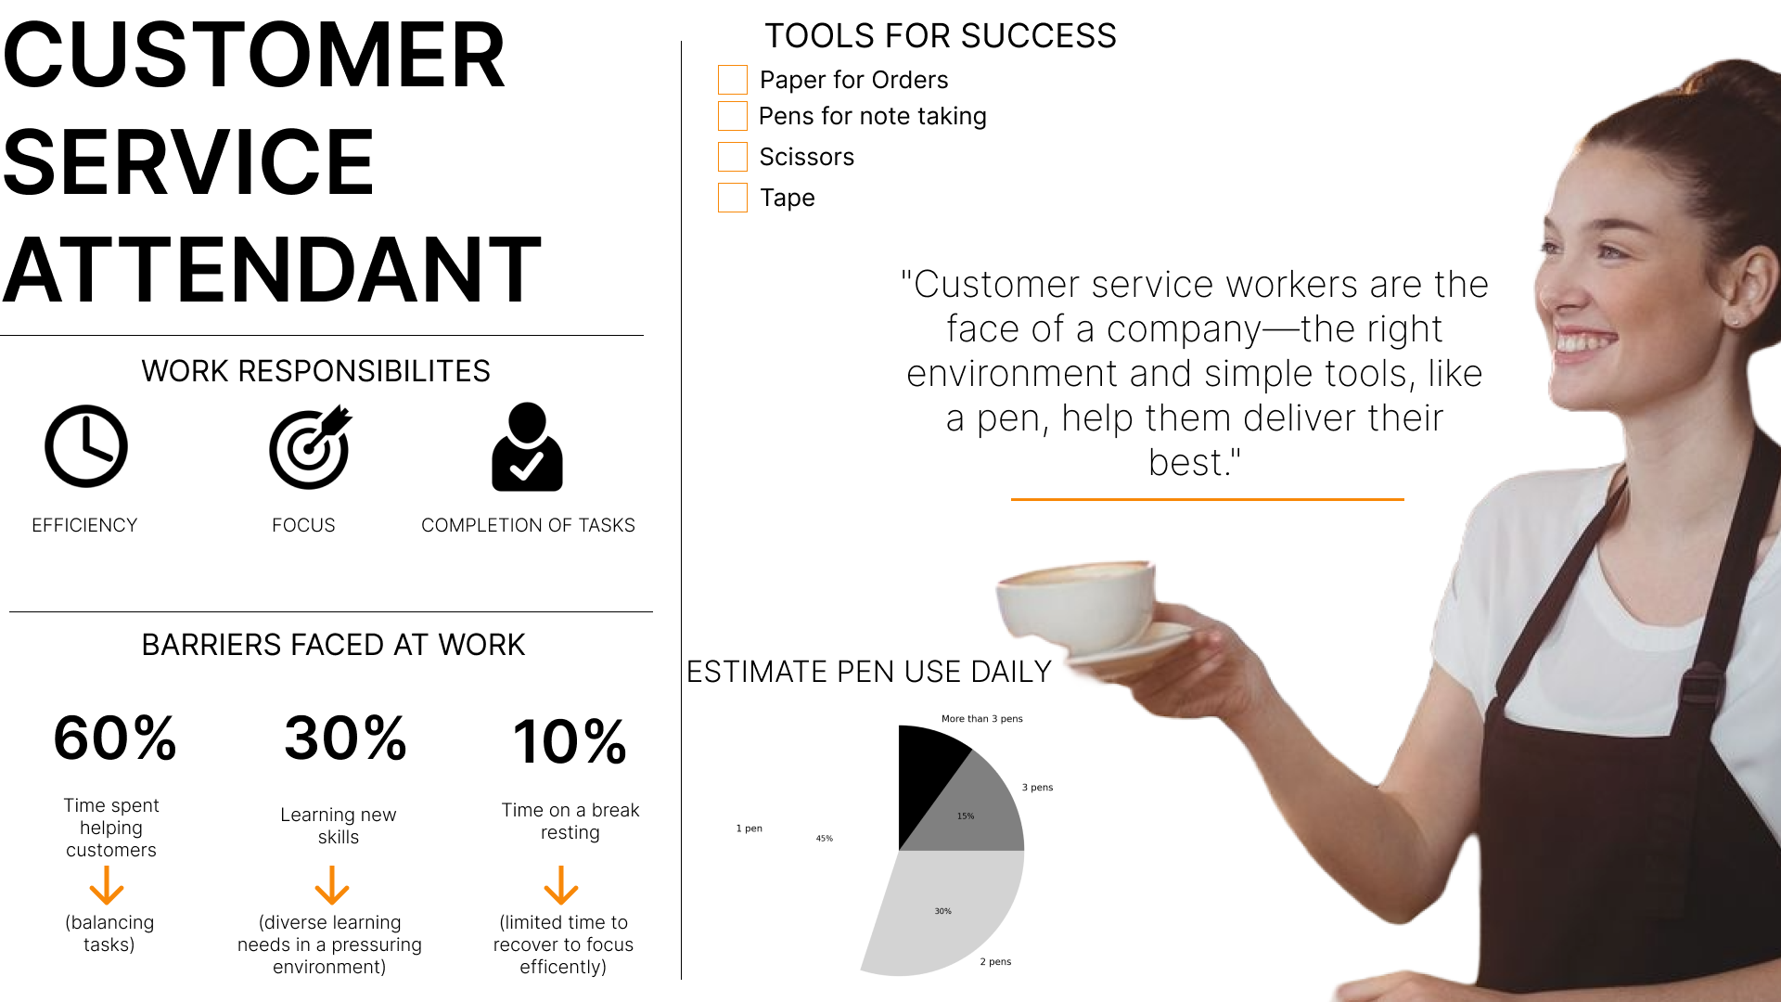

Slide 6
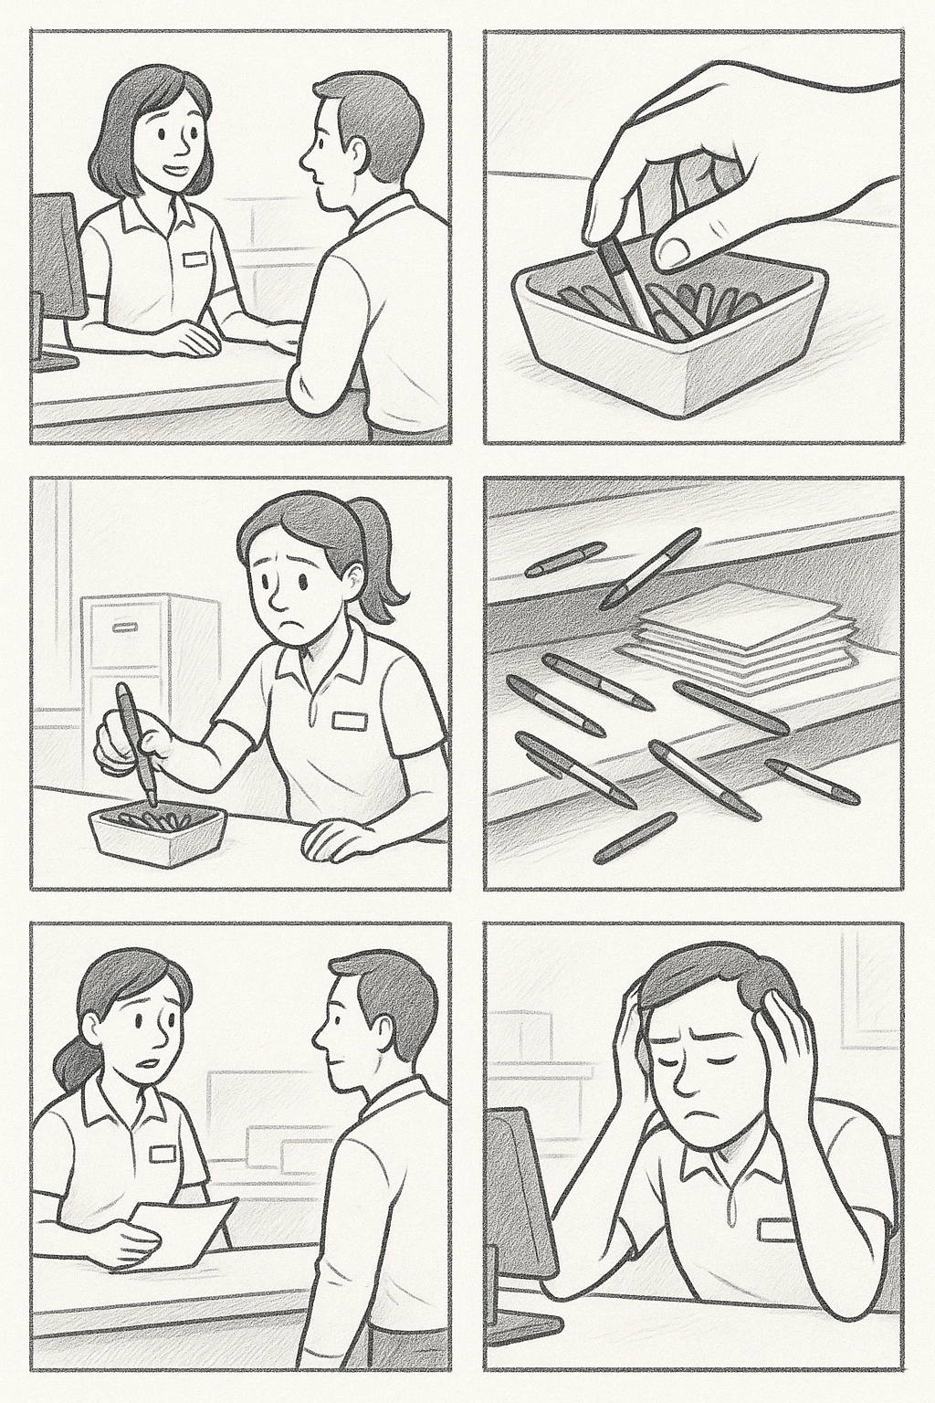
KEY USER PAIN POINTS
Balancing customer expectations and work performance
Sourcing the product with enough efficiency
Accessibility to resources empower the user
Reliability to share resources effectively for diverse needs
The user journey graphic was made using Generative AI, given original prompts and edited to communicate a human message.

Slide 7
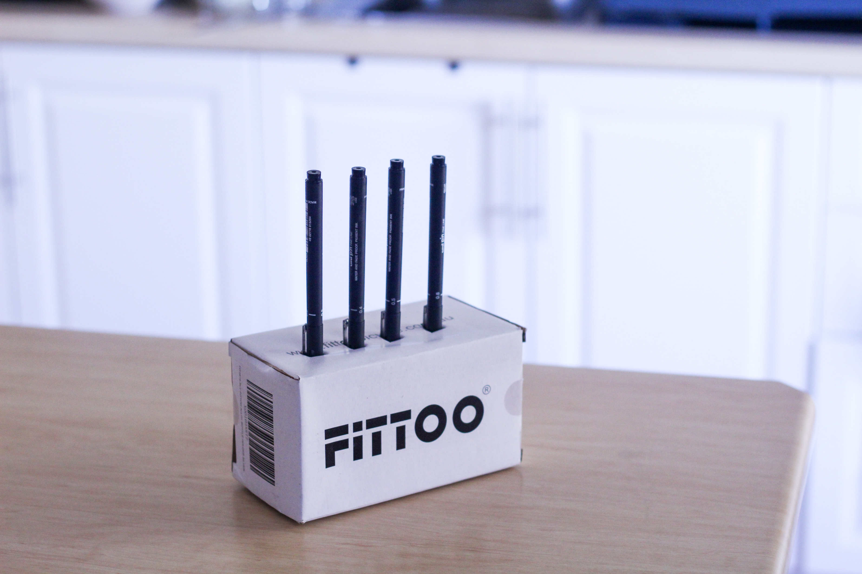
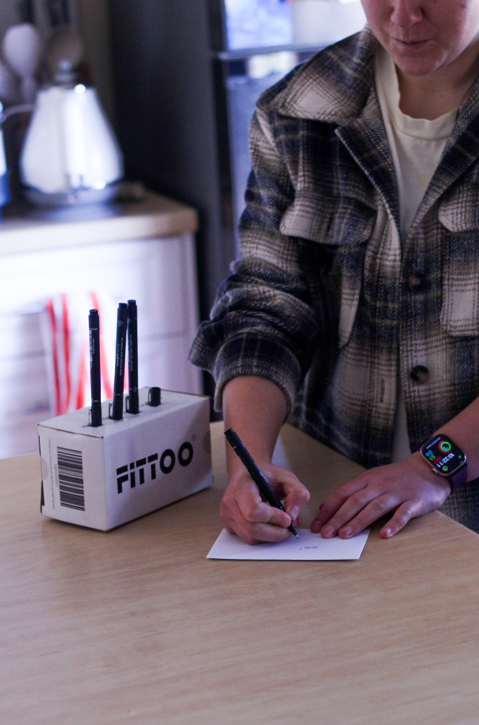
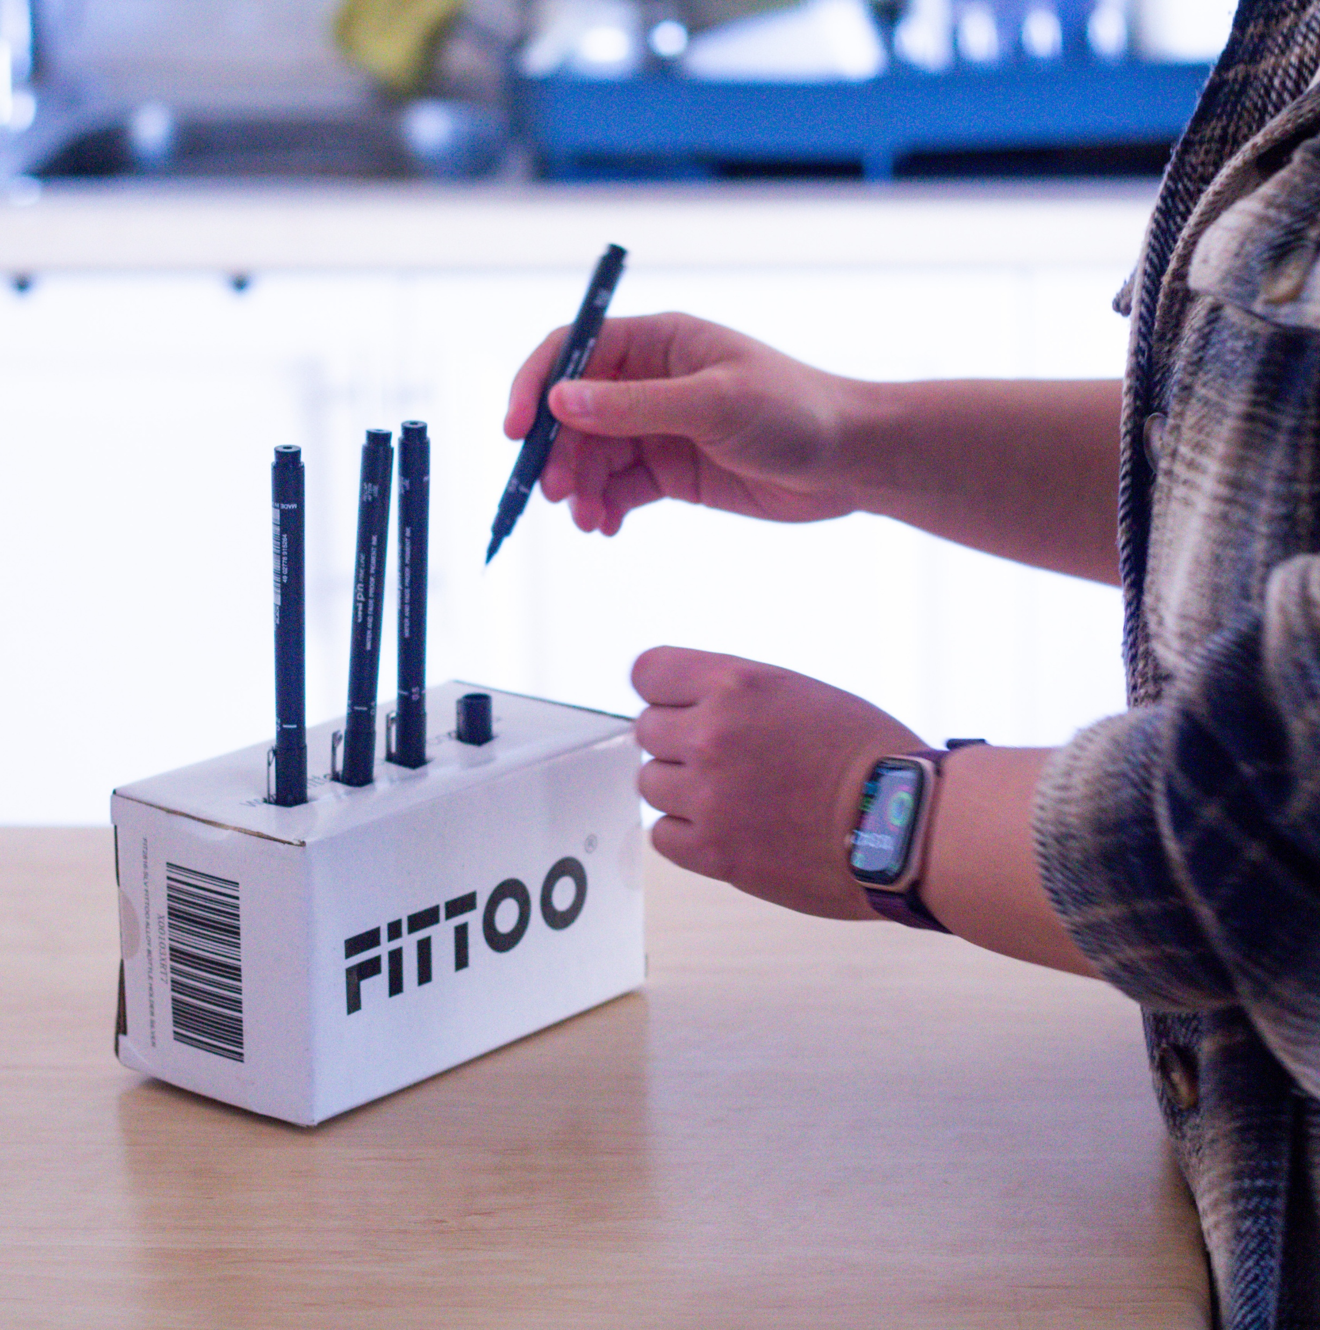
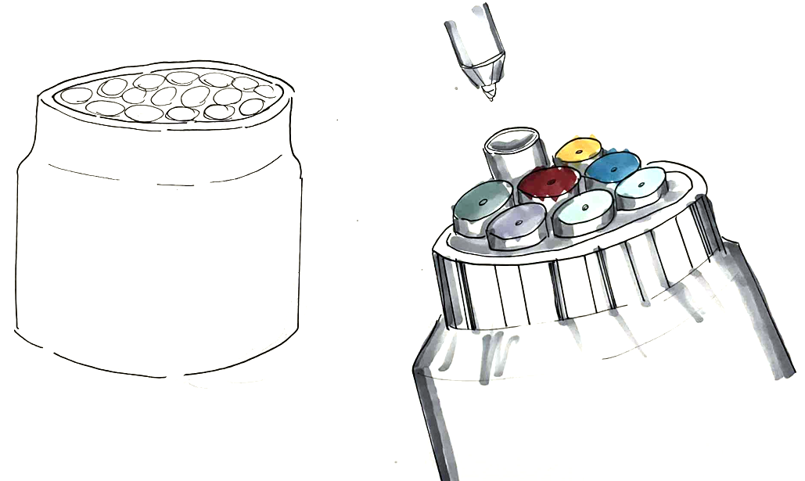
Iteration

Slide 8
Sketch Model Testing
“I like the idea, its just a bit boxy
Miriam
“It looks a bit weird and kind of angry with all the pens sticking out. Otherwise cool.”
- Peter

Slide 9
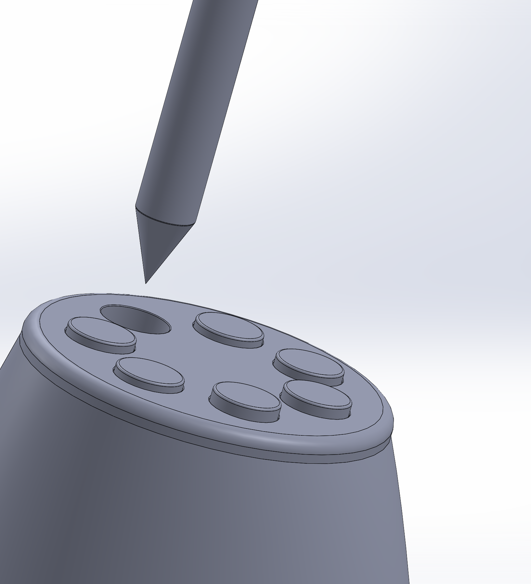
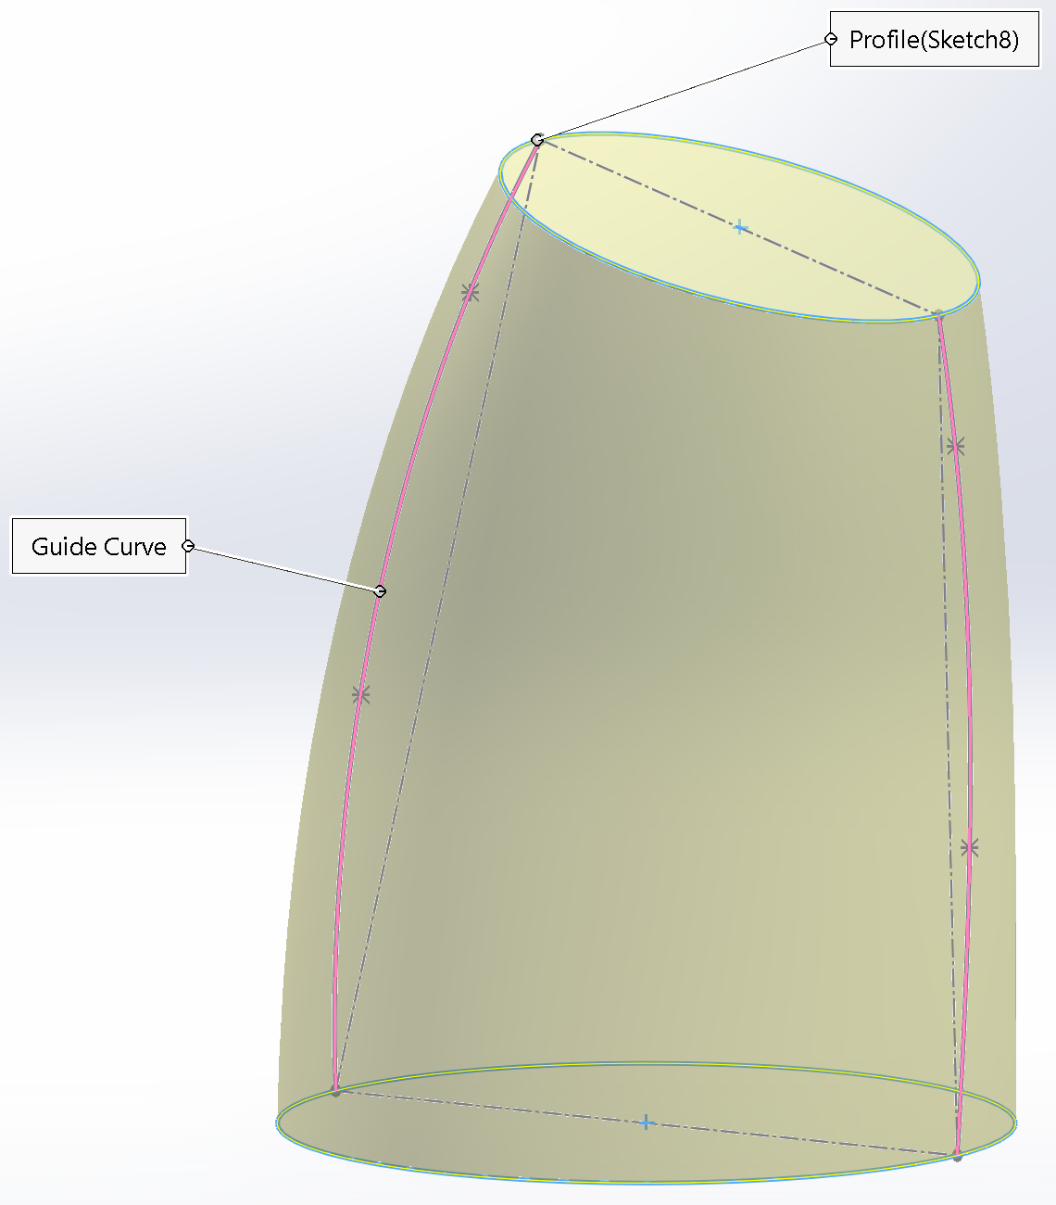
Cad Workflow
Press on pens to release spring loaded mechanism

Slide 10
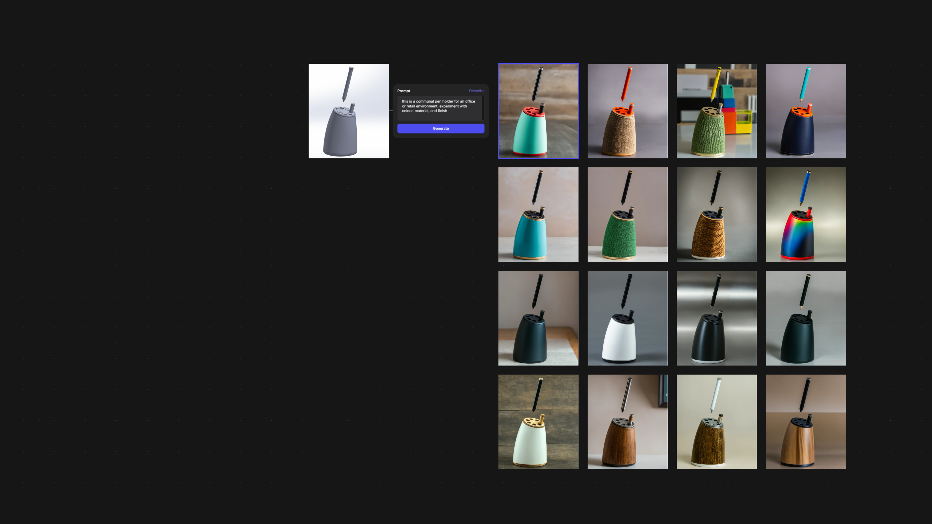
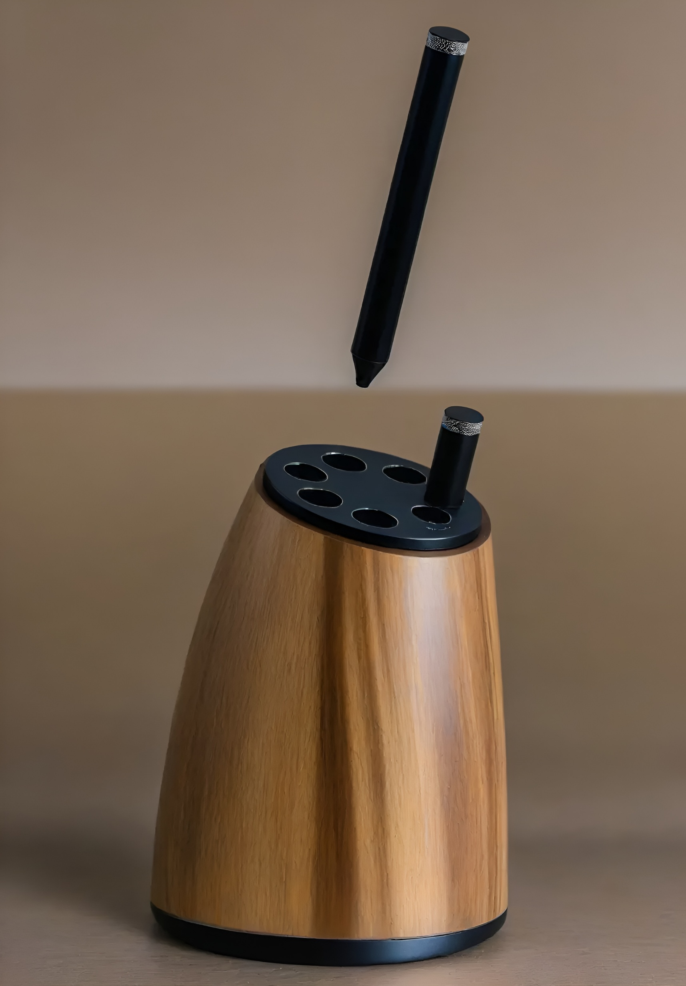
CMF Exploration - Vizcom
Vizcom is a tool that enables designers to rapidly generate high quality outputs using generative AI, while keeping the user in control.

Slide 11
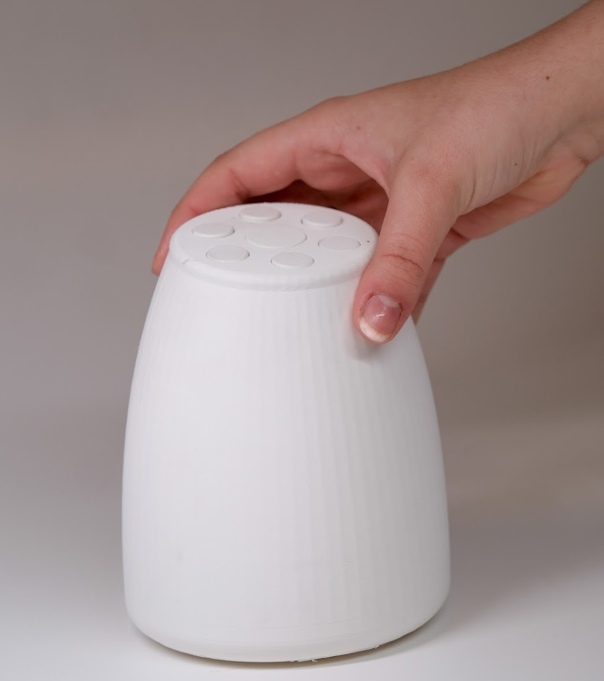

Presentation Model

Slide 12
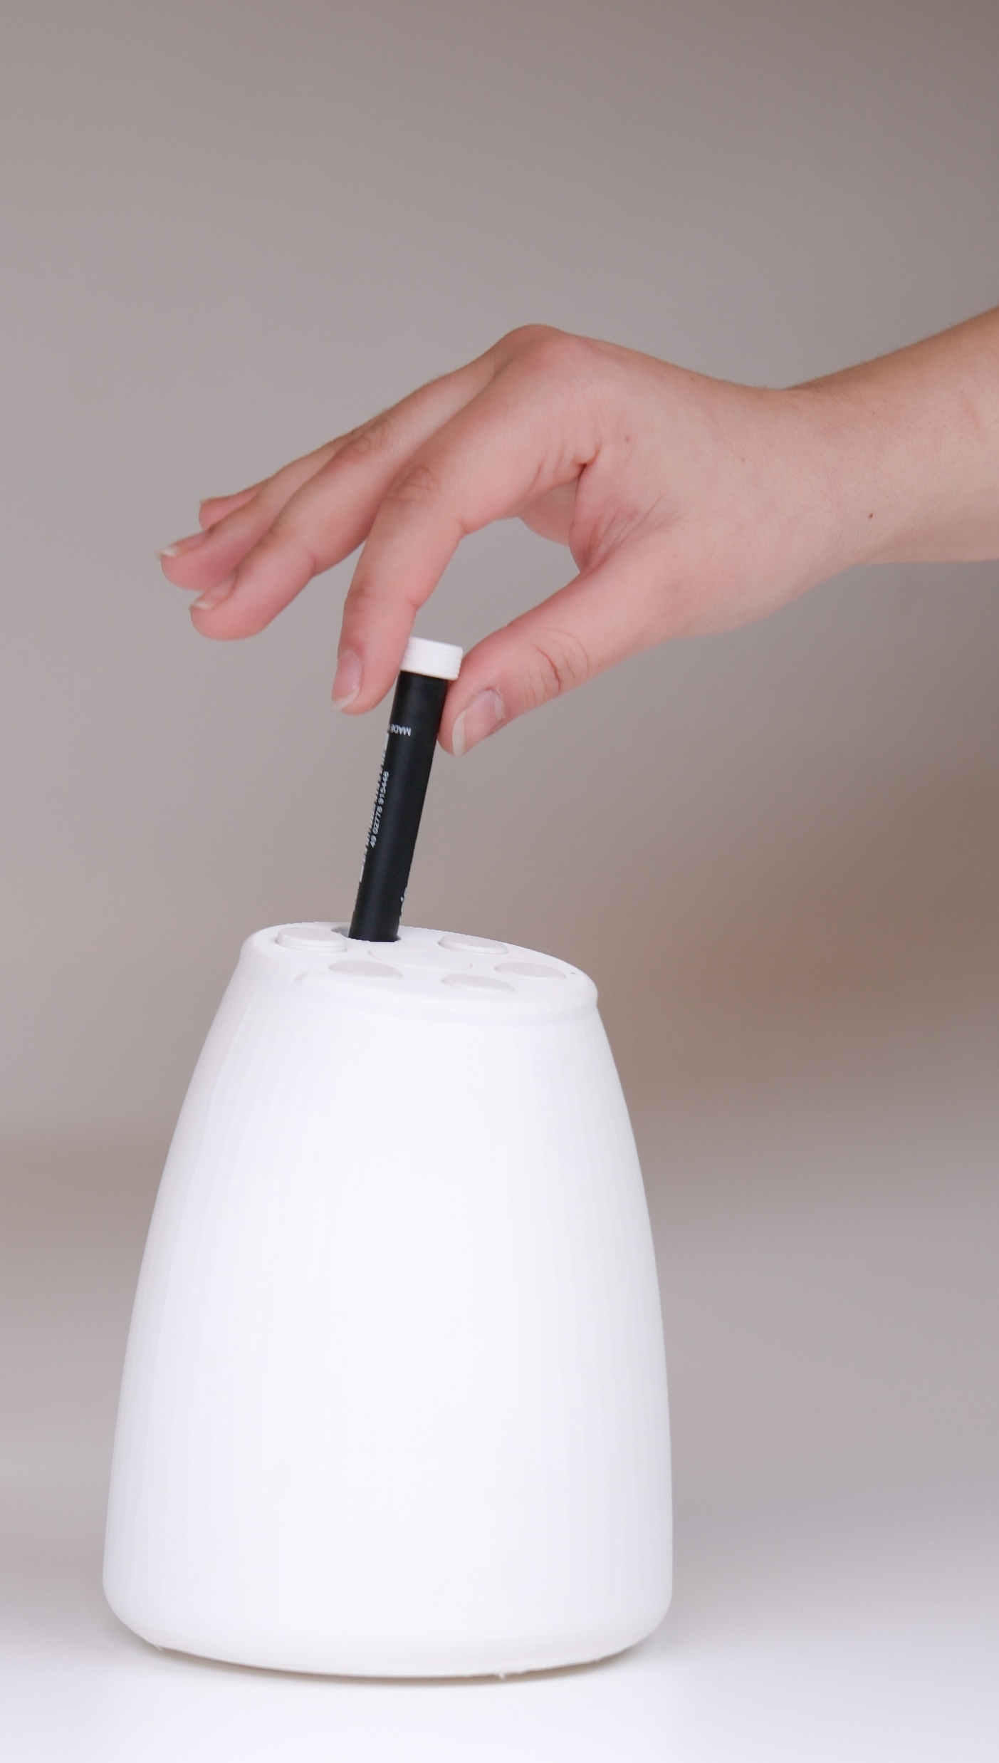
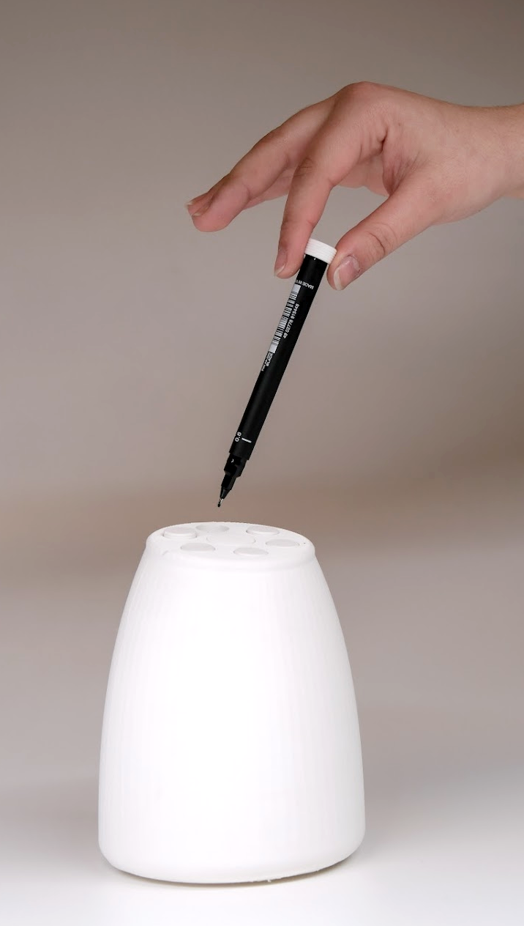

Functionality Demonstration

Slide 13
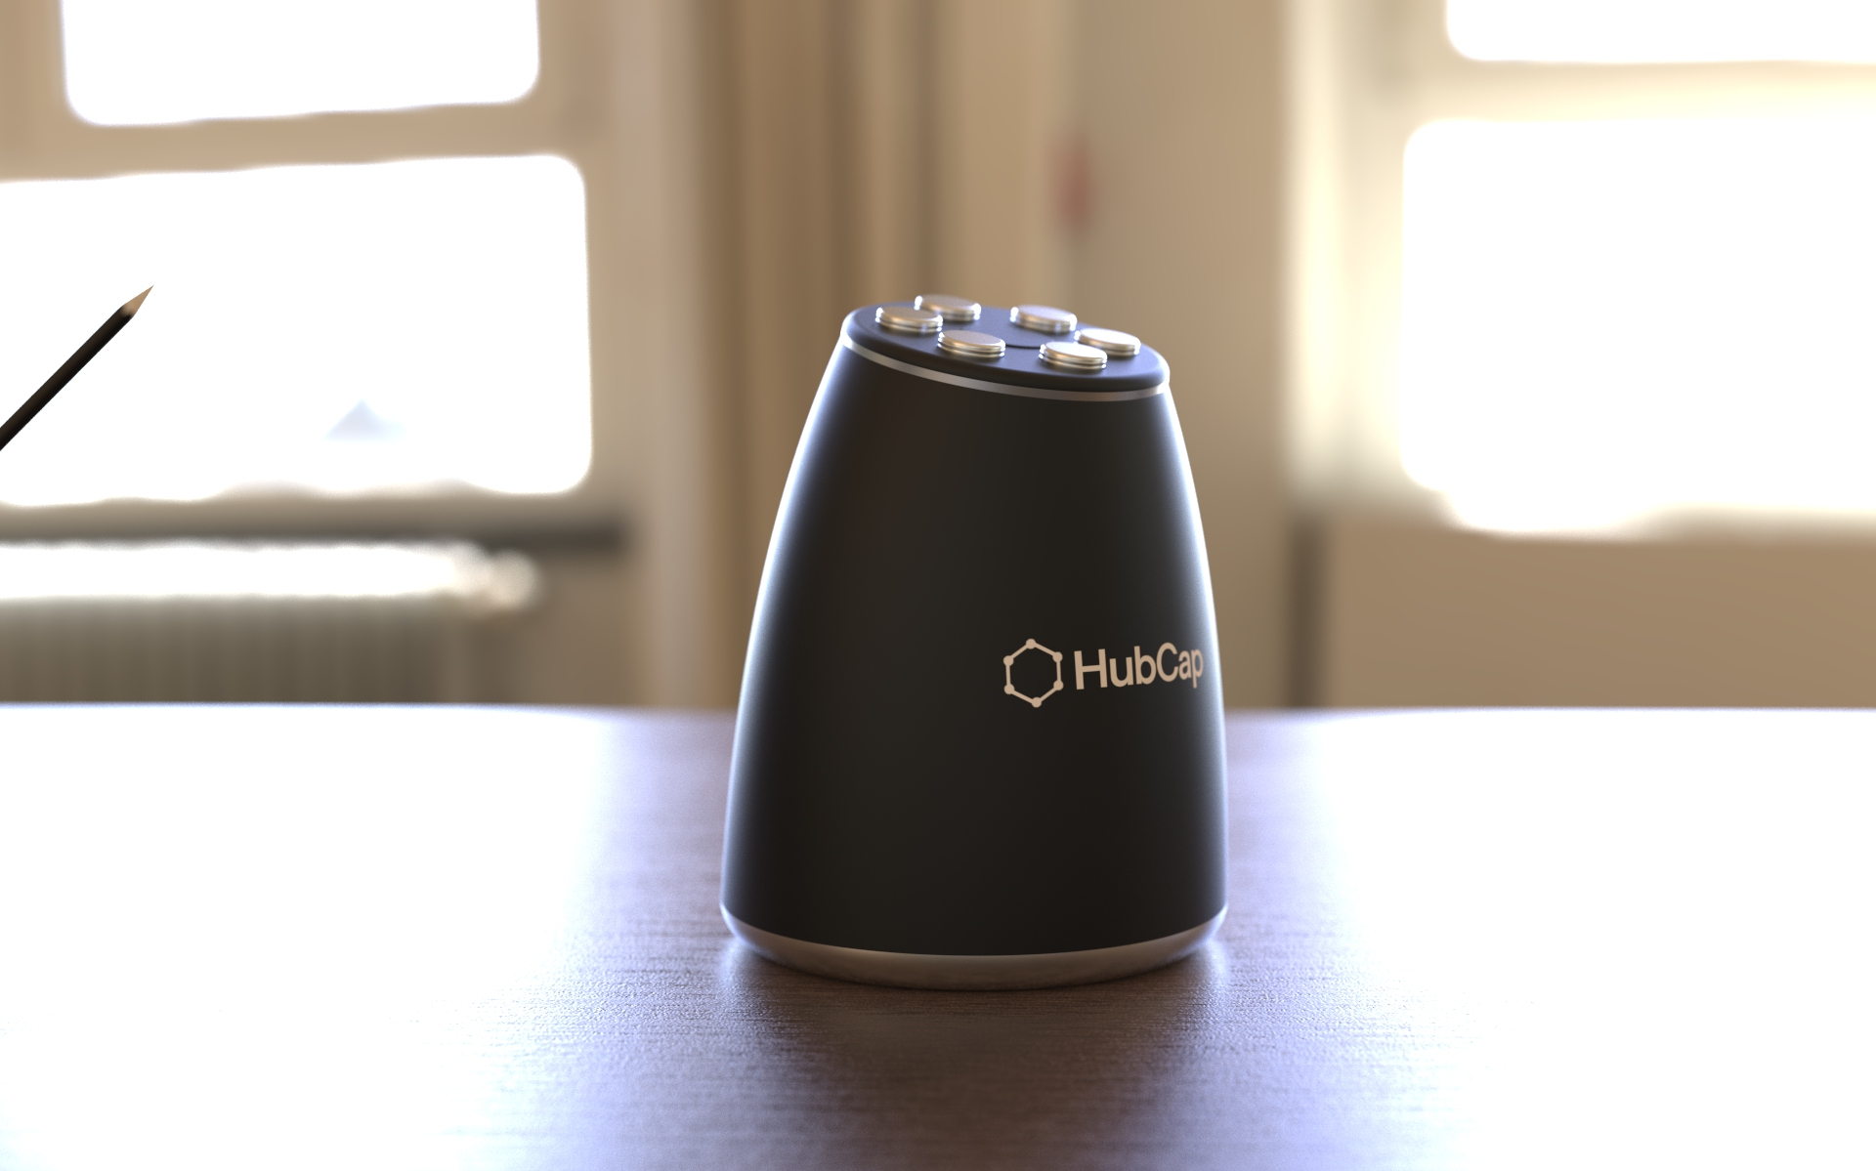

Slide 14
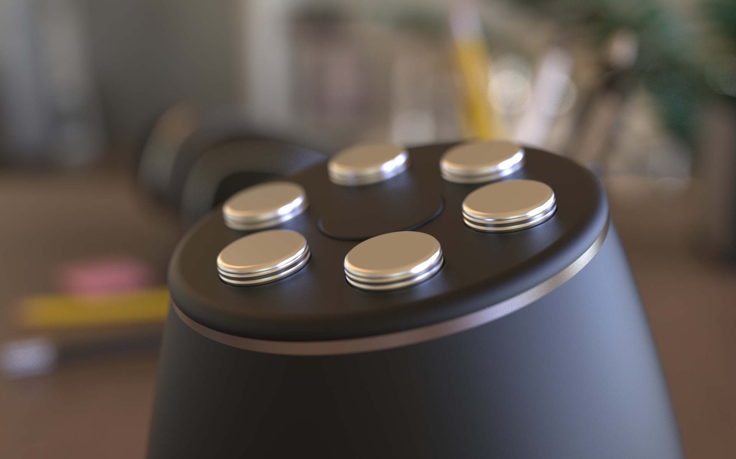
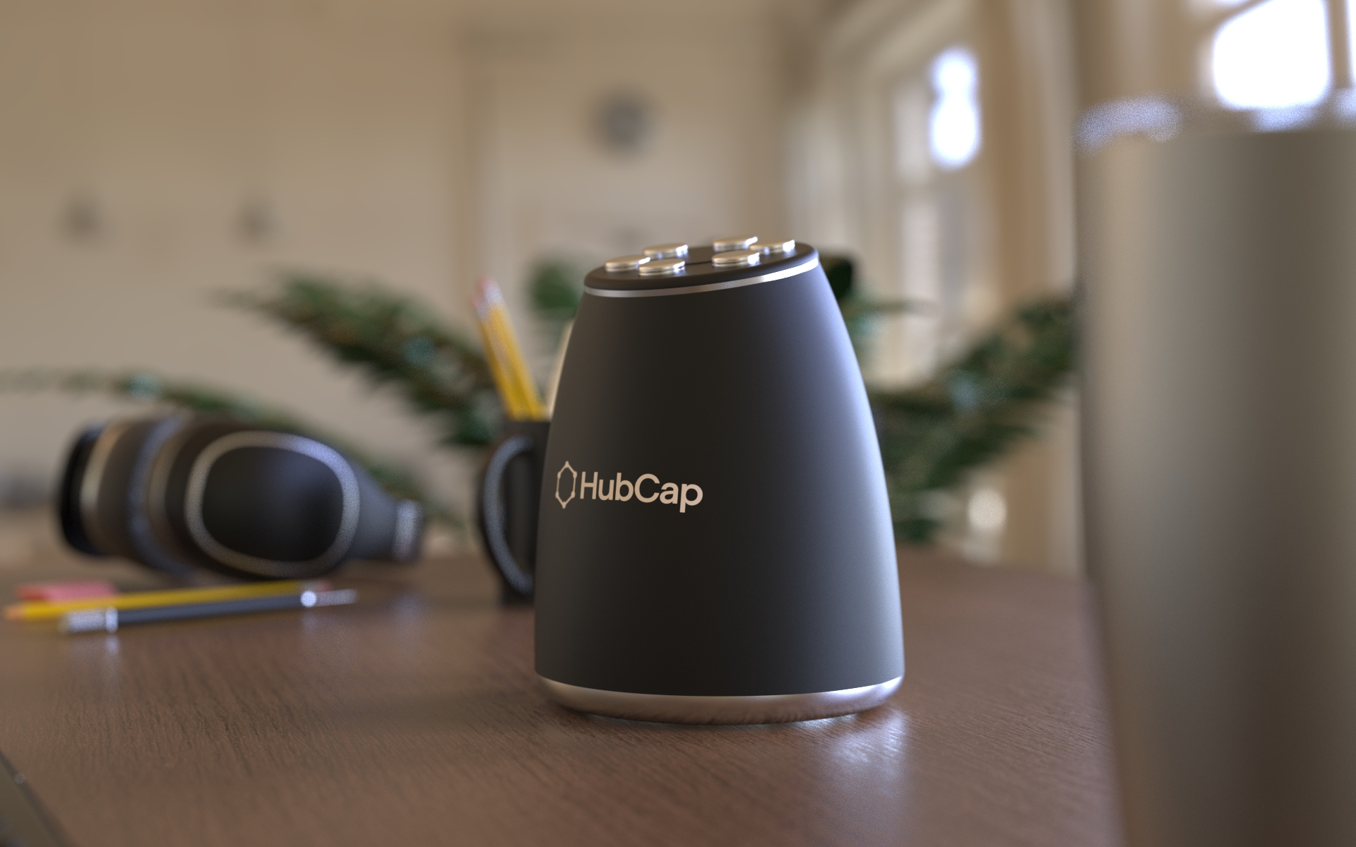

Slide 15
Textured Stainless Steel

Slide 17
Powder coated Finish

Slide 18
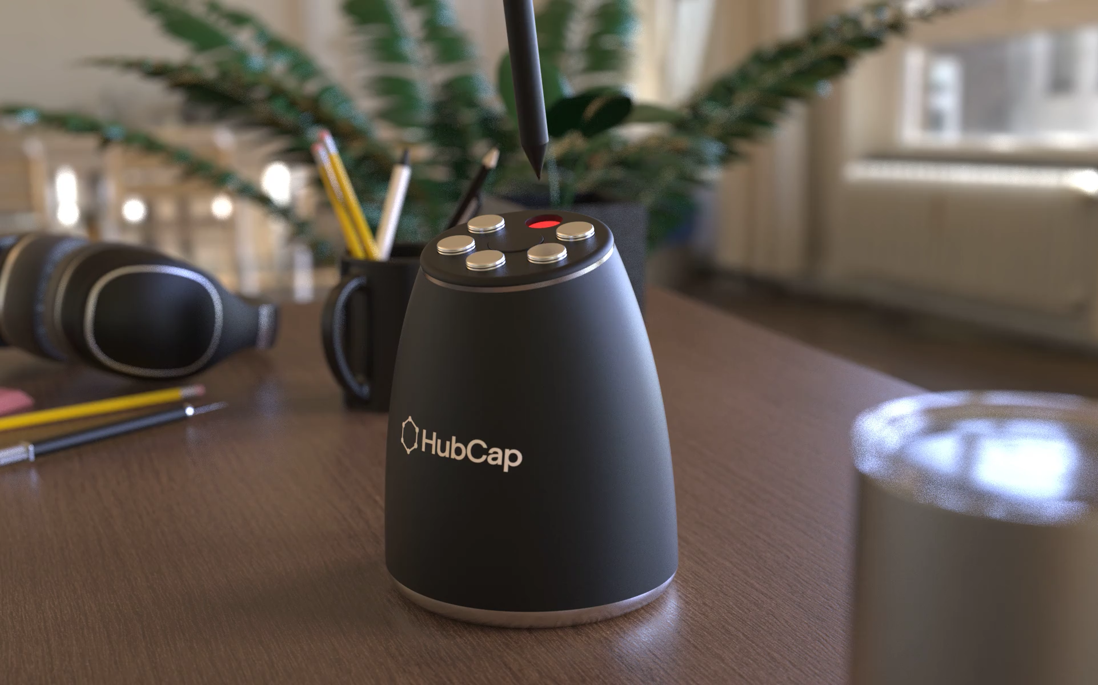

Slide 19
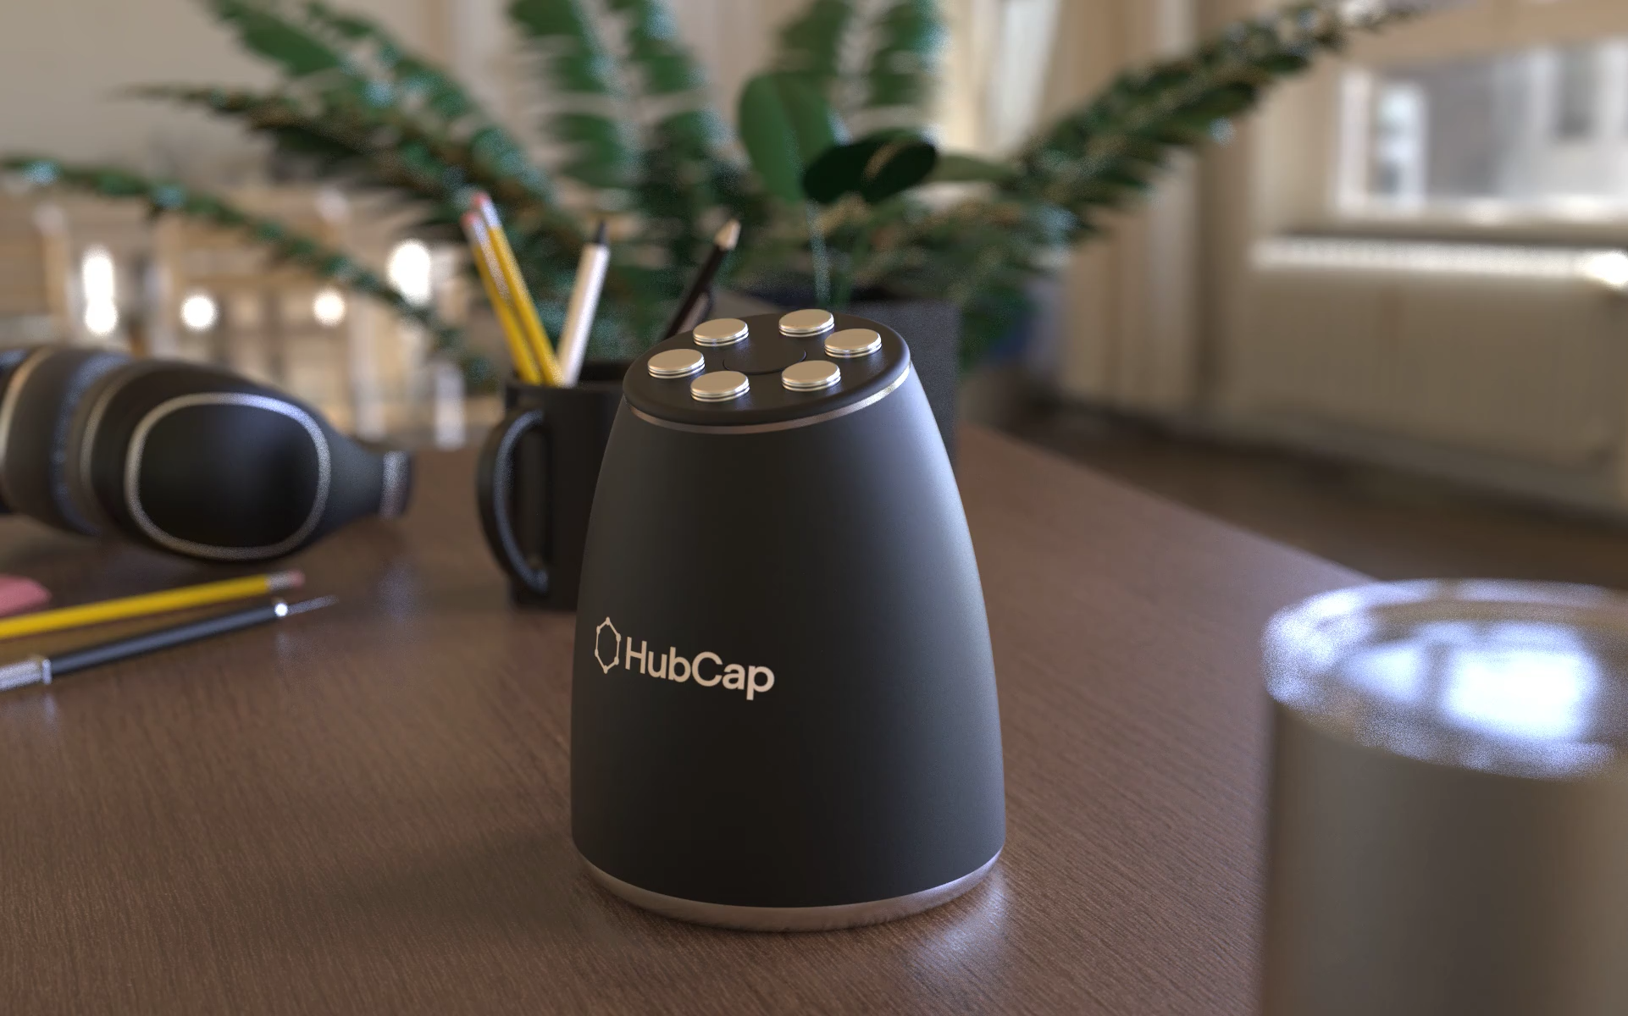

Slide 20
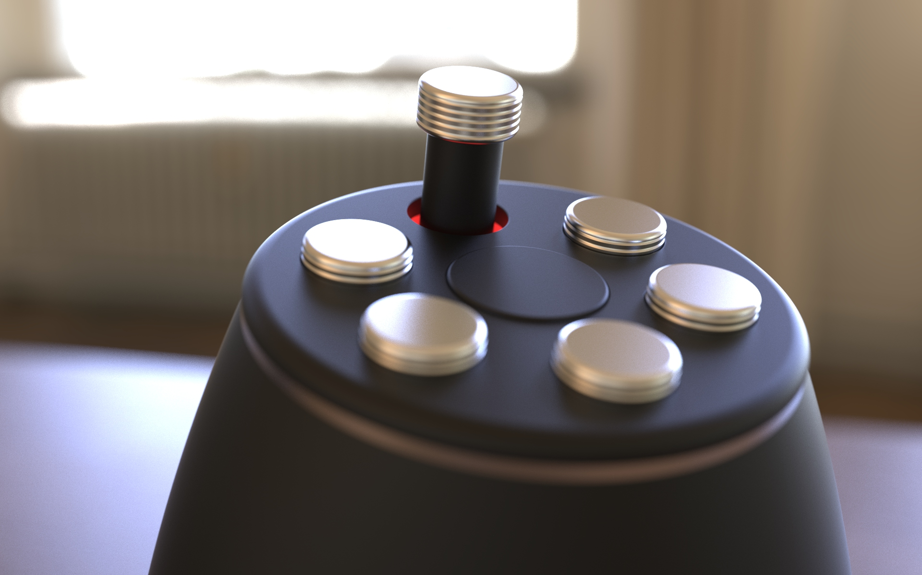

Slide 21
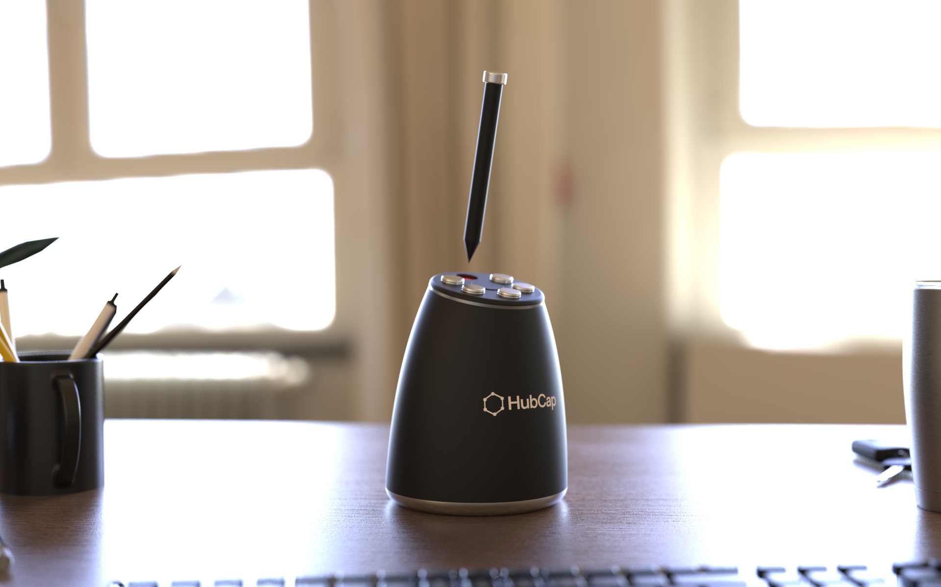

Slide 22

Thanks.

