Slide 1
Technology
Roadmap
Template

Slide 2
Creating a Technology Roadmap

Slide 3
Aligning Technology Roadmap with Business Mission
Effective technology strategies are those that are in harmony with the core mission of the business, driving impactful and meaningful progress.
Understanding Your Business Mission: Briefly define what a business mission is and
emphasize the importance of having a clear mission statement.
The Role of Technology in Achieving Business Goals: Discuss how technology is not just a
support function but a strategic tool that can help achieve broader business objectives.
Alignment for Impact: Explain how aligning the technology roadmap with the business
mission ensures that technology initiatives directly contribute to the desired impact.
Examples of Alignment: Provide a couple of examples where technology alignment with
business mission has led to significant advancements or success.

Slide 4



Establishing Guiding Principles for Your Technology Roadmap
Examples of a Few Guiding Principles
Guiding principles serve as the compass for your technology roadmap, ensuring that every step taken is in the right direction.
Principle 1: User-Centric Design
Prioritizing the needs and experiences of end-users in all technological developments
What are Guiding Principles?
Foundational beliefs and values that steer technology decisions, ensuring alignment with business vision and goals.
Use as a decision-making compass, setting clear criteria for prioritizing technology initiatives based on alignment with organizational objectives.
Principle 2: Scalability & Flexibility
Ensuring that the technology can grow and adapt with the business, accommodating future change.
Importance of Guiding Principles
Strategic Alignment: Guiding principles align technology initiatives with the organizational mission and strategic goals.
Consistent Decision-Making: They offer a clear framework for prioritizing projects in line with long-term business objectives.
Tailoring your Principles
Principle 3: Security & Compliance
Customized principles embody an organization's specific goals, culture, and operational context, ensuring relevance and effectiveness.
Tailored principles resonate more with team members, fostering a sense of ownership and alignment with organizational values and objectives.
Upholding the highest standards of data security and regulatory compliance in every technological implementation.

Slide 5
Fidelity & Timeframes in Technology Roadmap Planning
Fidelity in roadmap design is based upon the concept that you have better precision, more detail and better commitments to projects, especially in the near term. Over time, fidelity generally decreases to allow flexibility for adapting to changes and new information.
When thinking through timeframes we want to scope up to a two-year picture as any longer will be influenced by events (economic, organization, etc.). The following are a recommended start:
Short Term (0-6 months)
Near Term (6-12 months)
Long Term (12-24 months)
Short to Near Term Focus:
Flexibility in Long Term:
Emphasize the importance of focusing on the short to near term for detailed planning, as these periods are more predictable and manageable.
Highlight how long-term goals and priorities are subject to change due to various factors like market trends, technological advancements, and organizational shifts. Therefore, long-term planning should be more flexible and revisited regularly.

Slide 6
Roadmap Structure & Initiatives

Slide 7
Roadmap Structure
The projects on the roadmap are broken into five major categories, each containing sub-activities which will be outlined in the following slides.
  Cloud Selection Process
  DB Setup / Procured
  User Tooling
  Security
  Design Data Pipelines
  Build Phase 1 Sources
  Build Phase 2 Sources
  Design ML Ops
  Build ML Ops
  Build vs. Buy Analysis
  Procurement
  Product Design and Build
  Product Rollout and Launch
  ID / Hire Analytic Thought Leader
  Empower / Enable Data Analyst
  Build Operations Data Team
  Advanced Analytics Use Case Prioritization
Infrastructure
Data
Software
Resourcing
Delivery Management
  Provide project governance and management across projects and initiatives

Slide 8
One Year Roadmap
Q1 2025
Q2 2025
Q3 2025
Q4 2025
($XXX-$XXX)
($XXX-$XXX)
($XXX-$XXX)
($XXX-$XXX)
Client Led Project
Partner Led Project
Project Dependency
IF 1
  Cloud Selection Process
IF 2
DB Setup / Procured
IF 3
  User Tooling
Infrastructure
Software
Talent
Data Governance
Delivery Management
IF 4
  Security
DA 1
  Design Data Pipelines
DA 2
Ne business
  Build Phase 1 Sources
DA 3
  Build Phase 2 Sources
DA 4
DA 5
  Design ML Ops
  Build ML Ops
RE 1
  ID / Hire Analytic Thought Leader
RE 2
  Empower / Enable Data Analyst
RE 3
  Build Operations Data Team
RE 4
  Advanced Analytics Use Case Prioritization
SW 1
  Build vs. Buy Analysis
SW 2
  Procure Services
SW 3
  Product Design and Build
SW 4
  Product Rollout and Launch
DM1
  Provide project governance and management across projects and initiatives

Slide 9
Data Initiative 3: Build Phase 2 Sources
DA 3
Quick Win
Accessing existing data stored in S3 will allow for accelerated pipeline development as an initial step is already completed.
Team Thoughts
Estimated Cost
$X - $Y
1
One Senior Consultant
1
One Consultant
Start: Q3-2025
SUMMARY
Deploy Databricks to “Client” leveraging existing AWS S3 assets. Provide a unified Data Lakehouse environment to expose data throughout the organization to speed development of analytic products.
Databricks provides an industry leading data platform as a service. Leveraging already owned cloud data storage, it provides organizations with compute resources and a powerful suite of tools to enable data analytics in a collaborative environment.
The initial goals will be to develop necessary frameworks and support structure to facilitate security and operations in Databricks and expose the data assets produced by the “Client” project.
2-4 Weeks: Procure and deploy Databricks on clients AWS instance
6-10 Weeks: Work under client guidance to build workflows and frameworks to support ongoing operations and compliance needs
8-12 Weeks: Develop views to the “Client” data modeled after views available in the Data Mart
Improved tooling that creates leverage and reduces support efforts
Platform that supports broad integration of data
Enables machine learning and other advanced analytics
DESCRIPTION
TASKS
Concurrent Activities
BENEFITS / CAPABILITIES

Slide 10
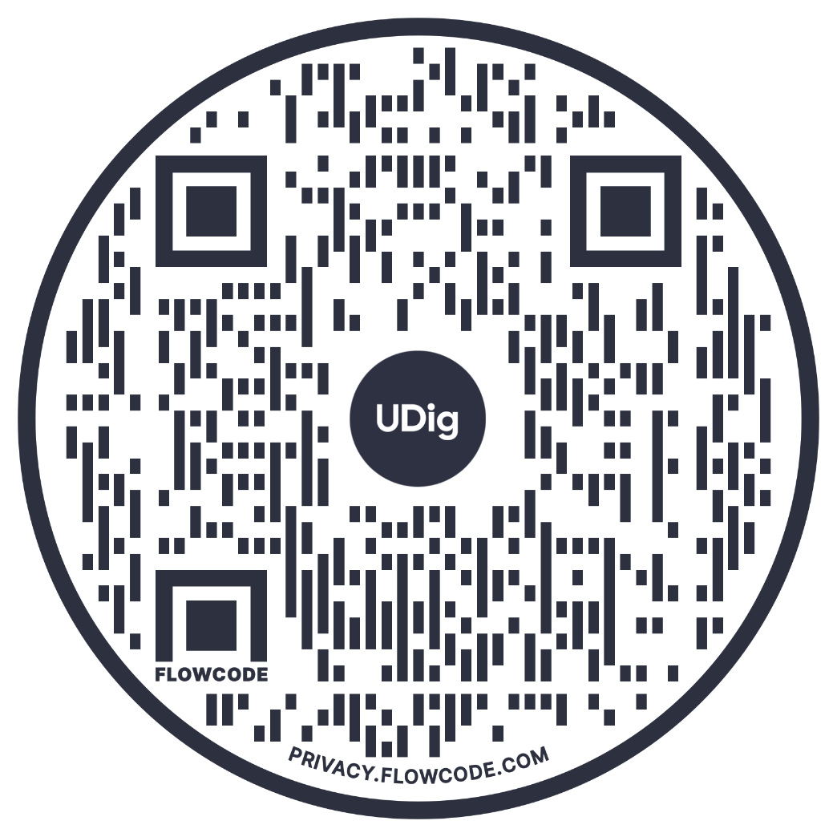
Partner with UDig
to Create Your Technology Strategy
Building a winning tech roadmap doesn’t have to be a daunting, painstaking process. Contact us and let our technology strategists help you identify the best path forward for your business.
Let's Talk

