Slide 1








The Squeeze' IN

Slide 2

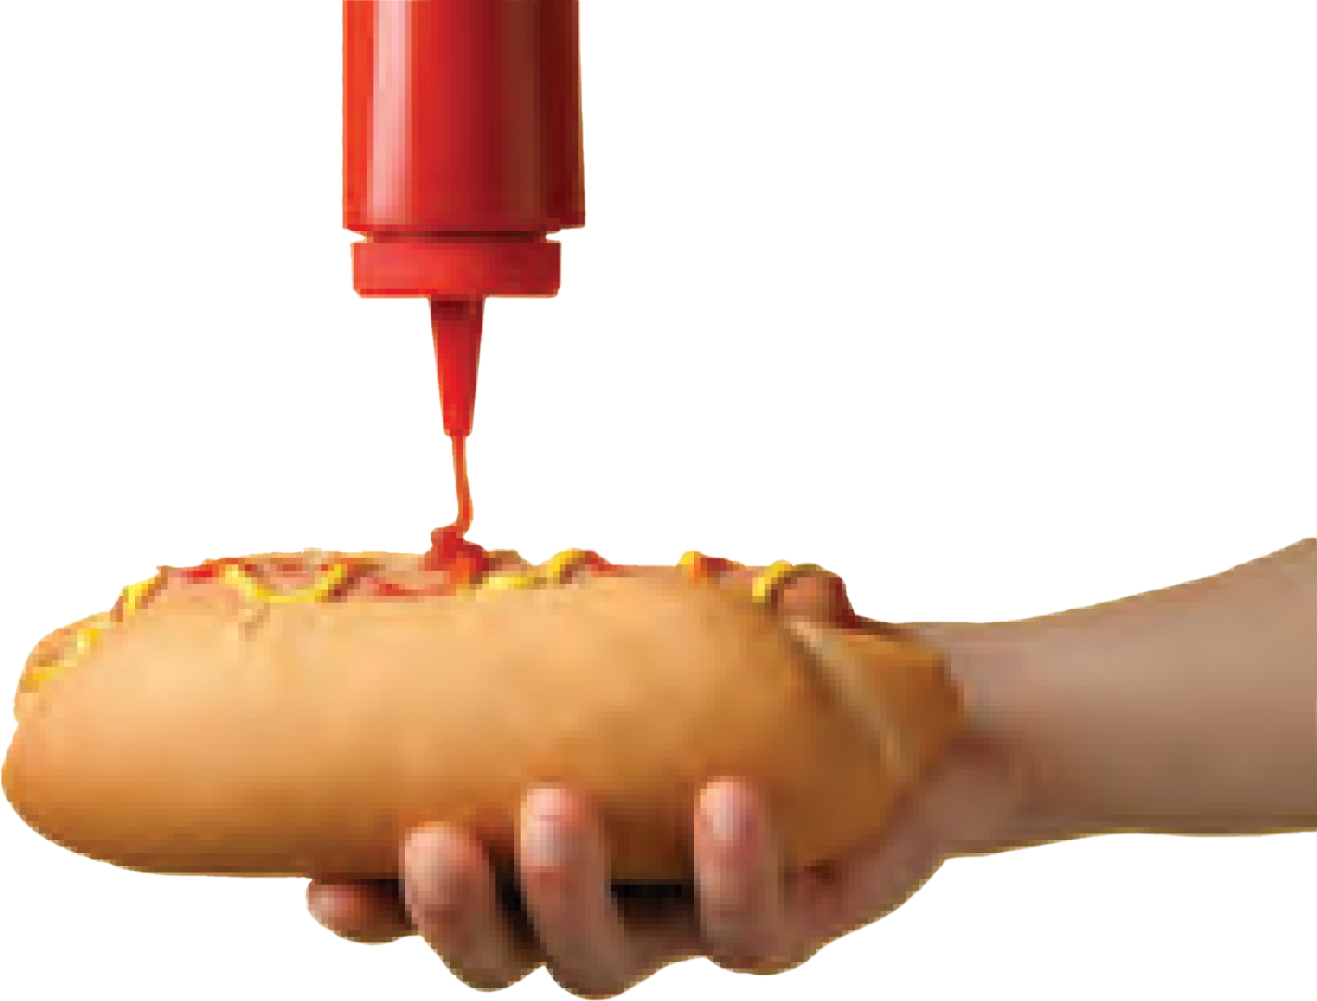




Why
Squeeze' in?
Customer
Reviews
Jarrett L.
I grew up going to the Squeeze-in. The hotdogs are incredible. The toppings are delicious. Ask for a hotdog with everything. You will get a hotdog with ketchup, mustard, relish and onions. It's a winning combination!
The Squeeze-In in Sunbury has been helping hot dog fans satisfy their cravings for more than 65 years.
Nicole D.
I have always loved stopping by for a good squeeze-dog. Now my son and nephews love it too!
The popular hot dog joint serves six types of dogs, which pretty much guarantees a return visit to try each of them.
Once you Squeeze' In, you will be welcomed by our amazing staff who will meet with your hunger needs!
Richard C.
This is a staple of the Sunbury community. If you are lucky, Angelina will be your server!
Come down to The Squeeze' In today! The best hot dogs in downtown PA!
Craig E.
The place is awesome and it has a great selection of dogs. They were packed so I did not have a chance to do the squeeze. Today was my ªrst visit. I will be back if I ever happen to be around the Danville « Sunbury area again!
Address: 448 1¥2 Market St, Sunbury, PA 17801 Phone #: (570)-863- 2117
Since 1945!
SUNBURY
PA

Slide 3



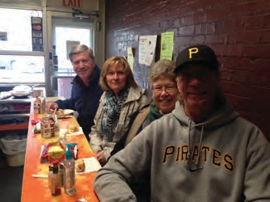
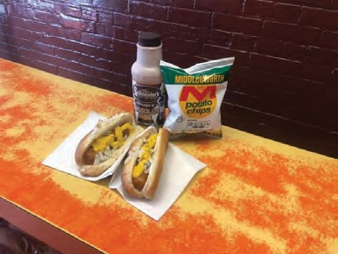

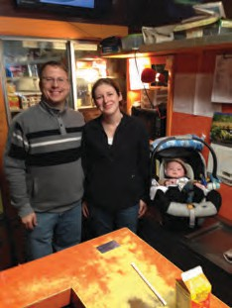
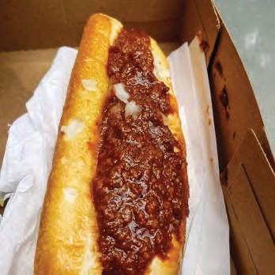
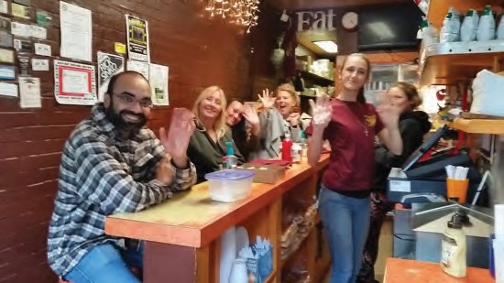











Updated
The Squeeze IN
SUNBURY
PA
HOT DOGS!
Neon light
ABCDEFGHIJKLMNOPQRS TUVWXYZ
1234567890
Stylescape
. Our new and improved stylescape for The Squeeze' In shows various aspects which will describe our newest design
layout!
2023

Slide 4





Mustard
BBQ
Mayonase
Crisp
3C2110
Opacity: 100%
C: 50%
M: 73%
Y: 84%
K: 70%
FCEE21 Opacity: 100% | FFFFFF Opacity: 100% | 231F20 Opacity: 100%
C: 4% | C: 0% | C: 0%
M: 0% | M: 0% | M: 0%
Y: 93% | Y: 0% | Y: 0%
K: 0% | K: 0% | K: 100%

Slide 5




BELL MT
ABCDEFGHIJKLMNOPQRSTUVWXYZ
1234567890
MINION
KIDSPLACE DEMO
ABCDEFGHIJKLMNOPQRSTUVWXYZ
1234567890
VARIABLE CONCEPT
ABCDEFGHIJKLMNOPQRSTUVWXYZ 1234567890

Slide 6





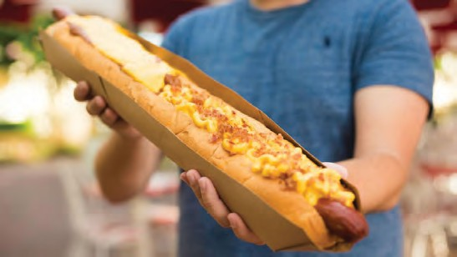
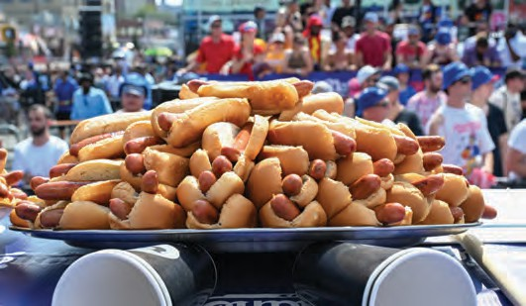
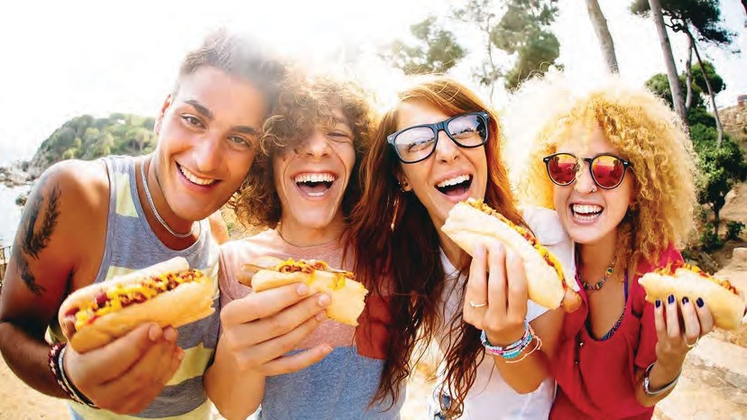
Target auidence
. Teenagers
. Jaywalkers
. Families of 3 or above
. Bicyclists
. Workers on lunch breaks
. Older Couples

Slide 7




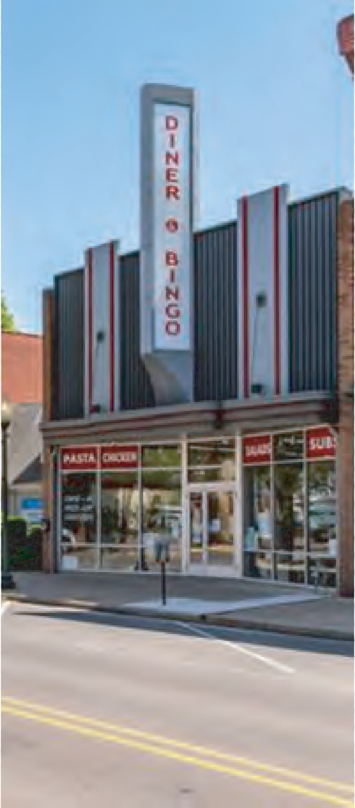
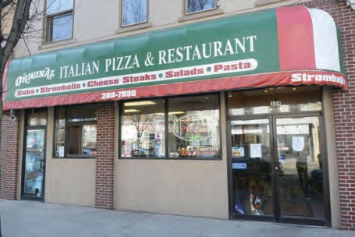

The Diner and Bingo
Original Italian Pizza
339 Market St, Sunbury, PA 17801
427 Market St, Sunbury, PA 17801
SANTANA'S
Bar and Grill
339 Market St, Sunbury, PA 17801

Slide 8


















Additional Logo Designs
SUNBURY
PA
Mascot Logo
Combination Mark
Lettermark Logo
Alternate Mark
The Squeeze' IN

Slide 9


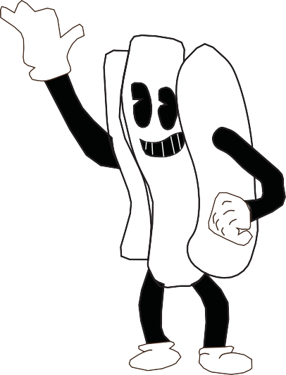







Squeeze'
The
IN
The Squeeze' IN

Slide 10














squeeze The
Previous Designs
the
squeeze
in
In
Squeeze
In

Slide 11

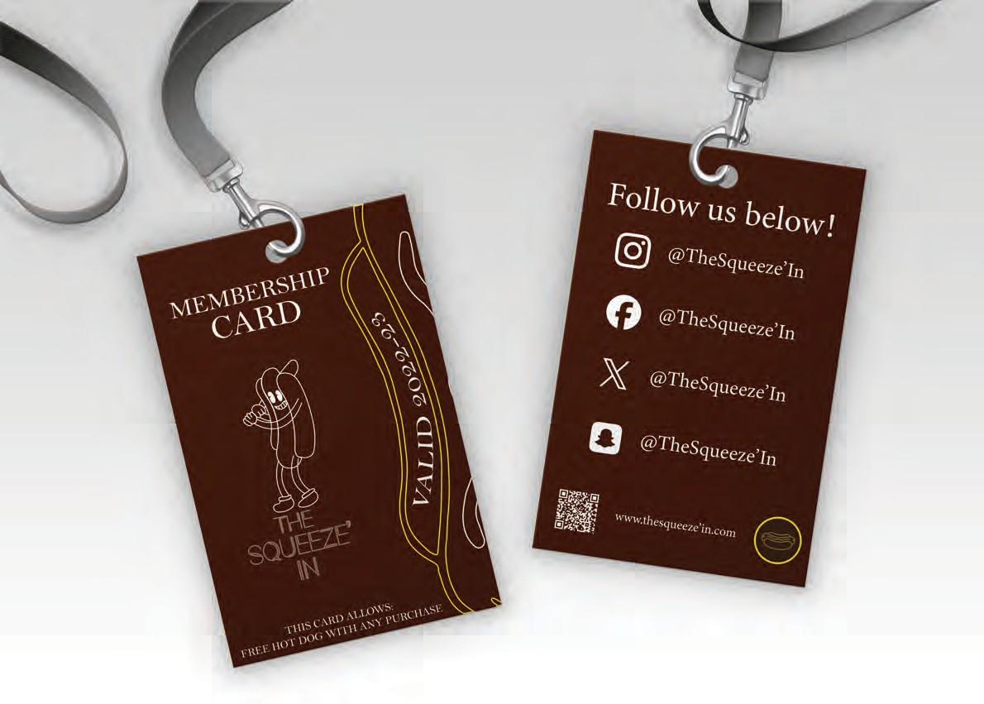


Slide 12

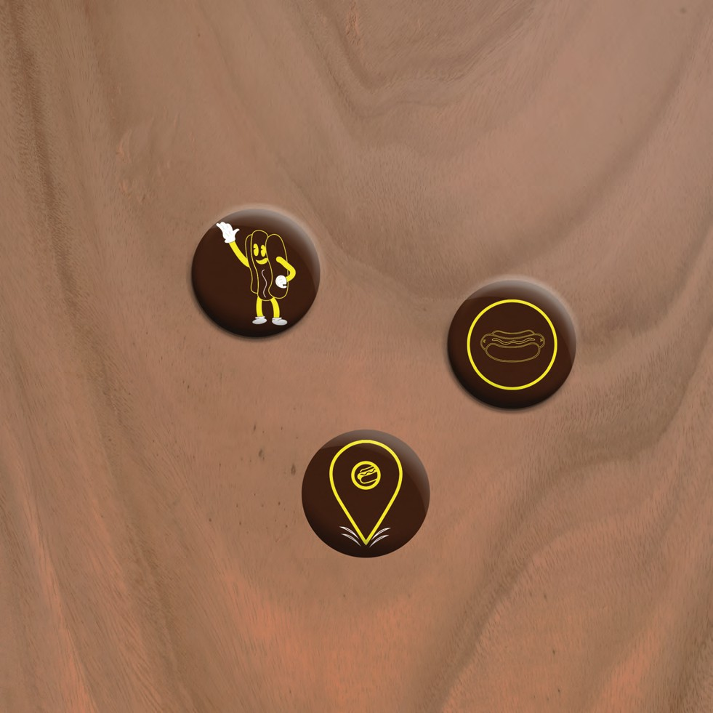

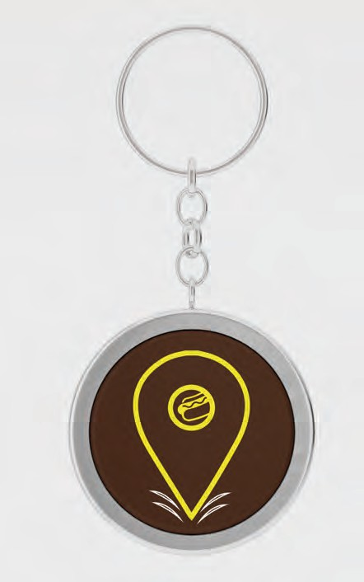
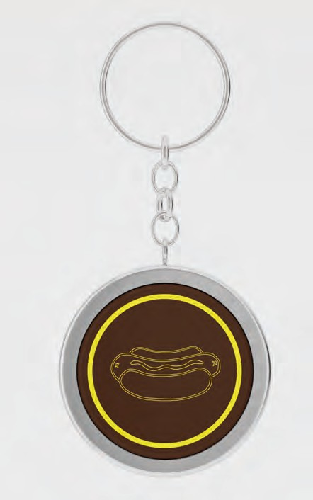
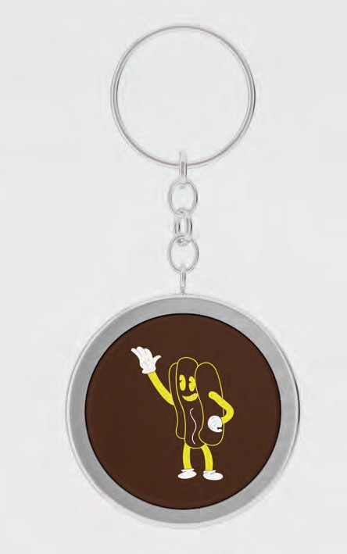

Slide 13
















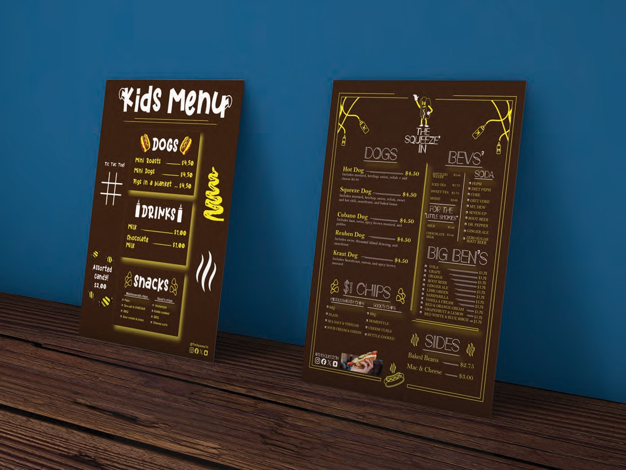






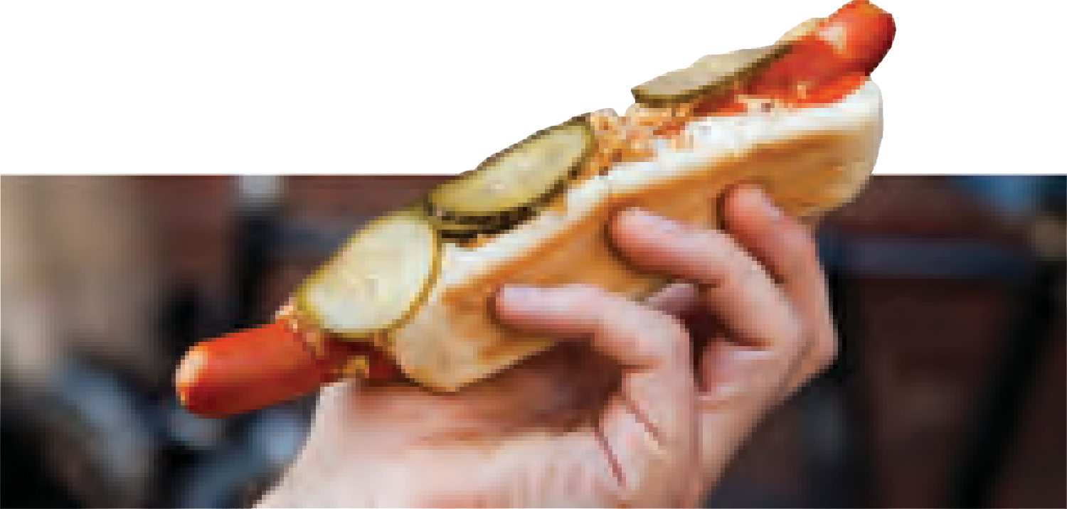

Menu Design
DOGS
BEVS'
.
soda
PEPSI
DIET PEPSI COKE
DIET COKE MT. DEW
SEVEN-UP
Hot Dog $4.50
Includes mustard, ketchup, onion, relish + add
cheese $0.50
Squeeze Dog $4.50
Includes mustard, ketchup, onion, relish, sweet and hot chili, sauerkraut, and baked beans
BOTTLED $1.oo WATER
.
ICED TEA
SWEET TEA MOXIE
$1.75
.
.
$1.75
$2.00
.
FOR THE
"Little Smokies"
.
.
. DR. PEPPER
Cubano Dog $4.50
Includes ham, swiss, spicy brown mustard, and
pickles
Reuben Dog $4.50
Includes swiss, thousand island dressing, and sauerkraut
Kraut Dog $4.50
Includes Sauerkraut, onions, and spicy brown mustard
ROOT BEER
MILK
$1.oo
.
GINGER ALE
ZERO SUGAR ROOT BEER
CHOCOLATE $1.oo MILK
BIG BEN'S
.
.
.
COLA GRAPE ORANGE
$1.75
$1.75
$1.75
$1.75
$1.75
$1.75
$1.75
$1.75
$1.75
$1.75
$1.75
.
.
.
ROOT BEER GINGER ALE LIME GREEN SARSPARILLA
.
$1 chips
.
.
VANILLA CREAM
.
RED & ORANGE CREAM GRAPEFRUIT & LEMON RED WHITE & BLUE BIRCH
.
.
.
Middleswrath chips Good's chips
BBQ
.
BBQ HOMESTYLE CHEESE CURLS KETTLE COOKED
.
PLAIN
.
.
SOUR CREAM & OINION .
SIDES
SEA SALT & VINEGAR
Baked Beans
$2.75
$3.00
Mac & Cheese
@TheSqueeze'In

Slide 14







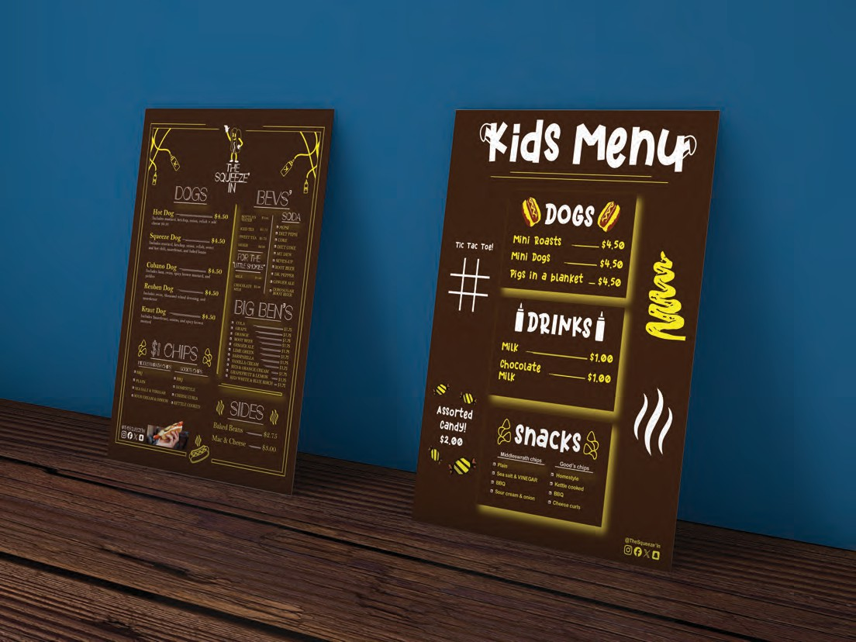










Kids Menu Design
Color Me In!
2023
DOGS
Mini Roasts Mini Dogs
$4.50
$4.50
$4.50
Tic Tac Toe!
Pigs in a blanket
DRI NKS
Milk
$1.00
Chocolate Milk
$1.00
Assorted Candy!
$2.00
. Middleswrath chips
. Good’s chips
.
Sea salt & VINEGAR .
Sour cream & onion .
BBQ
Plain
Homestyle
.
Kettle cooked BBQ
Cheese curls
@TheSqueeze’In

Slide 15

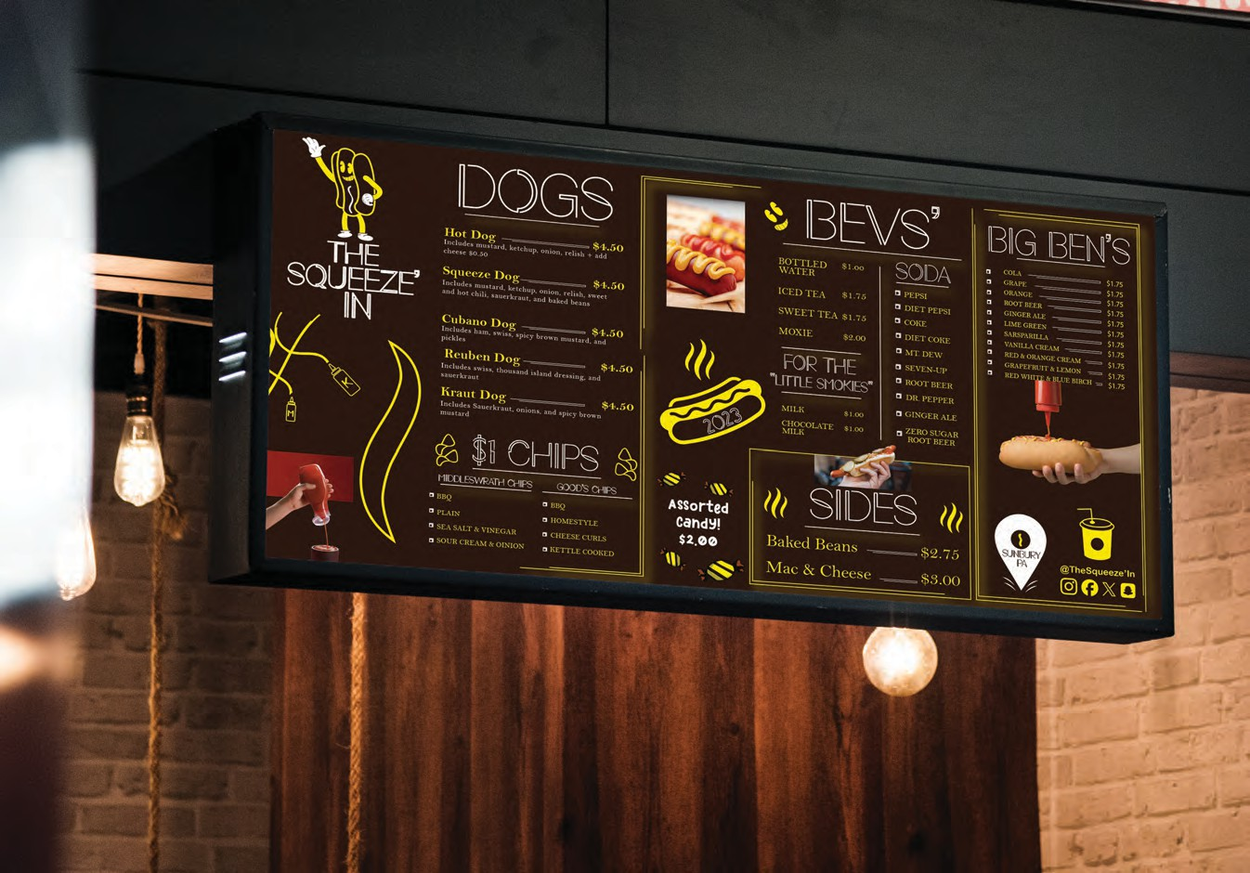





















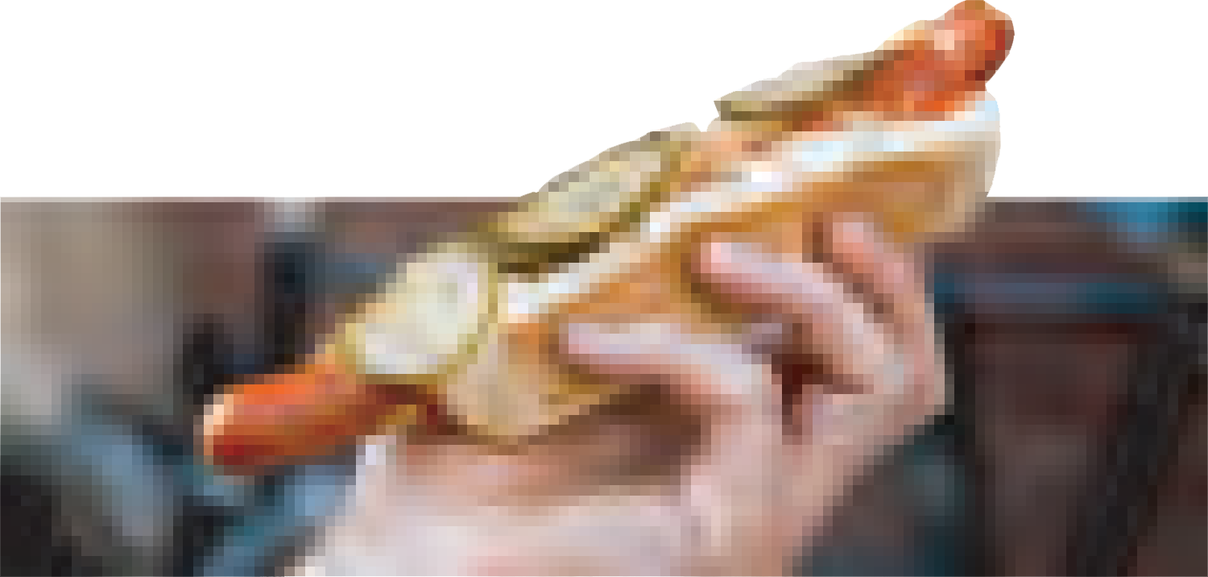






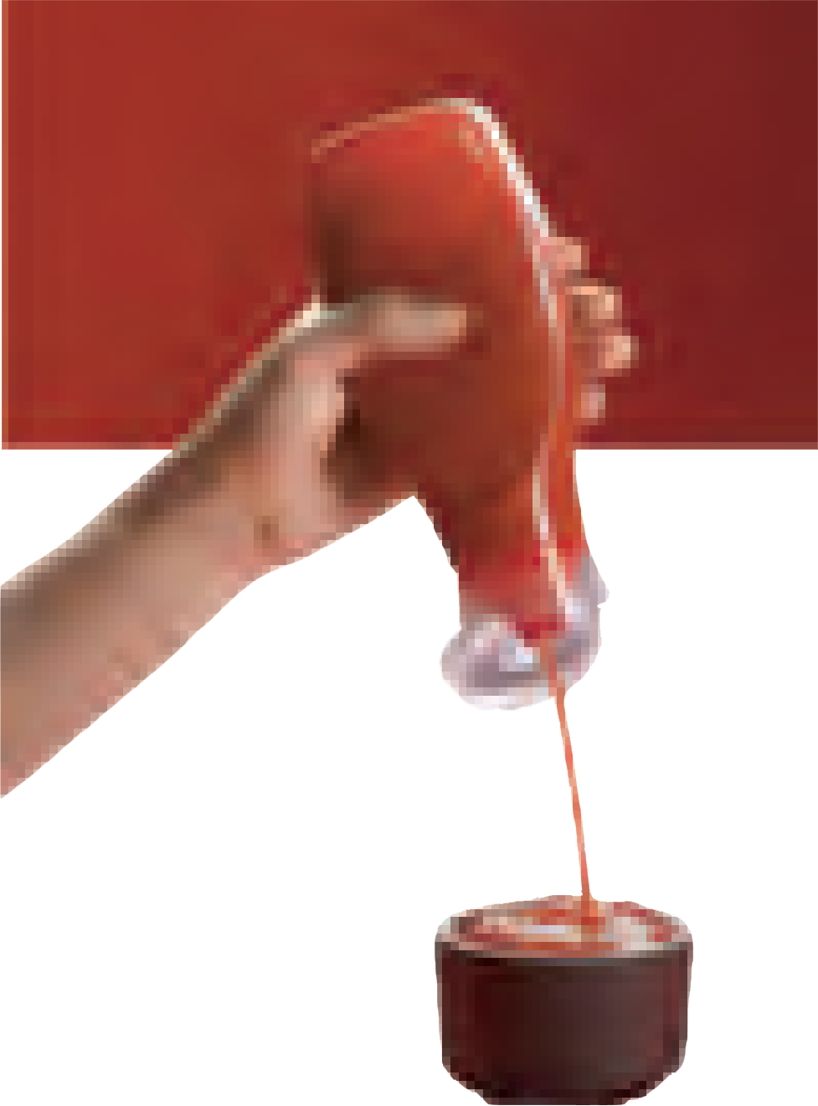







Menu board Design
DOGS
Bevs'
BIG BEN'S
soda
. GRA^{COLA}PE
Hot Dog $4.50
Includes mustard, ketchup, onion, relish + add
cheese $0.50
Squeeze Dog $4.50
Includes mustard, ketchup, onion, relish, sweet and hot chili, sauerkraut, and baked beans
BOTTLED $1.oo WATER
.
.
$1.75
$1.75
$1.75
$1.75
$1.75
$1.75
$1.75
$1.75
$1.75
$1.75
$1.75
.
.
ORANGE
.
PEPSI
DIET PEPSI COKE
DIET COKE MT. DEW
SEVEN-UP
.
ROOT BEER GINGER ALE LIME GREEN
ICED TEA
$1.75
.
.
.
.
.
SWEET TEA $1.75
MOXIE $2.00
FOR THE
"Little Smokies"
CHOCOLATE $1.00 .
MILK $1.00
MILK
SARSPARILLA
.
.
VANILLA CREAM
Cubano Dog $4.50
Includes ham, swiss, spicy brown mustard, and
pickles
Reuben Dog $4.50
Includes swiss, thousand island dressing, and sauerkraut
Kraut Dog $4.50
Includes Sauerkraut, onions, and spicy brown mustard
.
RED & ORANGE CREAM GRAPEFRUIT & LEMON RED WHITE & BLUE BIRCH
ROOT BEER
.GINGER ALE
DR. PEPPER
2023
ZERO SUGAR ROOT BEER
$1 chips
SIDES
Baked Beans $2.75
Mac & Cheese $3.00
. Middleswrath chips . Good's chips
. .
Assorted Candy!
$2.00
BBQ BBQ
.^{PLAIN}SASEA LT & VINEGAR .
SOUR CREAM & OINION
HOMESTYLE
CHEESE CURLS KETTLE COOKED
SUNBURY
PA
@TheSqueeze’In

Slide 16


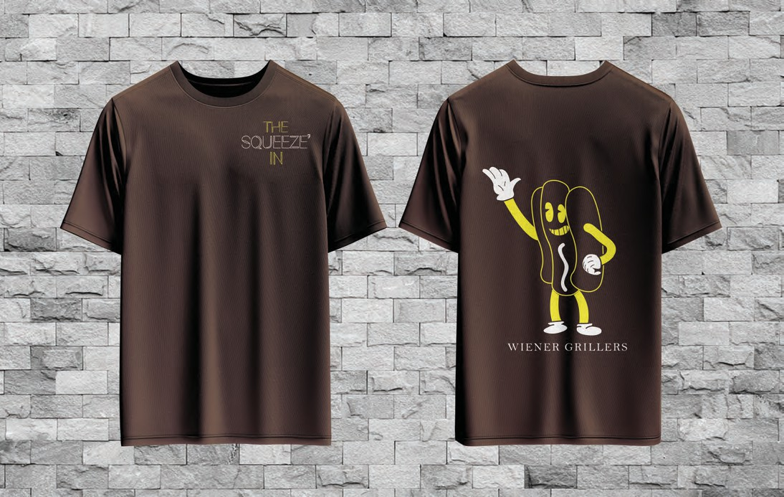
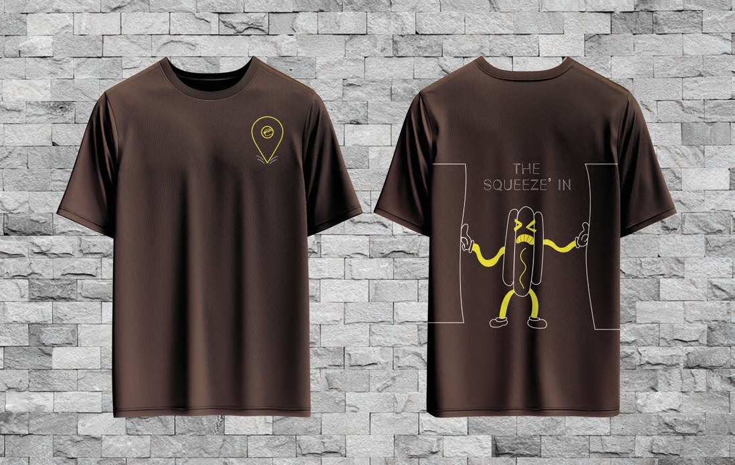

Slide 17

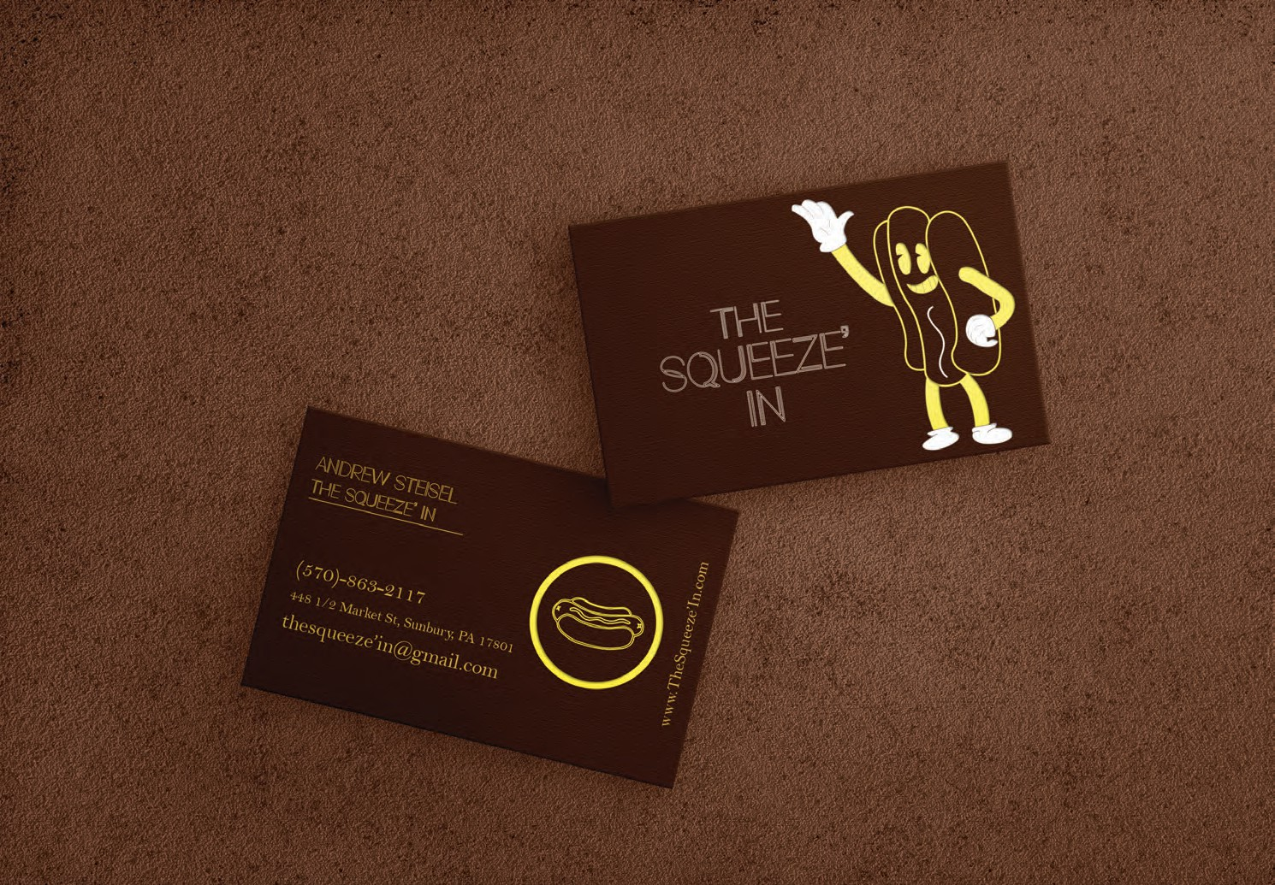

Slide 18

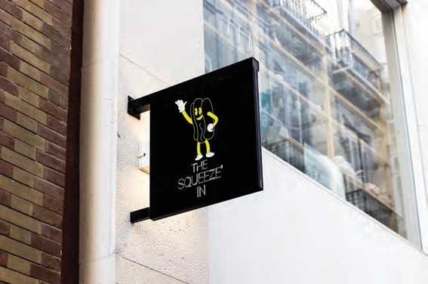

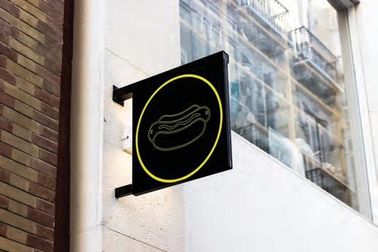
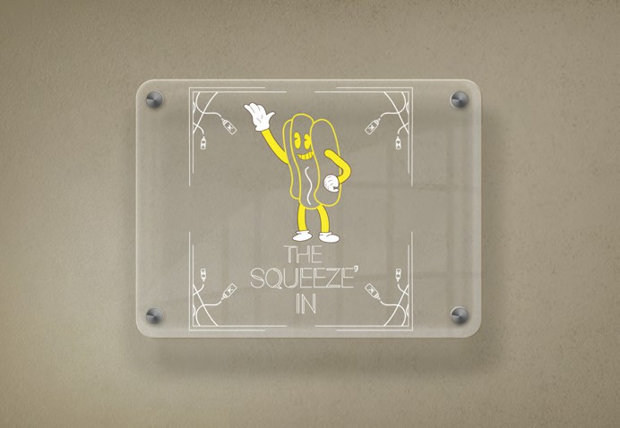

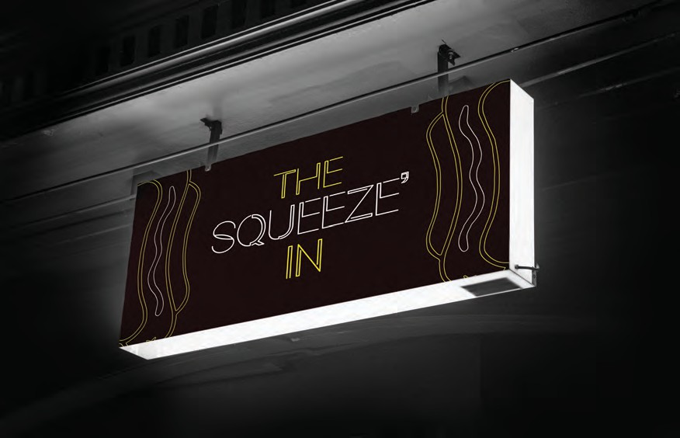
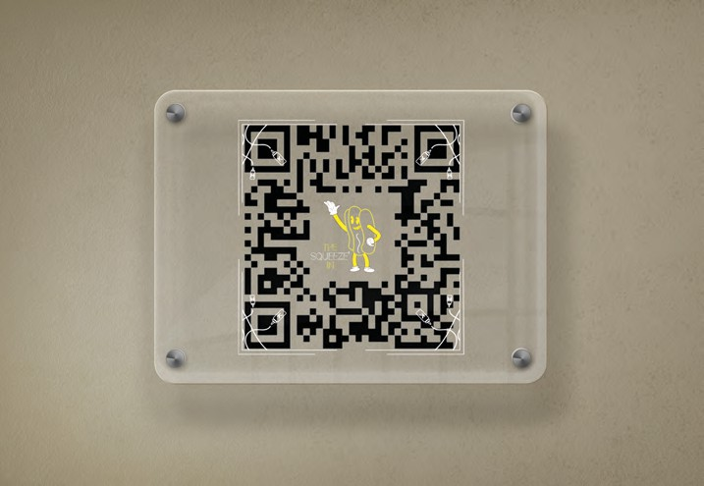

Slide 19




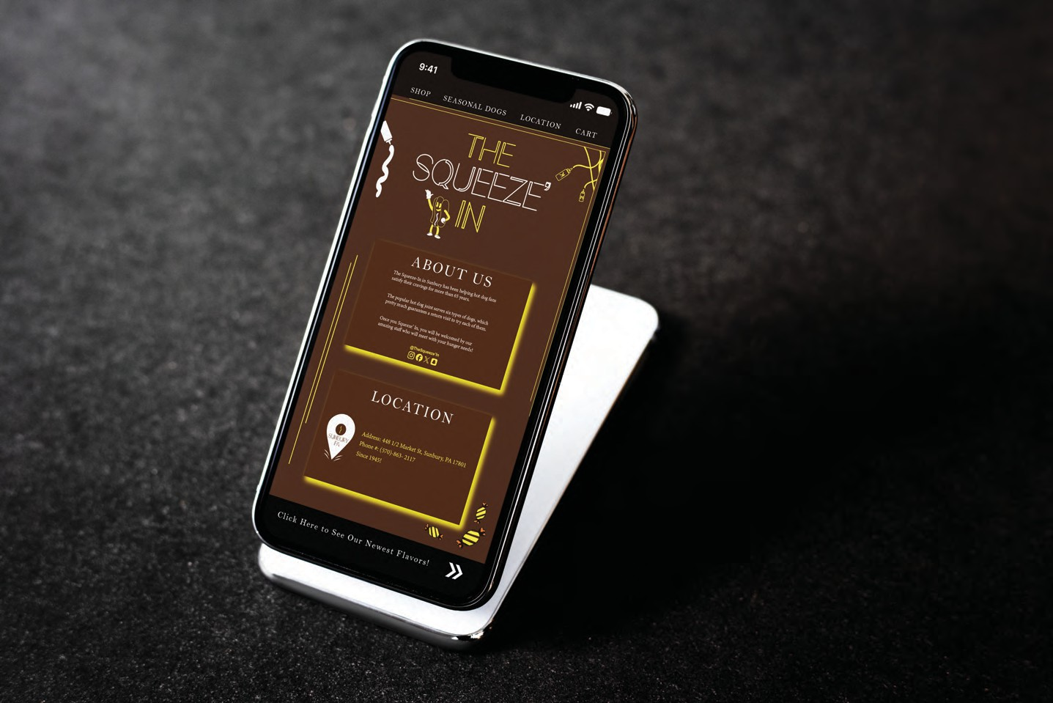

Slide 20


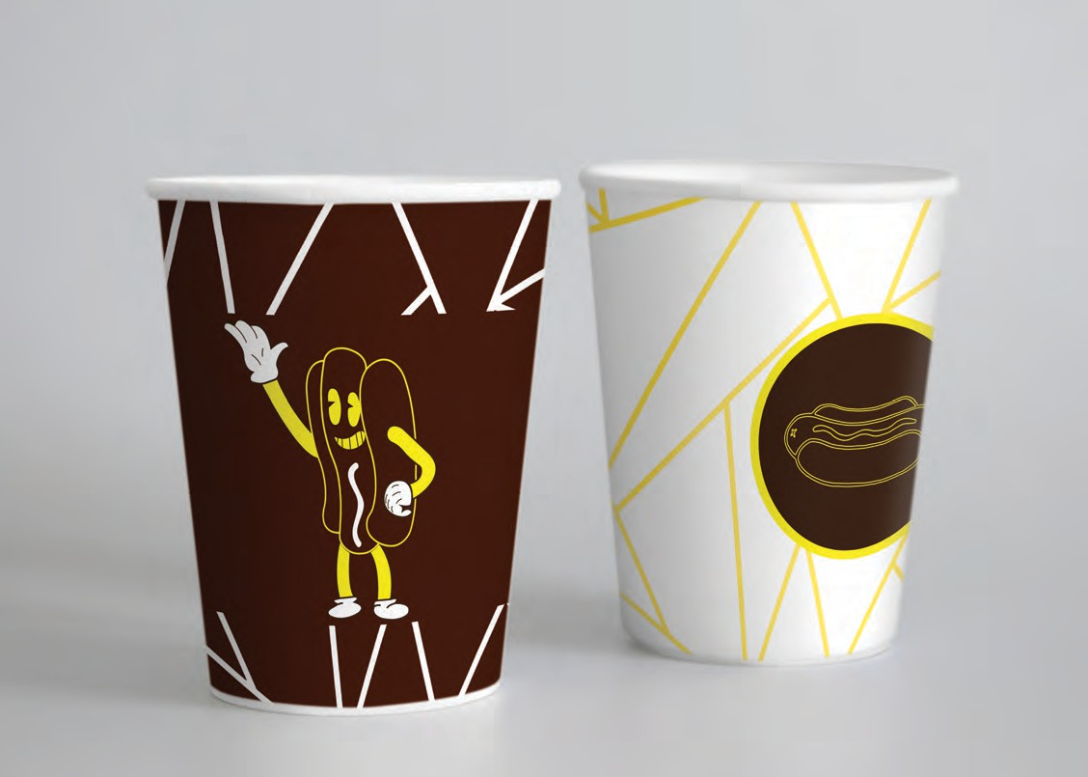
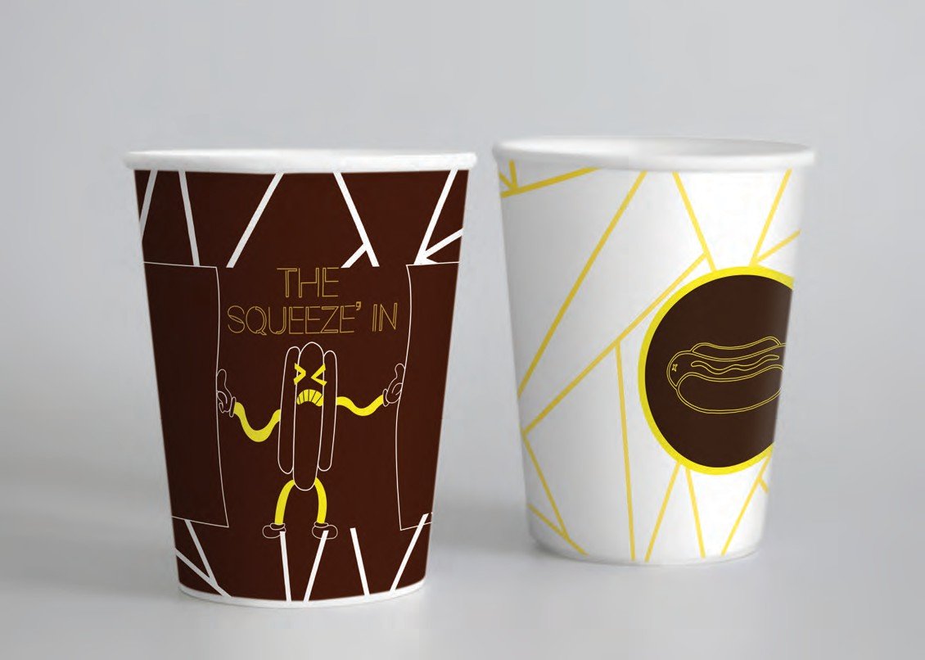

Slide 21




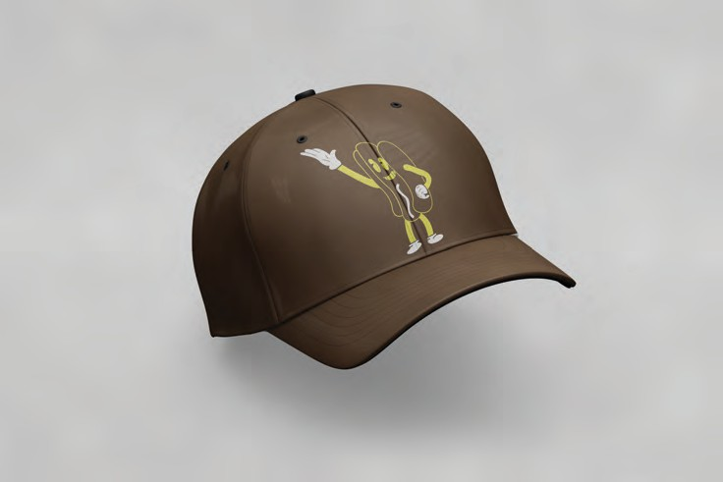


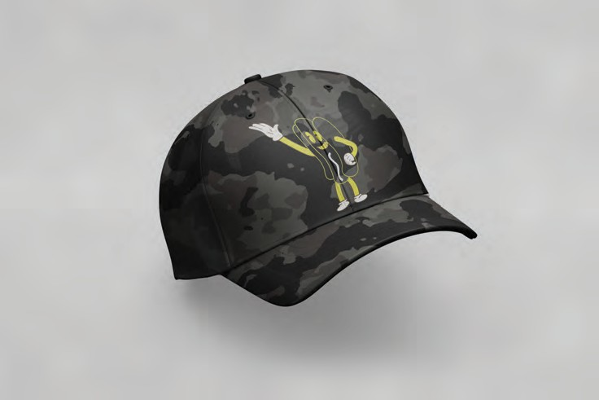

Slide 22


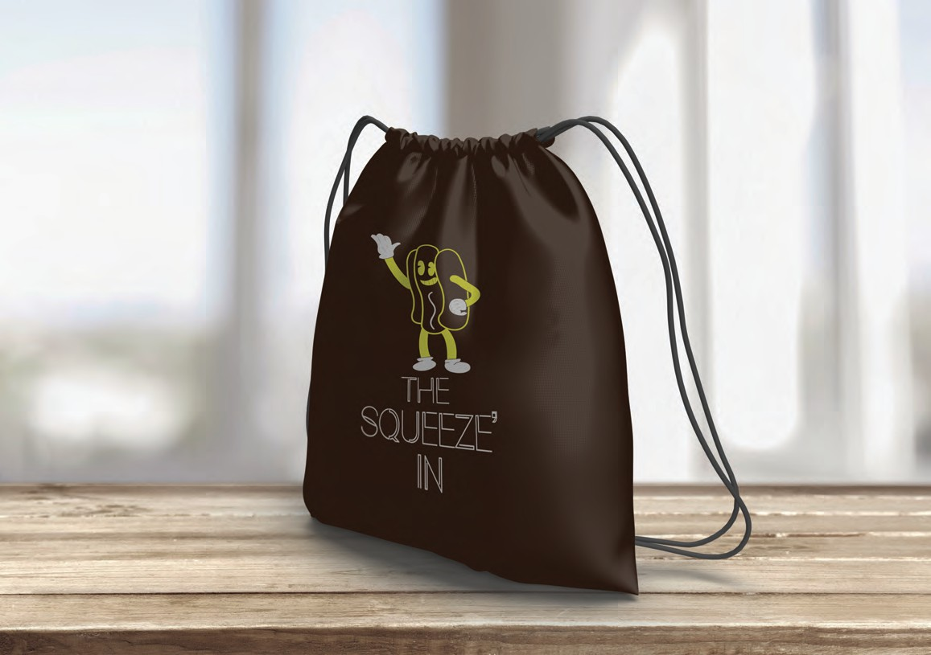
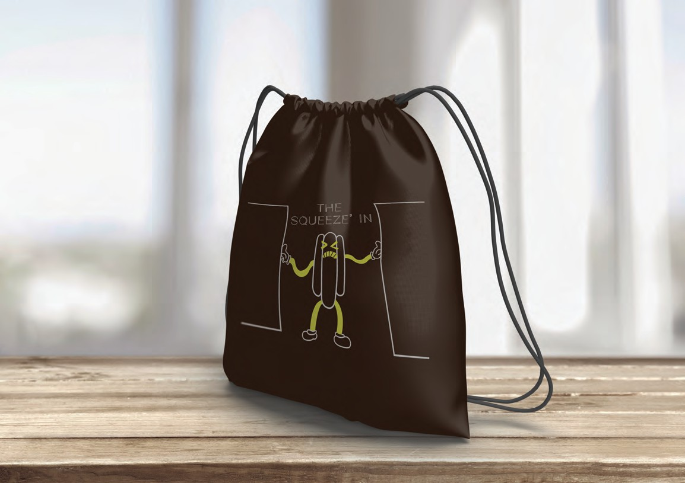

Slide 23

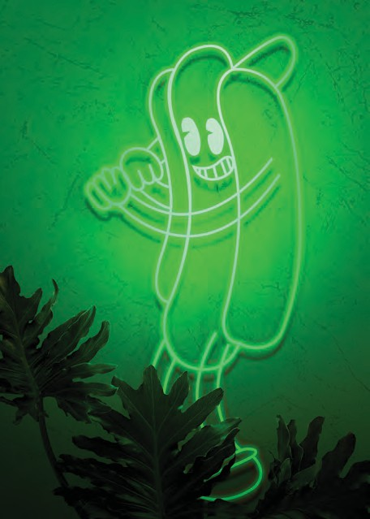



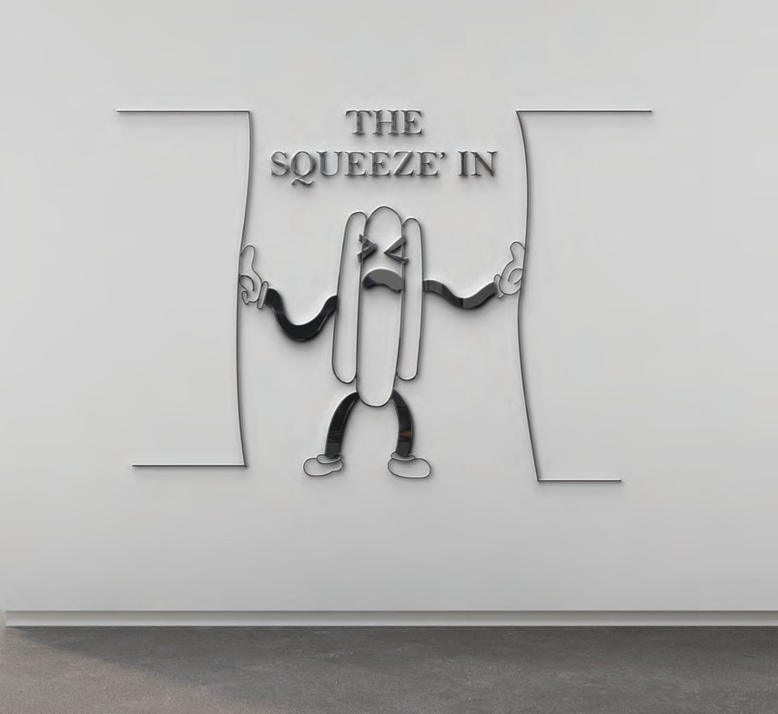



Slide 24

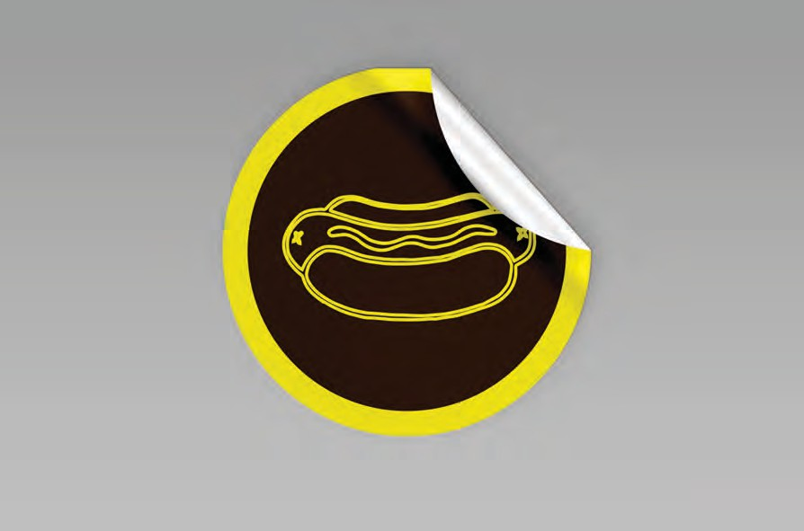

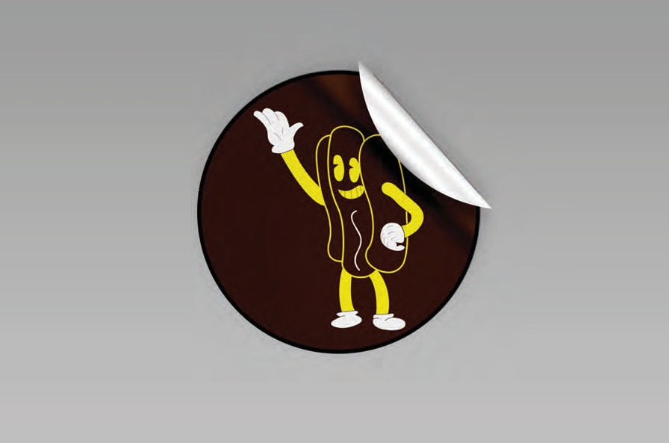

Slide 25

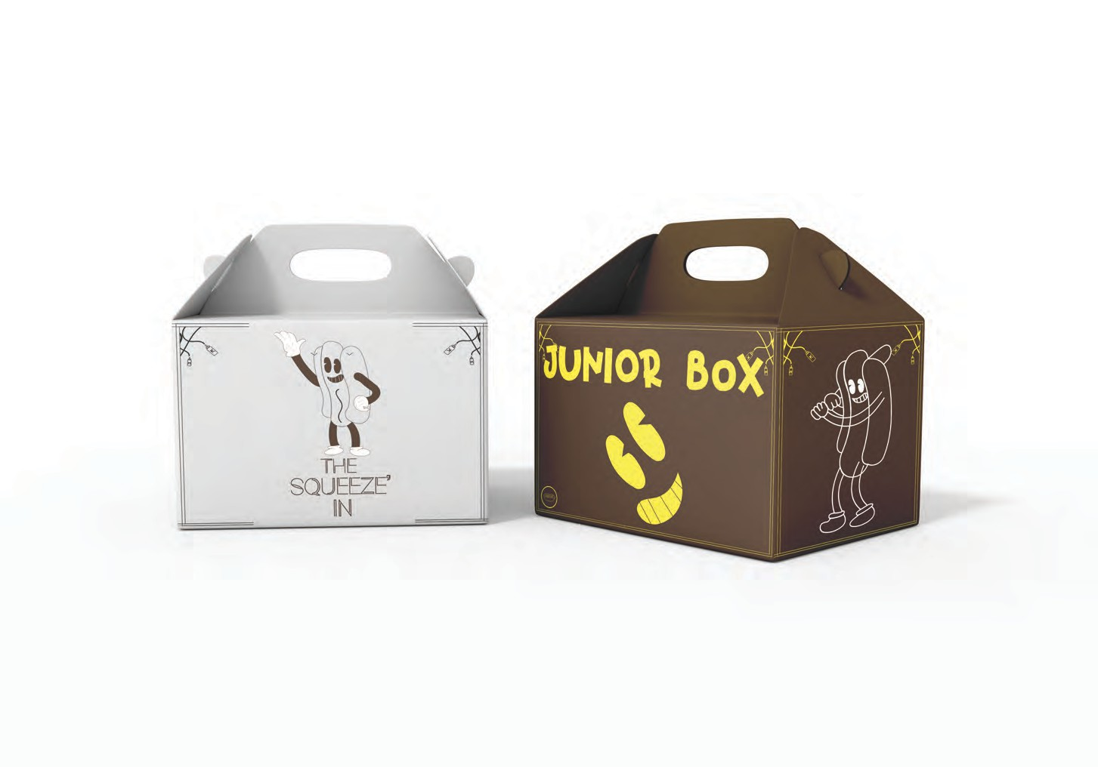

Slide 26

Contact Information
Designer- Andrew Steisel
Main Email-
steiselandrew@gmail.com
School Email- steian@farmingdale.edu
Phone #- (631)-637-0874

