Slide 1


Carlton Lancaster–SVP
clancaster@northamericanautocare.com
m. 817.875.8222

Slide 2
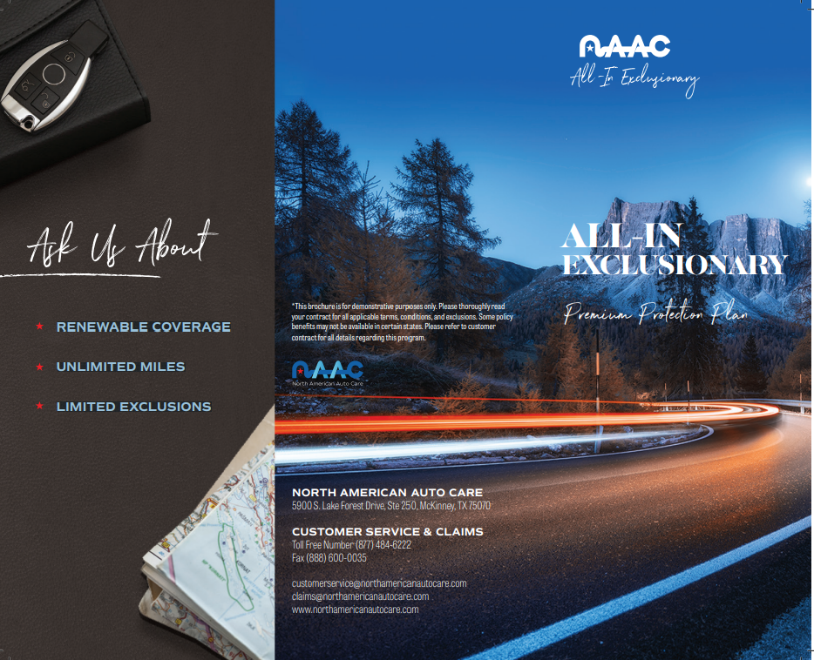
All-In Service Contract
-Fully Insured by an A Rated Insurance Company
-Simple 3 class rating: Asian, Domestic/VW/Volvo, European/Basic
-$0, $50 & disappearing deductible options available
-Standard deductible: Disappearing $100
-New & USED – ALL terms are Unlimited Miles
-NEW - Up to Current + 2 model years, and up to 35,000 miles
  -USED - Up to Current + 7 model years, and up to 60,000 miles
Exclusionary coverage full term
Limited Exclusions Rideshare (Uber, Lyft, Door Dash) OK (no Taxi, limo)
Very few surcharges:
  -All Wheel Drive / 4X4 -Diesel
  -Qualified Commercial -Ride Share
  -Turbocharger -Supercharger -Up to 6” lift or 4” lower
  -Some model specific surcharges
NEW & USED TERMS – ALL terms are Unlimited Miles
  NEW Current +2 years, up to 35,000 miles - Terms up to 8 years
  USED Current +7 years Up to 60,000 miles - Terms up to 6 years
-Wear and Tear & Seals and Gasket coverage included
-Online rating and fulfillment
-Roadside, Rental and Trip Interruption included
Carlton Lancaster–SVP
clancaster@northamericanautocare.com
m. 817.875.8222

Slide 3
All-In Terms + 2 Years Eligibility
Term | 0 to 12,000 | 12,001 to 24,000 | 24,001 to 35,000
12 | Unlimited Miles | Unlimited Miles | Unlimited Miles
24 | Unlimited Miles | Unlimited Miles | Unlimited Miles
36 | Unlimited Miles | Unlimited Miles | Unlimited Miles
48 | Unlimited Miles | Unlimited Miles | Unlimited Miles
60 | Unlimited Miles | Unlimited Miles | Unlimited Miles
72 | Unlimited Miles | Unlimited Miles | Unlimited Miles
84 | Unlimited Miles | Unlimited Miles | Unlimited Miles
96 | Unlimited Miles | Unlimited Miles | Unlimited Miles
*$100 Disappearing Deductible
Carlton Lancaster–SVP
clancaster@northamericanautocare.com
m. 817.875.8222
Excluded Vehicles
Acura NSC, Alfa Romeo, Aston Martin, Bentley, BMW (Alpina, M*, 8), Bugatti, Cadillac V*, Corvette Z06, Dodge (Viper, Stealth), Ferrari, Ford *Mustang Shelby GT500, Cobra SVT) Ford Diesel 2005-2008), Hummer, Lamborghini, Lotus, Maserati, Maybach, MB AMG, Rolls-Royce, Saab, Saturn, Tesla

Slide 4
All-In Terms + 7 Years Eligibility
Term | 0 to 24,000 | 24,001 to 40,000 | 40,001 to 60,000
12 | Unlimited Miles | Unlimited Miles | Unlimited Miles
24 | Unlimited Miles | Unlimited Miles | Unlimited Miles
36 | Unlimited Miles | Unlimited Miles | Unlimited Miles
48 | Unlimited Miles | Unlimited Miles | Unlimited Miles
60 | Unlimited Miles | Unlimited Miles | Unlimited Miles
72 | Unlimited Miles | Unlimited Miles | Unlimited Miles
*$100 Disappearing Deductible
Carlton Lancaster–SVP
clancaster@northamericanautocare.com
m. 817.875.8222
Excluded Vehicles
Acura NSC, Alfa Romeo, Aston Martin, Bentley, BMW (Alpina, M*, 8), Bugatti, Cadillac V*, Corvette Z06, Dodge (Viper, Stealth), Ferrari, Ford *Mustang Shelby GT500, Cobra SVT) Ford Diesel 2005-2008), Hummer, Lamborghini, Lotus, Maserati, Maybach, MB AMG, Rolls-Royce, Saab, Saturn, Tesla

Slide 5

-Fully Insured by an A Rated Insurance Company
-Simple 5 class rating
-Wrap available
-$0, $50 & disappearing deductible available
-Standard deductible $100
-Up to Current + 5 model years, and up to 100,000 miles
-Exclusionary coverage full term
-Limited Exclusions
  Computer programmers (Chips) OK ~ Deletes & Modifications OK
  Deletes & Modifications OK
  Rideshare (Uber, Lyft, Door Dash) OK (not Taxi, limo, etc.)
-Very few surcharges:
  All Wheel Drive / 4X4
  Diesel
  Lifted
  Dual rear wheels
  Commercial use
-Limited ineligible vehicles
-Up to 12” Lift
-Terms up to 10 years
-Wear and Tear & Seal and gasket coverage included
-Online rating and fulfillment through SEFI Admin
-Roadside, Rental and Trip Interruption included
BTB Contract
Carlton Lancaster–SVP
clancaster@northamericanautocare.com
m. 817.875.8222

Slide 6
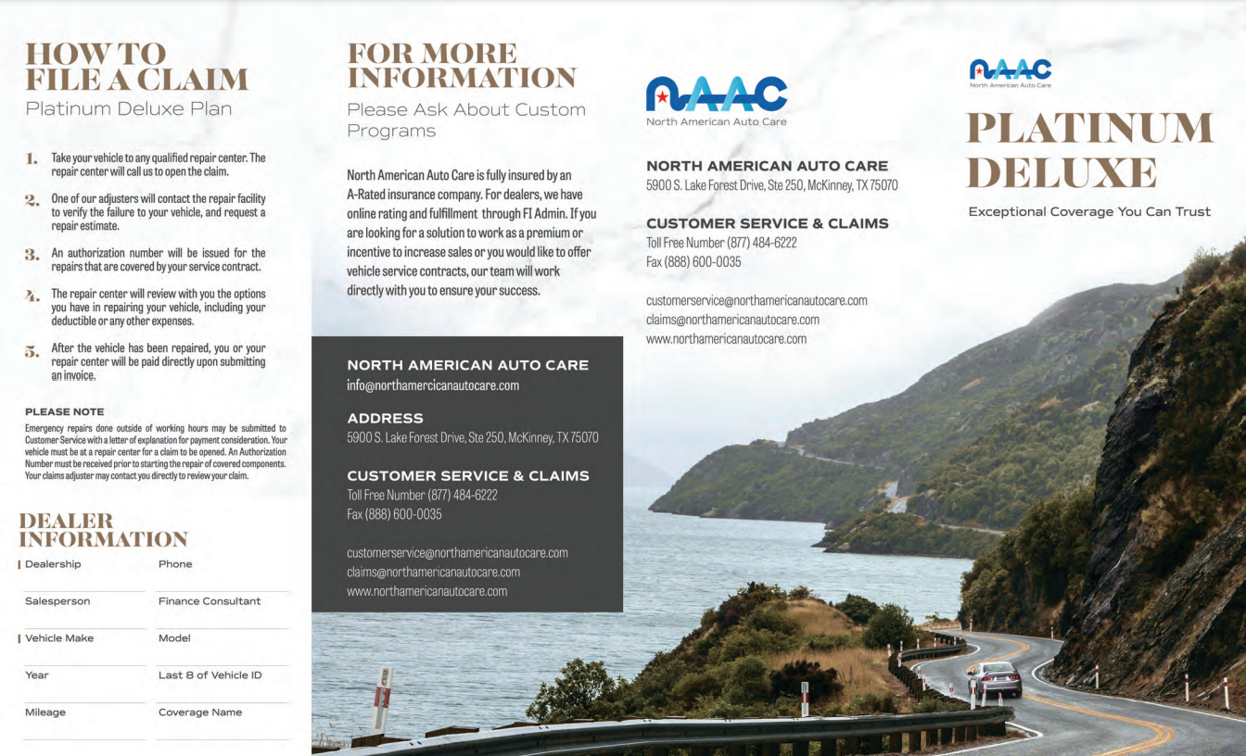
-Fully Insured by an A Rated Insurance Company
-Exclusionary coverage up to 200,000 odometer miles
  Coverage changes from exclusionary to powertrain plus when covered vehicle odometer reaches 200,001 miles
-$100 Standard Deductible, $0 deductible available
-12 classes
-Only a Few excluded vehicles:
  Bugatti ~ Hummer H1 & H2
-Up to 20 model years, up to100,000 odometer miles at time of sale
-All terms are add-on time and miles
-Limited Exclusions:
  No exclusion for Dually – Dual rear wheel one-ton trucks
  No exclusion for Diesel Modifications (Chip, Deletes, etc.)
  Ride Share is not excluded (Uber, Lyft, Door Dash, etc.)
-Limited surcharges:
  Hybrid ~ Commercial Use
  Up to 8” Lift ~ Snowplow
  Diesel ~ One Ton
  All wheel drive / 4X4
-2,4 & 5-year terms
-Seals and gasket coverage included
-Online rating and fulfillment through SEFI Admin
-Roadside, Rental and Trip Interruption included
Platinum Deluxe Contract
Carlton Lancaster–SVP
clancaster@northamericanautocare.com
m. 817.875.8222

Slide 7

-Fully Insured by an A Rated Insurance Company
-Simple 5 classes
-4 coverage levels: Powertrain, Powertrain Plus, Select, & Preferred
  PT: Engine, Transmission, Transfer case & Differential
  PT Plus: PT add Basic A/C, axles, and rental $30 per day up to 3 days
  Select: PT and PT Plus add Fuel Pump, additional differential, basic cooling additional A/C, steering, suspension, brakes, electrical, trip interrupt
  Preferred: all above add More Engine, Transmission, Differential, Cooling, A/C, Electrical, Fuel, Fluids, Diagnosis and Rental $30 per day up to 5 days
-Standard deductible $100 per component
  Maximum of $200 per visit
-Any year AND Any mileage on Powertrain & Powertrain Plus: 12, 24, & 36 terms
  Any year for all levels
-Powertrain & Powertrain plus
  12-, 24,- & 36-month terms ~ unlimited miles
  48-, 60,- & 72-month terms ~ up to 90,000 miles
-Select & Preferred
  12- & 24-month terms ~ up to 150,000 miles
  36-month terms ~ up to 100,000 miles
  48-, 60,- & 72-month terms ~ up to 90,000 miles
-Limited list of ineligible vehicles
-Limited Exclusions:
  No exclusion for Diesel Modifications (chip, deletes, etc.) or Rideshare
-Limited surcharges:
  Up to 12” Lift ~ After sale allowance ~ Commercial use
-Seals and gasket coverage included on all levels
-Online rating and fulfillment
-Roadside on all levels ~ Rental & Trip Interruption included except Powertrain
Xceptional Contract
Carlton Lancaster–SVP
clancaster@northamericanautocare.com
m. 817.875.8222

Slide 8
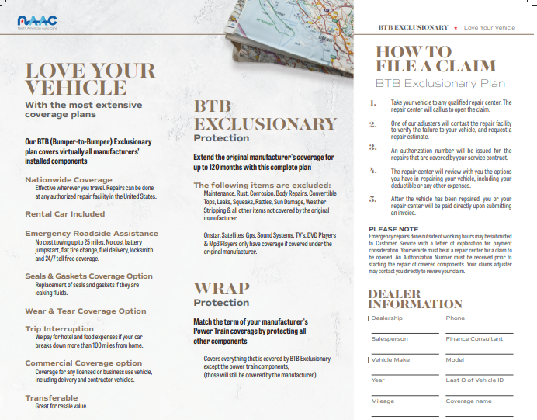
BTB Wrap
-BTBWRAP COVERAGE Wrap coverage is intended to cover the components that the manufacturer covered under their original new car Warranty once the initial phase of the manufacturer’s Warranty has expired AND while the Vehicle is still covered under the manufacturer’s power train Warranty.
Our maximum liability for BTB Wrap Coverage is the Cost to repair any covered Mechanical Break down as per the terms of this Agreement. The total of benefits payable for the term of the Agreement shall not exceed the original Vehicle Purchase price as shown on the front of this Agreement or the J.D. Power retail value of the Vehicle at the time of repair.
$0 Deductible---+100
$50 Deductible---+50
Disappearing Deductible---+80
AWD/4X4---+100
Diesel---+200
Dual Rear Wheel---+200
Commercial Vehicle---+300
INELIGIBLE VEHICLES: Corvette (ZO6 & ZR1 models), Hummer H1, Volt
Carlton Lancaster–SVP
clancaster@northamericanautocare.com
m. 817.875.8222

Slide 9
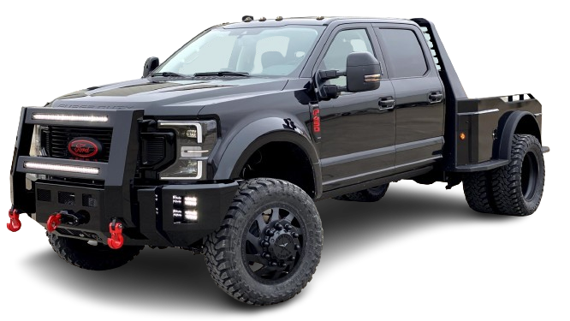
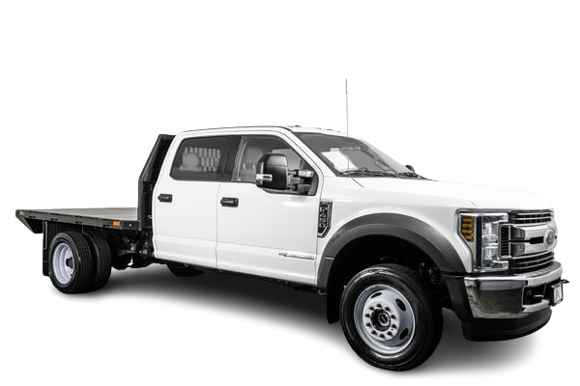
BTB Fleet Program
North American Auto Care is excited to introduce our new Fleet Truck Program, designed to provide comprehensive coverage and peace of mind for commercial fleet operators.
This program includes our renowned BTB (Bumper-to-Bumper) coverage, ensuring that every aspect of your fleet is protected. With a term of 48 months and up to 150,000 miles, this program offers extended protection to keep your trucks on the road longer.
The commercial surcharge is conveniently built into the rate, simplifying budgeting and planning. Additionally, we offer two optional surcharges for dually and lifted trucks, allowing you to customize your coverage to meet the specific needs of your fleet. Trust North American Auto Care to deliver the reliability and support your business depends on.
Carlton Lancaster–SVP
clancaster@northamericanautocare.com
m. 817.875.8222

Slide 10
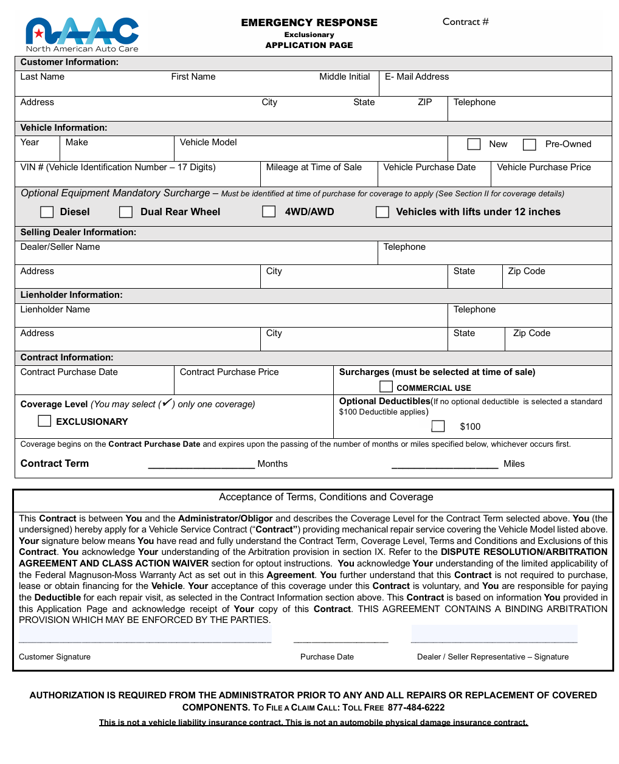
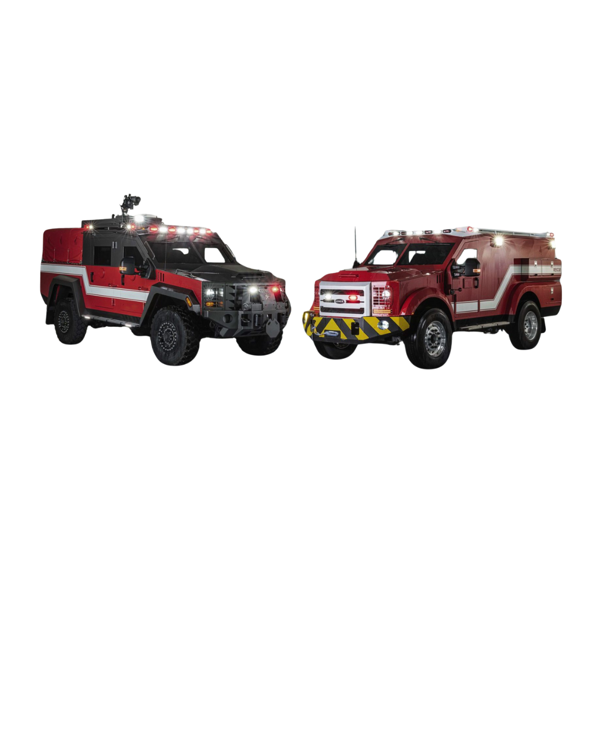
Emergency Response
North American Auto Care is proud to introduce our new Emergency Response Exclusionary Program — one of the most comprehensive protection plans available.
This program provides coverage on nearly every factory-installed mechanical and electrical component, along with wear-and-tear protection that goes beyond the traditional service contract. Customers will also enjoy valuable additional benefits, including rental car reimbursement, emergency roadside assistance, trip interruption coverage, fluid replacement, and diagnostic allowances — all supported by NAAC’s trusted claims team and 24/7 customer assistance.
For dealers, this program means greater customer satisfaction and stronger F&I profitability. With optional surcharges for commercial use, diesel engines, and lift kits, the Emergency Response Program provides flexibility for a wide range of vehicles and customer needs. Combined with premium roadside and living benefits such as hotel and meal reimbursement and nationwide towing, North American Auto Care continues to lead the way in providing superior protection and value to both dealers and their customers.
Carlton Lancaster–SVP
clancaster@northamericanautocare.com
m. 817.875.8222

Slide 11
All Programs One Sheet
All-In +2 +7Eligibility
-New & USED
-ALL terms are Unlimited Miles -
-NEW -Up to Current + 2 model years, and up to 35,000 miles Terms up to 8
-USED -Up to Current + 7 model years, and up to 60,000 miles Terms up to 7 years
-Very few surcharges:
*All Wheel Drive / 4X4 -Diesel -Qualified Commercial -Ride Share -Turbocharger
*Supercharger -Up to 6” lift or 4” lower
*Exclusionary coverage full term
Xceptional
-Used
-Powertrain & Powertrain plus 12,24 & 36-month terms.
-Unlimited miles up 3 years
-48, 60 & 72-month terms ~ up to 90,000 miles up to 6 years
-Select & Preferred 12 & 24-month terms ~ up to 150,000 miles up to 2 years
-36-month terms ~ up to 100,000 miles up to 3 years
-48, 60 & 72-month terms ~ up to 90,000 miles up to 6 years
-No exclusion for Diesel Modifications (chip, deletes, etc.) or Rideshare
-Up to 12” Lift, After sale allowance, Commercial use
BTB
-New & USED
-Eligibility- Current 5 model years, and up to 100,000 miles
-Exclusionary coverage full term -Limited Exclusions o Computer programmers (Chips) OK
-Deletes & Modifications OK o Shocks and Struts are NOT excluded o Deletes & Modifications OK o Rideshare (Uber, Lyft, Door Dash) OK (not Taxi, limo, etc.) -Very few surcharges: All Wheel Drive, 4X4, Diesel, Lifted, Dual rear wheels, Commercial use
-Limited ineligible vehicles -Up to 12” Lift -Terms up to 10 years -Wear and Tear & Seal and gasket coverage included
-Up to 12” Lift -Terms up to 10 years
GAP
-New used Franchise and Independent
-Up to 150% of retail, and up to $100,000 retail price
-Available for both Franchise and Independent dealers
-Terms (5 terms for Franchise & 4 terms for Independent dealers)
-0–48 months 49–60 months o 61–72 months 73–84 months
85–96 months *this term is only available for franchise dealers
-Ride Share allowed (Uber, Lyft, Door Dash, etc.) not Taxi, limo etc.
Complete Care
-Eligibility of 100,000 miles
-Rates for New or Used
-Current plus X model years
-Coverage for: Tire & Wheel, Road Hazard, Paintless Dent Repair, Windshield Repair o Key (Fob) Replacement
-8 popular lease terms available
Platinum Deluxe
-Used
-60/150
-Up to 20 model years, up to100,000 odometer miles at time of sale -All terms are add-on time and miles -Limited Exclusions: No exclusion for Dually, Dual rear wheel one-ton trucks, No exclusion for Diesel Modifications (Chip, Deletes, etc.) Ride Share is not excluded (Uber, Lyft, Door Dash, etc.)
-Limited surcharges: Hybrid, Commercial Use, Up to 8” Lift, Snowplow, Diesel, One Ton, All wheel drive / 4X4
-4- & 5-year terms

Slide 12
Carlton Lancaster–SVP
clancaster@northamericanautocare.com
m. 817.875.8222

