Slide 1


The AI Hardware Partner
From Edge AI to Off-Grid Mesh:
Hands-On with Semtech 4th Gen LR2021
Violet SU
violet@seeed.cc

Slide 2
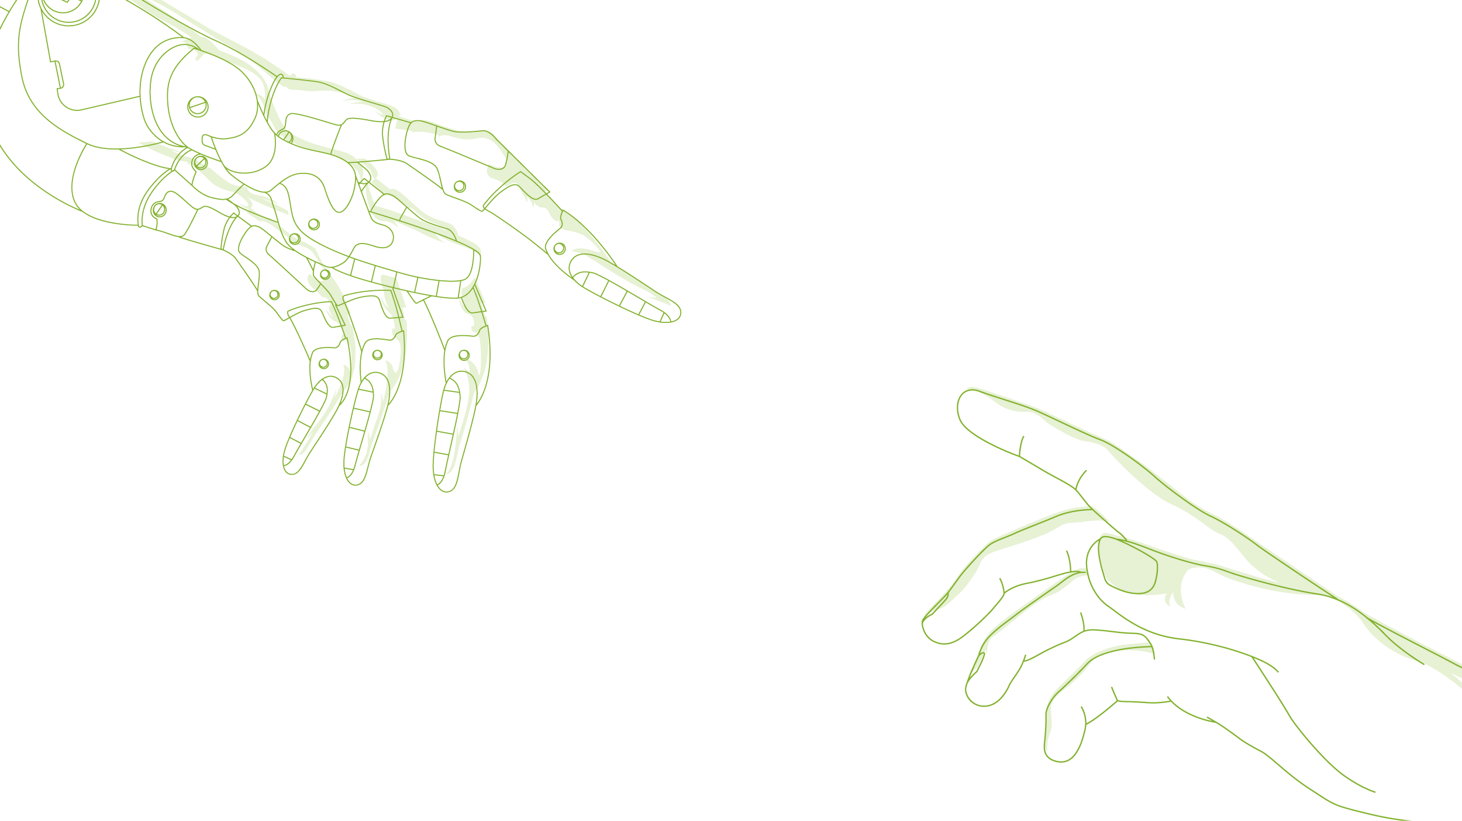
The AI Hardware Partner
Part 1: Unlocking 4th Gen LR2021 Architecture
Beyond Legacy LoRa.
Part 2: Bridging LR2021 to Edge AI Vision
Introducing Wio-LR2021 Module & ESP32-S3 Dev Board.
Live Demo: Streaming AI Vision Keyframes over Sub-GHz FLRC.
Part 3: Mesh Everything: The Seeed Studio Ecosystem
SenseCAP MeshTracker X1: LR2021 in action for Meshtastic off-grid tracking.
Part 4: Interactive Q&A and Live Testing.

Slide 3
The AI Hardware Partner
Unlocking 4th Gen LR2021

Slide 4
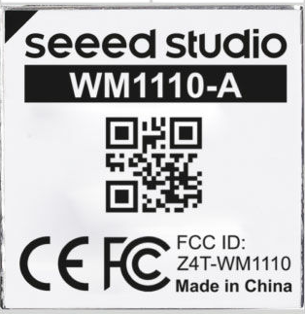
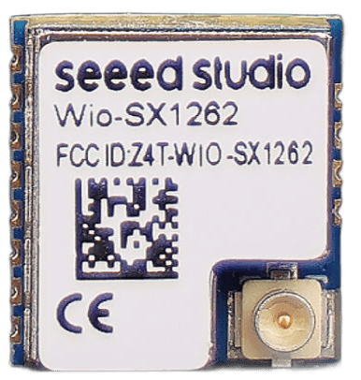
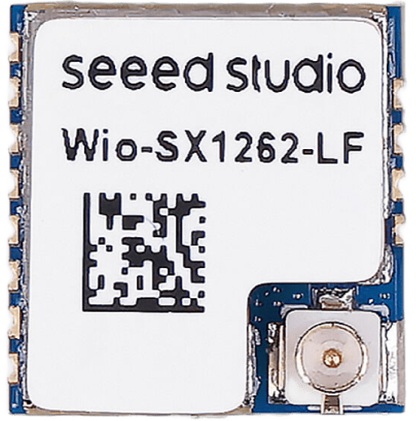
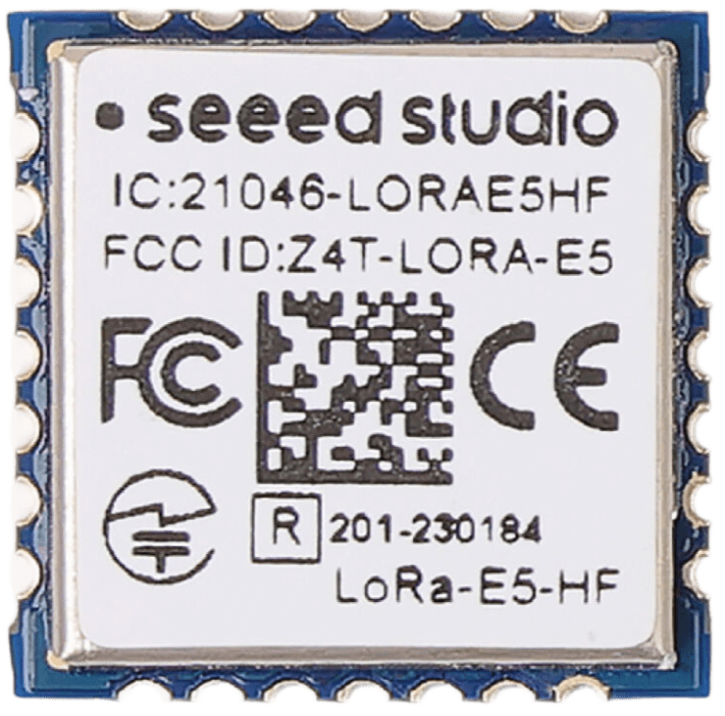
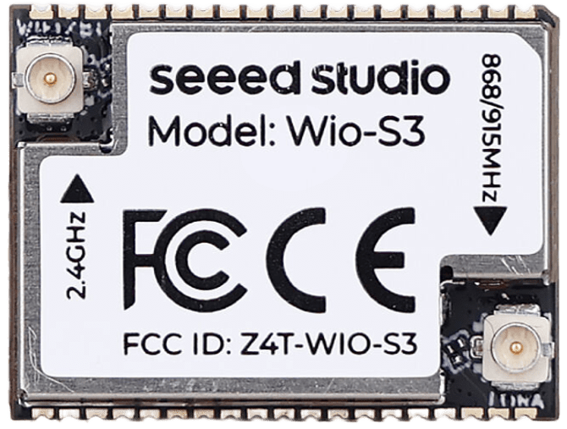
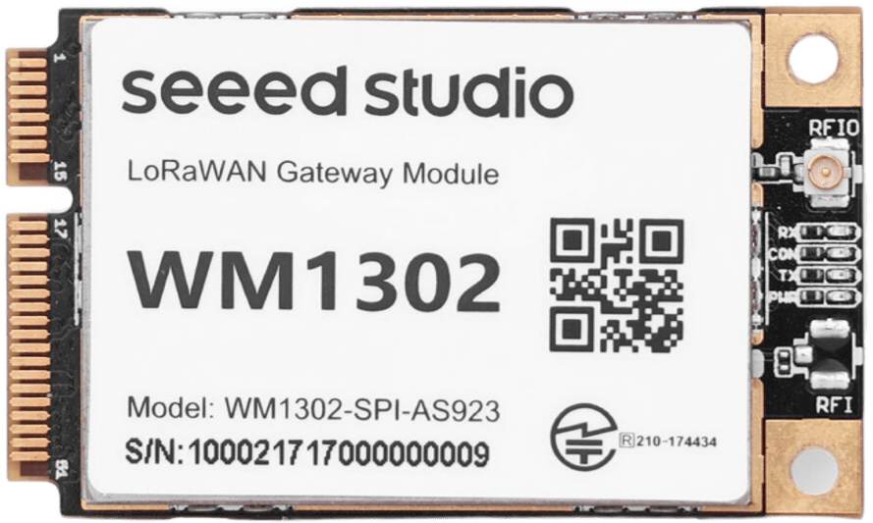
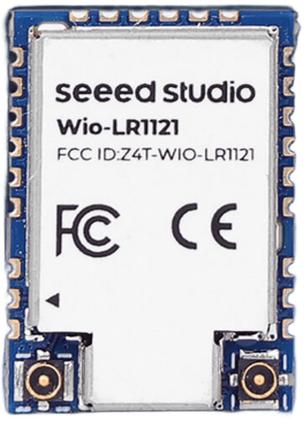
Semtech LoRa IP Gen 1 to Gen 4 Roadmap:
The AI Hardware Partner
Gen 1 (SX1276/78/1110):
Established the LoRaWAN ecosystem; basic telemetry, higher RX power.
Gen 2 (SX1262):
RX power optimization (4.6 mA), +22 dBm TX, industry workhorse.
Gen 3 (LR1121):
Multi-band expansion (Sub-GHz, 2.4GHz, S-Band NTN).

Slide 5
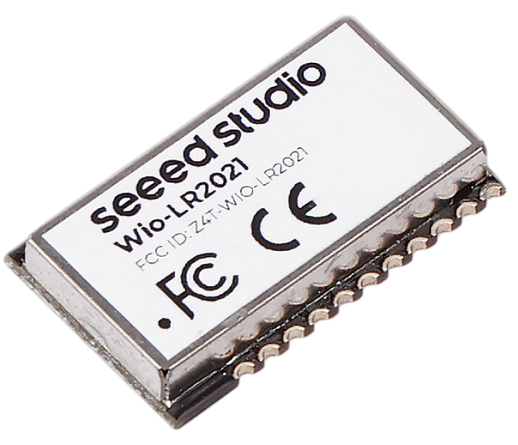
The AI Hardware Partner
Semtech LoRa Plus™ LR2021 Gen4 LoRa® IP
Gen 4 (LR2021 "LoRa Plus"):
Eliminates the historical trade-off between distance and bandwidth.
The Next-Gen Paradigm:
Dubbed LoRa Plus™—bridging ultra-long-range sensing with high-speed local data pipelines.
Dual-Engine Modem:
Native support for both long-range LoRa & high-throughput FLRC (2.6 Mbps).
Unified Global Frequency:
Sub-GHz (150–960 MHz), 2.4 GHz ISM, and S-Band Satellite* (1.9–2.5 GHz) in a single silicon.
Direct-Tie RF Front-End:
Simplified matching network with superior sensitivity and lower system BOM.
*Module design and operator support required

Slide 6
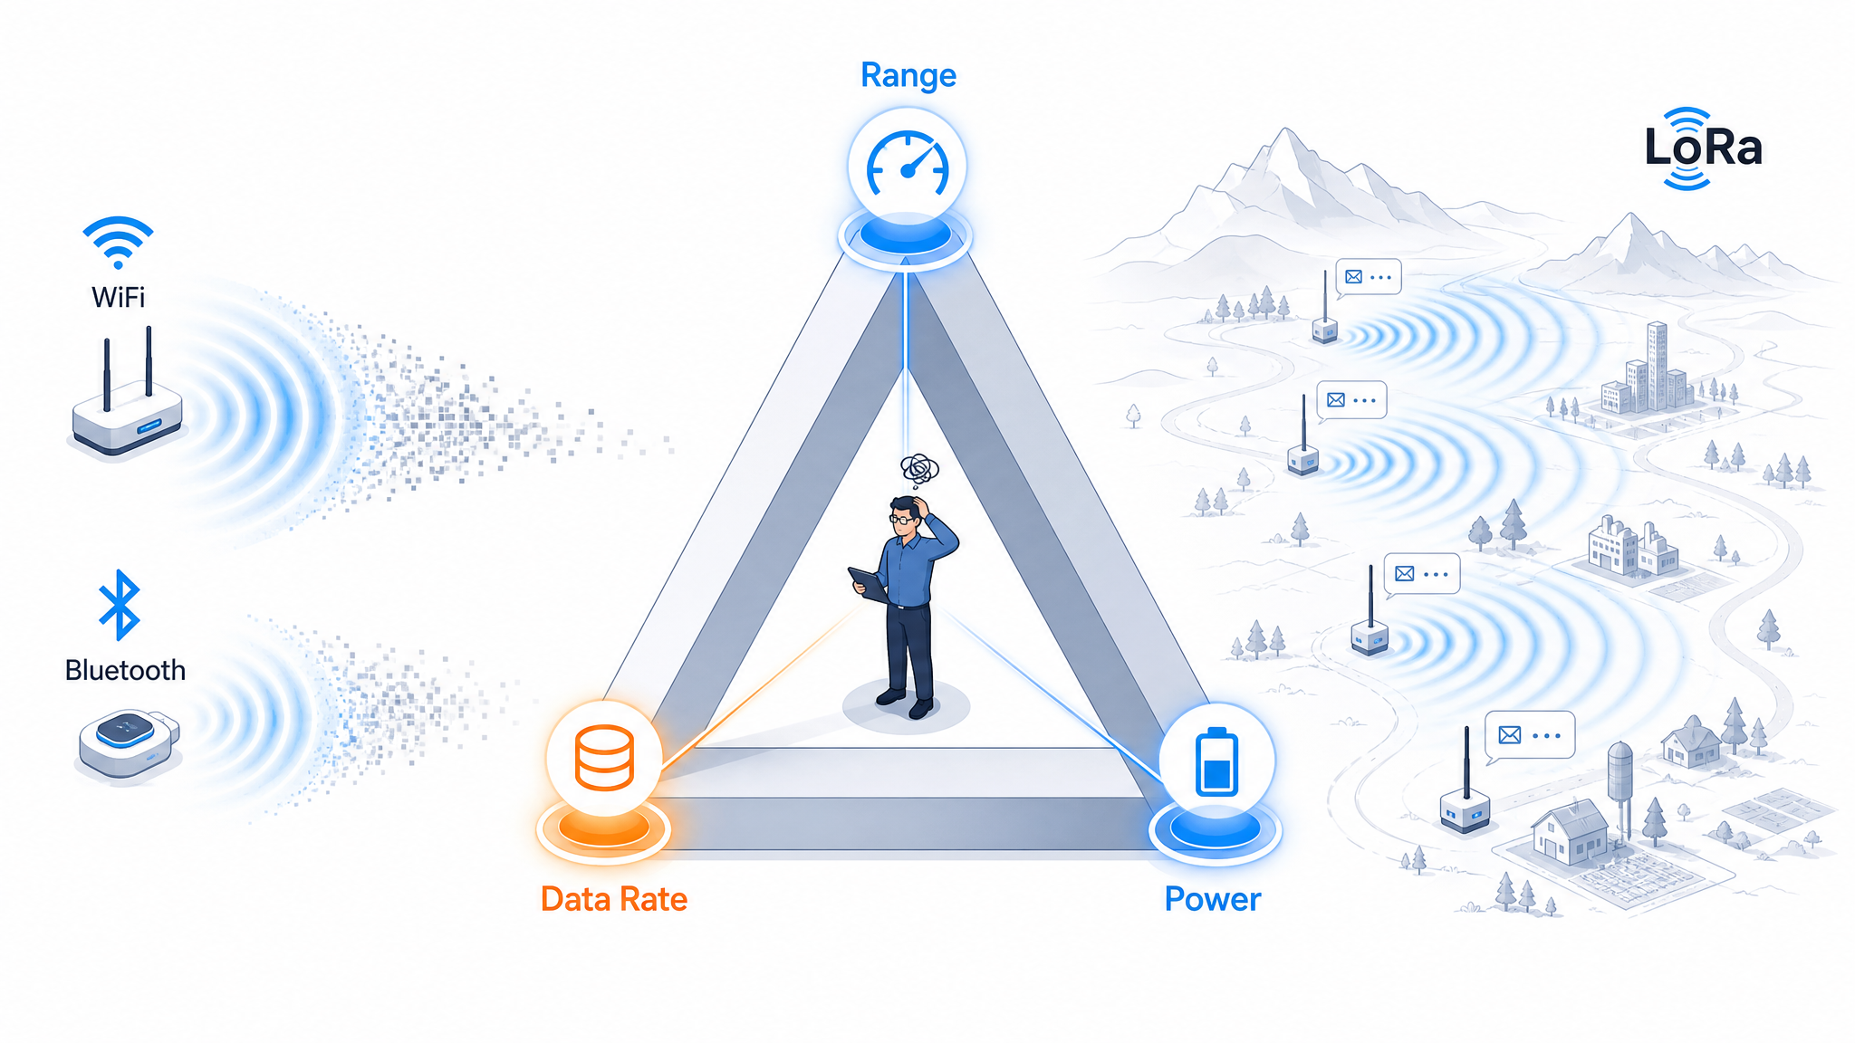



Slide 7
The AI Hardware Partner
LR2021 Dev Kit DEMO

Slide 8
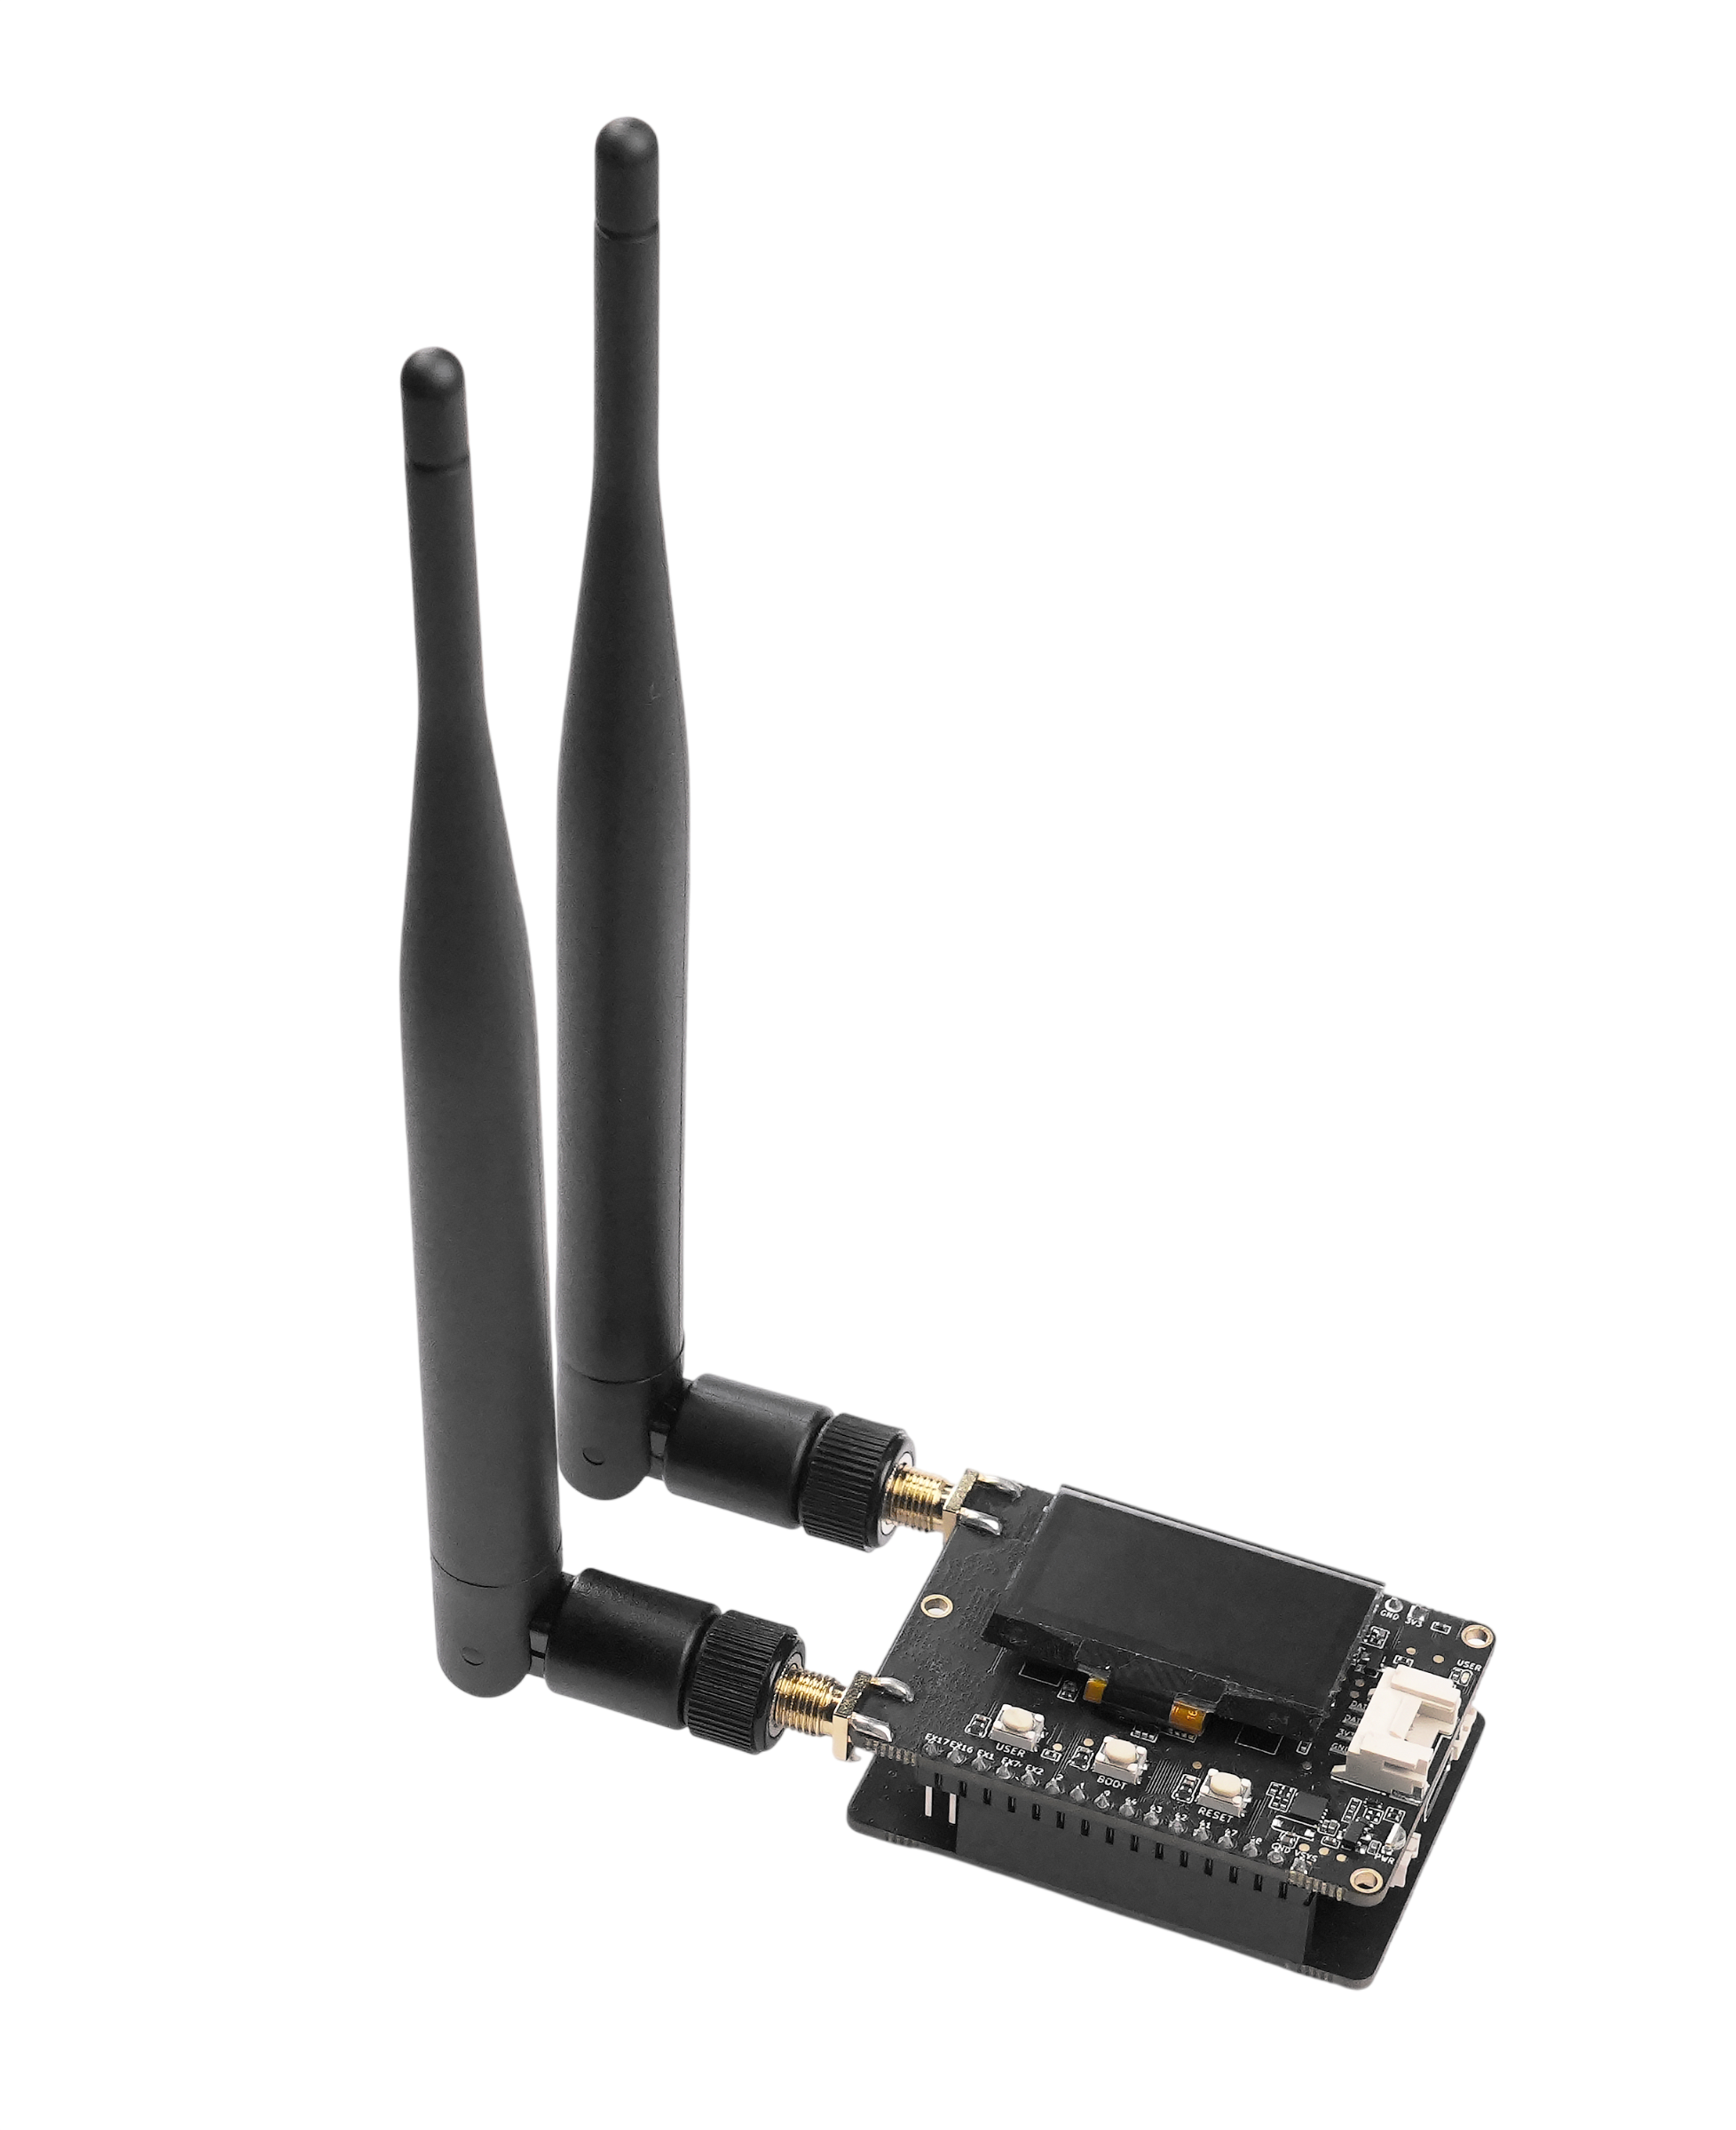
The AI Hardware Partner
DESCRIPTION :
Wio‑LR2021 development kits
Built around Wio-LR2021 transceiver module and ESP32-S3
Transmitters pre‑loaded with Face Detection AI models
VALUE PROPOSITION:​
Showcases of FLRC modulation at 2.6 Mbps for edge AI vision
Proving the module’s ability to handle real-time visual data transmission
Rapid prototyping for wireless image streaming over Sub‑GHz bands with extended range potential

Slide 9
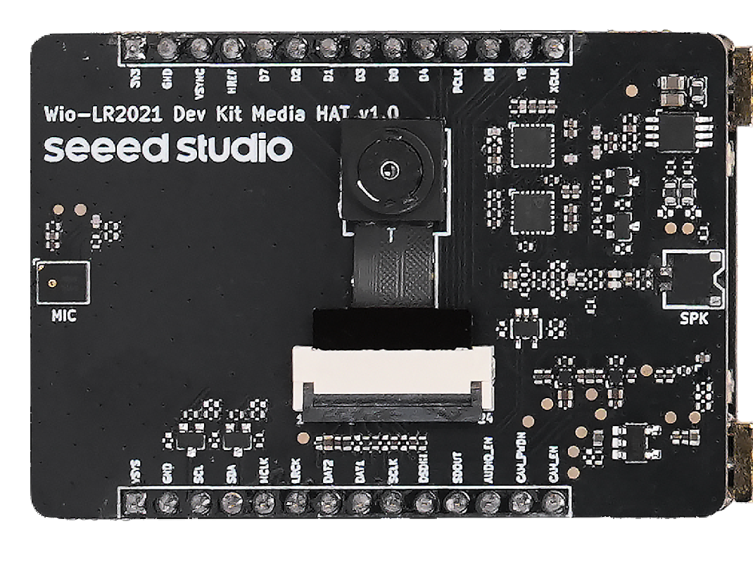
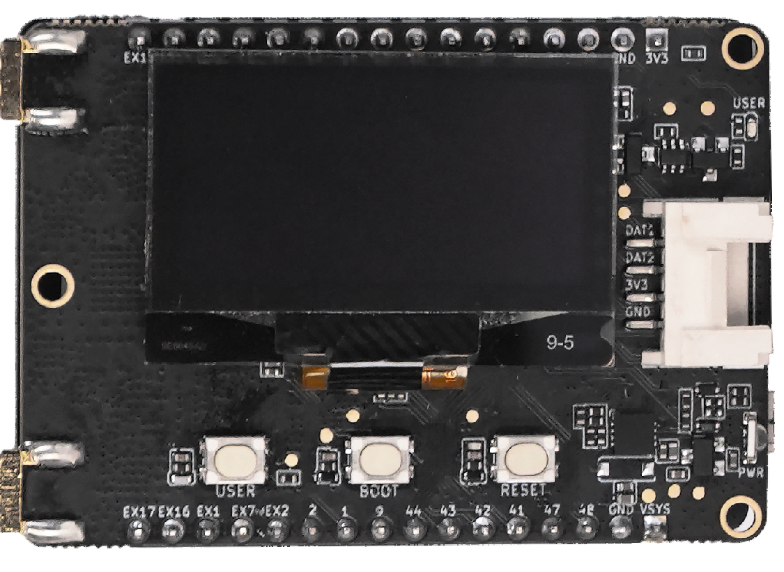
The AI Hardware Partner
Media HAT
Camera
Microphone
Speaker Interface
1.3 inch OLED Display
Grove Connector
Main Board

Slide 10
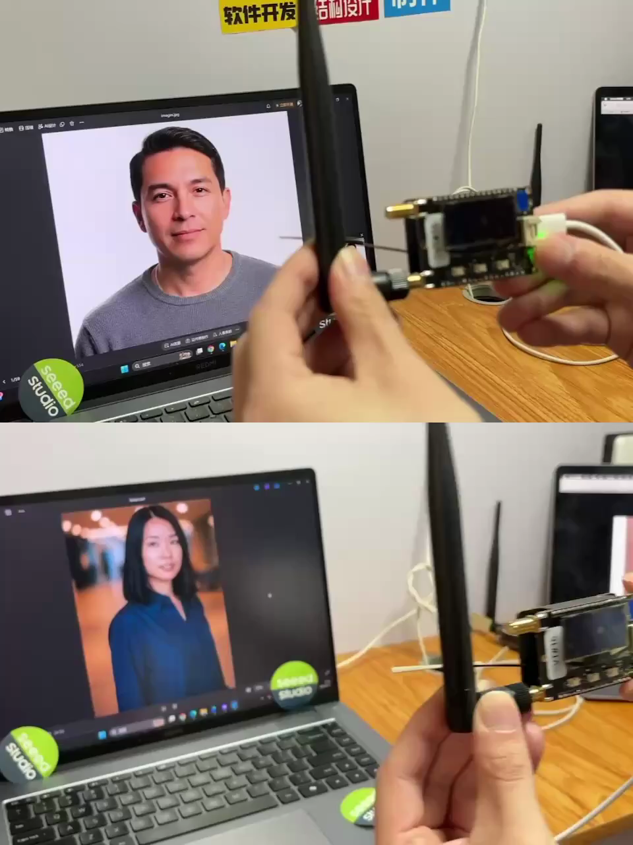
The AI Hardware Partner
Please connect:
AP Name: Wio-LR2021-FLRC-RX-xxxx
Password: 12345678
Then:
Log in to this IP using a browser
Login IP: 192.168.4.1

Slide 11
The AI Hardware Partner
Mesh Everything:
The Seeed Studio Ecosystem

Slide 12

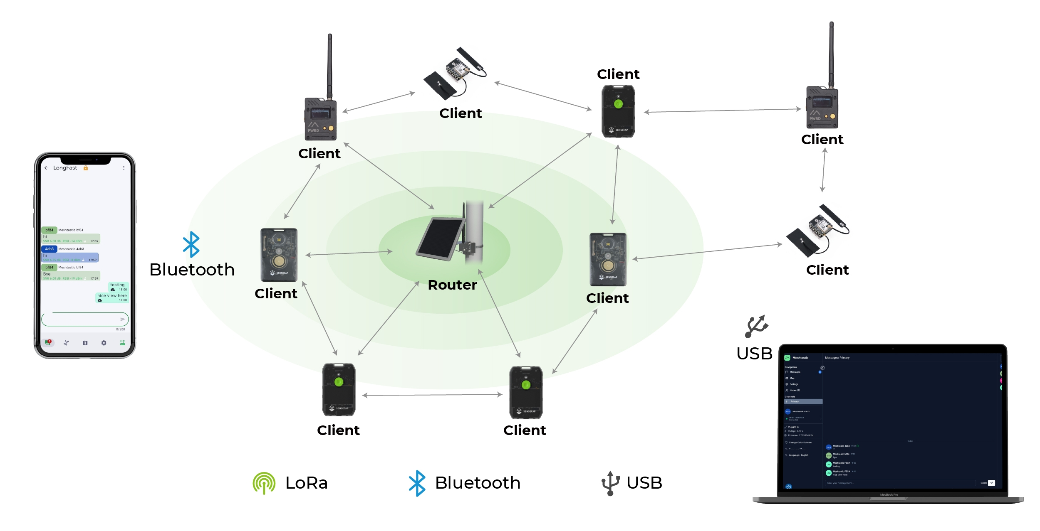
Learn more:
What is Meshtastic?
An open-source project that lets you create long-range, off-grid communication — no cell towers, no Wi-Fi, no monthly fees.
How It Works
Key Facts for Creators
Each device is a tiny, low-power radio. When you send a text message from your device, it hops from device to device over radio waves until it reaches the destination.
Think of it as a text-based, long-range pager system that also shares GPS locations—working completely without cell service, Wi-Fi, or internet.
OFF-GRID
Works without cellular service, Wi-Fi, or internet infrastructure
FREE
100% free to use — no SIM card, no subscription, no hidden costs
LONG
RANGE
Range: typically 1–10 km (line of sight); can extend to 100+ km via relay nodes
LOW
POWER
Ultra low power — devices last days to weeks on a single charge
STORE&
FORWARD
Messages remain available in the mesh and can be delivered when devices reconnect
LICENSE-FREE
No license or certification required.
Applications
Outdoor Adventures
Emergency Preparedness
High-Density Events
Maker / DIY Community
Stay connected on hikes, camping trips, and remote areas with no cell service
Build a communication network that works when the grid goes down
Concerts, Festivals & Expos
A thriving open-source ecosystem for custom projects and experiments
Notes:
单击此处添加文本

Slide 13
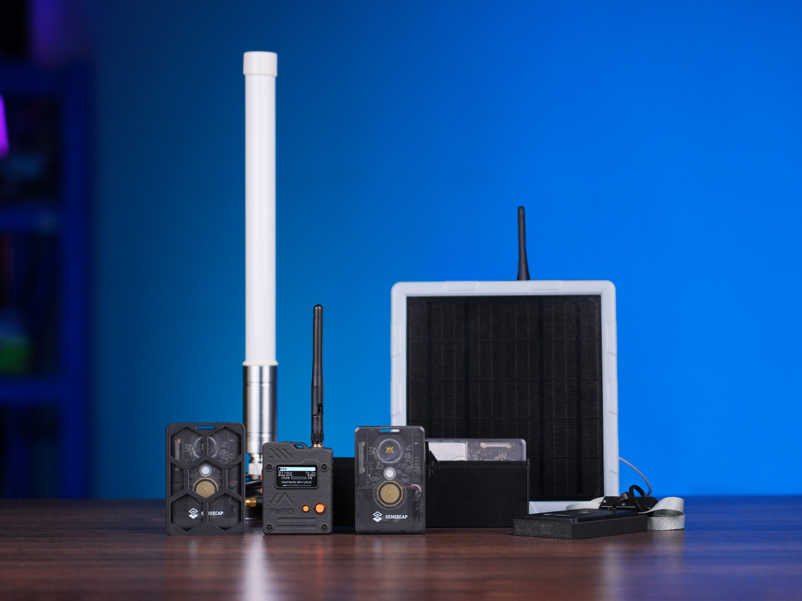
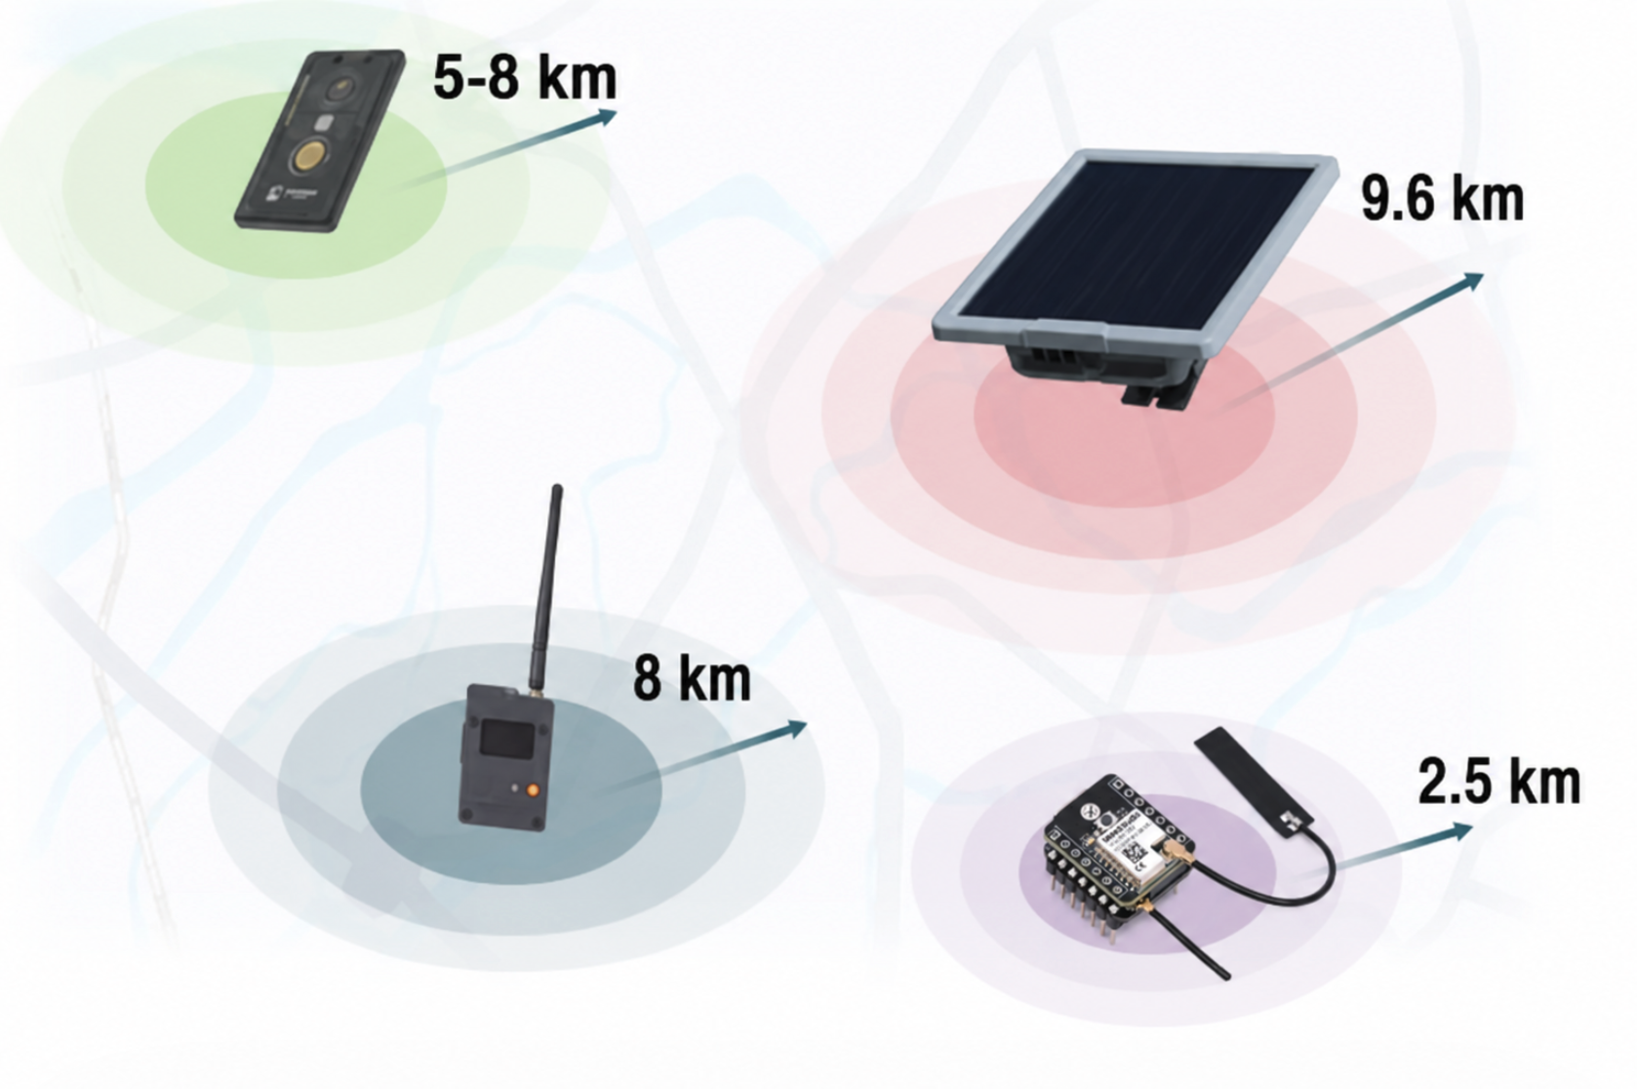
Meshtastic-compatible Products
Ready-to-use devices: Fast deployment, 100% Off-Grid, Subscription-Free
SenseCAP Card Tracker T1000-E
SenseCAP Wio Tracker L1 Pro
SenseCAP Solar Node P1 & P1 Pro
XIAO Kit (ESP32 & nRF52840)

Slide 14
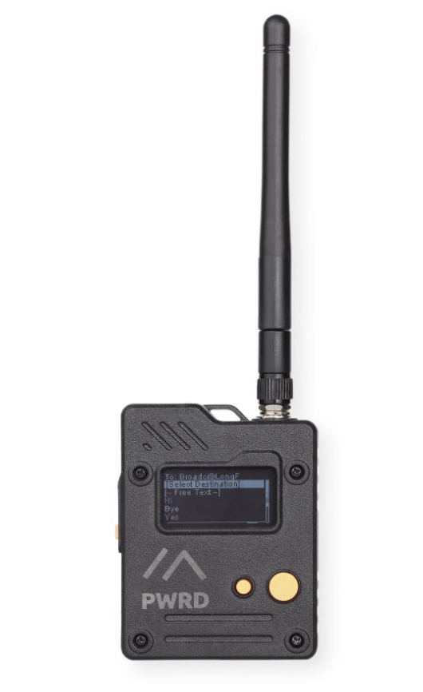
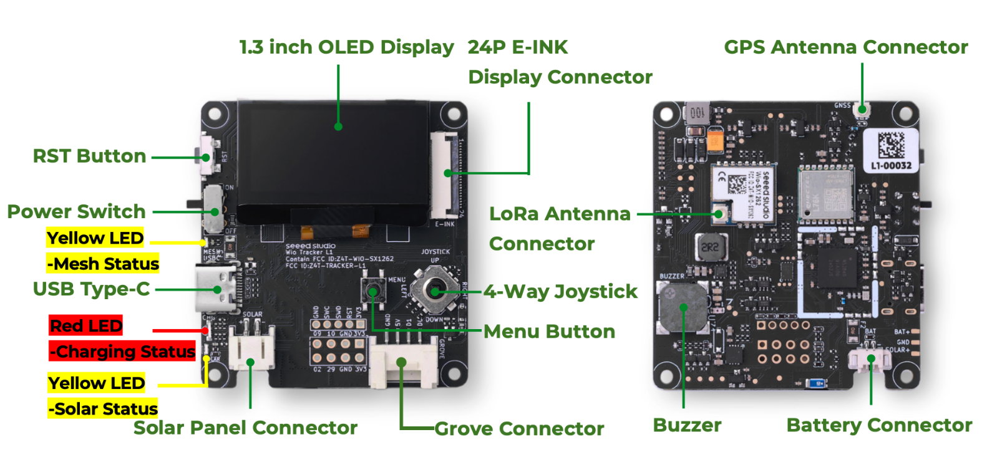
SenseCAP Wio Tracker L1 Pro
Features：
All-New PC+ABS Casing
Built-in Screen: Direct messaging and location viewing without a phone
Easy Operation：4-way joystick, one-handed menu navigation
High Expandability：Equipped with Grove connectors to plug in sensors
Triple Power Supply Options：Built-in battery, Type-C fast charging, and solar input support

Slide 15
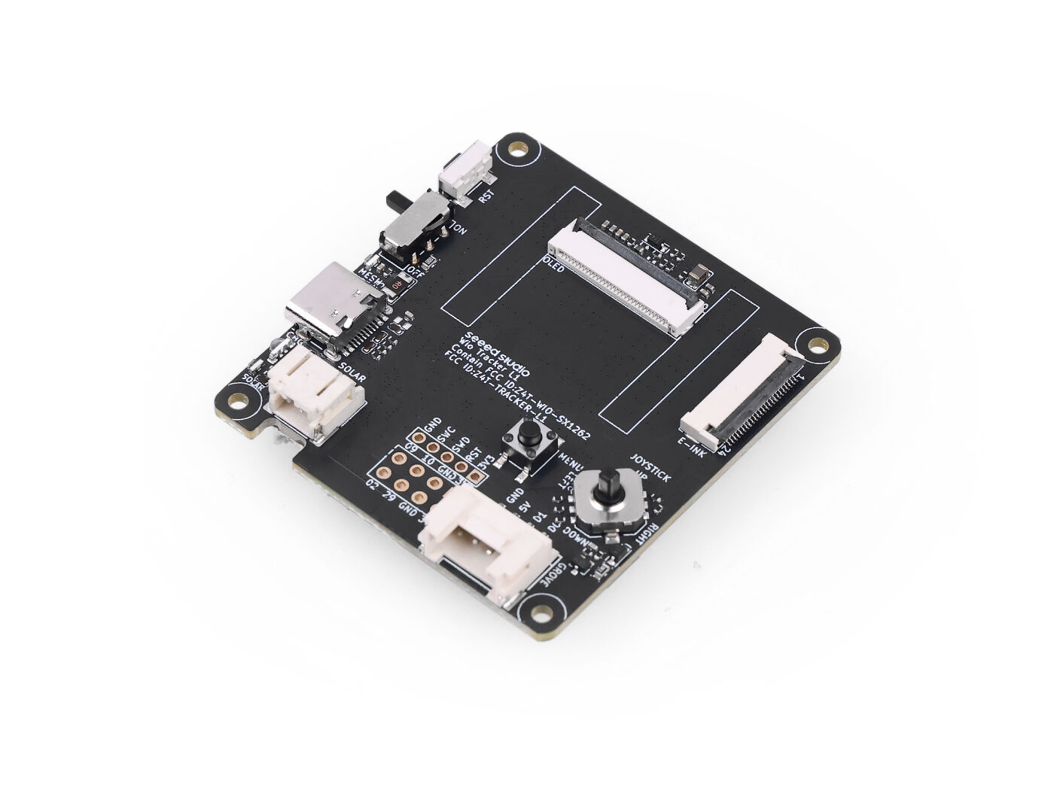
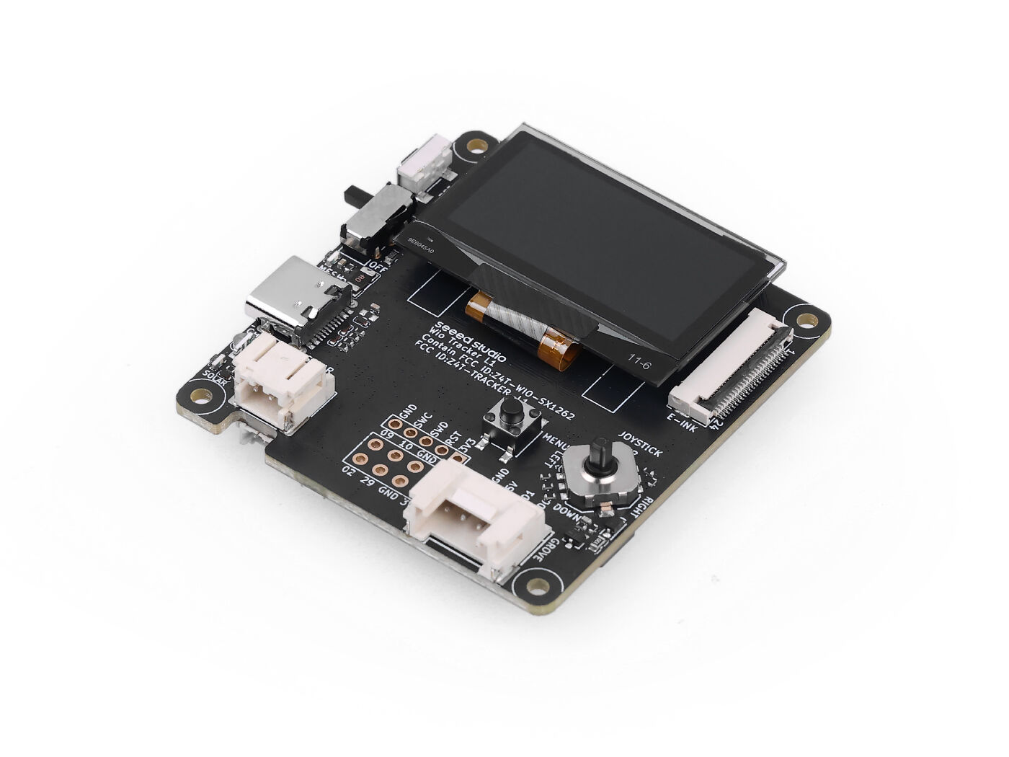
Wio Tracker L1 Dev Board
Product Name | Wio Tracker L1 Lite | Wio Tracker L1 | Wio Tracker L1 E-ink
Image
Screen | / | 1.3-inch OLED | 2.13-inch E-ink
Features：
Plug & Play: Pre-flashed Meshtastic firmware for instant setup
Triple Power: Supports Type-C, Li-ion battery, and Solar input
High Expandability: Grove-compatible for rapid industrial customization

Slide 16
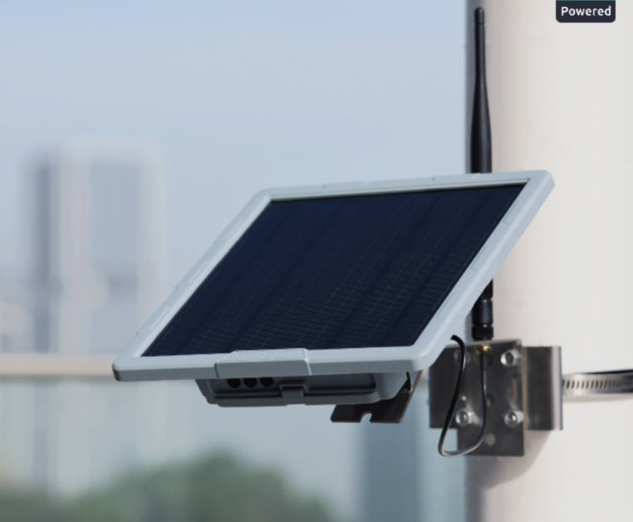
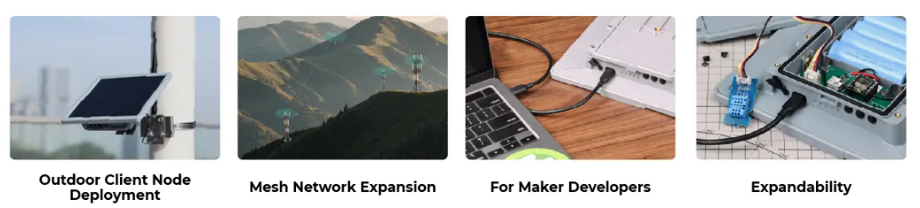
SenseCAP Solar Node P1& P1 pro
Features：
Sustainable Power: 5W solar panel +batteries last over 2 months( P1 Pro)
Long-range communication: 8 to 9 km
Long-term outdoor use: Rugged protective casing, IPX5 waterproof
High Expandability：Equipped with Grove connectors to plug in sensors
Accessory Options：Multiple antenna choices
Easy to install: Align → Insert → Lock, mountable on poles or walls
Applications：
Notes:
Solar Node 的核心优势是供电和部署方式。它集成太阳能板和电池，可以在户外长期工作，减少人工维护频率。P1 Pro 配备 5W 太阳能板和更大的电池容量，更适合长期户外部署。
在通信方面，它支持外置天线，可以根据部署环境选择不同增益的天线。比如普通覆盖可以使用 3 dBi 天线，如果安装在高处、环境开阔，也可以选择更高增益天线来提升水平方向覆盖能力。图中标注的 8 到 9 公里属于开阔环境下的参考通信距离，实际效果仍然取决于安装高度、遮挡、天线、地形和 LoRa 参数。
另外，它也保留了 Grove 扩展接口，可以接入传感器，所以也可以用于一些户外数据采集或开发测试场景。

Slide 17
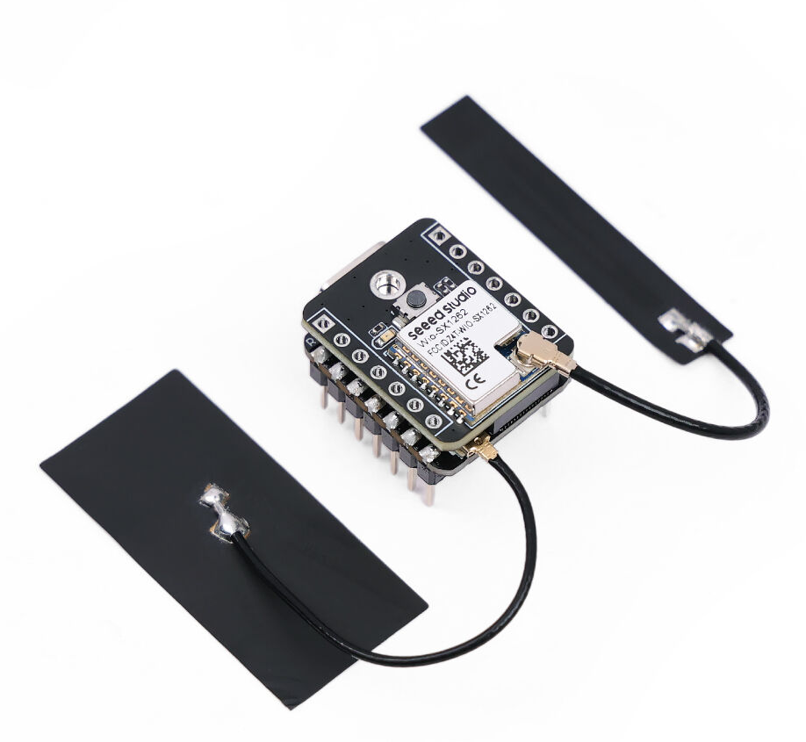
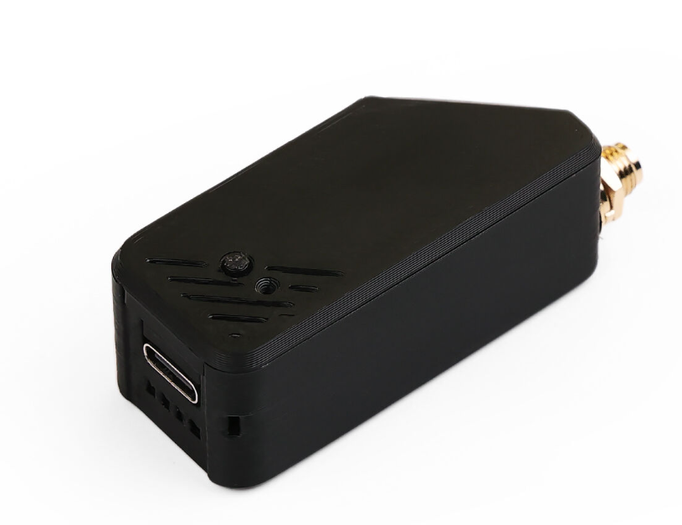
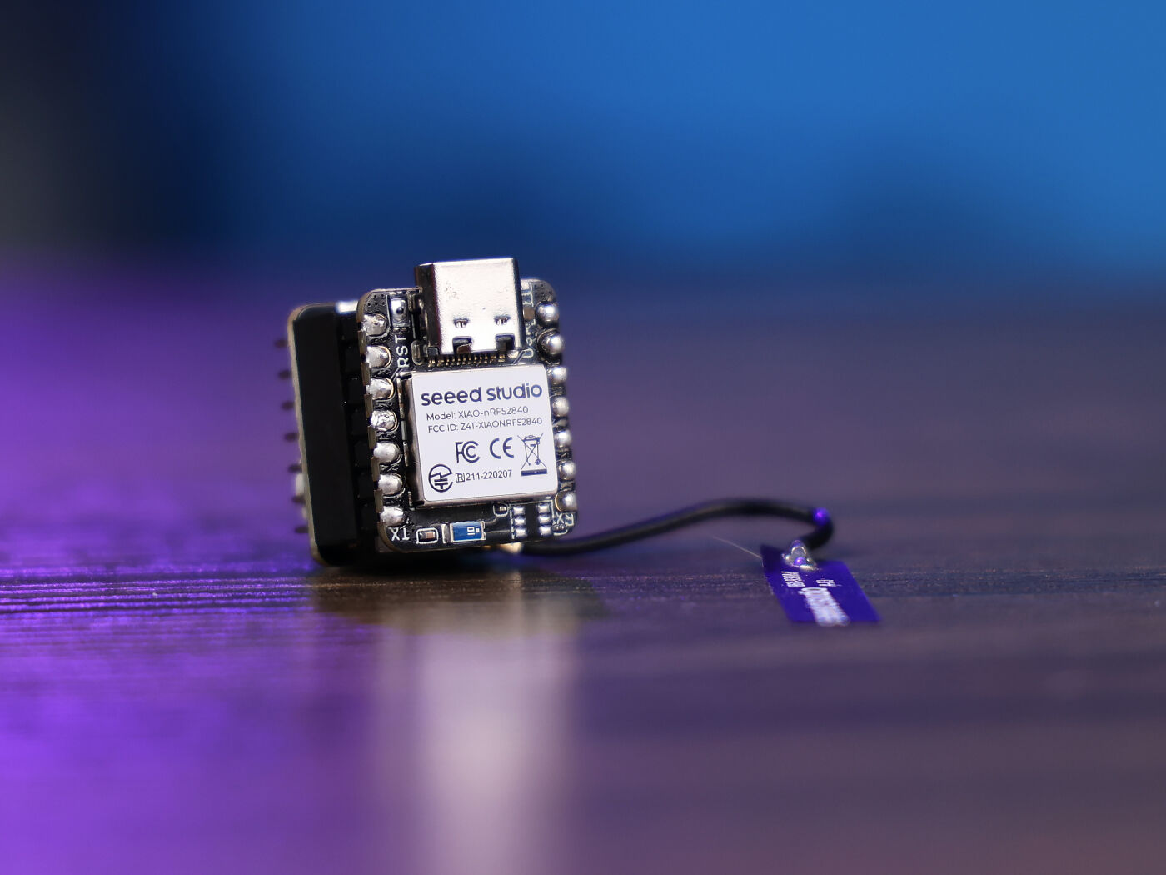
XIAO Dev Kits for Meshtastic®
This series offers a user-friendly, plug-and-play experience with pre-flashed firmware for instant deployment. It supports LoRa , BLE or Wi-Fi for versatile communication needs and features seamless Grove compatibility for rapid sensor integration and customization.
XIAO ESP32S3 & Wio-SX1262 Kit
High Performance
Multiple Applications: Can be developed as a Meshtastic node or router, a LoRa & LoRaWAN sensor, or a single-channel LoRaWAN gateway
XIAO nRF52840 & Wio-SX1262 Kit
Ultra-Low Power
Bluetooth 5.0 with NFC

Slide 18

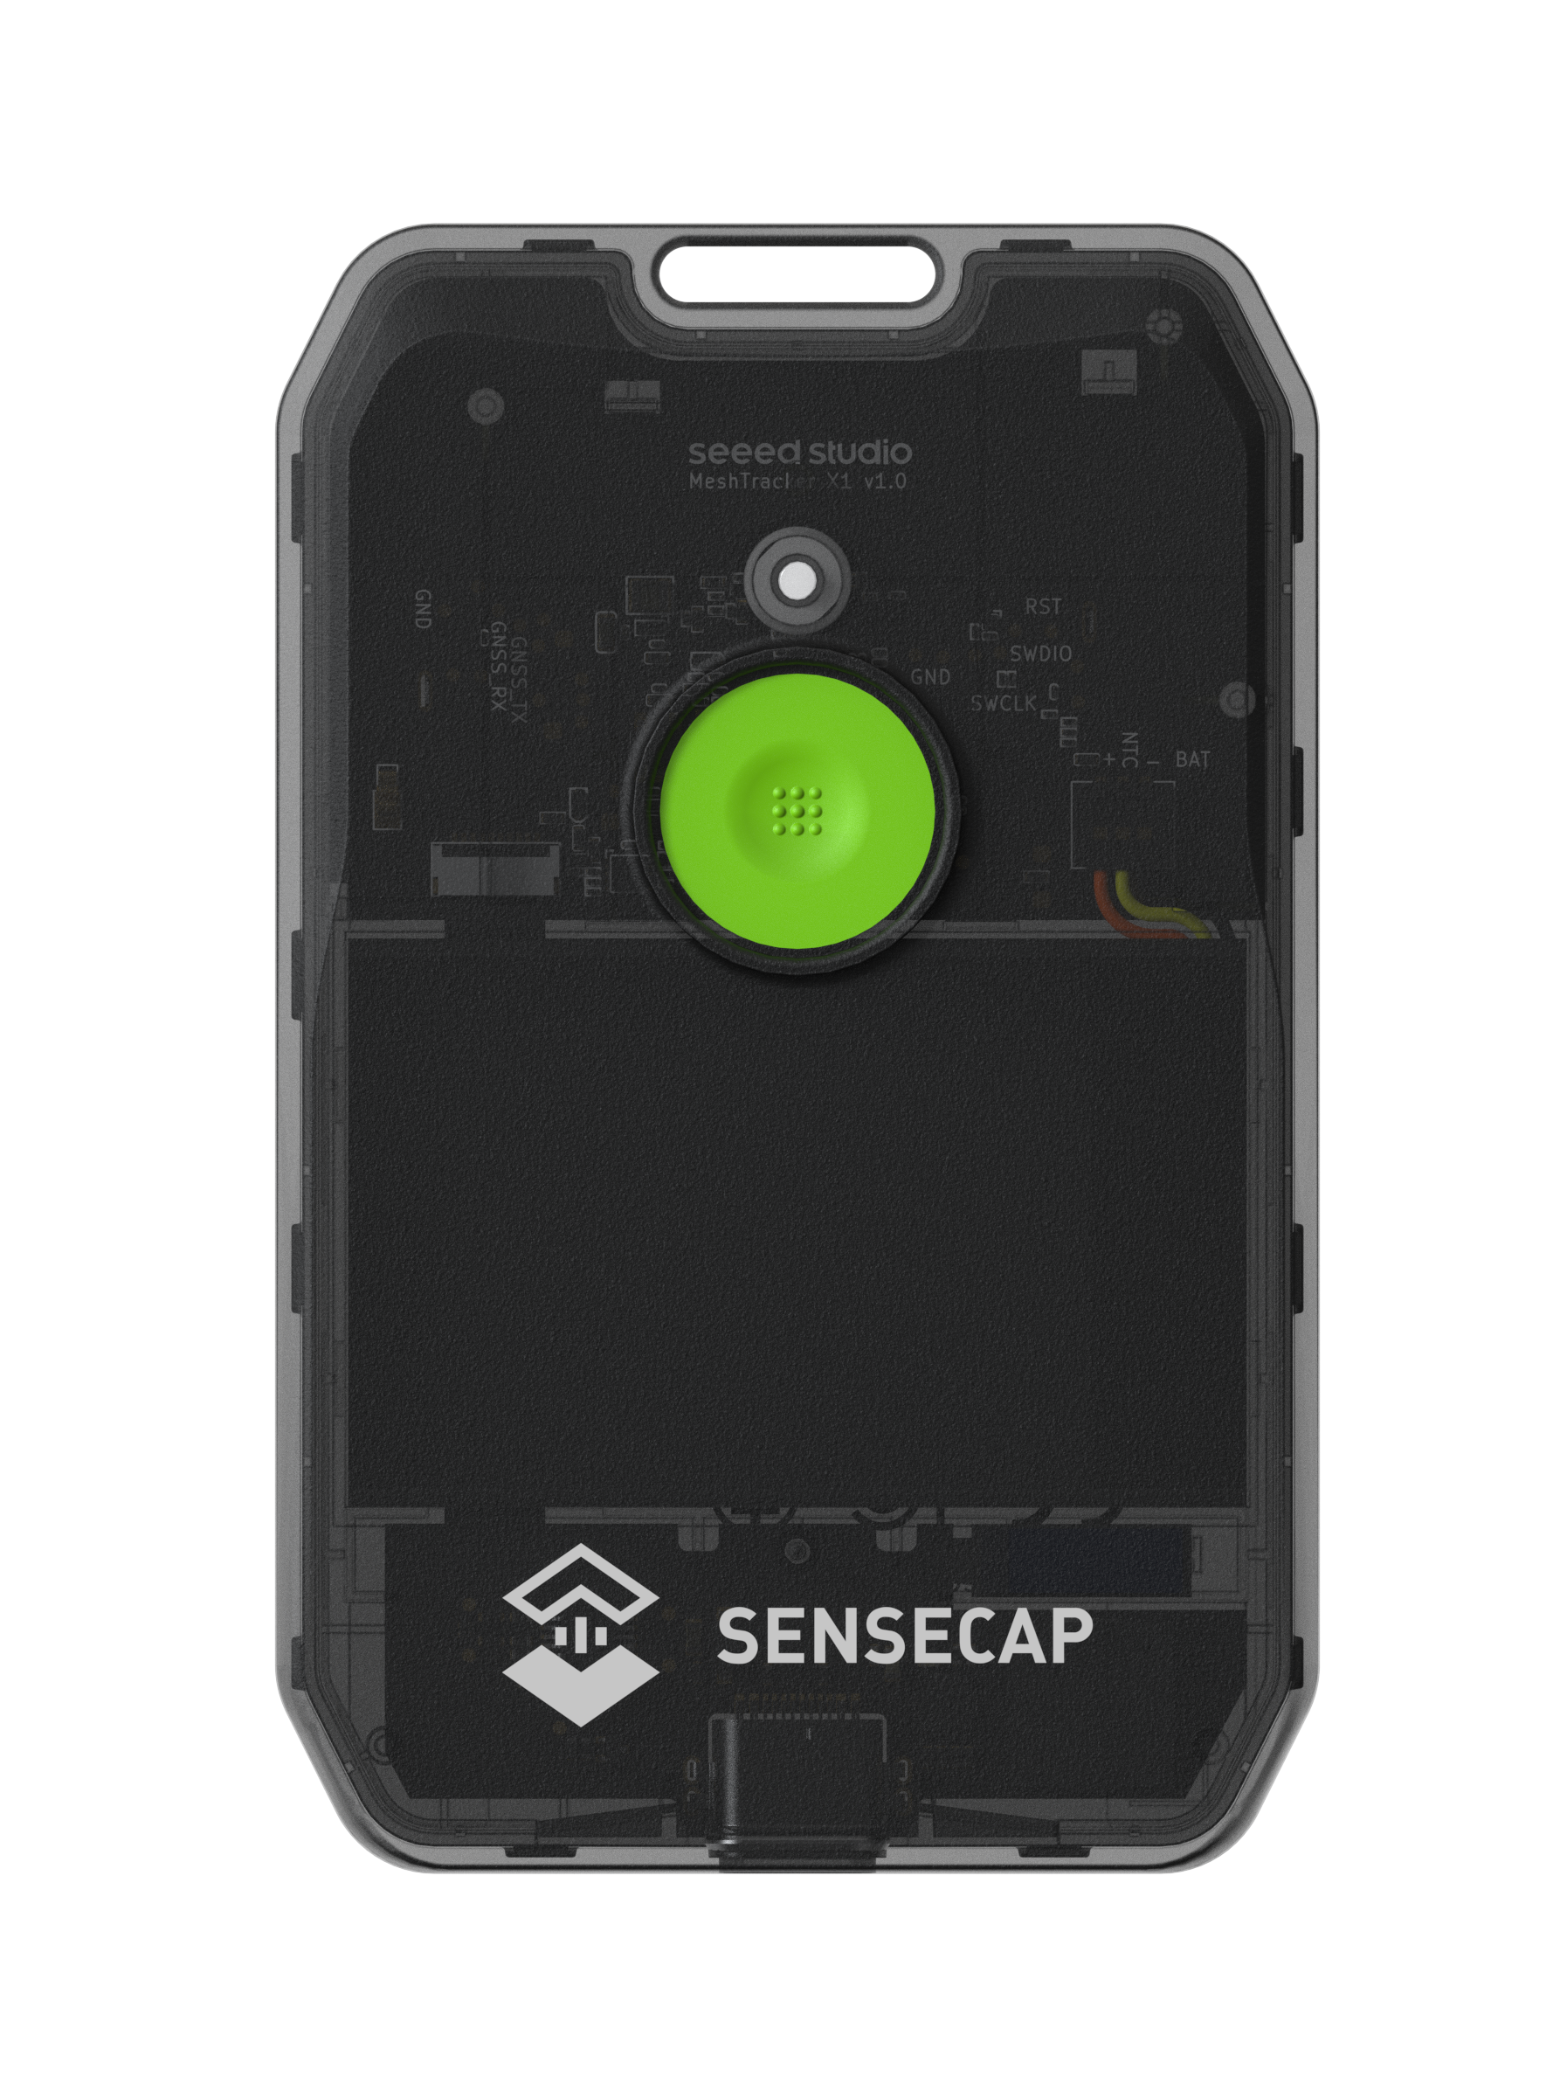








PRODUCT OVERVIEW
MeshTracker X1
Your Best Everyday Carry Companion for Off-grid Communication
Text Message Support
No Monthly Fee
Stay connected beyond cellular, Wi-Fi, and Ethernet coverage.
No SIM card, no subscription fee needed
Card-sized
Accurate Location Tracking
Fits in your wallet, easy to carry anywhere
Share and view locations on the map, even off-grid
Waterproof and Dustproof
Last for Days
Built fot the outdoors. IP66 dust&water resistant
1100mAh high battery capacity, Up to 5 days on a single charge
USB-C Charging
Long-Range Coverage
Standard USB-C interface, convenient for daily use
Benefiting from LR2021 communication up to 8 km without service
Notes:
单击此处添加文本

Slide 19

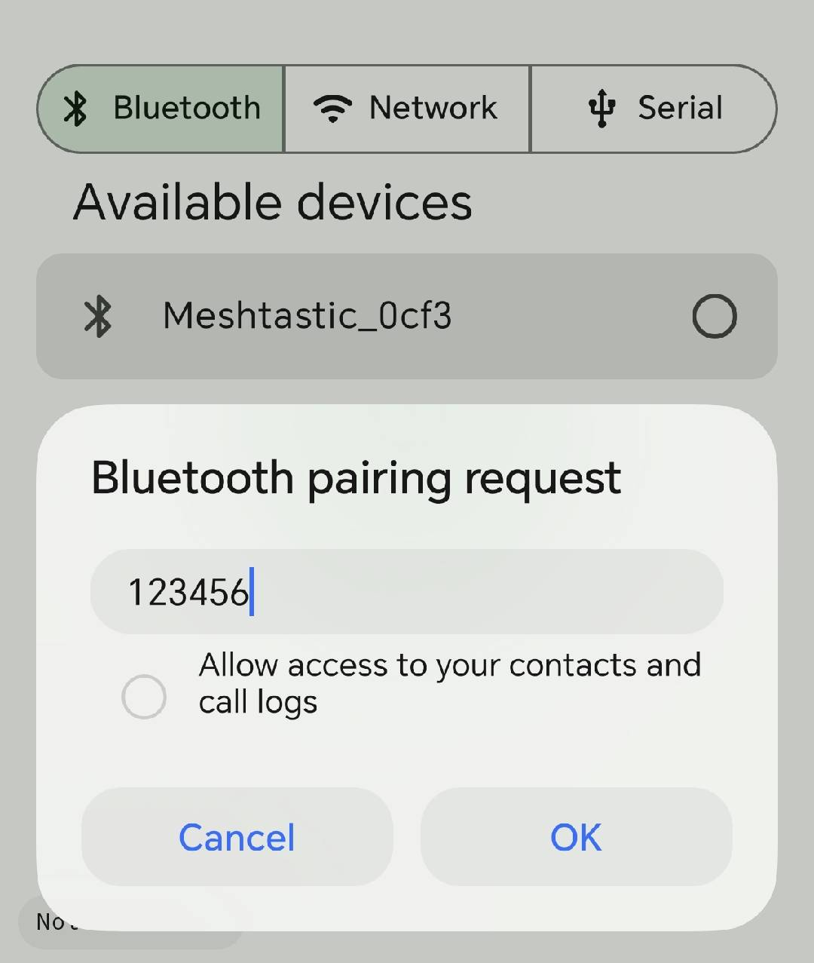
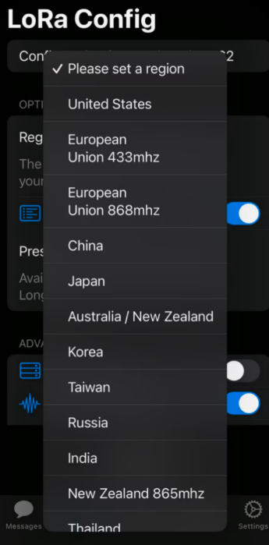



How to use MeshTracker X1?
1. Power On
2. Download App
3. Pair X1 with APP
4. Configure LoRa and Start Using
Click Once
Notes:
单击此处添加文本

Slide 20
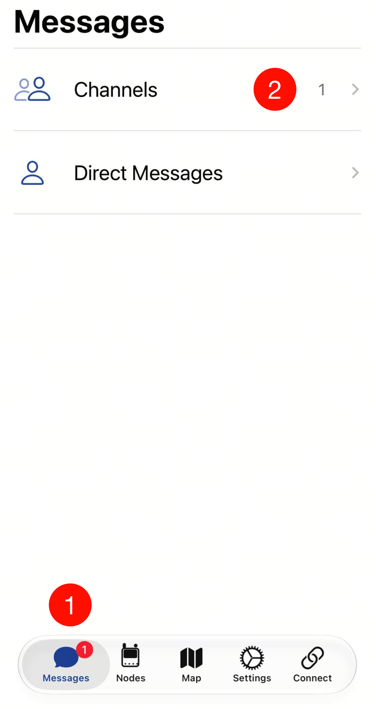
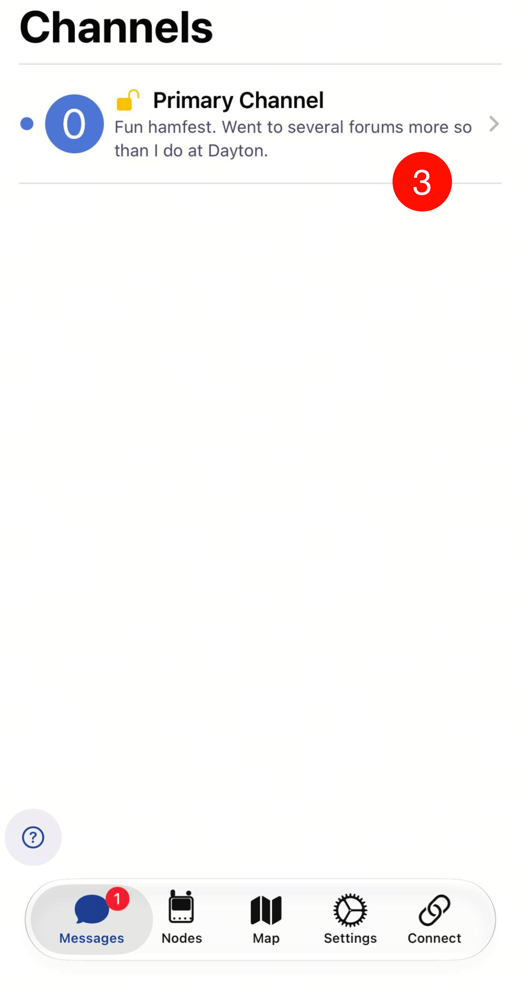
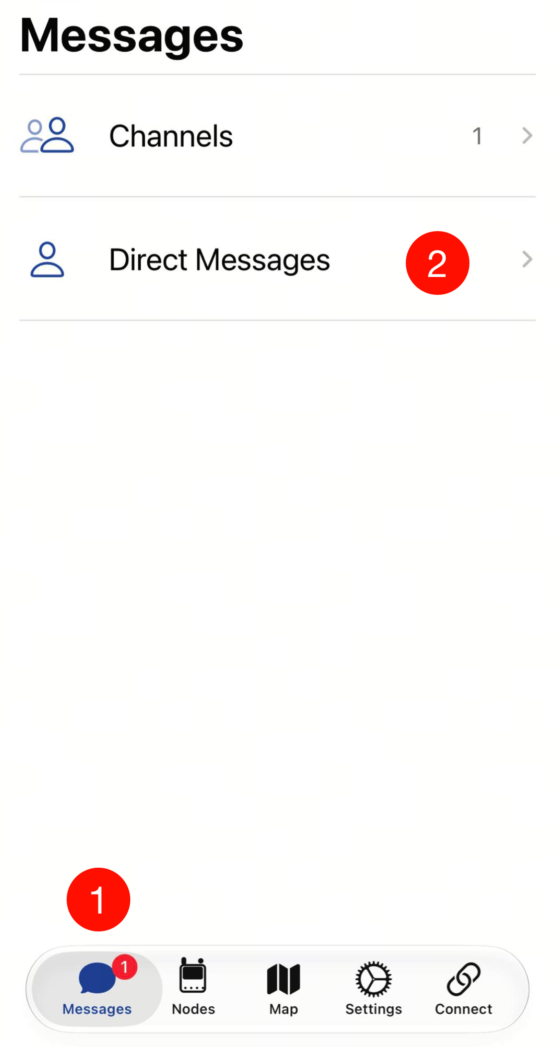
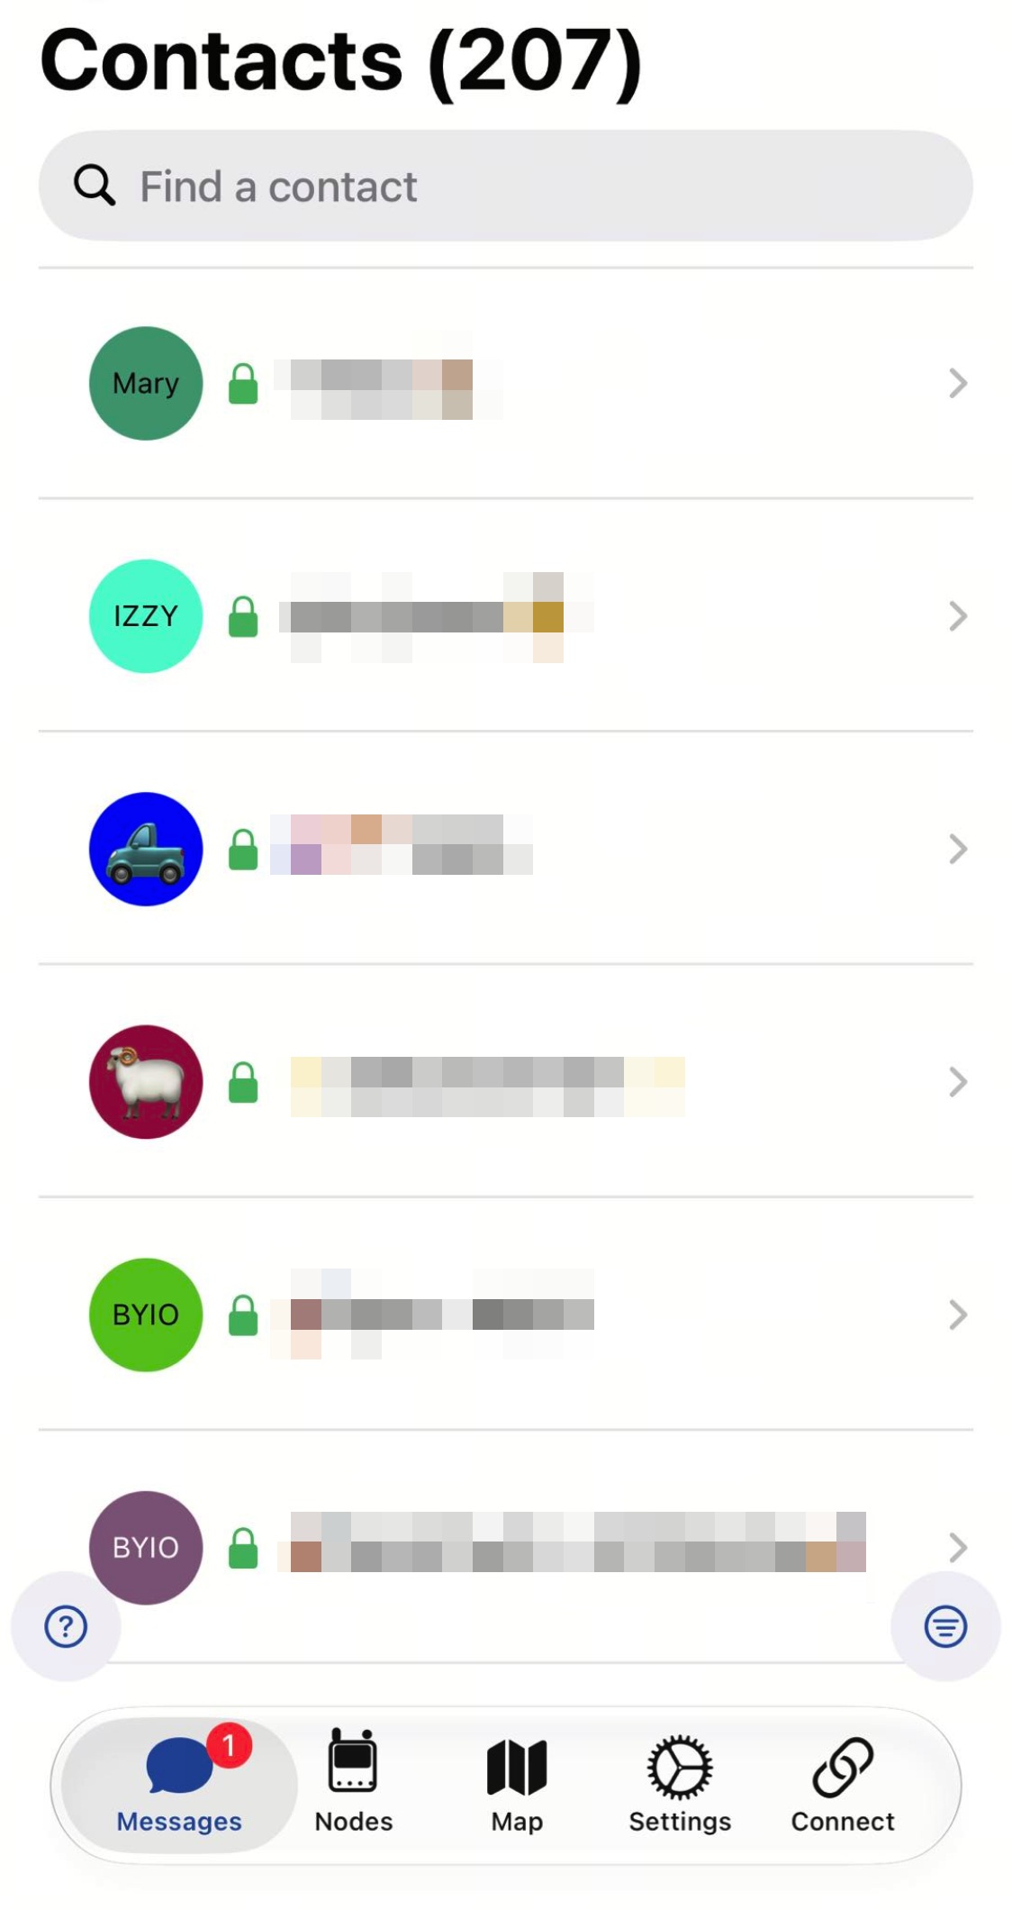
How to use MeshTracker X1 on?
Broadcast message
Private direct message
Notes:
单击此处添加文本

Slide 21
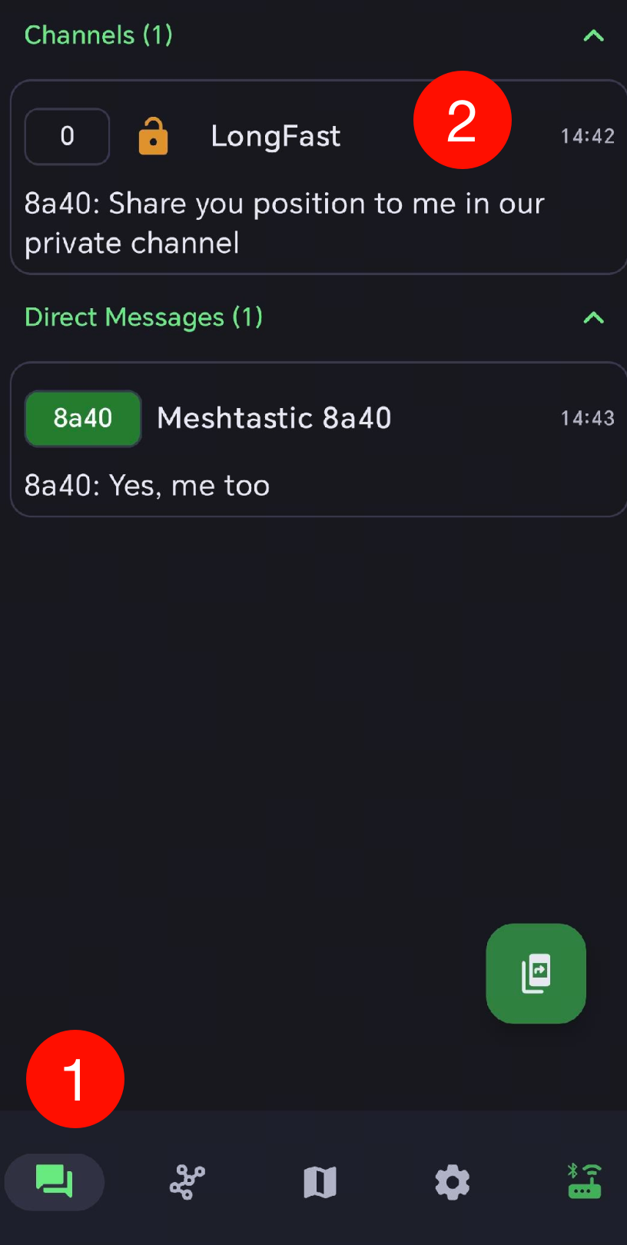
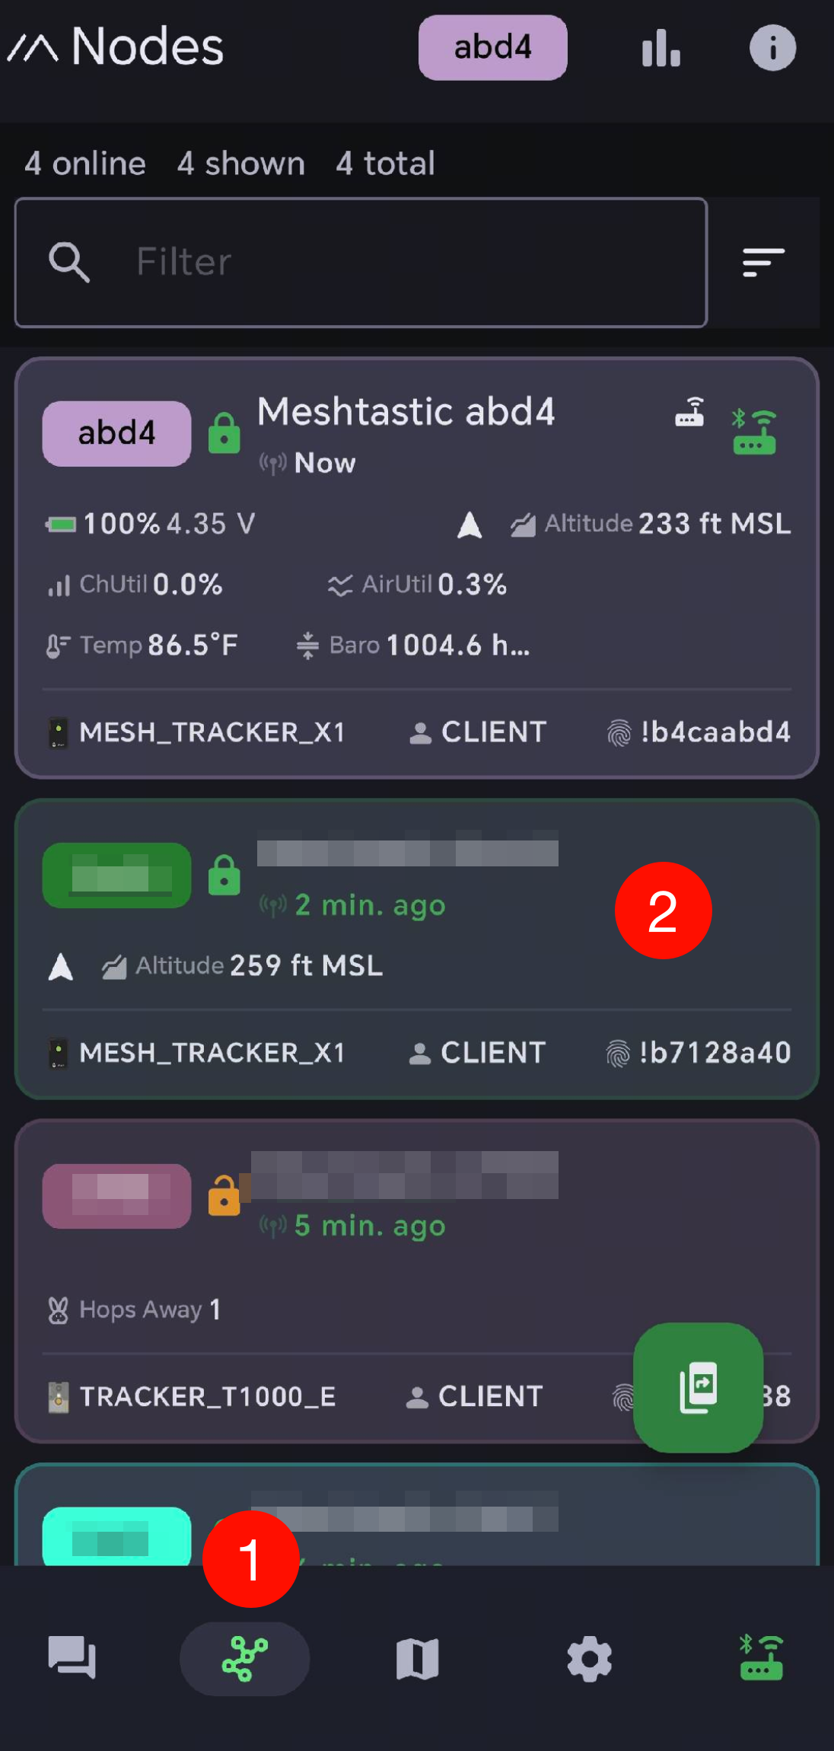
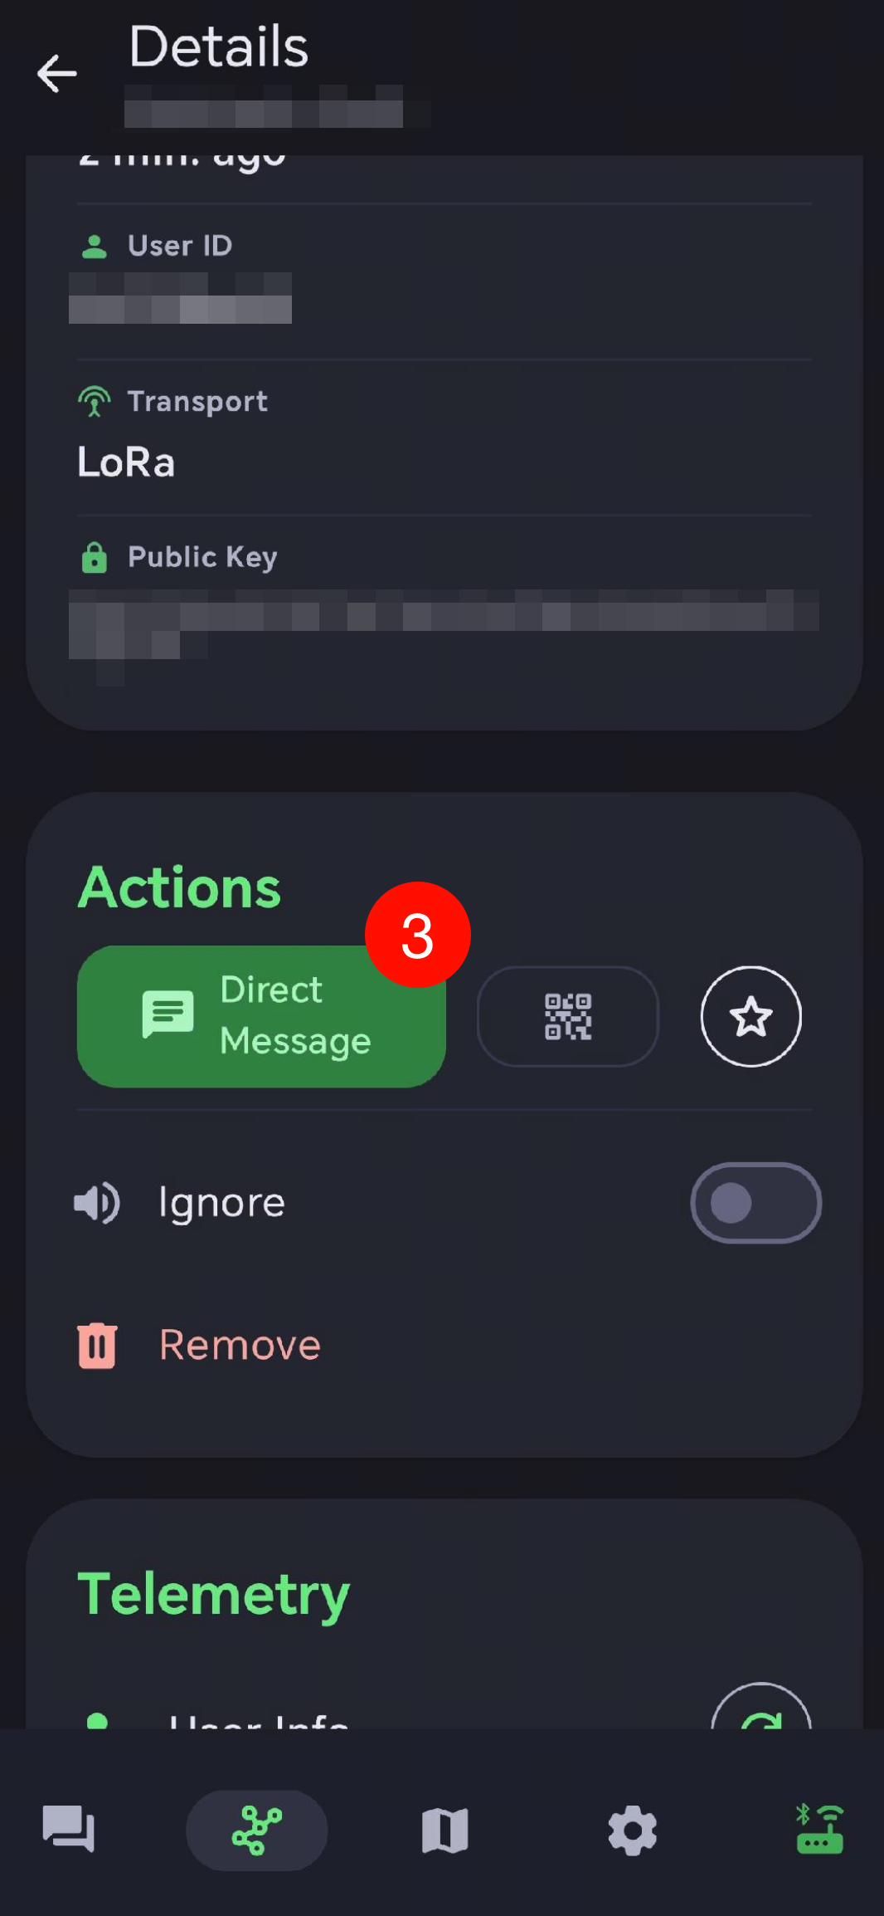
How to use MeshTracker X1?
Broadcast message
Private direct message
Notes:
单击此处添加文本

Slide 22

Thank you!
X1 10% DISCOUNT CODE: 4TTC2026X1
Complete survey!

