Slide 1

Module 3
Learner Groups
www.schooltalk.co.nz

Slide 2

Module 3 - Learner Groups
Within this training module, you will familiarise yourself with:
3.0 Purpose of grouping
3.1 Making a group
3.2 Moving learners around groups
3.3 Changing the name or tags of a learner group
3.4 Groups and gap analysis

Slide 3
3.0 Purpose of Grouping
Grouping is used for a number of reasons:
Tracking the progress of a group of target learners, so they are easy to see on one screen
Creating differentiated learning opportunities based on where each learner is at
Planning events
Accessing achievement data for learners
Marking progress, setting goals and identifying gaps from one screen

Slide 4
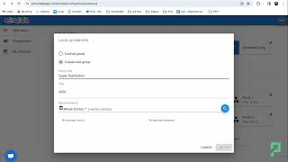
3.1 Create a learner group
This video will guide you through how a group is created. You can create a new group for any reason you desire. You can add learners by searching them individually, or copy and paste their names from your planning docs, put commas in between the names and search a group of learners at the same time.

Slide 5
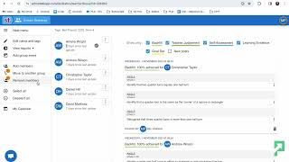
3.2 Move learners around groups
It is very easy to move learners around groups, ensuring that you can easily use flexible grouping strategies. In this video you will see how to:
Add new learners to a group
Remove learners from a group
Move learners to a new group
Move learners from one existing group to another

Slide 6
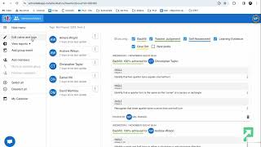
3.3 Edit the name or tags of a learner group
You can change the name of a learner group and keep the learners attached to it.
Click the pinned group you want to change the name of.
Select ‘edit name and tags’.
Type the new name or tags, and click save.

Slide 7
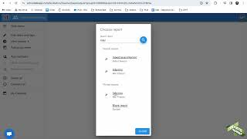
3.4 Groups and Gap Analysis
Sometimes you will want to track the progress of a specific group of learners. This might be a target group of learners, such as a learning support or an acceleration group. You can create a gap analysis for a group of learners, or open any saved gap analysis for a group of learners. This video will show you how to do both.

