Slide 1

Company Overview
November 2025

Slide 2


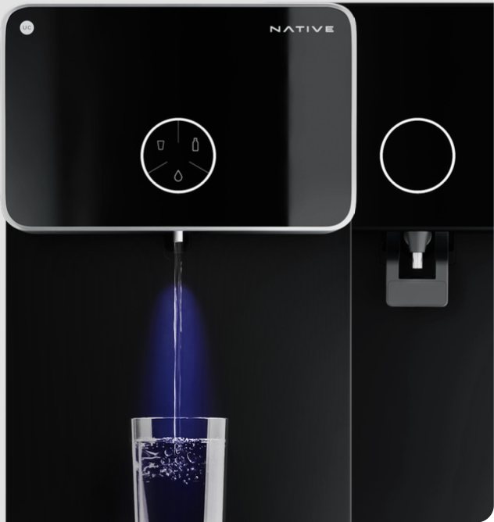
Home services done right
High quality, standardised services and solutions delivered to your doorstep
Home Services
Cleaners, Beauticians, Hair Stylists, Massage Therapists, Plumbers, Electricians, Carpenters, Painters, Appliance Technicians, House help workers etc.
Native devices
Water purifiers &
Smart door locks

Slide 3
Urban Company
India’s leading home services platform
Large TAM
Customer obsession
Capital efficient with a strong balance sheet
UC has pioneered online home services in India. Market leader in the $60 bn+¹ India home services market
Consistently reliable, high quality services have made UC a household brand, with 84.9%² of NTV from repeat users
Strong unit economics and capital efficiency - INR 3,052 Cr lifetime primary capital raised with INR 2,136 Cr⁴ cash and cash equivalents available
Proven Scale, Growth & Profitability
Strong moats
Strong team and governance
Scale (H1 FY26 NTV: ₹ 2,060 Cr²), Revenue growth (40%² ex KSA) & Profitability (Adjusted EBITDA ex Insta ₹ 41 Cr²)
Our multi-category hyperlocal marketplace enjoys strong network effects and is hard to replicate
Founder led business with a strong management team and an accomplished, independent board of directors
Full stack supply side integration
Growth strategy
Full stack approach empowers service professionals with training, certification, tooling, technology, SOPs, insurance and financial support. This drives higher earnings and loyalty - 80%³ NTV comes from repeat professionals
Growth will come from densification & deeper penetration in existing markets (India, Middle East & Singapore), improving our current offerings and scaling new products (Native devices) and services (Insta Help, Wall Décor etc.)
Note: ¹Estimated India TAM for CY25 ²For H1 FY26. ³For FY25 ⁴As at Sep 30 2025

Slide 4





We operate across 4 business segments
India Consumer Services (ex Insta)
Native
International Business
Insta Help
High quality home & beauty services delivered at home
Home devices and solutions
UAE, Singapore and the Kingdom of Saudi Arabia (JV)
All in one help in 15 minutes when your maid is away

Slide 5


UC in a nut shell
For H1FY26
Net Transaction Value (NTV)
₹2061 Cr
Revenue from Operations
₹747 Cr
Adjusted
EBITDA
₹(14) Cr
Adjusted EBITDA (Ex. of Insta Help)
₹42 Cr
25% YoY
34% YoY
₹(13) Cr YoY change
₹41 Cr YoY change
27% YoY (ex KSA)
40% YoY (ex KSA)
Annual Transacting Users (million)
7.4
Monthly active service partners
55,798
Total city
footprint
51
Average customer rating
4.80

Slide 6

H1 FY26 Segment level performance
40% revenue growth YoY. Insta Help investments lead to an overall loss of INR (14) Cr
Key metrics
Consolidated
India consumer services (ex Insta)
Native
International
Insta Help
Net Transaction Value
INR 2,060.5 Cr
INR 1,577.9 Cr
INR 176.5 Cr
INR 295.3 Cr
INR 10.8 Cr
(YoY growth)
25.4%
14.4%
188.8%
45.1%
Revenue from operations
INR 747.3 Cr
INR 533.6 Cr
INR 135.0 Cr
INR 77.1 Cr
INR 1.6 Cr
(YoY growth)
33.9%
20.5%
198.1%
10.3%
(YoY growth) Ex KSA
39.6%
63.3%
Contribution Profit
INR 387.4 Cr
INR 325.0 Cr
INR 52.3 Cr
(As a % of NTV)
18.8%
20.6%
17.7%
Adjusted EBITDA
INR (13.6) Cr
INR 60.9 Cr
INR (17.8) Cr
INR (2.6) Cr
INR (54.1) Cr
(As a % of Net NTV)
(0.7)%
3.9%
(10.1)%
(0.9)%
Adjusted EBITDA ex Insta
INR 40.5 Cr
(As a % of Net NTV)
2.0%

Slide 7
UC Consolidated P&L: Operating leverage visible over the years.
Investments in Insta Help impacted profitability for H1 FY26
UC Consolidated P&L (INR Cr) |  | FY23 | FY24 | FY25 | H1 FY26
Net Transaction Value |  | 2,078 | 2,564 | 3,271 | 2,061
Revenue from Operations (Net of GST & discounts) |  | 637 | 828 | 1,144 | 747
– Services |  | 496 | 651 | 840 | 509
– Products (B2B2C) |  | 136 | 148 | 188 | 104
– Products (Native) |  | 4 | 29 | 116 | 135
Cost of products (B2B2C) |  | (102) | (109) | (142) | (75)
Cost of products (Native) |  | (3) | (19) | (70) | (75)
Cost of services¹ |  | (25) | (35) | (55) | (30)
Other Direct Expenses² |  | (39) | (37) | (33) | (14)
Gross Profit |  | 467 | 628 | 845 | 554
Gross Profit as a % of NTV |  | 22.5% | 24.5% | 25.8% | 26.7%
CX & PX support costs and refunds³ |  | (68) | (75) | (99) | (72)
Other semi-variable expenses⁴ |  | (57) | (70) | (109) | (96)
Contribution Profit |  | 343 | 482 | 637 | 388
Contribution Profit as a % of NTV |  | 16.5% | 18.8% | 19.5% | 18.8%
Salaries and employee benefits |  | (311) | (305) | (315) | (192)
Customer marketing expenses |  | (178) | (162) | (161) | (105)
General, administrative & other indirect expenses⁵ |  | (152) | (134) | (149) | (103)
Adjusted EBITDA |  | (298) | (119) | 12 | (14)
Adjusted EBITDA as a % of NTV |  | (14.3%) | (4.6%) | 0.4% | (0.7%)
Share based compensation⁶ |  | (93) | (57) | (73) | (48)
Other income |  | 90 | 100 | 116 | 64
Depreciation + Others⁷ |  | (11) | (17) | (18) | (18)
Listing Expenses |  | 0 | 0 | (1) | (19)
Share of loss from JV⁸ |  | 0 | 0 | (9) | (19)
Profit Before Tax |  | (312) | (93) | 29 | (53)

Slide 8
Notes to the P&L
1
Cost of services represents the payout to service professionals in cases where Net NTV (Net of GST and Discounts) is recognised as revenue by the platform These services include Pest Control & Revamp services (in India) & Services rendered in KSA until commencement of the JV
5
General, administrative & other indirect expenses include lease rentals, travel costs, legal and professional expenses, software costs, bad debts and other expenses. Lease expenses have not been adjusted for IND AS 116 – Accounting for leases. Rental expenses (pay- outs + accruals) have been included under G&A Expenses
2
Other direct expenses include payment gateway charges, call masking and communication costs, background verification expenses, etc,
6
Share based compensation is based on four-year vesting from grant date adjusted for forfeiture % and normalized for prior year adjustments
3
CX & PX support costs and refunds represents the cost of third-party entities who handle professional and customer queries and complaints. This line also
Includes good will refunds given by the Company to customers, to the extent not netted off from Revenue from operations.
7
Others includes other non-operating income (reimbursements etc.), foreign currency translation gains/(losses), and one time inventory loss on account of fire in our third-party warehouse in Q1 FY26 of approximately INR 9 Cr. ,etc.
4
Other semi variable expenses include cloud hosting and bandwidth charges, partner incentives, warehousing and logistics costs, damages, Native warranty
Costs, etc.
8
KSA de-consolidated wef Janurary 1 2025

Slide 9
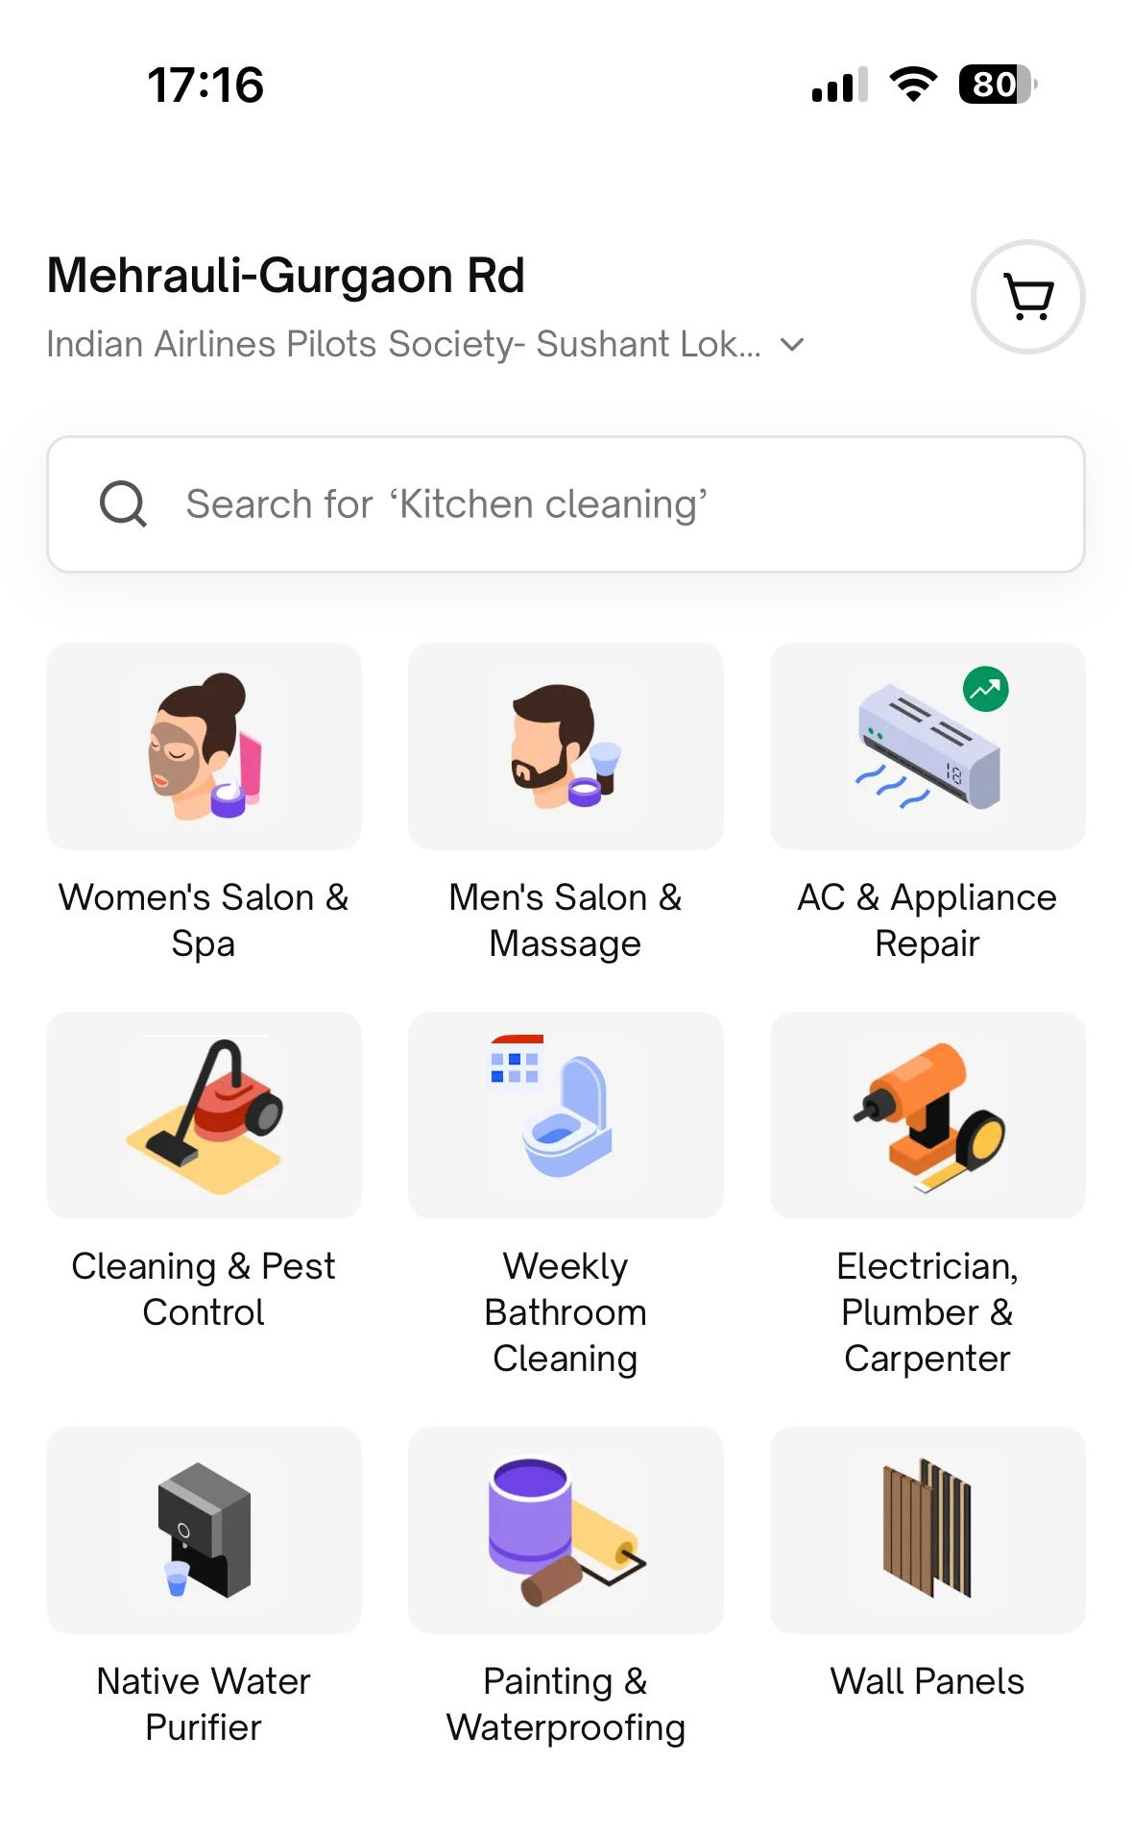
India Consumer Services
(ex Insta Help)

Slide 10
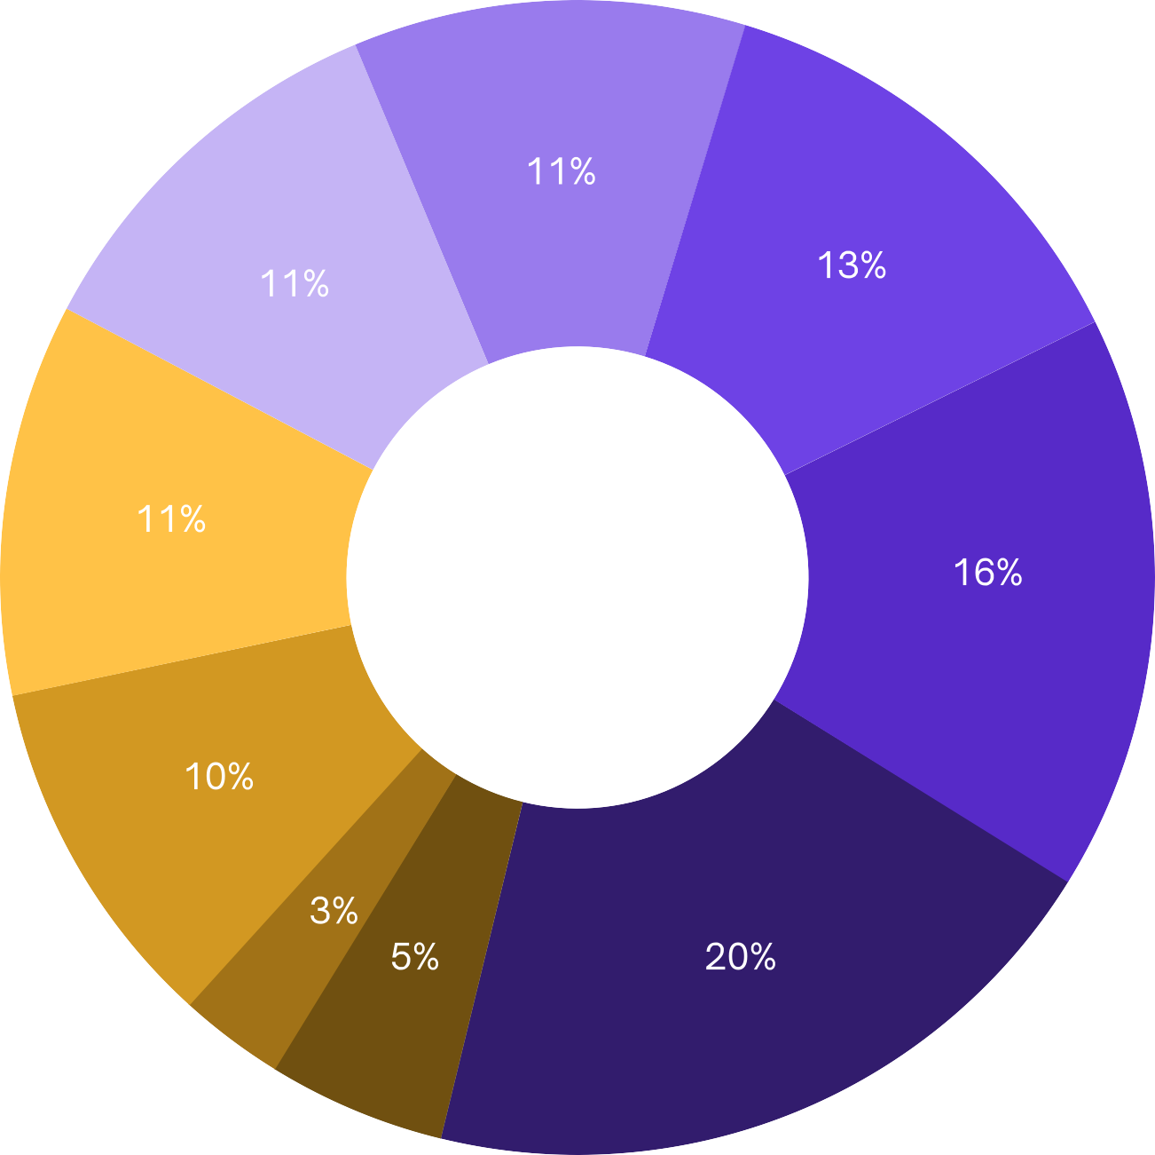






UC is the market leader in a
large, under-penetrated &
growing market
$ 97.4 bn by CY29 – growing at 10 – 11% p.a.
Dominated by unorganised, local supply
Consumers suffer from inconsistencies in quality, availability, pricing. availability and post service support
Current online penetration < 1%
Urban Company is the leading online full stack home services provider in India
Source: Redseer Report. ¹Other categories include Packers & Movers, Driver on Demand and Gardener

Slide 11










We operate a multi category, hyper local marketplace which is hard to replicate
12,000 service micro-markets
as on July 31, 2025

Slide 12








The India core business has demonstrated scale, growth and profitability
Revenue from Operations
(INR Cr)
Adjusted EBITDA
(INR Cr)
87.9
61.0
881.3
709.5
10.1
570.0
534.0
395.0
175.5
290.7
FY22
FY23
FY24
FY25
H1 FY26
FY22
FY23
FY24
FY25
H1 FY26

Slide 13











We offer a wide
assortment of services
to our customers

Slide 14




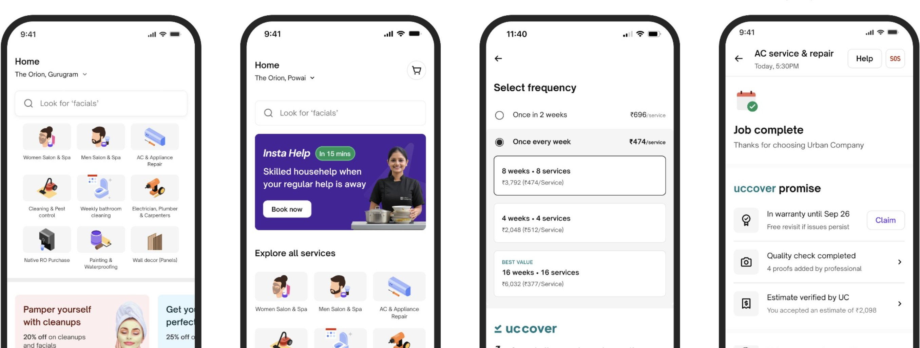
Our best-in-class customer app has intuitive consumer journeys
with wide assortment, quick availability and assured quality

Slide 15


Focus on consumer excellence has led to
NTV retention improving with time
Consumer retention basis NTV (ex Native)
Financial year
2018
2019
2020
2021
2022
2023
2024
2025
2018
100%
101%
117%
89%
121%
153%
162%
175%
2019
100%
101%
70%
91%
133%
120%
129%
2020
100%
59%
71%
82%
87%
94%
2021
100%
82%
78%
79%
84%
2022
100%
75%
70%
73%
2023
100%
74%
71%
2024
100%
77%
2025
100%

Slide 16

85% of NTV comes from loyal, retained users
Retained versus new user NTV contribution for India Consumer Services (ex Insta)

Slide 17
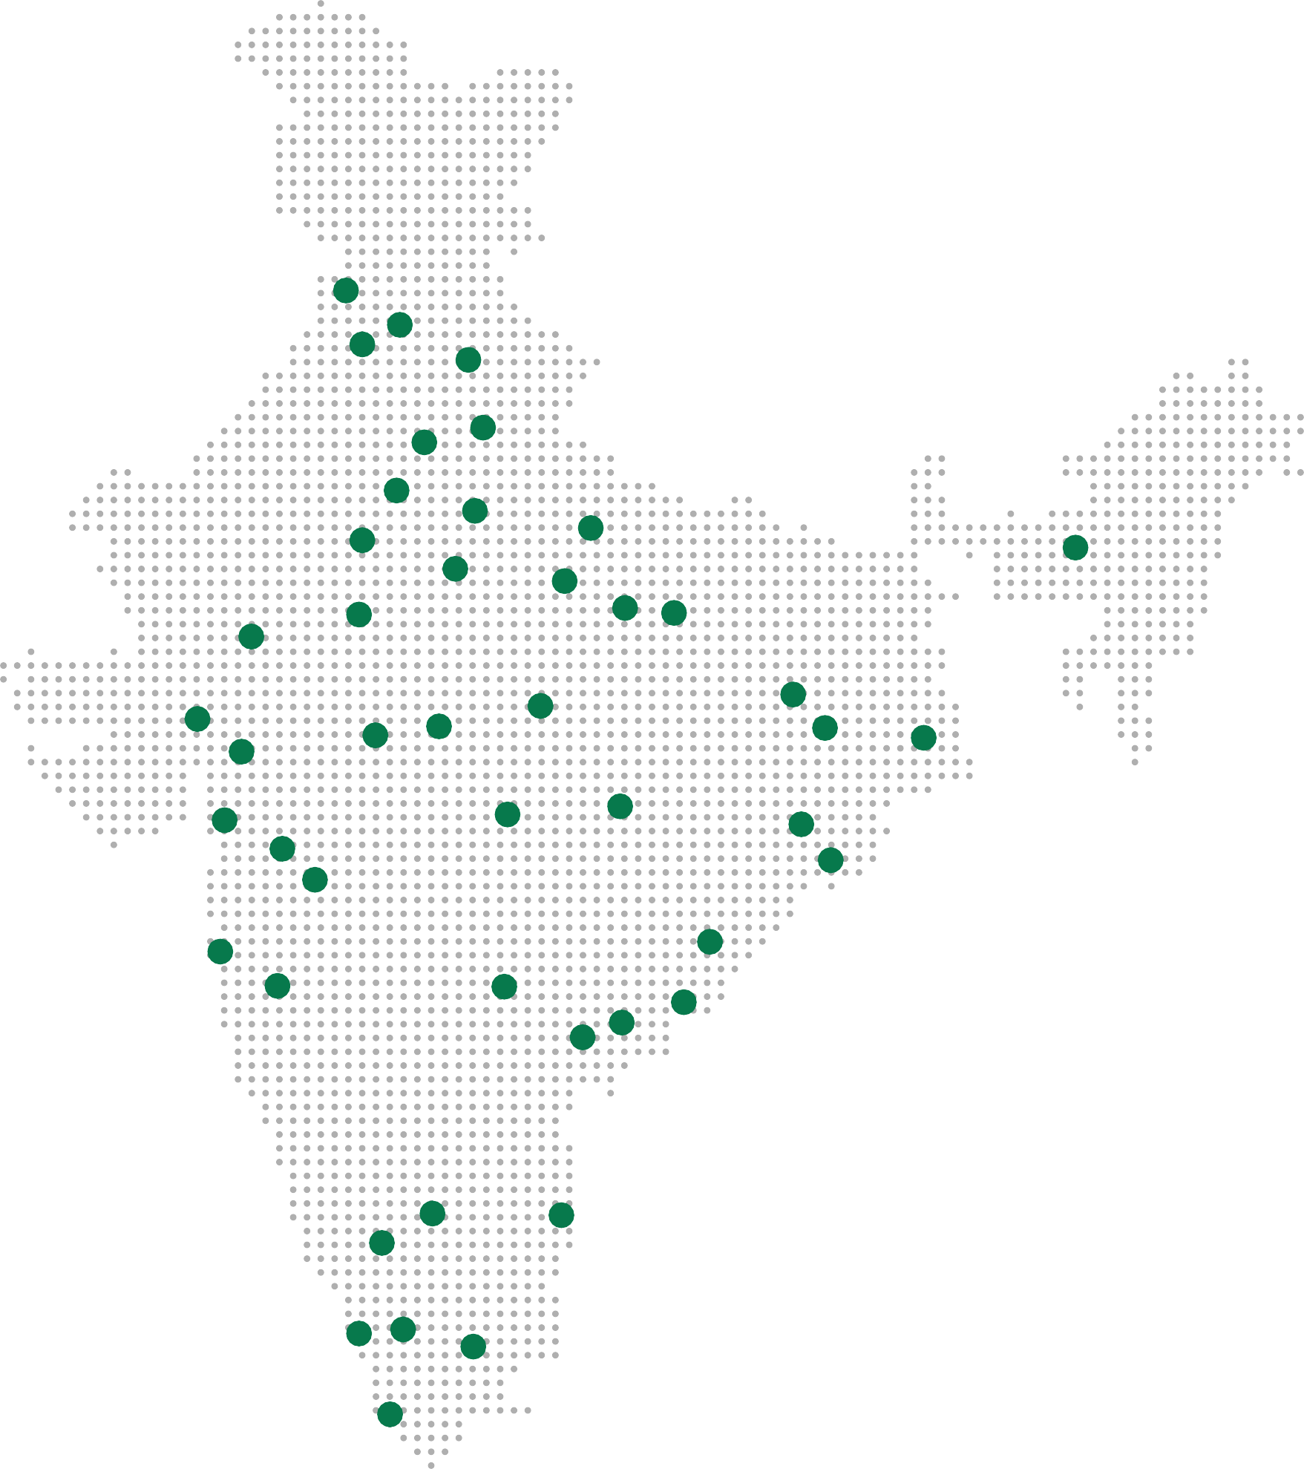
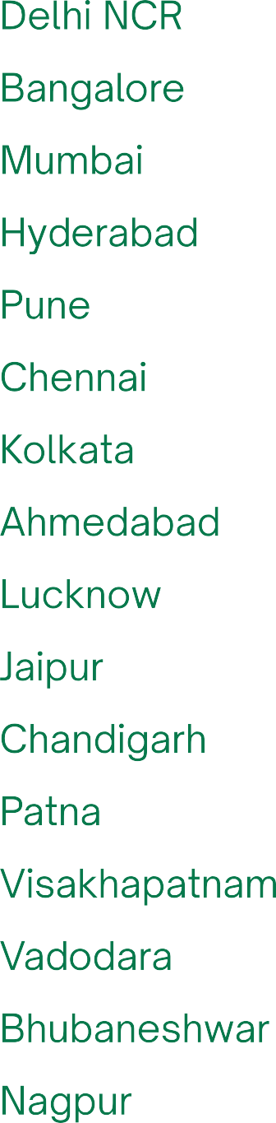
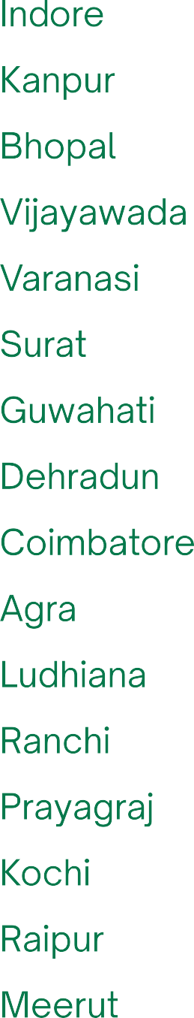
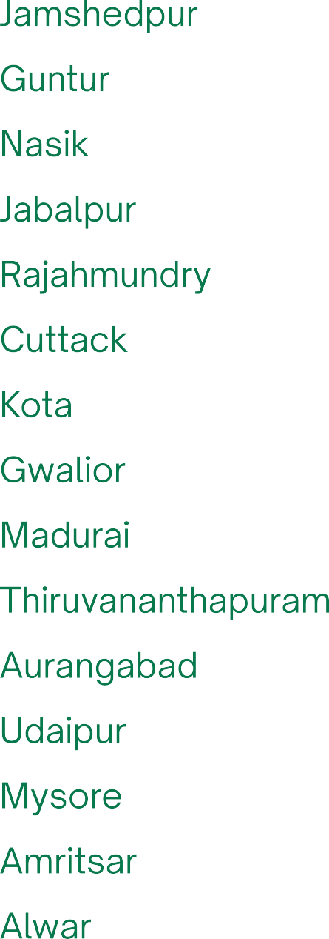
Driving growth
Our focus will be on densification (deepening penetration in existing hubs) and rolling out category offerings across the Top 50 cities where we have a presence

Slide 18
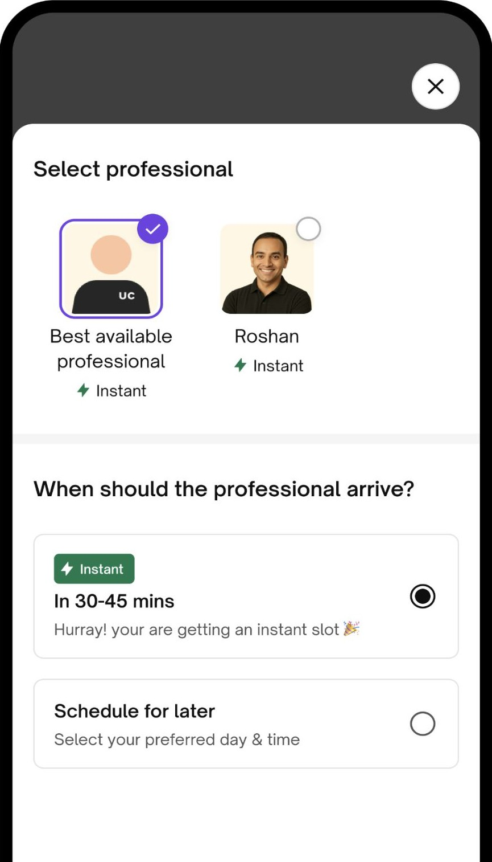
Driving growth
Speed
Faster fulfilment times in key categories will help drive consumer preference
Availability basis partner schedule and proximity
With scale and density, aspiration to be come more and more instant

Slide 19


Driving growth
Revamp - Wall Panels & Home Décor solutions
Nascent, fast growing category
Easy to install, easy to maintain – uplift your
home’s look
Wide assortment, easy to visualise and efficient execution

Slide 20
UC’s partner engagement model
We have pioneered a full-stack, vertically integrated approach to building home service
Brand, market access and best-in-class earnings
Average monthly in hand earnings are INR 26.4K
Financing and insurance
Social security for service professional well being
Products, tools and consumables
High quality products for better consumer experience
Training and certification
Classroom trainings to upskill professionals
Robust technology platform
Deeply embedded workflows with proof of work

Slide 21
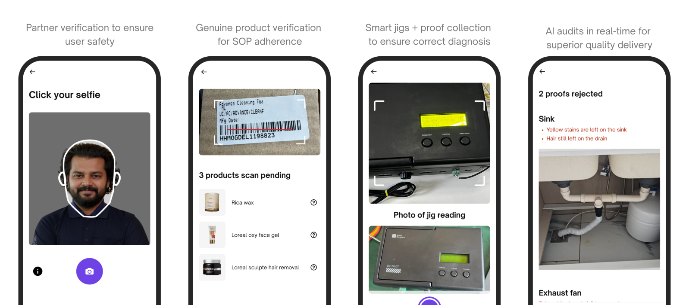
Technology & performance
On job assistance, SOP compliance and quality checks

Slide 22
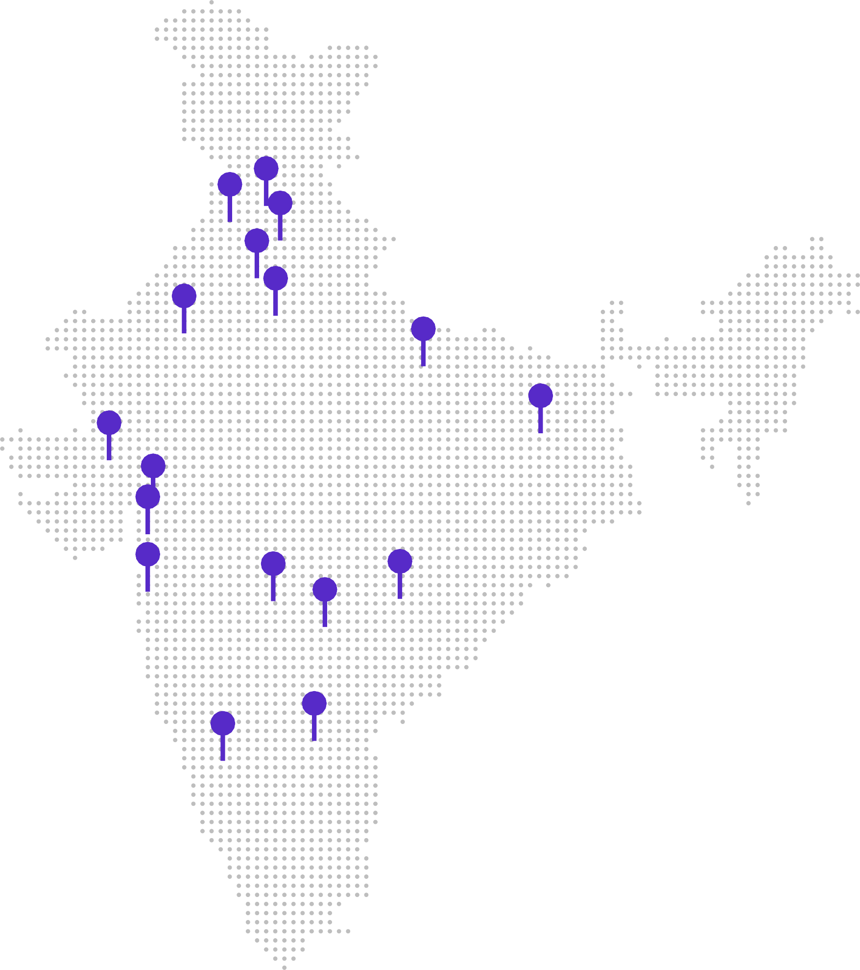
Training and Certification
Training is a key pillar of the full stack
model to create and
upgrade supply
As on Jun 30, 2025
290,000 sq ft of training space – sufficient capacity for the future
240+ training rooms across 17 cities
300+ permanent trainers
Across 17 super categories to teach technical & soft skills with unique pedagogy developed in house
Special curriculum
Designed to train personnel with no prior experience in the industry. Enables up skilling and job creation

Slide 23

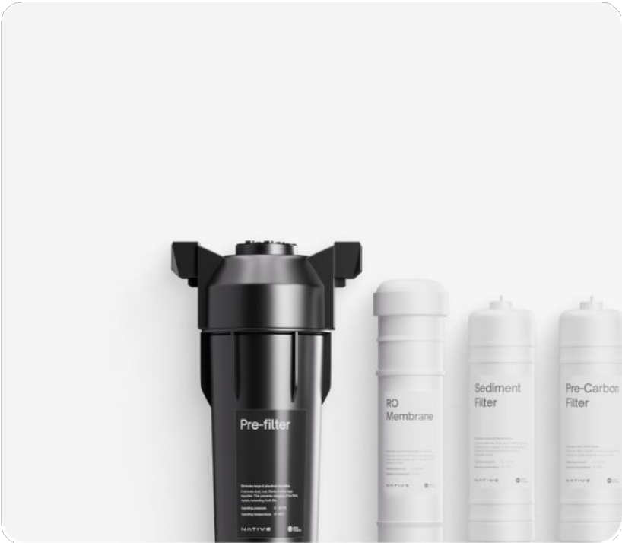






Products and tools
Empowering professionals with
high quality, affordable products to
deliver a seamless service experience
INR 104 Cr¹ Net Revenue
From sale of products to service professionals
Diversified product range
Presence across beauty and cleaning products and RO filters
Reasonable pricing and reliable fulfilment
Products sold at competitive prices and delivered to professionals’ doorstep
Product innovation
Roll on wax and AC jet pump
¹For H1 FY26

Slide 24
Best-in-class earnings
UC service professionals in India earned INR 26.4K in-hand p.m. Top 5% earned INR 45K
UC Professionals earned 30-40% higher than individuals not associated with any platform in CY24. 80% NTV in FY25 came from repeat professionals.
Details
Unit
All
professionals
Partners with > 30 services in a month
Top 20%
partners
Top 10%
partners
Top 5%
partners
% monthly active partners
%
100%
64%
20%
10%
5%
Gross earnings (average)
In INR per month
50,022
61,999
76,424
84,550
91,719
UC commissions & fee%
%
28.0%
27.5%
27.6%
27.4%
27.3%
Indirect taxes
In INR per month
511
622
735
783
815
Travel costs
In INR per month
1,829
2,391
2,814
3,185
3,523
Product costs
In INR per month
7,245
8,316
11,139
12,157
13,258
Net average earnings
In INR per month
26,407
33,599
40,677
45,256
49,066
Hours spent on the platform
Hours per month
83
104
128
143
155
Net Earnings per hour
In INR per month
317
323
317
317
316
Source: Redseer report; Note: ¹ For the purpose of calculating net earnings, the following types of service professionals have been excluded – service professional operating in large home painting category, aggregators and service professionals who are in their first calendar month on the platform and yet to complete a full month. ² Gross earnings represents the sum of the amount paid by the consumer (gross of discounts) and incentives earned by service professionals on the platform for the relevant set of service professionals as defined under note 1. ³ Urban Company fee % represents the portion of the gross earnings retained by Urban Company as a % of the total gross earnings. ⁴ For male service professionals, travel costs are assumed basis average distance travelled per job * fuel cost (basis mileage assumptions) + maintenance cost of vehicle. For female service professionals, travel costs are assumed on the basis that 40% female professionals use personal vehicles and the rest use autorickshaws - for own vehicle assumptions, cost assumptions are the same as defined for male service professionals. Autorickshaw rates are averages basis individual city rates where we operate. ⁵ Product costs and additional personnel costs represents the sum of costs borne by the service professionals towards the cost of consumables used during service delivery, cost of tools amortised over estimated useful life and payouts made by the service professionals to additional personnel in certain service categories.

Slide 25
Best-in-class earnings
Service professional utilisation and net earnings have grown consistently
Net earnings have grown by 32% over the past two financial years
FY | Net earnings per month (INR)
FY25 | 26,407
FY24 | 22,716
FY23 | 20,060
FY22 | 18,845

Slide 26
UC India Consumer Services (ex Insta) P&L
Sustained margin improvement driven mainly by operating leverage
India Consumer Services (ex Insta) P&L (INR Cr) |  | FY23 | FY24 | FY25 | H1FY26
Net Transaction Value |  | 1,805 | 2,216 | 2,667 | 1,578
Revenue from Operations (Net of GST & discounts) |  | 570 | 710 | 881 | 534
– Services |  | 436 | 563 | 695 | 431
– Products (B2B2C) |  | 134 | 147 | 187 | 102
Cost of products (B2B2C) |  | (100) | (108) | (141) | (74)
Cost of services¹ |  | (15) | (20) | (28) | (28)
Other Direct Expenses² |  | (28) | (26) | (20) | (8)
Gross Profit |  | 426 | 555 | 693 | 424
Gross Profit as a % of NTV |  | 23.6% | 25.0% | 26.0% | 26.9%
CX & PX support costs and refunds³ |  | (61) | (67) | (86) | (58)
Other semi-variable expenses⁴ |  | (45) | (53) | (68) | (41)
Contribution Profit |  | 320 | 435 | 539 | 325
Contribution Profit as a % of NTV |  | 17.7% | 19.6% | 20.2% | 20.6%
Salaries and employee benefits |  | (250) | (245) | (252) | (143)
Customer marketing expenses |  | (128) | (101) | (80) | (49)
General, administrative & other indirect expenses⁵ |  | (118) | (99) | (120) | (71)
Adjusted EBITDA |  | (176) | (10) | 88 | 61
Adjusted EBITDA as a % of NTV |  | (9.7%) | (0.5%) | 3.3% | 3.9%

Slide 27
Notes to the P&L
1
Cost of services represents the payout to service professionals in cases where Net NTV (Net of GST and Discounts) is recognised as revenue by the platform These services include Pest Control & Revamp services (in India) & Services rendered in KSA until commencement of the JV
5
General, administrative & other indirect expenses include lease rentals, travel costs , legal and professional expenses, software costs, bad debts and other expenses. Lease expenses have not been adjusted for IND AS 116 – Accounting for leases. Rental expenses (pay- outs + accruals) have been included under G&A Expenses
2
Other direct expenses include payment gateway charges, call masking and communication costs, background verification expenses, etc.
3
CX & PX support costs and refunds represents the cost of third-party entities who handle professional and customer queries and complaints. This line also
Includes good will refunds given by the Company to customers, to the extent not netted off from Revenue from operations.
4
Other semi variable expenses include cloud hosting and bandwidth charges, partner incentives, warehousing and logistics costs, damages, Native warranty
Costs, etc.

Slide 28

Native
Native

Slide 29
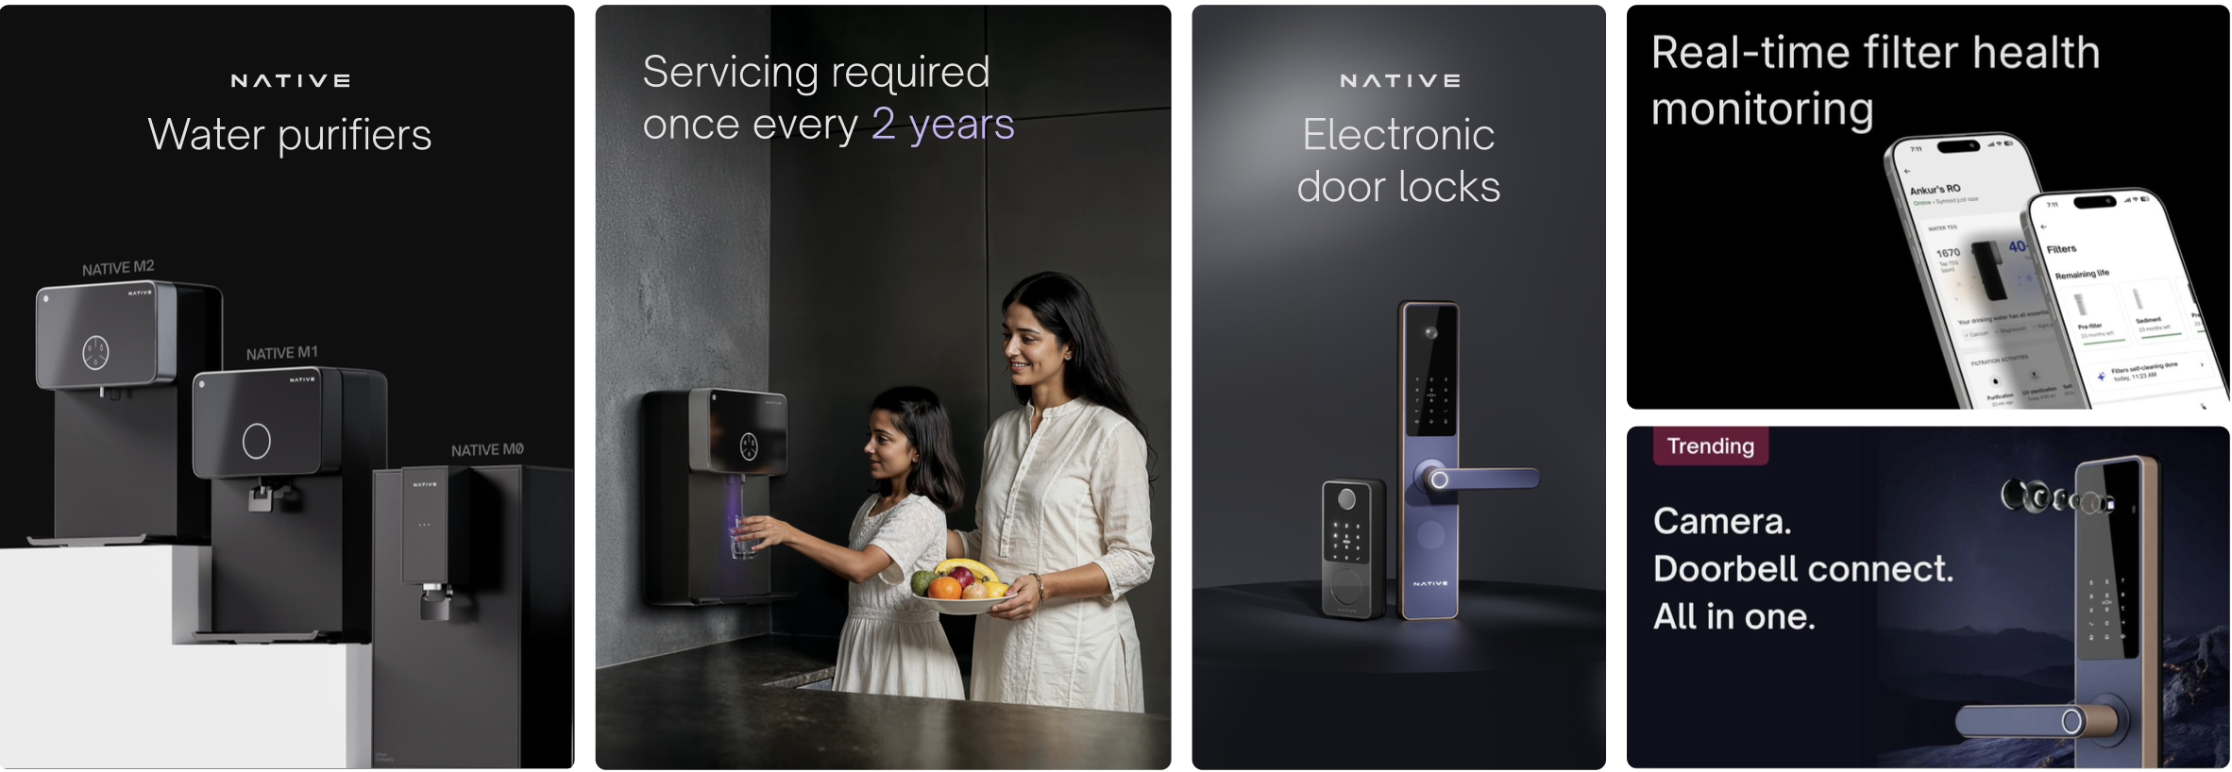
Native Devices
World class products designed in house, using latest technology
and in-app integration to deliver a great consumer experience

Slide 30
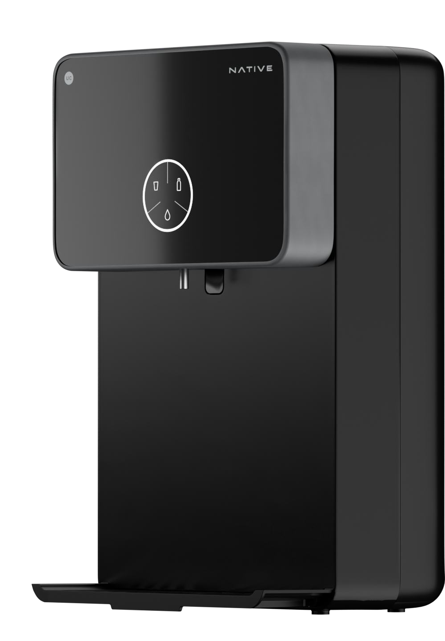
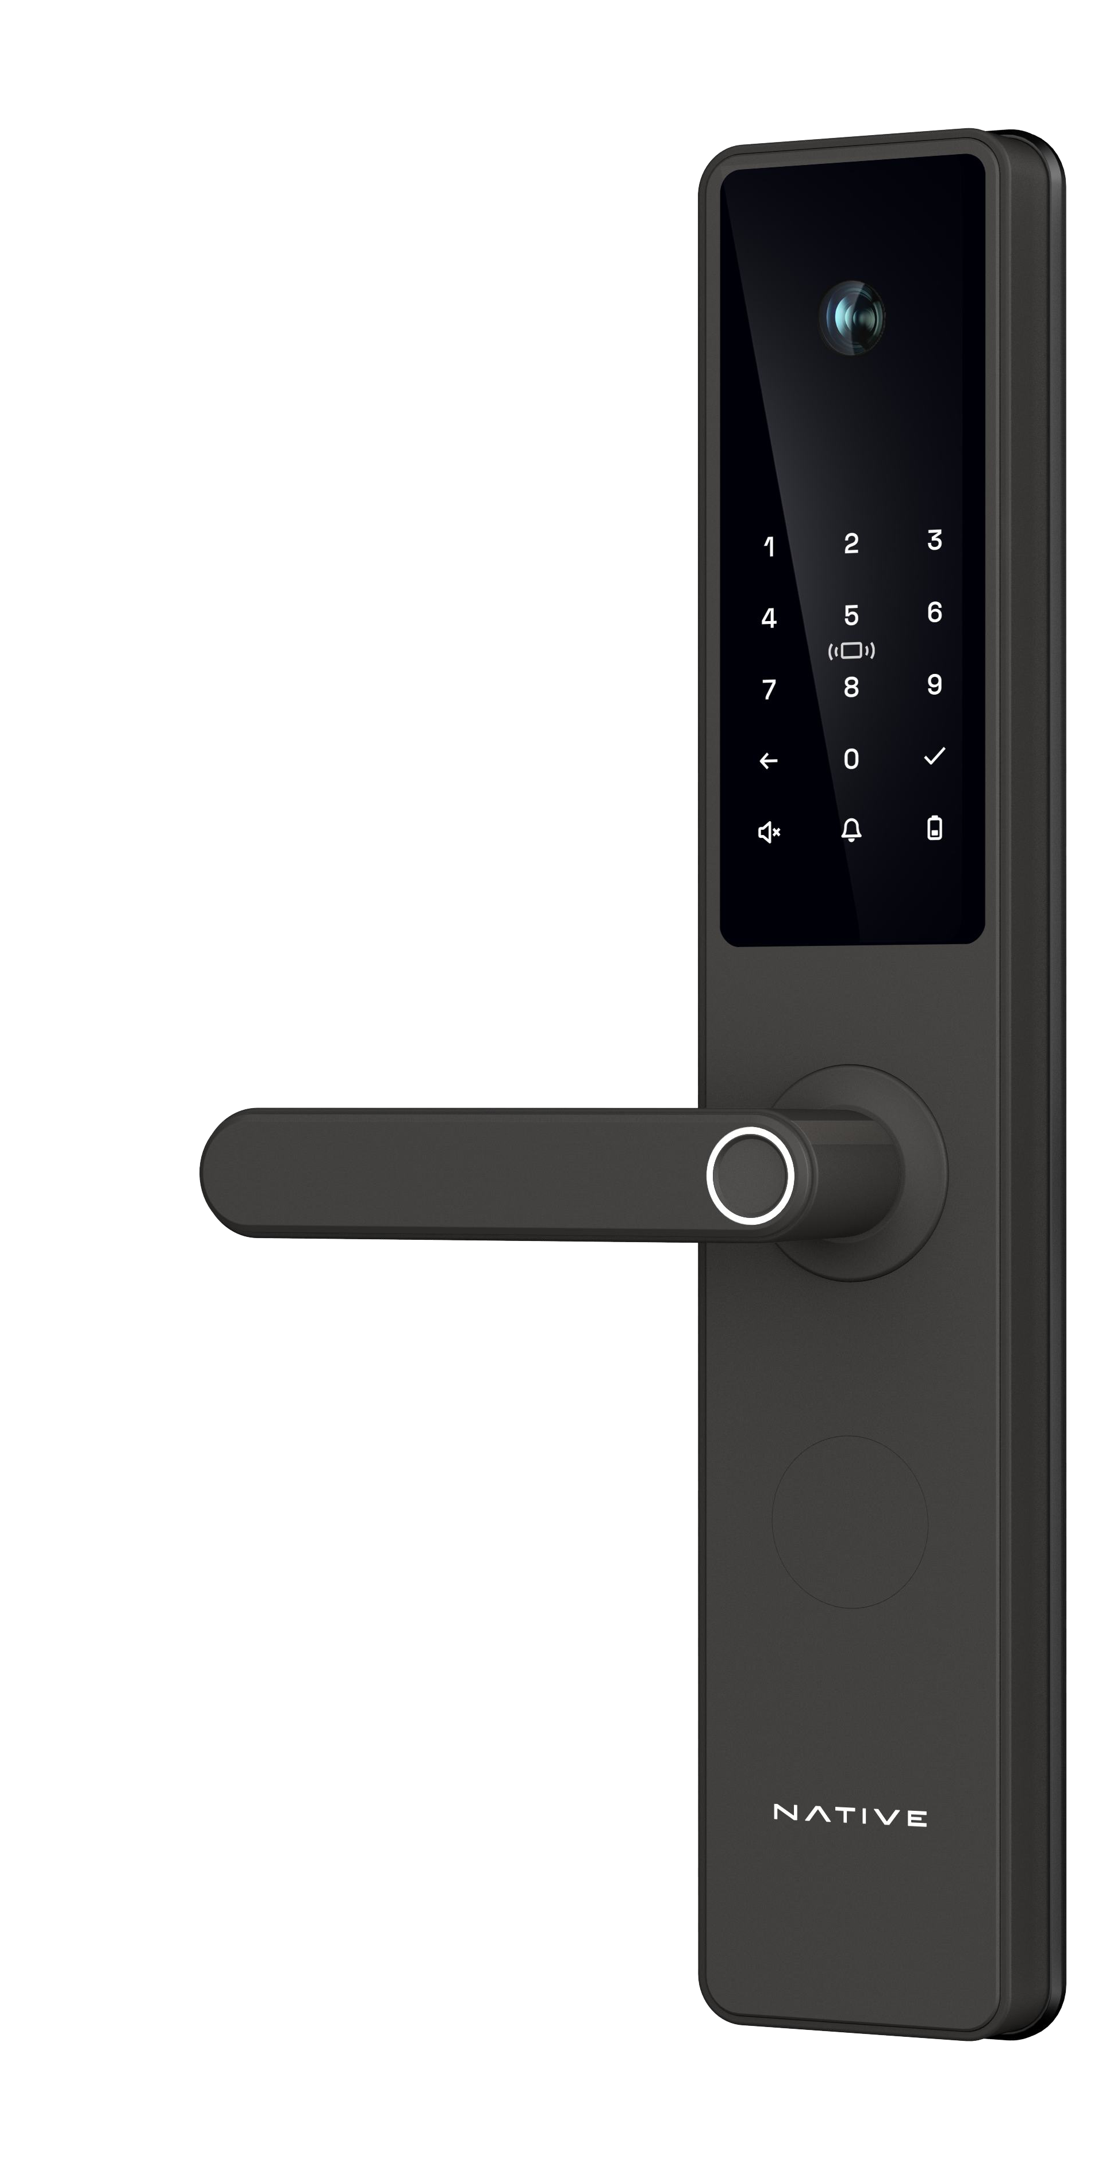
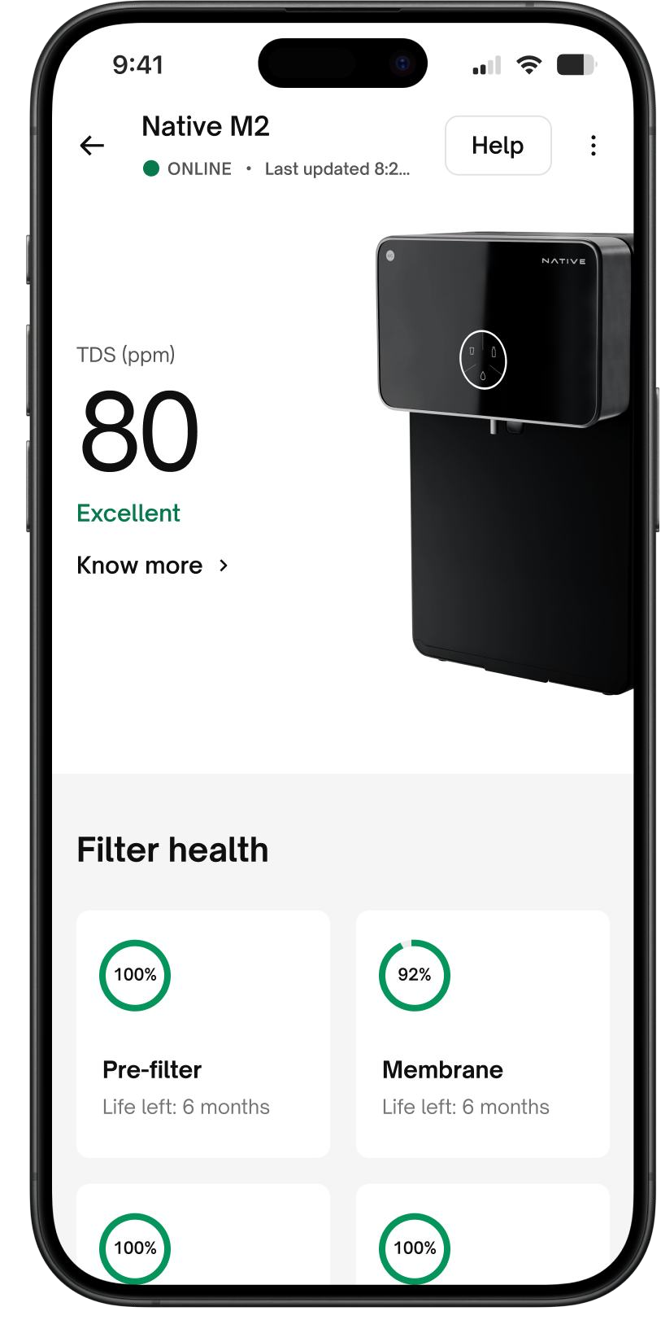
Native is an integral part of UC’s vision to be a Trusted Home Platform
We service > 4.5 Mn appliances every year, giving us insights into consumer needs and expectations
Our platform and service fleet enjoy the trust of millions of consumers, giving us a unique distribution advantage
We have a technology first mindset, helping us build world class products for the Indian home
We bring strong capabilities in product design, sourcing and supply chain management from our core business

Slide 31

Native is off to a great start with rapidly growing sales & strong customer ratings
198%
300%

Slide 32
Native margins have improved steadily with scale
- On the path to breakeven
Native P&L (INR Cr) | FY23 | FY24 | FY25 | H1 FY26
Net Transaction Value | 5 | 38 | 156 | 176
Revenue from operations (net of GST and discounts) | 4 | 29 | 116 | 135
Adjusted EBITDA | (1.3) | (26) | (39) | (18)
Adjusted EBITDA as a % of NTV | (25.0)% | (68.0)% | (25.1%) | (10.2%)

Slide 33

International Business

Slide 34



International Business
CY 2024 TAM in $ bn
Estimated market CAGR CY24-29
We operate in the UAE, Singapore &
The Kingdom of Saudi Arabia (KSA)
10 – 11%
Large, fast-growing markets
Characterised by growing urbanisation, expatriate heavy population and rising disposable incomes
Consumer habits
15.0
Do-it-for-me approach to home and beauty services
7 – 8%
6 – 7%
4.5
3.9
Source: Redseer Report

Slide 35
Our International business has scaled well
Adjusted EBITDA break even achieved in Q2 FY26
Margins over the long term will be similar to India Core Services
International business P&L (INR Cr) | FY24 | FY25 | H1 FY26
Net Transaction Value | 311 | 448 | 295
Net Transaction Value (ex KSA) | 292 | 400 | 295
Revenue from operations | 90 | 147 | 77
Revenue from operations (ex KSA) | 75 | 105 | 77
Contribution Profit | 45 | 86 | 52
Contribution Profit as a % of NTV | 14.1% | 19.1% | 17.7%
Adjusted EBITDA | (83) | (37) | (3)
Adjusted EBITDA as a % of NTV | (26.8%) | (8.2%) | (1%)

Slide 36

Joint Venture with SMASCO in the Kingdom of Saudi Arabia
Combining SMASCO’s supply sourcing expertise and UC’s technology stack & training capability
JV Revenue from operations
INR Crore
Urban Company + SMASCO JV
Q1 FY26
Q2 FY26
Wef January 1, 2025 – UC no longer consolidates results from the KSA JV– share of JV losses reported below Adjusted EBITDA

Slide 37




Insta Help

Slide 38
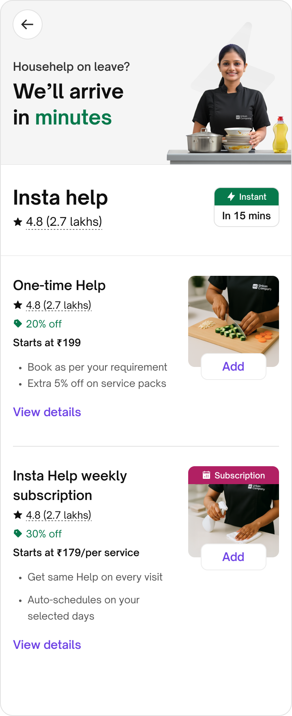


Insta Help
Get all in one help in 15 minutes
when your maid is away

Slide 39
Strong consumer traction with 468K orders within 8 months of launch
Core India services took ~4.5 years to reach this scale
Large TAM
Fulfilled orders
(‘000)
With usage frequency well ahead of core services
Strong user traction
Healthy retention and repeat across micro markets in 7 cities
Investing for growth
Early stage investments in professional onboarding, earnings support and discounting have led to an Adjusted EBITDA loss of INR (54) Cr during H1 FY26. AOV has seen a steady improvement
UC has a clear right to win
with a sizeable user base, proven execution and enabling tech stack

Slide 40
Governance and ESG

Slide 41
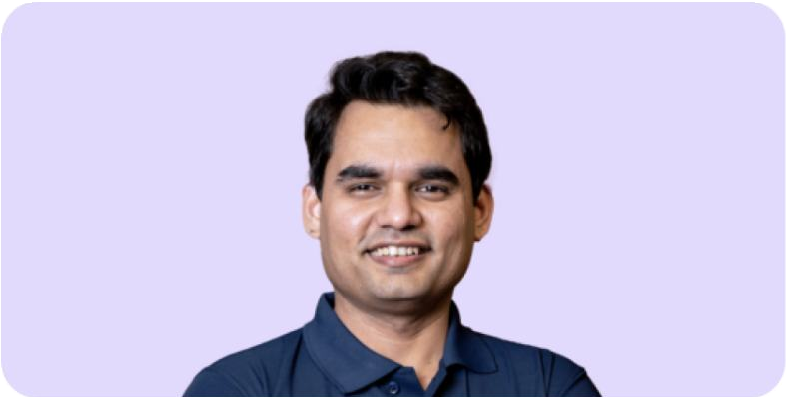


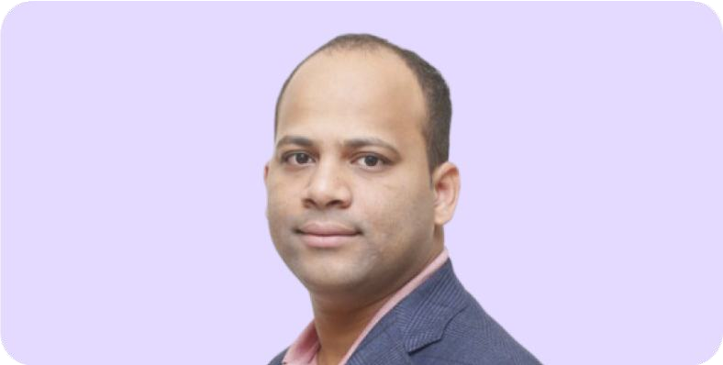






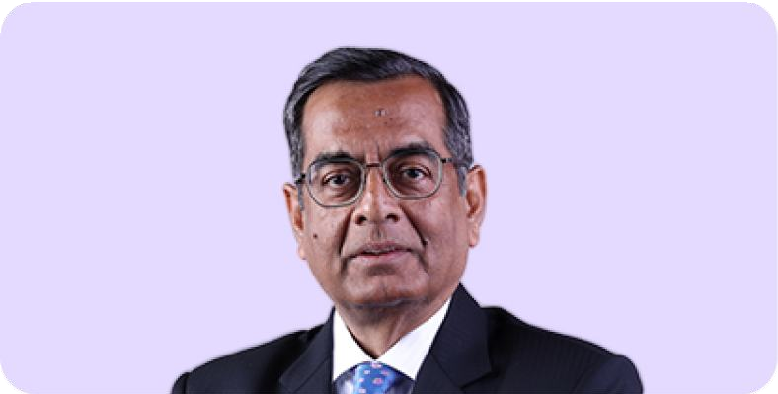

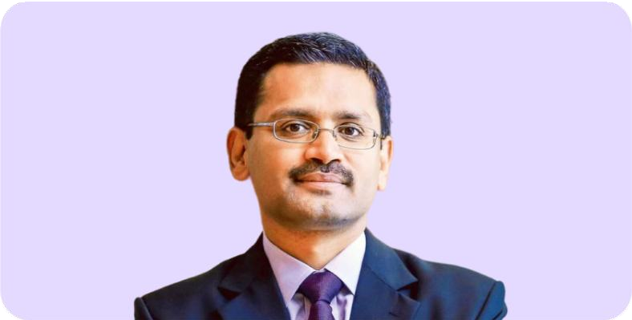








Promoters and Board of Directors

Slide 42





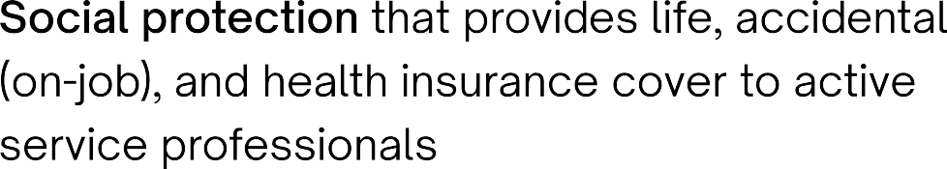





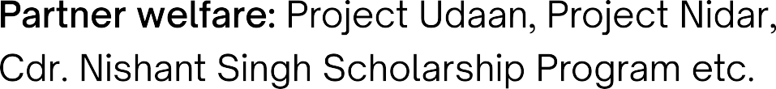
Key pillars of our ESG program

Slide 43
Thank You

