Slide 1
Panel:
Multiple Solutions for
Sub-GHz Connectivity

Slide 2
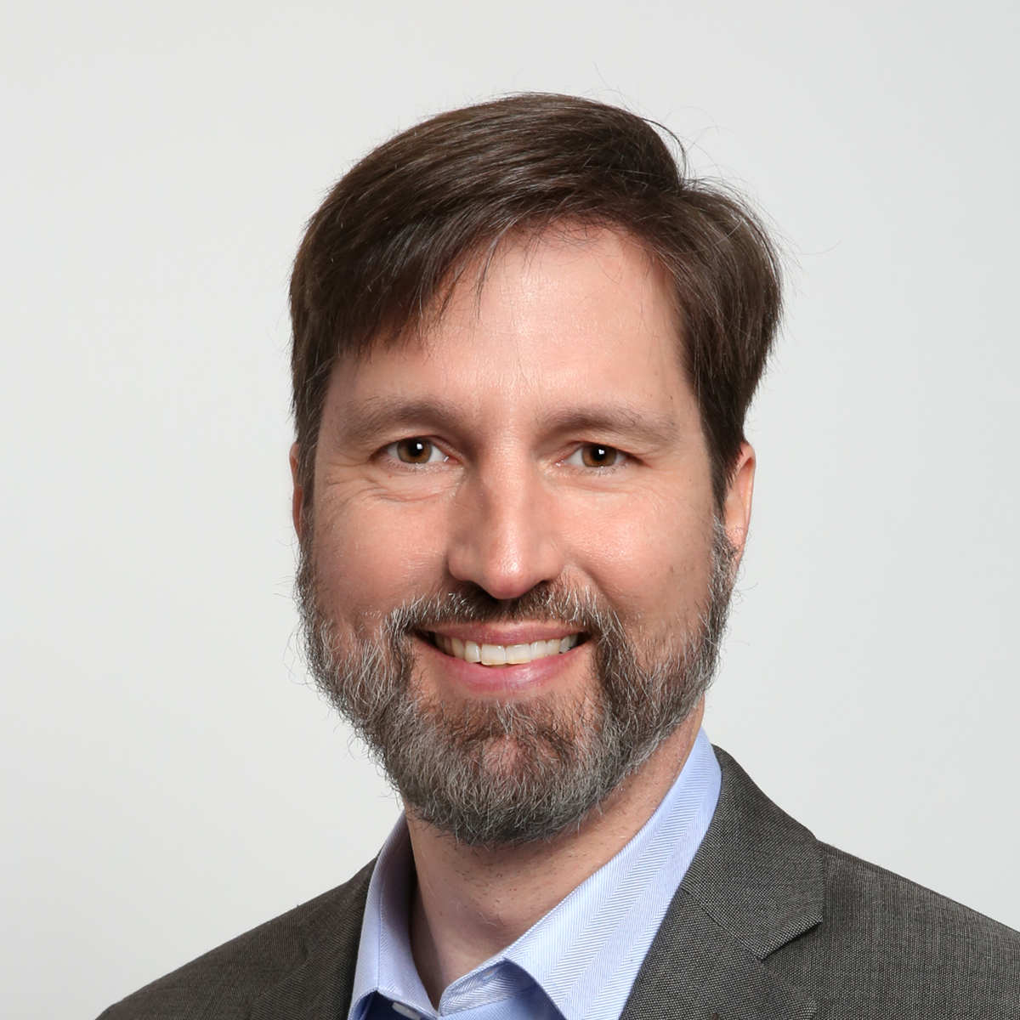

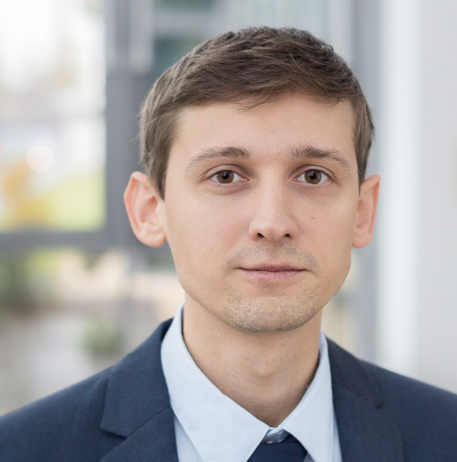
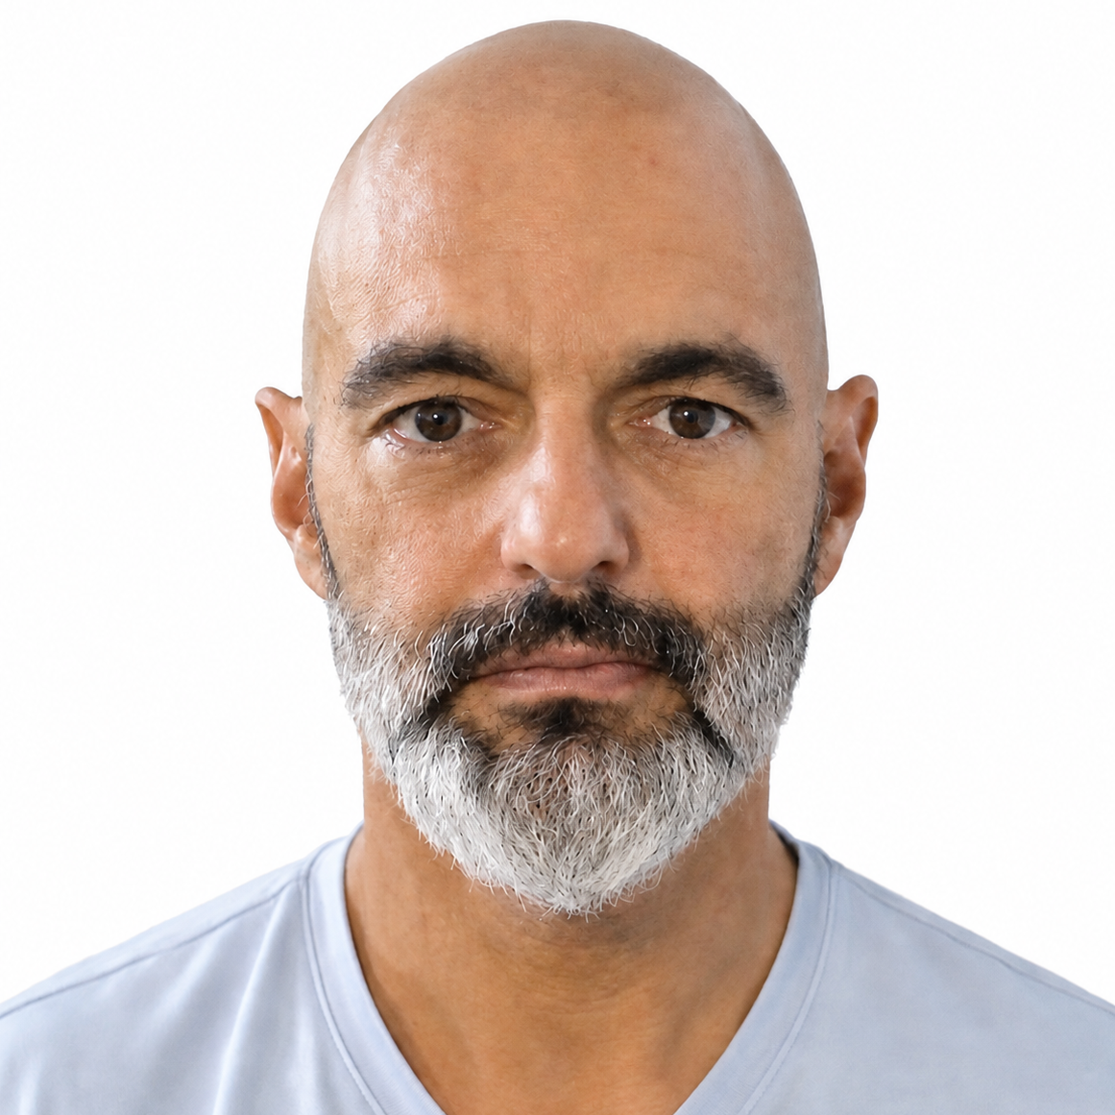
Multiple Solutions for Sub-GHz Connectivity
Brent Corn
MODERATOR
Soren Lorentsen
Amazon
Andras Erdo
Silicon Labs
Lazaros Kapsias
Quectel

