Slide 1


September 2026
Skylo Introduction
Never lose coverage

Slide 2
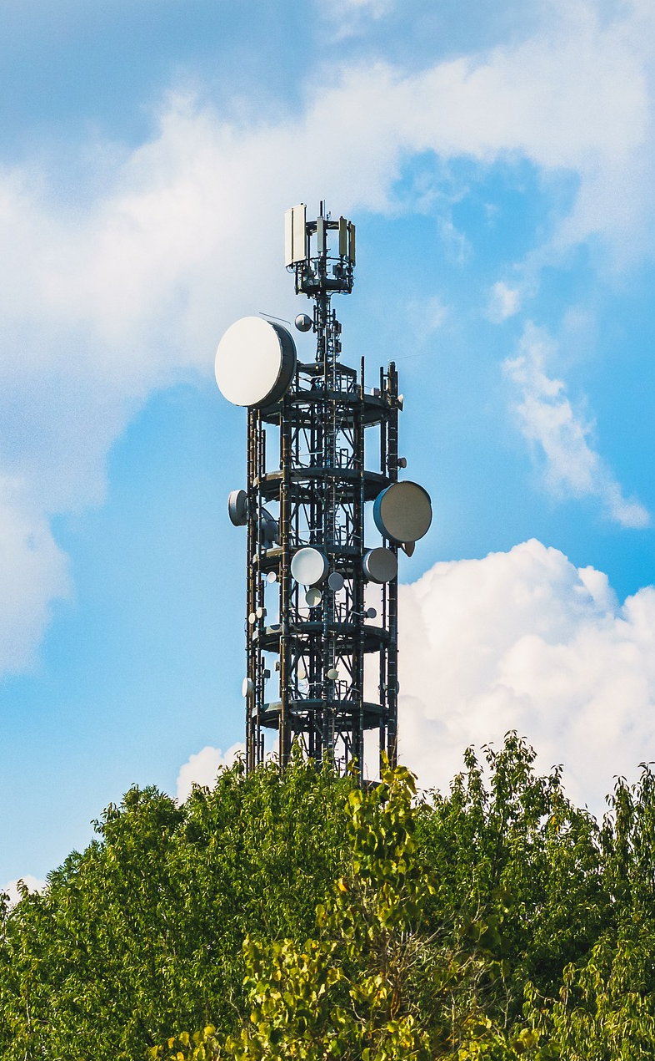
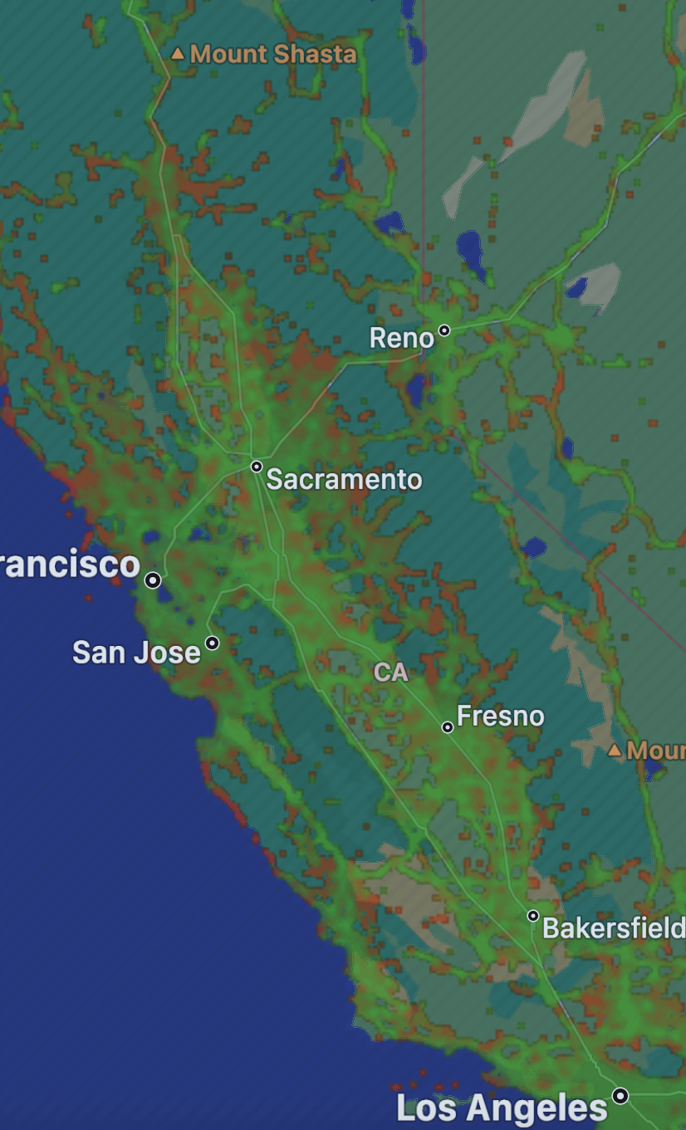





Mission-Critical Applications Limited by Network Coverage
Cellular networks cover only 15% of the globe
Legacy satellites networks are expensive and not interoperable with cellular / 5G
Legacy satellite solutions
require custom hardware
Source: https://www.opensignal.com/networks/usa/verizon-coverage and Beecham Research Delopying IoT Everywhere https://iot-everywhere.com/download/178/
‹#›
Notes:
Skylo was founded in 2017 to solve a very big connectivity problem that shows up in 3 distinct ways
Mobile Carriers around the world have focused their network build out in areas of greatest population density. That makes sense but it has left 85% of the global surface uncovered
Historically, satellite networks and mobile networks have not worked well together.
Satellite connectivity has historically required custom hardware which was expensive and meant you had to carry an additional device.

Slide 3
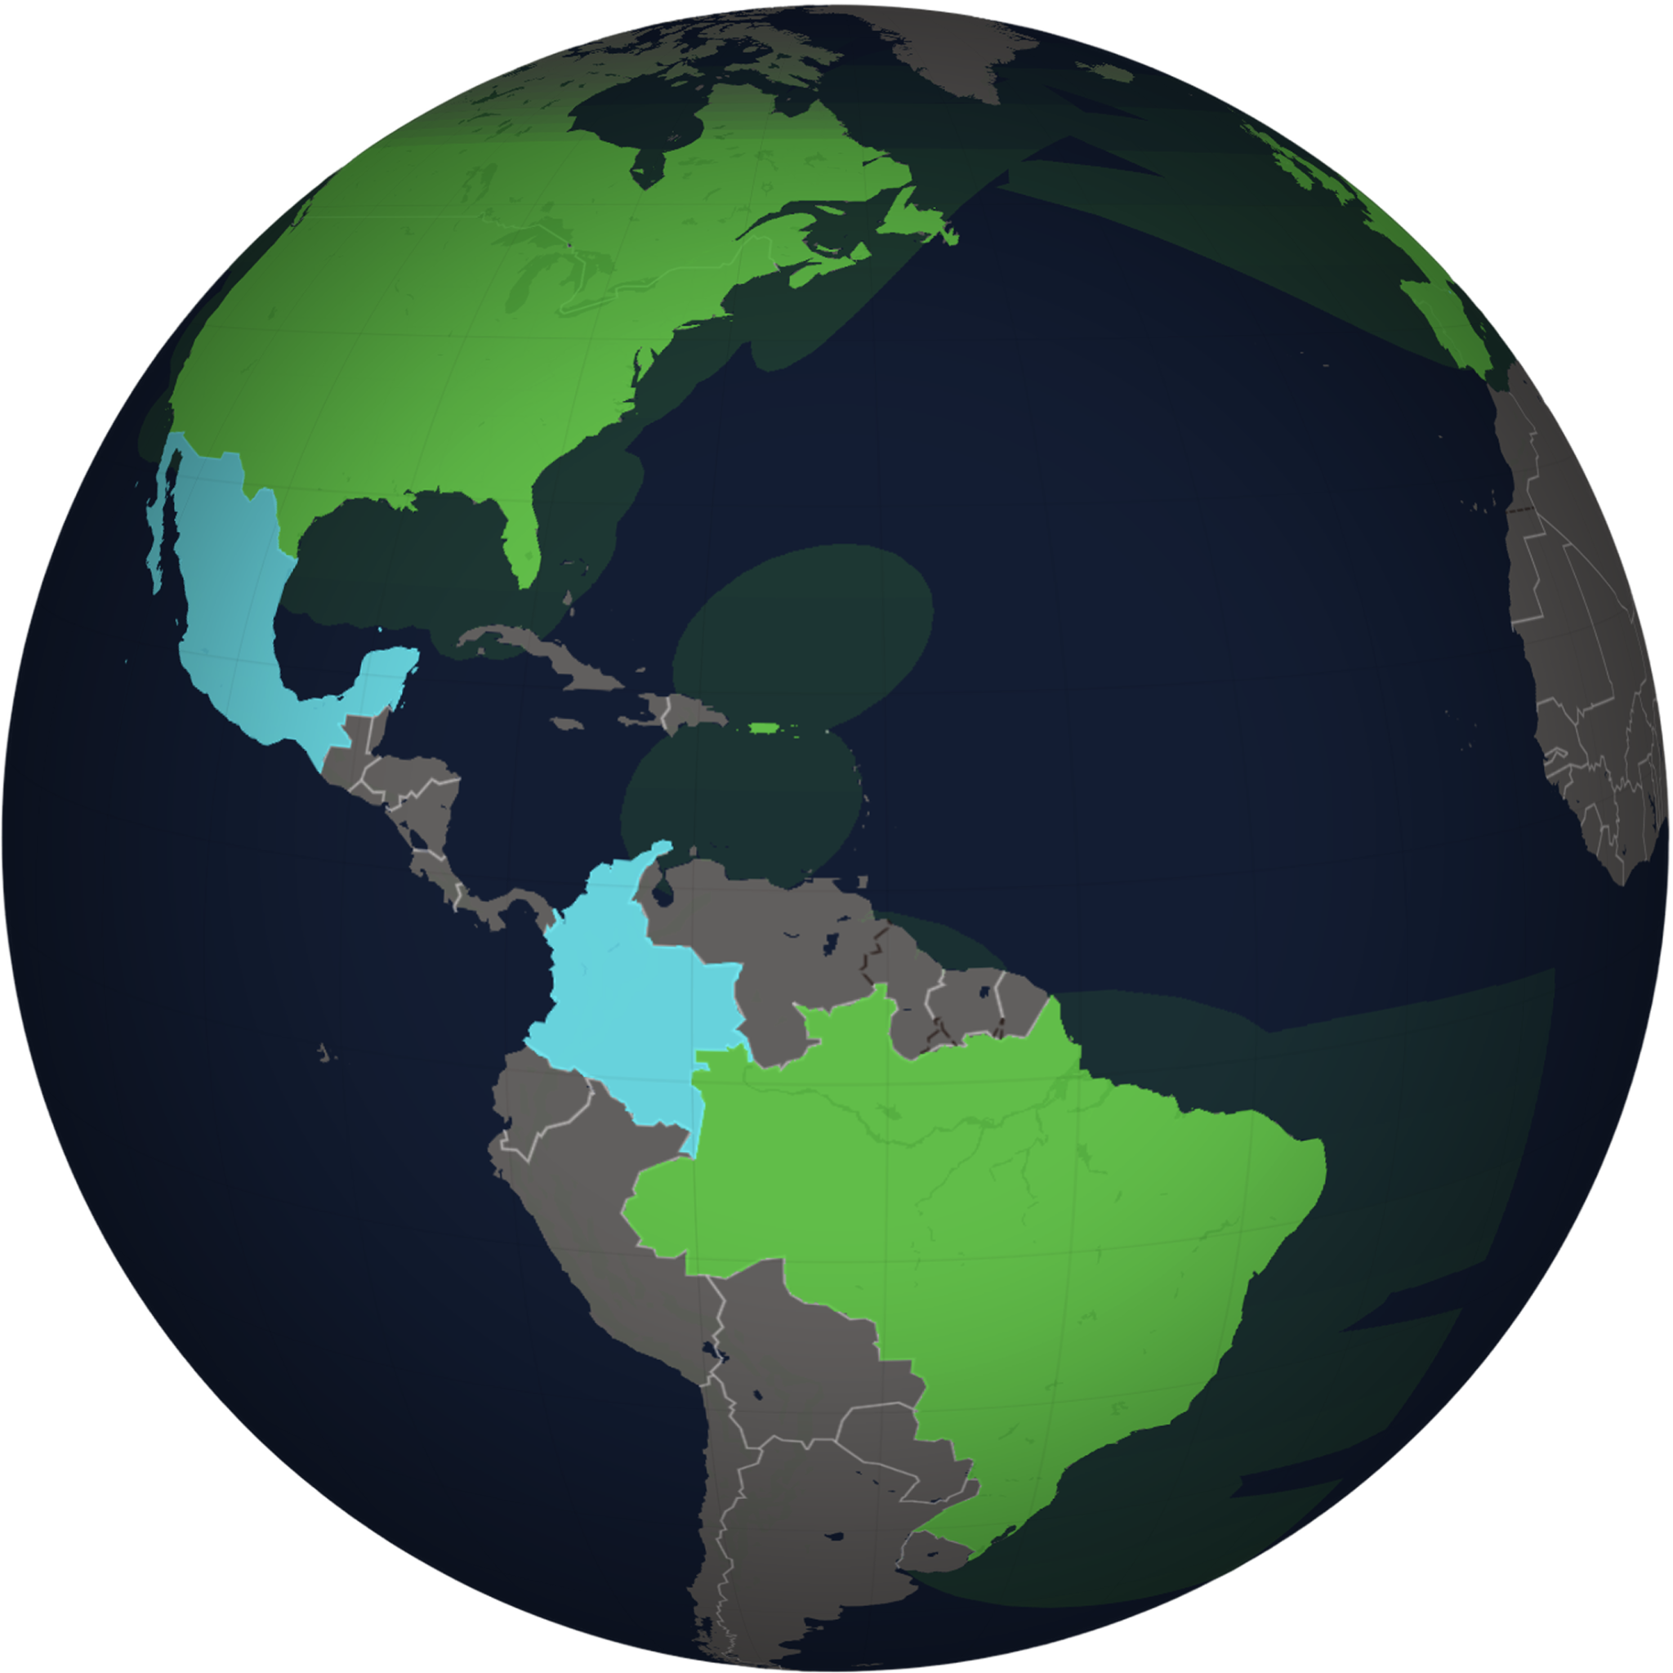
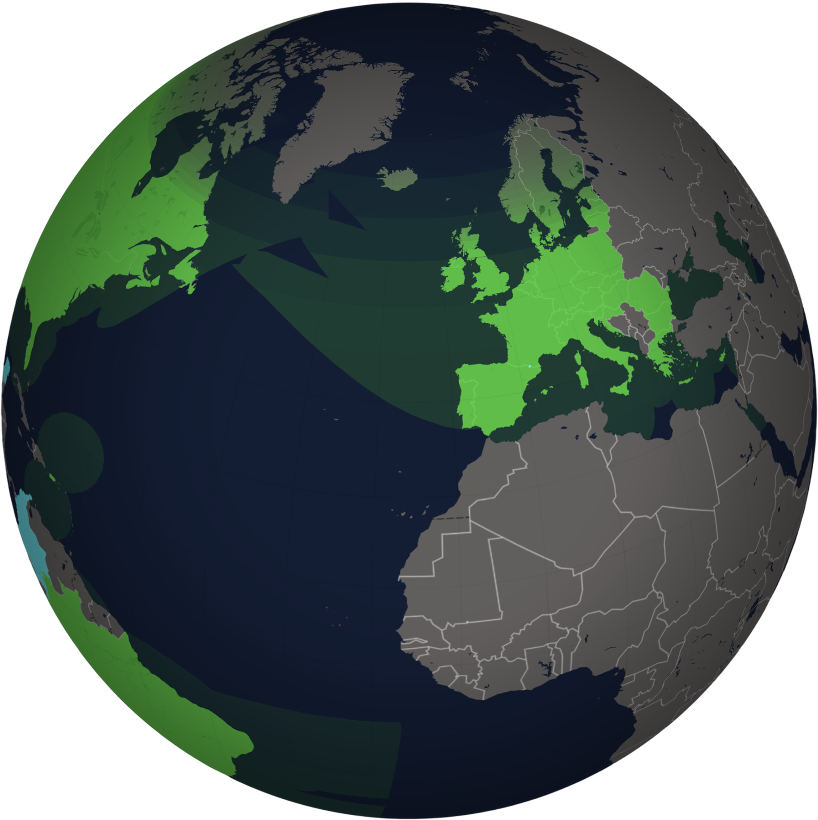
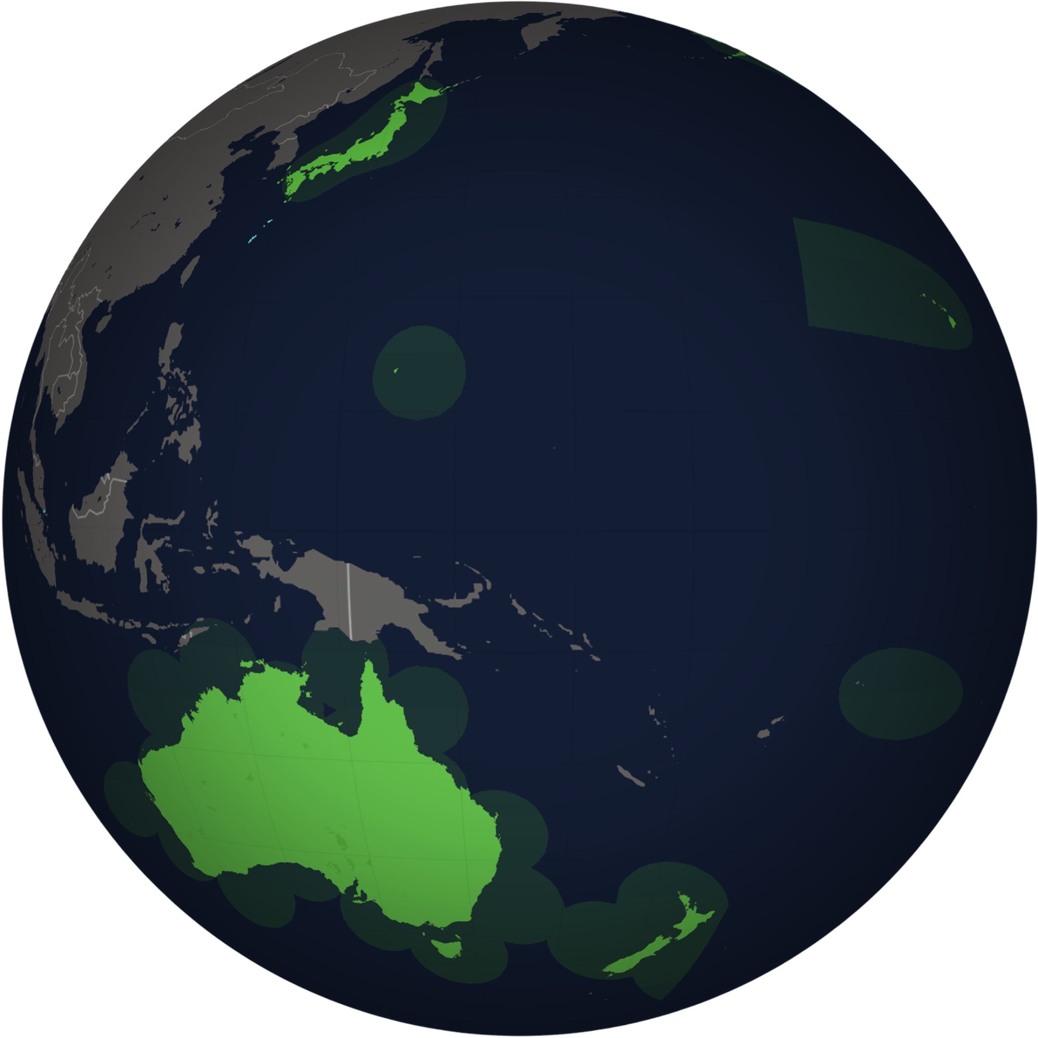
Skylo is the world’s largest standards-based D2D operator
COVERAGE
ACTIVATIONS
DEVICES
AVAILABILITY
UPTIME
20M+
100+
41+
99.9%
Devices on Skylo’s network: phones, wearables, IoT
Skylo Certified chipsets, modules and devices
Licensed countries, revenue generating across 5 continents
Jan – Jun '26 actuals · 6 of 6 above target
Skylo is now the 4th largest US carrier, and has cemented itself as the global standard for ‘direct-to-device’ connectivity

Slide 4
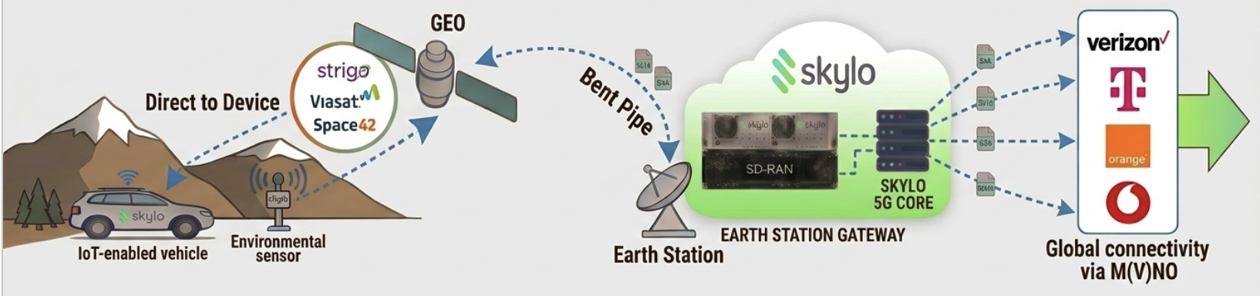
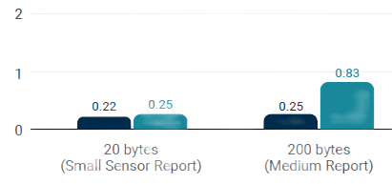

How Skylo works: our 3GPP-compliant satellite network
TECHNOLOGY
Transport
UDP + NIDD
NIDD = Non-IP Data Delivery
1200 Byte MTU
NIDD drops 28-byte IP/UDP header
=22% fewer billed bytes, every message
Latency
Uplink: 10 – 20 sec
Downlink: 3 – 15 sec
Minimum 2 packets/min
(50 Byte Packet)
User Experience
No pointing needed
7 – 10 dB headroom absorbs foliage, weather and antenna orientation
Works at highway speeds
Doppler handled by GNSS pre-compensation
Power
Reuse the power design.
Rethink the antenna
Peak Tx power similar to cellular
Source: Nordic Semiconductor
‹#›

Slide 5
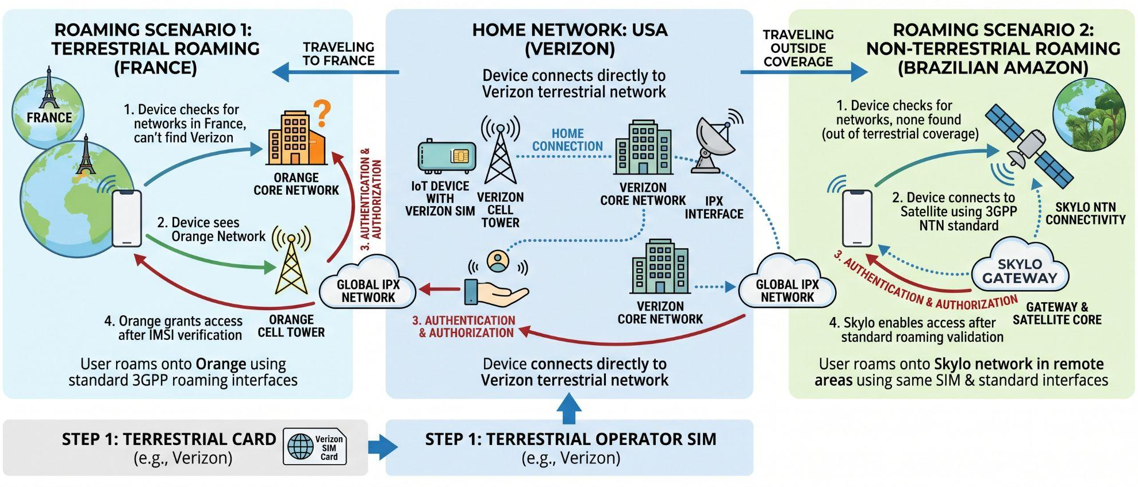

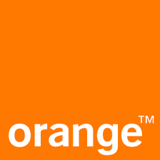
Skylo enables seamless 3GPP roaming
TECHNOLOGY
Terrestrial and non-terrestrial (NTN): Universal access for standard IoT devices via a single 3GPP SIM

Slide 6













IoT Use Cases that can benefit from NTN
MARKET
Oil & Gas
Security & Safety
Digital Payments
Agriculture
Predictive Maintenance
Supply Chain
Maritime & Fisheries
Transportation
Government
Energy & Utilities
Manufacturing
Environment

Slide 7
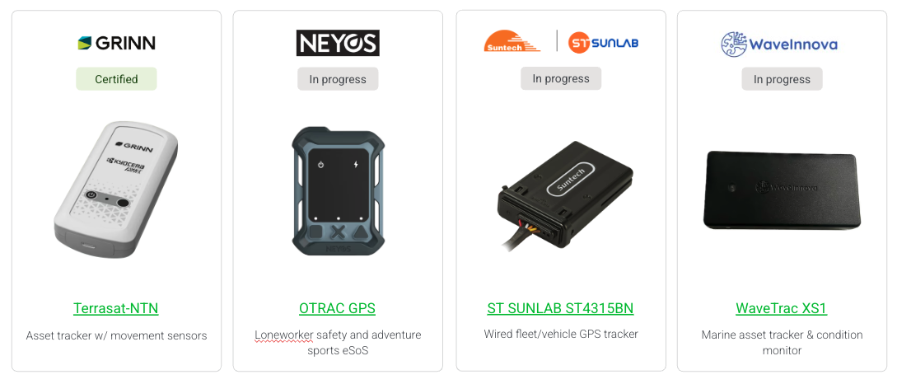
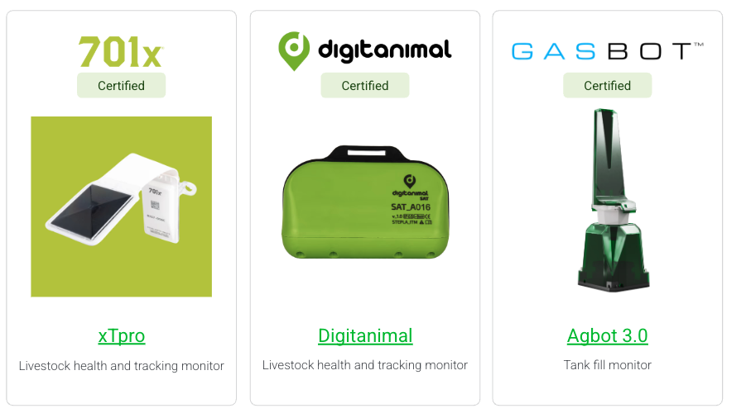
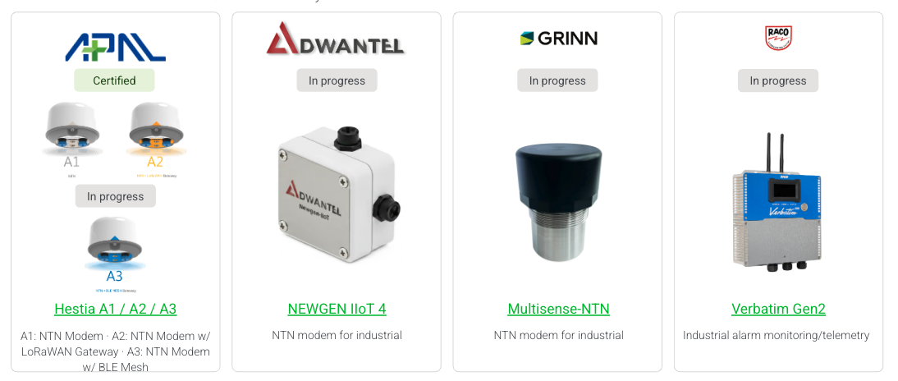
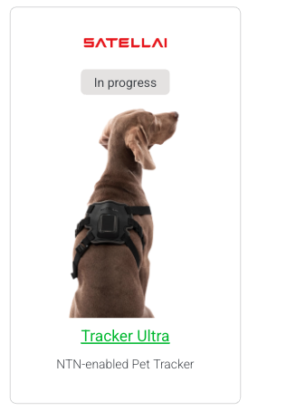
Certified Devices
HARDWARE ECOSYSTEM
IoT devices: Asset trackers
IoT devices: Agriculture
IoT devices: Data loggers
IoT devices: Other
https://www.skylo.tech/certified-devices

Slide 8





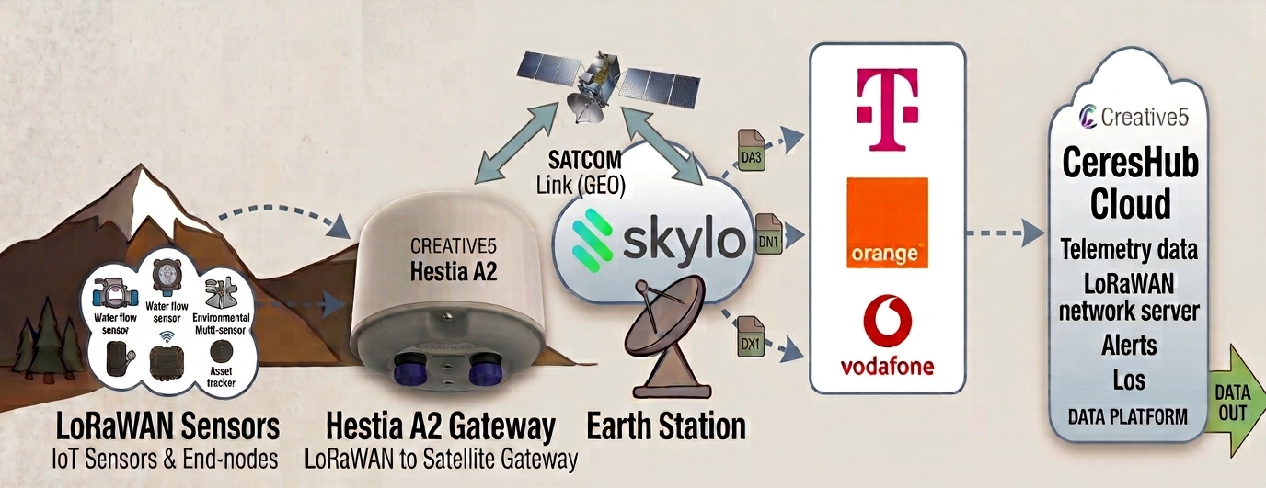
Case Study: Creative5 LoRaWAN Backhaul Over Satellite NTN
MARKET
Phase 1: Remote sensors
Phase 2: Creative5 Hestia A2
Phase 3: Skylo 3GPP NTN
Phase 4: CeresHub & LNS
Hyper-local telemetry across farms, pipelines, and forest clusters.
Geostationary & non-terrestrial direct satellite routing.
Enterprise telemetry visualization and remote actuation.
Up to 16 LoRaWAN Nodes
Form: 113 × 76 mm Dome (IP67)
Licensed L/S Bands
LoRaWAN Network Server
LORAWAN SUB-GHZ
Module: Compal RMM-T1
3GPP REL-17
CLOUD
SYNC
Power: <1W Peak (Solar / Battery)
RS-485 Modbus RTU
Eliminates Cellular Dead Zones
Direct-to-Orbit Uplink
REST / MQTT API Feeds
Multi-km Field Radius
LoRaWAN Gateway + Satellite Uplink
Two-Way Transmission
Real-time Alerts & OTA
< 1 Watt
95% lower draw vs VSAT / Starlink
16 Nodes / Gateway
Sub-GHz LoRaWAN node aggregation
IP67 Weatherproof
Rugged all-weather dome housing
100% NTN Coverage
Zero reliance on terrestrial cell towers

Slide 9
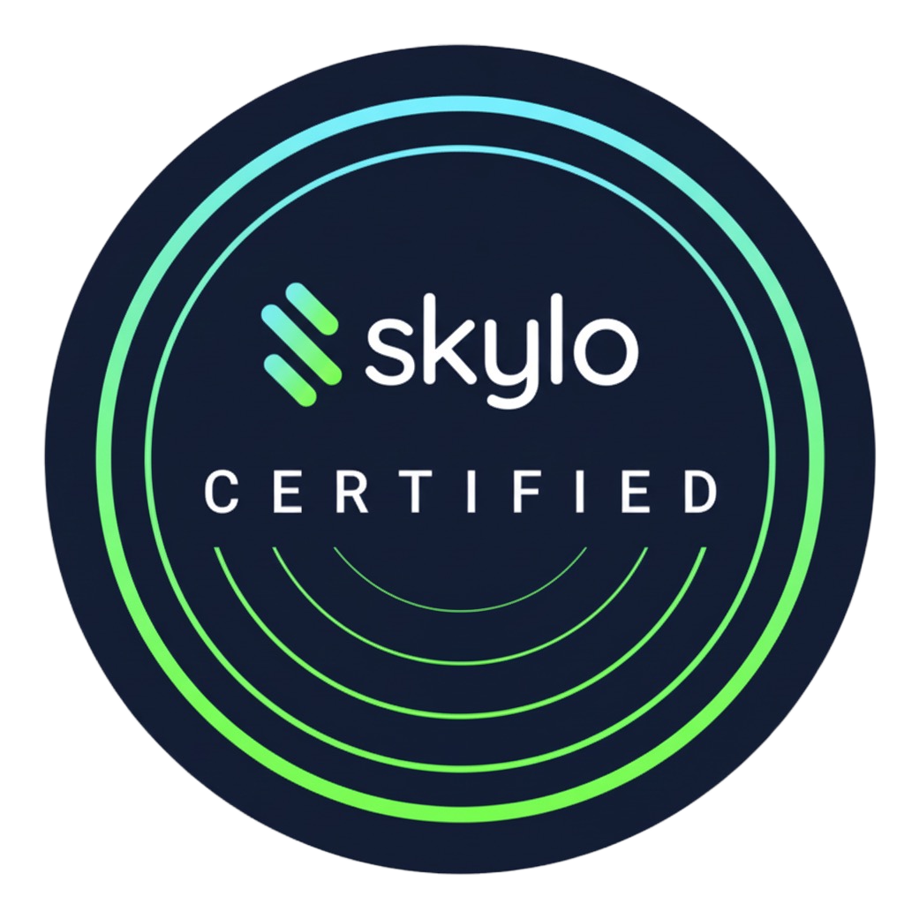
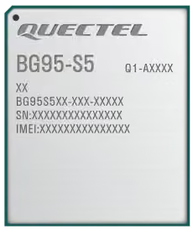
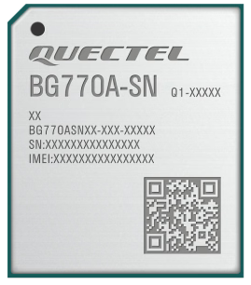
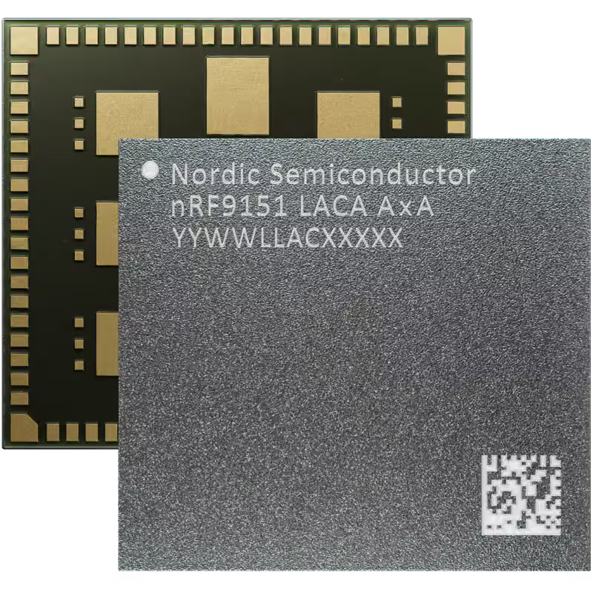
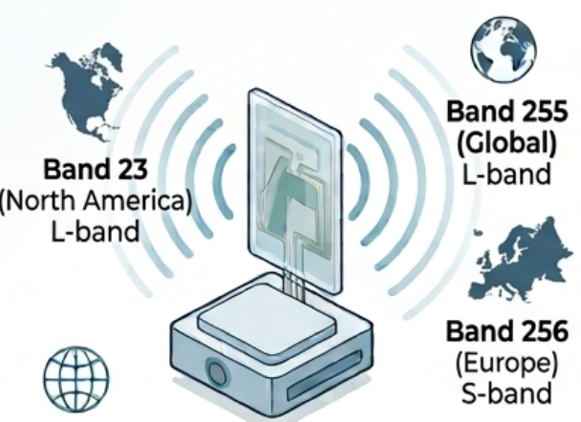

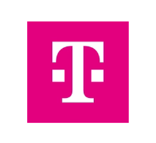

Deploying on Skylo is as easy as 1, 2, 3
GETTING STARTED
01
02
03
Use a Skylo
certified module
Ensure antenna supports Skylo frequencies
Use a SIM from any Skylo partner
Choose from a pre-integrated list of leading IoT modules.
Use an NTN-capable antenna with broad frequency coverage. Support for L-band (Band 23, 255) and S-band (Band 256)
Seamless connectivity through a partner’s SIM and roaming agreement. Access Skylo via your existing operator relationship.
Quectel BG95-S5
Quectel BG770A-SN
Nordic nRF9151

Slide 10
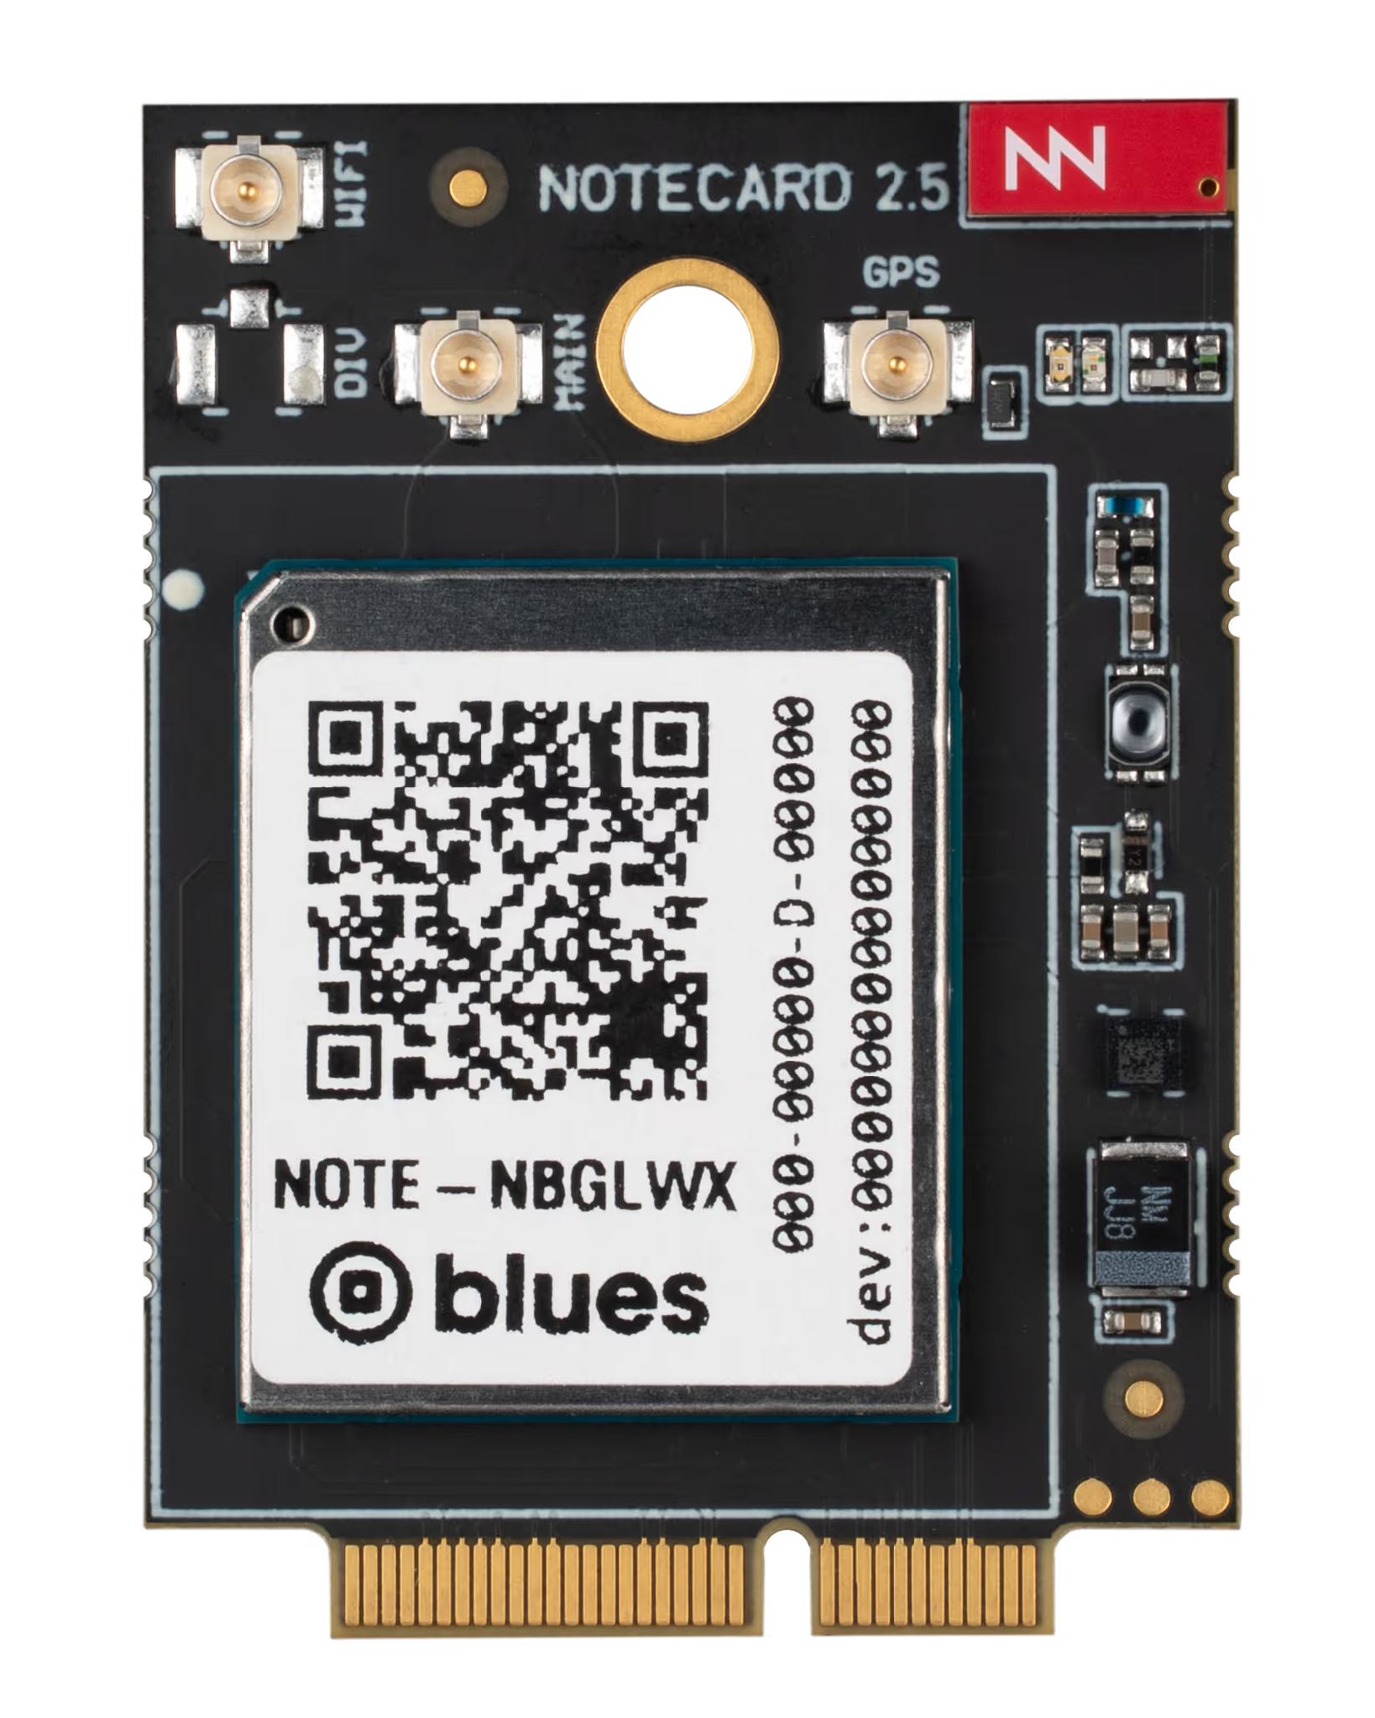


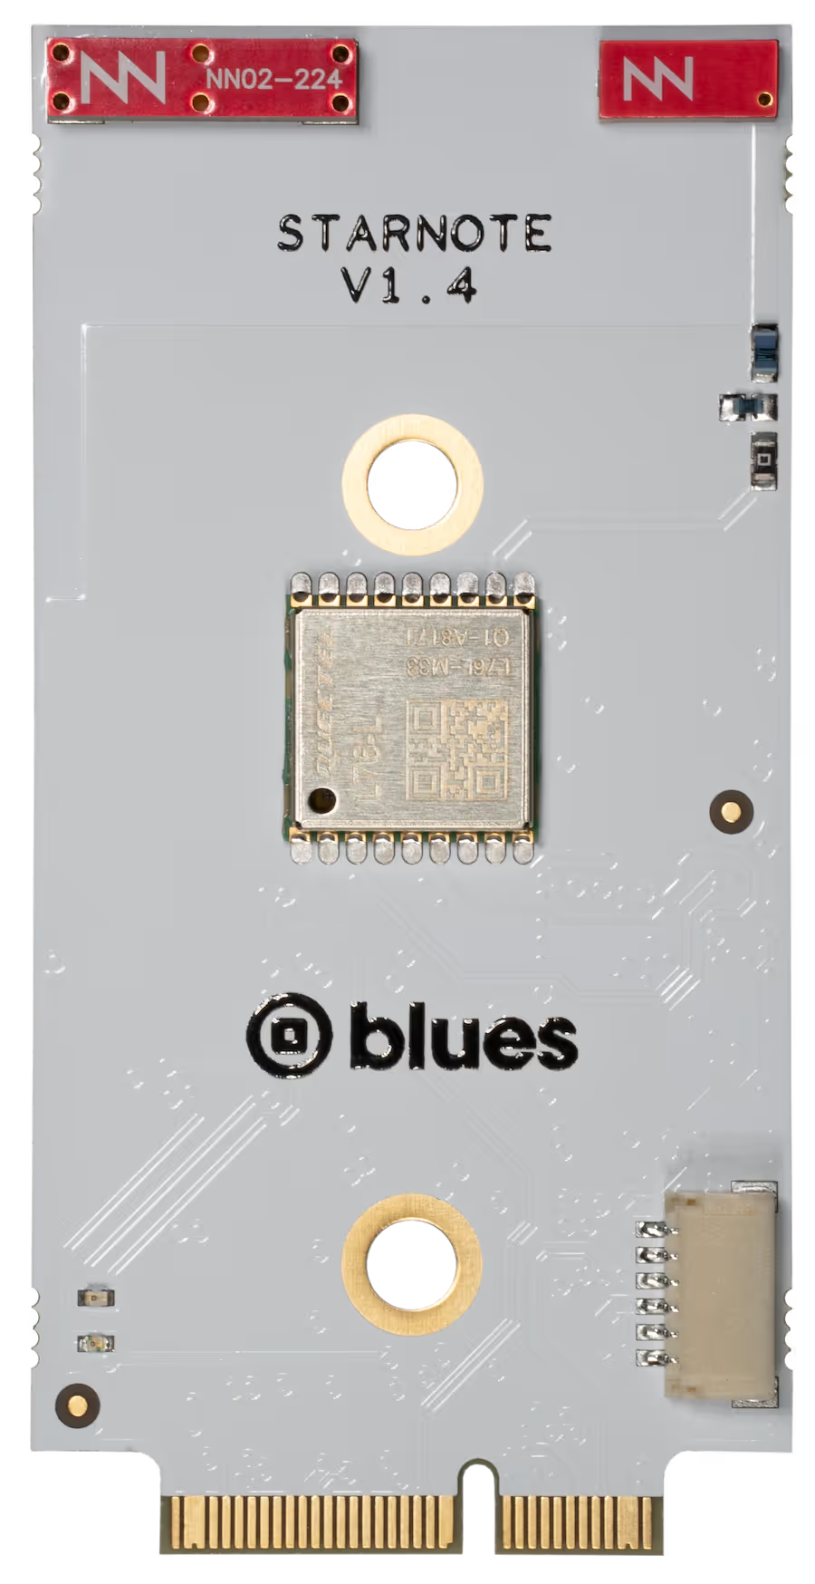
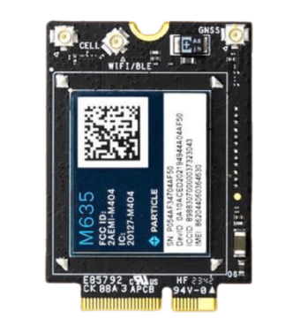
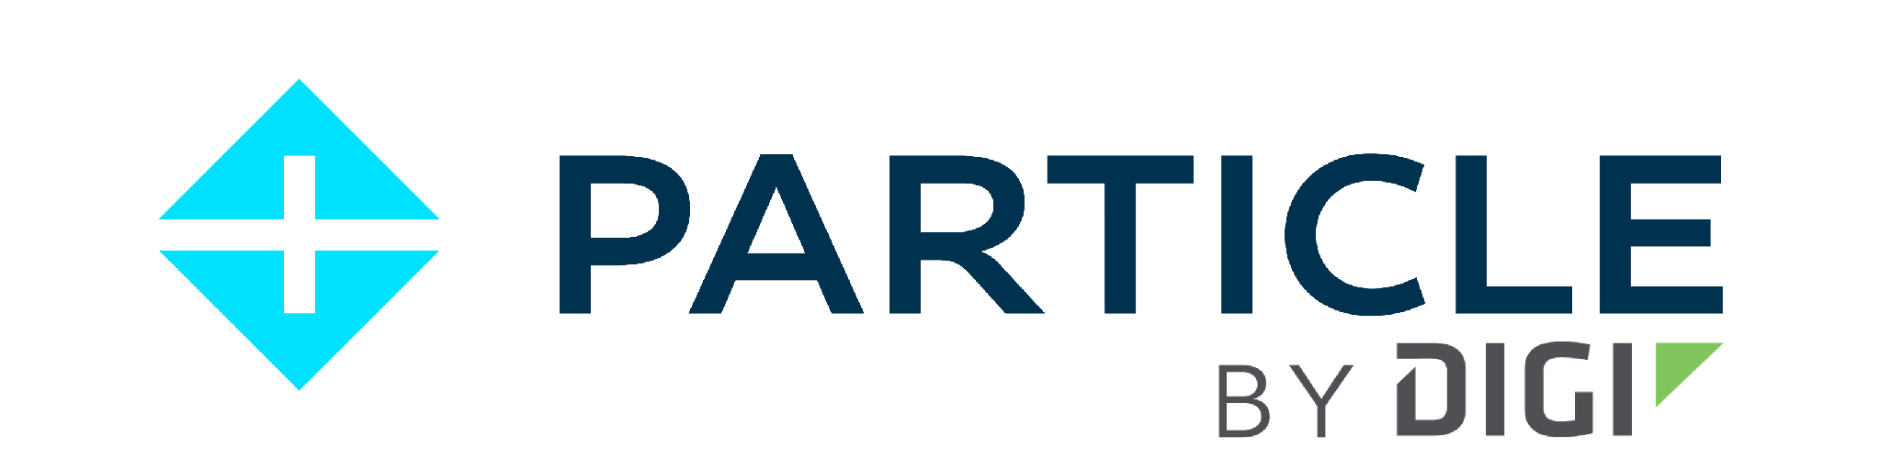
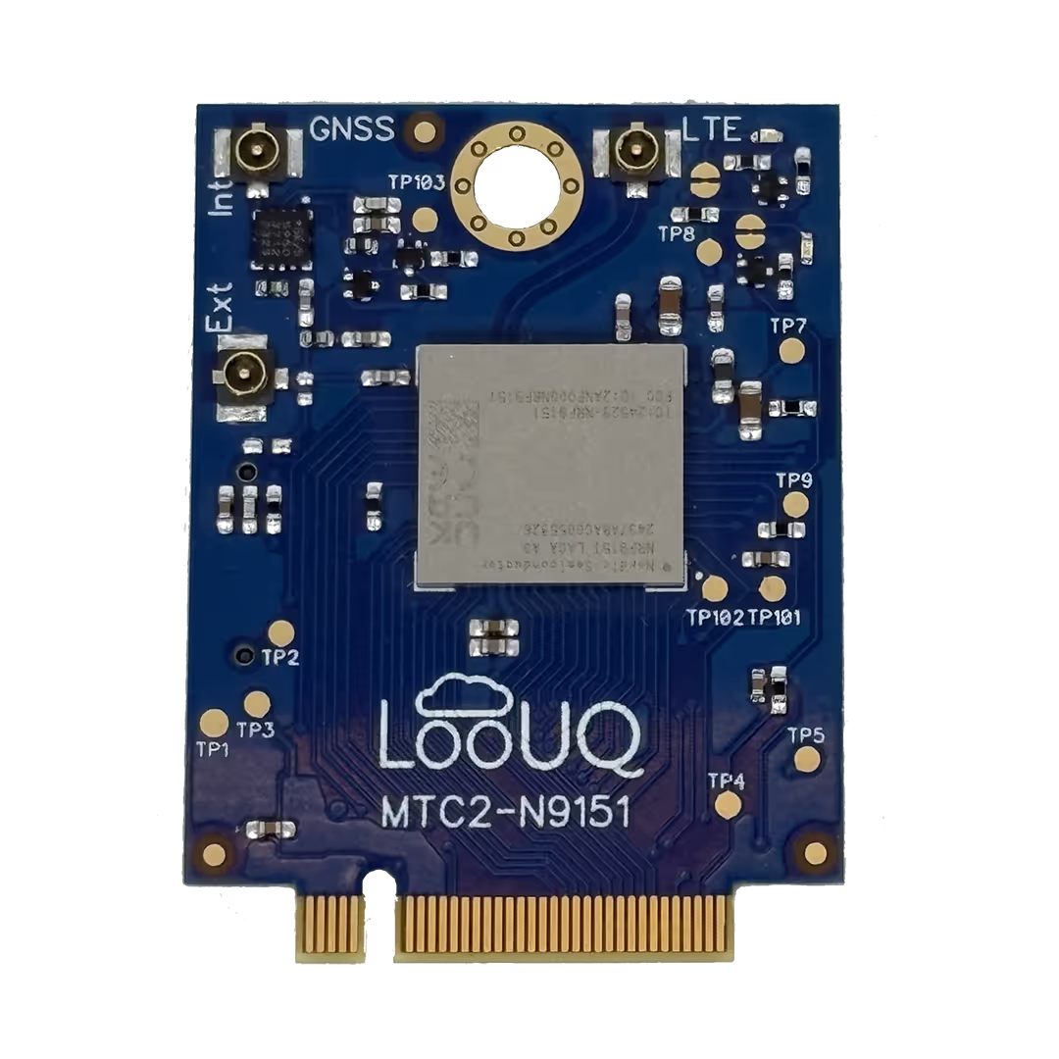


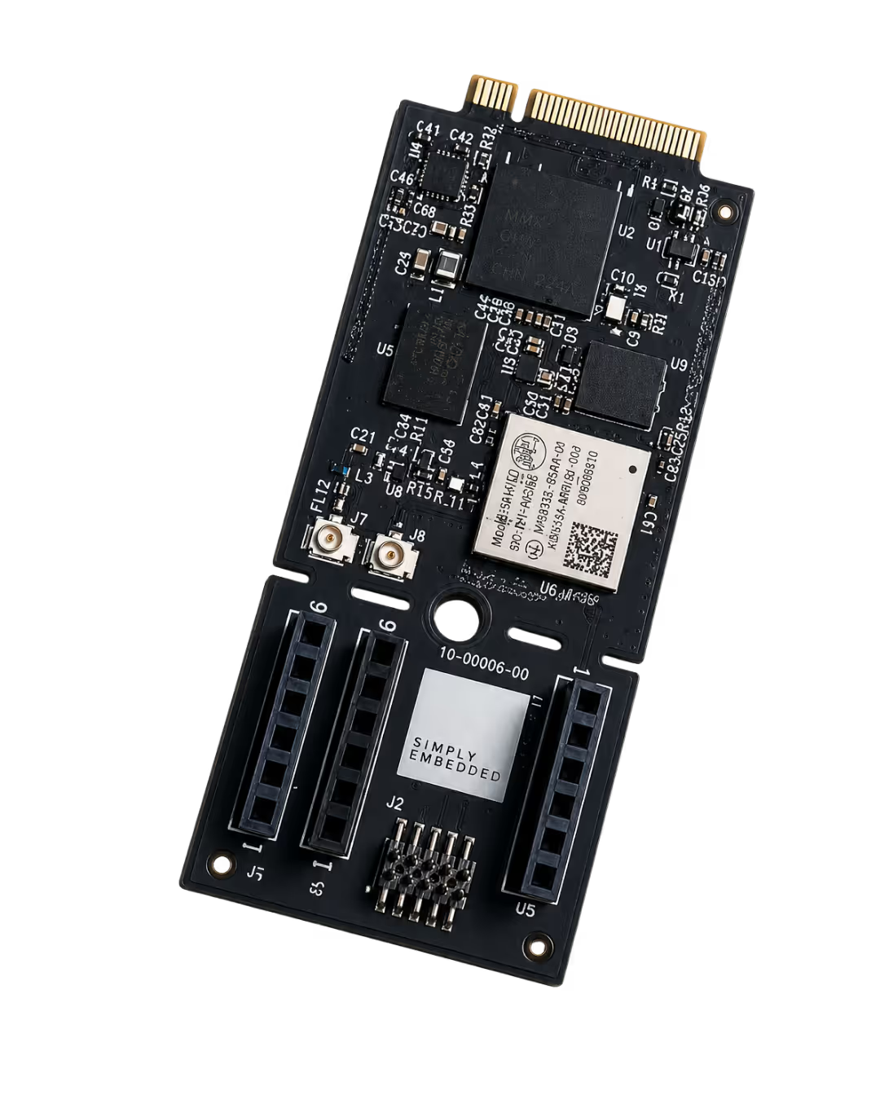




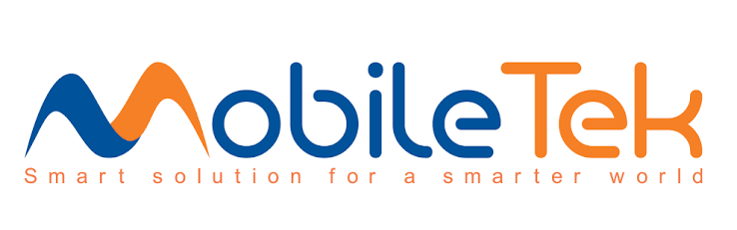


Get Started Today - Embedded modems EVKs
HARDWARE ECOSYSTEM
OEMs using Skylo certified Embedded Modems + Antenna can deploy commercially without obtaining separate Skylo Certification
Partner
Photo
Product
Description
Cert. status
Where to buy
Notecard for Skylo
m.2 built on the Quectel BG95-S5
Blues shop
Certified
Starnote for Skylo
m.2 built on the Quectel CC660D-LS
Blues shop
Certified
M-SoM (M635)
m.2 built on the Quectel BG95-S5
Particle store
In Progress
MTC2-N9151
m.2 built on the Nordic nRF9151
LooUQ
In Progress
Wrangler
m.2 built on the Murata Type1 SC
Rodeo IoT
In Progress
Module EVKs also available from:

Slide 11

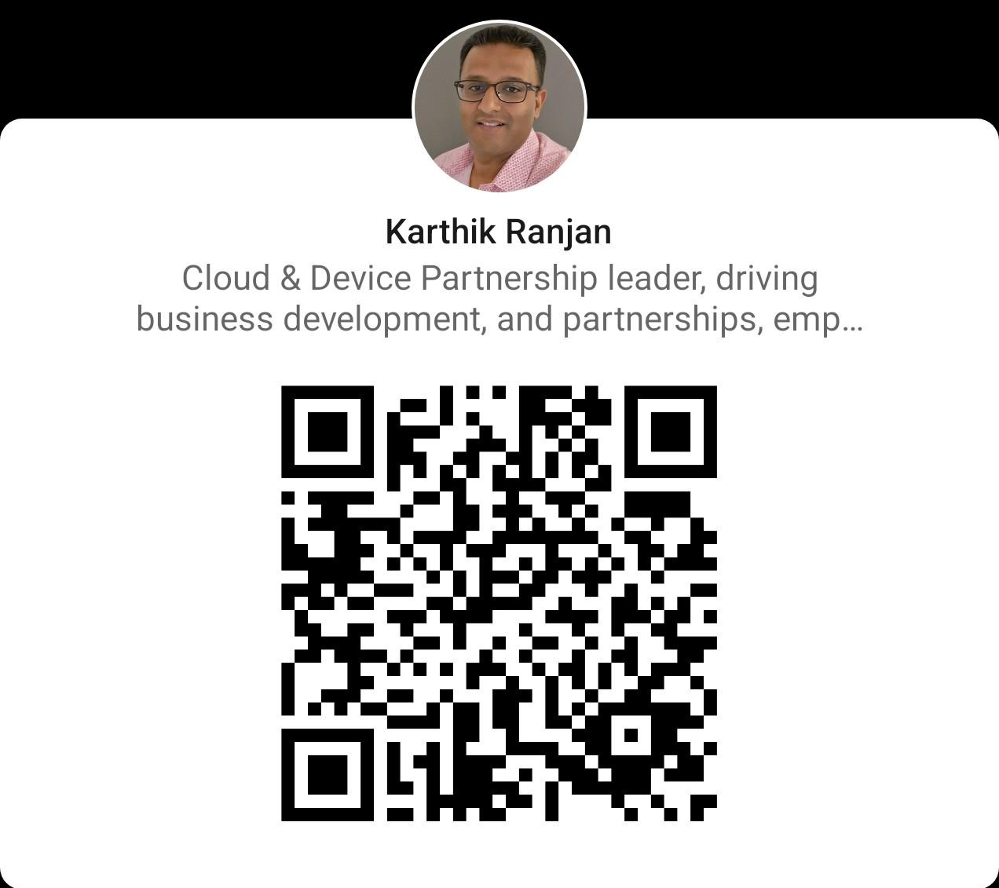
Email: info@skylo.tech
Online: skylo.tech
United States
2301 Leghorn Street
Mountain View
CA 94043
India
No.192, Whitefield Main Rd, B Narayanapura, Mahadevapura, Bengaluru, Karnataka 560048
Finland
Metsänpojankuja 1,
02130 Espoo Finland

