Slide 1



FROM CONNECTED THINGS
TO THINKING SYSTEMS
The next chapter of IoT
Alistair Fulton
CEO, AMESA
Partner, Momenta Ventures
The Things Conference 2026
Notes:
0:00–0:45 — Open: For most of my career in IoT, we have been trying to answer one question: how do we connect the physical world? That question is now becoming the less interesting one. The next chapter is what connected systems are trusted to decide and do.
“Good morning.
I’ve spent a pretty significant part of my career working in IoT. And for most of that time, the question we’ve been trying to answer has been remarkably consistent:
How do we connect the physical world?
How do we connect a machine? How do we connect a sensor? How do we get data out of a factory, a building, a vehicle or a piece of infrastructure and into the cloud?
And collectively, this industry has done an extraordinary job of answering that question.
But I think something quite fundamental has changed.
The interesting question is no longer simply: how do we connect the physical world?
It’s:
Once everything is connected, what are we prepared to let those connected systems actually do?
Because we're moving from an era of connected things into an era of thinking systems.”

Slide 2
THE JOURNEY
IoT has been a 20-year journey up the stack
CONNECT
→
OBSERVE
→
UNDERSTAND
→
DECIDE
→
ACT
Things can talk
We can see
AI can explain
Systems choose
Systems intervene
We have largely solved the first two. AI is rapidly solving the third.
The frontier is the last two.
02
Notes:
0:45–2:00 — IoT connected things, cloud platforms made them observable, analytics and AI made them understandable. Most industrial systems still stop at insight. A dashboard is not autonomy; a prediction is not a decision.
“If you look at the evolution of IoT, I think you can describe it in five words.
Connect. Observe. Understand. Decide. Act.
We spent the first part of the IoT revolution solving connectivity.
Then we built cloud platforms that allowed us to observe what was happening.
Analytics—and now AI—gave us increasingly sophisticated ways of understanding it.
And that has created enormous value.
But most industrial systems still stop somewhere around here.
We can tell an operator what's happening.
We can increasingly tell them what's going to happen.
But the next two steps are fundamentally different.
What should we do about it?
And ultimately:
Can the system do it itself?
That, to me, is the next frontier of IoT.”

Slide 3
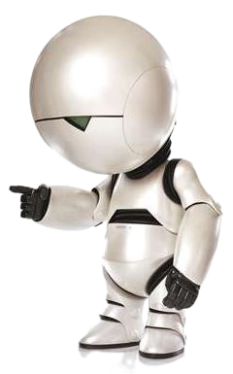

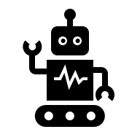
Dave, I predict that the reactor chamber will reach critical in 10 minutes unless we vent the coolant.
THE GAP
Seriously? Quick - please vent the coolant!!!
HAL
Prediction is not decision-making.
Oh no! Please vent the coolant!
I would love to help Dave, I have a brain the size of a planet after all, but my controls only allow me to observe impending disaster…
DAVE
Would you like me to create a Jira ticket? Dave?
HAL
03
Notes:
2:00–3:15 — Predictive AI can tell you a limit will be breached. The hard part is choosing the intervention: what to change, by how much, in what order, under what constraints, and what to watch next.
“And this distinction is really important.
Imagine an AI system in a production facility tells me:
‘Temperature will exceed the operating limit in 17 minutes.’
That's useful. It's probably valuable.
But now imagine another system says:
‘Reduce steam by four percent, maintain the current feed rate, and check the response in 90 seconds.’
Those sound superficially similar.
But they're actually completely different classes of intelligence.
The first system has made a prediction.
The second has made an operational decision.
And making that second statement safely requires understanding the process, the constraints, the interactions between variables, the consequences of being wrong—and what to do next.
That's a much harder problem.”

Slide 4
THE MISSING INPUT
The most valuable industrial dataset may not be a dataset
It is the judgment of your best operators.
Experience
Intuition
Constraints
Exceptions
Trade-offs
Much of this knowledge is tacit: learned over years, rarely documented,
and invisible to conventional model training.
04
Notes:
3:15–4:45 — The best plant operators carry pattern recognition, exceptions and trade-offs accumulated over years. Industrial AI must learn from people, not only historical data.
“And here's where this gets particularly interesting.
Because if you go into almost any factory in the world and ask:
‘Who really knows how this process works?’
Eventually, somebody will point at a person.
It might be Maria who's been running the line for 22 years.
Or Dave who can hear something in a machine that nobody else can hear.
These people have built incredibly sophisticated mental models of their processes.
They understand experience, exceptions, constraints and trade-offs.
They know that when these three things happen together on a humid Tuesday afternoon, you don't do what the operating manual says—you do something slightly different.
And much of that knowledge doesn't exist in the historian.
It isn't in the ERP system.
It isn't in a database.
It's in someone's head.”

Slide 5
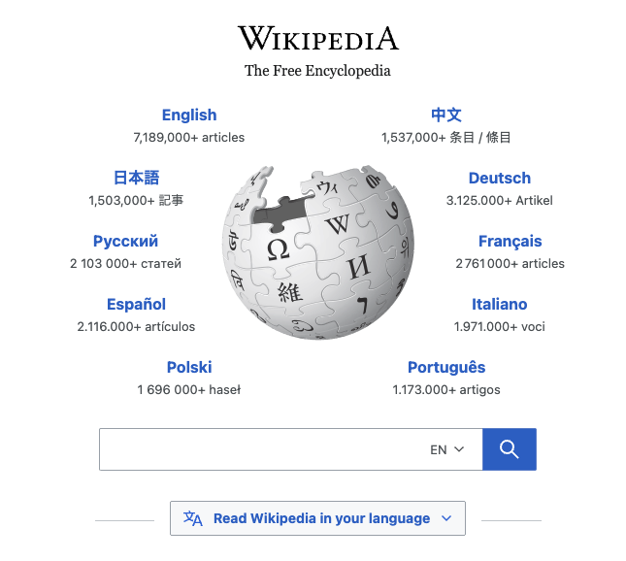
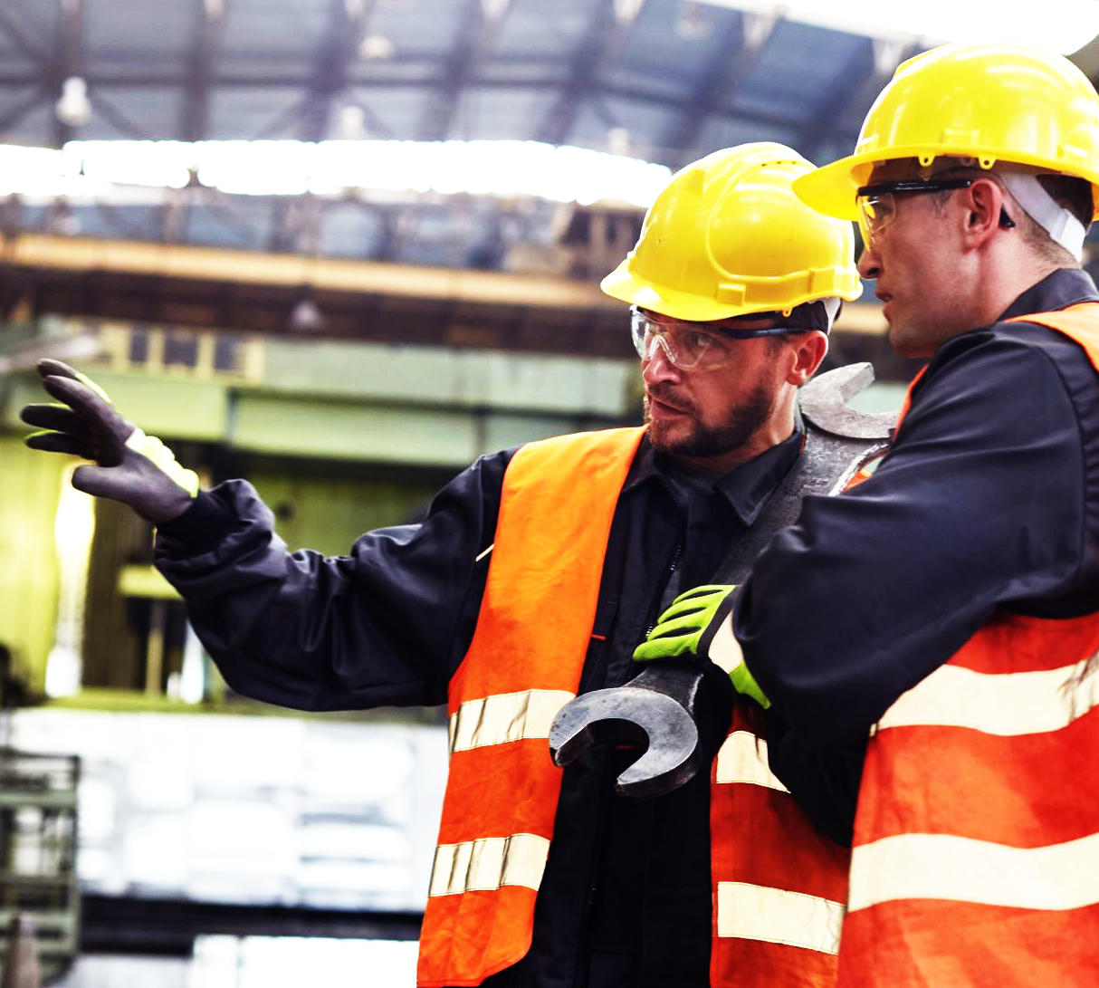
The Internet taught AI everything humanity has written down.
Industrial AI needs to learn everything our best operators
never wrote down.
05
Notes:
4:45–5:45 — Pause. Anchor line. This changes the problem from simply training bigger models to teaching systems how work is actually done.
“And this leads to what I think is one of the really interesting differences between consumer AI and industrial AI.
The Internet taught AI an extraordinary amount of everything humanity has written down.
But industrial AI needs to learn something else:
Everything our best operators never wrote down.
The tacit knowledge.
The judgment.
The things that somebody learned after twenty years of making thousands of decisions.
And increasingly, we're asking whether that expertise can be transferred from people into machines.”

Slide 6
MACHINE TEACHING
What if we teach machines the way we teach people?
SHOW
EXPLAIN
PRACTICE
CORRECT
Demonstrate good decisions
Capture why they work
Let agents try safely
Coach failures & edge cases
The objective is not to imitate the operator.
It is to transfer the operator’s decision logic.
06
Notes:
5:45–7:15 — We teach a new operator with examples, explanations, practice and correction. We are not cloning a person; we are transferring decision logic and combining it with data, physics, constraints and policy.
“One way of thinking about this is surprisingly simple.
How would we teach a new human operator?
We wouldn't give them ten years of historian data and say, ‘Good luck.’
We'd show them.
We'd explain why we made particular decisions.
We'd let them practice.
They'd make mistakes.
We'd correct them.
And over time, they'd encounter more situations and become increasingly competent.
I think there's a really interesting idea emerging in Industrial AI around doing something analogous with machines.
Show. Explain. Practice. Correct.
The objective isn't to create a digital copy of Dave or Maria.
It's to capture the decision logic behind their expertise and combine that with everything machines are good at—data, computation, consistency and scale.”

Slide 7
AGENTIC SYSTEMS
Industrial autonomy will look more like a team than a brain
PROCESS
QUALITY
SAFETY
OPERATING OBJECTIVE
Shared goal
ENERGY
MAINTENANCE
THROUGHPUT
Specialists reason about different objectives — then coordinate under shared constraints.
07
Notes:
7:15–8:45 — Plants already operate through teams balancing quality, energy, throughput, safety and maintenance. Agentic systems can mirror that structure.
“And I also don't think the future factory is going to be controlled by one enormous omniscient AI.
Factories don't work like that today.
They're operated by teams of specialists.
Someone cares about quality.
Someone cares about throughput.
Someone cares about energy.
Someone cares about maintenance.
And somebody has to balance all of those objectives while respecting safety and process constraints.
I think autonomous industrial systems will increasingly look similar.
Teams of specialized agents, each understanding a particular objective or aspect of the process, coordinating their decisions around a common operating goal.
Less like one giant brain.
More like a very effective operating team.”

Slide 8
THE PROVING GROUND
Before AI controls the plant, where does it learn to fly?
DIGITAL TWIN / SIMULATION
PILOTS HAVE
FLIGHT SIMULATORS.
AGENT DECISION
AUTONOMOUS INDUSTRIAL AI
NEEDS THE SAME IDEA.
OUTCOME + FEEDBACK
REPEAT × 1000s
08
Notes:
8:45–10:15 — Simulation lets agents explore, fail cheaply, experience rare conditions and build evidence before production. Deployment should not be the experiment.
“But now we encounter a fairly obvious problem.
Where do we let these agents learn?
Because a production facility is a terrible classroom.
We wouldn't train a commercial pilot by giving them a 787 full of passengers and saying:
‘Go experiment.’
We give them a flight simulator.
They experience engine failures.
Bad weather.
Unusual situations.
They make mistakes.
They can crash.
And then they do it again.
Industrial AI needs the equivalent.
Digital twins and simulation can become flight simulators for autonomous systems—places where agents can make thousands of decisions, experience situations that rarely occur in production, fail safely and learn the consequences.”

Slide 9

BEFORE AN AI IS ALLOWED TO CONTROL
A PLANT LIKE THIS...
HOW DOES IT PROVE THAT IT IS READY?
09
Notes:
10:15–11:15 — Central question. Pause. Trust cannot be a marketing claim or model benchmark. Competence must be demonstrated against operating scenarios, constraints, failure modes and objectives.
“And that leads to what I think may be one of the most important questions we're going to have to answer as an industry.
Before an AI is allowed to control something that matters, how does it prove that it is ready?
Because saying a model is 97 percent accurate isn't enough.
A benchmark isn't enough.
And ‘the vendor says it's safe’ certainly isn't enough.
If an AI is going to influence a chemical process, an energy system, a production line or critical infrastructure, we need evidence that it can operate competently within that environment.
Autonomy has to be earned.”

Slide 10
PROGRESSIVE AUTONOMY
Autonomy should be earned, not switched on
01
OBSERVE
Understand the process
02
RECOMMEND
Suggest operator actions
03
SUPERVISE
Act with human approval
04
CONTROL
Act inside defined bounds
Trust grows with demonstrated competence.
10
Notes:
11:15–12:45 — A practical maturity path: observe, recommend, supervise, control. Autonomy expands only as evidence accumulates.
“And importantly, this doesn't have to be binary.
We don't have to choose between humans running everything and turning the factory over to AI.
There's a progression.
First, the system observes.
Then it starts making recommendations.
Then perhaps it's allowed to act, but only with human approval.
And eventually, once it has demonstrated sufficient competence, it's allowed to control parts of the process within clearly defined boundaries.
Observe. Recommend. Supervise. Control.
The amount of autonomy grows as the evidence grows.
That makes autonomous AI much less of a leap of faith.”

Slide 11
GOVERNANCE
Intelligence without constraints is not industrial autonomy
BOUNDARIES
OBSERVABILITY
PROVENANCE
OVERRIDE
AUDIT
What may it change?
Why that decision?
Which model acted?
Who can stop it?
Can we reconstruct it?
Governance is not the brake on autonomy.
It is what makes autonomy deployable.
11
Notes:
12:45–14:15 — Runtime boundaries, observability, provenance, override and auditability are the control layer that lets us deploy faster with confidence.
“But competence alone isn't enough.
The system also needs boundaries.
What is the agent allowed to change?
Why did it make this particular decision?
Which model or policy made the decision?
Can a human override it?
And six months later, can I reconstruct exactly what happened?
This is where governance becomes incredibly important.
And I don't think governance should be viewed as something that slows AI down.
Quite the opposite.
Governance is what allows us to deploy autonomy faster.
Because it gives us the confidence to let these systems act.”

Slide 12
PUTTING IT TOGETHER
The architecture of a thinking system
SENSE
→
TEACH
→
PRACTICE
→
DECIDE
→
ACT
IoT + operational data
Human expertise
Simulation / twins
Specialized agents
Bounded control
This is the shift from connected infrastructure to operational intelligence.
12
Notes:
14:15–15:45 — Synthesize: connected data is the sensory system; human expertise teaches; simulation provides practice; agents decide; governance bounds action.
“So put all of this together, and you start to see a different architecture emerging.
First, sense.
That's the world this community has spent years building: sensors, devices, connectivity, operational data.
Then teach—bring human expertise into the system.
Then practice—give intelligence somewhere safe to experiment through simulation and digital twins.
Then decide—specialized agents reasoning about what should happen.
And finally act—but inside explicit, governed boundaries.
Sense. Teach. Practice. Decide. Act.
That's when connected infrastructure starts becoming something fundamentally different.
It becomes an operationally intelligent system.”

Slide 13
IMPLICATIONS
What changes for the IoT industry?
DATA → DECISIONS
DEVICES → SYSTEMS
Value moves beyond telemetry.
The unit of intelligence becomes the process.
MODELS → AGENTS
DEPLOY → PROVE
Reasoning becomes operational.
Simulation becomes part of the lifecycle.
13
Notes:
15:45–17:30 — Make this relevant to The Things Conference audience. Device makers, connectivity providers and platforms should think about how their data participates in closed-loop decisions, not only how it reaches the cloud.
“And I think this transition has some fairly profound implications for those of us in IoT.
For years, we've measured success in things like connected devices, messages transmitted, data stored and dashboards created.
But the value is moving further up the stack.
Data becomes decisions.
The unit of intelligence moves from an individual device toward the process or system that device participates in.
Models increasingly become agents capable of reasoning and taking action.
And perhaps most importantly, deployment starts becoming proof.
It isn't enough to get the model running at the edge.
We have to demonstrate that the resulting system behaves competently in the physical world.
So the data coming from the things we've spent twenty years connecting isn't the end product.
Increasingly, it's the sensory input to something much larger.”

Slide 14
IoT gave machines
SENSES.
AI gave machines
INTELLIGENCE.
Agents give machines
AGENCY.
Practice gives us
CONFIDENCE.
Governance gives us
CONTROL.
14
Notes:
17:30–18:45 — Verbal recap. Keep the cadence. Practice creates evidence; governance makes that evidence operationally meaningful.
“So perhaps another way of describing the journey is this:
IoT gave machines senses.
We allowed them to perceive the physical world.
AI gave machines intelligence.
They can increasingly understand what they're seeing.
Agents give machines agency.
They can decide what should happen next.
But those last two pieces are critical.
Practice gives us confidence.
And:
Governance gives us control.
Put those five things together and we have something very different from the IoT systems we've spent the last twenty years building.”

Slide 15
THE NEXT DECADE OF IoT
WON’T BE DEFINED BY
HOW MANY THINGS WE CONNECT.
IT WILL BE DEFINED BY
WHAT WE TRUST THEM TO DO.
Thank you
15
Notes:
18:45–20:00 — Close by returning to the abstract. The connected-device era gave us visibility. The thinking-system era gives us agency. The winners will not simply build the smartest models; they will build systems we are prepared to trust with the physical world. Leave a few seconds for the final line to land.
“So I'll leave you with this.
For the last decade or two, our industry has been obsessed with the number of things we can connect.
Billions of devices.
Trillions of messages.
Exabytes of data.
And all of that infrastructure was necessary.
But I increasingly think we're going to look back and realize that connectivity was the foundation, not the destination.
Because the next decade of IoT won't be defined by how many things we connect.
It will be defined by what we trust them to do.
Thank you.”

