Slide 1
Data Strategy
Roadmap
Template

Slide 2
Roadmap Structure
The projects on the roadmap are broken into five major categories, each containing sub-activities which will be outlined in the following slides.
  Cloud Selection Process
  DB Setup / Procured
  User Tooling
  Security
  Design Data Pipelines
  Build Phase 1 Sources
  Build Phase 2 Sources
  Design ML Ops
  Build ML Ops
  ID / Hire Analytic Thought Leader
  Empower / Enable Data Analyst
  Build Operations Data Team
  Advanced Analytics Use Case Prioritization
  Develop Operational Model for Data Monetization
  Establish Data Governance Charter
  Kick off Data Governance Committee
  Prioritize / Fund / Monitor Work
Infrastructure
Software
Talent
Data Governance
Delivery Management
  Provide project governance and management across projects and initiatives

Slide 3
One Year Roadmap
Q1 2025
Q2 2025
Q3 2025
Q4 2025
($XXX-$XXX)
($XXX-$XXX)
($XXX-$XXX)
($XXX-$XXX)
Client Led Project
Partner Led Project
Project Dependency
IF 1
  Cloud Selection Process
IF 2
DB Setup / Procured
IF 3
  User Tooling
Infrastructure
Software
Talent
Data Governance
Delivery Management
IF 4
  Security
SW 1
  Design Data Pipelines
SW 2
Ne business
  Build Phase 1 Sources
SW 3
  Build Phase 2 Sources
SW 4
SW 5
  Design ML Ops
  Build ML Ops
TA 1
  ID / Hire Analytic Thought Leader
TA 2
  Empower / Enable Data Analyst
TA 3
  Build Operations Data Team
TA 4
  Advanced Analytics Use Case Prioritization
DG 1
  Develop Operational Model for Data Monetization
DG 2
  Establish Data Governance Charter
DG 3
  Kick off Data Governance Committee
DG 4
  Prioritize / Fund / Monitor Work
DM1
  Provide project governance and management across projects and initiatives

Slide 4
Software Initiative 3: Build Phase 2 Sources
SW 3
Quick Win
Placing Hasura on top of the existing v4 database could create an immediately available API
Team Thoughts
Estimated Cost
$X - $Y
1
One Senior Consultant
1
One Consultant
Start: Q3-2025
SUMMARY
Deploy Databricks to “Client” leveraging existing AWS S3 assets. Provide a unified Data Lakehouse environment to expose data throughout the organization to speed development of analytic products.
Databricks provides an industry leading data platform as a service. Leveraging already owned cloud data storage, it provides organizations with compute resources and a powerful suite of tools to enable data analytics in a collaborative environment.
The initial goals will be to develop necessary frameworks and support structure to facilitate security and operations in Databricks and expose the data assets produced by the “Client” project.
2-4 Weeks: Procure and deploy Databricks on clients AWS instance
6-10 Weeks: Work under client guidance to build workflows and frameworks to support ongoing operations and compliance needs
8-12 Weeks: Develop views to the “Client” data modeled after views available in the Data Mart
Improved tooling that creates leverage and reduces support efforts
Platform that supports broad integration of data
Enables machine learning and other advanced analytics
DESCRIPTION
TASKS
Concurrent Activities
BENEFITS / CAPABILITIES

Slide 5
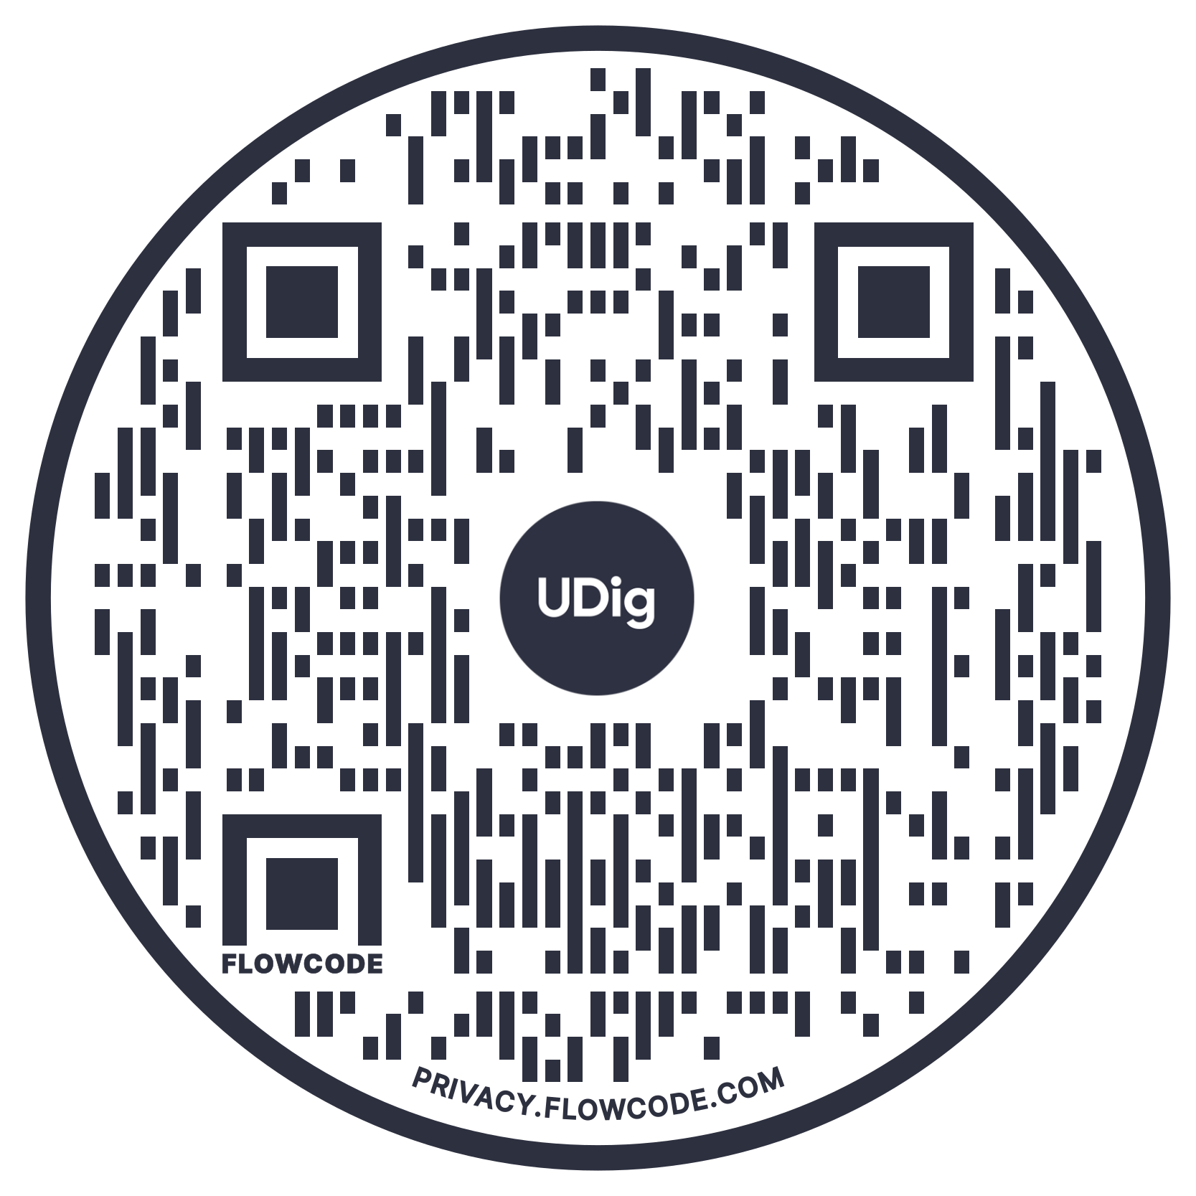
Partner with UDig to Create Your Data Strategy
Building a winning data roadmap doesn’t have to be a daunting, painstaking process. Contact us and let our data strategists help you identify the best path forward for your business.
Let's Talk

