Slide 1
Connecting at Scale: Making Every Device Speak One Language
Jon Harros, Head of Testing & Certification
Notes:
Focus area: Connecting devices at scale.
Abstract:
Getting two devices to talk to each other is hard. Getting an entire industry to agree on how all devices should talk to each other is harder but that's the challenge the Connectivity Standards Alliance decided to solve, and the result is Matter. This session looks at how Matter became a single, IP-based protocol capable of scaling across brands, categories, and continents, and what it takes to keep reliability and security intact as adoption accelerates from thousands of devices to billions.
Quote we provided ahead of the conference:
"The IoT ecosystem is advancing quickly, and realizing its full potential means the industry moving together — that's exactly what Alliance standards like Matter and Aliro make possible. At The Things Conference, we're excited to spotlight how our standards turn that promise into secure, dependable connectivity across diverse deployment." - Krista Ingram, Head of Marketing, Connectivity Standards Alliance

Slide 2









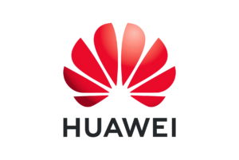



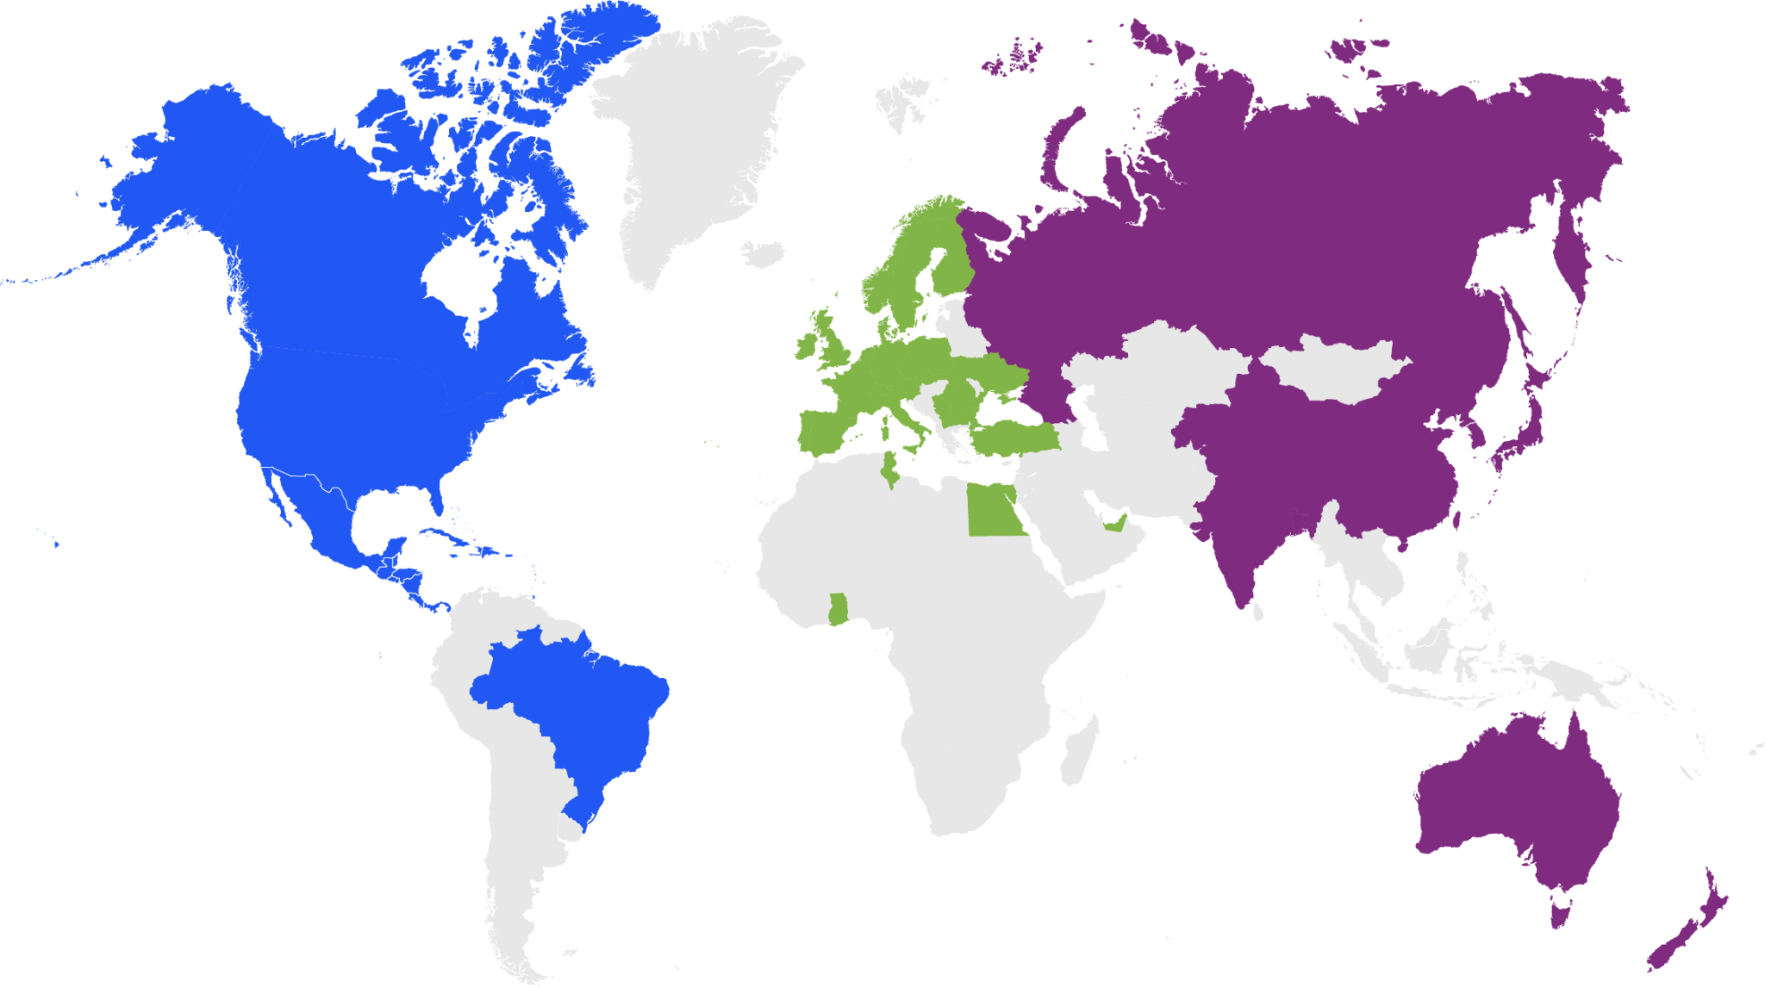










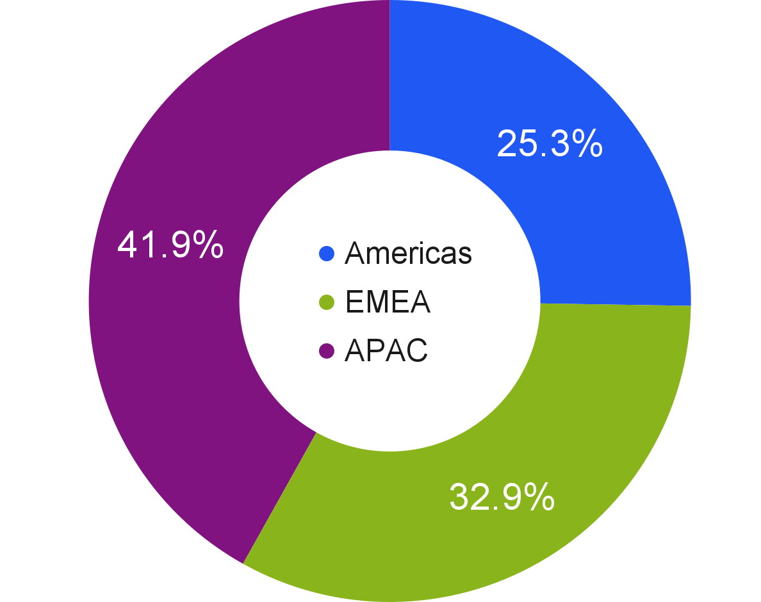











Global Leadership
Global Collaboration
940+ Members Companies*
10,000+ individuals
45 countries
*As of June 2026, includes Promoters, Participants, Adopters, and Associates
Notes:
IoT should positively transform the way we live, work, and play.
Complexity, closed ecosystems and challenges of accessibility, security and trust have held back progress.
Since 2002, Connectivity Standards Alliance has been dedicated to creating open standards that make the Internet of Things (IoT) simple, interoperable, and secure.
Now 940+ Member Companies, 10,000+ individuals, global reach across 45 countries
Member-driven voice & vision actively influence industry → revolutionizing the connected world

Slide 3









Our Members Drive the Alliance Forward
Aliro
Matter
Members actively influence the IoT industry with their voice and vision.
Through Member-driven work, we continue to revolutionize the connected world.
Product
Security
Zigbee
Data Privacy
Group
Member Group
China
EU Interest
Group
Japan Interest
Group
Notes:
Getting the work done - each WG represents a diverse, but connected community working towards industry-driven requirements.
Zigbee continues to power billions of large-scale, low-power deployments worldwide — with 200+ companies and 6,000+ certified devices behind it — and its recent Zigbee 4.0 update adds longer-range support, hubless pairing, batch commissioning, and stronger security.
Aliro → open standard for mobile-first access control, letting phones, wearables, and other credentials work securely across readers and systems from different manufacturers. Launched in February with 220+ companies across the access control value chain, it has quickly gained real momentum — backed by all three major wallet providers and already shipping in products from several leading brands.
Product Security Certification Program → recently expanded from individual devices to full IoT systems, added two levels of security assurance, and aligned with major global regulations, making security compliance simpler for manufacturers worldwide.

Slide 4







A single, IP-based protocol
Simplified development for manufacturers
Increased choice & compatibility for consumers
Rapid, global adoption & transformative impact
A seal of approval that devices will work seamlessly and securely together
Simple
Interoperable
Reliable
Secure
Notes:
To make connected living scalable for users who want the outcome (e.g., energy savings, convenience, security) without the process requires a turnkey solution.
Devices need to work together out of the box, across brands, with no configuration required.
That's what Matter was built for.
It’s the cornerstone of a more interoperable, simple, and secure IoT.
A unifying protocol, a common language for the IoT
SIMPLIFYING the complex → for manufacturers, retailers, consumers; right member players made it real, proved it works → now focused delivering products in-market
Increasing INTEROPERABILITY → new performance baseline, companies can pivot to value/innovation
Raising the bar for RELIABILITY & SECURITY – building confidence & trust
Matter opened up the smart home → now expanding that definition

Slide 5

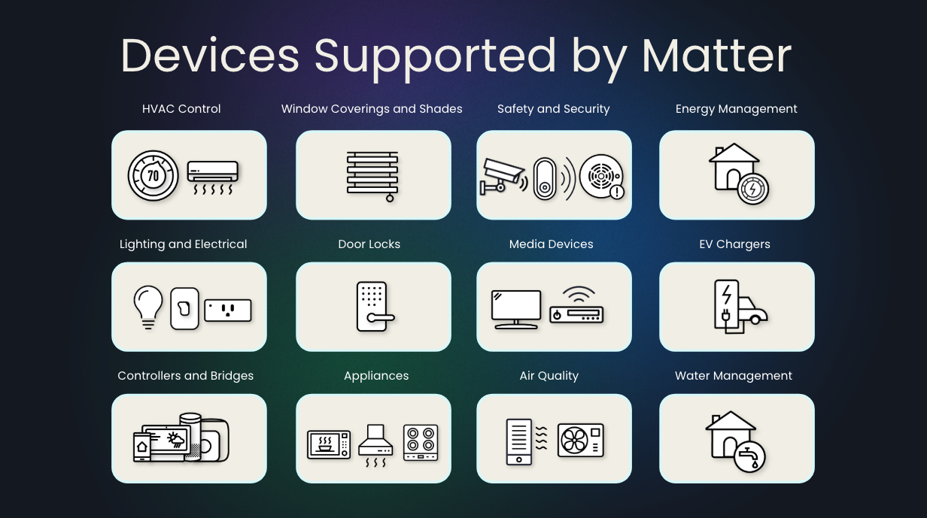
| Evolving and Extending Reach
Ongoing Release Planning
Multi-Release Cadence - Major / Minor
Devices, Functional Updates, Continuous Improvement
Active Use Case Teams
Robot Vacuum Cleaners
Media Devices
Environmental Sensing / Controls
Smoke & CO Detectors
Energy Management (EV Charging +)
Water Management
Access Points, Border Routers
Ambient Motion / Presence Sensing
Notes:
As Matter matures and gains widespread adoption, offering easier set up, better reliability, enhanced security, interoperability with other devices and across brands, & more options across categories → it’s driving more smart home devices added to homes.
Consumers seeing the benefits that smart devices can bring, including convenience, security & safety, weather & energy management.
Membership committed to maturing & evolving Matter; moving from standardization to productization, as it fits individual plans and roadmaps
Ongoing spec releases → new devices, functional updates, and continuous improvement
Use case teams develop future enhancements and additional devices

Slide 6

Notes:
CONCLUSION
Members committed to maturing & evolving Matter standard
More building blocks, building in capabilities for future features
It’s the right time with the right people and the Alliance is the right place→ together we can lighten the load
The time is now to take a seat at the table to have a voice in expanding IoT in the smart home and revolutionizing the connected world
Members across globe & industry → from leading technology companies & household brands to innovative startups, come together to bring best ideas & technologies; solving biggest problems in the smart home to make connecting devices easier for consumers & opening doors for innovation.
Have moved from standardization to productization, as it fits each company’s individual plans and roadmaps
It’s a journey, not a single destination.

