Slide 1
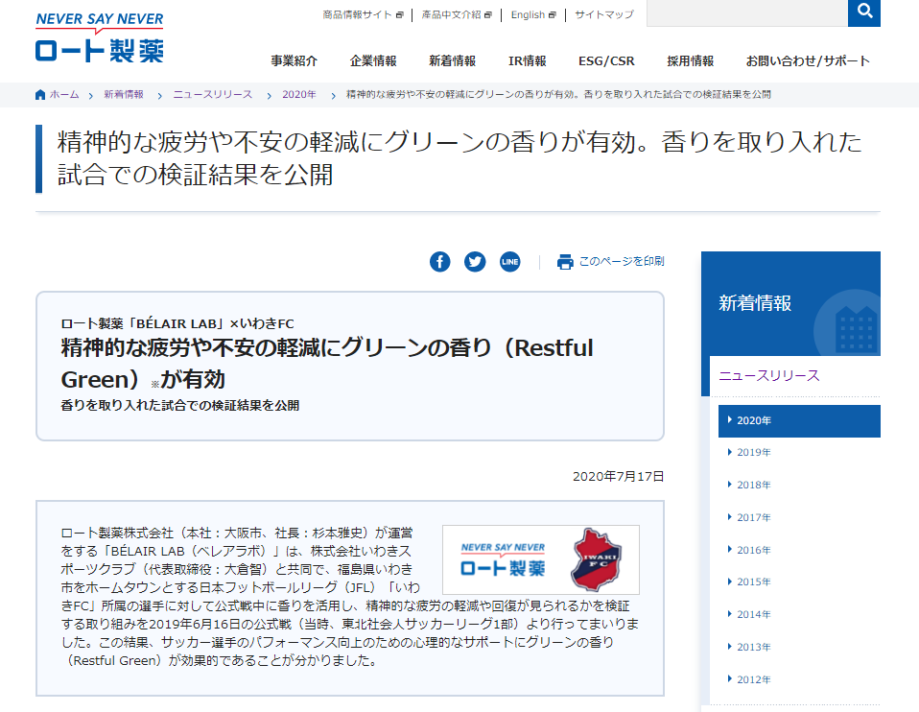
New green scent effective at reducing mental fatigue and anxiety, latest soccer game study shows.
English translation in collaboration with Kai Proschan @Subarashii.online
Rohto’s BÉLAIR LAB × Iwaki Football Club (Soccer) Aug 2020
Specifically designed green scent named Restful Green* is effective in reducing mental fatigue and anxiety
“BÉLAIR LAB” (Tokyo) operated by Rohto Pharmaceutical Co., Ltd. (headquartered in Osaka, President: Masafumi Sugimoto) in collaboration with Iwaki Sports Club Co., Ltd. (based in Iwaki City, Fukushima prefecture, President: Satoshi Okura) presented a scent to “Iwaki FC” athletes during their official game on June 16, 2019 to explore its effect on mental fatigue reduction and recovery. Results show that green fragrance Restful Green is effective for psychological support and at improving the soccer players’ performance.

Slide 2
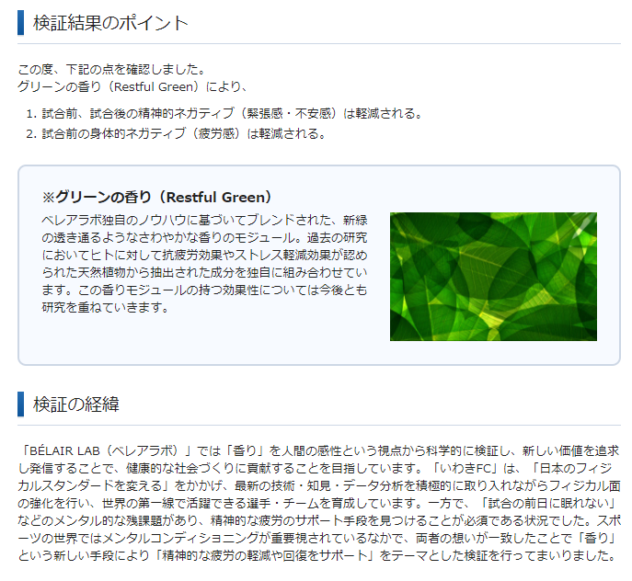
Findings
Green fragrance baptized Restful Green
1. Reduces negative mental conditions (tension and anxiety) before and after the match.
2. Reduces negative physical conditions (fatigue) before the match.
※Green scent Restful Green
A fresh, almost transparent green scent module composed via BÉLAIR LAB’s proprietary knowledge. Based on previous research, we have assembled a unique combination of natural plant extracts and nature identical molecules recognized for stress-reducing and anti-fatigue effects on humans. We shall continue to study the effectiveness of this fragrance module.

Slide 3
Methodology
"BÉLAIR LAB" study scents and fragrances from a scientific perspective as it relates to the human senses (Kansei studies). It works towards contributing to the creation of a healthier society via the pursuit and the transmission of new values and proven benefits. "Iwaki FC" is developing a world-class team of players by incorporating the latest technologies and information and data analysis, to strengthen their physical condition and ultimately “change the physical standard of Japan”.
Furthermore, the remaining mental challenge of “I can’t sleep the day before the match” was addressed. Ways to support mental fatigue during this time also had to be explored. Mental conditioning is a key ingredient in the world of sports. BélAir Lab had made a commitment to study the topic of “supporting the reduction and recovery of mental fatigue” via scents.

Slide 4
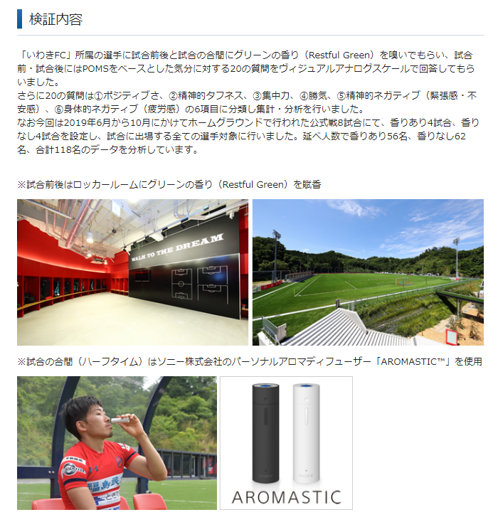
Content
We asked Iwaki FC players to smell the green scent module Restful Green before and after the games, as well as during halftimes. They had to answer 20 questions pre- and post-game about their mood based on a POMS visual analog scale.
The 20 questions were classified into 6 categories, 1) Positivity, 2) Mental toughness, 3) Focus, 4) Motivation, 5) Mental impairments (tension/anxiety), and 6) Physical impairments (fatigue). Results were assembled and analyzed thereafter.
Note: The study was conducted over eight (8) home games from June - October 2019. Four (4) games incorporated the fragrance and four (4) did not for all participating athletes. Of the 118 total number of subjects, 56 were actually exposed to the scent, and 62 were part of the control group.
* Green fragrance Restful Green was played in the locker rooms before and after matches
**Sony Corporation’s individual aroma diffuser "AROMASTIC™" was used by each athlete at halftimes.

Slide 5
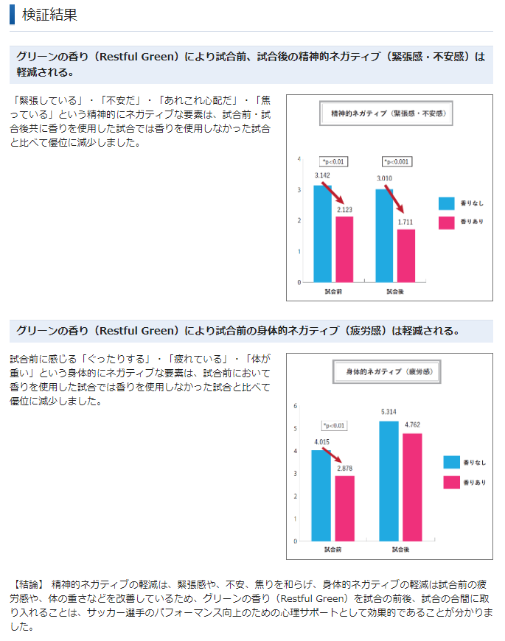
Mental negatives (tension and anxiety)
No scent
Scent used
Results
Green scent Restful Green reduces mental impairments (tension and anxiety) before and after the match.
Matches that incorporated the fragrance before and after had significantly less mental impairments (“I'm nervous", "I'm worried", "I'm worried about this", "I'm impatient”) than those that did not.
Before the match
After the match

Slide 6
Physical negatives (fatigue)
No scent
Scent used
Green scent Restful Green reduces physical negatives (fatigue) before the match.
Games that incorporated the fragrance before had significantly reduced physical impairments (“I'm lethargic”, "I'm tired”, “I feel heavy“) compared to games that did not.
Before the match
After the match
[Conclusion] It was discovered that incorporating the green scent Restful Green before, after, and in the game (halftime) was effective in psychological support and improved the soccer players’ performance. This includes reduced mental impairment (tension, anxiety, and impatience) and physical impairment (tiredness, lethargy).

Slide 7
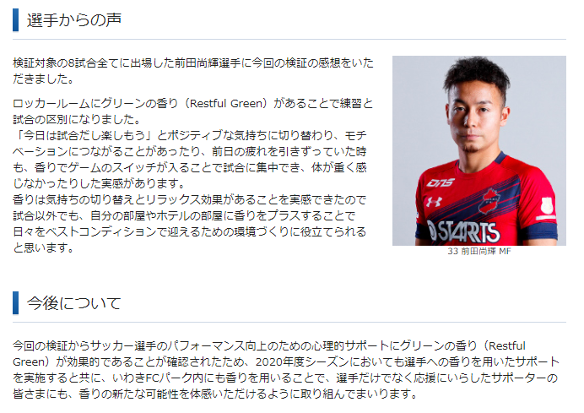
Player’s Testimonial
Naoki Maeda, who participated in all eight games, is giving us his testimonial on the study:
“The green fragrance Restful Green in the locker room allowed us to distinguish between practice and games.
It allowed the transition to a positive mood (“Today’s the game, let’s have fun”) which can help with motivation. Even when you're tired from the day before, the scent puts you in game-mode, and allows you to concentrate and not feel as lethargic.
I realized that the scent has an emotional and relaxing effect. By incorporating it in my room or hotel rooms, it can be useful to create an environment that supports a prime condition daily, even outside of the game.
Looking ahead
From this study, the green scent Restful Green is confirmed as effective for psychological support at improving the performance of soccer players. We shall continue to provide fragrance support to players into the 2020 season. At the same time, we are looking into using the fragrance at Iwaki FC Park so that the attendees can also experience the benefits of the fragrance.

Slide 8
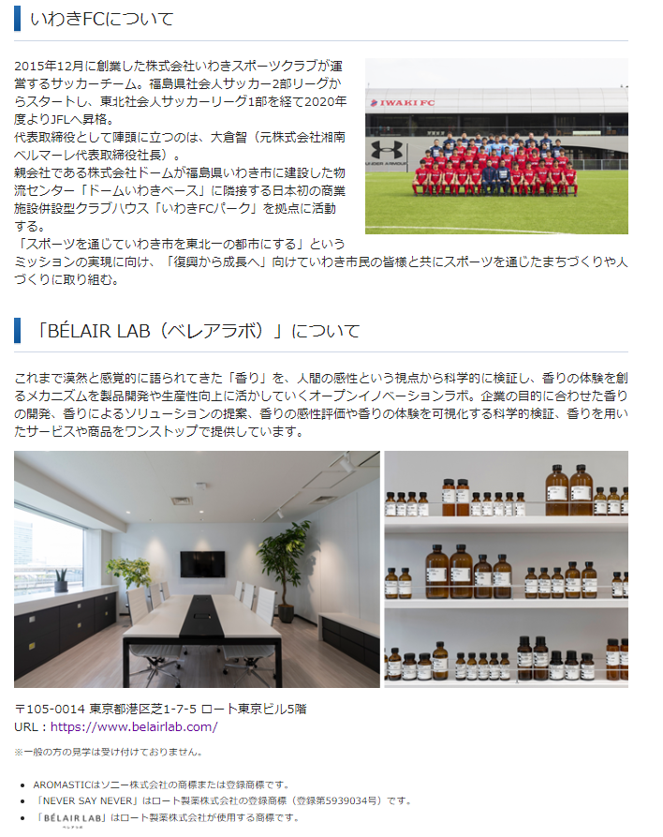
About Iwaki FC
A soccer team founded in December 2015 by Iwaki Sports Club Co., Ltd.. It initially started out as the Fukushima Prefecture Adult Soccer Second Division League, then passed through the Tohoku Adult Soccer League Division One, to finally being promoted to the Japanese Football League (JFL) in FY2020.
Satoshi Okura (former President and CEO of Shonan Bellmare Co., Ltd.) acts as the lead representative director.
They operate out of “Iwaki FC Park”, Japan's first clubhouse with a commercial facility, which is adjacent to Dome Iwaki Base, a logistics center constructed by parent company, Dome Co., Ltd.
In order to fulfill the mission of "making Iwaki City the No. 1 city in Tohoku through sports," we will work together with citizens of Iwaki "from reconstruction to growth" in urban and community development through sports.

Slide 9
About "BÉL AIR LAB“
An open innovation lab that scientifically investigates “fragrance”, which has been inconsistently studied in terms of all humans senses as a whole. It utilizes the reaction mechanisms during fragrance interaction for product development and productivity improvement. We provide a one-stop service for developing scents tailored to the industry’s goals, offering scented solutions, and scientifically verifying and visualizing scent sensation and scent experiences among other senses.
Rohto Tokyo Building FL5, 1-7-5 Shiba, Minato-ku
Tokyo 105-0014
URL：https://www.belairlab.com/
*We do not accept tours by the general public.
*AROMASTIC is a trademark or registered trademark of Sony Corporation.
*"NEVER SAY NEVER" is a registered trademark (Registered No. 5939034) of Rohto Pharmaceutical Co., Ltd.
* " BÉLAIR LAB " is a trademark owned by Rohto Pharmaceutical Co., Ltd.

