Slide 1

Powering AI Data Centers Sustainably
Nathaniel Burola, Sam Jung, Nadia Lee, George Parks

Slide 2
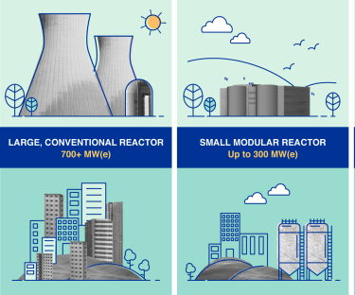
Overview
AI energy demand is projected to reach 10% of U.S. electric consumption by 2030.
Data centers consumed 2% of global electricity in 2022
  Projected to reach 8% in the U.S. by 2030.
To meet this power demand, AI companies are investing heavily in small modular reactors (SMRs)
  SMRs are nuclear reactors favored for their reliability, and potential for mass-production
  However, SMRs generate up to 30x more nuclear waste when compared to traditional reactors.
This waste can be handled two ways: storage, or reprocessing.
  Current U.S. regulation bans reprocessing.
Notes:
AI energy demand is projected to reach 10% of U.S. electric consumption by 2030.
Data centers consumed 2% of global electricity in 2022
Projected to reach 8% in the U.S. by 2030.
To meet this power demand, AI companies are investing heavily in small modular reactors (SMRs)
SMRs are nuclear reactors favored for their reliability, and potential for mass-production
However, SMRs generate up to 30x more nuclear waste when compared to traditional reactors.
This waste can be handled two ways: storage, or reprocessing.
Current U.S. regulation bans reprocessing.

Slide 3

The Case for Reprocessing Nuclear Waste
Challenges with current storage:
Yucca Mountain nuclear waste repository is a proposed storage facility for nuclear waste within Yucca Mountain.
Yucca Mountain capped at 70,000 metric tons of waste; demand now at 88,000 metric tons.
Long-term storage of nuclear waste will not meet the growing production of SMRs.
Benefits of reprocessing nuclear waste:
Reduces nuclear waste volume and recovers valuable materials
1
Mitigates local opposition (NIMBY) and avoids continuous facility expansion
2
Supports the development of a low-carbon energy supply to meet the growing demands of AI data centers and grid infrastructure.
3
Notes:
Focus on regulating downstream impacts of AI, rather than the technology itself.
Challenges with current storage:
Yucca Mountain nuclear waste repository is a proposed storage facility for nuclear waste within Yucca Mountain.
Yucca Mountain capped at 70,000 metric tons of waste; demand now at 88,000 metric tons.
Long-term storage of nuclear waste will not meet the growing production of SMRs.
Benefits of reprocessing nuclear waste:
Reduces nuclear waste volume and recovers valuable materials
Mitigates local opposition (NIMBY) and avoids continuous facility expansion
Supports the development of a low-carbon energy supply to meet the growing demands of AI data centers and grid infrastructure.

Slide 4
Policy Proposal
1. Legalize Nuclear Waste Reprocessing
Facilitate public and private sector involvement.
Congress passing law directing…
Department of Energy (DOE) to implement the following:
2. Providing tax benefits for research and development (R&D)
Encourage innovation in reprocessing technologies.
3. Establish a reprocessing task force
Incentivize public-private partnerships for research and facility development.
Notes:
Our policy would recommend congress to pass a law directing the DOE to:
legalize Nuclear Waste Reprocessing: This would facilitate public and private sector involvement.
provide Tax Benefits for R&D: our policy would offer tax incentives to
facilitate the research dedicated to decreasing costs and increasing yield of nuclear waste reprocessing technology
Finally, our policy would convene a Task Force for Reprocessing Initiatives: Convening a task force of private sector companies, public or private utilities, trade associations, federal agencies (e.g., NRC, EPA, DOE, NIST), and other relevant stakeholders. This task force should be responsible for:
Developing standards and metrics for effectiveness and safety of waste reprocessing
Determining types of waste that can be most effectively reprocessed
Incentivizing public-private partnerships on research, development, and construction of waste reprocessing facilities
Training new and existing professionals to build, maintain, and advance nuclear power infrastructure
Identifying and mitigating potential proliferation or national security concerns

Slide 5
Feasibility
Current Regulation
Sustainability
International Precedent
DOE and Nuclear Regulatory Commission (NRC) are authorized to manage nuclear materials
Decommissioning bonds already guarantee safe storage of existing nuclear waste produced by SMRs
Reprocessing decreases the availability of hazardous material and shortens radioactive lifespan
Supporting SMR research reduces the environmental impact of data centers on the public power grid.
Lower electricity prices for American households.
Reprocessing technology has already been developed and used in other countries.
  EX: France is able to reclaim 96% of the reusable material from spent nuclear fuel.
IAEA ensures safety through novel, standardized measurement techniques.
Clear legal authority delegated to relevant agencies.
Reduce AI’s impact on consumers at scale.
Reprocessing has already been legalized internationally.
Notes:
Current Regulation:
Clear legal authority delegated to relevant agencies.
DOE and Nuclear Regulatory Commission (NRC) are authorized to manage nuclear materials
Decommissioning bonds already guarantee safe storage of existing nuclear waste produced by SMRs
SUSTAINABILITY:
Reduce AI’s impact on consumers at scale.
Reprocessing decreases the availability of hazardous material and shortens radioactive lifespan
Supporting SMR research reduces the environmental impact of data centers on the public power grid.
Lower electricity prices for American households.
INTERNATIONAL PRECEDENT:
Reprocessing has already been legalized internationally.
Reprocessing technology has already been developed and used in other countries.
EX: France is able to reclaim 96% of the reusable material from spent nuclear fuel.
IAEA ensures safety through novel, standardized measurement techniques.

Slide 6
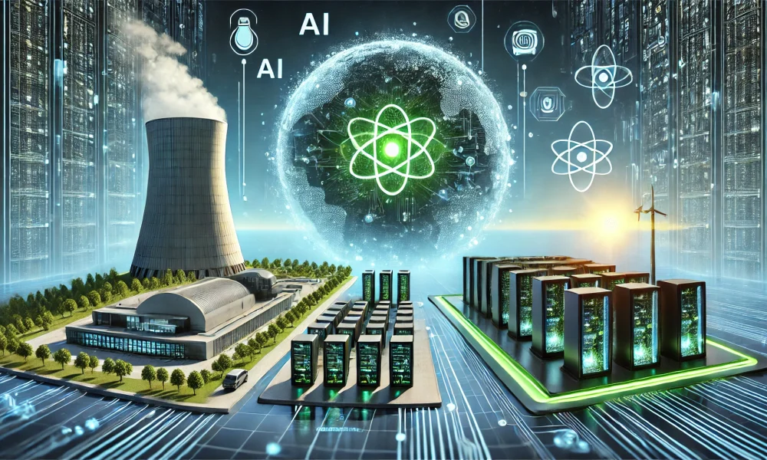
Conclusion
Nuclear reprocessing is essential to meet the energy demands of AI while minimizing waste and addressing non-proliferation concerns.
Policy changes will ensure a sustainable, secure energy future while unlocking economic benefits through R&D and job creation.
Expanding nuclear capacity supports AI-driven innovation and protects consumers from rising costs.
Notes:
Nuclear reprocessing is essential to meet the energy demands of AI while minimizing waste and addressing non-proliferation concerns.
Policy changes will ensure a sustainable, secure energy future while unlocking economic benefits through R&D and job creation.
Expanding nuclear capacity supports AI-driven innovation and protects consumers from rising costs.

