Slide 1


AIRLINEZ
April
2025
flightdeck@airlinez.io

Slide 2
AIRLINEZ turns chart trading into an eSport

Slide 3
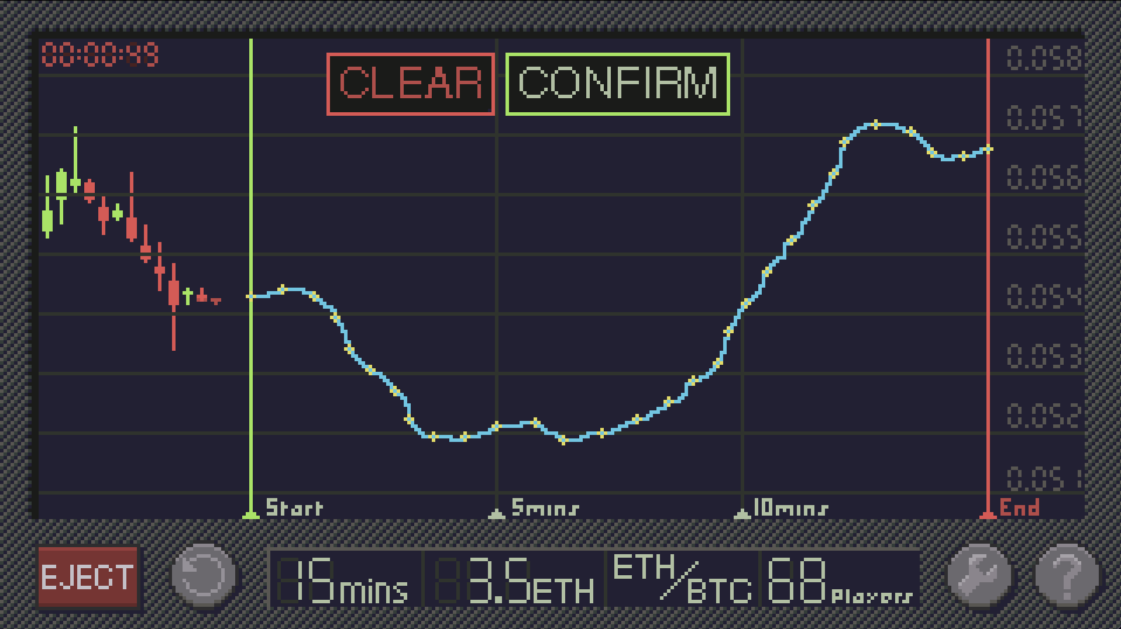
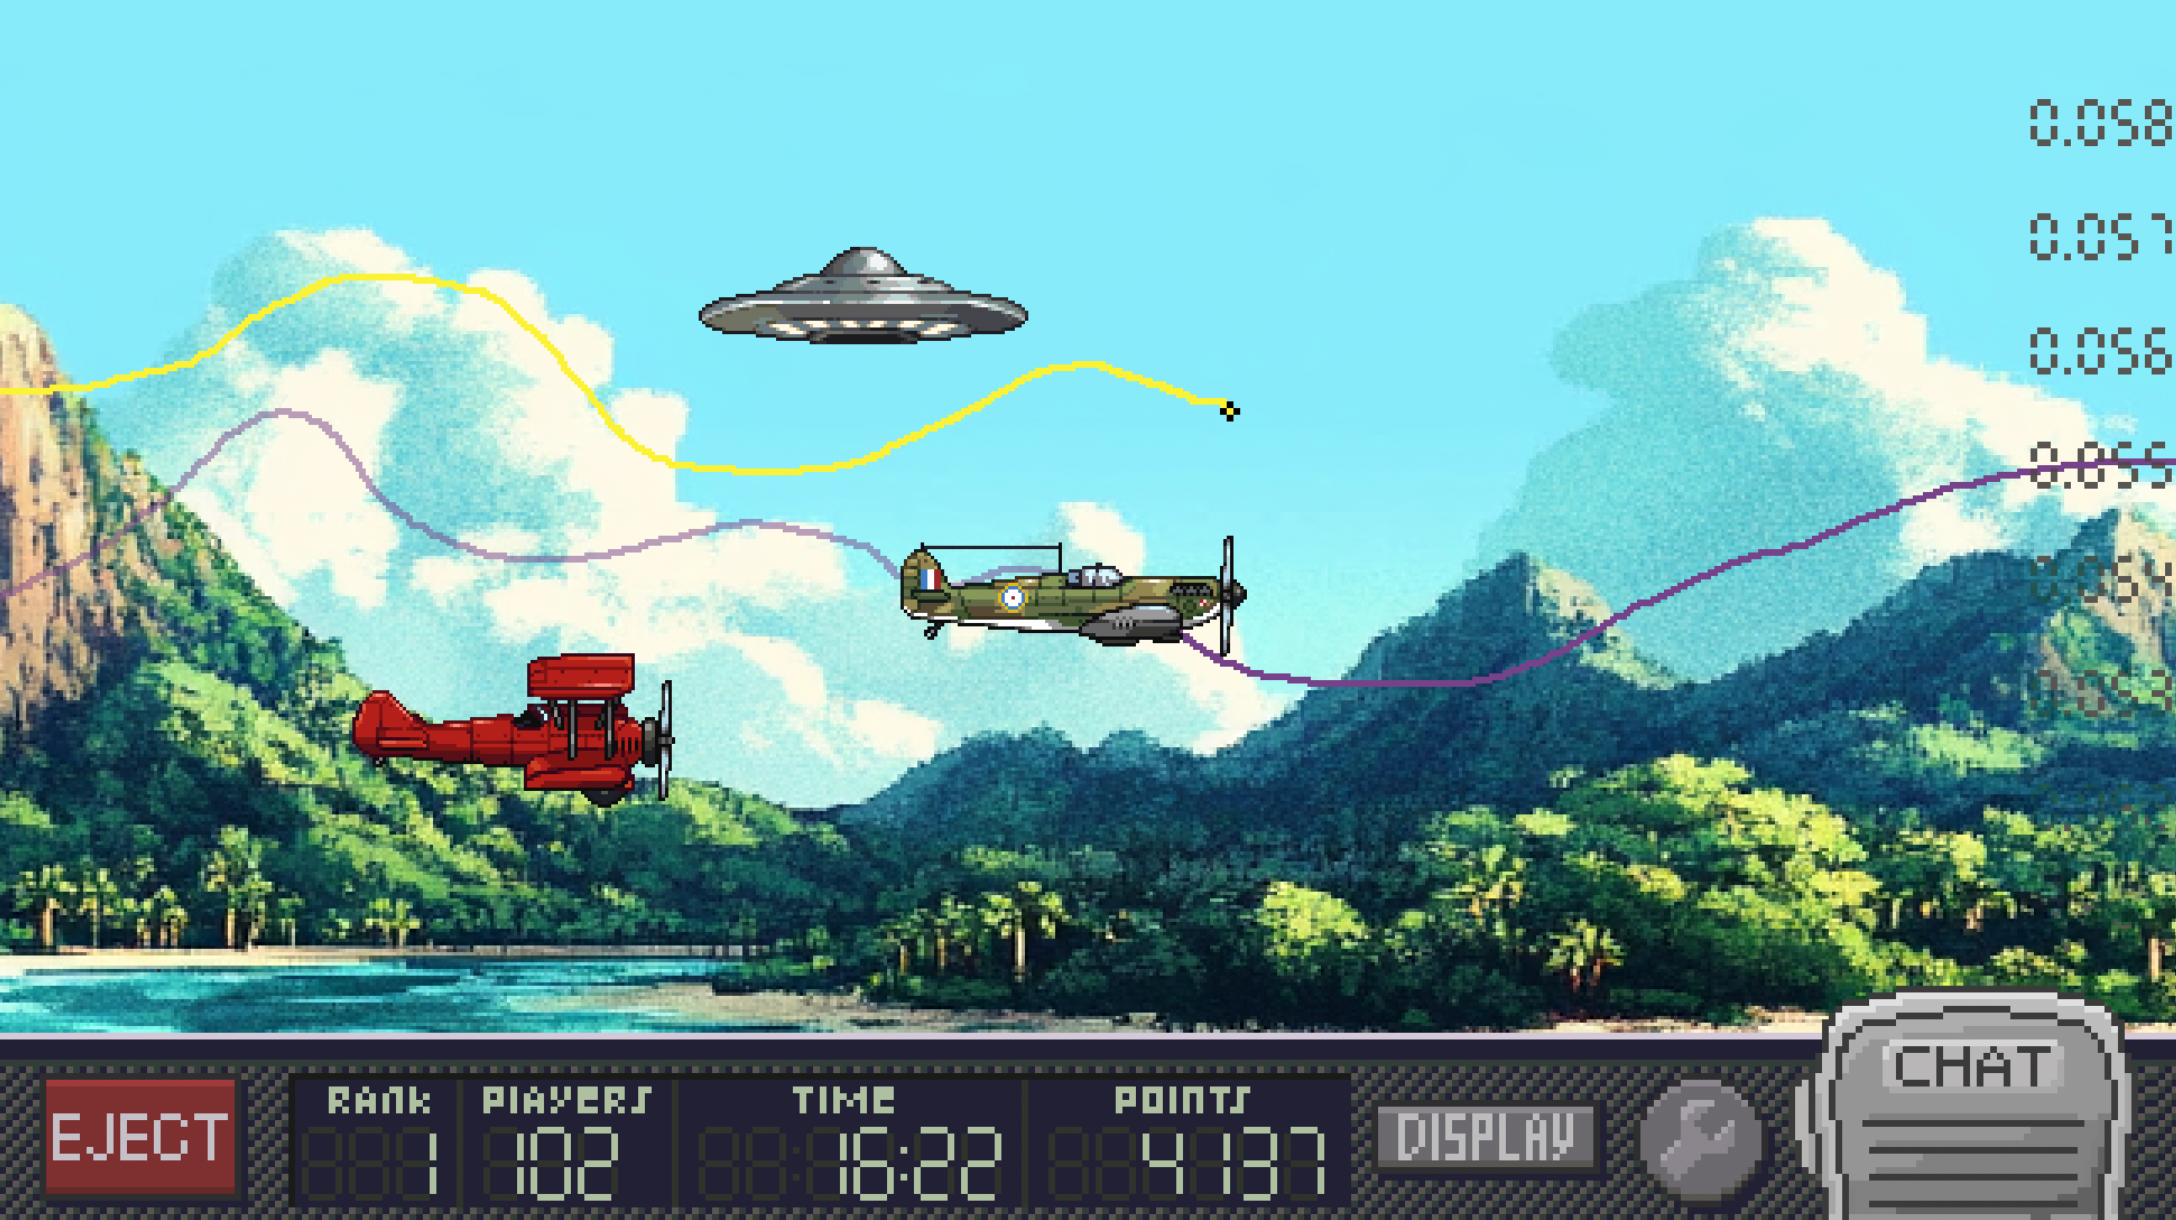
It’s very simple
Draw the chart with a
swipe of your hand
Compete against friends (and enemies)
then
See our UX demo at https://airlinez.io

Slide 4
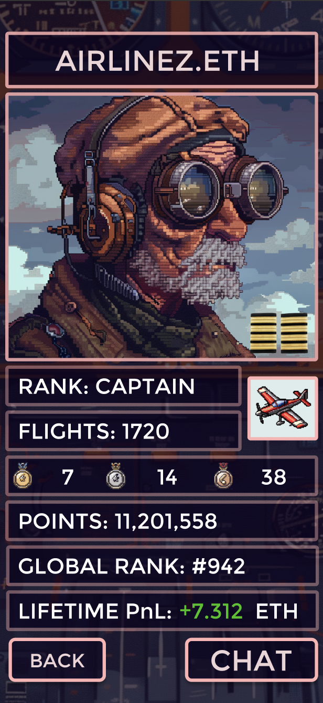
It’s TA, but gamified. That means:
Leaderboards
In-game chat
Flagship games
Unlockable rare items (skins, aircraft, etc)
Ranks
Exclusive game access and content for higher ranks
and more
… all of the juicy incentives you can build around a game loop, now applied to TA.

Slide 5
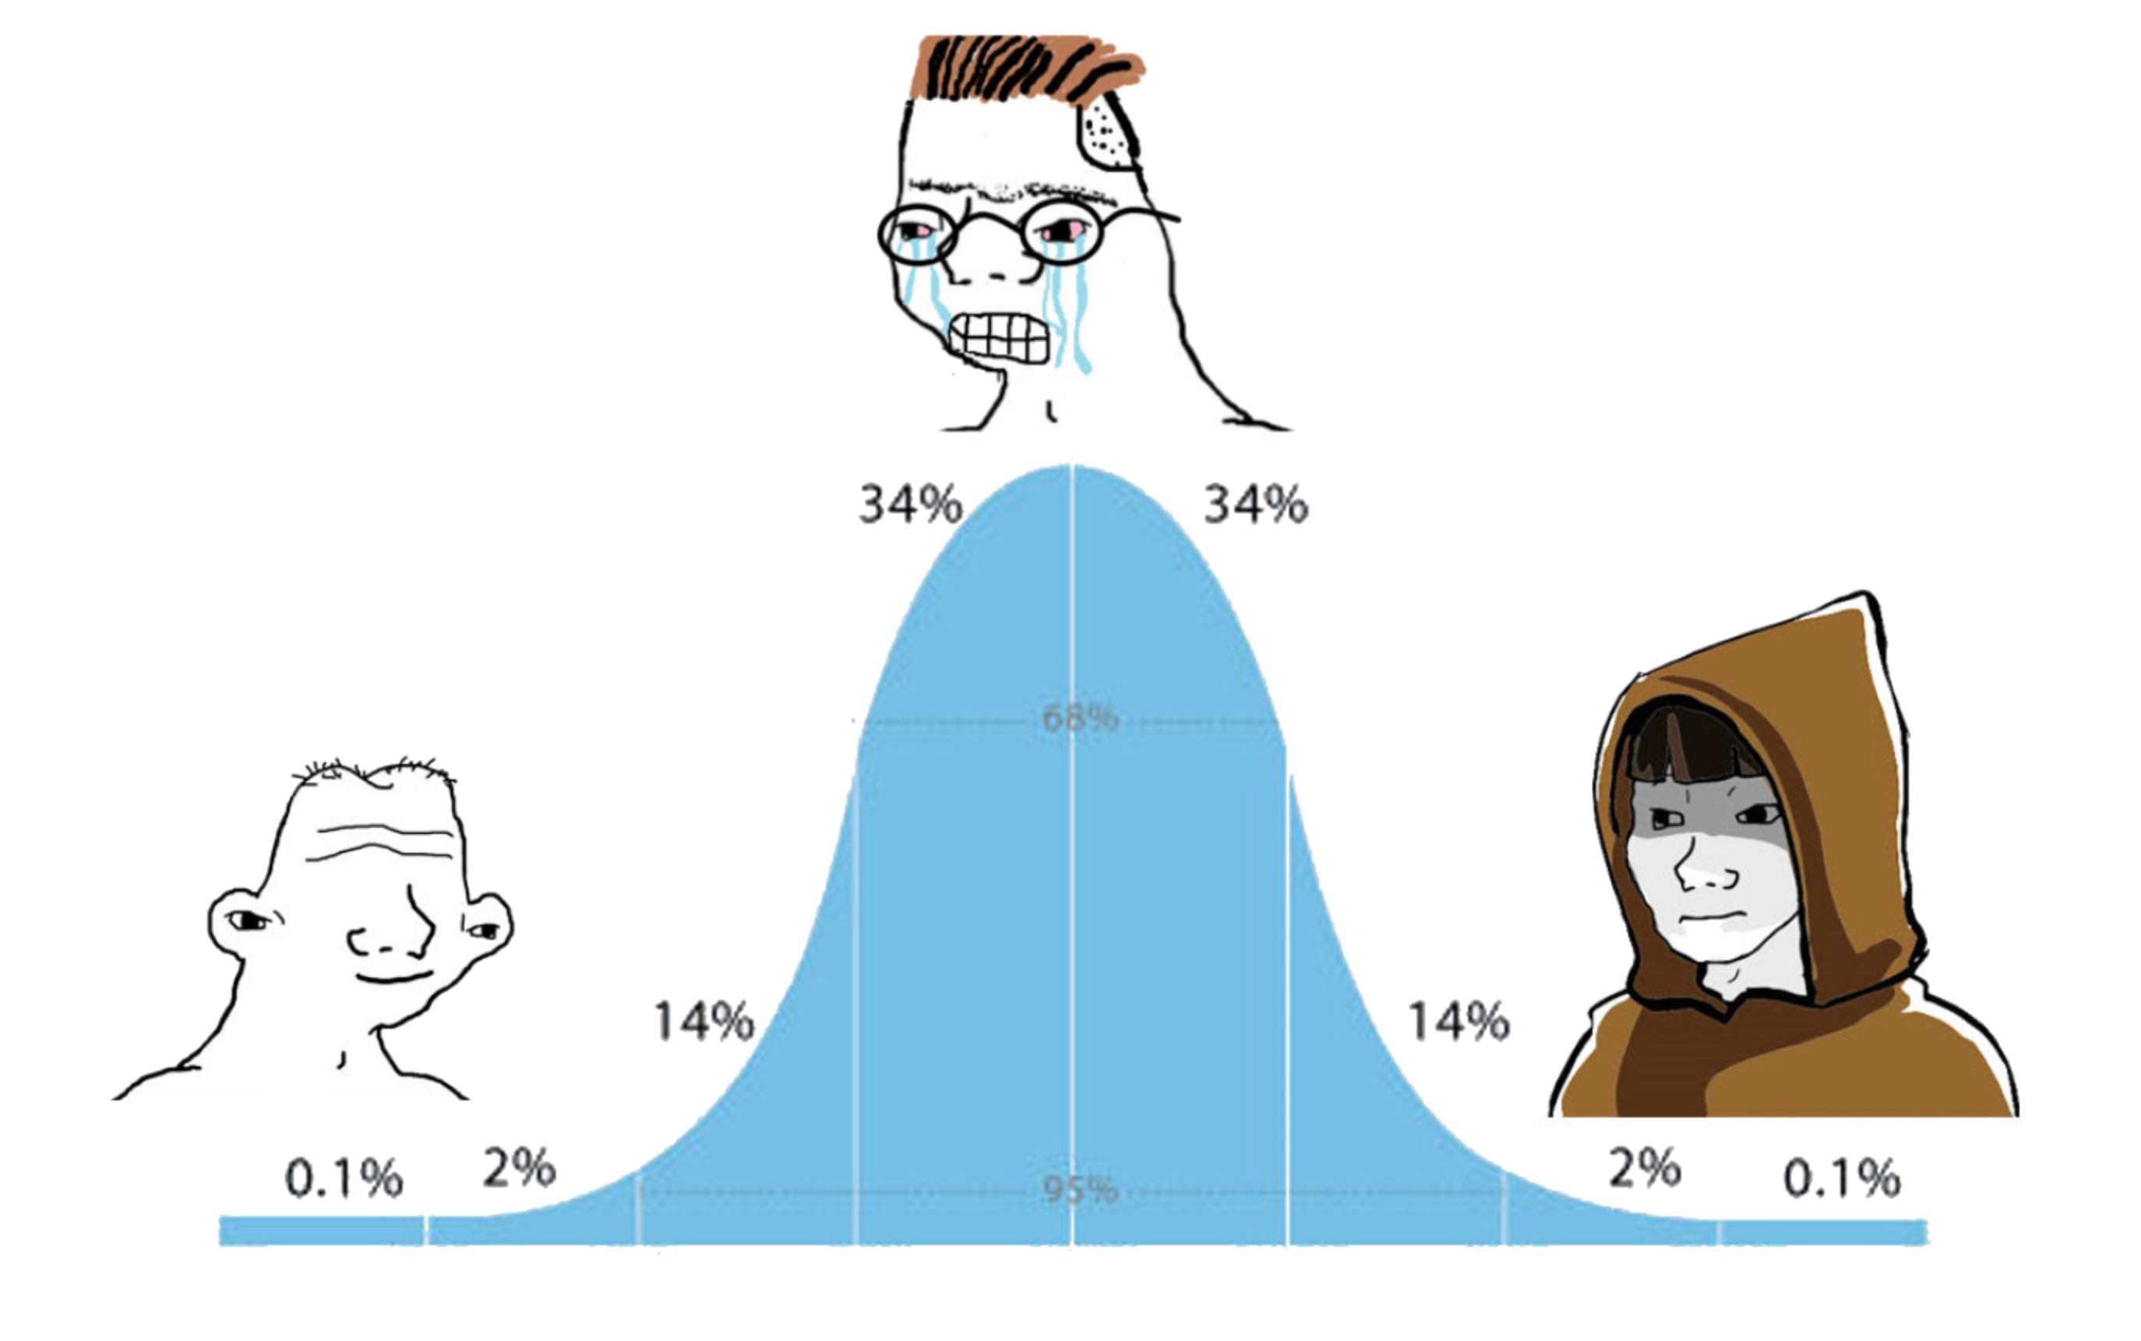
The Target Market:
“There’s nothing fun
to do in crypto”
Memecoins
PnDs
Current thing
Getting scammed
MEV searching
Node operation
Bot trading

Slide 6




The Competition:
While nothing like AIRLINEZ currently exists, we are competing in the Web3 “attention economy” against other retail-facing products. Here’s how we stack up against some current leaders:
Is it… Product | Fun | Fair | Easy to Learn | Replayable | Built to last
 | Good | OK | Good | OK | Very Good
 | OK | Poor | Good | OK | OK
 | Very Good | Very Good | Very Good | Very Good | Very Good
 | OK | Good | OK | OK | Good

Slide 7

The Technology:
Airlinez is very proud to have early access to Chainlink Data Streams. Low latency, tamperproof price feeds provide our users with certainty that Airlinez is a completely fair and neutral platform.
The Airlinez token will also be built on the Chainlink Cross Chain Token standard.
The Airlinez game contracts are being built on Arbitrum AnyTrust, the high throughput, low cost blockchain from the most credible and innovative L2 team in the space.

Slide 8

Aetheling, the creative minds behind AIRLINEZ, are working with EvaCodes, experienced blockchain developers with a raft of existing Web3 and gamefi titles, to build an MVP for this product, with an aim to have an early version released by late Q2 2025
Who is building it?

Slide 9
Roadmap:
2024
Initial
conception
Early design and
technical development
MVP design and
Development
Q1
Q2
Q3
Q4
2025
“Pre-season”
Non-monetised
“Season 1”
Monetised launch
MVP launch
Token launch
Q1
Q2
Q3
Q4
2026
dNFT avatars, advanced game modes, and more…

Slide 10

From the Founder:
As a full-time crypto native for the past seven years, I’ve looked on with disappointment as the retail experience has failed to keep up with the general rate of Web3 development.
2025 sees exceptional advances in cheap blockspace, ancillary tooling, and wallet UX, but the app layer is lagging far behind.
This gap is an opportunity. One that is begging to be addressed by app-layer teams who deeply understand the retail experience.
AIRLINEZ will provide retail traders with something fun, fair, affordable and compelling. Something that they can do in Web3 every single day.
-Pete

Slide 11
Interested?
We are raising seed capital to continue the development of the Airlinez game post-MVP.
We are equally looking for partners who can assist with GTM, compliance, token issuance and all of the other complexities that come with launching in Web3.
We’d love to hear from you.
Contact:
flightdeck@airlinez.io

